Slide 1

感恩遇见，相互成就，本课件资料仅供您个人参考、教学使用，严禁自行在网络传播，违者依知识产权法追究法律责任。
更多教学资源请关注
公众号：溯恩高中英语
知识产权声明

Slide 2
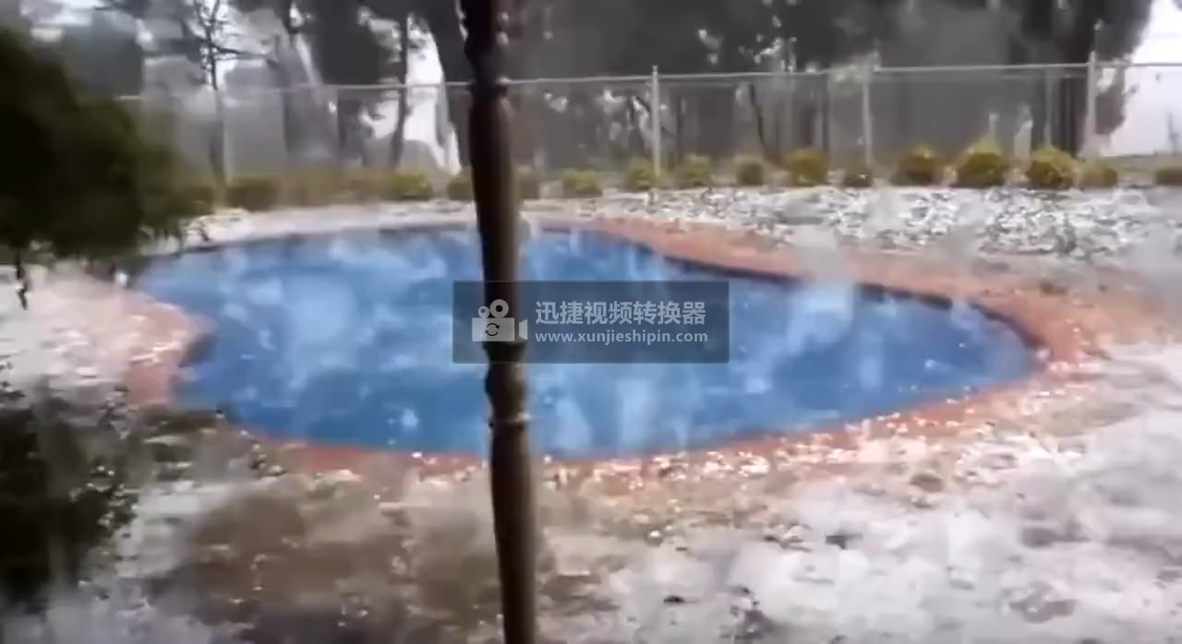

Slide 3
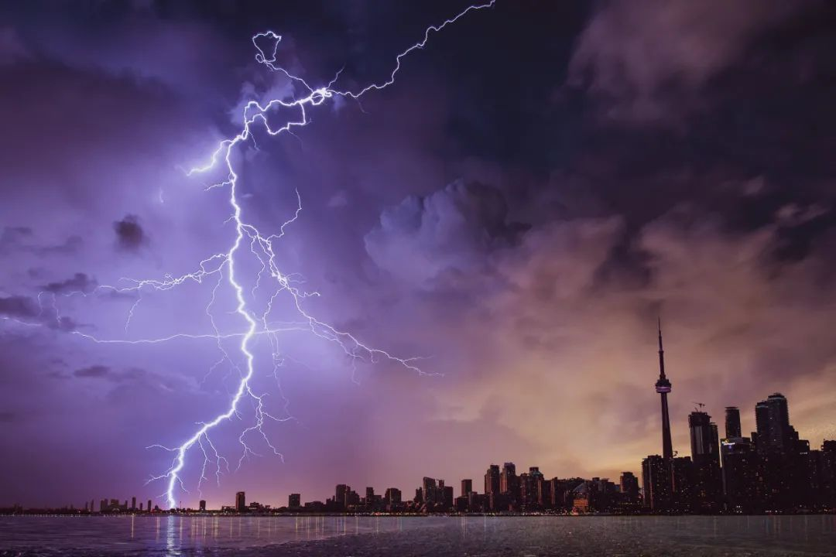
Report natural disasters
Listening & Speaking
衢州二中 徐飞

Slide 4

About natural disasters
What have I konwn | What I want to know
for example: Japan is a frequently earthquake-hit area. ... | for example: Why is Japan more frequently stricken by earthquakes? ...

Slide 5
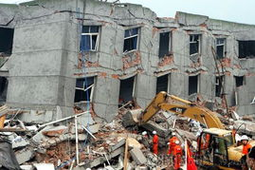
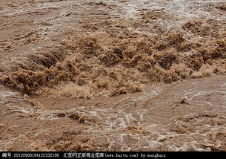
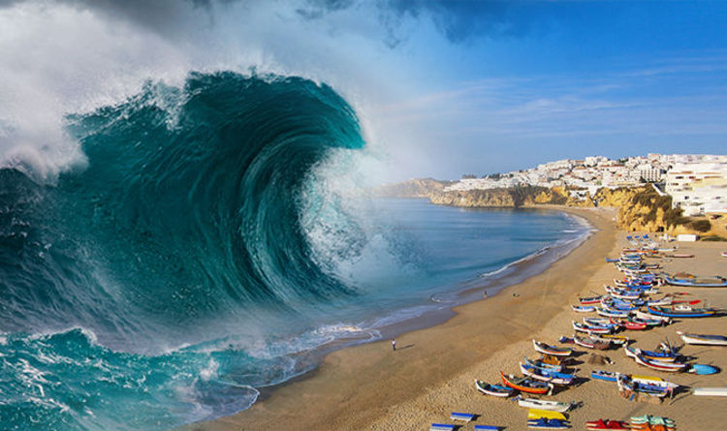
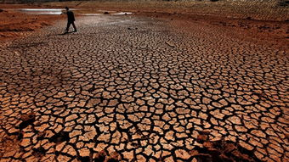
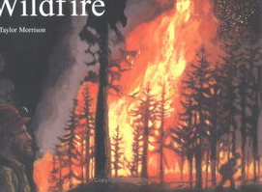
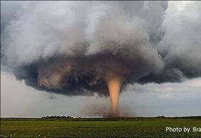
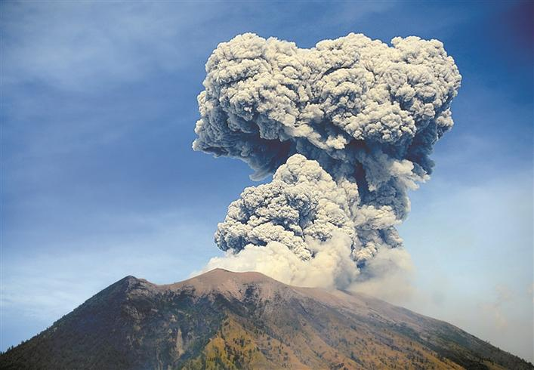
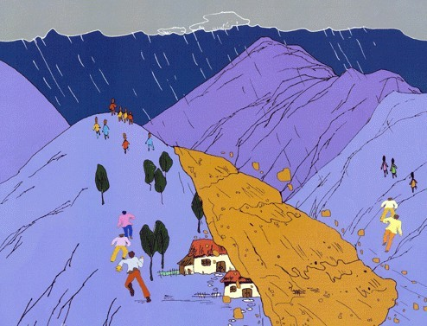
earthquake
flood
tsunami
drought
wildfire
tornado
volcanic eruption
landslide

Slide 6


How can we learn about natural disasters?
news reports

Slide 7



Listen to the news reports and tick the disasters that you hear.
● earthquake ● tornado ● wildfire ●drought
● landslide ● tsunami ● flood ● volcanic eruption

Slide 8
If you were a news reporter on natural disasters, what do you want to tell in the report?
●When ● What ● Where
●Why ●Who ● How

Slide 9
News report 1
Good morning, it's 17 April. A strong earthquake hit Ecuador yesterday. The 7.8-magnitude earthquake damaged many buildings, and early reports said that about 230 people were killed and more than 1,500 were injured. Volunteers and rescue workers are helping the survivors.

Slide 10
News report 2
Good evening. Today is 27 March. More news about the floods in central China. The government is helping more than 12,000 people in Hunan and Jiangxi get away from the rising water. Homes and land have been destroyed, but no one has been killed. Rescue workers and soldiers are working day and night to make sure that people are safe. They are also bringing food and water to those whose homes were lost in the disaster.

Slide 11
News report 3
Breaking news, Saturday 12 August. A tornado was just seen in southern Memphis. Eyewitnesses said that at 9:25 a.m., the tornado destroyed four homes. A police officer tells us that at least one person has died. More tornados are possible, and the police advise avoiding the area.

Slide 12
News report 4
And in Seoul, a landslide damaged a library and a supermarket in a southern neighbourhood. The landslide was caused by the heavy rain that has fallen in Seoul over the past week. According to the police, no one was injured in the landslide, but several cars were damaged. Those are the top news for today, Wednesday 21 July.

Slide 13
summary
What makes a good news report?
content | language features（特征）
time
disaster
place
damage
rescue work
victim（受害者）
...
vivid & varied (多样的) verbs:
A strong earthquake hit...; The earthquake damaged...; 230 people were killed; more than 1,500 were injured; rescue workers are helping...; are working day and night; A tornado was just seen; one person has died; The landslide was caused by...;
different tenses(时态)：
The 7.8­magnitude earthquake damaged...; early reports said that...; rescue workers are helping...; Homes and land have been destroyed; A police officer tells us that...

Slide 14
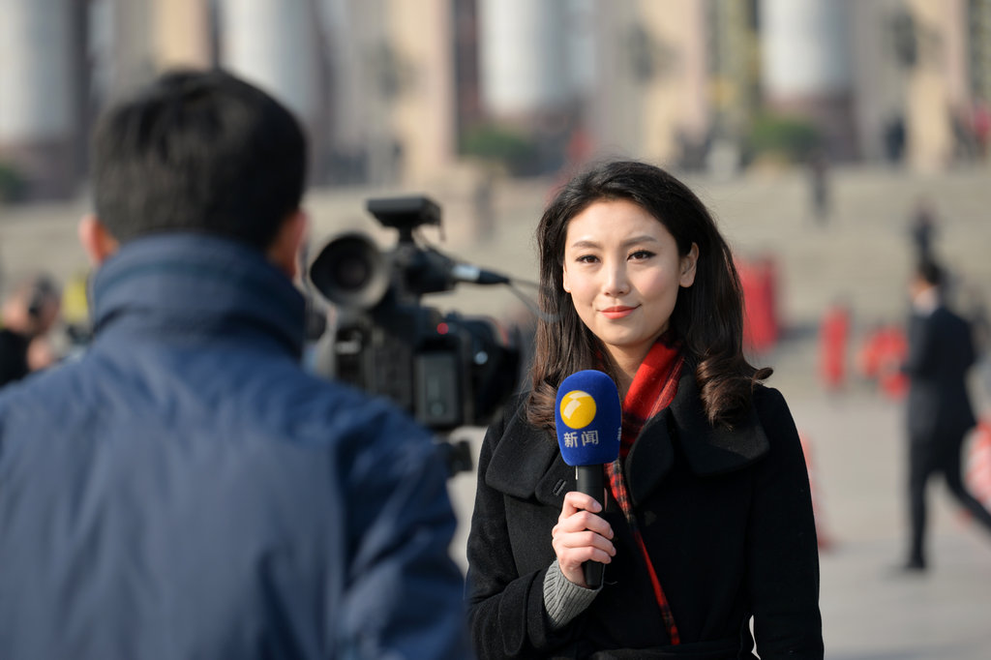

Let’s make a news report

Slide 15
Earthquake
Wildfire
Flood
Wenchuan, China
Alberta, Canada
Colombo, Sri Lanka
● 14:28 Monday, 12 May
● Magnitude 7.8 (8.0)
● At least 8,500 killed (by 13 May)
● Rescue workers
(medical teams, troops,volunteers, etc.) organized quickly
● Began on 1 May
● 2,400 homes destroyed
● Almost 88,000 people evacuated
● Hundreds of firefighters arrived
● Planes, helicopters used to fight the fire
● No deaths, no injuries
● Began in May
● 82 killed, 500,000 affected
● Rescue teams provide food and water
● Shelters set up by the government

Slide 16
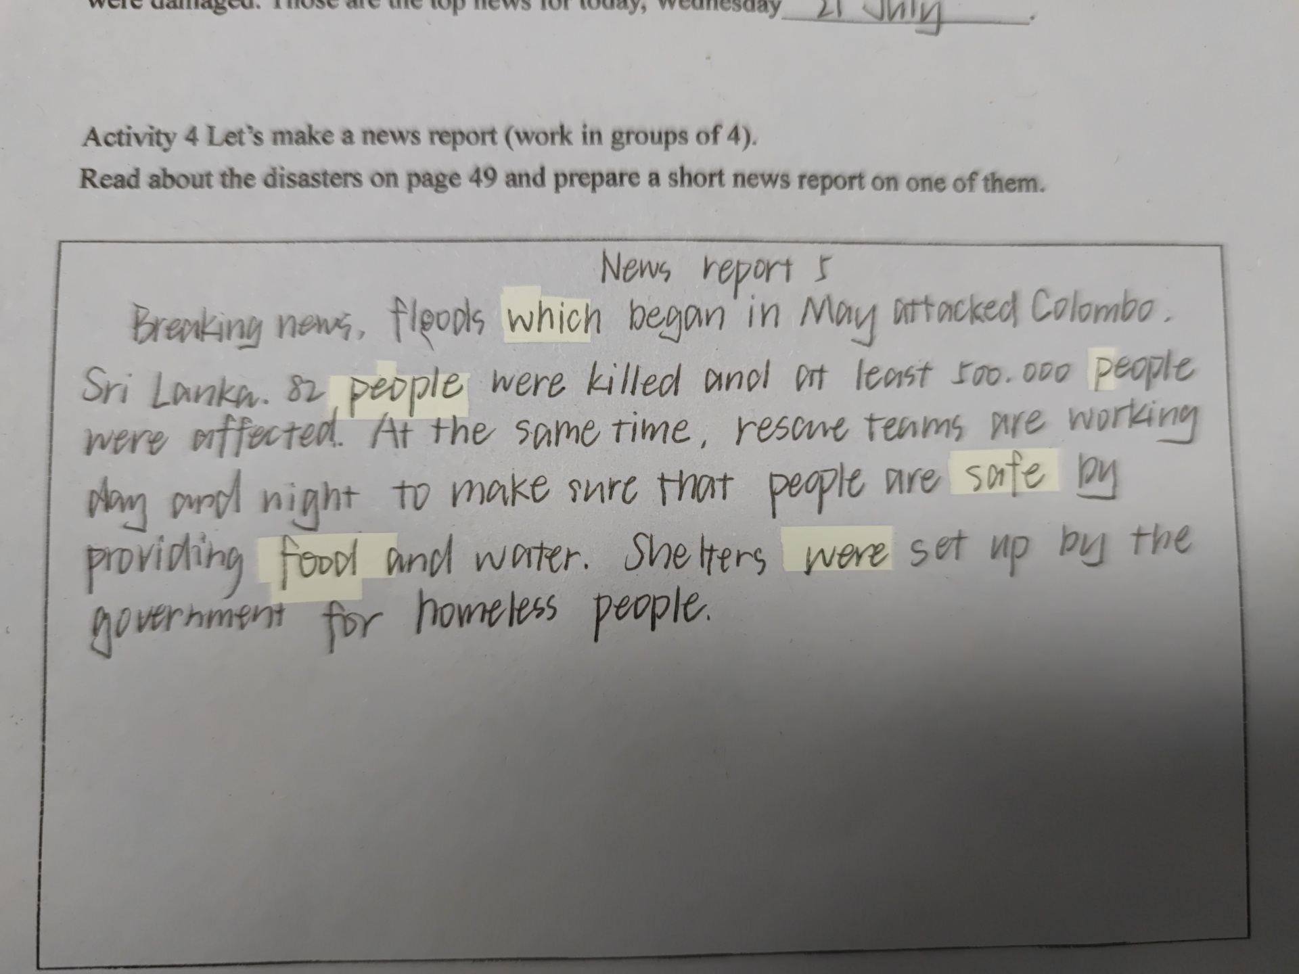
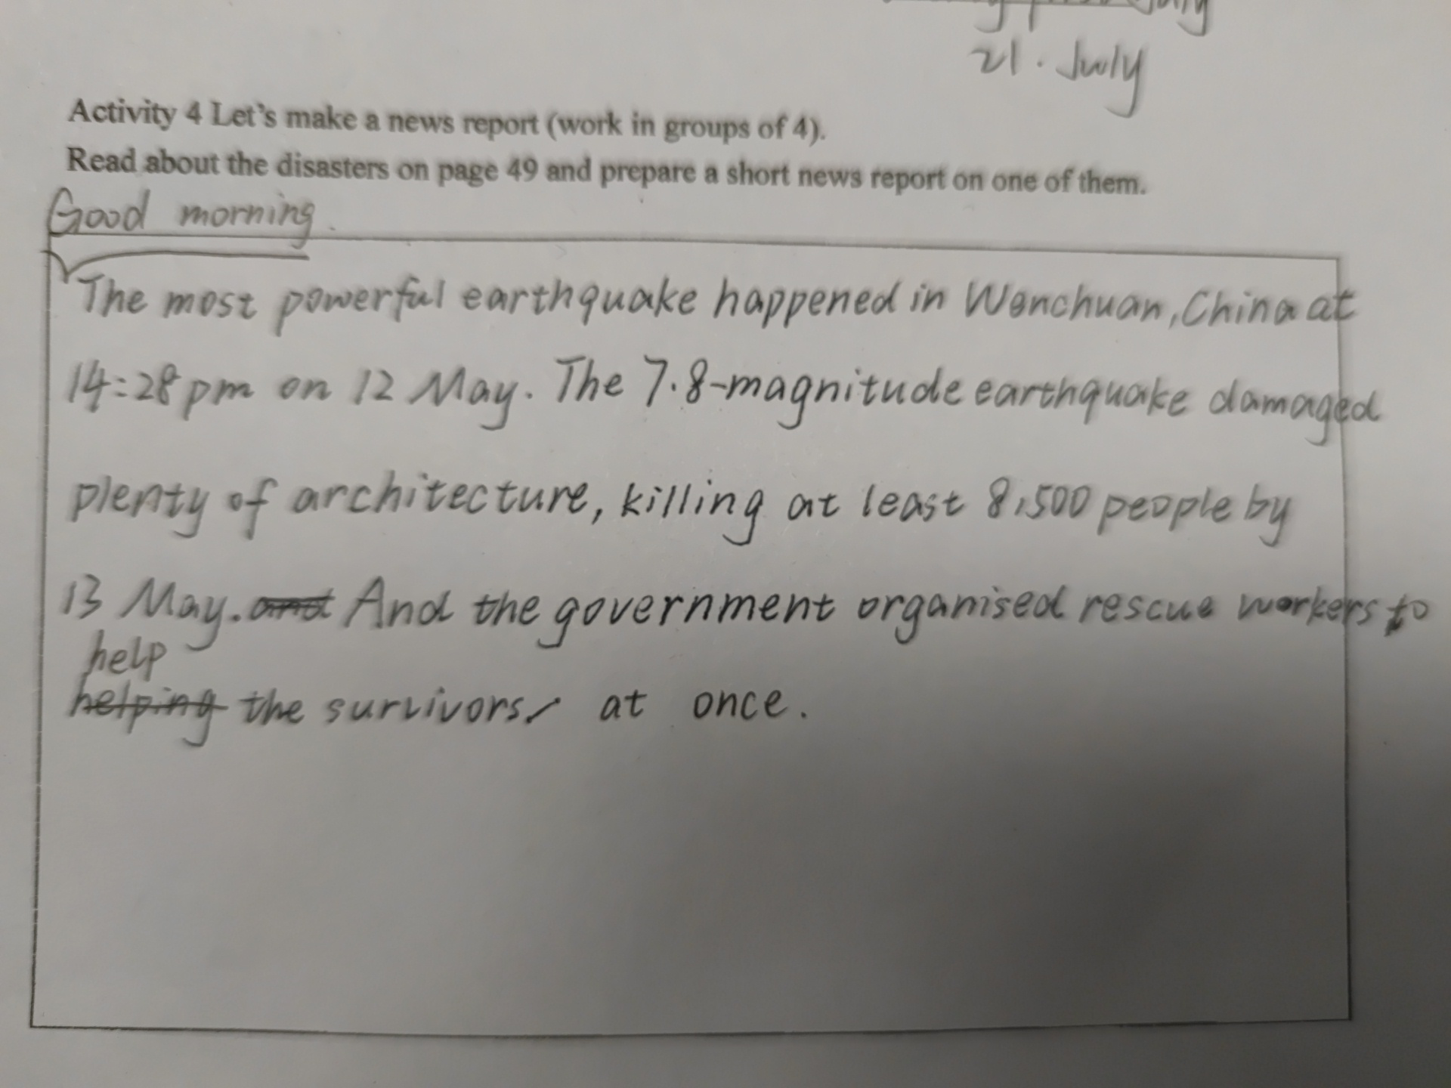
Students‘ works

Slide 17
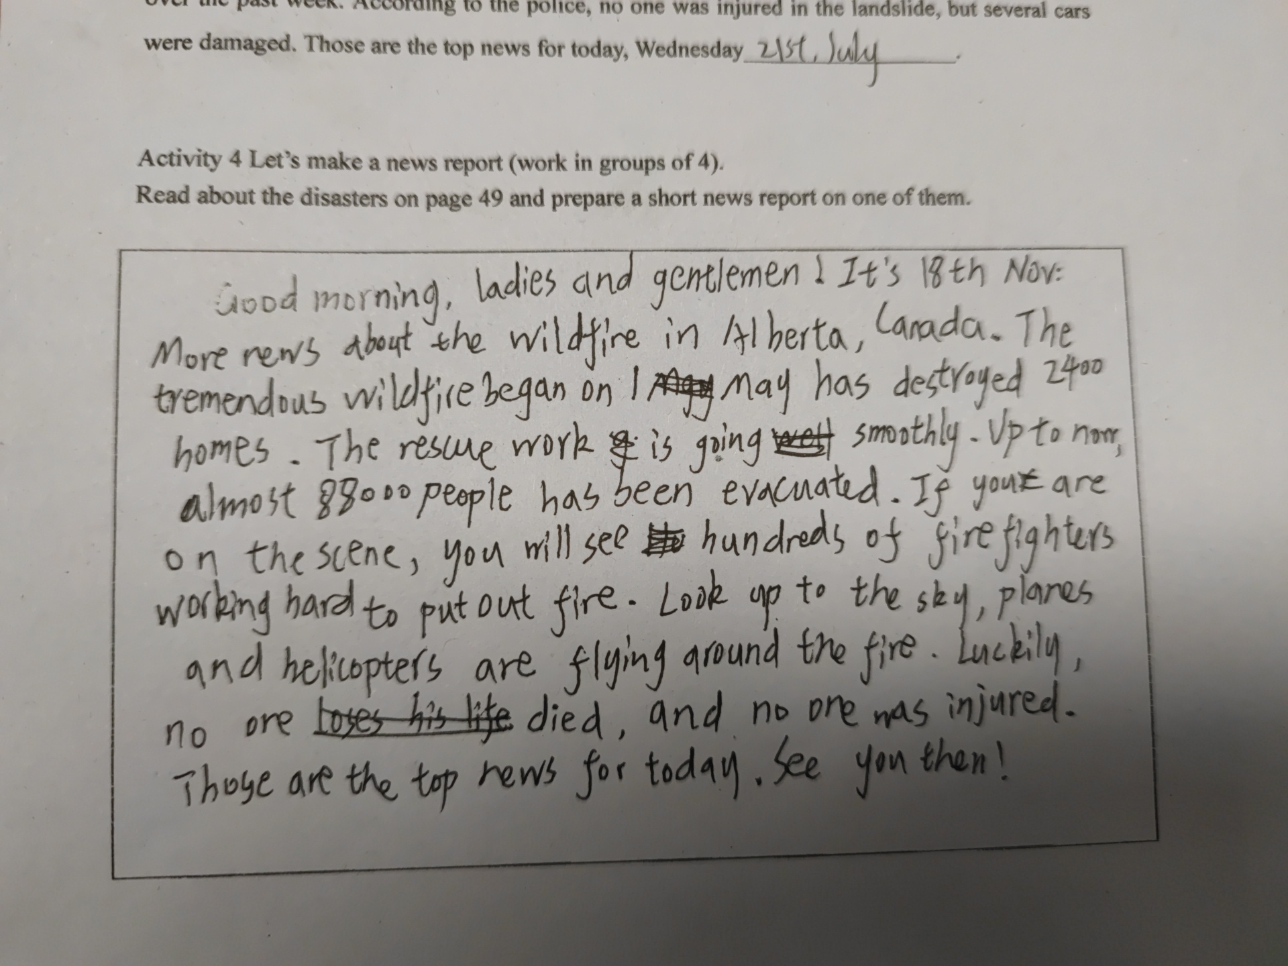

Slide 18
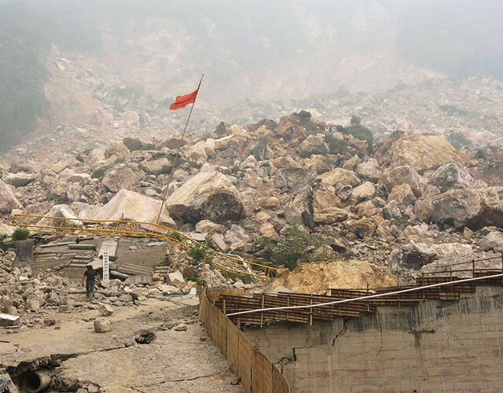
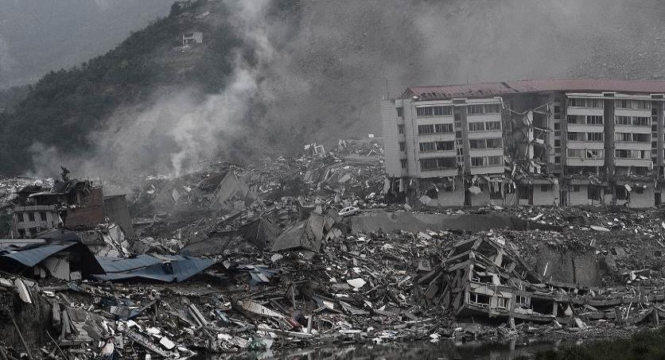
01
A possible sample
News Report on Earthquake
Breaking news. Today is 13 May.
A huge earthquake hit Wenchuan, China yesterday. It has killed at least 8,500 people by now. The earthquake was 7.8 magnitude.
Injured survivors have been moved to safety by rescue workers, including medical workers, troops, and volunteers, who organized quickly.
PPT模板下载：www.1ppt.com/moban/ 行业PPT模板：www.1ppt.com/hangye/
节日PPT模板：www.1ppt.com/jieri/ PPT素材下载：www.1ppt.com/sucai/
PPT背景图片：www.1ppt.com/beijing/ PPT图表下载：www.1ppt.com/tubiao/
优秀PPT下载：www.1ppt.com/xiazai/ PPT教程： www.1ppt.com/powerpoint/
Word教程： www.1ppt.com/word/ Excel教程：www.1ppt.com/excel/
资料下载：www.1ppt.com/ziliao/ PPT课件下载：www.1ppt.com/kejian/
范文下载：www.1ppt.com/fanwen/ 试卷下载：www.1ppt.com/shiti/
教案下载：www.1ppt.com/jiaoan/
字体下载：www.1ppt.com/ziti/

Slide 19
Assignment
1. Find the latest news about a natural disaster and write a news report.
2. Record it like a news reporter.

