Slide 1

感恩遇见，相互成就，本课件资料仅供您个人参考、教学使用，严禁自行在网络传播，违者依知识产权法追究法律责任。
更多教学资源请关注
公众号：溯恩高中英语
知识产权声明

Slide 2
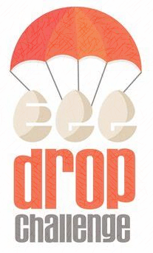
2021年11月高三9+1联盟
Egg Drop Challenge
浙江省慈溪中学 宋浩颖 李晓燕

Slide 3
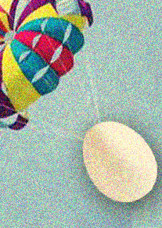
Read for plot
Read for theme
Read for language
语篇解读
Text analysis

Slide 4

原题呈现
“OK, everybody. It’s that time of year,” said my science teacher, Mr. Beal. “This Friday we’ll have the annual Egg Drop Challenge. Bring your best containers to class. You can work alone or work together.”
Mr. Beal’s fifth-grade Egg Drop Challenge was an institution at my school. The goal of the Challenge was simple—you had to build a protective container to keep an egg from breaking when dropped over the stadium wall.
My best friend, Cassie, and I grinned at each other. We always worked on projects together. She’s brainy; I’m creative. We’re the perfect combination, like peanut butter and marshmallow cream(棉花糖霜), which happens to be my favorite kind of sandwich.
I made my favorite sandwich that afternoon while waiting for Cassie to come over and work on the container. Spreading the fluffy marshmallow cream gave me an idea.
“I have a brilliant design for our egg container!” I said when Cassie arrived. She looked at me eagerly. “We can cushion it with some marshmallow cream. You know, to absorb the shock of the impact,” I explained. “You’ve got to be kidding, Laura.” Cassie exclaimed. “You have a better idea?” Cassie pointed to a sketch(草图)in her notebook. “Actually, I do. We put the egg in a basket with parachute(降落伞)attached. It will simply float to safety.” “It's too easy for something to go wrong. It will never work!” I said. Cassie rolled her eyes, “The parachute is better than that stupid idea.”
I couldn't believe it. Of course we’d had our little fights in the past, but this was different. She’d never called any of my ideas “stupid” before. “Then I'll build mine and you build yours, and we’ll just see whose is better.” “Fine!” Cassie threw her notebook into her backpack and stormed out. And just like that, our friendship was broken. Like an egg dropped from the top of a stadium without marshmallow cream to protect it.
注意：1.续写词数应为150左右；2. 请按如下格式在答题卡的相应位置作答。
Paragraph 1: When Friday finally came, I had to admit that Cassie’s Egg Force One looked pretty good.
Paragraph 2: By the fourth round, only Cassie and I were left.

Slide 5
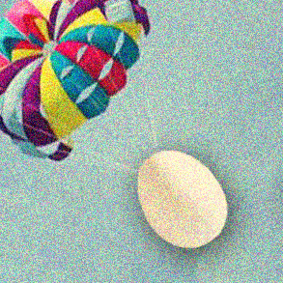
Read for plot
Who: I(Laura), Cassie, Mr. Beal
When: the annual Egg Drop Challenge
Where: school stadium
What: Cassie and I, a used-to-be perfect pair, quarrelled over different ideas for egg containers in the annual Egg Drop Challenge, and that triggered a friendship crisis.

Slide 6

Read for plot
Beginning: the annual Egg Drop Challenging was to be held.
Developing: Cassie and I quarrelled over different idea for egg containers.
Climax: Cassie and I were to compete in the annual game
Ending: Cassie won/I won/both won/both lost…
beginning
Developing
climax
Ending

Slide 7
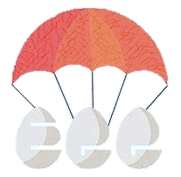
Read for plot
character analysis
I (Laura) & Cassie both in fifth grade
creative
brainy
Both came up with ideas for egg containers soon after Mr. Beal announced the game
blunt
stubborn
I: “it will never work”
Cassie: “You’ve got to be kidding.”; “stupid idea”
Cassie rolled her eyes.
Cassie threw her notebook into her backpack and stormed out.
Didn’t buy each other’s ideas

Slide 8
Read for plot
FEELINGS
beginning
excited
confident
quarrel
mad
hurt
the game
nervous
excited (if won)
the end
Joyful
sad (if lost)
How did Cassie & I feel in different stages?

Slide 9
Read for language
Language appreciation
How to describe a fifth-grade kid: verbs make it more powerful
  “my best friend, Cassie, and I grinned at each other.”
  “Cassie exclaimed.”
  “Cassie rolled her eyes.”
  “Cassie threw her notebook into her backpack and stormed out.”
Figures of speech: simile makes a description more vivid
  “we’re the perfect combination, like peanut butter and marshmallow cream”
  And just like that, our friendship was broken.
  “like an egg dropped from the top of a stadium without marshmallow cream to protect it,”

Slide 10
Read for theme
foreshadowing
We’re the perfect combination.
Our friendship was broken. Like an egg dropped from the top of a stadium without marshmallow cream to protect it.
Friendship is like an egg. It can be broken if no efforts are made to protect it.
THEME

Slide 11
Categorize the key words
Read the given sentences
Ask questions
情节预测

Slide 12
Read for Clues
key words
Mr. Beal, Egg Drop Challenge, container, egg, dropped, Cassie, basket, parachute, friendship, protect
CATEGORIES: divide the key words into different groups
Characters: Mr. Beal, Cassie
Verbs: drop, protect
Settings: Egg Drop Challenge, egg, container, basket, parachute
Theme: friendship

Slide 13
Read for Clues
beginning sentences
When Friday finally came, I had to admit that Cassie’s Egg Force One looked pretty good.
By the fourth round, only Cassie and I were left.
  How did I feel when I saw Cassie’s “pretty good” egg container?
  What did we do in the Egg Drop Challenge? (describe the game)
  What happened to Cassie’s egg and my egg in the first round?
  How did Cassie react? How did I react? how did other students react?
  What happened to our eggs? Who won the game?
  How did Cassie and I take the result?
  Did they fix their friendship? How?
  What lesson did I learn from this experience?

Slide 14
how to describe a game
how to describe nervousness
话题语言

Slide 15
how to describe
Nervousness
My heart began to thump with excitement. My gaze shifted to Cassie, who was in fits of giggles with others.
I caught a trace of unease on her face.
I could feel that all the eyes were fixed on us and the atmosphere was more than suffocating. A strong sense of nervousness surged through me.
Heart pounding and palms sweating, I put the egg cautiously into the basket.
No eggs ever survived such a height and my hands were drenched in sweat.
LANGUAGE

Slide 16
How to describe a game
The audience let out thundering cheers, some even whistling wildly. With a triumphant air, Cassie received myriads of thumbs-up and cast me a proud look.
As Mr. Beal blew the whistle, the exciting Egg Drop Challenge began, with a wave of thunderstorm applause and yells exploding from the audience.
Suddenly, a hush settled over the stairs; everyone was awaiting our performance.
An air of tense and excitement settle over the crowd.
Hardly had Mr. Beal announced the game began than we loosened hold of the containers and let the eggs go.
LANGUAGE

Slide 17
范文及高分作文

Slide 18
范文
When Friday finally rolled around, I had to admit that Cassie’s Egg Force One looked pretty good. She had used a handkerchief to create a small parachute. It was tied to a basket that held soft packing peanuts and, in the center of it all, her egg. Cassie cast a queer look at me as if to declare war. The competition was on. My classmates carried their egg containers up three stadium steps and dropped them over the side wall. One by one. The egg broke, the owner out. Sighs and yells echoed. Soon the side walk was already dotted with egg shells from failed drops.

Slide 19
范文
By the fourth launch, only Cassie and I were left. Taking a deep breath, I let go of my box. Then I raced down and got to the bottom before Cassie did. When I saw yolk and egg white seeping from the container, my heart sank. Then I saw Cassie’s basket lying beside mine, empty. “My egg bounced out,” she explained, pointing to a broken shell in the grass. “I guess the pilot had an egg-jector seat,” I offered. Cassie looked at me, and her glare softened. I grinned. She giggled. “A tie,” Mr. Beal announced. But we knew we'd won something more important than the Egg Drop Challenge.

Slide 20
高分作文1
When Friday finally rolled around, I had to admit that Cassie’s Egg Force One looked pretty good. Her plastic basket with parachute was elaborately designed. When thrown into the air, it opened its parachute, whirled around like a butterfly and then landed on the ground slowly and quietly, demonstrating that there wasn’t any crack on the egg. The audience let out thundering cheers, some even whistling wildly. With a triumphant air, Cassie received myriads of thumbs-up and cast me a proud look. The minute I let go of my egg, I stumbled down stairs in a hurry, in a desperate attempt to check it. My heart beat wildly as I found the egg safe and sound. Then the next few minutes witnessed fierce competition between other groups.

Slide 21
高分作文1
By the fourth launch, only Cassie and I were left. I cast a side glance at her. She was holding her container tightly, no longer looking that confident. So did I. “Drop!” Hands trembling, I let go of the container, stretching out to keep them in sight, and rushed down to check. However, under the lid was an egg that was badly cracked! I stood still. I heard Cassie sobbing. She must have failed too. Yet, her failure didn’t comfort me. Instead, it left me in thought. My marshmallow cream leaked just now, while her parachute didn’t function due to the sudden wind. What if we combined our ideas? If only we hadn’t broken up! I looked towards Cassie and our eyes met. We giggled. I knew our friendship was back.

Slide 22
高分作文2
When Friday finally rolled around, I had to admit that Cassie’s Egg Force One looked pretty good. Equipped with a small parachute, it stood out from various protective containers. There was obvious confidence written on Cassie’s face. Soon, the Egg Drop Challenge began. Cassie let go of her Egg Force One and it landed perfectly. When it came to my turn, I felt butterflies in my stomach and my eyes followed all the way my Egg Cushion dropped. I was wild with joy as I saw my egg safe in the marshmallow. The game continued. The next two rounds witnessed many broken egg shells.

Slide 23
高分作文2
By the fourth launch, only Cassie and I were left. I could feel that all the eyes were fixed on us. A strong sense of nervousness surged through me. Next to me, Cassie was also under great pressure. Then we saw our eggs drop. Suddenly, I heard a clear crack sound. My heart sank. I slowly bent down to check but found no cracks at all. I turned around and found Cassie’s basket was broken. Mr. Beal announced the winner of this year’s Egg Drop Challenge and I heard my name. I cast a big beam and found Cassie run away with tears running on her cheeks. I found her curled up in the corner. Huddling her into my arms, I patted her on the back and murmured to her how sorry I was. That day, I not only won the challenge but also the most precious friendship back.

Slide 24
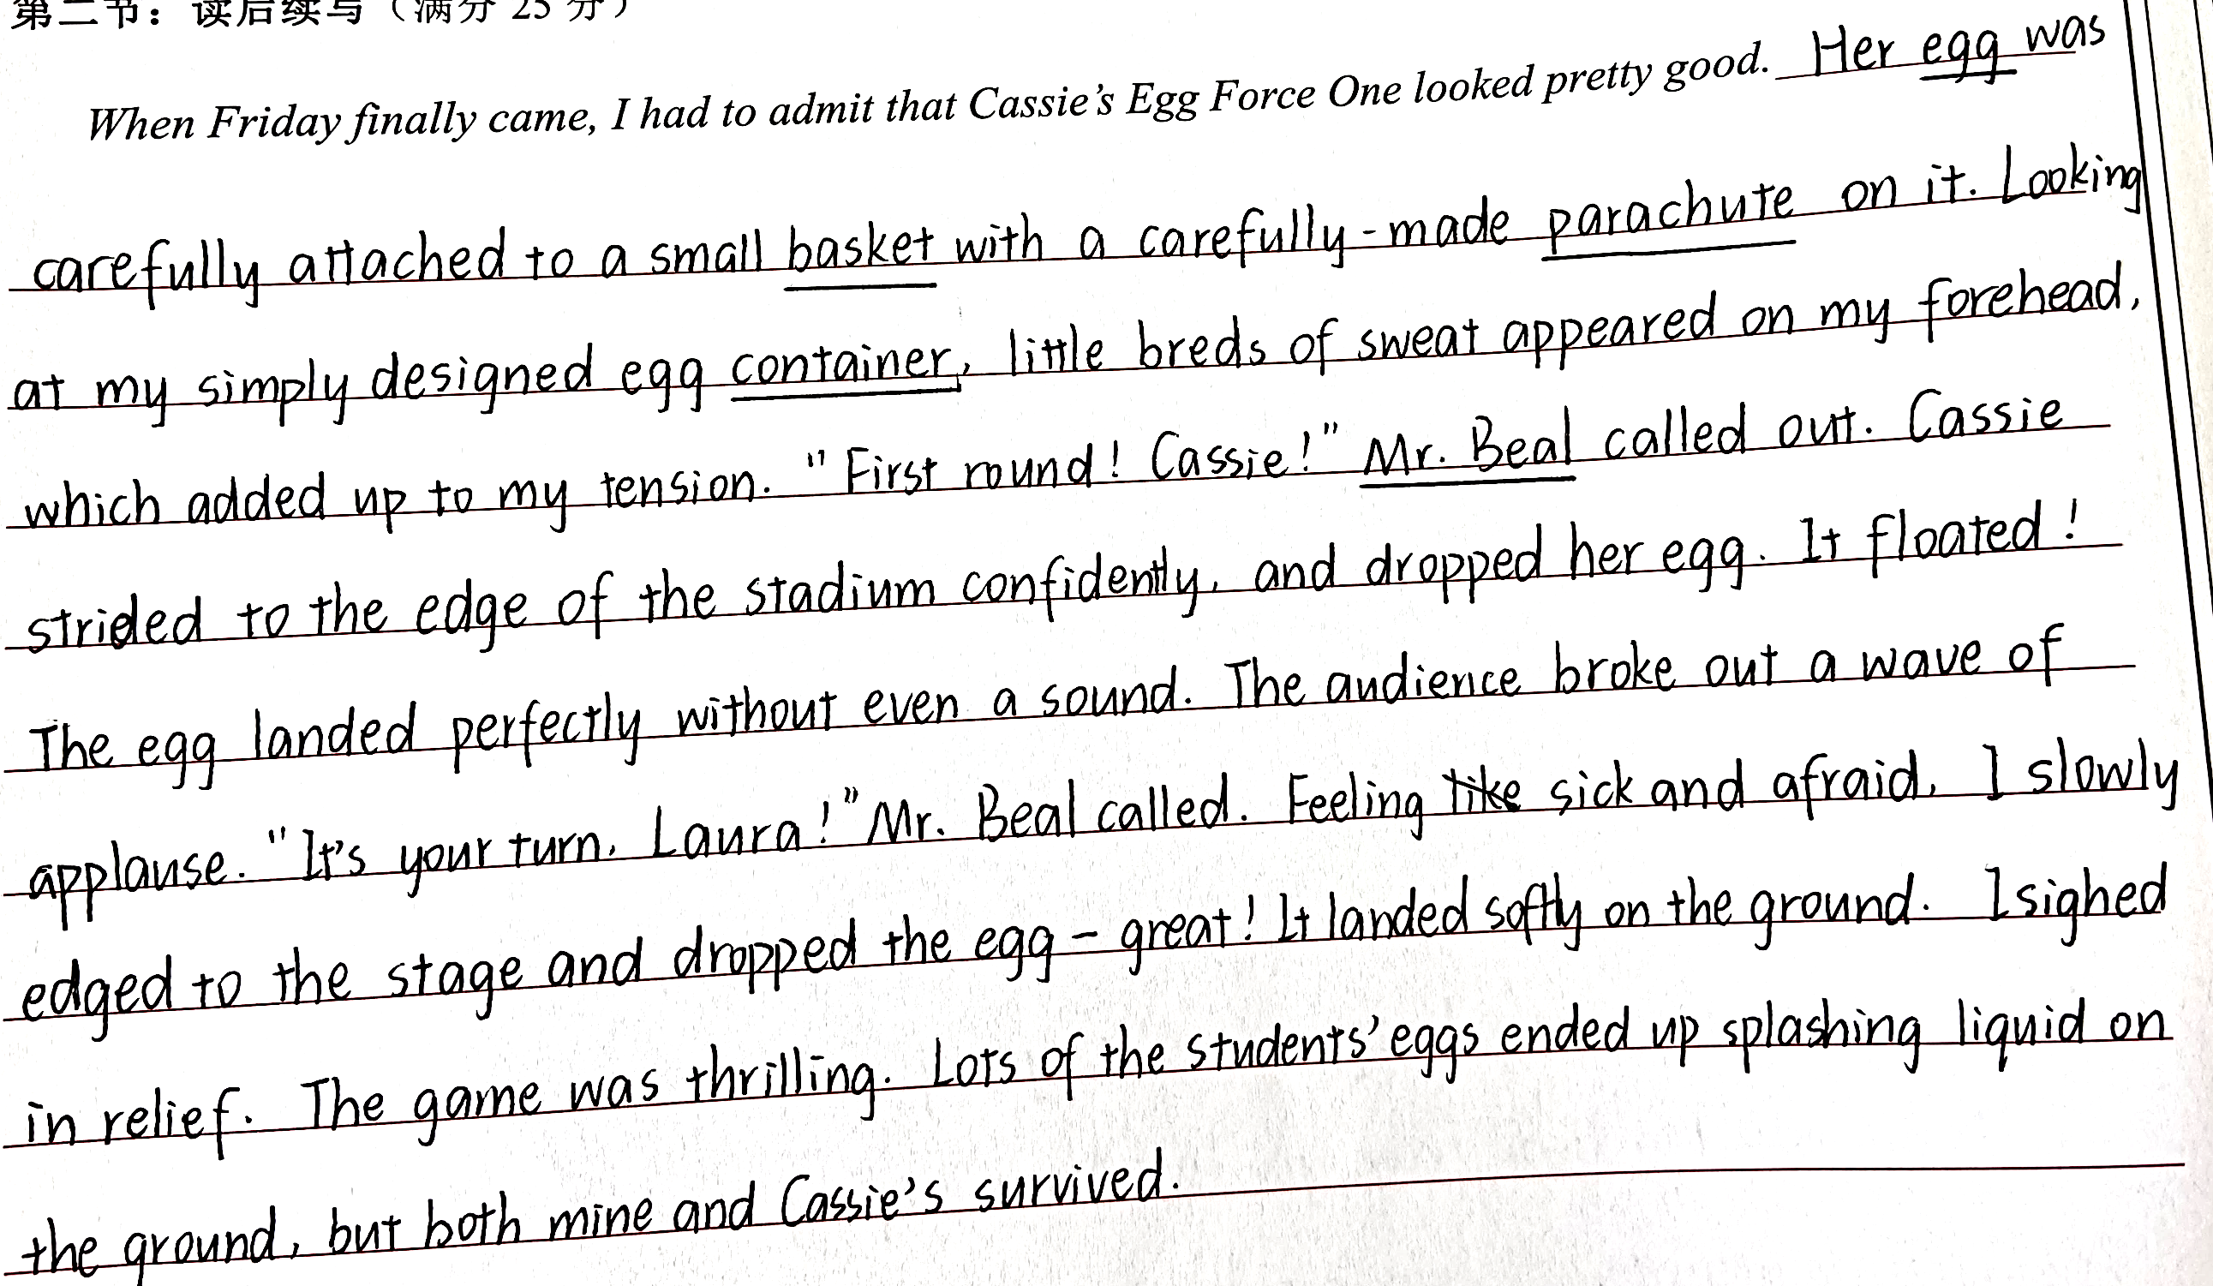
高分作文3

Slide 25
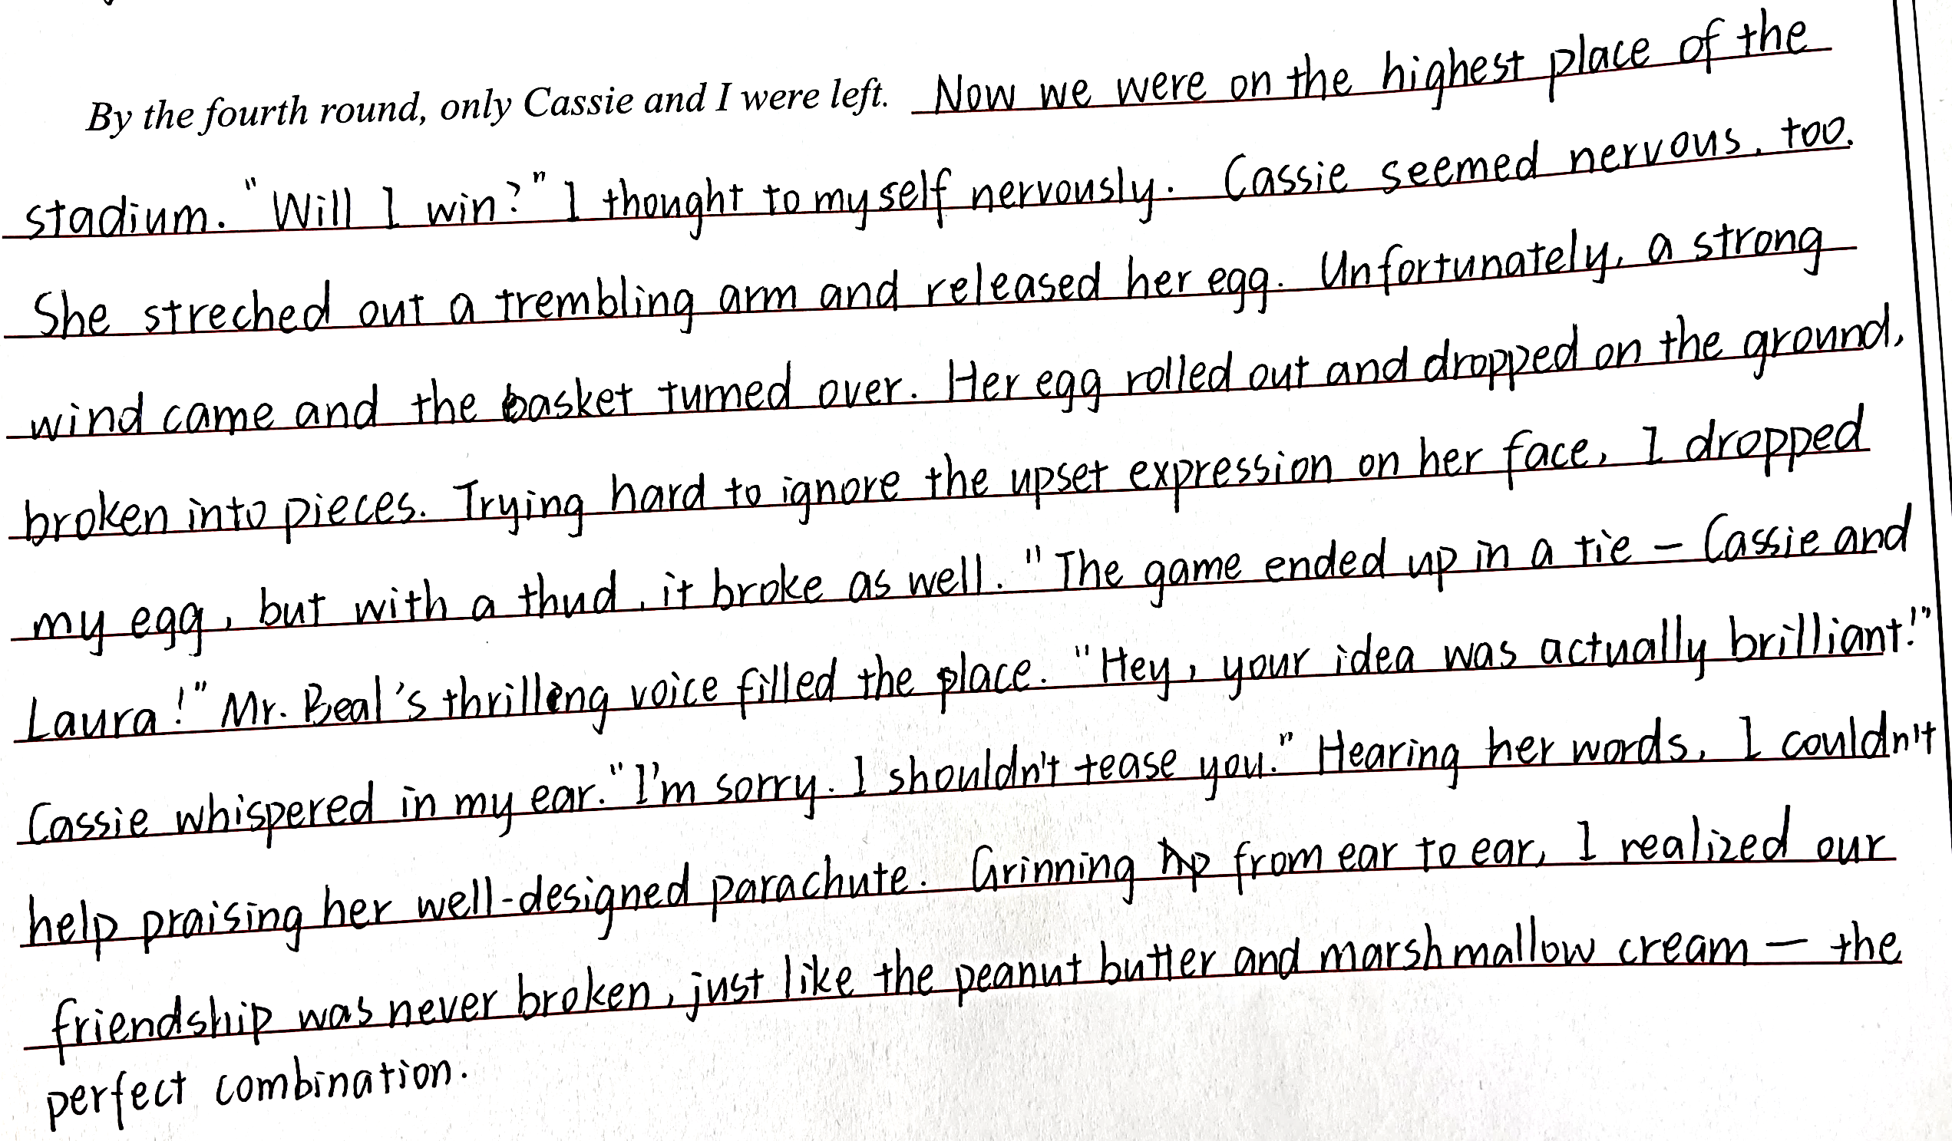
高分作文3

Slide 26
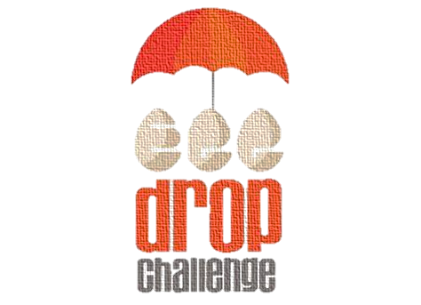
Thanks!

