Slide 1
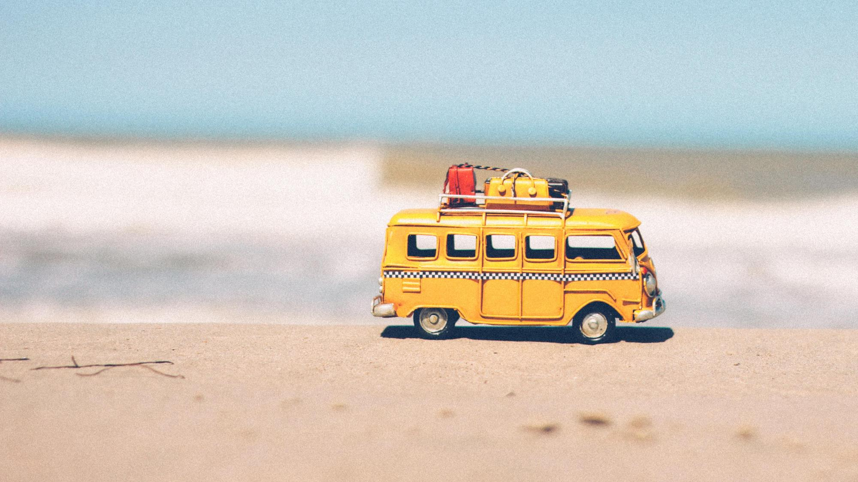
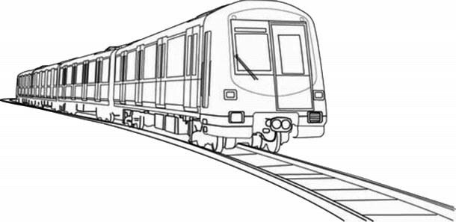
Unit 4 Journey Across A Vast Land
Using Language (1)
龙游县第二高级中学 邹琦
衢州第三中学 邱赛仙

Slide 2
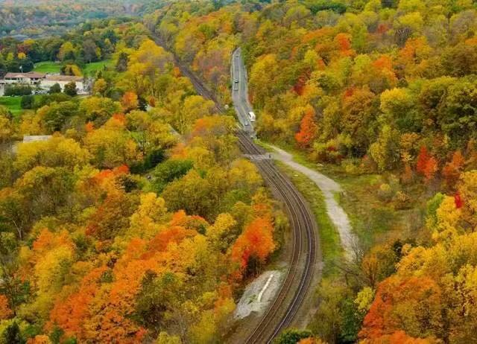
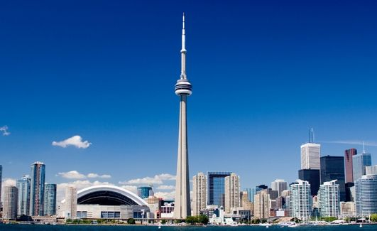

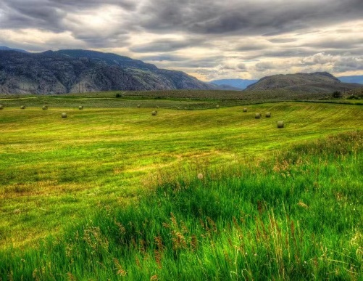
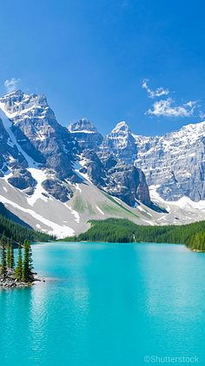
What have Daiyu and Liu Qian learned about Canada?
climate
cities
scenery
culture
geography
activities

Slide 3
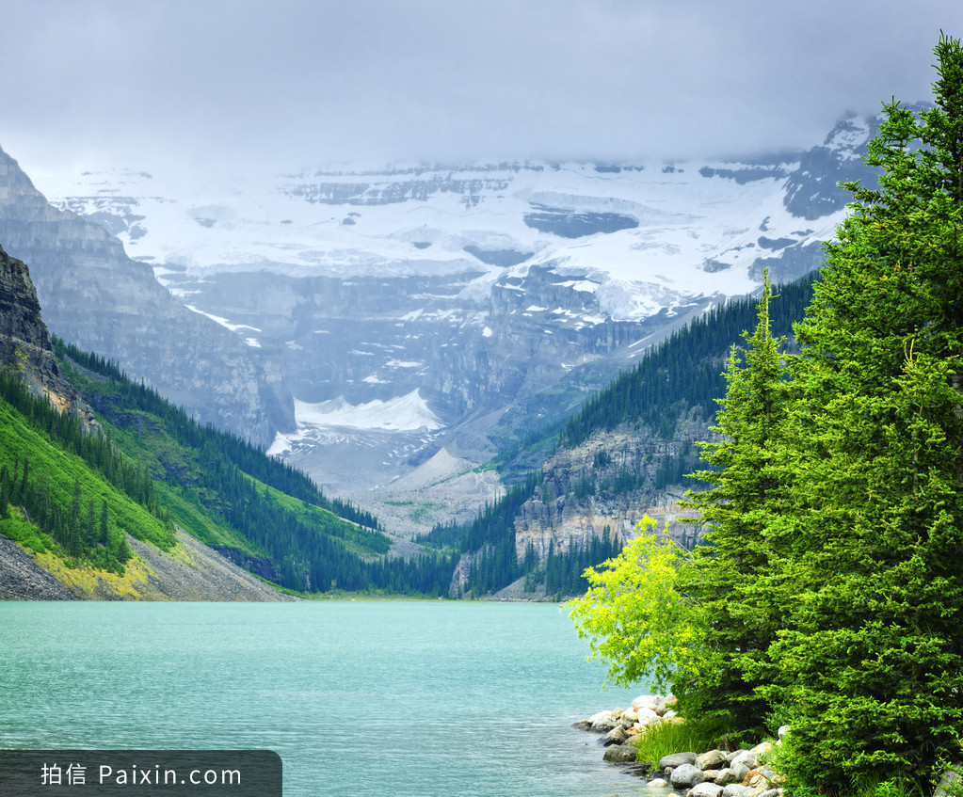
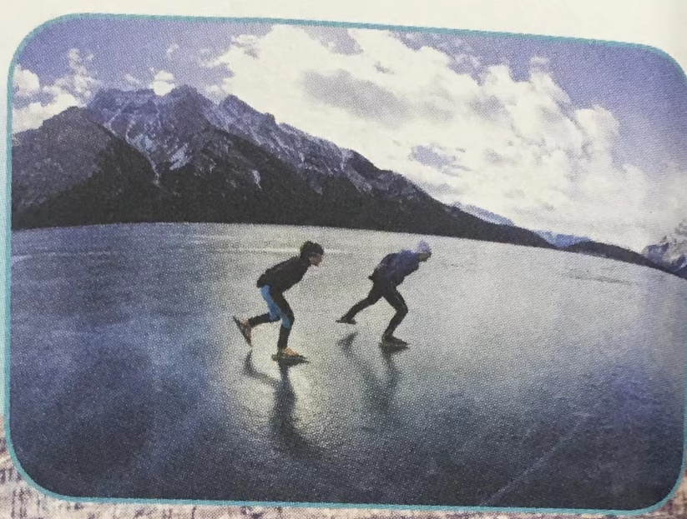
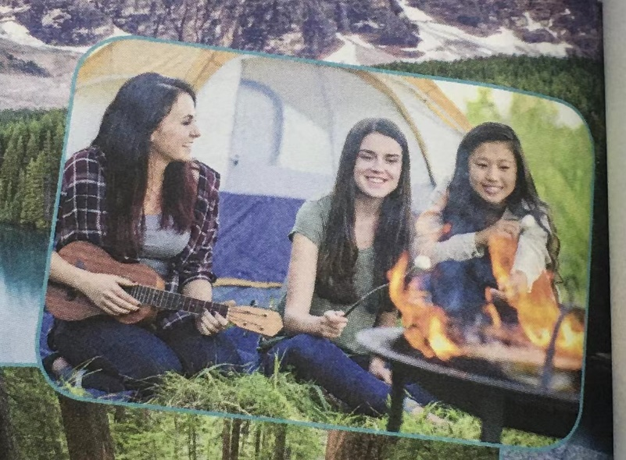
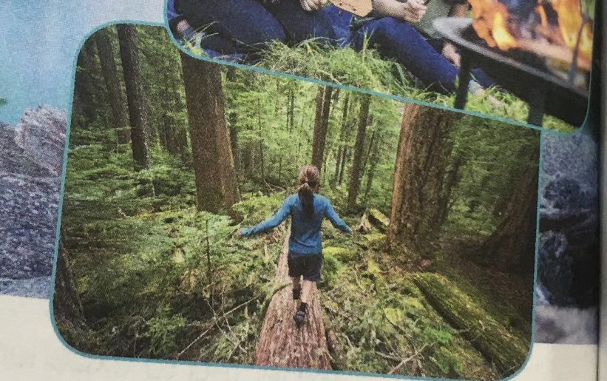
viewing and speaking
Look at the pictures and guess what they will be talking about.
What else do you want to know? Raise your questions.

Slide 4

listening and checking
What do people do when Lake Louise freezes over in winter?
2. What does Anna say about Canadian summers?
3. How far is it from Edmonton to Winnipeg?
4. What kinds of things do people do in Winnipeg?
5. What other long rail journey have Li Daiyu and Liu Qian taken?
People like to go skating on the ice.
Many places of Canada have cool summers. However, many areas of South Canada have very hot summers.
More than 1,300 kilometres.
Skiing, hiking, camping, and city things like movies or restaurants on the weekends.
They travelled from Beijing to Moscow on the Trans-Siberian Railway through Mongolia.

Slide 5
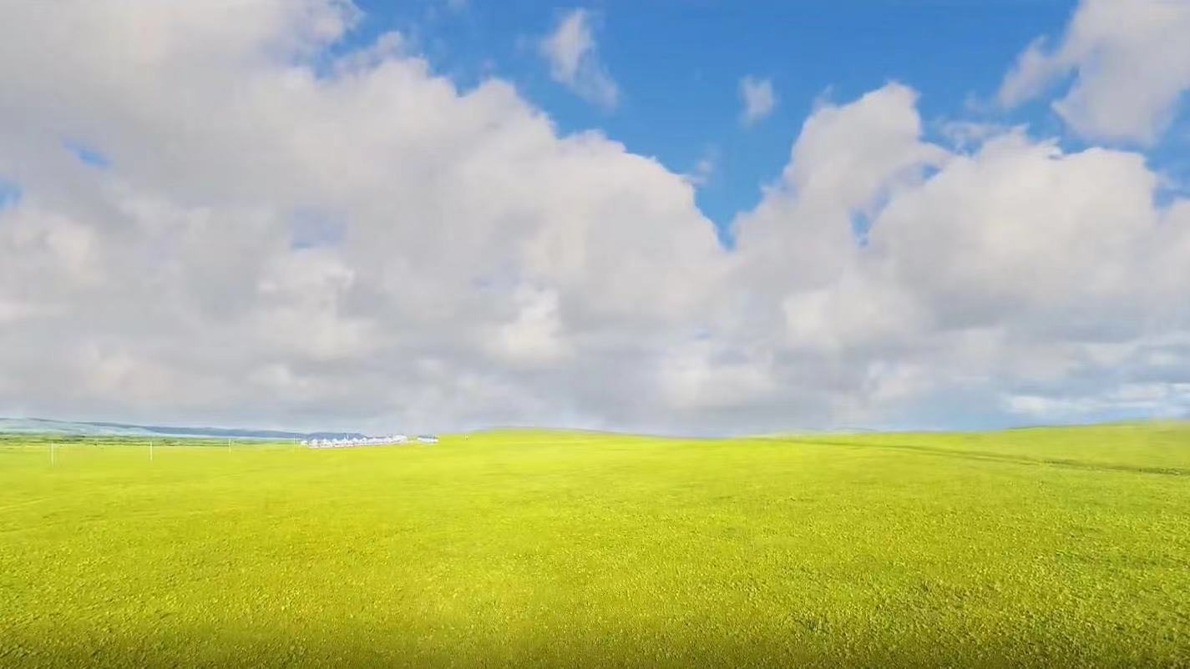
learning and matching
A. with no mountains or hills
all kinds of things
for a long distance
I’m surprised
spend time
very warm
the exact middle of something
words fail me
as hot as an oven
3. as plat as a pancake
4. as far as the eye can see
dead centre
kill time
you name it

Slide 6
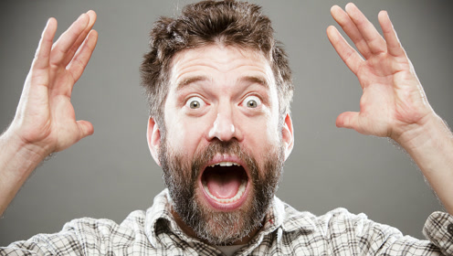
listen for details
scenery
Daiyu: Look there, Liu Qian! What a beautiful lake!
Liu Qian: Oh, ___________________! That must be Lake Louise! It’s so
beautiful! ___________________.
Anna: Yes, that’s Lake Louise.
Daiyu: It’s pretty.
Anna: It’s even prettier in winter, after the lake freezes over.
People like to go skating on the ice.
my goodness
Words fail me
I’m surprised!

Slide 7
language learning
How can we express our surprise?
I think it’s fantastic!
What was it like?
It can’t be true!
What a surprise!
My goodness！
Words fail me!
Good heavens!
Wow! How interesting/amazing!

Slide 8

listen for details
climate
Liu Qian: Does all of Canada get so cold in winter?
Anna: A lot of it does.
Daiyu: So then, Canada must have cool summers as well.
Anna: That’s certainly true of many places. However, many places of
south Canada have a continental climate, with _____________
summers and _____________________________winters, so some days it gets ___________________________.
very hot
very cold
as hot as an oven
freezing cold

Slide 9
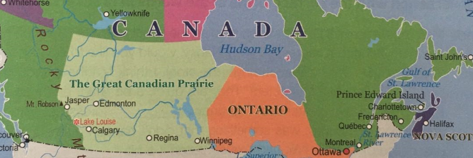
listen for details
geography
Liu Qian: Is all of Canada full of mountains like here?
Anna: Oh, no. In fact, by the time we get to Edmonton, we’ll be in the
_______. This is ________________________ and stretches
__________________________ --- more than 1,300 kilometres---
until we reach Winnipeg. After that, there are lakes and forests.
Daiyu: What kind of places in Winnipeg?
Anna: It’s a small city almost in the ______________________ of North America, ...
Liu Qian: What do you do to _________________ there?
Anna: Oh, _______________________... skiing, hiking, camping. But also city things:
…
a long distance
with no mountains or hills
Prairie
as flat as a pancake
as far as the eye can see
the exact middle of something
dead centre
activities
kill time
you name it
all kinds of it

Slide 10
listening and predicting
geography
Anna: … So is this your first long train journey?
Daiyu: Oh,no. Last autumn, we travelled from Beijing to Moscow on
the Trans-Siberian Railway through Mongolia.
Anna: _______________________! _______________________?
Liu Qian: Well, once you ___________________________, you pass through
some _______________________________and then enter ______________________________________________________.
Anna: Do a lot of people live in that area?
Daiyu: Oh, not at all! There are a few small towns ____________________, but but the land is ____________________. Sometimes you might see ….
Anna: Wow, that sounds __________________!
How interesting
What was it like
go north from Beijing
low mountains
the grasslands with its rolling hills
along the way
pretty empty
incredible

Slide 11
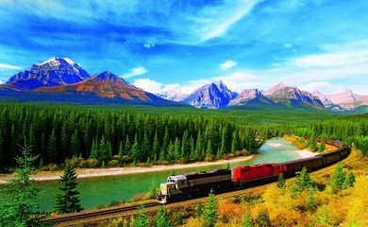
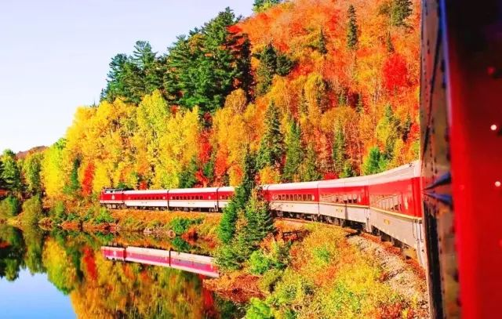
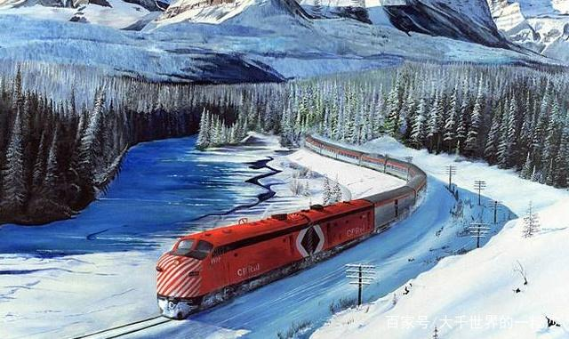

listening and predicting
Anna: I thought China would be very crowded,
given its large population.
Daiyu: Well, contrary to what people believe,
there are a lot of vast and empty spaces in
China, actually.
Anna: That’s great! There must be amazing
scenery to see in China then!
What will they talk about?

Slide 12
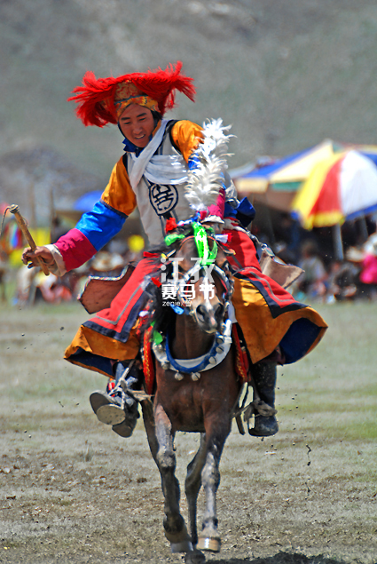
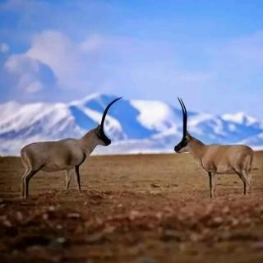
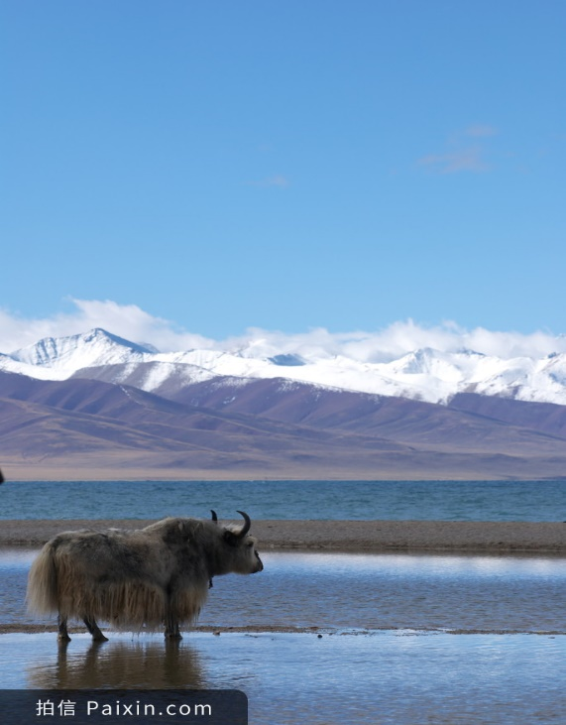
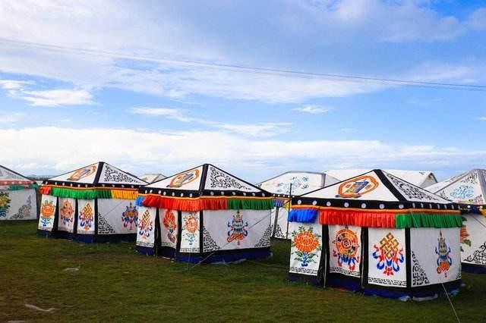
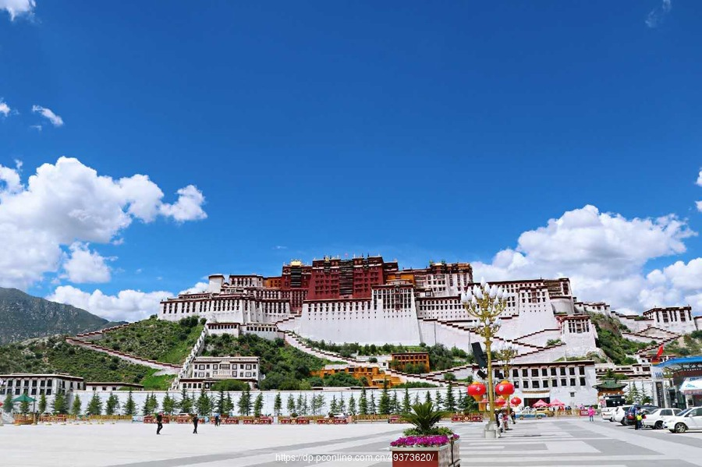
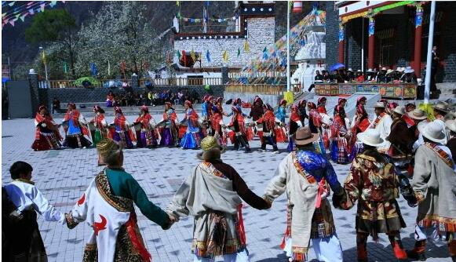

Slide 13
Act out the sample in groups
LQ: There is. My favorite trip was by train to Tibet. First, we travelled south across the
Kunlun Mountains.
D: Even though it was summer, they were still covered in snow. It was so beautiful.
LQ: Then we entered the Tibetan Plateau（青藏高原）.
D: The scenery there was simply fantastic. Green grass as far as the eye could see. And
there were so many wild animals.
LQ: Yes! We saw a lot of antelopes, yaks, deer… and I think I even saw a snow leopard.
A: Good heavens! That’s one of the rarest animals on earth.
LQ: But you know what was really extraordinary about our trip?
A: No, what?
LQ: The railway is so high that the trains have a special oxygen supply for the passengers,
kind of like you would find on an airplane, so that no one will become ill.
A: You’re kidding! Anyhow, the next station is my stop! Take care and enjoy the rest of
your trip!
……
How can we end our conversation naturally ?

Slide 14
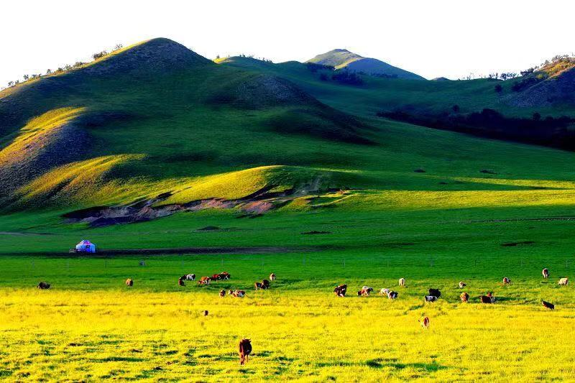
language learning
How can we end our conversation naturally ?
I have to run. Good talking to you.
I’ll catch you later.
It was good/nice meeting you.
I’m sure you want to relax a bit. I’ll let you go.
Sorry, I can’t talk longer. I’m actually on my way to…
Well, I have to go. I’ll talk to you later.
Make your own conversation.

Slide 15
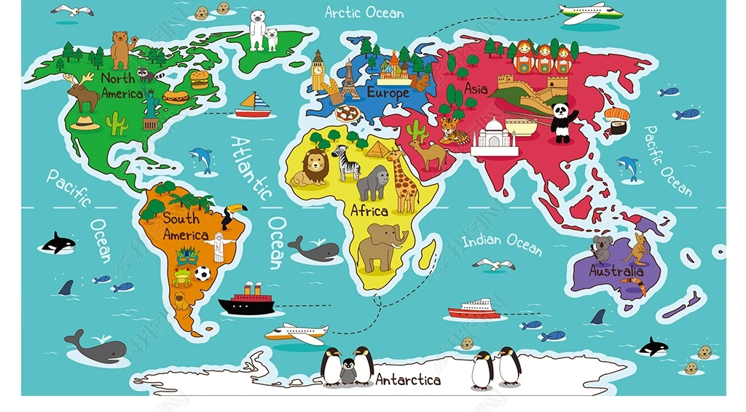
Assignment
Make sentences with the idioms learnt today.
2. Build your word bank based on the following mindmap .
climate
cities
culture
scenery
geography
activities

Slide 16
-THANK YOU-

