Slide 1

感恩遇见，相互成就，本课件资料仅供您个人参考、教学使用，严禁自行在网络传播，违者依知识产权法追究法律责任。
更多教学资源请关注
公众号：溯恩高中英语
知识产权声明

Slide 2

基于“矛盾冲突分析与设计”的读后续写微技能培养
——以2021.11绍兴市一模“读后续写”为例
Chunhui High School
Xuan Yefei
2021.11.25

Slide 3

Conflict:
to be different, opposed, or contradictory: to fail to be in agreement or accord
life and death 生死
good and evil 善恶
success and failure成败
rise and fall 兴衰
love and hatred 爱恨
loss and gain 得失
……
loyalty and crafty 忠奸
honor and disgrace 荣辱
right and wrong 是非

Slide 4
What are the main conflicts in a story?
环境与环境
人物与人物
A
B
人物与环境
C
D
性格与
情感
Why do authors use conflicts and how can we use conflicts in a story?

Slide 5
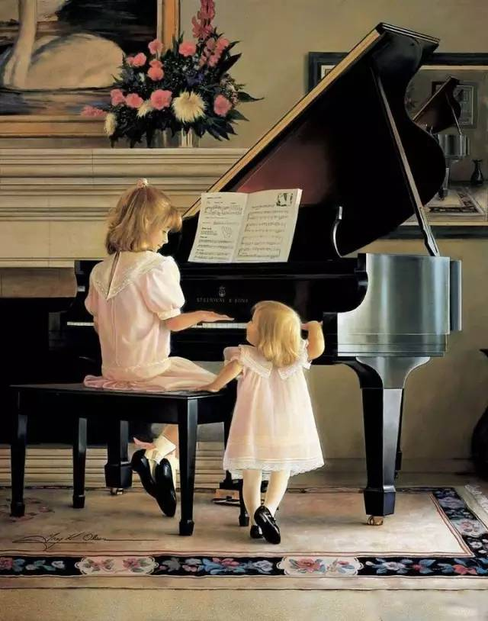
Analyze and design conflicts based on
“A Bittersweet Face-off”
Bittersweet

Slide 6
“A Bittersweet Face-off”
1) As a country music song goes, “She’s a wild one with an angel’s face.” That is my younger sister, Lulu. When I think of her, I think of trying to tame a wild horse.
2) It is hard to find words to describe my relationship with Lulu. “All-out nuclear warfare” could not interpret it quite exactly. The irony is that we are very much alike: we share the hot-tempered and fast-forgiving personality.
3)Speaking of personalities, the Chinese Zodiac ( 属 相 ) describes Lulu and me perfectly. People born in the Pig Year are “stubborn” and “tough” and often “fly into anger,” although they “never harbour a grudge (记仇)” as they are honest and warm-hearted. That is Lulu and I exactly, with an age gap of twelve years.
4)I had my first face-off with Lulu when she was about five. It was a freezing winter afternoon in New Haven, Connecticut. Mum and Dad were at work. Babysitting Lulu at home, I decided that it would be the perfect time to introduce Lulu to the piano as I was in the learning process myself. Excited about working together — with her brown curls, round eyes, and China doll face, Lulu was desperately cute – I put her on the piano bench, on top of some comfortable pillows. I then demonstrated how to play a single note with a single finger, and asked her to do the same. A small request, but Lulu refused, preferring instead to smash at many notes at the same time with two open palms. When I asked her to stop, she smashed harder and faster. When I tried to pull her away from the piano, she began yelling, crying, and kicking angrily.
5)Fifteen minutes later, she was still yelling, crying, and kicking, and I had had it! Avoiding her blows, I dragged the screaming demon (恶魔) to our back door, and threw it open. The wind chill was six degrees below zero, and my own face hurt from just a few seconds’ exposure to the icy air.
Part 1(para.1-3)
Introduction to the sisters
Part 2(para.4-5)
Description of the face-off

Slide 7
What are Lulu’s and my personalities?
1)As a country music song goes, “She’s a wild one with an angel’s face.” That is my younger sister, Lulu. When I think of her, I think of trying to tame a wild horse.
2) It is hard to find words to describe my relationship with Lulu. “All-out nuclear warfare” could not interpret it quite exactly. The irony is that we are very much alike: we share the hot-tempered and fast-forgiving personality.
3)Speaking of personalities, the Chinese Zodiac ( 属 相 ) describes Lulu and me perfectly. People born in the Pig Year are “stubborn” and “tough” and often “fly into anger,” although they “never harbour a grudge (记仇)” as they are honest and warm-hearted. That is Lulu and I exactly, with an age gap of twelve years.
“She’s a wild one with an angel’s face.”
wild side
hot-tempered
stubborn
tough
easy to fly into anger
conflict1:
personality-to-personality
mild side
fast forgiving
never harbour a grudge
honest
warm-hearted
Creating conflicts by using antonymous 反义的 adjectives.

Slide 8
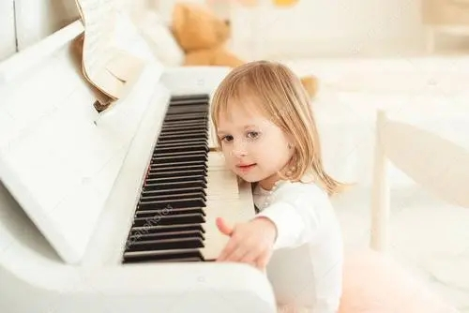
What’s Lulu’s appearance?
External side
With her brown curls, round eyes, and China doll face, Lulu was desperately cute.
an angel
Internal side
a demon
a wild horse
Conflict 2: appearance-to-personality conflict

Slide 9
4) I had my first face-off with Lulu when she was about five. It was a freezing winter afternoon in New Haven, Connecticut. Mum and Dad were at work. Babysitting Lulu at home, I decided that it would be the perfect time to introduce Lulu to the piano as I was in the learning process myself…… A small request, but Lulu refused, preferring instead to smash at many notes at the same time with two open palms. When I asked her to stop, she smashed harder and faster. When I tried to pull her away from the piano, she began yelling, crying, and kicking angrily.
5)Fifteen minutes later, she was still yelling, crying, and kicking, and I had had it! Avoiding her blows, I dragged the screaming demon (恶魔) to our back door, and threw it open. The wind chill was six degrees below zero, and my own face hurt from just a few seconds’ exposure to the icy air.
Face-off
—the sharpest conflict
What did “I” do?
What did Lulu react?
Demonstrated how to play with a singer finger
Asked her to stop
Tried to pull her away from the piano
Dragged her to the back door and threw it open
Refused
Preferred to smash at many notes…
Smashed harder and harder
Began yelling, crying and kicking angrily
Stubborn and determined
Rebellious 叛逆的 and untamable不可驯服的
Conflict 3: Character-to-character conflict
Creating conflicts with a series of verbs连动

Slide 10
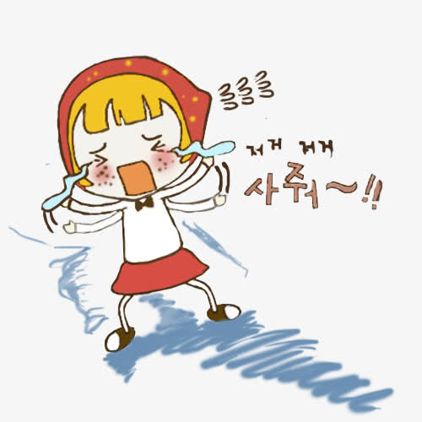
Paragraph 1: But I was determined to teach the little wild one a lesson.
What might be the lesson?
What did I do and say?
What was Lulu’s reaction?
Did it work?
Paragraph2: Lulu’s teeth were clicking repeatedly together because of cold, but she shook her head again.
Why did Lulu’s shake her head?
What was my feeling and reaction?
What was the ending and theme?
What was the weather like?
Conflict 4:
environment-to-character
Freezing cold
What was my reaction?
Insisting determination
What was Lulu’s reaction?
Uncompromising不妥协的 stubbornness

Slide 11
Paragraph 1: But I was determined to teach the little wild one a lesson.
Paragraph2: Lulu’s teeth were clicking repeatedly together because of cold, but she shook her head again.
Did I care about Lulu?
Conflict 5: emotion-to-emotion
Excited about working together — with her brown curls, round eyes, and China doll face, Lulu was desperately cute – I put her on the piano bench, on top of some comfortable pillows.
What might be the theme?
Lulu is a wild one , but I love her and will always love her as an angel!
Blood is thicker than water!
Love conquers everything!

Slide 12
A Bittersweet Face-off
conflicts
Personality-to- personality
Appearance-to-personality
Character-to-character
Environment-to emotion
Emotion-to-emotion

Slide 13
character-to-character conflicts
(”I”)
(Lulu)
勃然大怒，言行激烈
桀骜不驯，无动于衷
Holding her collar, I clenched my fist and threatened her to stop crying, “I will throw you out of house if you don’t listen to me”.
I dragged the little wild out of the back door, slamming the door furiously behind her.
Instead of being obedient, Lulu shook her head fiercely and stepped outside, ignoring the chilly wind.
environment-to-character conflicts
寒风冽凛，环境恶劣
无惧寒风，绝不妥协
The frigid gusts of wind stung our faces and beat against the window.
The little creature still stood still, facing me in a challenging way. She would rather freeze to death than give in.

Slide 14
emotion-to-emotion conflict
成就满满，舒适惬意
逐渐担忧，心绪不宁
Going back to my warm house, I was immersed in a surge of triumph, dipping a biscuit in a steaming cup of hot chocolate.
A dull dread began seeping through my body- the little one was wearing only her sweater and tights, which made me feel exceedingly unsettled.
appearance-to-personality conflict
楚楚可爱，如同天使
可恨可憎，神似恶魔
With her apple-like face and grape-like eyes, she was desperately cute.
Rooted to the spot like a wild horse, she was reluctantly to step in.

Slide 15
Assignment
Apply “conflicts” to your previous writing and polish it.
Appreciate the possible version and find out the conflicts.
But I was determined to teach the little wild one a lesson. “You can‘t stay in the house if you don’t listen to me,” I said sternly严厉地. Instead of being obedient, Lulu stepped outside, facing me in a challenging way. A dull dread began seeping through my body - the little one was wearing only her sweater and tights. "Okay, you've decided to behave," I said quickly.“ Come in now.“ However, Lulu shook her head with a stubborn look in her eyes. "Don't be silly, Lulu." I was panicking. "It’s freezing. You're going to get sick. Come in now.“
Lulu‘s teeth were clicking repeatedly together because of cold, but she shook her head again. It suddenly dawned on me that I had underestimated Lulu. She would rather freeze to death than give in. My mind racing, I changed tactics战术 immediately, begging and bribing诱哄 Lulu to come back into the house. When Mum and Dad arrived home, they found Lulu contentedly soaking in a hot bath, dipping a biscuit in a steaming cup of hot chocolate, desperately cute. Anyway, I love Lulu, a similar wild one with an angel's face.

Slide 16
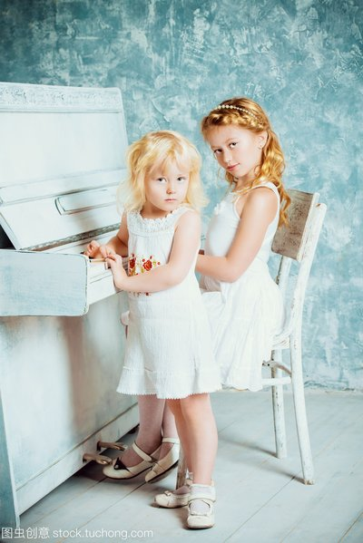
Thank you!

