Slide 1

感恩遇见，相互成就，本课件资料仅供您个人参考、教学使用，严禁自行在网络传播，违者依知识产权法追究法律责任。
更多教学资源请关注
公众号：溯恩高中英语
知识产权声明

Slide 2

2021年11月暨阳联考读后续写讲评Saving the Daisies
陈星可 浙江省天台中学

Slide 3
试题呈现：
At dawn, Taylor opened her sleepy eyes and looked out of the window at the foggy field below.“NO!" she cried, now fully awake. Buttermilk the cow was in Mama's daisy patch(雏菊地).
“I must have forgotten to lock the gate last night,” Taylor thought as she pulled a sweater over her head. Mama was planning to sell daisy bouquets (花束) at the fair next week, but Buttermilk was eating the flowers.
Taylor hurried outside and grabbed the lead rope on the wall. “Why can't you stay in the field?”she called to Buttermilk as she headed across the yard to the daisy patch.
Buttermilk still stood there chewing flowers. Annoyed,Taylor thought to herself, “When I grew up, I’ll be an artist and paint pictures all day. I’ll never own a cow. Too much trouble.”
Just as Taylor was about to throw the lead rope onto Buttermilk's collar, the family dog, Red, rounded the corner of the house. Startled, Buttermilk took off, tearing through the daisies and across the yard. She finally ran

Slide 4
试题呈现：
through the open gate and into the field.
“Thank goodness!”Taylor said as she closed the gate and secured the lock. She turned to look at the flower garden, where most of the daisies were either eaten or trampled(踩踏).
Mama came out of the house. “What's going on?” she asked. She looked sadly at her garden. “I forgot to lock the gate,” Taylor said. “I'm so sorry.”
“I know you are.” Mama sighed and gave Taylor a hug. “You learned an important lesson today.”Taylor’s heart was heavy as she went back into the house. She had to think of a way to make it up to her mother.
Paragraph 1: Suddenly, a painting on the wall caught Taylor’s eye. ____ ___________________________________________________________
Paragraph 2:The morning of the fair, Taylor came downstairs to invite Mama to see the surprise.______________________________________

Slide 5
Learn language：
1.天亮时
我突然明白...
2.胡乱穿上一件卫衣
3.正准备所就在这时
4.绕过屋角
5.受到惊吓
6.横冲直撞穿过雏菊
7.上好锁
8.吸取教训
给某人一个教训
9.弥补
10.吸引某人的注意力
1.at dawn
It dawned on me that...
2.pull on/ throw on a sweater
3.was about to do.. when...
4.round the corner of the house
5.be/ get startled
6.tear through the daisies
7.seure the lock
8.learn a lesson
teach sb. a lesson
9.make up (for...)
10.catch/arrest/attract sb’s eye/attention

Slide 6
Understand the story：
Taylor’s mother grew a patch of daisies ______ she planned to sell the daisy boutiques at the air next week. But last night Taylor forgot ______(lock) the gate, as a result of ______ Buttermilk the cow got into the field this morning. The cow was chewing the flowers, leaving the daisies either eaten or _________(trample). And the ___________(appear) of the family dog Red made Buttermilk startled, leaving the situation even ________(bad). Feeling quite guilty, Taylor _________(apologize) to her mother, admitting her carelessness and at heart she decided to do something to make it _____ to her mother. All of a sudden, the painting __________(hang) on the wall caught her attention.
and
to lock
which
trampled
appearance
worse
apologized
up
hanging

Slide 7
Understand the story：
Mama grew daisies in the field and and wanted to sell them at the fair
The painting caught her attention...?
Taylor invited Mama to see the surprise...?
Story
Taylor forgot to lock the gate and Buttermilk ate the daisies
Taylor’s heart was heavy and wanted to make it up to Mama
inspired + ？
expectant +?
Emotion
expectant
frustrated, guilty
annoyed

Slide 8
Design the plot: Underlined words
Taylor
Mama
daisy
boutique
wall
way
hug
hug
paint
run
own
“Maybe I can paint as many pictures of daisies as I can and sell them at the fair. This way, I can make it up to Mama somehow.” Taylor thought to herself.
Then together they loaded the daisy bouquets left in the field and Taylor’s paintings onto the van and set off for the fair.
“Amazing!” Mama was too excited to utter more words, giving Taylor a big hug. And he instantly understood why her girl had been locking herself up in the bedroom these days.
What they didn’t expect was that the paintings were sold out in just a while, much more popular that the real daisies grown in her field.
Really delighted that she had successfully made it up to mother, Daisy ran into her mother’s arms and her Dad scooped her up threw her her in the air.
Tip: Imporant underlined words can help you think up a plot/scene appropriate to the story.

Slide 9
Design the plot: Q-A
Paragraph 1:Suddenly, a painting on the wall caught Taylor's eye._______
Paragraph 2:The morning of the fair, Taylor came downstairs to invite Mama to see the surprise. ______________________________________
Q1:What was her idea about the painting? What did she intend to do?
Q2: How did she put the idea into practice?
Q3: What was the surprise? And what did she look forward to?
逆推法
Q1:What did her mother see? And how did she react?
Q2:How did they deal with the surprise? And where?
Q3:Did she make it up to Mama this way?

Slide 10
Design the plot: Q-A
Paragraph 1:Suddenly, a painting on the wall caught Taylor's eye._______
Q1:What was her idea about the painting? What did she intend to do?
“Maybe I can paint as many pictures of daisies as I can and sell them at the fair. This way, I can make it up to Mama somehow.” Taylor thought to herself.
“Since the daisies were destroyed, will painting some pictures of the daisy bouquets do?” she thought to herself, “maybe we can sell the daisy pictures as my dream is to be an artist.”
“I can paint some daisy bouquets and sell them at the fair. Hope people will buy my works, through which I could make it up to Mama, ” Taylor thought to herself, her face lighting up with excitement.
On the painting, a field of daisies were swaying gently in the gentle breeze, bathed in the gentle sunlight.

Slide 11
Design the plot: Q-A
Paragraph 1:Suddenly, a painting on the wall caught Taylor's eye._______
Q2: How did she put the idea into practice?
Immediately she started to work, devoting every moment she could spare to her painting work.
The following week witnessed Tailor watching the daisies carefully in the field, and drawing pictures of daisy from different angels.
Taylor raced upstairs, grabbed her art supplies and got ready to paint. She sat down at her desk, looking out the window at the remaining daisies below. As her brush moved smoothly across the papers, daisies came alive.
It was not long before Taylor completed twelve pieces and the bedroom now turned into a garden of daisies, which seemed to come alive.

Slide 12
Design the plot: Q-A
Paragraph 1:Suddenly, a painting on the wall caught Taylor's eye._______
Q3: What was the surprise? And what did she look forward to?
Looking at all this, Daisy looked forward to the fair eagerly and anticipated to give Mama a surprise.
All the work done, Tailor heaved a digh of relief. “It must be a big surprise for Mama.” Taylor nodded, a big smile creeping over her face.
During the days before the fair, Taylor made one painting after another, hoping to give Mama a big surprise, which could potentially make up for her mistake.
By the end of the week, she had completed two dozen paintings. Appreciating her great masterpieces, she couldn’t contain her excitement, jumping and clapping.

Slide 13
Design the plot: Q-A
Paragraph 2:The morning of the fair, Taylor came downstairs to invite Mama to see the surprise. ___________________
Q1:What did her mother see? And how did she react?
When she opened the door, what greeted her was a pile of paintings of daisies filling every corner of the room, floating her in a world of warm fragrance. Immediately aware of what the surprise was and what was in Taylor’s mind, Mama gave Taylor a big hug, really proud of her.
Hardly had Mama opened the door when she was entirely surprised at the scene, utterly in disbelief at what she was seeing. Daisy paintings were everywhere, bright and cheerful in the morning light.
Amazed by the pictures everywhere, Mama almost dropped her jaw, and realized immediately what her lovely girl was up to upstairs these days.

Slide 14
Design the plot: Q-A
Paragraph 2:The morning of the fair, Taylor came downstairs to invite Mama to see the surprise. ___________________
Q2:How did they deal with the surprise? And where?
Then together they loaded the daisy bouquets left in the field and Taylor’s paintings onto the van and set off for the fair.
“Do you think anyone will buy them?” Taylor asked. Stroking her hair affectionately, Mama wrapped her in a hug and nodded, “Oh, sweetie, yes. I’m sure they will.” After loading the daisy bouquets and paintings into the van, they headed for the fair.
“Oh, yes, sweetie. I’m sure they will. And you have a better lesson than I expected.” Mama smiled.

Slide 15
Design the plot: Q-A
Paragraph 2:The morning of the fair, Taylor came downstairs to invite Mama to see the surprise. ___________________
Q3:Did she make it up to Mama this way?
No matter how much money the paintings valued, Taylor’s warm heart and commitment were invaluable.
What they didn’t expect was that the paintings were sold out in just a while, much more popular that the real daisies grown in her field.
It turned out that people loved not only those daisy bouquets but the daisy paintings as well. All were sold out soon.

Slide 16
Design the plot: foreshadowing
Overshadowing | Possible plot
Mama was planning to sell daisy bouquets (花束) at the fair next week;Suddenly, a painting on the wall caught Taylor’s eye
Para2:Taylor把她所画的雏菊的画拿到fair去卖。
When I grew up, I’ll be an artist and paint pictures all day. I’ll never own a cow.
Para1:Taylor打算努力多画一些画，来弥补对妈妈的过失。
You learned an important lesson today.
Para2:妈妈从Taylor身上学到了更重要的一课。
She had to think of a way to make it up to her mother.
Para2:Taylor成功地弥补了她的过失。
Tip: Overshadowing can make the story you make up reasonable, logical and coherent.

Slide 17
参考范文：
Suddenly, a painting on the wall caught Taylor’s eye. “That’s it,”she exclaimed, her eyes twinkling with excitement. Taylor raced upstairs, grabbed her art supplies and got ready to paint. She sat down at her desk, looking out the window at the remaining daisies below. As her brush moved smoothly across the papers, daisies came alive. At the thought that this ideal way might work, Taylor’s face lit up with pleasure. During the days before the fair, Taylor made one painting after another, hoping to give Mama a big surprise which could make up for her mistake.

Slide 18
参考范文：
The morning of the fair, Taylor came downstairs to invite Mama to see the surprise. Hardly had Mama opened the door when she was entirely surprised at the scene, utterly in disbelief at what she was seeing. Daisy paintings were everywhere, bright and cheerful in the morning light. “Do you think anyone will buy them?”Taylor asked. Stroking her hair affectionately, Mama wrapped her in a hug and nodded, “Oh, sweetie, yes. I’m sure they will.”After loading the daisy bouquets and paintings into the van, they headed for the fair. No matter how much money the paintings valued, Taylor’s warm heart and commitment were invaluable.

Slide 19
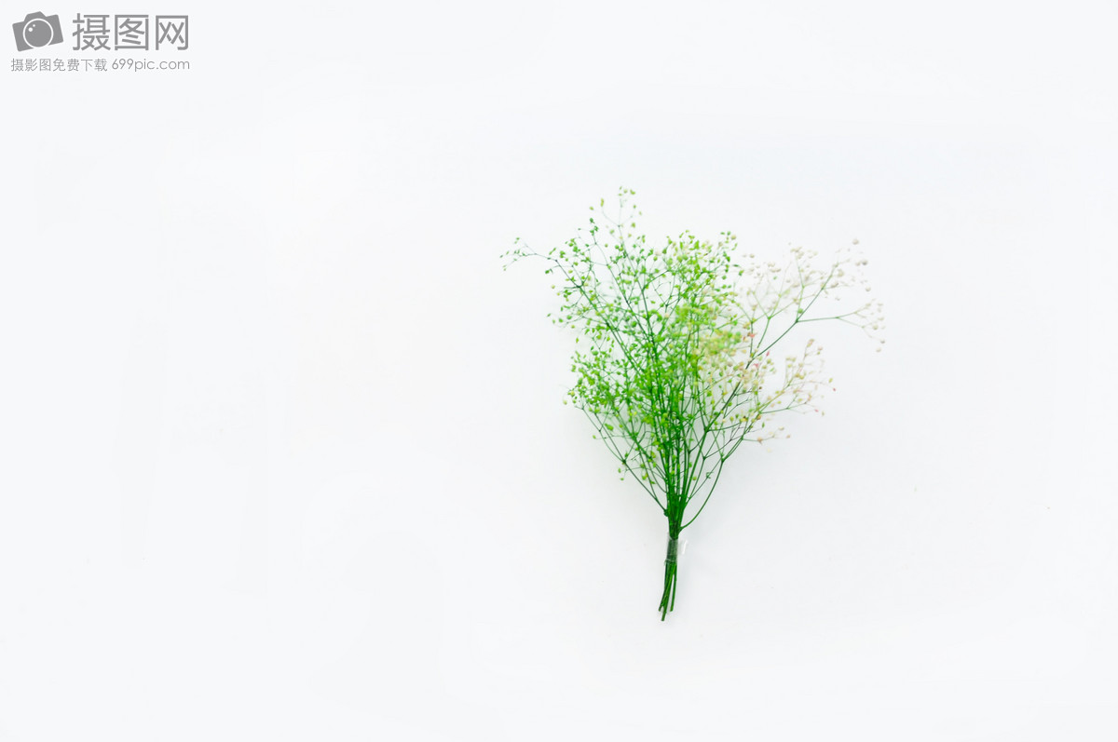
下水作文：
Suddenly, a painting on the wall caught Taylor's eye. On the painting, a field of daisies were swaying gently in the gentle breeze, bathed in the gentle sunlight. “Maybe I can paint as many pictures of daisies as I can and sell them at the fair. This way, I can make it up to Mama somehow,”Taylor thought to herself. Immediately she started to work, devoting every moment she could spare to her painting work. It was not long before Taylor completed twelve pieces and the bedroom now turned into a garden of daisies, which seemed to come alive. Looking at all this, Daisy looked forward to the fair eagerly and anticipated to give Mama a surprise. 105

Slide 20
下水作文：
The morning of the fair, Taylor came downstairs to invite Mama to see the surprise. When she opened the door, what greeted her was a pile of paintings of daisies filling every corner of the room, floating her in a world of warm fragrance. Immediately aware of what the surprise was and what was in Taylor’s mind, Mama gave Taylor a big hug, really proud of her. Then together they loaded the daisy bouquets left in the garden and Taylor’s paintings onto the van and set off for the fair. What they didn’t expect was that the paintings were sold out in just a while, much more popular that the real daisies grown in her garden. 101

Slide 21
读后续写30天冲刺建议：
分类整理、巩固素材语料：
要形成丰富扎实的语料库，按照“情绪、心理活动、动作、场景、动态场景、有意境的句子”等几方面的内容进行分类记忆。各类中又按照人、身体部位、情绪名词等三类做主语分别记忆一些有场面感的句子。这一块内容最好能够通过默写或者听写来巩固。
掌握高效的句子升级策略，驾驭长句子：
借助于头脑风暴模式，熟知重要的几种句子升级方法，如倒装结构、虚拟语气、各种从句、无灵主语、修饰性副词、主位推进等等，融合动作、心理活动和情绪等元素，练就长短句的交错运用。

Slide 22
读后续写30天冲刺建议：
构建合理的结尾套路：
多阅读读后续写试题，思考并判断各中类型的文本应该采用什么样的结尾比较合适，并且熟知各种结尾的一般性写法。结尾方式可以分为Message点睛式、环境描写烘托式、展望将来式、回首反思式、自然过程式、首尾呼应式等等。

Slide 23

Shine your English !

