Slide 1

感恩遇见，相互成就，本课件资料仅供您个人参考、教学使用，严禁自行在网络传播，违者依知识产权法追究法律责任。
更多教学资源请关注
公众号：溯恩高中英语
知识产权声明

Slide 2
Reading and Thinking
Unit2
Bridging Cultures
-BY lily

Slide 3
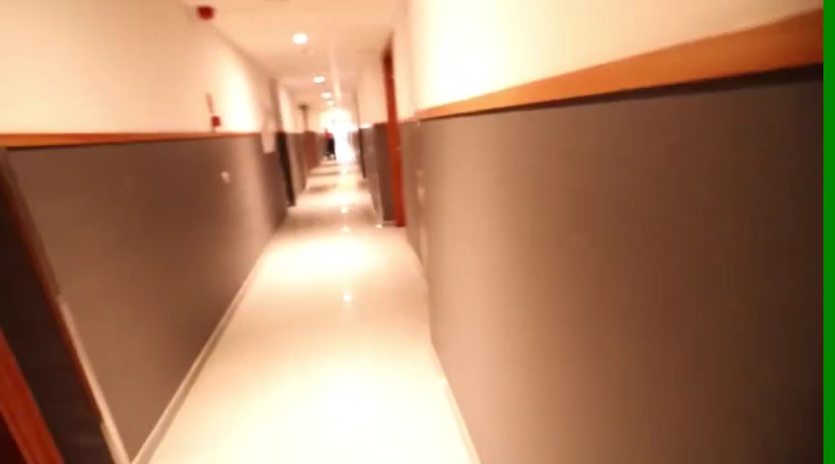
A Vlog about ______________________
a student’s first day of college studying abroad
What challenges might he meet?

Slide 4
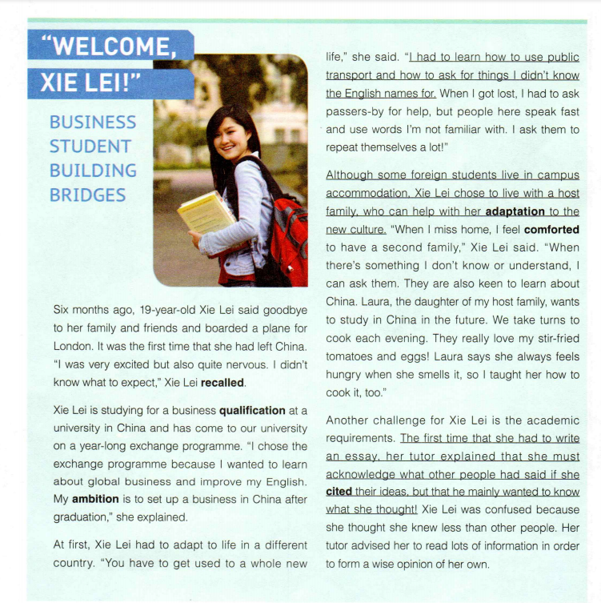
1. Where might you read this passage?
Who is saying it?
“
!”
Who is Xie Lei ?
the newspaper of an overseas university
What bridges ?
2. What might you read in this passage?
the life of an exchange student from China, Xie Lei

Slide 5
the Structure and Main Idea
paragraph 1
Xie Lei’s feeling when leaving China
paragraph 2
Xie Lei’s major and ambition
paragraph 3
paragraph 4
Xie Lei’s challenges abroad and her feelings
paragraph 5
paragraph 6
paragraph 7
Xie Lei’s present situation
paragraph 8
the editor’s wish to Xie Lei

Slide 6
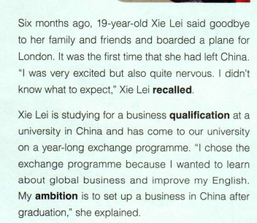
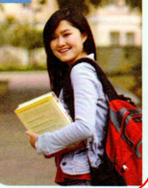
Who is Xie Lei ?
Xie Lei’s feeling when leaving China
ambitious; daring to try new things;
why did she learn abroad?

Slide 7
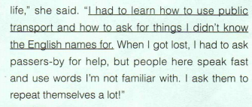
Challenges
para3-6
feelings
excited but nervous and confused
cultural shocks
It was the first time that she had left China.
daily life
awkward;
not familiar
adaptation to a whole new life
lonely sometimes
but comforted to live with a host family
academics requirements
homesickness
confused
no idea
write an essay
participating in class and giving presentations

Slide 8
Challenges
para3-7
feelings
excited but nervous and confused
at home
It was the first time that she had left China.
be involved
in social activities
awkward;
not familiar
surprised
adaptation to a whole new life
Her presentation on Chinese art was a great success.
lonely sometimes
but comforted to live with a host family
comforted
homesickness
live with
a host family
confused
no idea
write an essay
participating in class and giving presentations
Solutions

Slide 9
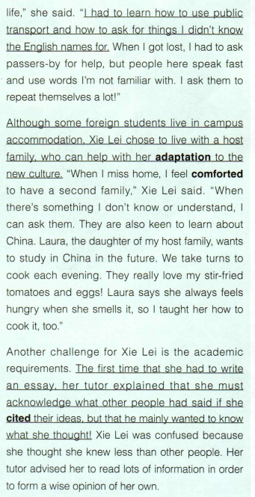
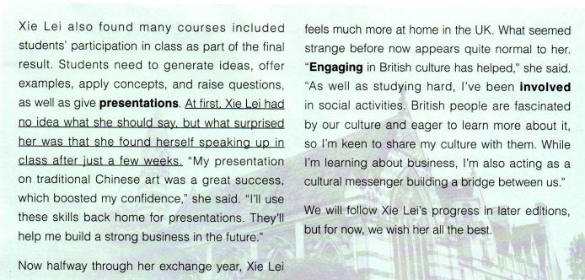
What helped Xie Lei adapt to the life abroad ?
to engage in the new culture and involve in social activities
input
nervous and excited to leave for London
found it difficult to
adapt to the new life and academic requirements
to learn new things and ask for help and suggestions
speak up in class confidently
six month ago
at first
share Chinese culture
after just a few weeks
Now halfway through
output
feel much more at home
and what seemed strange appears normal to her
Later
progress ?

Slide 10
What Chinese culture did Xie Lei share abroad ?
Chinese cuisine
Chinese art

Slide 11

cultural shocks
to engage in the new culture and involve in social activities
What bridges ?
a cultural messenger
share Chinese culture
a bridge of culture

Slide 12
Why does Xie Lei choose to join in the exchange programme?
Why do people choose to join in the exchange programme?
for further education
to extend horizon
obtain growth and experience

Slide 13
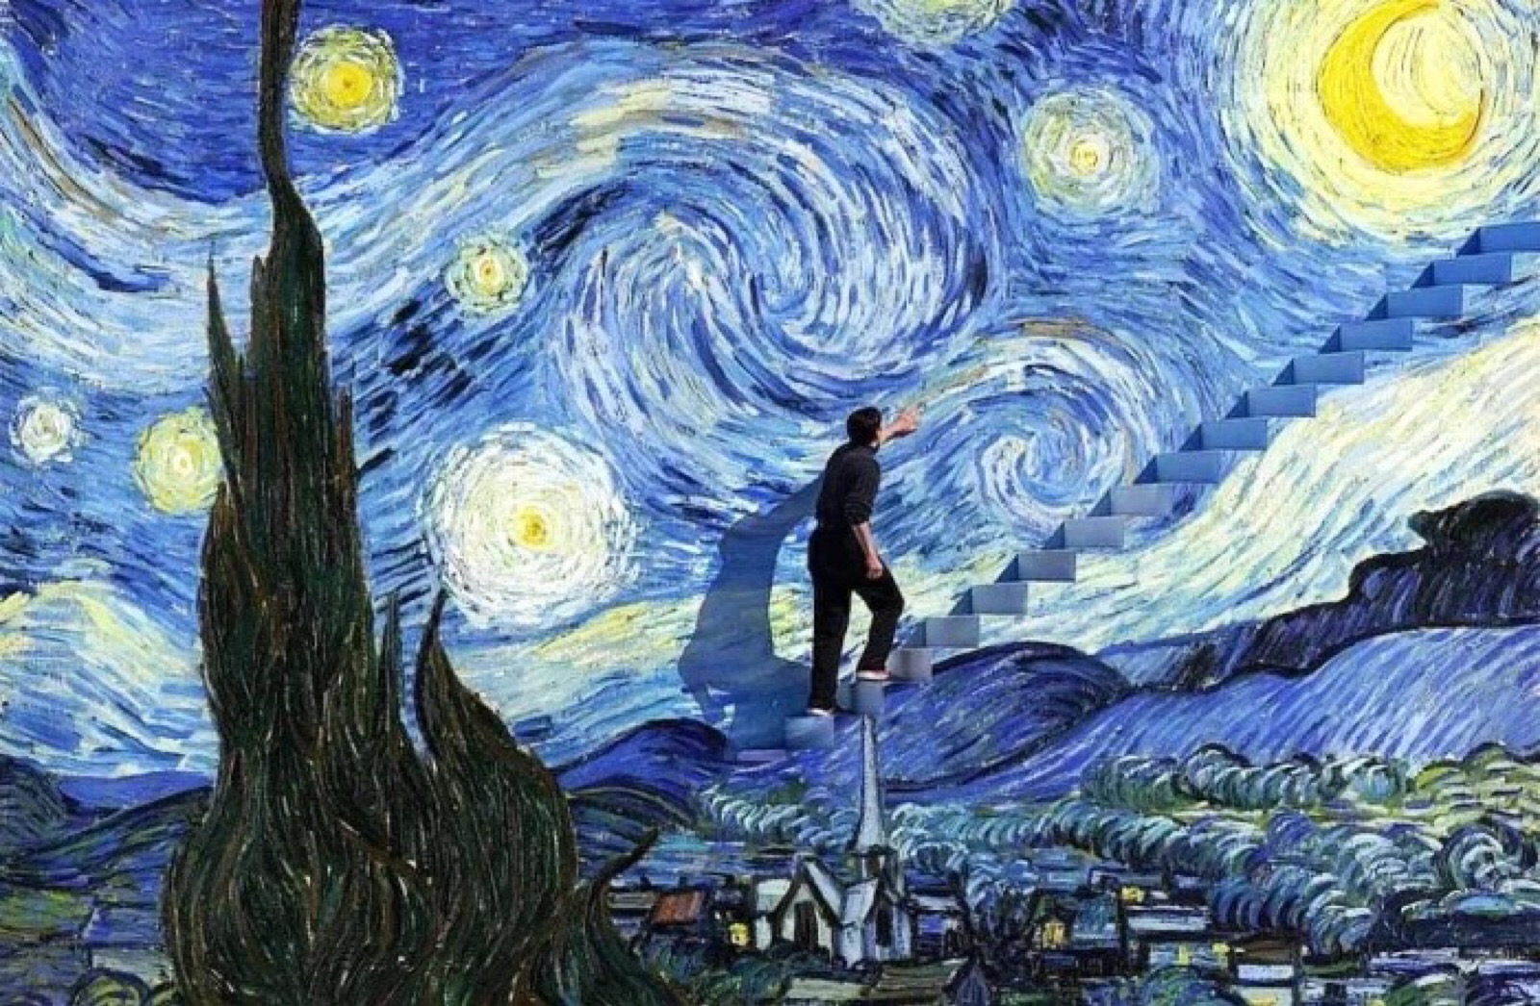
I am not the same, having seen the moon shine on the other side of the world.
---Mary Anne Radmacher
What might be transformed?

Slide 14
Homework
If a visiting group including exchange students from British, France, the USA , Germany and Russia is going to visit our school for a week, you are asked to receive them.
Here are some preparation work you need to do:
1. 6 people in a group
2.To search some information about the differences of this country from China in the aspects like the climate, food, customs and education system
3. make a report

Slide 15

Thank You.

