Slide 1

感恩遇见，相互成就，本课件资料仅供您个人参考、教学使用，严禁自行在网络传播，违者依知识产权法追究法律责任。
更多教学资源请关注
公众号：溯恩高中英语
知识产权声明

Slide 2
Unit 4 Journey across a vast land
Discover useful structures s Pt clause
人教版 选择性必修 第二册
-ed / –ing forms used as predicative and adverbial
江山滨江高级中学 毛春蕾
衢州第三中学 邱赛仙

Slide 3
Discovering the form
(Para 1)For both of them, the thought of crossing the whole country by trail was exciting.
(Para 2)They were pleased to see the beautiful mountains looking out over the city.
(Para 5)However, they did not anticipate seeing such an open country, and were truly amazed.
What is –ing/-ed form used as?

Slide 4
Comparing the usage
(Para 1)For both of them, the thought of crossing the whole country by trail was exciting.
(Para 2)They were pleased to see the beautiful mountains looking out over the city.
(Para 5)However, they did not anticipate seeing such an open country, and were truly amazed.
-ing form as a predicative is used to
while -ed form is to .

Slide 5
Describe feelings | Describe places, things, or people
Practice1
interested
interesting
disappointed
disappointing
excited
exciting
frightened
frightening
tired
tiring
amazed
amazing
1. A: Are you in visiting the newly built museum downtown？
B: Not really. I’d rather go to the new theme park, which is more .
2. A: Don’t you think that dog is ? Better not get close to it.
B: Actually, I think that the dog is just because there are so many
people around.
3. A: Do you feel after a whole day’s hike along the river.
B: Yes. It is so that I’m almost worn out.
interested
interesting
frightening
frightened
tired
tiring

Slide 6
Practice1
Describe feelings | Describe places, things, or people
interested | interesting
disappointed | disappointing
excited | exciting
frightened | frightening
tired | tiring
amazed | amazing
4.The girls were to see such an open country.
The farms covered a very large area, which was .
5.Going into the wilderness alone can be .
Do you feel when going into the wilderness alone?
amazed
amazing
frightened
frightening

Slide 7
Practice2
bore excite tire satisfy
1.We became when thinking about those beautiful locations in
Finland. We expected to experience a lot of things there.
2.We went to bed as soon as we arrived at the hotel because we were
so . The eight-hour train ride was quite .
3.I was not with the hotel. It was not as clean as I had expected.
But we had a meal at the hotel’s restaurant, so I felt a bit
Better later on.
4.It was raining hard the next day, so we just stayed in the hotel and
watched TV. Sadly, the TV programmes that day were really .
As we had nothing to do, we felt pretty .
excited
exciting
tired
tiring
satisfied
satisfying
boring
bored

Slide 8
Summarizing the usage
(Para3) Looking at the beautiful scenery, they both agreed that it was the most awesome journey they had ever taken.
(Para3) Seen from the train window, the mountains and forests of Canada looked massive.
What is –ed/–ing form used as?

Slide 9
Discovering the function
(Para3) Looking at the beautiful scenery, they both agreed that it was the most awesome journey they had ever taken.
(Para3) Seen from the train window, the mountains and forests of Canada looked massive.
-ing/-ed as an adverbial is used to .

Slide 10
Practice1
see frighten head amaze
1. from the top of the mountain, the scenery was really
fascinating.
the scenery from the top of the mountain, I was fascinated
by the autumn colors.
2. eastwards, you will pass the Canadian Rockies.
Finally, the company-- by its new manager—started to
make a profit.
Seen
Seeing
Heading
headed

Slide 11
Practice2
Rewrite the sentences using –ed/-ing form.
Example: When people asked the man what the trip meant to him, he said it was
“an experience of a lifetime”.
When asked what the trip meant to him, the man said it was “an experience
of a lifetime”.
1.Butchart Gardens was transformed from a quarry. It has now
become a famous destination for travelers.
2.If you compare Quebec City with other cities in Canada, it seems
more like a charming European village.
Transformed from a quarry, Butchart Gardens has now become
a famous destination for travelers.
Compared with other cities in Canada, Quebec City seems more like
a charming European village.

Slide 12
Practice2
3.They did not know where to start their sightseeing in Luoyang, so they went to the Tourist Information Center.
4.When they heard that the Sea-to-Sky Highway was Canada’s most scenic drive, they made West Vancouver their first destination.
Not knowing where to start their sightseeing in Luoyang, they
went to the Tourist Information Center.
Hearing that the Sea-to-Sky Highway was Canada’s most scenic
drive, they made West Vancouver their first destination.

Slide 13
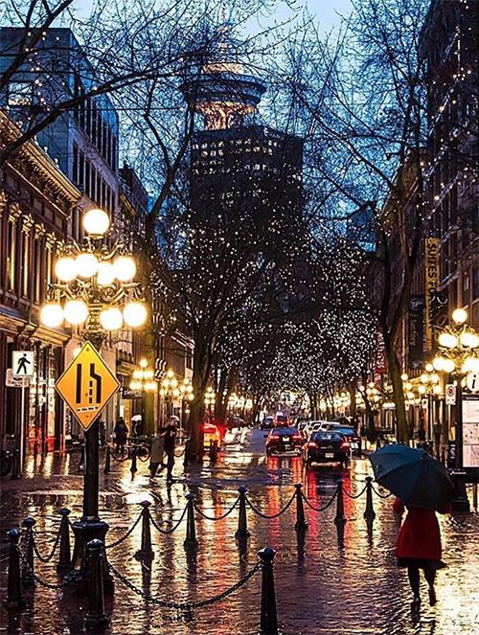
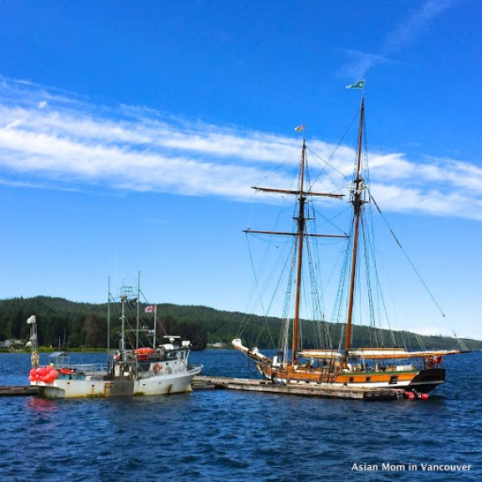
Summarizing the usage
1.Caught in a heavy rain in Vancouver, they were all wet.
Because they were caught in a heavy rain in Vancouver, …
2.Taking a boat ride out into the bay, they could see marvelous scenery.
Because they took a boat ride out into the bay, …
Vancouver
-ed和-ing形式做状语时，可表示原因，-ed形式与
其逻辑主语之间时被动关系，而-ing形式则表示
主动关系。
bay

Slide 14
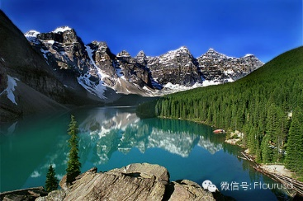
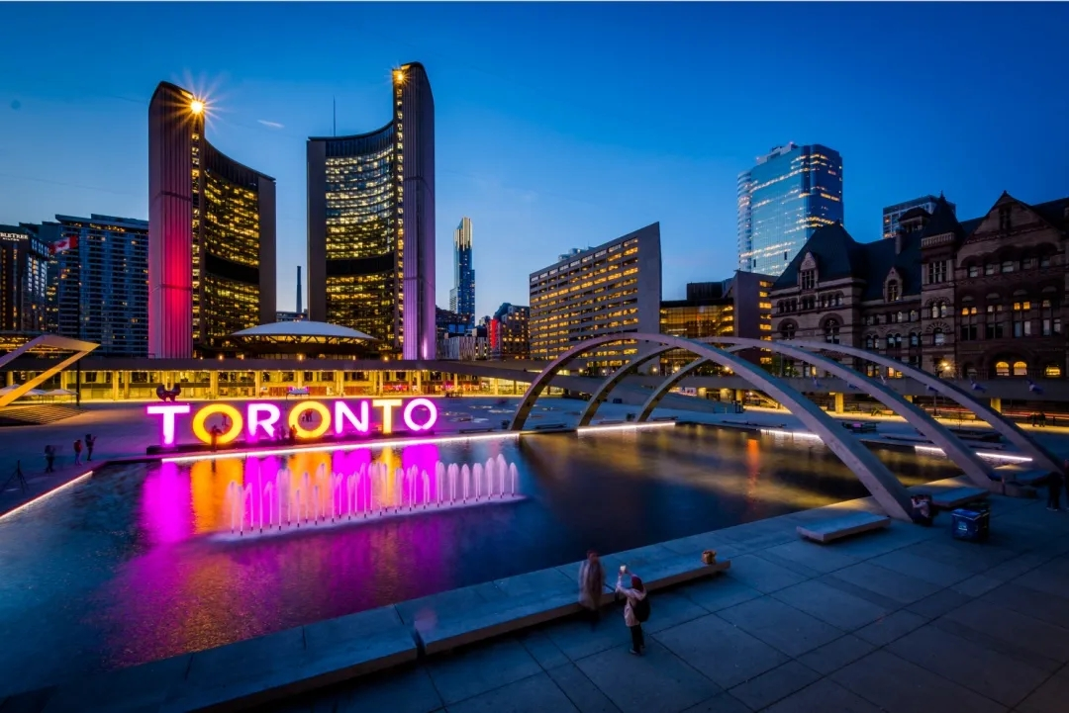
3. When passing through the Canadian Rockies,
they saw beautiful mountains and forests.
When they were passing through the Canadian
Rockies, …
4. When/If given another chance, they will pay a visit to Toronto once more.
When/If they are given another chance, …
-ed和-ing形式做状语时，也可表示时间或条件，
-ed形式与其逻辑主语之间时被动关系，而-ing形式
则表示主动关系。

Slide 15
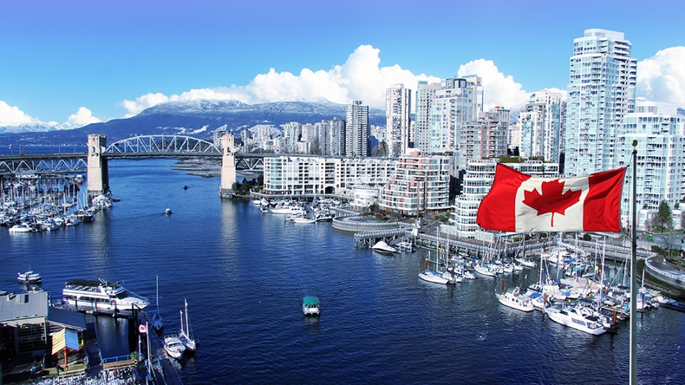
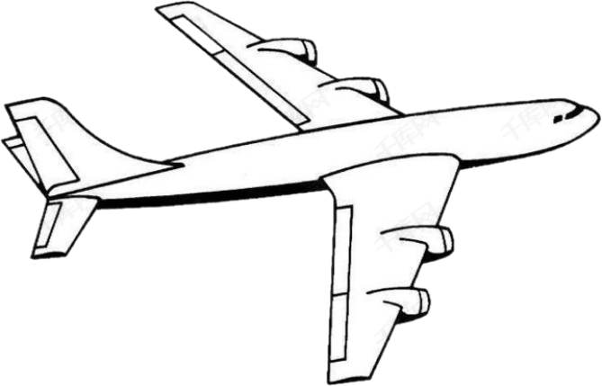
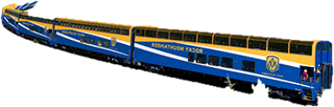
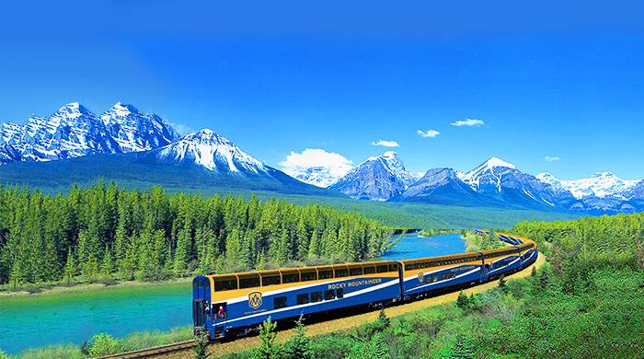
5. They are planning to fly to Vancouver,
followed by a train trip.
6.The two girls arose early to take the
train to Lake Louise, passing through
the Canadian Rockies.
-ed和-ing形式做状语时，还可表示伴随，
-ed形式与其逻辑主语之间时被动关系，
而-ing形式则表示主动关系。

Slide 16
Summary
 | -ed form | -ing form
做状语
做表语
与其逻辑主语间是
被动关系
与其逻辑主语间是主动
关系
通常用于说明人，
表示“某人感到…”
之意
主要用于说明事物，表示事物的性质或特征，有“某物是令人…”之意；

Slide 17
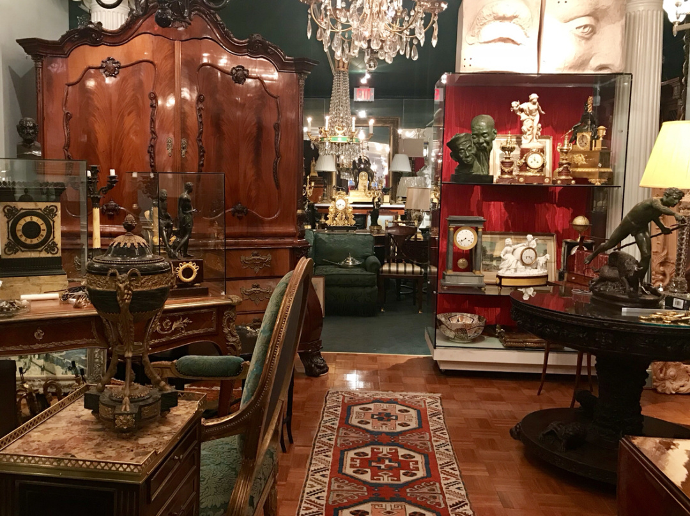
What did Li Daiyu and Liu Qian do in Vancouver?
take a boat ride out into the bay
visit wonderful shops selling
crafts and antiques

Slide 18
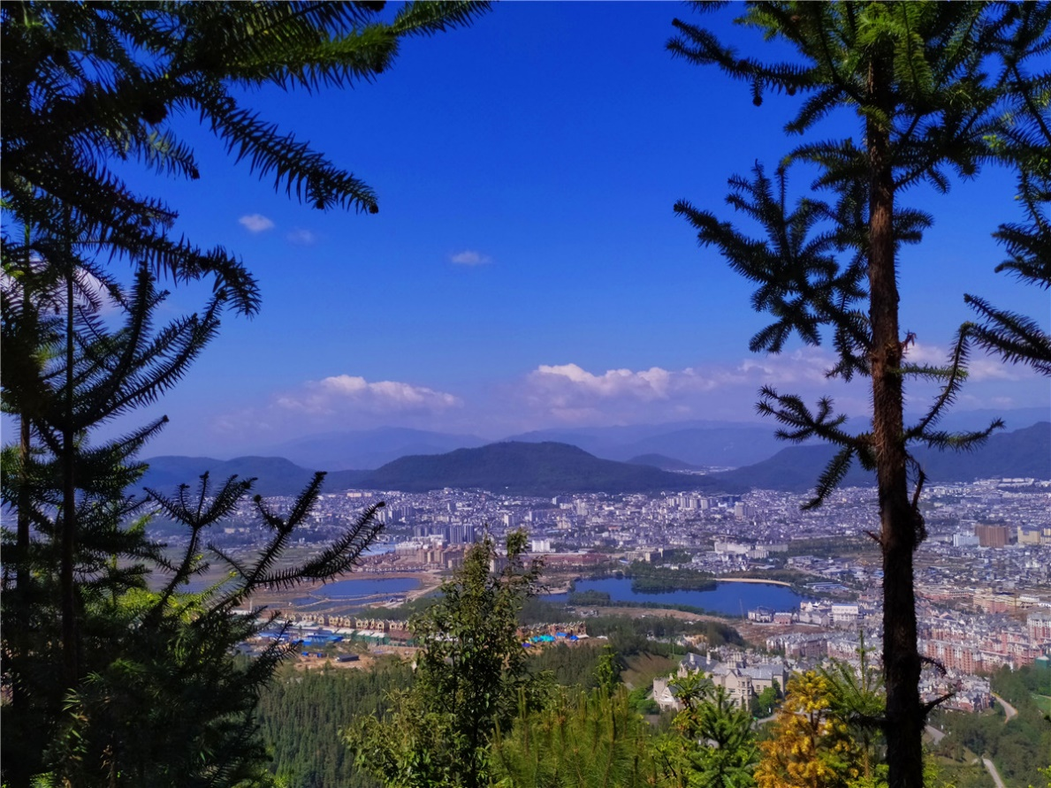
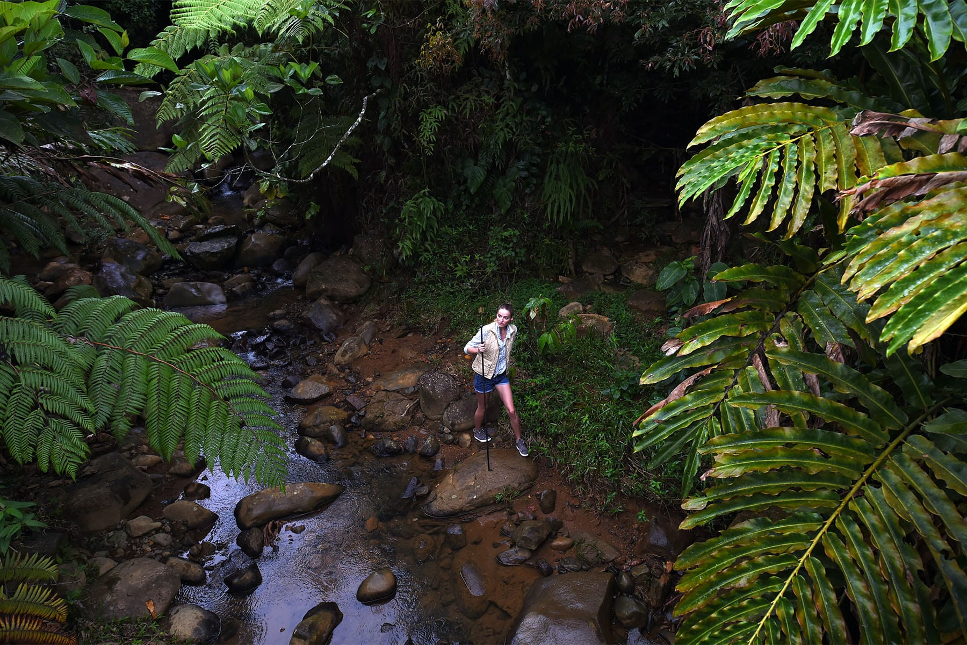
see the beautiful mountains
looking out over city
take a pleasant hike in a forest
just a short distance away

Slide 19
Suppose you are Li Daiyu, write a paragraph about your feelings or experience in Vancouver using some words in their -ed or –ing forms.
What did I do in Vancouver?
∙ take a boat ride out into the bay
∙ visit wonderful shops selling crafts and antiques
∙ see beautiful mountains
looking out over city
∙ take a pleasant hike in a forest
just a short distance away
For example:
Vancouver is the most
city I have ever visited. Among all
that I did in the city, was
. I was deeply impressed
by . When ,
I ……

Slide 20
Possible version:
Vancouver is the most attractive city I have ever visited. Among
all that I have done in the city, taking a boat ride out into the bay
was the most thrilling. I was deeply impressed by the magnificent
scenery out to the sea. When visiting an island that had wonderful
shop selling crafts and antiques, I was amazed at the exquisite
handicrafts and ancient works of art. The next day, it was clear
and mild. Seen from the top of the mountain, the city was far and
beautiful. I was tired coming down from the mountain while
taking a hike in a forest made me refreshed.

Slide 21
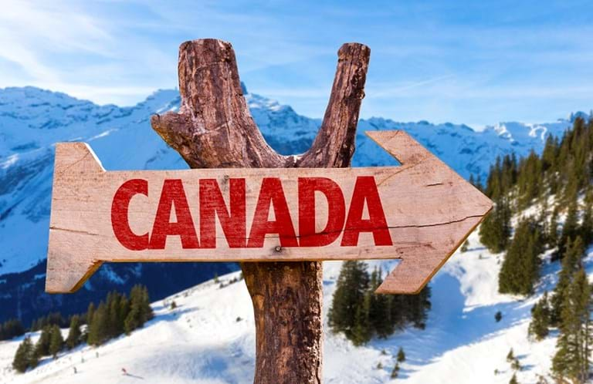
Assignment:
Suppose you are Li Daiyu, you are writing a diary on the train to Totonto, reflecting the days in Canada mostly using –ed or –ing forms.

Slide 22
Possible version:
Sitting in the seat on the train to Toronto with a warm drink in my hand,
I reflected on the days – days of pure magic. When first arriving at
Vancouver, I was deeply attracted by its beauty and prosperity. Despite
the rain, Liu Qian and I were thrilled to explore the city. Taking a boat
ride out into the bay and visiting the wonderful shops selling crafts
and antiques made the journey worthwhile. The next day, we took the
Train to Lake Louise. Looking at the beautiful mountains and forests of
Canada, I knew that it was the most awesome journey I had ever taken.
I was quite cheerful to see mountain goats, deer, a grizzly bear and an
eagle. Then I changed the train to a taxi. Seen from the taxi, the blue
water literally took my breath away with its exceptional beautiful. From
Edmonton, I was astonished at such an open country when the train
was heading southeast across the great Canadian Prairie. With the
train thundering on through the rolling hills, I saw red, gold and orange
bushes and maples outside the windows, which were beautiful and
fascinating.

Slide 23


