Slide 1

感恩遇见，相互成就，本课件资料仅供您个人参考、教学使用，严禁自行在网络传播，违者依知识产权法追究法律责任。
更多教学资源请关注
公众号：溯恩高中英语
知识产权声明

Slide 2
Build up Your Vocabulary
-How to grasp the meaning of words ?
-BY Lily

Slide 3
the longest English word
肺尘病
pneumonoultramicroscopicsilicovolcanoconiosis
/njuːˌməʊ.nəʊˌʌl.trə.maɪ.krəˌskɒp.ɪkˌsɪl.ɪ.kəʊ.vɒl.keɪ.nəʊ.kɒn.iˈəʊ.sɪs/
a lung disease caused by inhaling very fine ash and sand dust
pneumono-
ultra-
micro-
scopic-
silico-
of lung
to an extreme degree
small
of viewing or observing
of silicon 硅的
volcano-
coni-
-osis
mountain releasing lava and ash
affixes
of dust
a state of disease

Slide 4
What do these affixes mean?
Affix |  | Meaning | Examples | change
prefix | re-
 | dis-
 | micro-
 | trans-
Affix |  | Meaning | Examples | change
suffix | -ory
 | -ion
 | -ial
 | -ology

Slide 5
What do these affixes mean?
Affix |  | Meaning | Examples | change
prefix | re-
 | dis-
 | micro-
 | trans-
reunite, revise, recover, react, recall
again
not
discover, disappear, dislike, disable
meaning
small
microscope, microwave, microphone
complete change; through, across
transform, transplant, transport

Slide 6
What do these affixes mean?
Affix |  | Meaning | Examples | change
suffix | -ory
 | -ion
 | -ial
 | -ology
contradictory; advisory;compulsory;
of or relating to
action or process
infection, contribution, extinction, reaction...
part of speech
substantial, financial, official, commercial
having the characteristics of
a branch of knowledge
epidemiology, biology, physiology
Tip1: to grasp the meaning based on affixes and roots.

Slide 7
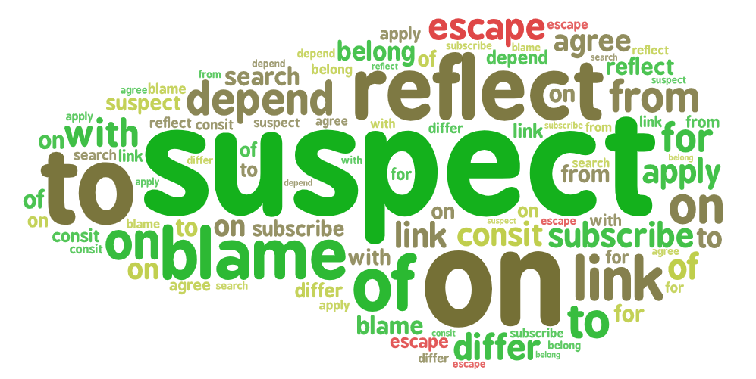
find as many collocations as possible
blame… for
suspect ... of ...
link ... to ...
subscribe to

Slide 8
Tell the meaning of following underlined phrases.
to pay to receive a product regularly
1. Millions of people subscribe to this online music service.
2. John Snow subscribed firmly to the belief that cholera was caused by an infection from germs in food or water.
3. There was no eividence to suggest that the disease was linked to bad air.
4. The hot weather is partly to blame for the water shortage.
5. If a person is suspected of an infection, his/her family members should be put in quarantine.
to agree with
to be connected to
to be responsible for
to believe that something, usually bad, may be true
Tip2: to grasp the meaning of words in collocations.

Slide 9
Practice
subscribe to suspect sb of sth blame… for sth link sth to sth
subscribe to
1. Many scientists ____________________the view that it is human activity that has caused global warming.
2.He was to____________________ the accident because he drove on the wrong side of the road.
3 The man ____________________being behind the robbery was seen crossing the street.
4 Since heart disease is often________________ our lifestyle choices, we need to make healthy living an important part of our lives.
blame for
was suspected of
linked to
Tip2: to grasp the meaning of words in collocations.

Slide 10
raw a household name substantial statistics handle
a household name
1. It is not unusual for an athlete to be well known while he is active, and quickly forgotten when his athletic career is over.
2. I'm sure she'll deal with the changes very well because she's very adaptable.
3. He was ready to serve dinner to his friends when he realized that he had forgotten to turn on the oven and the meat was not cooked yet.
4. He used his great influence to change the thinking of the scientific community on this issue.
5. Scientists have collected more data than expected to prove the theory.
handle
raw
substantial
statistics
Tip3: to grasp the meaning of words with synonyms.

Slide 11
infection multiple decrease severe transform proof blame substantial
topic sentence
be responsible for
British scientists believe they may have found a way to fight the common cold. It blocks a key protein in the body cells that is to ________________ for the spread of cold-causing virus. Targeting the host rather than _________________was a bit non-traditional but made sense because it was tricky to target the virus. Cold-causing virus are not only of _______________kinds, they also _______________ rapidly, meaning they can quickly develop resistance to medicine. Researchers are working on making a form of medicine that can be taken directly into one’s lungs, to____________ the chance of side effects. Though these scientists have made _________________ advances in their research, further__________ is needed to make sure such drugs are not so______________ that they harm the body.
blame
the disease
infection
to completely change appearance or character
difficult to deal with
multiple
transform
to reduce
decrease
evidence
substantial
proof
big and considerable
severe
serious
Tip4: to grasp the meaning of words in topic-related context.
Notes:
这个tip体现得不明显，而且这个文本本身也不容易理解。

Slide 12
Tip5: to grasp the meaning of words by a mind map.
virus
blame
spread
causes
science
&
scientists
tricky
resistance
fight disease
characteristics
multiple
transform
the common cold
decrease
substantial
effects
side effects
severe harm
target
host and infection
solutions
block protein cell

Slide 13
Summary
Tip1: to grasp the meaning based on affixes and roots.
Tip2: to grasp the meaning of words in collocations.
Tip3: to grasp the meaning of words with synonyms.
Tip4: to grasp the meaning of words in topic-related context.
Tip5: to grasp the meaning of words by a mind map.
-How to grasp the meaning of words ?

Slide 14
Homework
Make a mind map of vocabulary in this unit.
Notes:
可以提供几组学生的习作

Slide 15
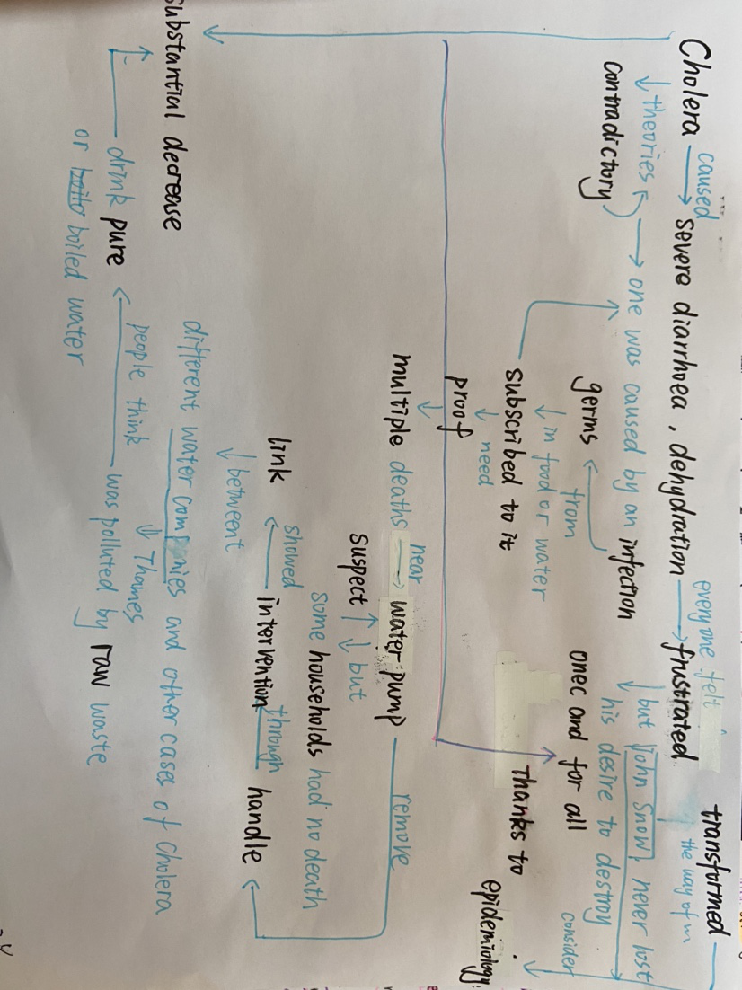

Slide 16
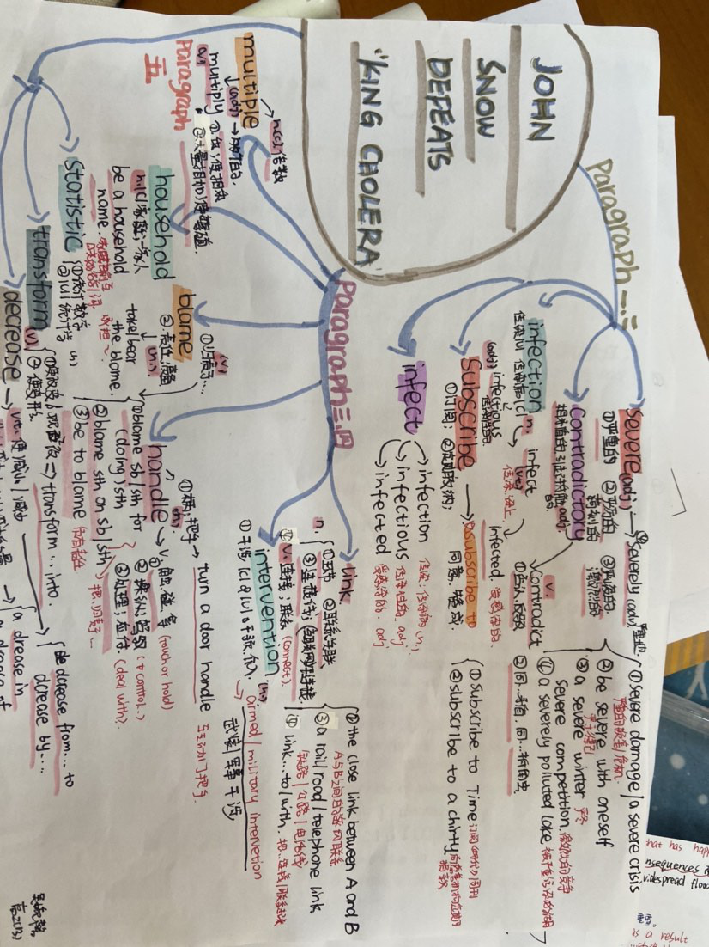

Slide 17
