Slide 1

感恩遇见，相互成就，本课件资料仅供您个人参考、教学使用，严禁自行在网络传播，违者依知识产权法追究法律责任。
更多教学资源请关注
公众号：溯恩高中英语
知识产权声明

Slide 2
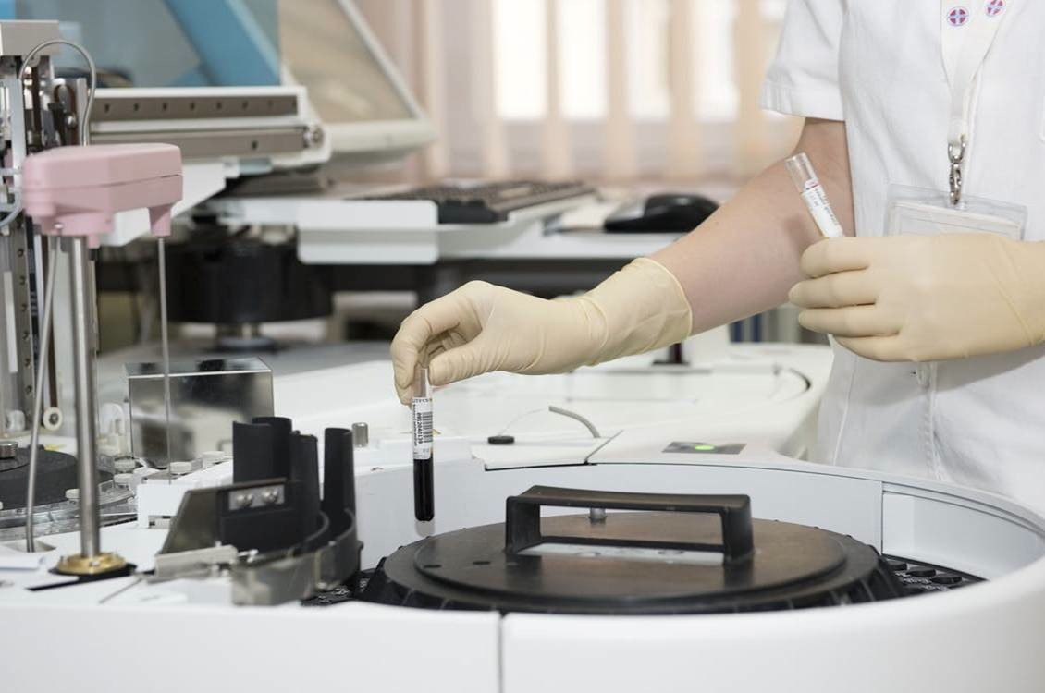
选择性必修二
Unit 1 Science and Scientists Using Language (1)
Talk about scientific experiences
杭州二中许丽君

Slide 3

Learning objectives
In this class, students will
get information about Judy’s experience in the scientific museum;
talk about different scientific experiences.
Brainstorm scientific research and experiment

Slide 4
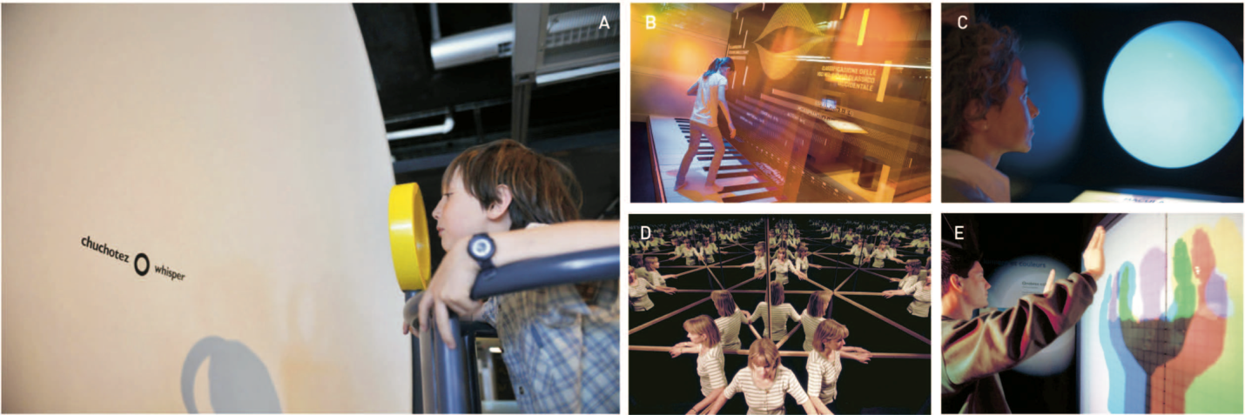
Pre-listening
Activity 1: Look at the photos and talk about what these activities have to do with science.
Where are they? Why do you think so?
At a party?
In a stadium?
In a restaurant?
In a museum?

At school?
In a theatre?
What can you see in the picture?
What is he/she doing?
Why is he/she doing that?

Slide 5
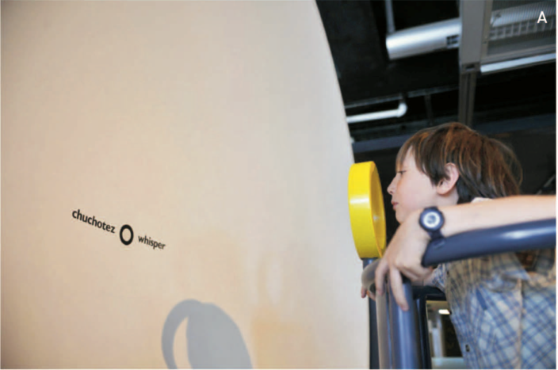
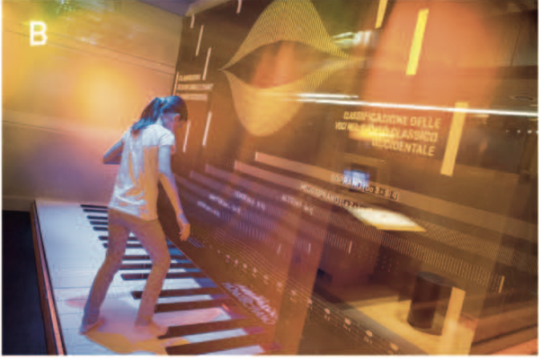
Pre-listening
Activity 1: Look at the photos and talk about what these activities have to do with science.
A . I think the dish in this exhibition is related to sound. Maybe the boy is whispering into the smaller circle and the dish can make his voice louder.
A
a giant dish whisper
B. This looks like a piano you play with your feet.
Maybe it shows how sound works.
B
a piano keyboard
play with feet

Slide 6
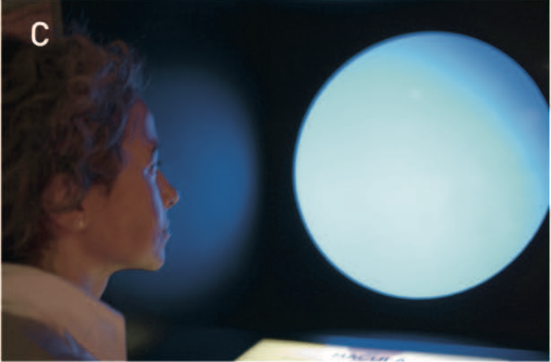
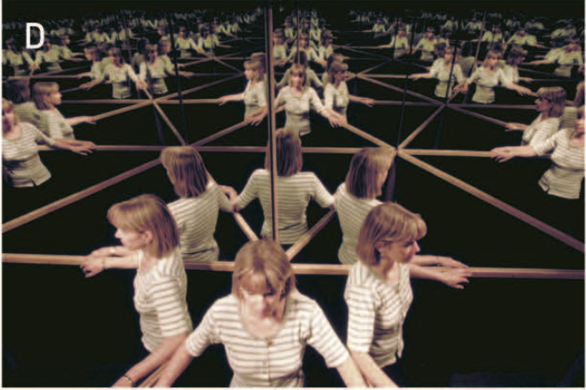
Pre-listening
Activity 1: Look at the photos and talk about what these activities have to do with science.
a blue screen bright lights
C. I'm not sure what this one shows, but it must be about light or eyesight.
C
a hall of mirrors reflect
D. It is a hall of mirrors. Maybe it has to do with the principles of reflection.
D

Slide 7
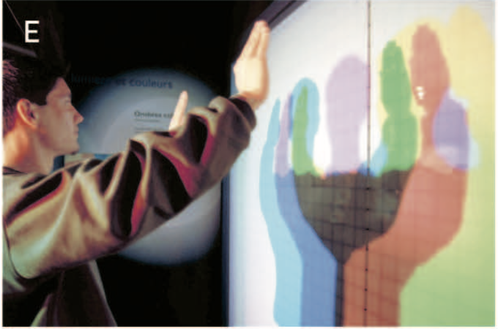
Pre-listening
Activity 1: Look at the photos and talk about what these activities have to do with science.
E. This is probably an experiment involving the composition of light.
E
n. 阴影
a white light
cast shadows
in the colour of the rainbow
v. 投射
n. 彩虹

Slide 8
Pre-listening
Activity 2: Using the photos, try to predict the answers to the following questions.
1. Where are the people in the conversation going to go?
2. What kind of place is it, and what does it focus on?
They are going to a science museum.
A place for delight, education and inspiration.
Scientific phenomena/discoveries on sound and light.
It is a science museum that focuses on letting visitors experience science through interactive learning exhibitions.

Slide 9

Pre-listening
Activity 2: Using the photos, try to predict the answers to the following questions.
3. What kinds of things can you do there?
Interactive activities to experience/experiment/explore.
You can probably try different activities to learn about sound, light, reflection, and so on.
For example, you can go to a room with many mirrors facing each other so it looks like there are many copies of you! Or you can play with a big piano on the floor.

Slide 10


Pre-listening
Activity 2: Using the photos, try to predict the answers to the following questions.
Predict by using pictures
One way to get more out of your listening is to predict what you will hear. Using the pictures provided and the knowledge you already have, you can guess the kinds of information you should listen for. At times, you may even be able to guess exactly what will be talked about. This will help you focus better when listening, making your listening more effective.

Slide 11


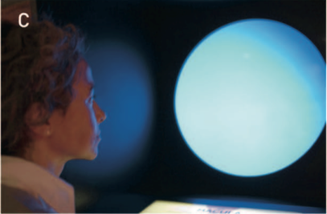
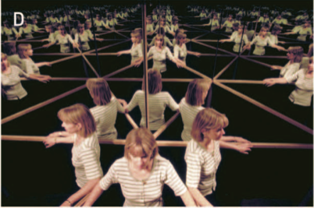


While-listening
Activity 3：(1) Listen to the conversation to check your prediction in Activity 2.
(2) Write down the letters (A-E) for the photos in the order that you hear them.
B
C
A
D
E
1 ________ 2 ________ 3 ________
4 ________ 5 ________

Slide 12



While-listening
(2) Write down the letters (A-E) for the photos in the order that you hear them.
D
a hall of mirrors
see myself reflected thousands of times
1
C
2
a blue screen
tiny bright lights
blood cells
E
3
a white light
cast different shadows
in every colour of the rainbow

Slide 13

While-listening
(2) Write down the letters (A-E) for the photos in the order that you hear them.
B
a giant piano keyboard
use your feet to play
play voices of classical singers
4
A
a giant dish
reflect the sound back
speak in a whisper
17 metres away
5

Slide 14
While-listening
(2) Write down the letters (A-E) for the photos in the order that you hear them.
A
B
C
D
E
1 ________ 2 ________ 3 ________
4 ________ 5 ________
D
C
E
B
A

Slide 15
While-listening
Activity 4: Listen again and complete the descriptions of the photos about scientific experiences in the conversation.
reflects
Photo A:
Photo B:
A giant dish; when you speak into it, it ________ the sound back and ________________. You can use it to speak in a ________ to someone 17 metres away.
makes it louder
whisper
A giant ______________ that you can use your feet to play. Instead of playing the sounds of a piano, it plays the voices of ________________.
piano keyboard
classical singers
You look at a blue screen for a while, and then suddenly you can see ________________ moving around on it. These are our _________________.
Photo C:
Photo D:
tiny bright lights
own blood cells
hall of mirrors
A ______________ where you can see yourself reflected thousands of times.
Photo E:
You stand in front of ____________, and it casts different shadows of you, in ________________ the rainbow.
a white light
every colour of

Slide 16
Post-listening
Activity 5: Fill in the blanks with the words and expressions in the box to finish the summary of the conversation.
piano keyboard | a hall of mirrors | whisper
blood cells | sound | experimented with
the rainbow | reflected | tiny bright lights
light | a field trip | cast different shadows
a field trip
Judy had __________ to a science museum with her classmates last week. First she went to an area for _____. In ________________ Judy saw herself reflected thousands of times.
light
a hall of mirrors
blood cells
experimented with
She also ________________ a blue screen and saw her own _________ moving around like _______________.
tiny bright lights

Slide 17
Post-listening
Activity 5: Fill in the blanks with the words and expressions in the box to finish the summary of the conversation.
piano keyboard | a hall of mirrors | whisper
blood cells | sound | experimented with
the rainbow | reflected | tiny bright lights
light | a field trip | cast different shadows
cast different
shadows
The thing Judy liked better was that a white light _____________ ____________ of Judy in every colour of ___________. Later Judy went to the area for ______.
the rainbow
sound
piano keyboard
Judy played a giant ______________ with her feet, and it even produced the voices of classical singers. She also played a giant dish, which ________ the sound back and made it louder so that you could _________ to someone 17 metres away.
reflected
whisper

Slide 18
Post-listening
Activity 6: Talk about something more on the scientific museum (Page 7, Activity 5).
The conversation is about the City of Science and Industry, a museum in Paris. Would you like to go to this museum? Why or why not?
Yes.
I would like to go to this museum to see the blue screen. I am curious to know what on earth is going on there and why I can see my blood cells moving around like tiny bright lights. I am sure it will be a lot of fun.
No.
It is not convenient because it is too far from China and there is no need to go so far when we have so many interesting places at home.
We can’t speak French and will have trouble in understanding what to do there.
Are there any museums like this in China? What other interesting museums are there?
Yes, there are, for example, the China Science and Technology Museum in Beijing and the Shanghai Science and Technology Museum.

Slide 19
Post-listening: Sample Study
phenomenon n. 现象
( pl. phenomena )
Let's talk about scientific phenomena
Today, I want to talk to you about a very strange phenomenon called a non-Newtonian liquid. You can make it easily using equal parts of water and cornflour, like I have here. A non-Newtonian fluid is strange because you can pour it like a liquid, but if you put any pressure on it, it suddenly becomes hard as concrete. In fact, it becomes hard enough to stand on. Then, as soon as you take the pressure off, it becomes a liquid again.This show that it is possible that something can exist as a liquid and a solid at the same time.
Definition / Term
Example
Explanation
Conclusion

Slide 20
Post-listening: talk about scientific phenomena
Activity 7: Talk about the scientific research or experiment that you are interested in.
(1) Brainstorm a scientific research or experiment (Page 7, Activity 6 & 7).
1. What scientific phenomenon is the example about?
A non-Newtonian fluid.
2. Do you know the phenomenon? Where did you know it?
Yes. In TV programs or books.
3. What other scientific research/experiments have you ever done or read about?
For example: the positive and negative charges of molecules.
n. 分子/微粒

Slide 21
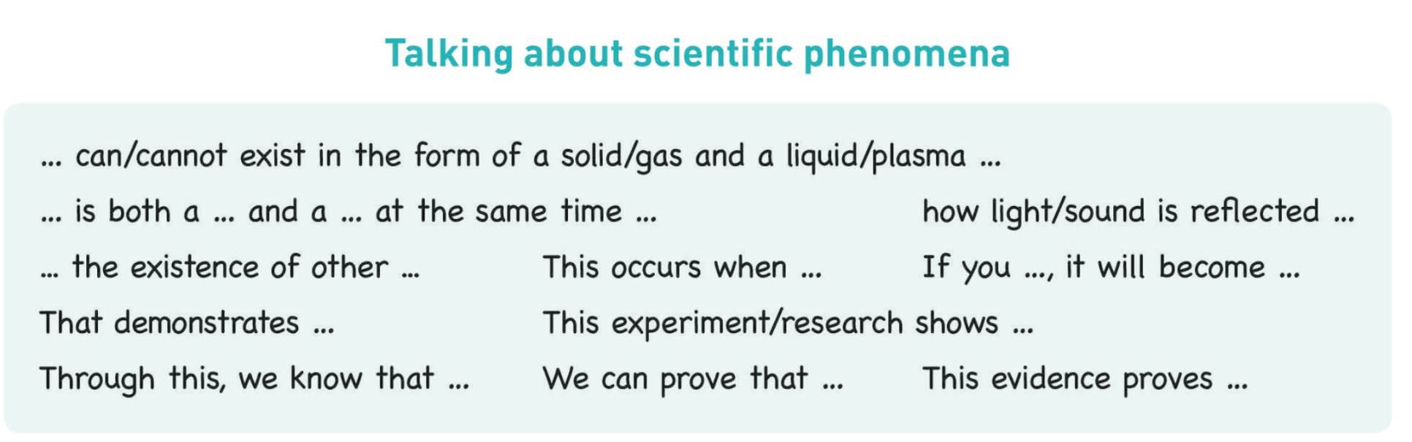
Post-listening: talk about scientific phenomena
(2) Read the expressions to talk about scientific phenomena (Page 7).
EXAMPLE
Today, I want to talk to you about a very strange phenomenon called…
You can make it easily using …
This shows that…

Slide 22
Post-listening: talk about scientific phenomena
Today, I want to talk to you about the positive and negative charges of molecules. We can demonstrate how these interact through a simple experiment using milk, dish soap, and food coloring. First, cover the bottom of a shallow plate with milk. Now add two or three drops of different liquid food coloring to the center of the milk. They should form one large dark puddle in the middle of the milk. Now, dip a cotton swab into dish soap, and it into the middle of the food place coloring. You will see the colors quickly move to escape from the soap, making interesting and beautiful patterns. This happens because the dish soap molecules have a strong negative charge, and the milk molecules have a strong positive charge. Like magnets, these molecules are attracted to each other, and so they appear to move around on the plate, taking the food coloring with them, making it look like the colors are quickly moving to escape from the soap.

Slide 23
Homework
1. Make a short presentation about the scientific research or experiment.
2. Use the example and useful expressions in Activity 7 on page 7 to help you.

Slide 24
Thank You for your attention！

