Slide 1

感恩遇见，相互成就，本课件资料仅供您个人参考、教学使用，严禁自行在网络传播，违者依知识产权法追究法律责任。
更多教学资源请关注
公众号：溯恩高中英语
知识产权声明

Slide 2
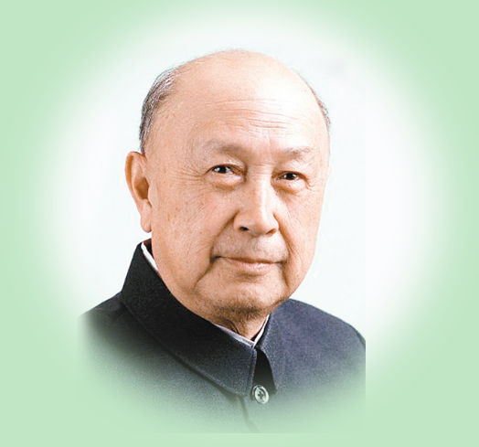
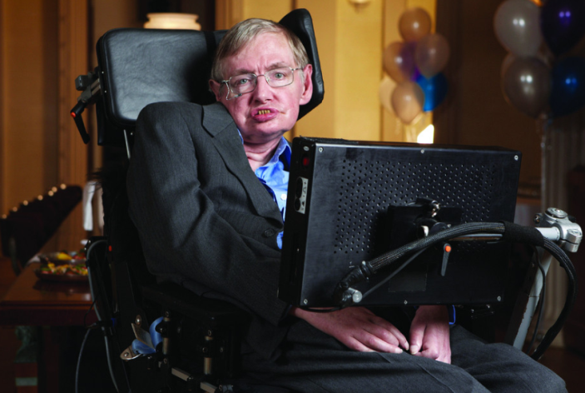
选择性必修二
Unit 1 Using Language （2）
write about what makes a great scientist
杭州二中许丽君

Slide 3

By the end of this period, students will be able to…
1. learn about the two great scientists' lives, deeds and characters；
2. grasp and use some words and phrases describing the qualities of great scientists;
3. write a composition about a famous scientist.

Slide 4
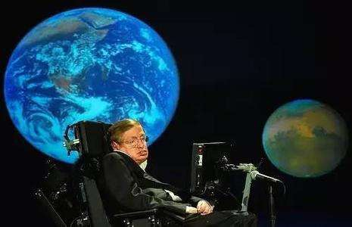
Pre-reading
What makes a great scientist?
creativity
curiosity
Scientists’ Qualities
perseverance
devotion
……

Slide 5
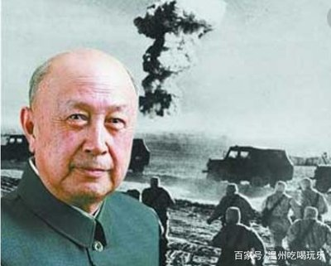
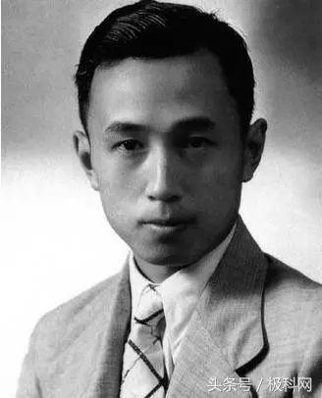
01.
The father of
China's aerospace
Qian Xuesen

Slide 6

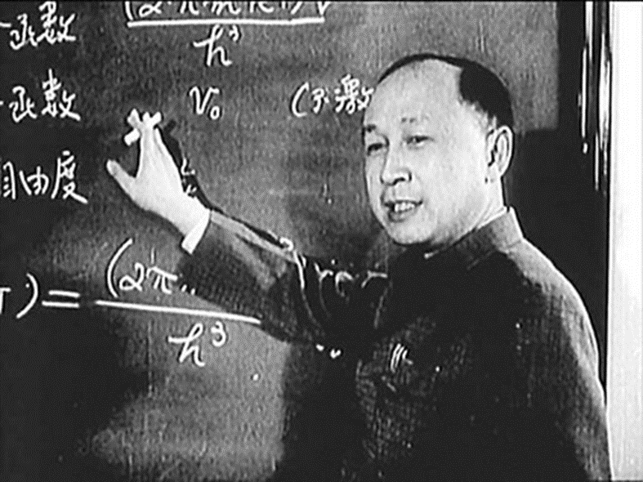
Fast-reading
The text is mainly about _______________________________________________
the brief introduction of Qian Xuesen and Stephen Hawking.
Study the structure of the texts:
The father of China's aerospace (Qian Xuesen)
Introduction
His personal history and accomplishments
His personality
His death and people's appreciation of him
Paragraph 1
Paragraphs 2-5
Paragraph 6
Paragraph 7

Slide 7
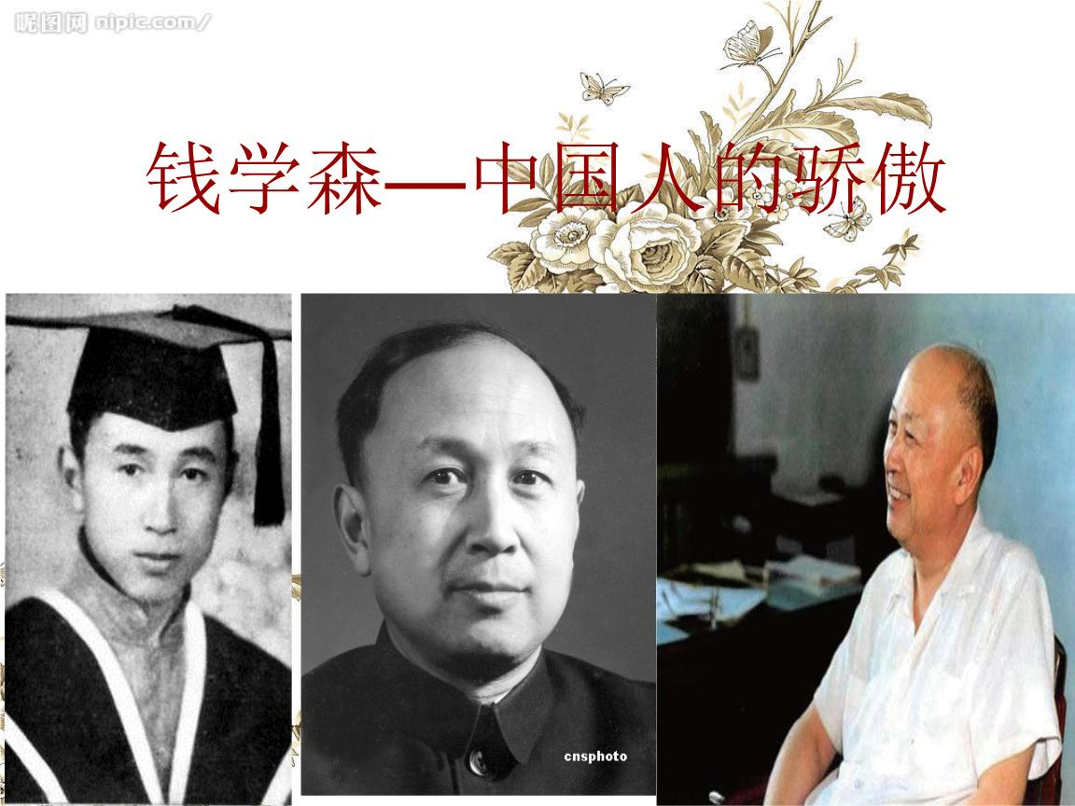
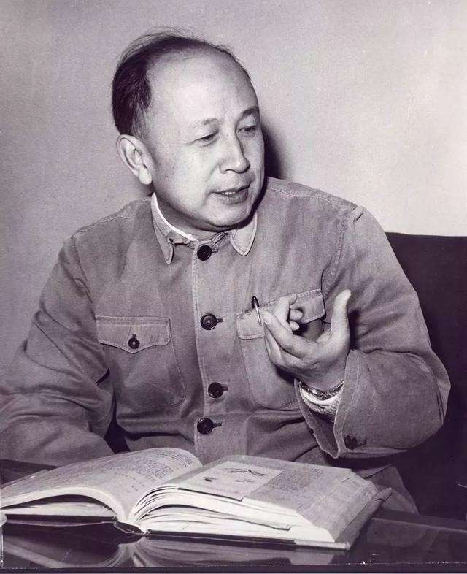
Read passage 1 with the following questions.
While-reading
I. True or False
1. Qian changed his major because of a shift in personal interest. （ ）
2. Qian's strong interest in art has a positive impact on a scientist's development. （ ）
II. Why was Qian called "the father of China's aerospace"?
F
T
Because no other scientist has had a greater impact on China's aerospace science than Qian Xuesen.

Slide 8
While-reading
Personal Resume/Profile
Name:
life span:
Keyword summary:
Education:
Qian Xuesen
from 1911 to 31st October 2009
the father of China's aerospace
a man with great scientific thought and scientific spirit
be patriotic serve his homeland with effort
be an extremely well-respected man
be knowledgeable a wide range of habits
1. Attend schools in Beijing
2. Then Shanghai Jiao Tong University

Slide 9
While-reading
Personal Resume/Profile
Education:
3. in 1932
4. in 1935
Experiences:
1. over the course of the 1930sand 1940s
2. As a graduate assistant
3. in the 1940s
4.in 1955
switch his major to aviation
went to the United States
become a pioneer in American jet and rocket technology
helped conduct important research into rocket propulsion
founded the Jet Propulsion Laboratory
returned to China

Slide 10
While-reading
Personal Resume/Profile
Achievement
Under Qian's leadership
followed by
in 1970
Because much of the technology behind the Shenzhou rockets can also be traced back to Qian's research, Qian earned the name of “ the father of China's aerospace.”
China developed the Dongfeng missiles
the first generation of Long March rockets
China successfully launched its first man-made satellite, Dong Fang Hong I , from a Long March rocket

Slide 11
Post-reading
What important personality and qualities Qian Xuesen had helped him
earn the name of “the father of China's aerospace?
patriotic
swithced major
knowledgeable
became a pioneer
conducted important research
co-founded JPL
determined
returned to China
took on the challenge in developing China's space science
……

Slide 12
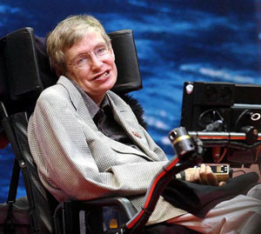
02.
A world of pure thought
A world of pure thought

Slide 13

While-reading
Study the structure of the texts:
A world of pure thought(Stephen Hawking)
Paragraph 1
Paragraph2
Paragraph3
Introduction
His claim to fame
Characteristics that made him great

Slide 14
While-reading
Read passage 2 with the following questions.
I. True or False
1. When Hawking was young, almost everyone believed that the universe began with a big bang. （ ）
2. Because Hawking was determined, he was able to succeed even though he was ill. （ ）
II. How was Hawking's own theory proven correct ?
F
T
Hawking's own theory was soon proven by astronomers with telescopes. .

Slide 15
While-reading
Features:
Stephen Hawking was ____________________________________________
His image_________________________________________________________
His achievement:--- about_______________________________________
The first was ____________________________, which holds that
——————————————————————————
The other was___________________________, which holds that
______________________________________________________________
one of the most famous and gifted scientists in physics
in his wheelchair, unable to move , use a computer to talk
two theories on the origin of the universe
the steady state theory
the universe has no beginning or end.
the big bang theory
the universe began at a single point in time and space.

Slide 16
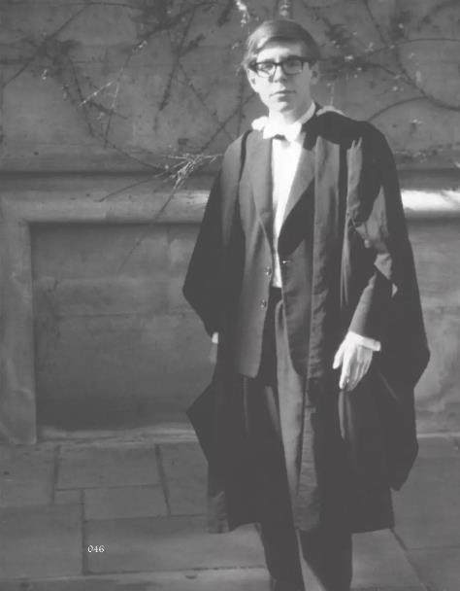
Post-reading
What made Stephen Hawking a genius?
be brilliant
be brave
be determined
be willing to admit his faults

Slide 17
Ⅱ 语法填空 （根据课文内容和语法规则完成短文）
When Qian Xuesen was young，he realised China needed air force 1___________（defend） the country，so he went to America to study aviation. As a graduate 2___________（assist） at an institute，he helped conduct important research into rocket propulsion. Finally，he became a pioneer in jet and rocket technology. 3___________Qian Xuesen returned to China in 1955，he was put 4___________charge of developing China’s rocket science，space and missile programme. Under his leadership，China made 5___________（outstand） progress in rockets，missiles and man-made satellites. Because of this，he earned the name of“the father of China’s aerospace”.
Stephen Hawking was a 6___________（gift） scientist.Since he came 7___________with a disease causing him unable to walk or speak，his world became one of abstract thought. There was a theory on the origin of the universe explaining the universe 8___________（begin） at a single point in time and space. His own work on the big bang theory was proven by astronomers with 9___________（telescope） and a new star was born. He was brilliant，brave and determined. And he was willing to admit his faults. This 10___________（combine） of his characteristics made him one of the greatest thinkers of modern times.
to defend
assistant
When
in
outstanding
gifted
down
began
telescopes
combination

Slide 18
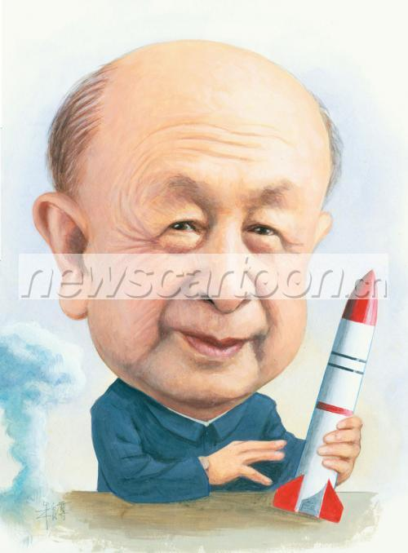
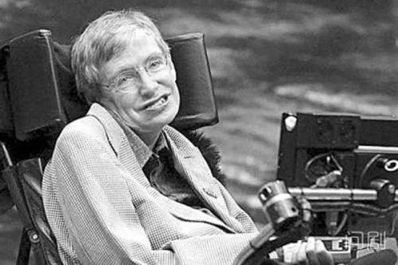
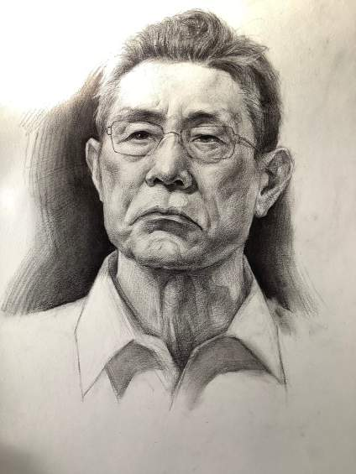
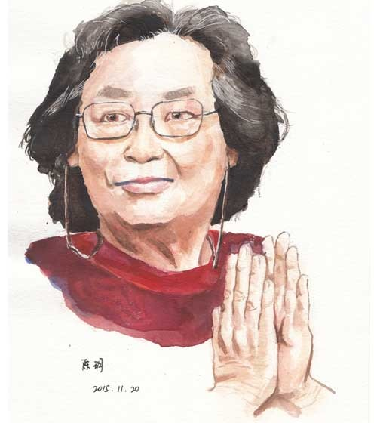
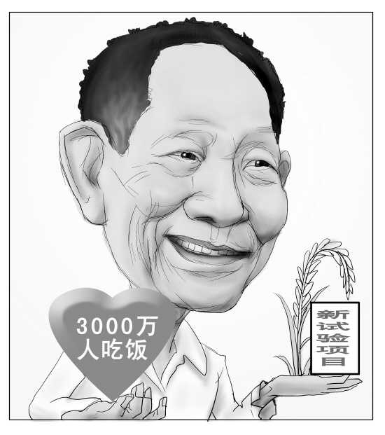
Summary
basic information:
1. age, sex, birth, background
2. appearance . character
3. education
4. big events in his or her life
5. evaluation
How to write an essay about an outstanding figure?

Slide 19

1. 1930生于北京， 自幼刻苦学习。
2. 为了解决粮食短缺问题，他选择去西南农业大学学习农业 。
3.自从1953年大学毕业后，他已经研究水稻几十年， 一直在位世界农业默默耕耘。
4. 由于他的不懈努力，我国水稻产量快速增长， 为很多国家解决了粮食的不足问题。
5. 他的最新愿望“海水水稻”也已经变为现实。
6. 他被誉为“杂交水稻之父”。
7. 虽然他很出名，但是他过着简朴的生活，不计名利。
8. 他虽然年事已高，但内心依旧年轻，依旧有不断实现自己梦想能力。
Practice:
write an essay about Yuan Longpin according to the following information.

Slide 20
Born in 1930 in Beijing， Yuan Longping studied hard when he was young. To tackle the shortage of food to eat, he chose to study agriculture and received an education at Southwest Agricultural in Chongqing. As a matter of fact, since his graduation from university in 1953, Yuan Longping has done research on rice for decades, devoting all his life to the research of agriculture. Through Yuan's tireless efforts, China's rice production is increasing rapidly, solving the problem of the lack of food for many other countries. Now his latest vision for “Seawater rice” has also become a reality. As a result, he is honored as “Father of Hybrid Rice” Though he is famous, he lives a simple life and cares little for celebrity or money. Despite his advanced years, Yuan Longping is still young at heart and has ongoing ability to fulfil his dreams.

Slide 21

Assignment
1. write a passage to describe a great scientist.
2. write an essay about the scientific spirit.

Slide 22

Thank you
for your attention！

