Slide 1

感恩遇见，相互成就，本课件资料仅供您个人参考、教学使用，严禁自行在网络传播，违者依知识产权法追究法律责任。
更多教学资源请关注
公众号：溯恩高中英语
知识产权声明

Slide 2
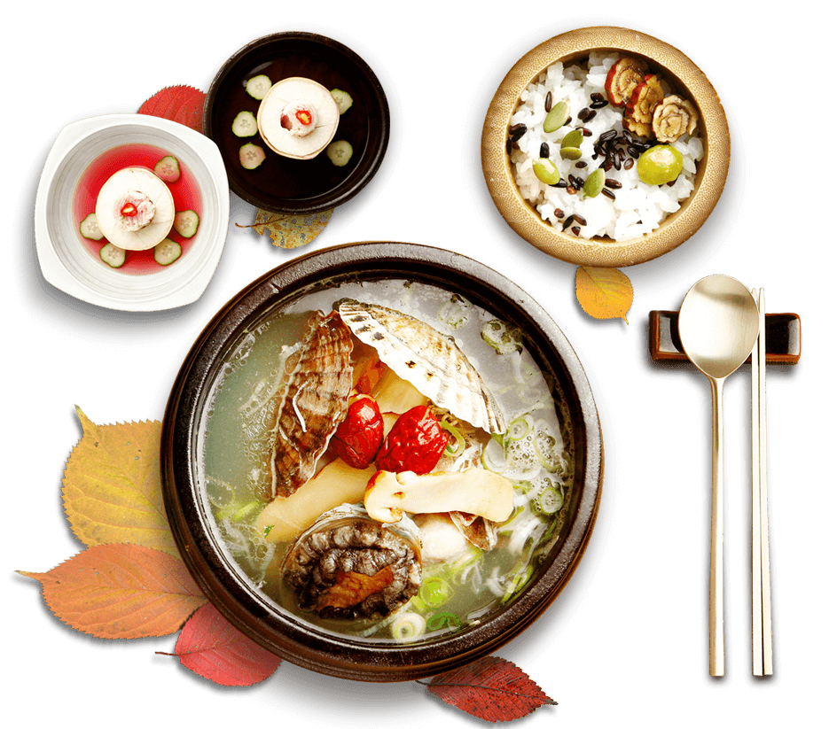
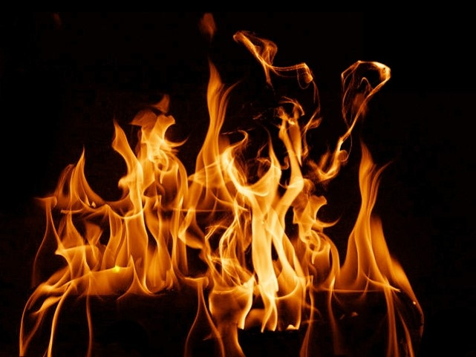
Unit3
Food and Culture

Slide 3
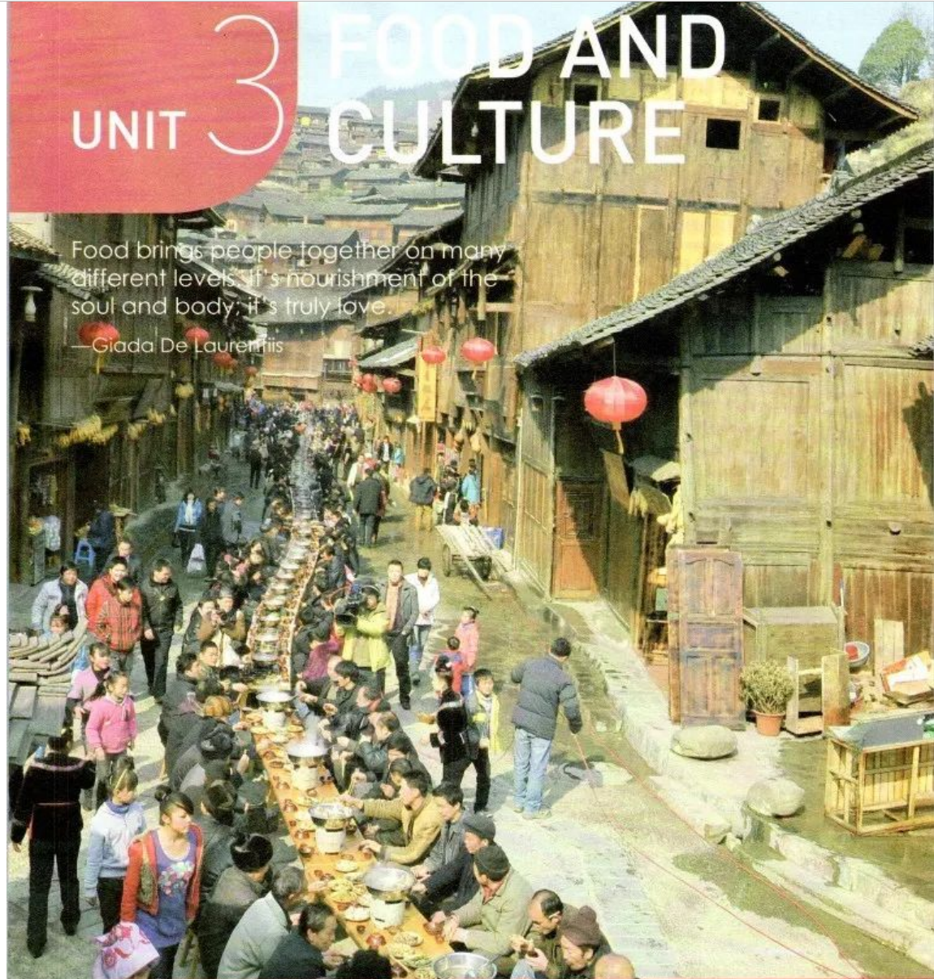
Warming up
1.What impresses you most in this picture?
Hundreds of people
Hundreds of hot pots
Hundreds of on long tables like a dragon
2.When and where do you think it was taken?
The building and lanterns show it was taken in an ethnic area during a festival.
It is a 1,000-person-Long-Table Banquet
in the Miao Stockade Village in Leishan, Guizhou.

Slide 4
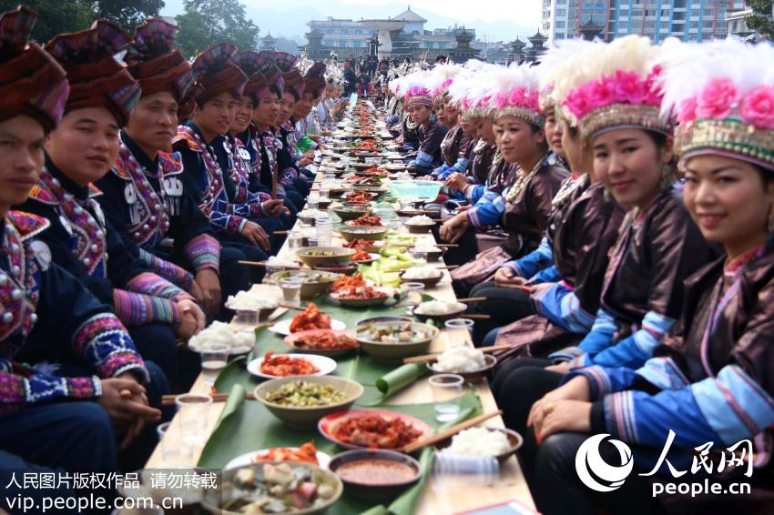
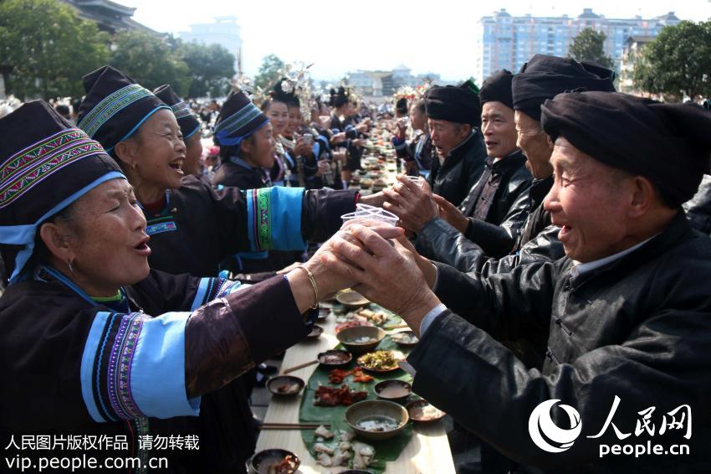
Warming up
It is also popular in ethnic minority areas in Guangxi, Yunnan, Hunan, etc.
Have you experienced such kind of banquet before ?
It is a good chance to enjoy_____ and then to know about the local ______.
food
culture

Slide 5
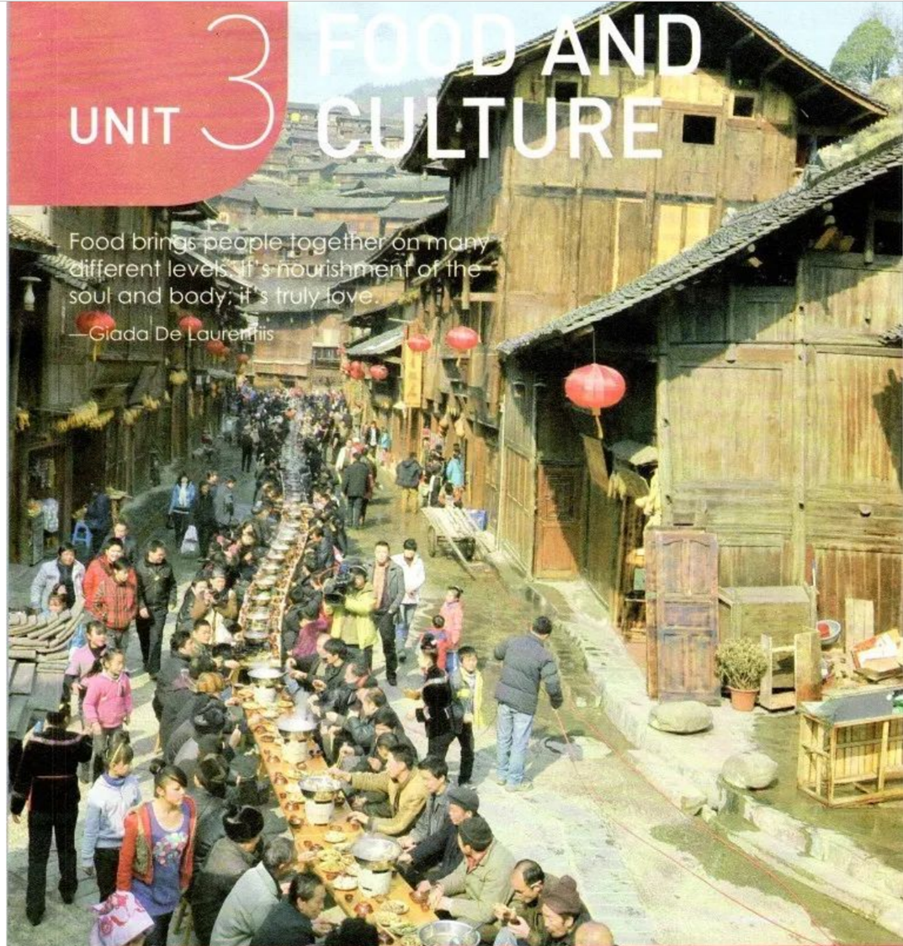
What kinds of levels?
What kinds of levels?
Food brings people together on many different levels.
It’s nourishment of the soul and body; it’s truly love.
---Giada De Laurentiis
Food nourishes our body
Food nourishes our heart/soul
different levels
Food provides a chance for people
to show and receive love

Slide 6
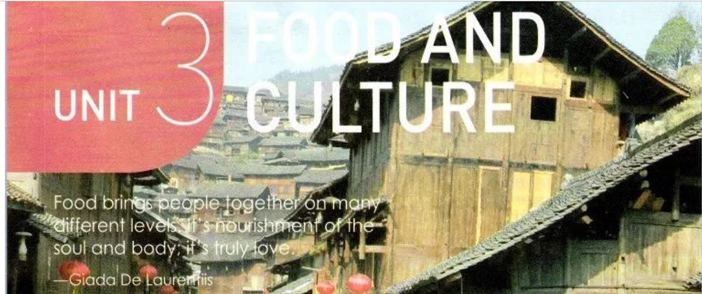
FOOD
CULTURE
YOUR opinion about the relationship between food and culture?
Food is one of the forms of culture
Food changes with culture.
Food mirrors/reflects culture.
If you experience the local food, you can enjoy know about people and culture
……

Slide 7
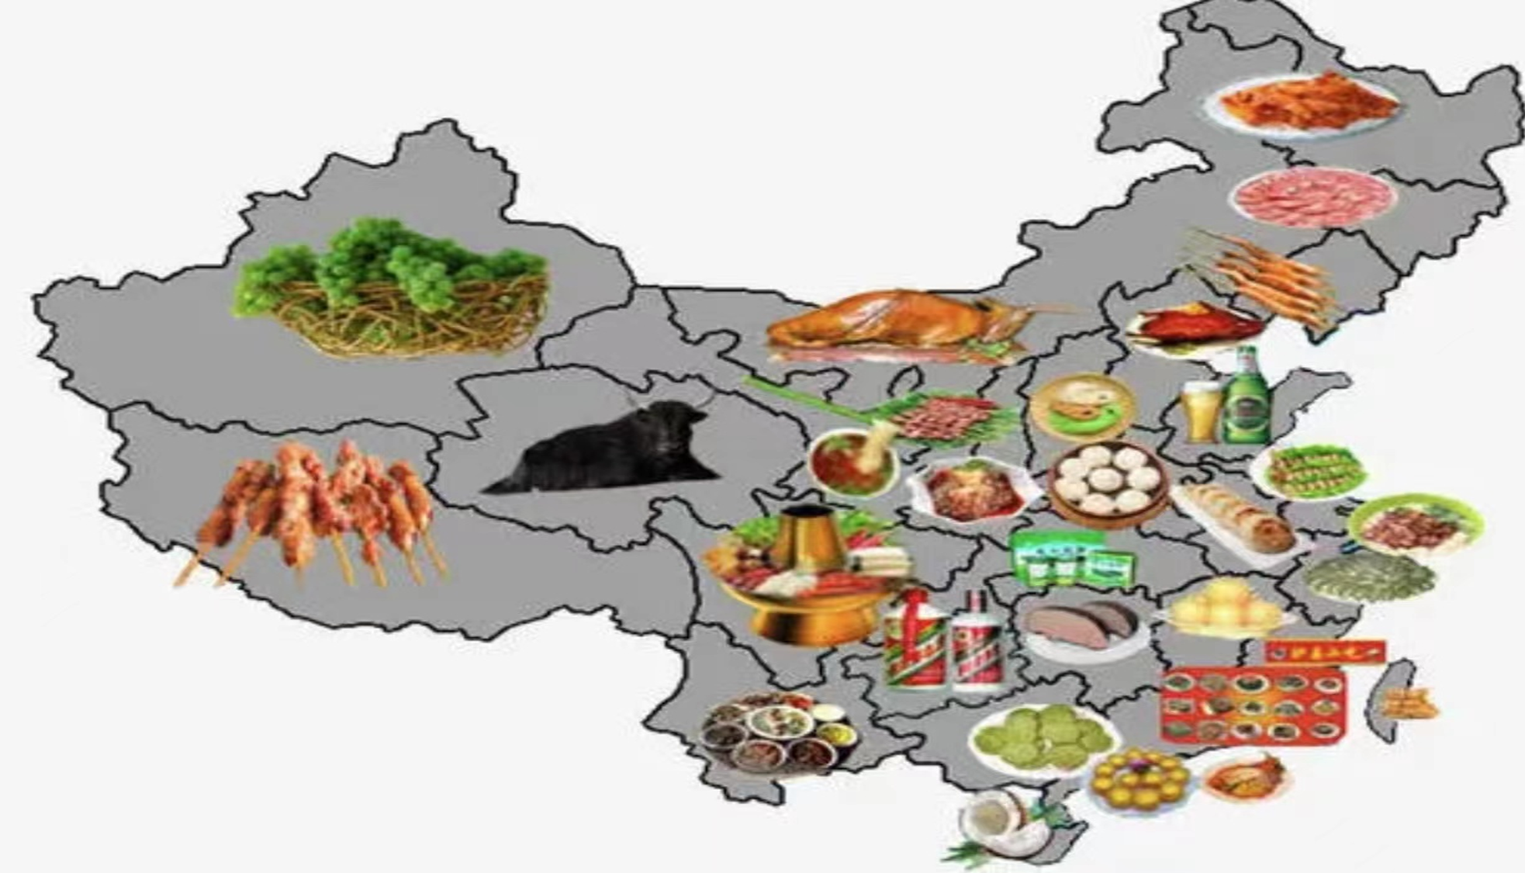
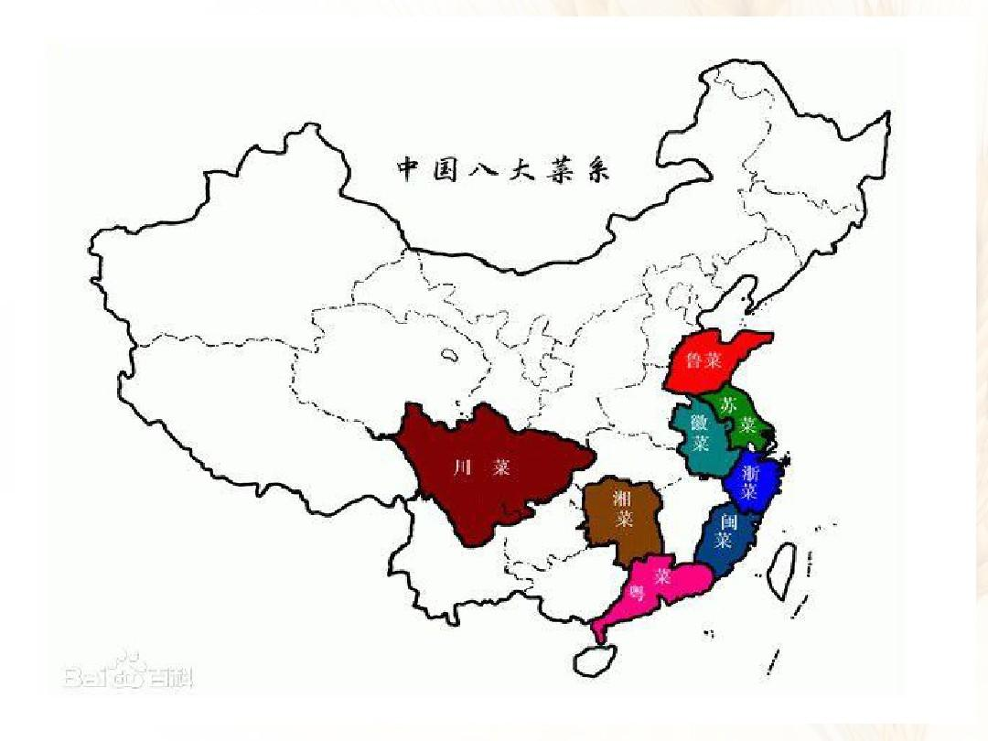
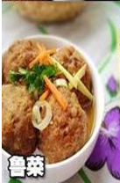
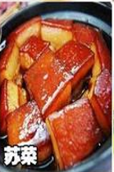
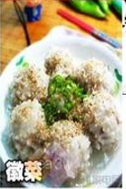
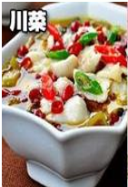
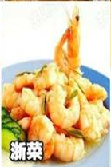
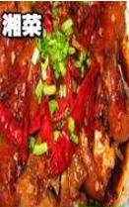
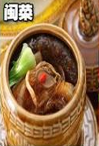
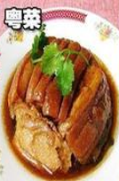
In China，people in different cultures enjoy different cuisines.

Slide 8
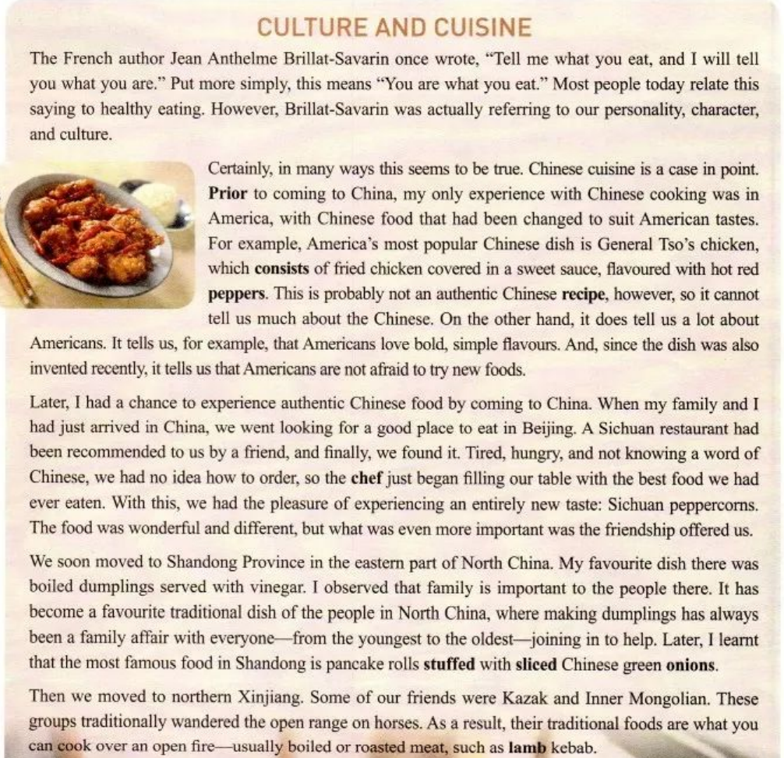
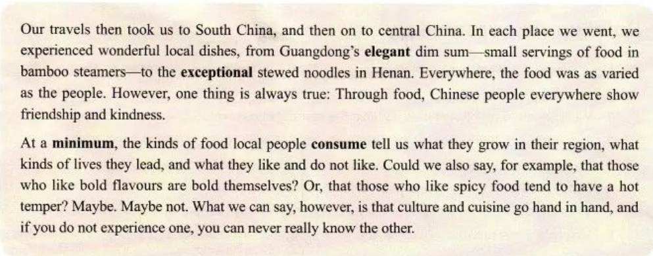
Read for sturcure
Topic（Para.1）
You are what you eat.
Body(Para.2-Para. 6)
different experiences
My _________________ with Chinese food.
Conclusion(Para.7)
Culture and cuisine go hand in hand.

Slide 9
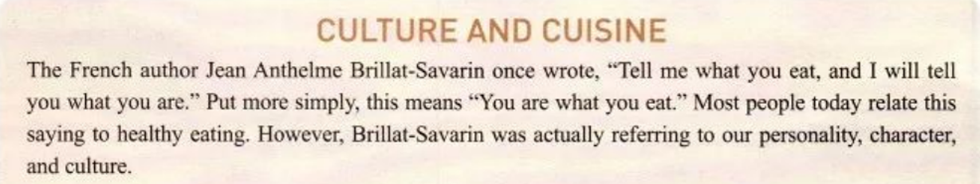
Read for details
quote n. vt.
1.Why does the author quote Jean’s words at the beginning?
To introduce the topic of the passage
2. What does the quote mean ?
The food we eat can tell something about our personality, character and culture.

Slide 10
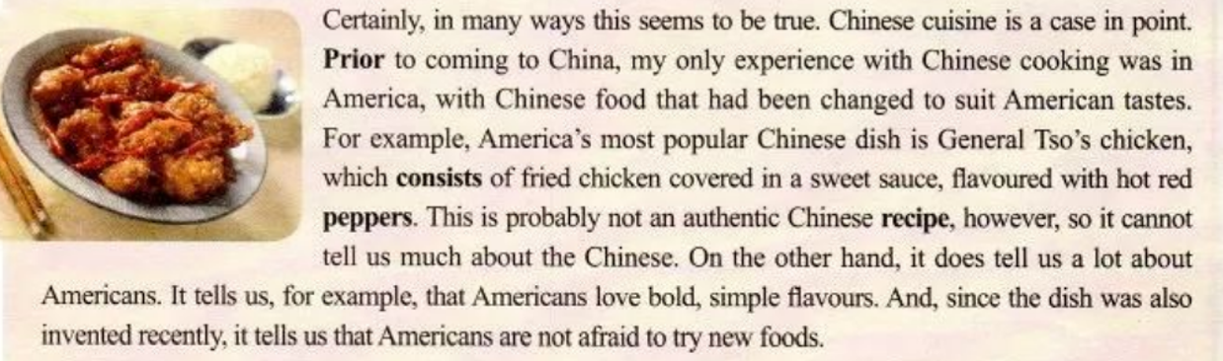
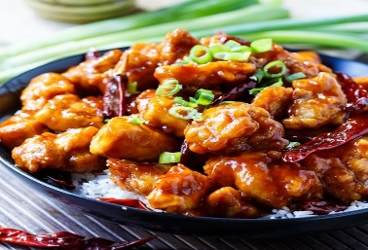
Para 2
“This” refers to
fried chicken covered in a sweet recipe.
This
repetition
America
Where
What Chinese cuisine？
（typical dish）
My comments
people/ culture
Chinese food changed to
suit American tastes
Americans are brave, confident and dare to try.
not authentic

Slide 11
Para 3-6
Work in groups and fill out the rest parts of the chart .
My different experiences with Chinese cuisines(Para.2--6)
where | What Chinese cuisine （typical dish） | My comments
 | Chinese food changed to suit American tastes General Tso’s chicken | not authentic
people/ culture
America
Beijing
Shandong
province
northen Xinjiang
…

Slide 12
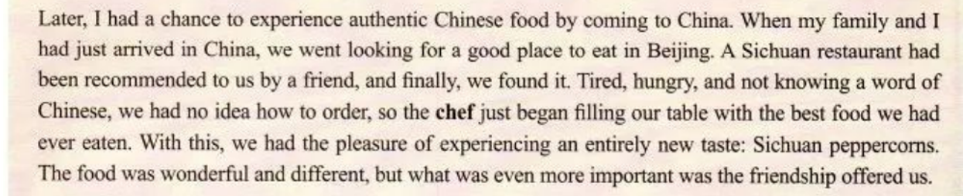
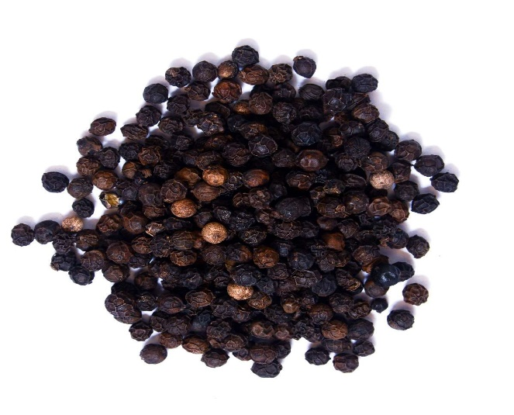
Para 3
this
“This” refers to
the fact that the chef served us the best food.
 | What Chinese cuisine (typical dish) | My comments
Where
People/ culture
Sichuan cuisine
authentic
the best
an entirely new taste
Wonderful and different
Beijing
People are friendly.
Sichuan peppercorns

Slide 13
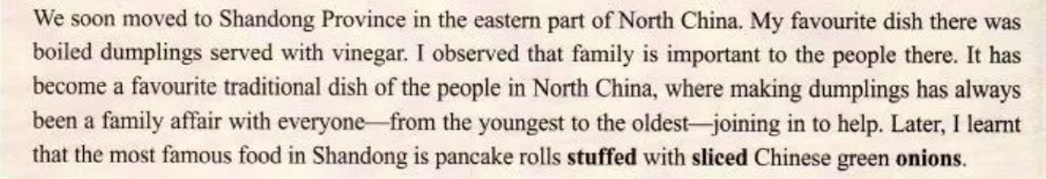
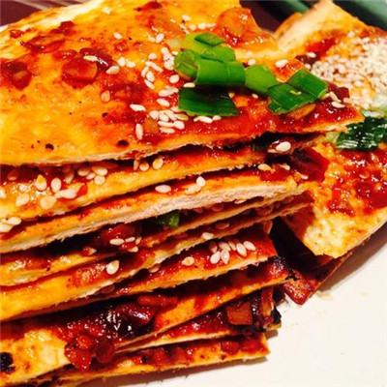
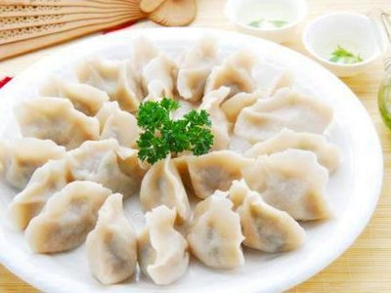
Para 4
It
“It ” refers to
my favorite dish.
 | What Chinese cuisine (typical dish) | My comments
Where
People/ culture
Shandong cuisine
Shandong
boiled dumplings served with vinegar;
Pancake rolls stuffed with sliced Chinese green onions
favorite
People think highly of family.

Slide 14
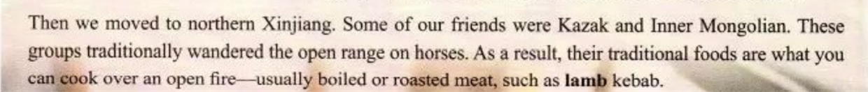
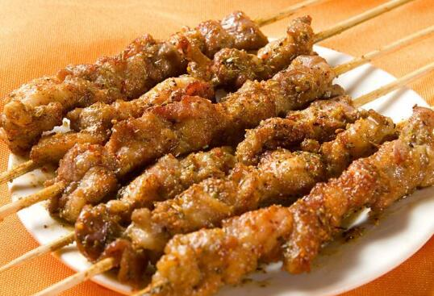
Para 5
What Chinese cuisine
(typical dish)
My comment
Where
people /culture
Xinjiang & Inner Mongolian food
People are simple, direct
broad- minded & enthusiastic.
/
Northern
Xinjiang
boiled or roasted meat
lamb kebab

Slide 15
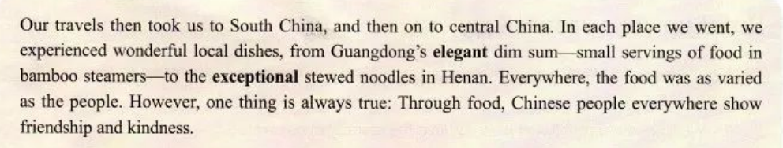
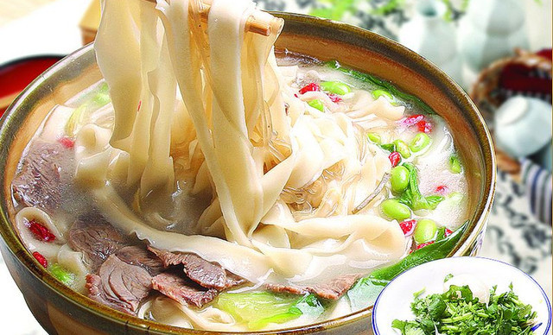
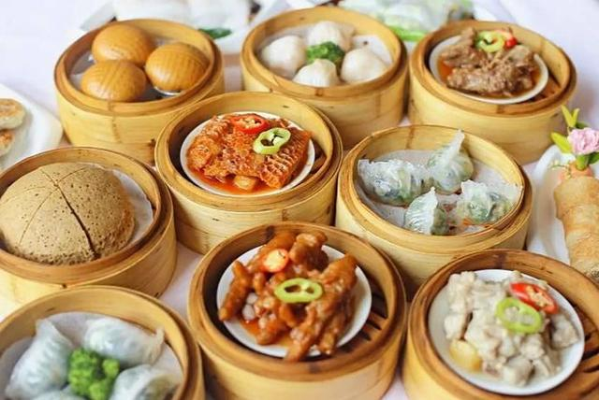
Para 6
people or culture
 | What Chinese cuisine (typical dish) | My comments
Where
Guangdong cuisine
wonderful
elegant
small
exceptional
People are friendly and kind.
South China
dim sum
central China
Henan cuisine
Stewed noodles

Slide 16
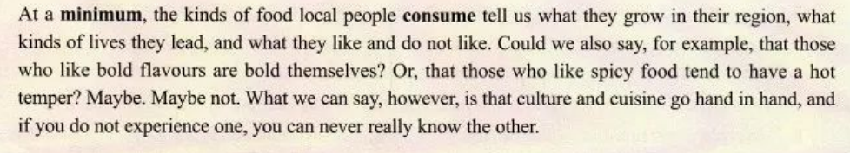
Para 7
one
the other
culture and cuisine
1. What does one… the other refer to?
2. The author’s purpose to write the passage is to
__________________________________________________
share with us his viewpoint that culture and cuisine go hand in hand
by his own experiences.

Slide 17
Read for language
Topic : you are what you eat
You are what you eat.
Chinese food in America
People live in different places and eat different kinds of food, so they share different cultures.
cause
Chinese food in Beijing
different kinds of food,
different cultures .
Chinese food in Shandong
effect
Chinese food in Xinjiang
Chinese food in Guangdong and Henan
Culture and cuisine
go hand in hand.
Conclusion : culture and cuisine go hand in hand

Slide 18
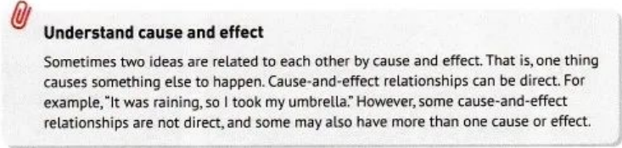
Understand cause and effect
Sometimes two ideas are related to each other by cause and effect. That is, one thing causes something else to happen.
Cause-and-effect relationships can be direct.
It was raining, so I took my umbrella.
However, some cause-and-effect relationships are not direct, and some may also have more than one cause or effect.

Slide 19
Match the causes and effects below.
cause
effect
The chef just began filling our table with the best food we had ever eaten.
B. Their traditional foods are what you can cook over an open fire.
C. Chinese food in America is changed to suit American tastes.
1. The flavour preferences of Americans often differ from those of the Chinese.
2. We had no idea how to order food.
3. These groups traditionally wandered the open range on horses.

Slide 20



More examples from the text:
(Para.2)
_____________________,
(Para.2)
_______________________.
(Para.3)
_______________________,
(Para.4)
_______________________.
(Para.5)
__________________,

Slide 21

Thinking
1.Why does the author use it as the title?
C
C
initial rhyme
catchy
condense the theme
add beauty to the language
Pride and Prejudice
forgive and forget
live and learn
sweet and sour
more examples

Slide 22
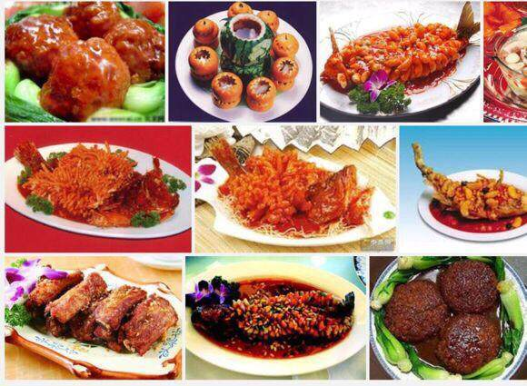
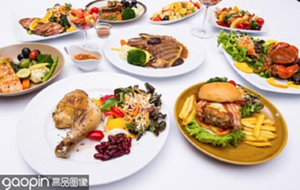
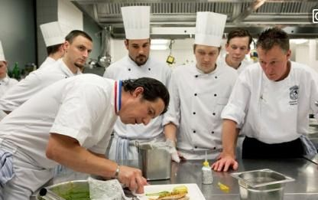
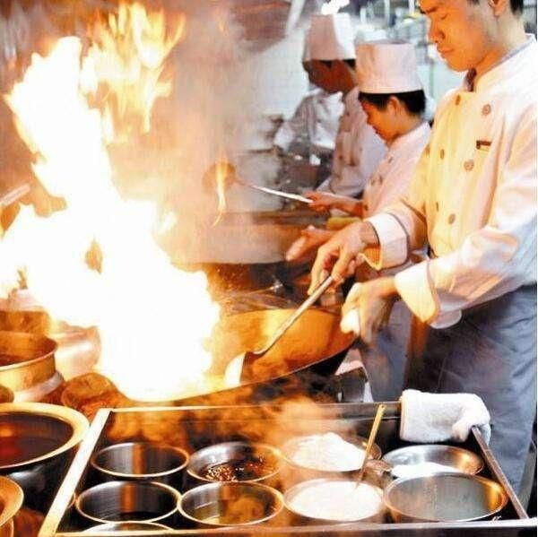
2.Thinking: With the impact of globalization, do you think food can still reflect different cultures? Why (not)?
people/ culture

Slide 23
Homework
Write a short passage to share your own experiences with culture and cuisines.
Culture and cuisines

Slide 24

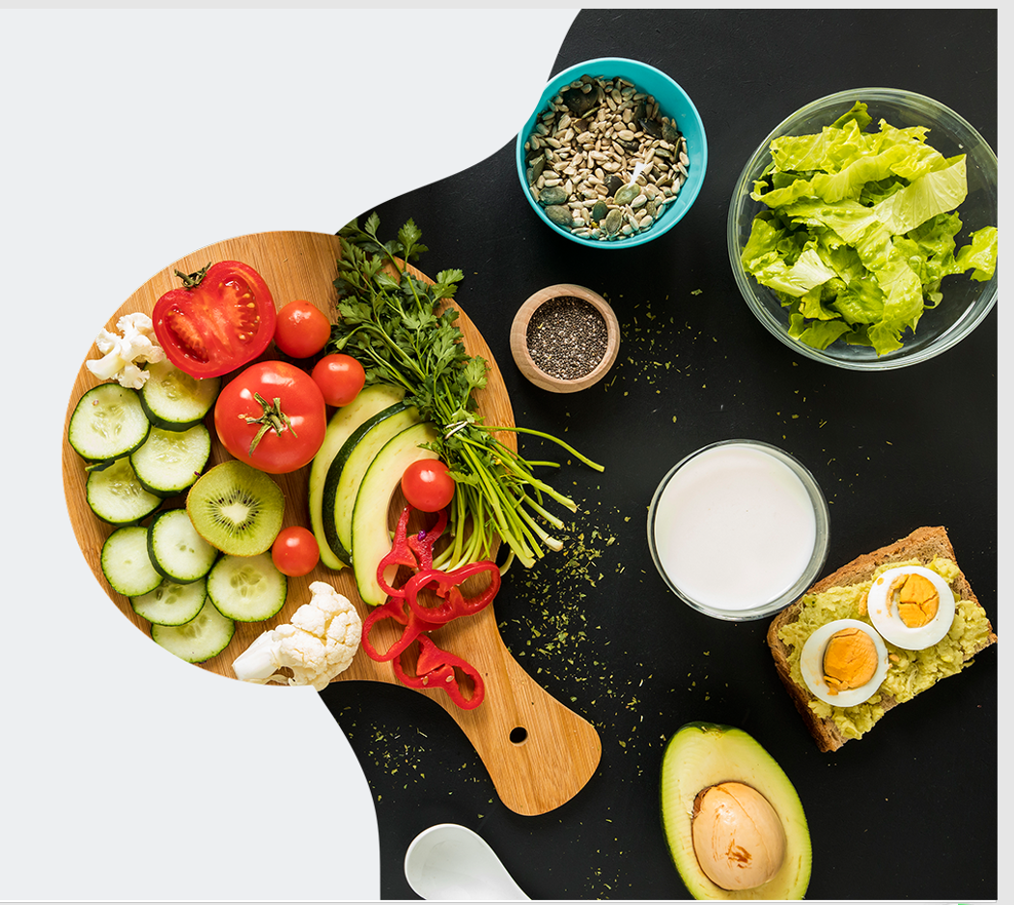
Enjoy your cuisine,
and enjoy your life.
Thank You!

