Slide 1

感恩遇见，相互成就，本课件资料仅供您个人参考、教学使用，严禁自行在网络传播，违者依知识产权法追究法律责任。
更多教学资源请关注
公众号：溯恩高中英语
知识产权声明

Slide 2
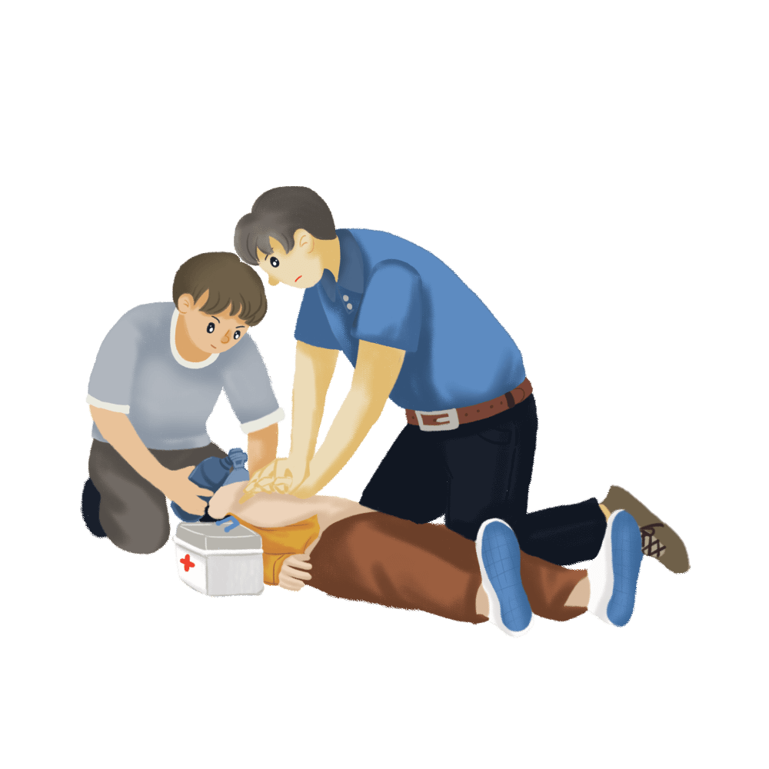

Unit 5 First Aid
Unit 5 First Aid
Using Language（1）
Learn to call emergency services
杭州二中许丽君

Slide 3
Learning objectives
.....
.....
.....
.....
By the end of the class, students will
1. learn to describe the emergency situations.
2. raise the awareness of helping others.
3. identify different kinds of medical emergencies;
4. practise listening for the instructions with an emergency phone call in the UK;
5. study language features of instructions, commands and procedures;
.....
.....

Slide 4
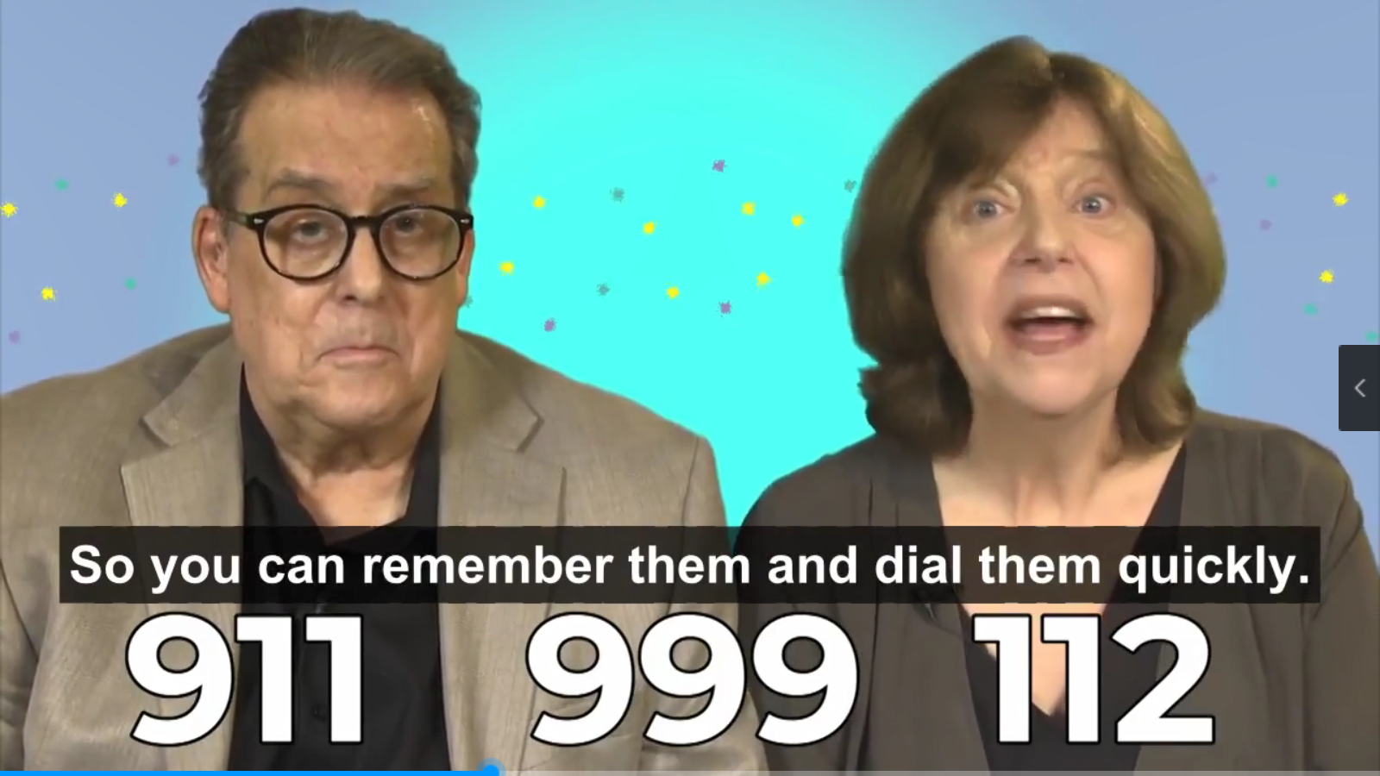
Lead in
1. Match the countries with the emergency numbers.
000
Why emergency numbers are very short?
Australia______
Canada______
China______
Japan______
Most European countries______
New Zealand______
South Korea______
the UK____________ the US______
119
112
120
111
000
911
999
911
120
119
112
111
119
999 & 112
911

Slide 5
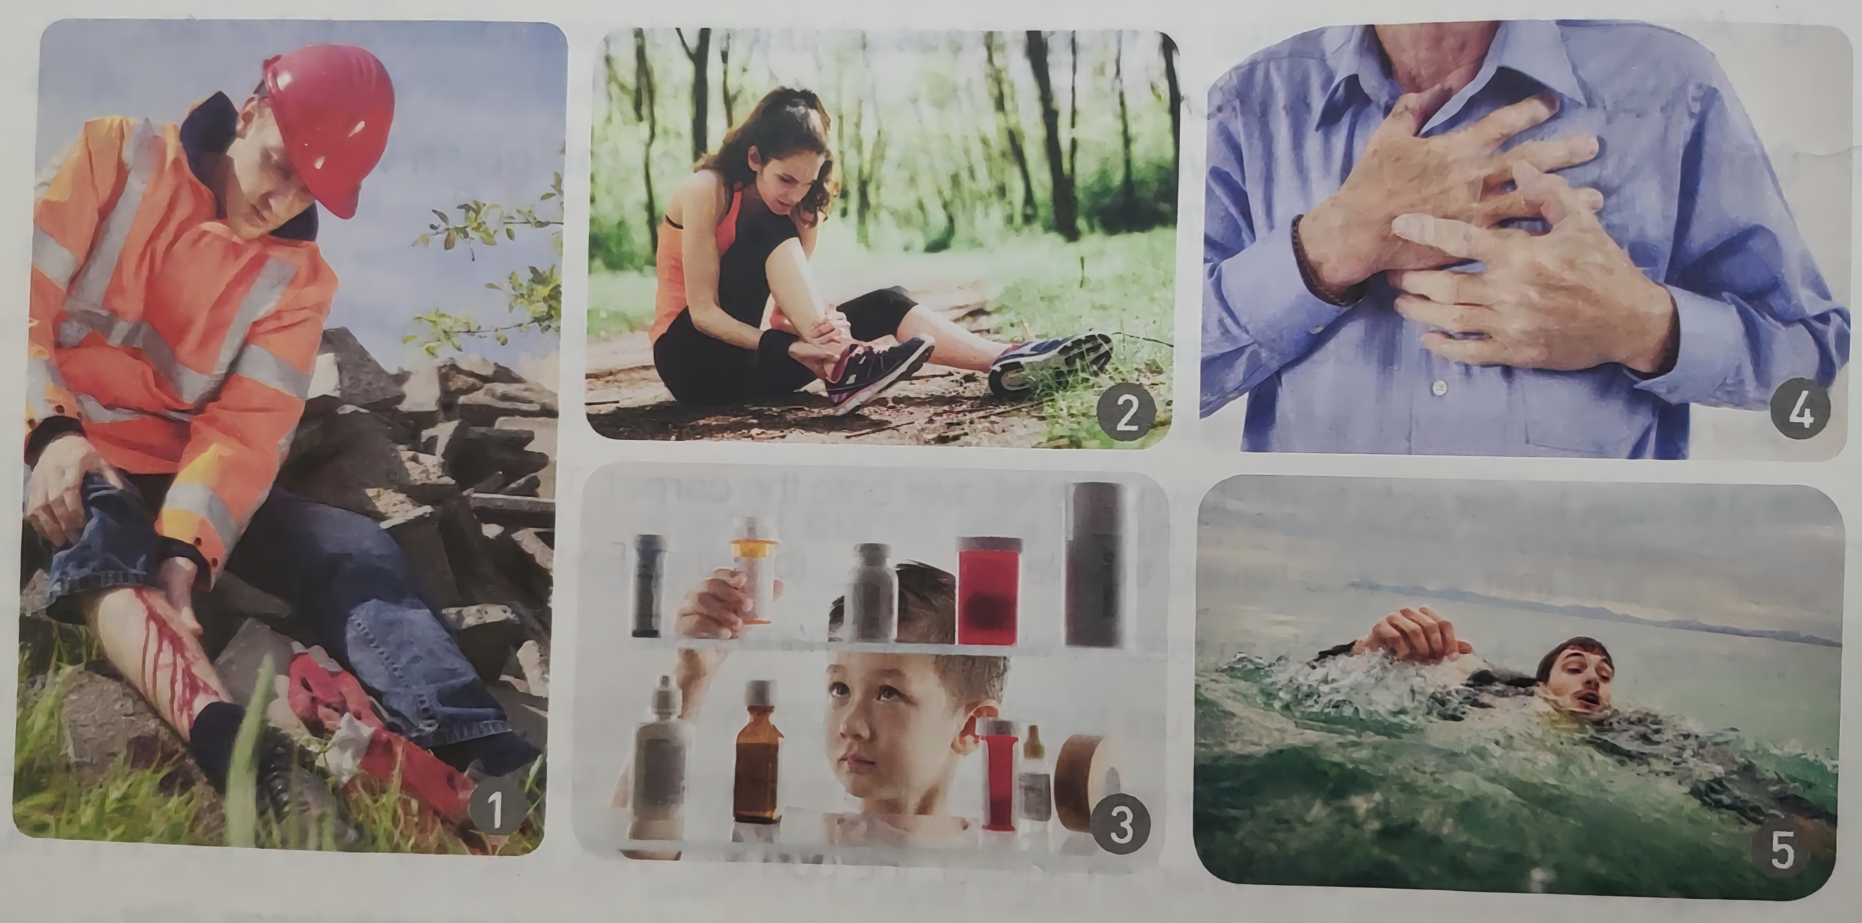
Lead in
2. Match the pictures below with the medical emergencies.
heart attack drowning sprained ankle poisoning bad cut/bleeding
For which medical emergencies will you call 120?
sprained ankle
heart attack
poisoning
drowning
bad cut/bleeding

Slide 6


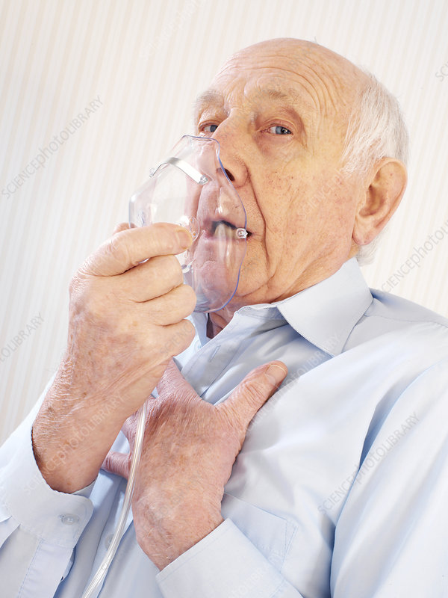
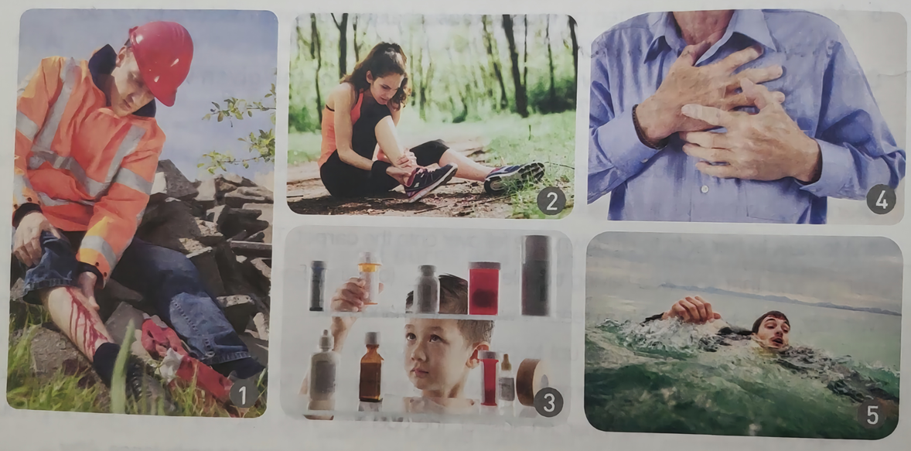

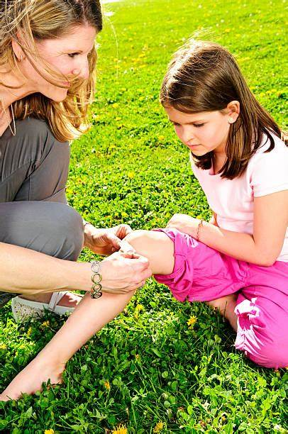
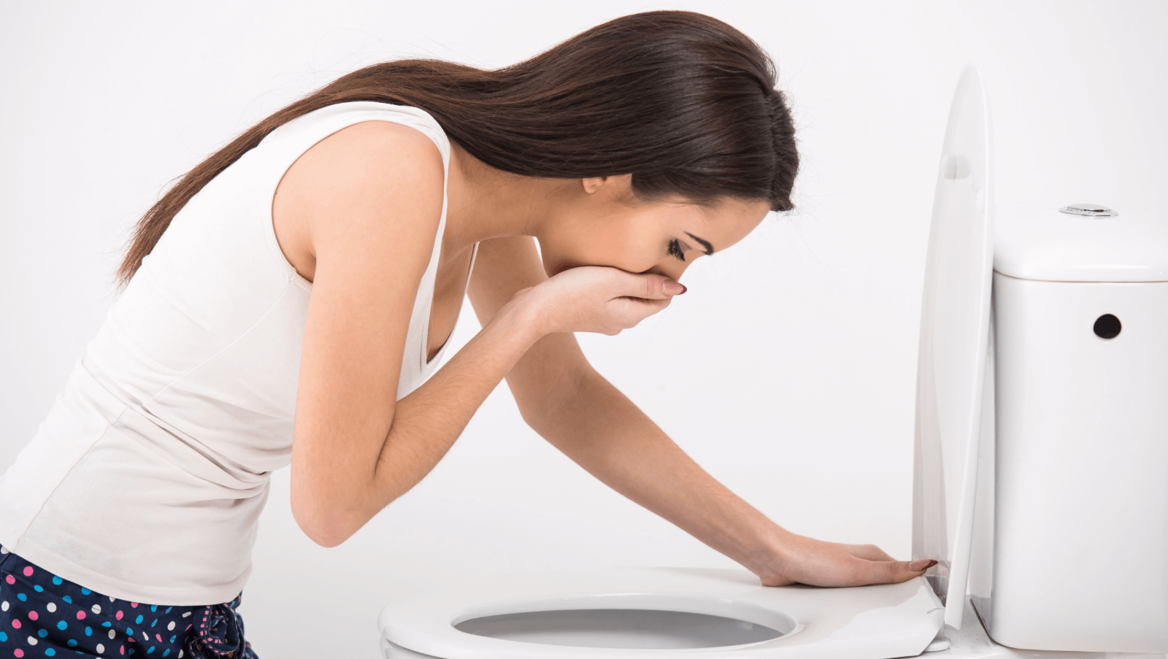
Lead in
When to call an ambulance
When not to call
When to call
Trouble breathing or unable to breathe
For a sprained or twisted ankle
Fainting or dizziness
Whenever the injury is not life threatening
Serious medical emergencies that you believe are life threatening
Getting a scraped knee bandaged
Symptoms of a heart attack
Severe or persistent vomiting

Slide 7

While Listening
3. Listen to a 999 call in England and choose the answers.
1. Why did the boy call 999?
Because his grandfather’s breathing has gotten really bad and they need an ambulance.
2. Who else was in the room with the boy and his grandfather?
A The boy’s mother B The boy’s grandmother C The boy’s father
4. What medical emergency do you think the boy’s grandfather suffered from?
A bleeding B heart attack C choking

Slide 8
While Listening
3. Listen to a 999 call in England and choose the answers.
3. How did the boy describe the old man’s condition?
___his lips are blue
___his breathing has gotten really bad
___his face looks funny
___I think he’s dying
___he’s not breathing again
___he’s started to breathe again
___he’s not breathing anymore!
___he’s making strange noises
5
1
3
2
7
4
8
6

Slide 9
While Listening
4. Listen again. Number the following instructions the operator gave.
______ Press down, twice a second.
______ Check to see if there is food in his mouth.
______ If your mother needs a break, change places.
______ Put him on his back.
______ Remove any pillows.
______ Tell your mum to put her hand in the middle of his chest.
5
3
Follow instructions
When giving commands, people usually use the imperative. lt's simple and
clear. To help the listeners follow what to do next, they use words such as first,next, then, after that, and finally. When listening to instructions in English, you should
listen carefully and don't panic.
follow the order of the instructions given to you.
answer any questions simply and directly when asked.
6
1
2
4

Slide 10
While Listening
Tapescript
Operator: Hello, this is the ambulance.
Boy: Hi, it’s my grandfather…his breathing has gotten really bad. We need an ambulance!
Operator: OK. Could you tell me your address?
Boy: 18 West Highgate.
Operator: And your phone number?
Boy: Oh, it’s…it’s 655-212. Please hurry! I think he’s dying!
Operator: Now calm down and tell me what’s wrong.
Boy: His face looks funny... [Screaming. ] Granddad! Granddad! Keep breathing! Help, please!
Operator: Right. How old is he?
Boy: He's 68.
location and phone number
information about the patient

Slide 11
While Listening
what’s happening now
Operator: And are you with him now?
Boy: Yes. Me and my mother.
Operator: I'll tell you what to do. First, is he on his back?
Boy: Yes, I just moved him on his back.
Operator: Next, remove any pillows.
Boy: OK. What next?
Operator: Now look in his mouth. Any food there?
Boy: No. Oh, he's started to breathe again.
Operator: So, he's breathing?
Boy: Yes, but his lips are blue! He's making strange noises! Can you hurry!
Operator: The ambulance is on the way. Is he conscious now?
Boy: No. [Boy starts crying.] He's not breathing again!
instructions

Slide 12
While Listening
Operator: Listen to me! Next, tell your mum to put her hand in the middle of his chest, and press Down.
Boy: Mum, put your hand in the middle of his chest and push down.
Operator: You need to do this quickly… twice per second.
Boy: Twice a second, Mum! Hurry! Oh, he's not breathing anymore!
Operator: Just be calm and do what I tell you. The ambulance is on the way. Press the chest twice a second. Keep doing it.
Boy: Keep doing it, Mum!
Operator: I know it's very tiring. If your mother needs a break, you should change places.
Boy: Please hurry up!... Oh, the ambulance is here! [Sound of a siren in the background.]
Operator: I can hear them. I can hear them.
Boy: Oh, thank you so much!
Is the boy calm or panic?

Slide 13
While Listening
5. In groups, discuss the following questions.
How did the operator keep the boy calm?
By telling him to calm down and calmly asking him questions.
2. What did the operator do to make this call a success?
She asked only the questions necessary to clearly find out the problem, and then she provided short and clear instructions as to what to do.
3. What do you think happened after the ambulance arrived?
The doctors continued to provide CPR, took some blood pressure tests and temperature checking, while they transported him to hospital.

Slide 14
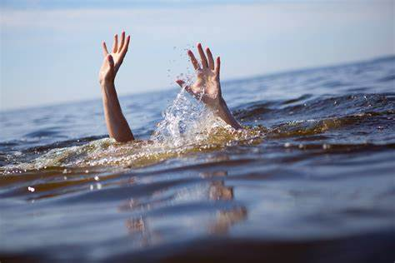
Post Listening
Key facts (from World Health Organization)
Drowning is the 3rd leading cause of unintentional injury death（意外伤害死亡） worldwide, accounting for 7% of all injury-related deaths.
There are an estimated 236 000 annual drowning deaths worldwide.

Slide 15
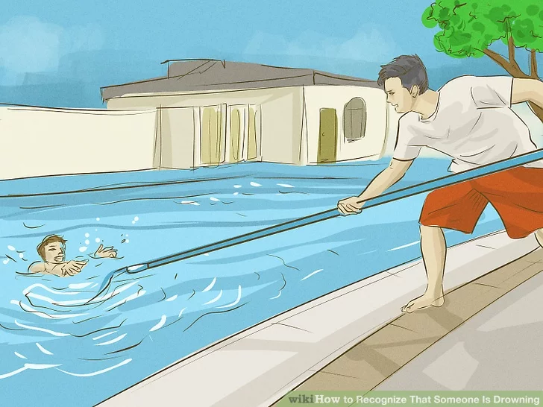
Post Listening
1. Employ a reach assist.
2. Call emergency medical services immediately to get help with the situation.
3. If you are unable to swim, you can dive into the water and get close to the victim with a life buoy.
try and get the attention of someone who can or find a lifeline that you can throw to the person.
4. If the situation is dangerous, dive into the water immediately.

Slide 16
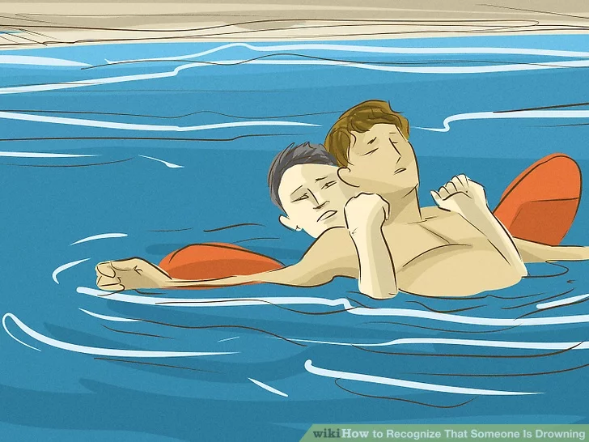
Post Listening
5. It’s best to approach the victim from the front.
behind
6. Make sure to communicate with the person and let them know you are there.
7. Avoid physical contact with a panicky swimmer, if at all possible.
A panicked swimmer may grab at anything that floats, including you.

Slide 17
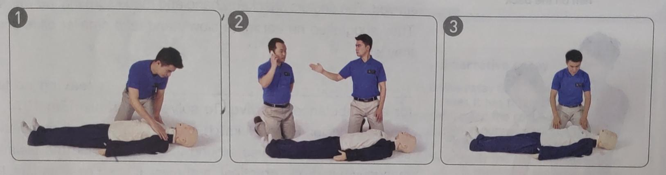
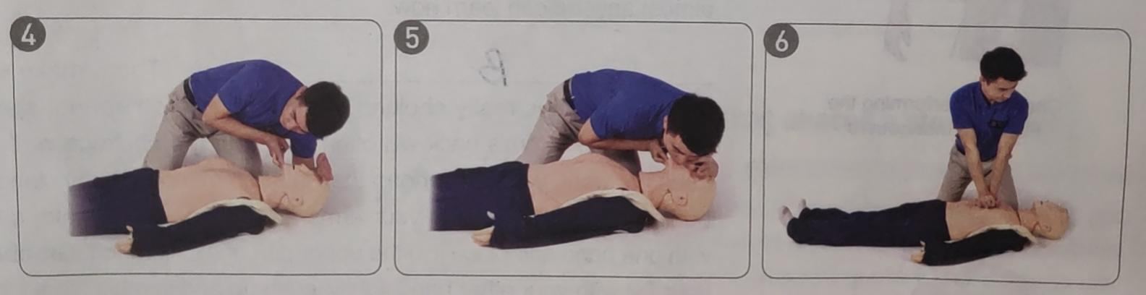
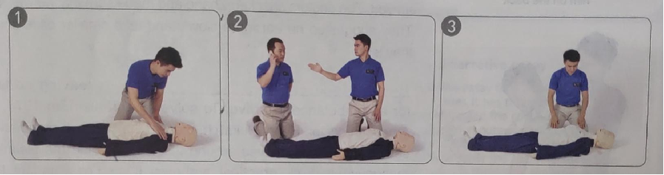
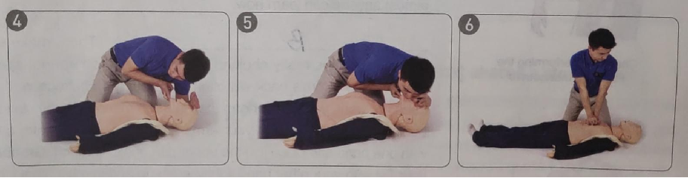
Post Listening
What is going on in each picture? Match the pictures with the steps.
lay the victim on his back
pat his shoulders
check for response
check to see if he is breathing
call for an ambulance
lift up his chin
remove any grass or sand from his mouth
perform CPR
perform mouth-to-mouth rescue breathing
cover his mouth
blow air in
push down on the centre of his chest

Slide 18
Post Listening
Use the words given below to describe the process.
If he does not respond, call for an ambulance or have someone else do so.
Lay the victim on his back.
Check for a response by patting his shoulders and talking loudly into each ear.
Observe the victim's chest for 5-10 seconds to check to see if he is breathing.
If the victim has breathing difficulties, check inside his mouth and remove any grass or sand. Then open his airway by gently lifting up his chin.
Perform CPR by clasping your
hands together and pushing down on the centre of his chest thirty times, followed by two more rescue breaths. Continue the process until help arrives.
Perform mouth-to-mouth rescue
breathing twice. Pinch his nose and cover his mouth with your mouth, and then blow air in for one second each time so that their chest rises slightly.

Slide 19
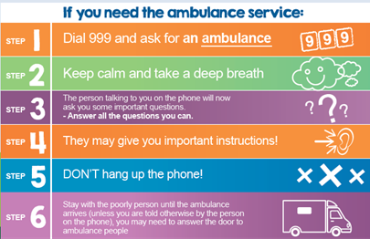
Group Discussion
If you need the ambulance service:
STEP 1 Dial the emergency number and ask for an ambulance
STEP 2Do not panic. Keep calm and take a deep breath
STEP 3 The call operator will now ask you some important questions --- Listen carefully and answer all the questions simply and directly.
STEP 4 They may give you important instructions! Follow the order
STEP 5 Don’t hang up the phone!
STEP 6 Stay with the poorly person until the ambulance arrives.

Slide 20

Group Discussion
Getting familiar with the emergency numbers.
Symptoms of common emergency health problems.
How to make an emergency phone call.
Steps we should take before the ambulance comes.
Today's lesson

Slide 21

Role-play an emergency call
One will be the friend of a drowning victim, and the other will be a telephone operator giving first-aid instructions. Use the pictures and useful expressions above to help you.
Your tone（语调）: anxious but serious
Questions: necessary
Reporter’s Instructions: short and clear

Slide 22
“How could I justify sitting there and doing nothing? We are all humans and we all have a responsibility to look after one another’s welfare.”
Summary
Help the person within your capability.
If you want to rescue a person from drowning...
Keep calm
Your safety is also important

Slide 23

1. Review situations requiring first aid.
2. Choose one emergency and collect its first-aid measures.

Slide 24
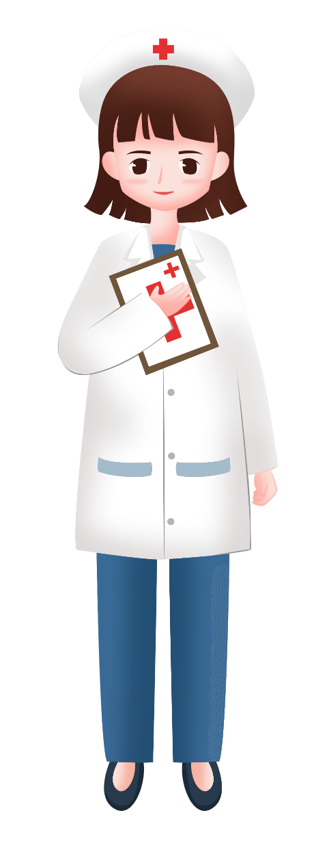
Thank you!
Thank you!

