Slide 1

感恩遇见，相互成就，本课件资料仅供您个人参考、教学使用，严禁自行在网络传播，违者依知识产权法追究法律责任。
更多教学资源请关注
公众号：溯恩高中英语
知识产权声明

Slide 2
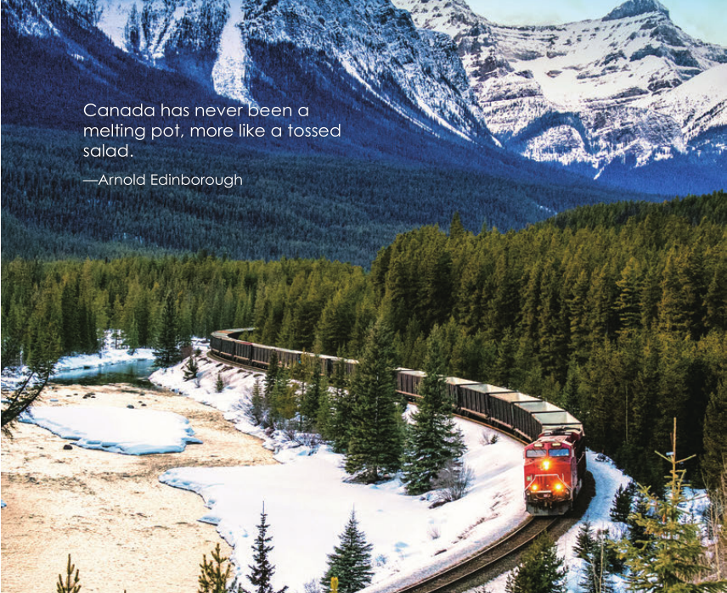
Unit 4 JOURNEY ACROSS A VAST LAND
READING AND THINKING
广东省东莞市第二高级中学
罗欣捷

Slide 3
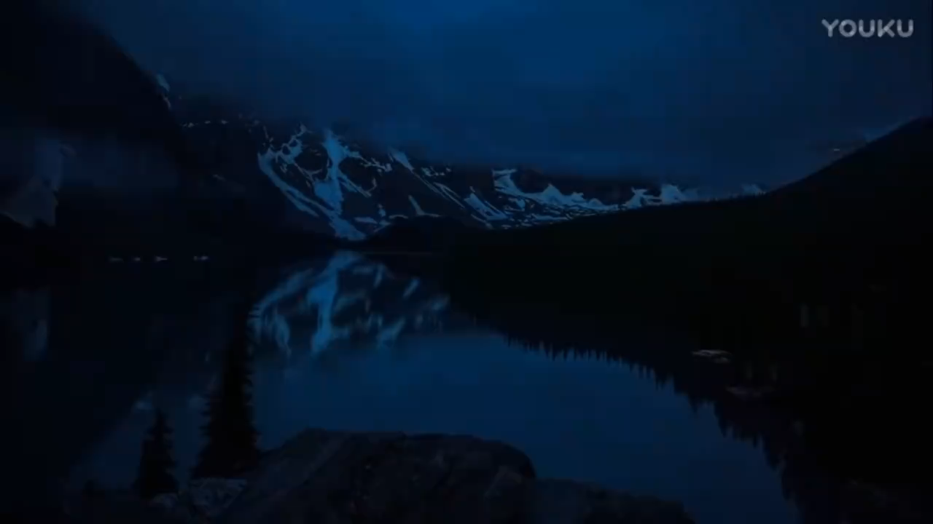
Lead in

Slide 4
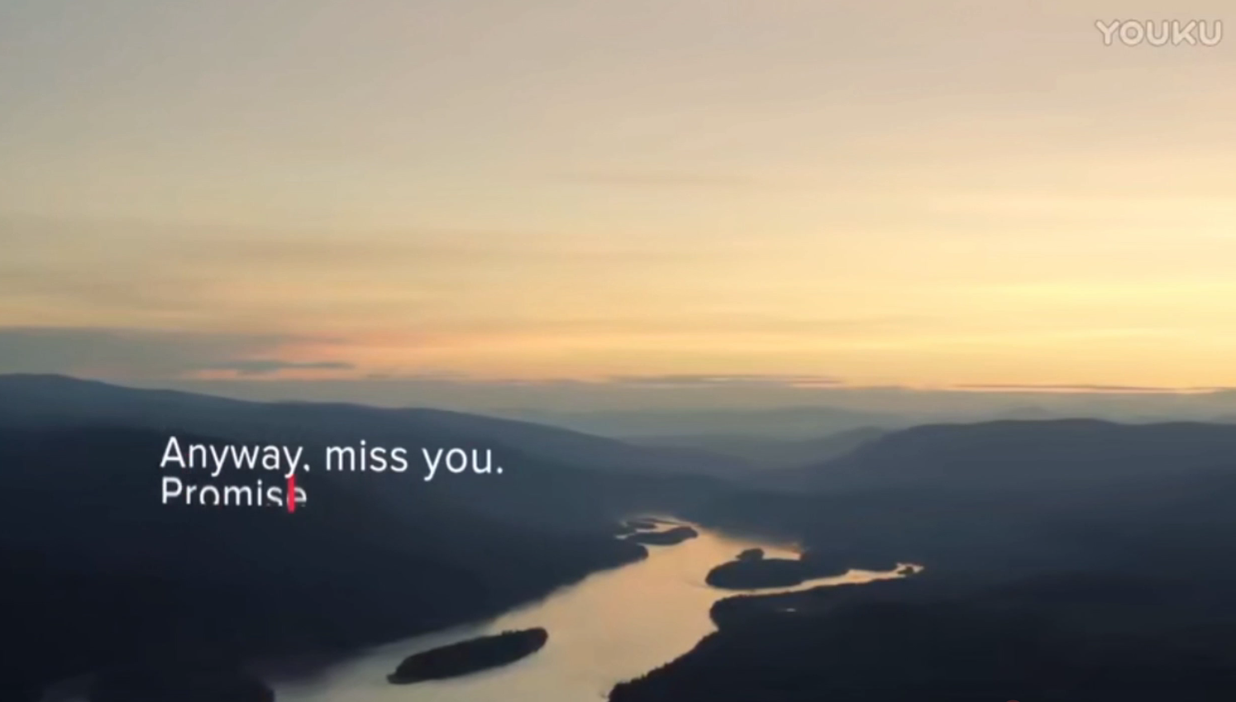
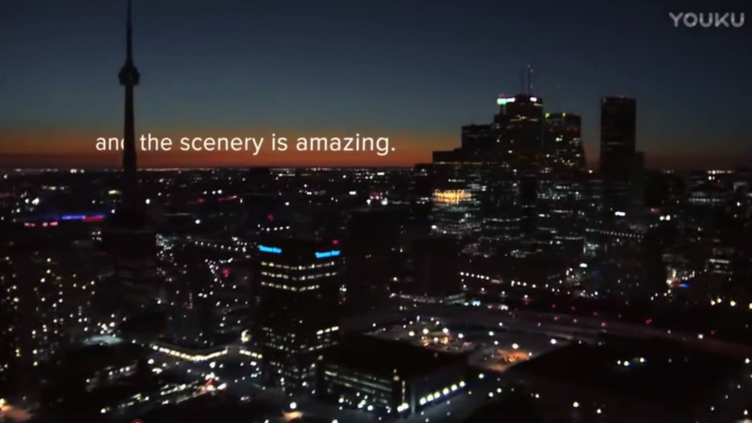
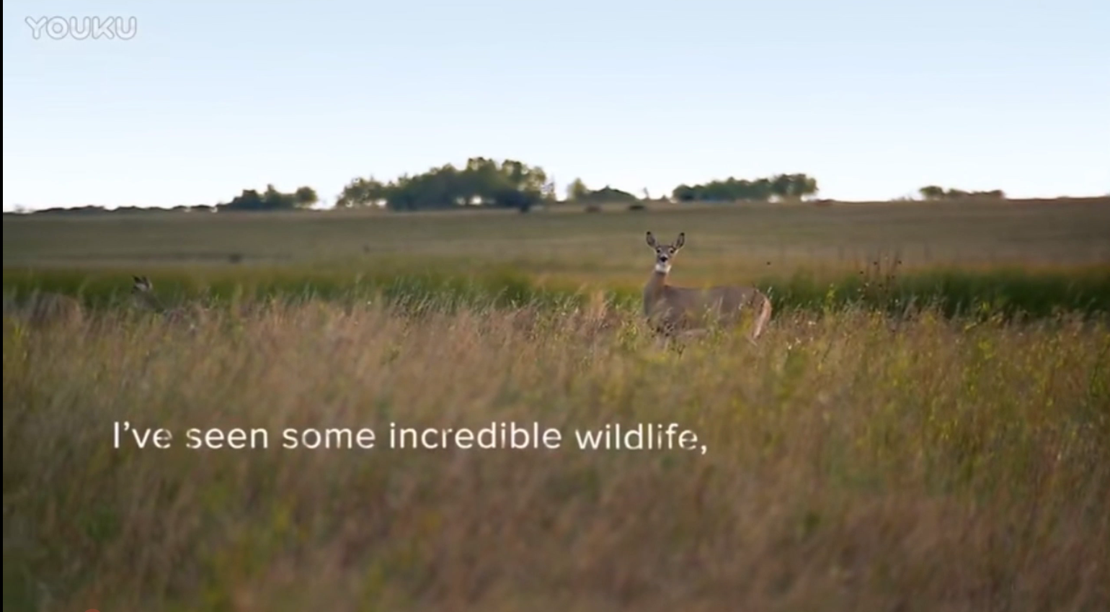
Lead in
Dear Mom,
My trip has been very relaxing.
I have seen some incredible wildlife and the scenery is amazing.
I’m keeping safe.
I stay mostly on the beaten path.
I’m eating well.
People here are polite.
Canada

Slide 5
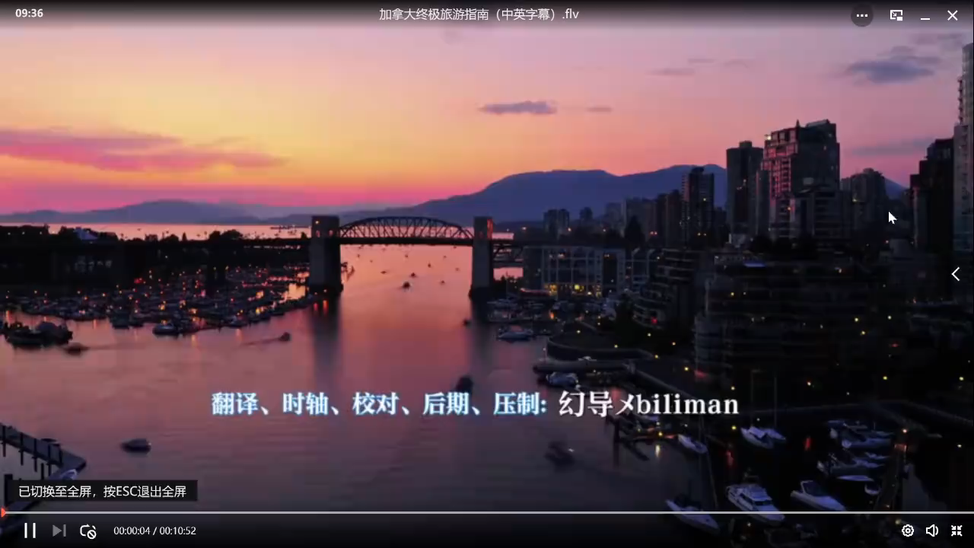
Canada
Pre-reading
What is Canada's land area ranking?
The second largest country in the world.

Slide 6
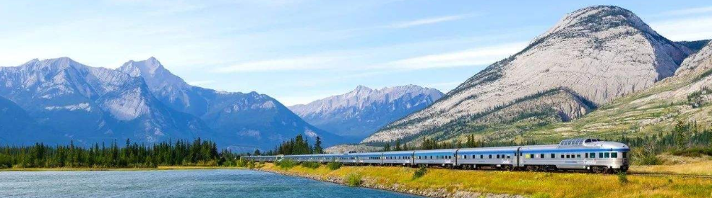
Pre-reading
What transportation will you choose when you are travelling in Canada?

Slide 7
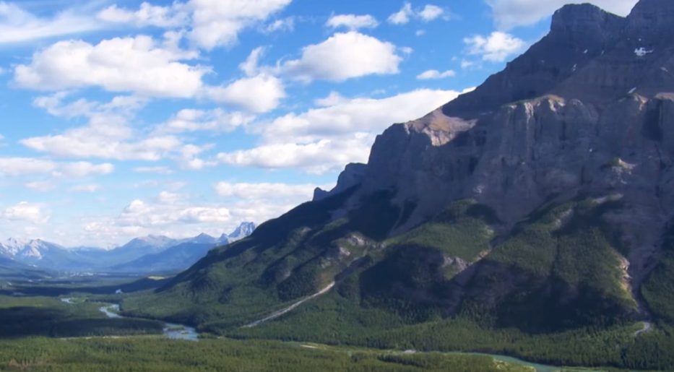
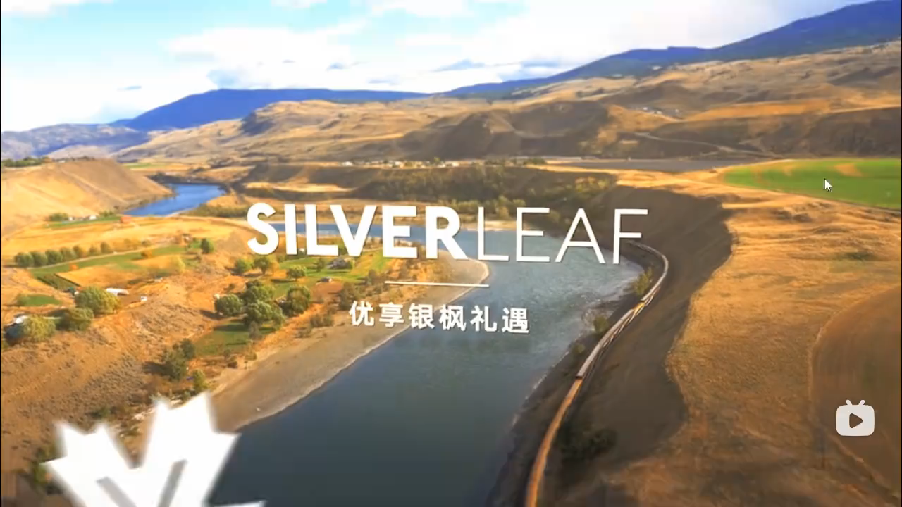
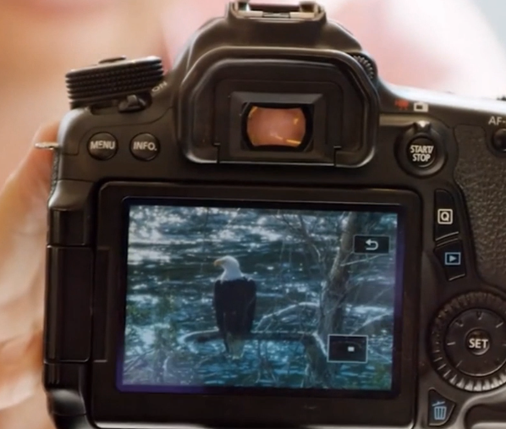
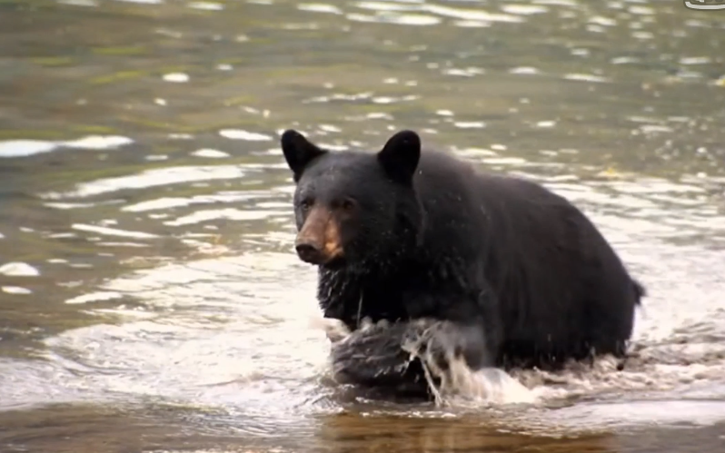
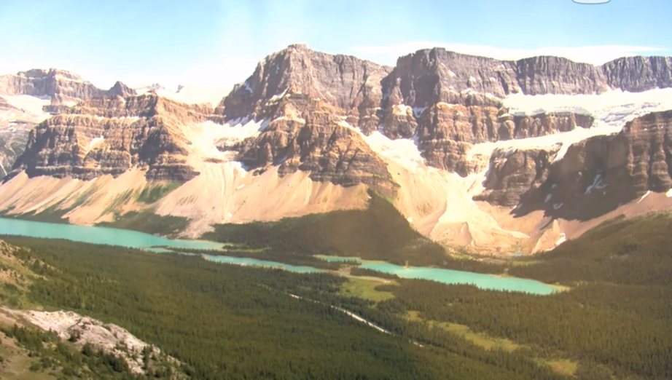
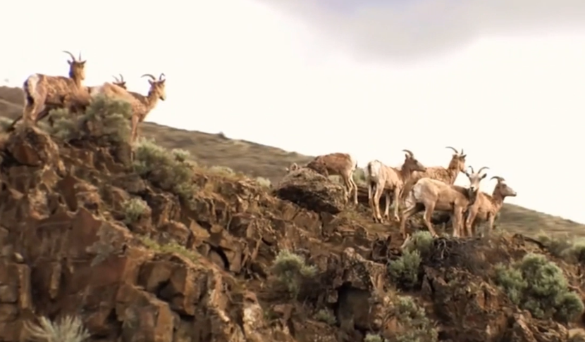
Pre-reading
1. What animals do you see?
2. What natural scenery do you see?

Slide 8

Reading: read for title
SEEING THE TRUE NORTH VIA RAIL:
VANCOUVER AND THE HEART OF CANADA
Where:
How:
What:
the True North Canada
by train
see scenery and people,
feeling, food

Slide 9

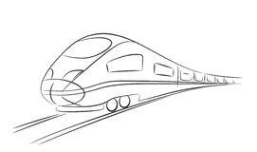
While-reading: fast reading
Who are the main characters?
How did they go there?
Where did they go?
Liu Qian & Li Daiyu
WHO
HOW

Slide 10
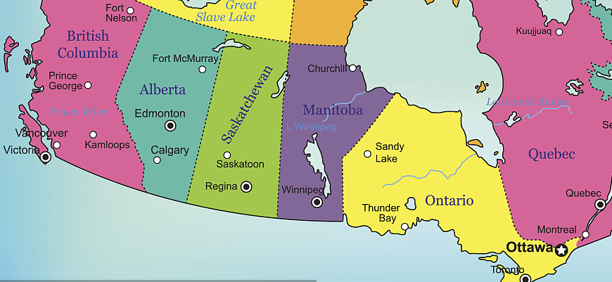
While-reading: fast reading
Jasper
The Great Canadian Prairie
Vancouver
Edmonton
Lake Louise
Winnipeg
Ontario
Toronto

Slide 11
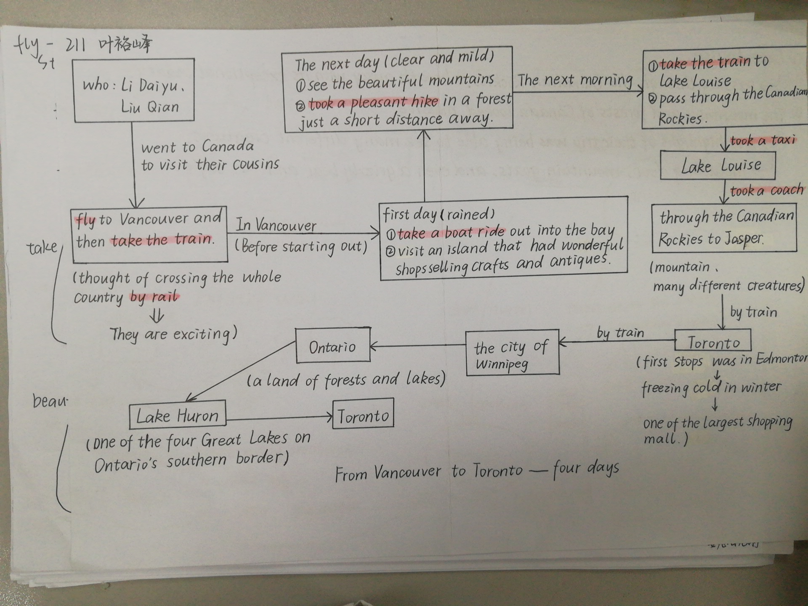
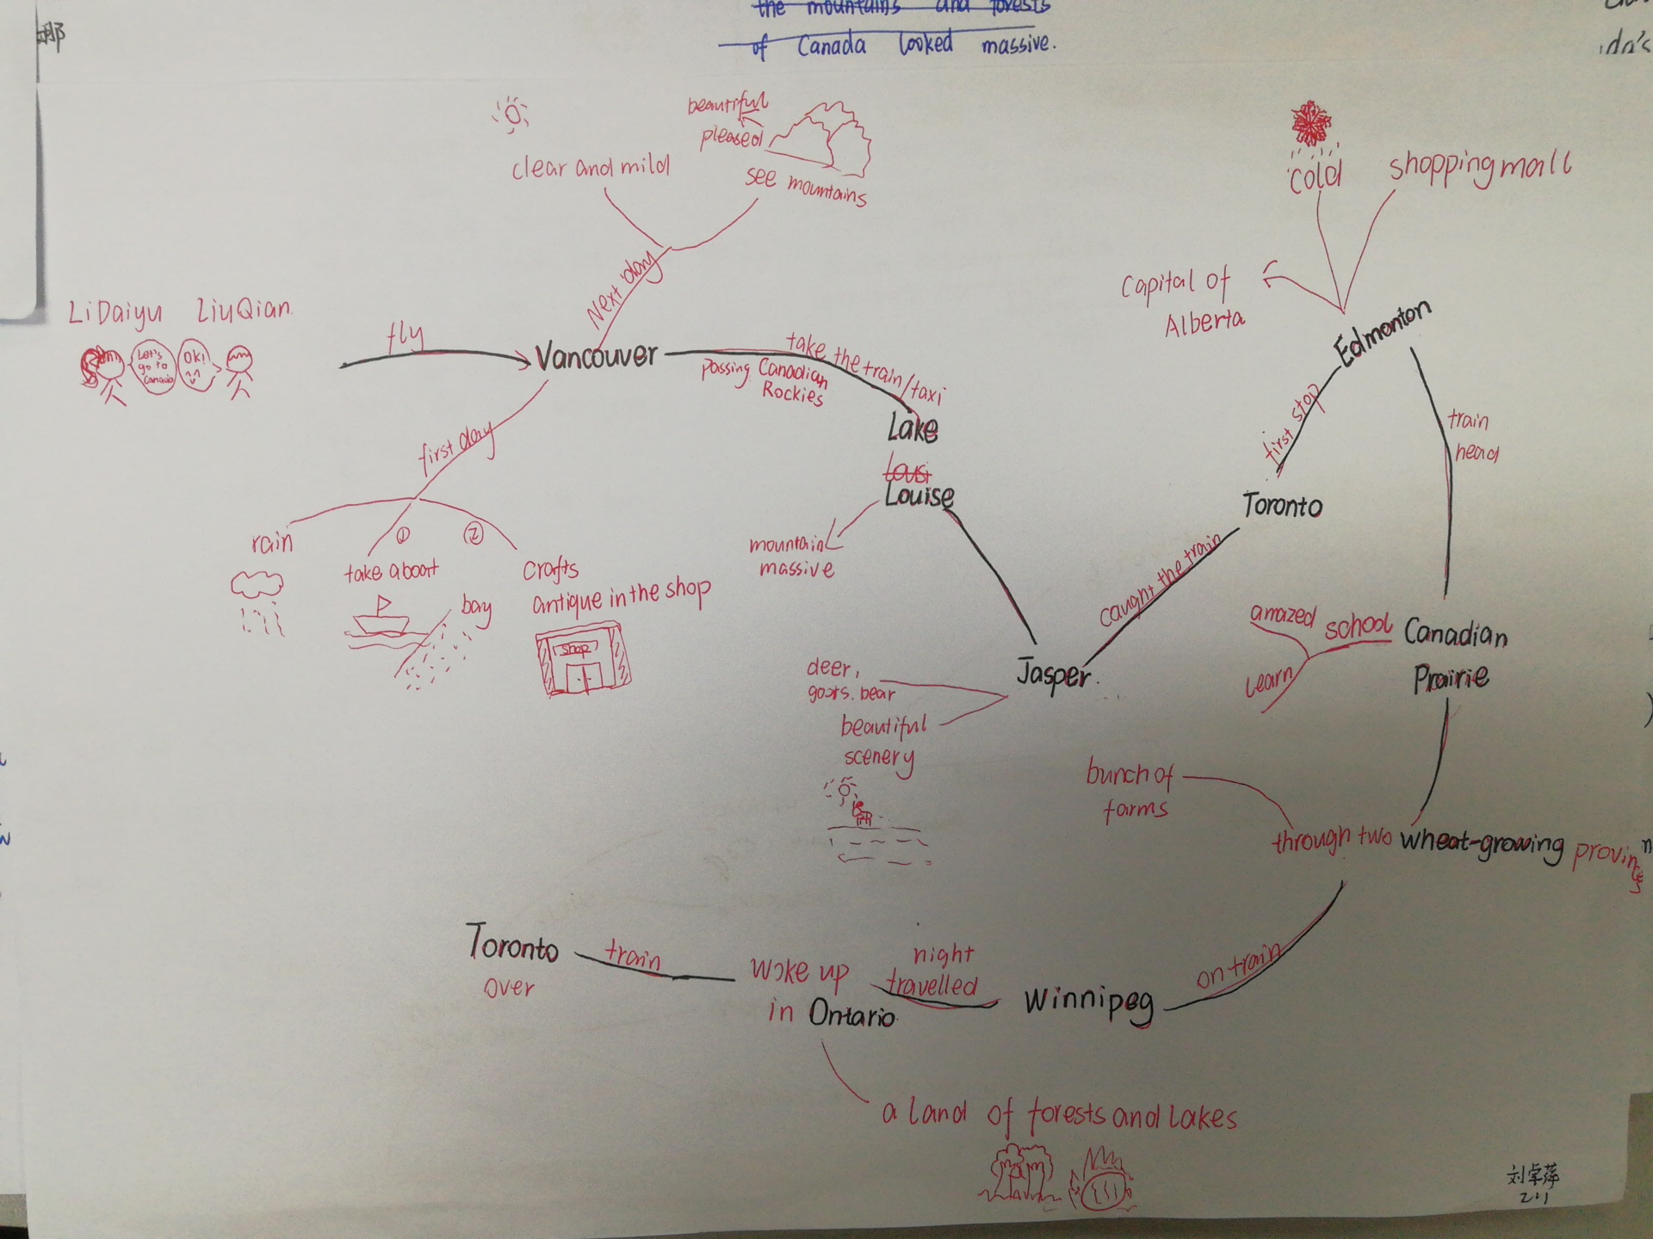
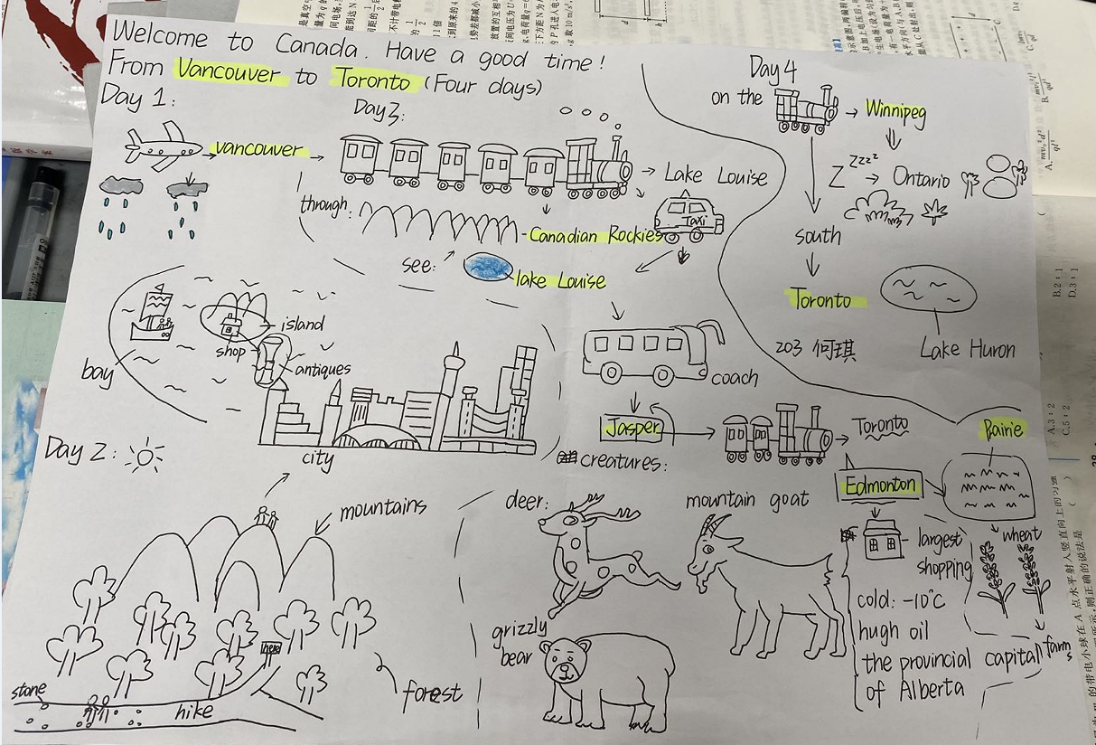
While-reading: Students’ mind map

Slide 12
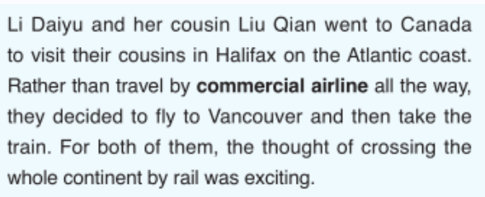
While-reading: read for content
Para 1
Place
Transportation
Time
Activities
Feeling

Slide 13
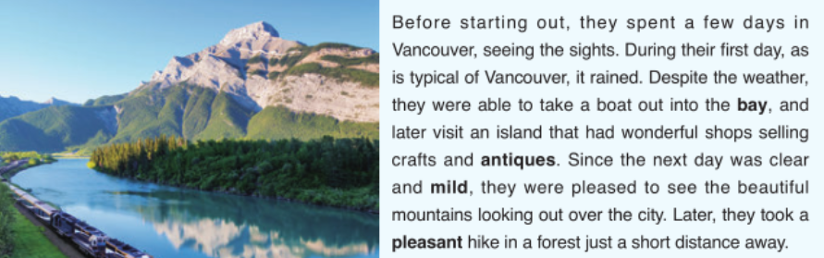

While-reading
Para 2
Vancouver
Take a boat
Before starting out, a few days, later
various activities
mild, clear, pleased, wonderful, pleasant

Slide 14
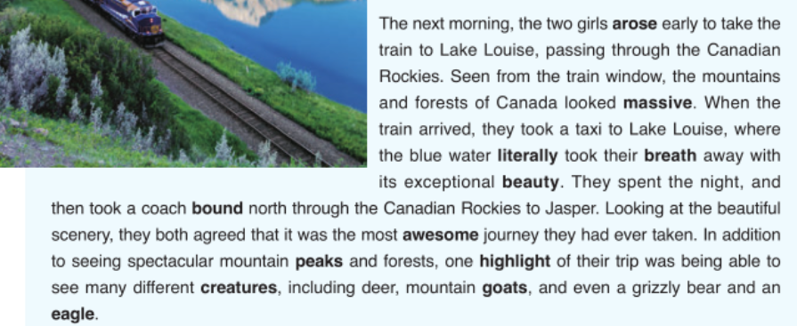
While-reading
Para 3
Lake Louise, the Canadian Rockies, Jasper
Train, taxi, coach
The next morning, spent the night
Enjoy the scenery and see creatures
took their breath away, awesome, spectacular, exceptional beauty

Slide 15

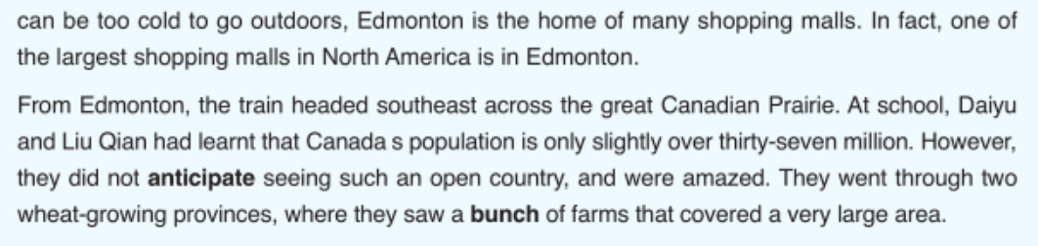
While-reading
Para 4&5
Edmonton, the great Canadian Prairie
Train
From Jasper, from Edmonton
Shopping mall, saw an open country
amazed

Slide 16
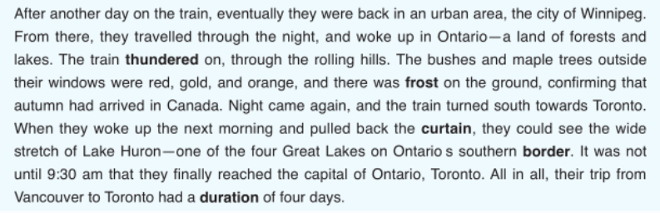
While-reading
Para 6
Winnipeg, Ontario, Toronto, Lake Huron
Train
After another day, Autumn
Enjoy the natural beauty
The rolling hills, the wide stretch of Lake

Slide 17
While reading: read for language
1. variety of verbs:
“starting out, spent, seeing, take a boat, visit, took a hike”
Read and compare：
...Go to a museum, go to the parks, go to see the buildings, go to eat the good local food, and go shopping at the local markets.

Slide 18
While reading: read for language
2. variety of adjectives:
“wonderful, mild, pleased, beautiful, pleasant, short...”
vivid description
persuasive
3. variety of persons：
“you” shows closeness
“sth” shows vividness

Slide 19
While reading: read for language
4. sentence structures
to emphasize
draw attention

Slide 20
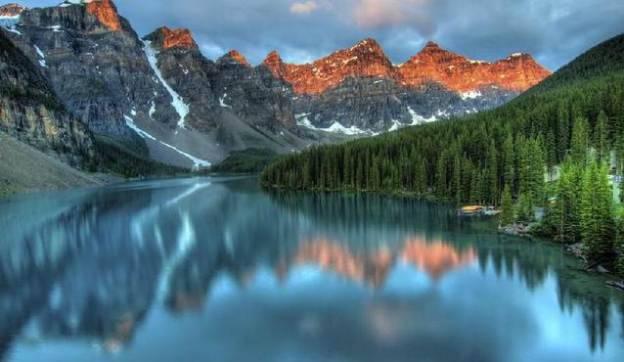
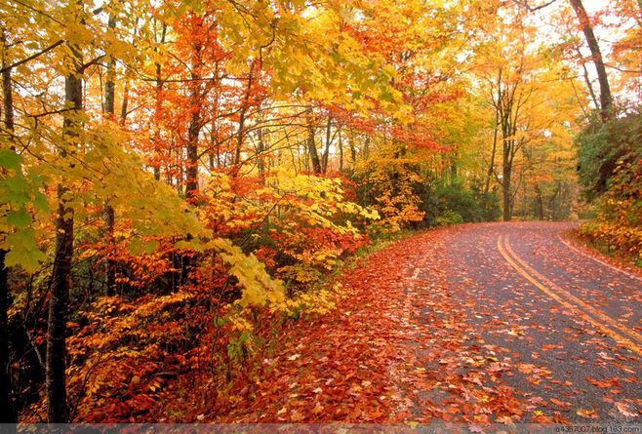
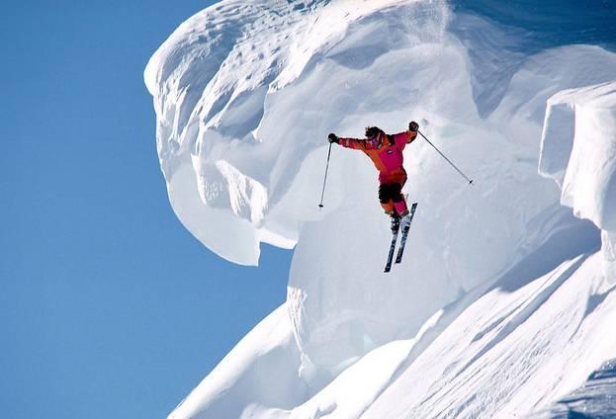
Speaking: share your journeys
Highlights of the journey | Language
 | v. | arise, take one’s breath away, explore, admire, appreciate, enjoy, wander, tour, cycle, taste, be amazed by
 | a. | spectacular, beautiful, breathtaking, massive, pleasant, awesome, relaxing, delicious, fascinating, peaceful...
 | n. | city, hill, greenery, lake, architecture, farms, birdsong, breeze, tent, kite, frost, scenery, sunrise, sunset, boat, mountain...
 | sentence | Before starting out..., During the first day, and later, Seen from..., Looking at..., In addition to doing... When they woke up..., Despite the weather...

Slide 21
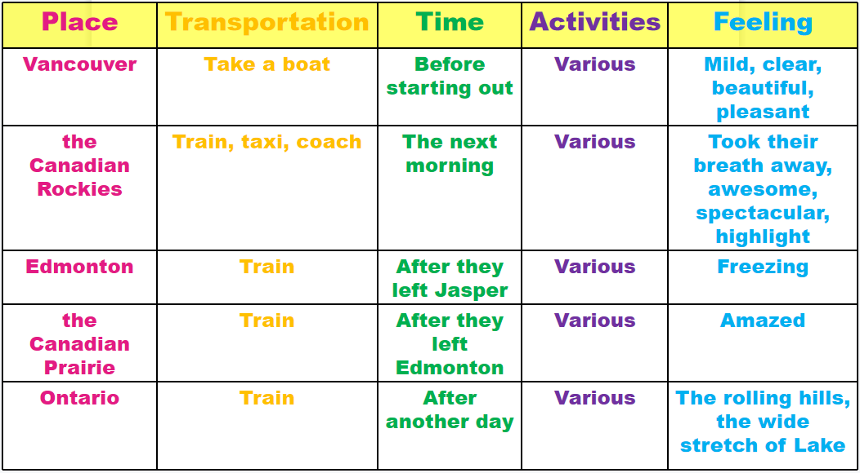
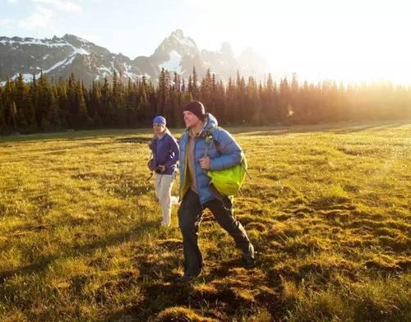
Speaking: share your journeys

Slide 22
Speaking: share your journey
Sample
I’d like to share one of my journey to the Greater Bay Area, which has been a wonderful trip so far.
We started in Dongguan, a one-day leisurely stroll in this romantic and peaceful city will be a feast for the mind and the eye. Then we took a coach to Shenzhen Bay. The scenery was spectafular--- the massive mountains, beautiful blue sea and all kinds of marine creatures. Finally, we took a train to Humen. Humen is an amazing city, through which you can feel the charm of Chinese history,Destruction of opium at Humen, and enjoy the delicous local seafood.
It has been a great trip, filling us with so many happy memories. We plan on spending about a week here getting rested up from our journey, and then we’ll fly home.
Greetings
Detailed tour information
Ending

Slide 23
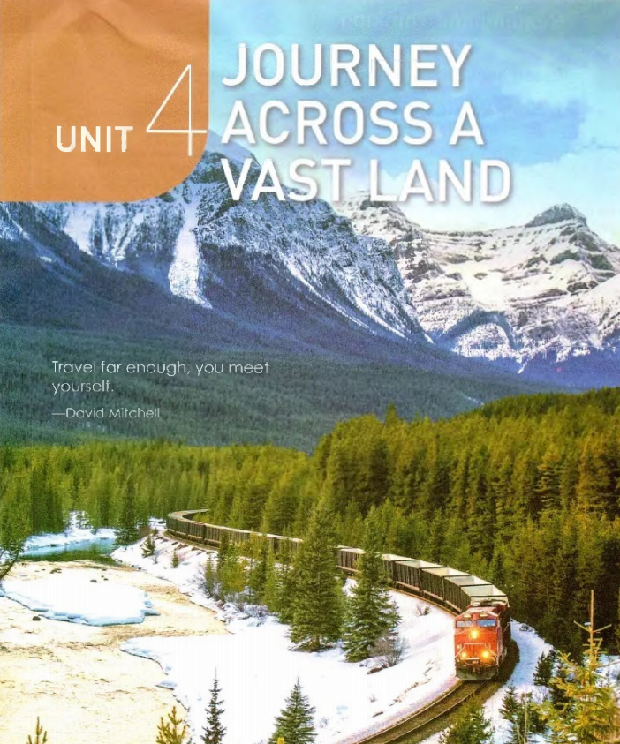
Summary
“It is better to travel ten thousand miles
than to read ten thousand books.”
Travel for enough, you meet yourself.
--- David Mitchell

Slide 24
Homework
1. Talk about journeys with your partners.
2. Write down your interesting journeys.

Slide 25
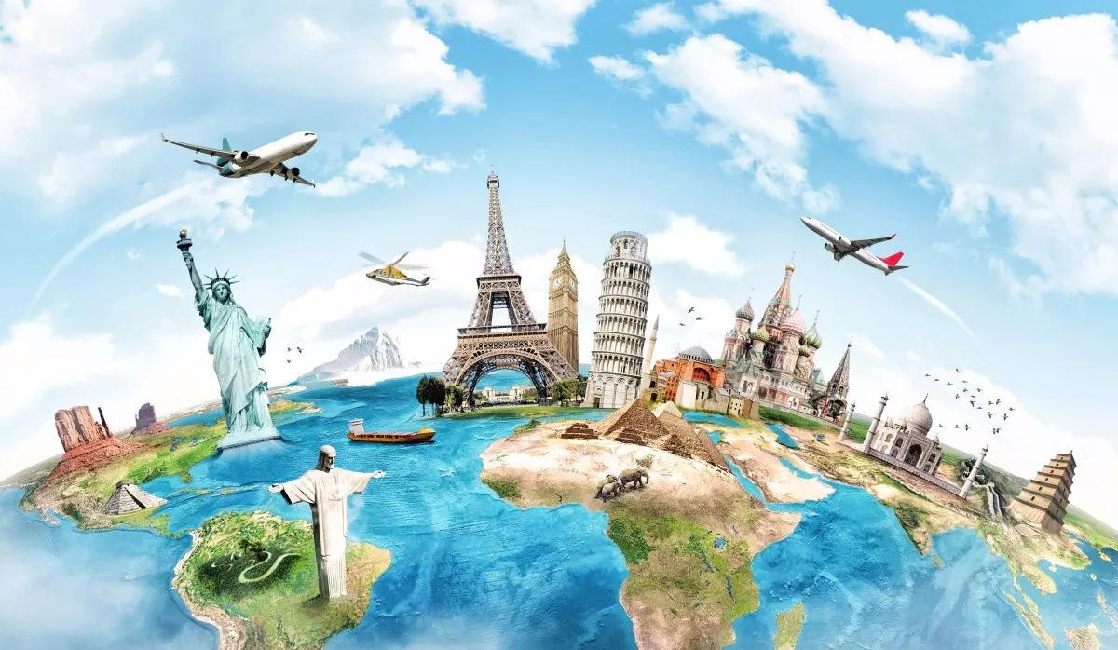
Thank you

