Slide 1

感恩遇见，相互成就，本课件资料仅供您个人参考、教学使用，严禁自行在网络传播，违者依知识产权法追究法律责任。
更多教学资源请关注
公众号：溯恩高中英语
知识产权声明

Slide 2

Unit 2 Bridging Cultures
Using Language
广东省东莞市第二高级中学 罗欣捷

Slide 3

Lead-in： An interview

Slide 4

Pre-reading
Do you think it’s necessary
to study abroad? And why?

Slide 5
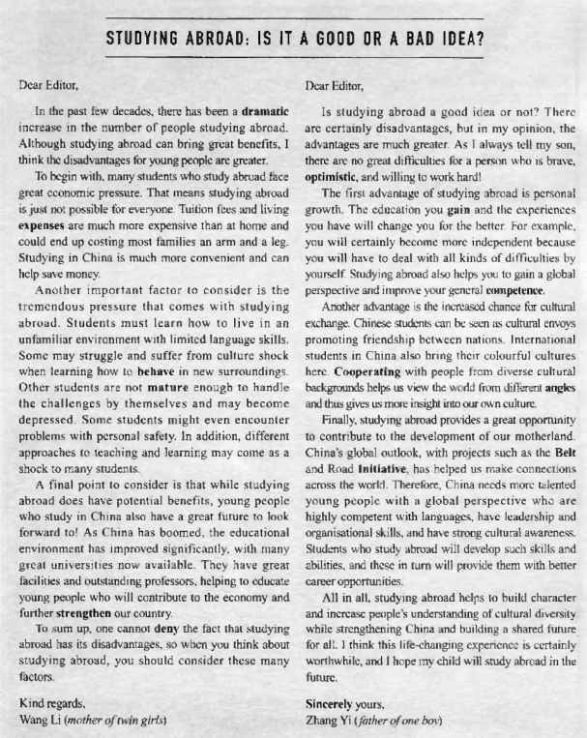
Skim for text type

Slide 6
Text type
Salutation
Two Letters
Just letters?
body
Complimentary Close

Slide 7

Read for title
title

Slide 8
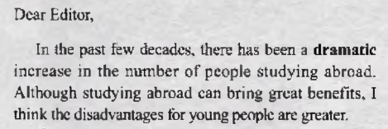
Read for content
STUDYING ABROAD: IS IT A GOOD OR BAD IDEA?
Para 1
fact
main point
1. What is the topic sentence?
2. How does the author state her opinion?

Slide 9
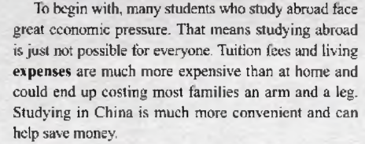
Read for content
Para 2
reason 1
evidence
What is the topic sentence?

Slide 10
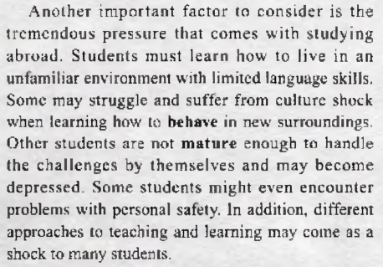
Read for content
Para 3
reason 2
evidence

Slide 11
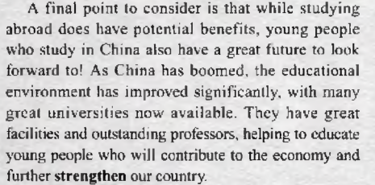
Read for content
Para 4
reason 3
evidence

Slide 12
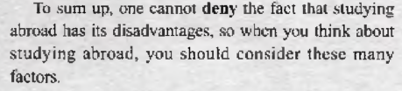
Read for content
Para 5
conclusion

Slide 13
text type
Read for structure
Paragraph | Argument chain | Letter 1
1
2
3
4
5
Introducing the topic
Fact: dramatic increase in the number of people studying abroad
Argumentative Letters
Main point
The disadvantages are greater.
Reason 1
great ecomonic pressure
tremendous pressure: unfamiliar environment, limited language skills, not mature, safety problems, different approaches to teaching and learning
Reason 2
Reason 3
great future for young people studying in China
Conclusion
should consider the disadvantages

Slide 14
Read for structure
Paragraph | Argument chain | Letter 2
1
2
3
4
5
Introducing the topic
Question:Is studying abroad a good idea or not?
Main point
The advantages are much greater.
Reason 1
personal growth
Reason 2
chance for cultural exchange
Reason 3
great opportunity to contribute to the development of our motherland
This life-changing experience is worthwhile.
Conclusion

Slide 15
The structure of argumentative essays
Start with a question or a fact
Part 1
State an opinion
Argumentative essays
Part 2
Give reasons and evidence to support an opinion
Part 3
State a conclusion

Slide 16
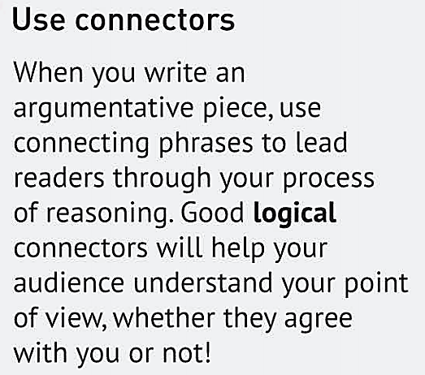
Read for langauge: Connectors
Underline the connectors used in these two letters and think about their meanings.

Slide 17
Read for language: Connectors
Paragraph | Letter 1 | Letter 2
1
2
3
4
5

Slide 18
Read for language: Connectors
Paragraph | Letter 1 | Letter 2
1 | although | but, in my opinion
2 | to begin with that means... | the first, for example, because
3 | another factor in addition | another advantage, also and thus
4 | a final point as, also | finally, therefore, such as
5 | to sum up so | all in all

Slide 19
Read for language: Connectors
Functions | Connectors
Point of view
in my opinion, as far as I know, as far as I am concerned
Summary
to sum up
all in all
Restarting
that means, in other words , that is to say
Listing
a final point
to begin with
another factor
in addition
also
finally
the first
therefore
because
as
Cause & effect
so
thus
Giving examples
such as
for example

Slide 20

Pre-writing: Discussion
Discuss with your group members
What are some other advantages or disadvantages of studying abroad that were not mentioned in the letters?

Slide 21
While-writing
Writing task:
Express your opinions on studying abroad.
Connectors
Point of view
Summary
Restarting
Listing
Cause & effect
Giving examples
Structure
Question or Fact
Opinion
Reasons & evidence
Conclusion

Slide 22
Sample Letter
question
Dear Editior,
Many people ask the question, “Why study abroad? After all, there are many great universities and schools in China that attract great professors both local and foreign.” I think that while this is true, this gets things slightly wrong. The question isn’t that people think the quality of their local university is not adequate, but rather how studying abroad helps and benefits the individuals in their own study and career plans.
By studying abroad, Chinese students get a better understanding of other cultures and countries, and learn to see themselves as global citizens. As a result, they can better understand China’s place in the world and how they can contribute to world peace and development.
In addition, overseas students can learn cross-cultural commnunication skills, which will help them understand how they can participate on the world stage. There are so many places in the world with hurting, needy people. With such skills and knowledge, they can better lend them a helping hand.
Finally, when our students return home, they can share their experience with others. There is a wide open world which they first learn about people from other countires, and their struggles and challenges.
In conclusion, the best way to get is by giving, and the easiest way to be loved is by loving others. I hope everyone will agree that there is a wonderful world out there which can contribute and help, and they can best do this through student exchange.
Best regards,
Liu Ping
opinion
Reasons and evidence
Conclusion

Slide 23
While-writing: Assessment
Checklist
Do you state your point with a question or a fact?
Is your main point clear?
Is the body of your letter logical and convincing?
Is your conclusion clear?
Have you used the connectors?

Slide 24
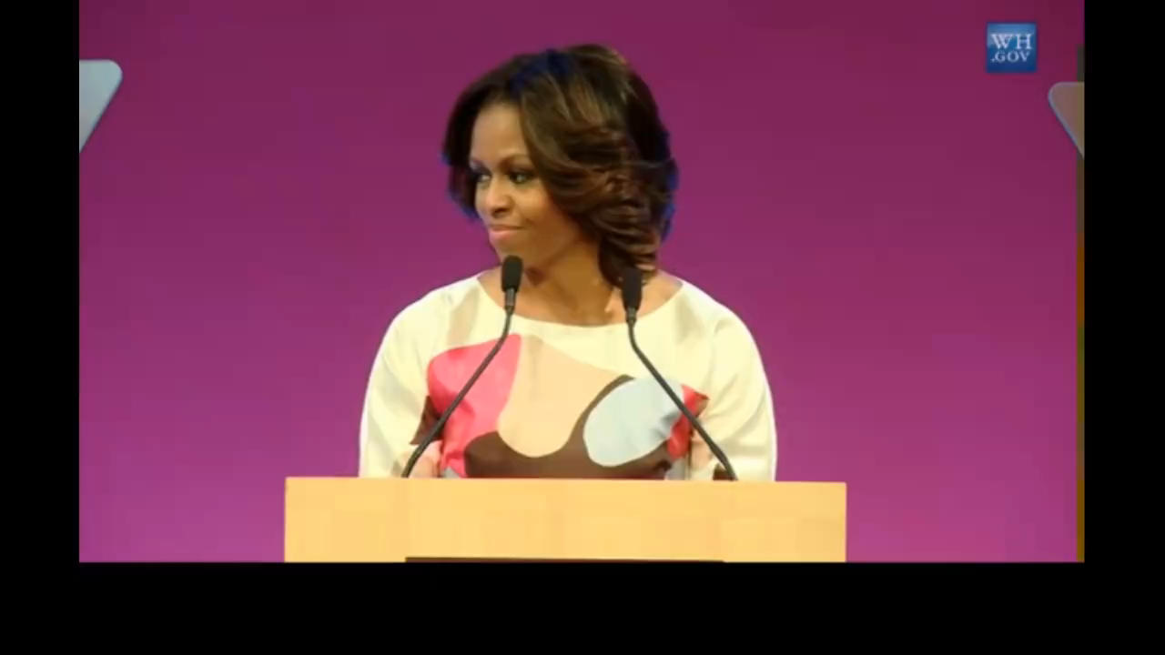
Summary: A speech from Michelle

Slide 25

Summary
Studying abroad increase people’s understanding of cultural diversity while strengthening China and building a shared future.

Slide 26
Summary & Homework
in class：
Figure out the structure of an argumentative letter and the connectors.
Learn to write a brief argumentative essay.
after class：
Polish your draft and exchange it with your classmates.

Slide 27

Thank you

