Slide 1

感恩遇见，相互成就，本课件资料仅供您个人参考、教学使用，严禁自行在网络传播，违者依知识产权法追究法律责任。
更多教学资源请关注
公众号：溯恩高中英语
知识产权声明

Slide 2

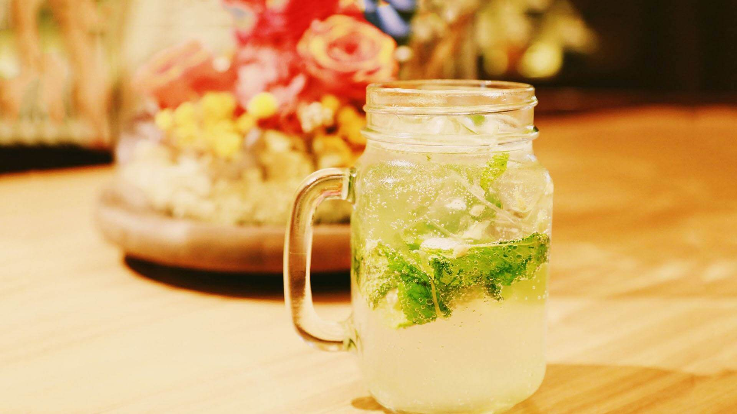
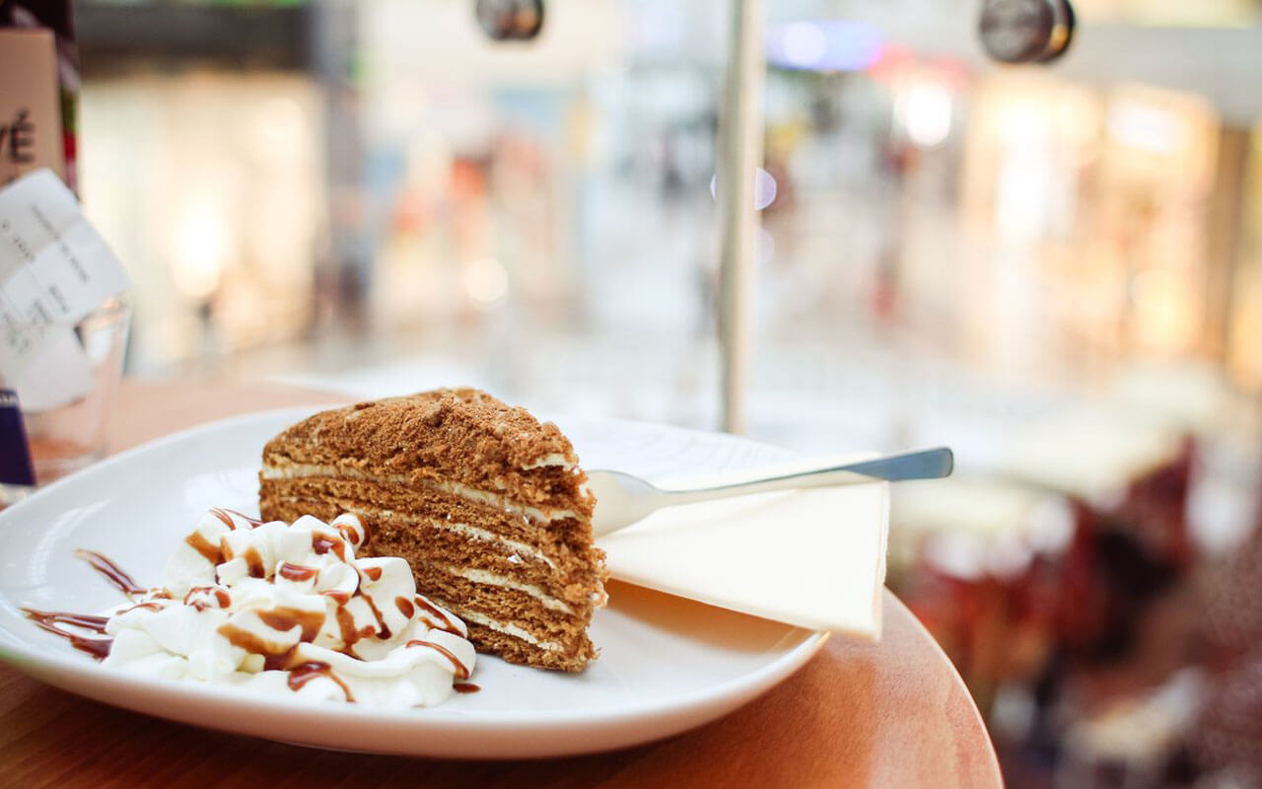
Book 5 Unit 3
Discover Useful Structure:
The Past Perfect Tense
Food and Culture
浙江 省常山县第一中学
洪笑英

Slide 3
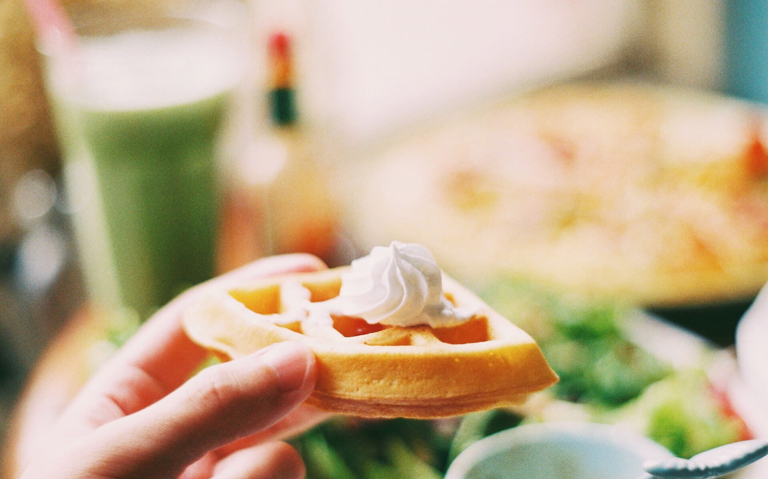
Contents
Food
01 Definition of the Past Perfect Tense
and
02 Identification of the Past Perfect Tense
Culture
03 Differences between the Past Perfect Tense
and other tenses
04 Application

Slide 4
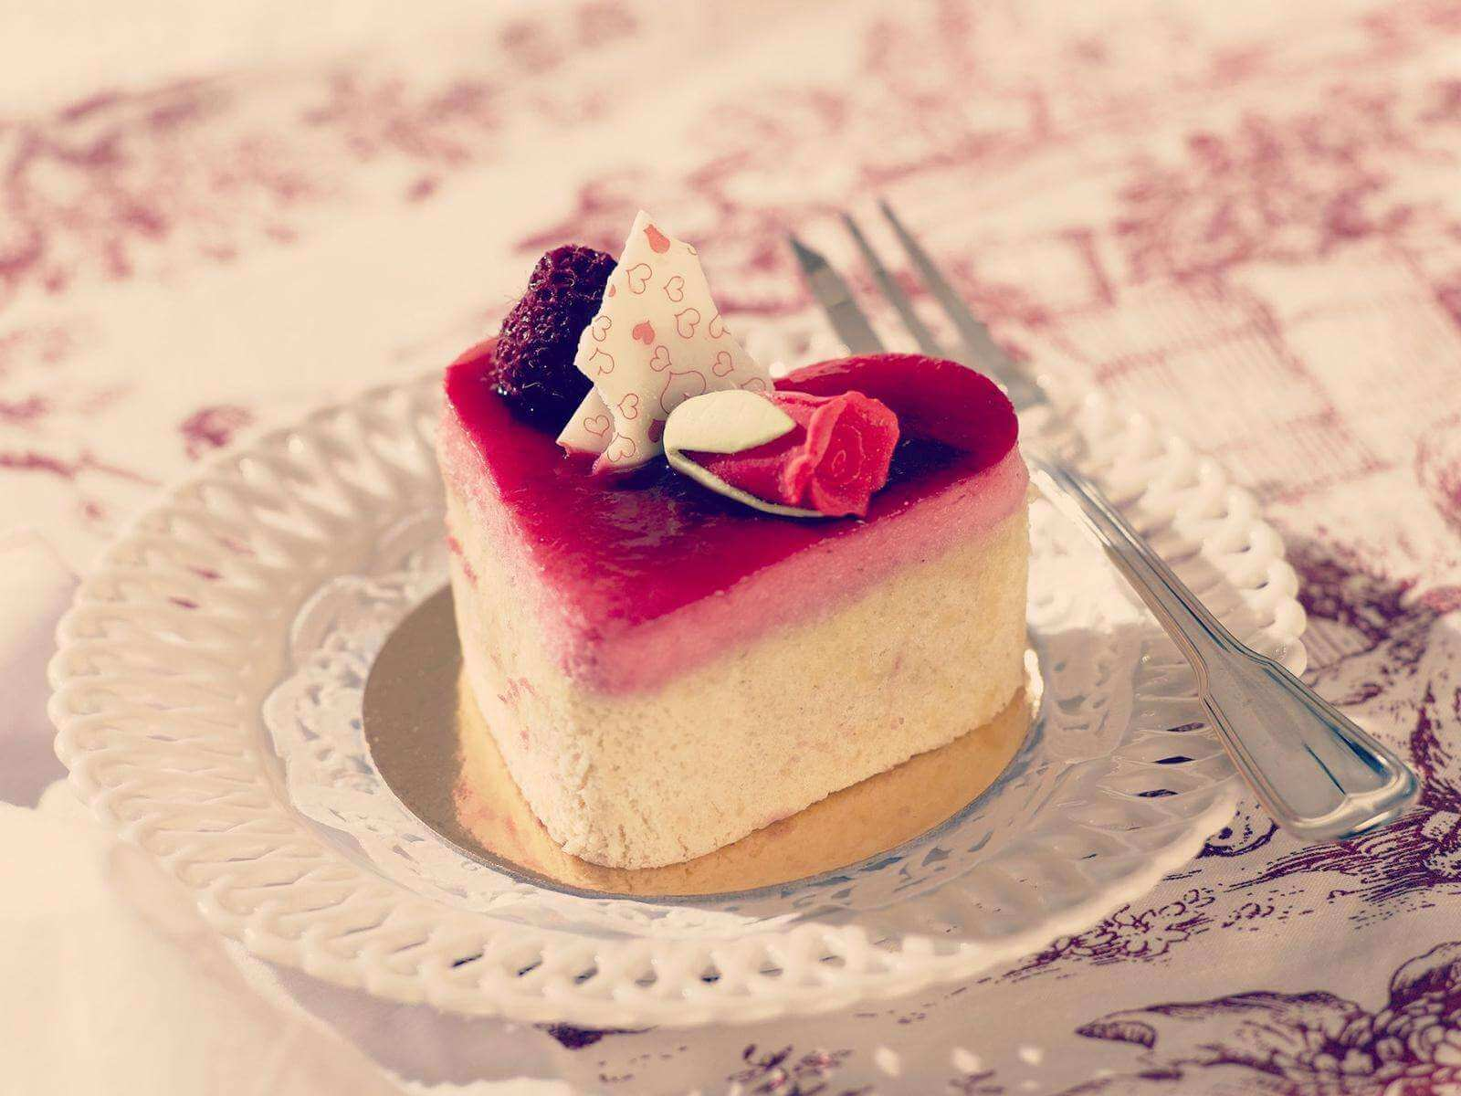
01
Definintion of
the Past Perfect Tense

Slide 5
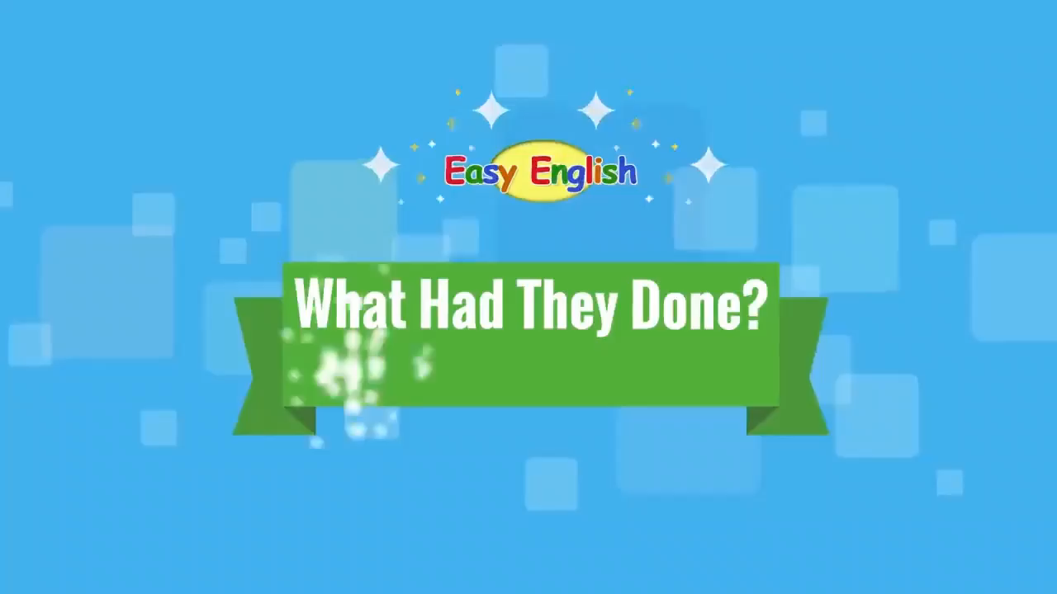
Sense the usage of the past perfect tense

Slide 6
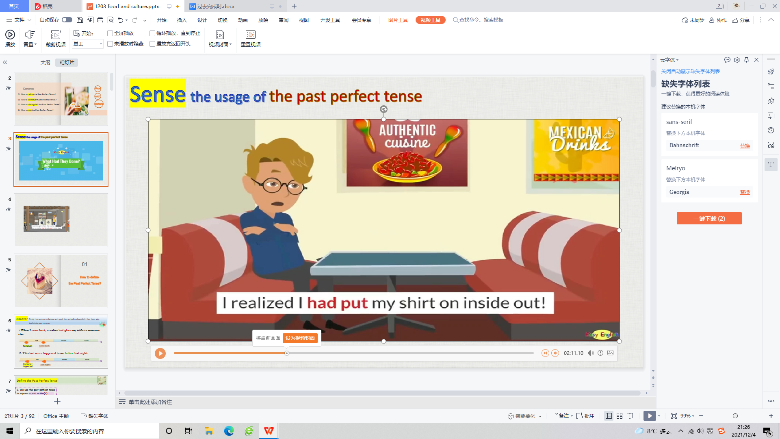
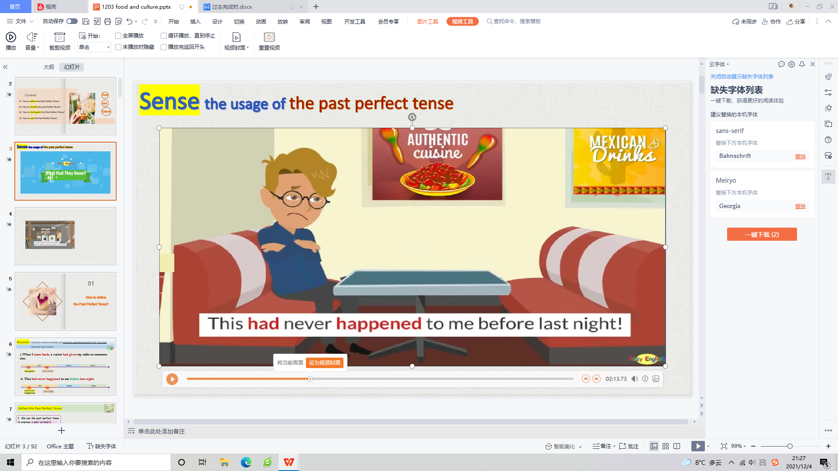
Discover: Study the sentences below and mark the circled words in the time axis (时间轴).
And state your reason.
had
put
realized
A
B
past
present
future
had
never happened
last
night
A
B
past
present
future

Slide 7
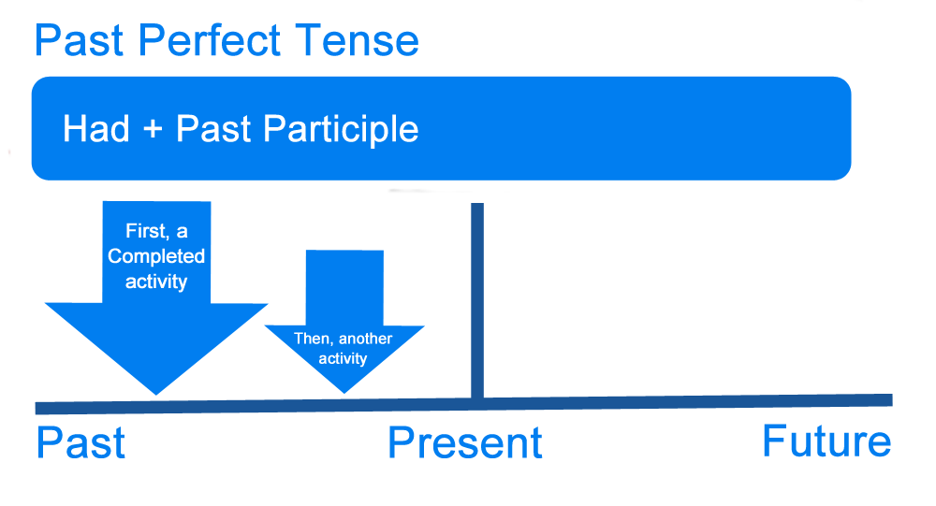
Definition of the Past Perfect Tense
1. We use the past perfect tense to express a past action(A) finished before another action(B) in the past.
B
A
2. We also use the past perfect tense to show that something(A) happened before a specific time(B) in the past.

Slide 8
Formula of the Past Perfect Tense
formation | active voice | passive voice
affirmative sentence
negative sentence
general question
wh-question
had+done
had been done
had not/hadn't + done
had not/hadn’t been done
Had + [subject] + done…?
Had + [subject] + been done…?
[question word] + had
+ [subject] + done…?
[question word] + had
+ [subject] + been done?

Slide 9
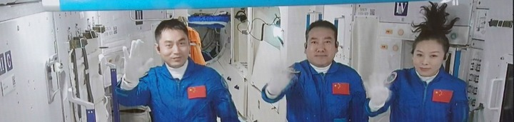
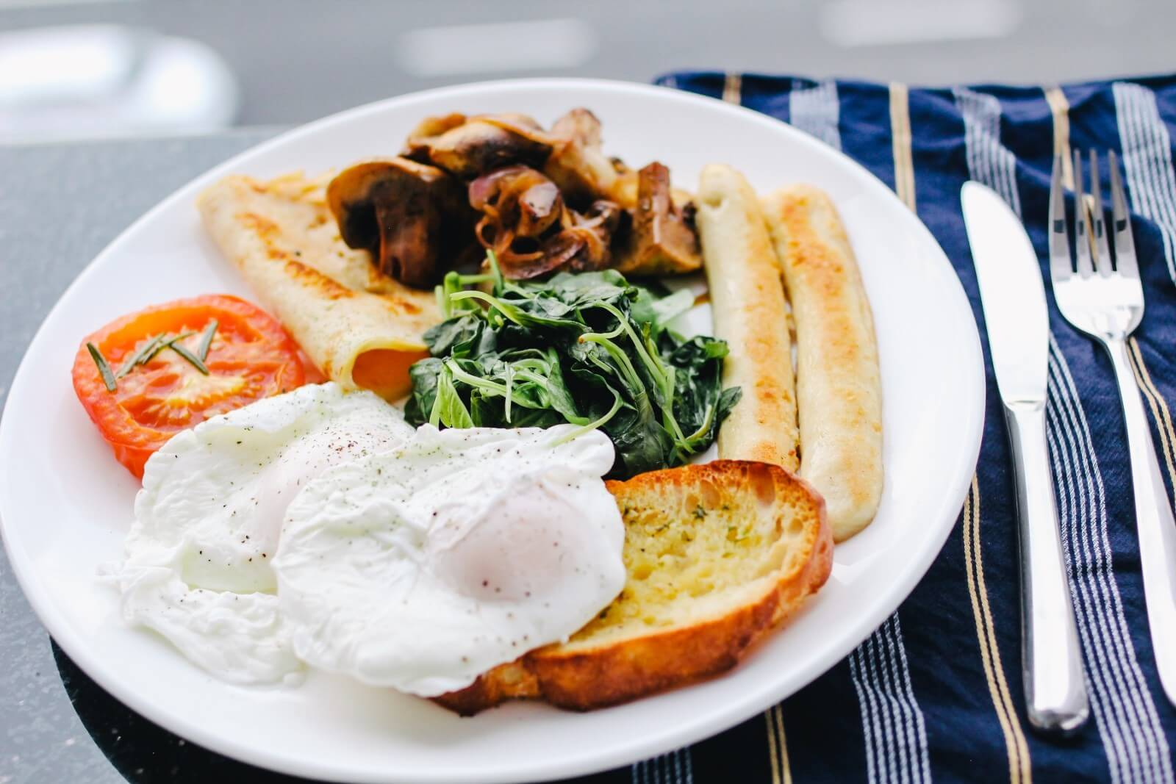
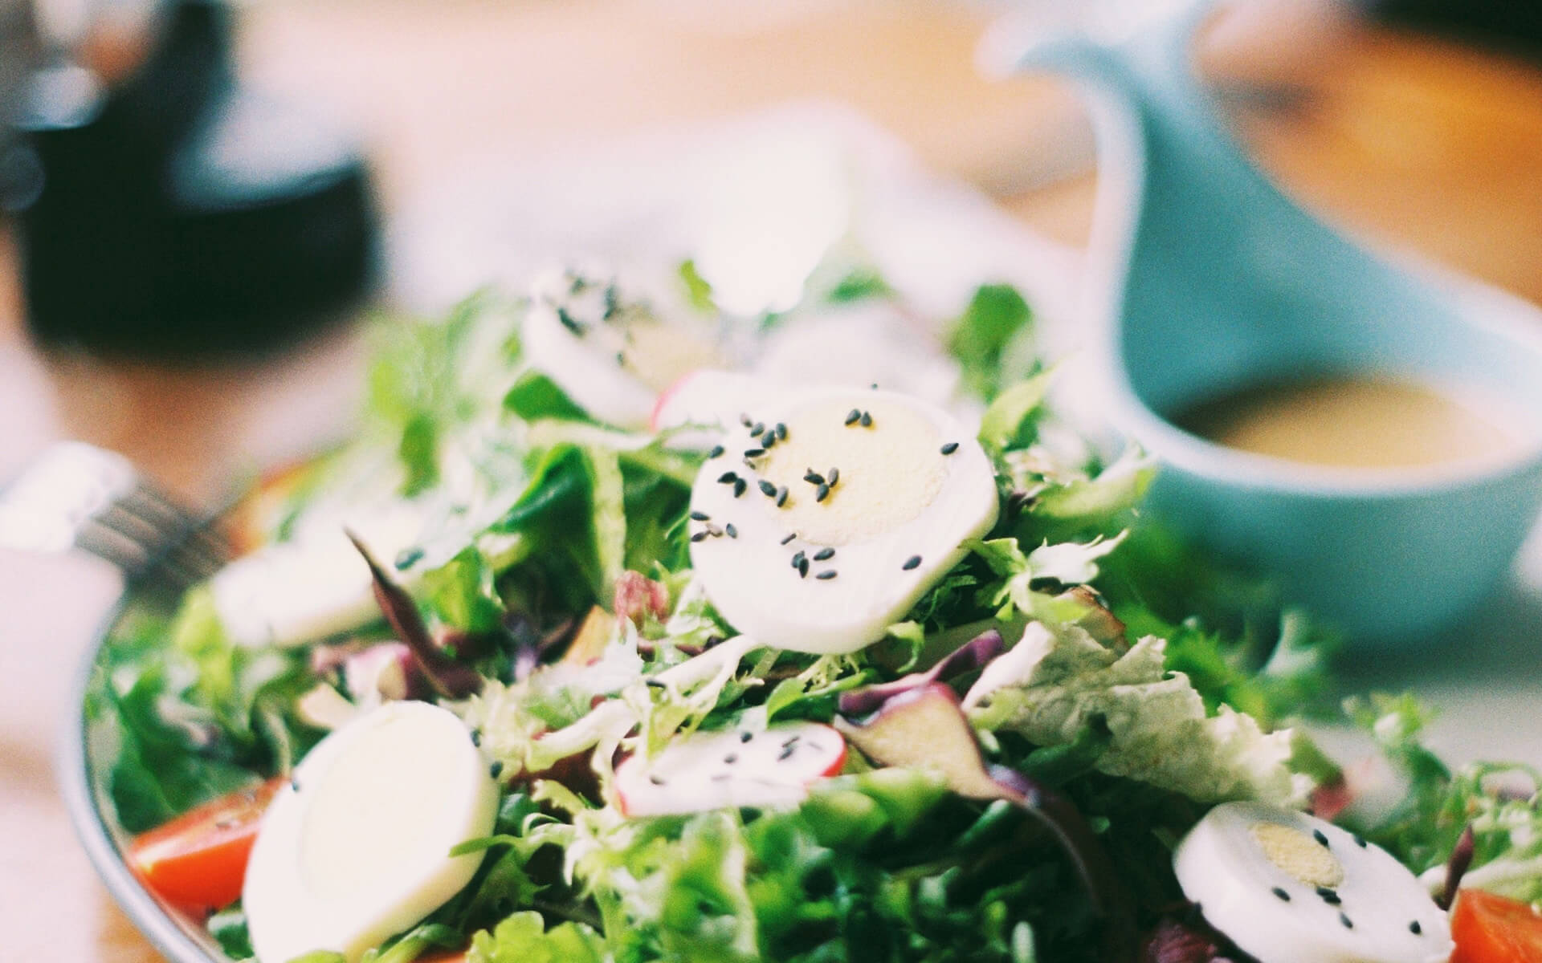
(1)Think: What gifts had the mission command prepared for the taikonauts on the Chinese New Year’s Eve before they set off for outer space?
I think the mission command had prepared ______________ .
The Shenzhou-13 taikonauts will celebrate the Chinese New Year’s Eve in outer space. “It’s my understanding that the mission command had prepared a large package of New Year gifts for us before we started, but we don’t know what they are,” crew member Wang Yaping said. “I am really looking forward to enjoying the special festival and I am sure the gifts will be full of surprises and wonders.

Slide 10

(2) Combine two sentences into one using the past perfect tense.
① First: The waiter gave my seat to someone else. Next: I came back.
② First: The thief ran away. Next: the police arrived.
③ First: The fire got out of control. Next: The firetruck drove up.
The waiter had given my seat to someone else when I came back.
The thief had run away by the time the police arrived.
The fire had gotten out of control when the firetruck drove up.

Slide 11
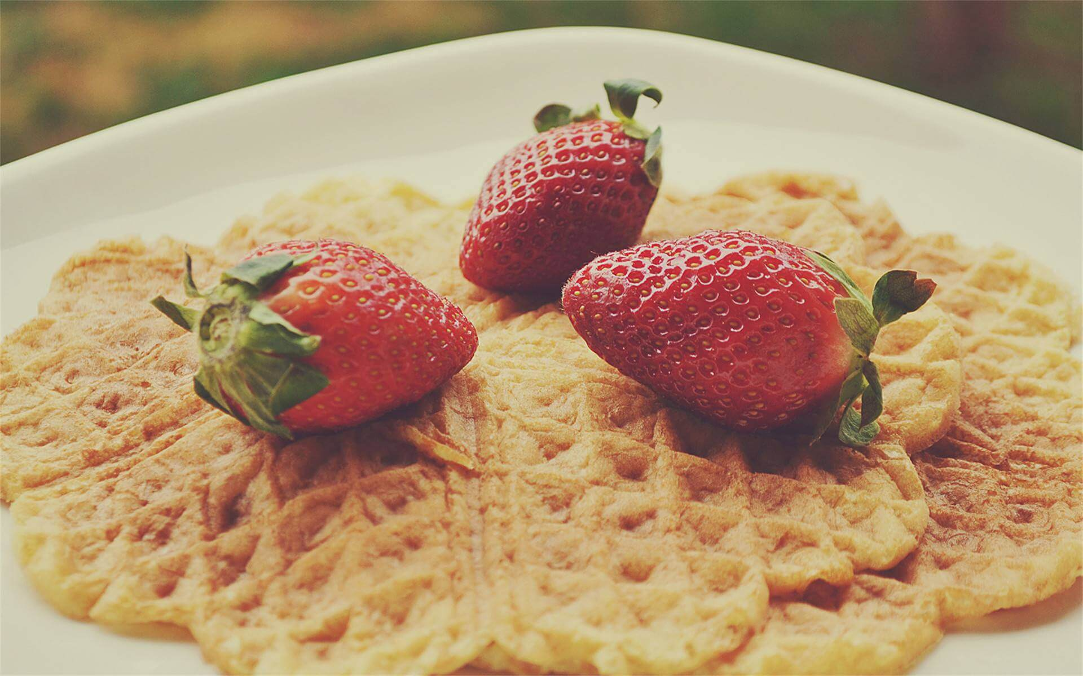
02
Identification
of the Past Perfect Tense

Slide 12
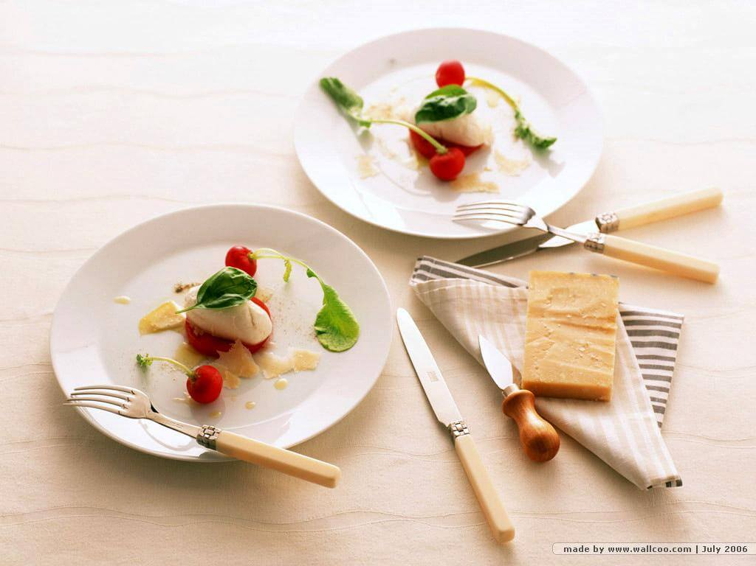
1. by，before，when，until, since+ a past action/time
*Dinner had been served by 6:00 p.m yesterday evening.
by + past time
*Amy had cooked their dinner by the time her husband came back from work.
by the time + clause ( past action)

Slide 13
2. already，yet, just
*I had just eaten my lunch when she phoned me.
*I arrived very late at the party. All my friends had already gone home.

Slide 14
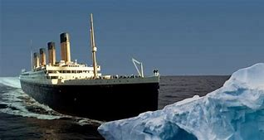
3.The context:
An action had happened before a past action/time.
* The Titanic sank because it had been badly damaged by an iceberg.
A
B
past
present
future
had been badly damaged
sank

Slide 15
4.Drills
(1) had + hoped/wished/expected/thought/intended/meant/supposed:
For an event that didn’t happen actually. It’s in unreal situations.
*I had meant to go on a trip with you, but I was busy with work then.
“本想”
Actually, I didn’t go on a trip with you.
*I had intended to see you, but I had to look after my little daughter at that
moment.
“本打算”
Actually, I didn’t see you.

Slide 16
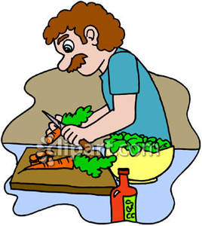
4.Drills
(2) It was the first/second… time + (that) sb. had done sth.
*It is the first time that Jason__________ (make) the salad.
has made
*It was the first time that Jason__________ (make) the salad.
had made

Slide 17
4. Drills
(3) “一……就……”：
No sooner had sb. done than sb. did sth./
Hardly/Scarcely/Barely had sb. done when sb. did sth.
*Hardly _____we _____ (leave) the house when it began to rain.
had
left
* No sooner _____she _____ (get) out of the building than it collasped in an instant.
had
got

Slide 18
03
Differences between
the Past Perfect Tense
and other tenses

Slide 19

1. the Past Perfect Tense VS the Past Tense
an action that finished before another action in the past.
an action that happened in the past
* Mary (arrive) at the cafe by six o’clock yesterday.
* Mary at the cafe at six o’clock yesterday.
had arrived
arrived

Slide 20
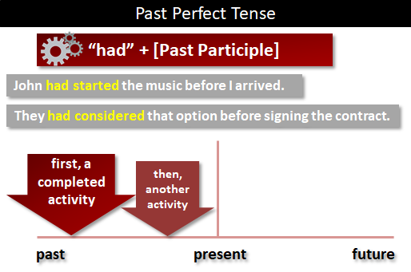
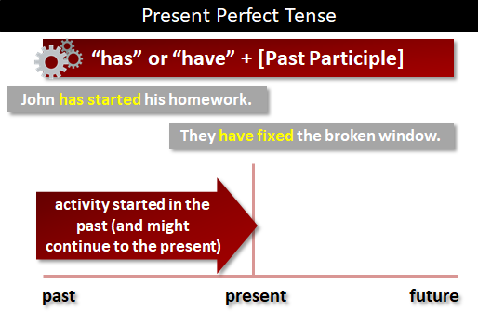
2.the Past Perfect Tense VS the Present Perfect Tense
the Past Perfect Tense
the Present
Perfect Tense
the Past Perfect Tense
an action that finished before another action in the past or another past time.
an action that began in the past, and might continue to the present
* David (work) with two scientists in the field of botany
before he was awarded the Nobel Prize.
had worked
* Since he graduated from Harvard University, David (work) with two scientists in the field of botany.
has worked

Slide 21
(1) Fill in the blanks.
（2020·浙江卷）阅读下面材料，在空白处填入适当的内容(1个单词)或括号内单词的正确形式。
Some time after 10,000 BC，people made the first real attempt to control the world they lived 56 ，through agriculture. Over thousands of years，they began to depend less on 57 could be hunted or gathered from the wild，and more on animals they had raised and crops they had sown.
Farming produced more food per person ___58___ hunting and gathering，so people were able to raise more children. And，as more children were born，more food 59 (need). Agriculture gave people their first experience of the power of technology 60 (change)lives.
By about 6000 BC，people 61 (discover) the best crops to grow and animals to raise. Later，they learned to work with the 62 (season)，planting at the right time and，in dry areas， 63 (make)use of annual floods to irrigate(灌溉)their fields.
This style of farming lasted for quite a long time. Then，with ___64___ rise of science，changes began. New methods
65 (mean) that fewer people worked in farming. In the last century or so，these changes have accelerated. New power machinery and artificial fertilizers(化肥)have now totally transformed a way of life that started in the Stone Age.
was needed
had discovered
【Keys】56. in 57. what 58. than 59. was needed 60. to change
61. had discovered 62. seasons 63. making 64. the 65. meant

Slide 22
(2) Give the correct forms of the verbs. If necessary, draw a time axis to help you..
past
perfect tense
past tense
present perfect tense
had prepared
(1) When I __________(arrive) home last night, I discovered that Jane ___________(prepare) a
beautiful candlelight dinner.
(2) Since I began acting, I (perform) in two plays. However, I ______________
(speak, never) publicly before I came to Hollywood in 2010.
(3) By the time I got to the office, the meeting_______________ (begin, already) without me.
arrived
have performed
had never spoken
had already begun

Slide 23
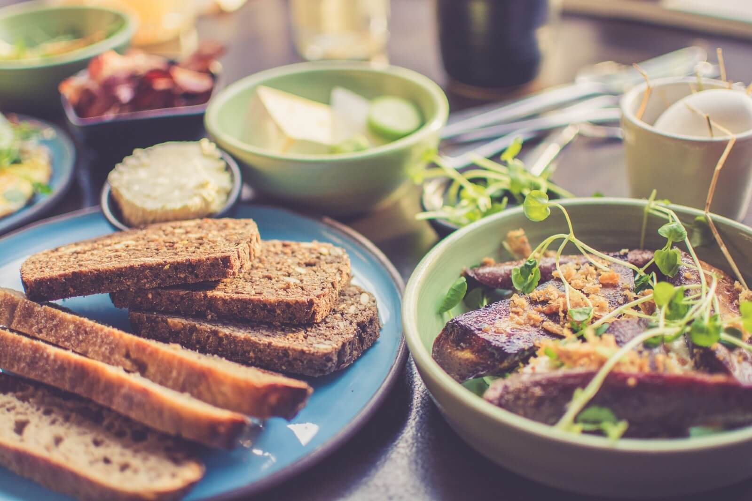
04
Application

Slide 24

1. Create your sentences with the past perfect tense.
Example:
Claire looked very happy when I saw her last week.
She had released her first album.
1. Sam froze.
2. The kitchen was in an unbelievable mess.
3. They became homeless.
4. The girl felt proud.
He had accidently broken into a tiger’s cave.
The cat had jumped up and down in it.
Their houses had been destroyed in a severe earthquake.
She had prepared a delicate cake for her mom on Mother’s Day.

Slide 25
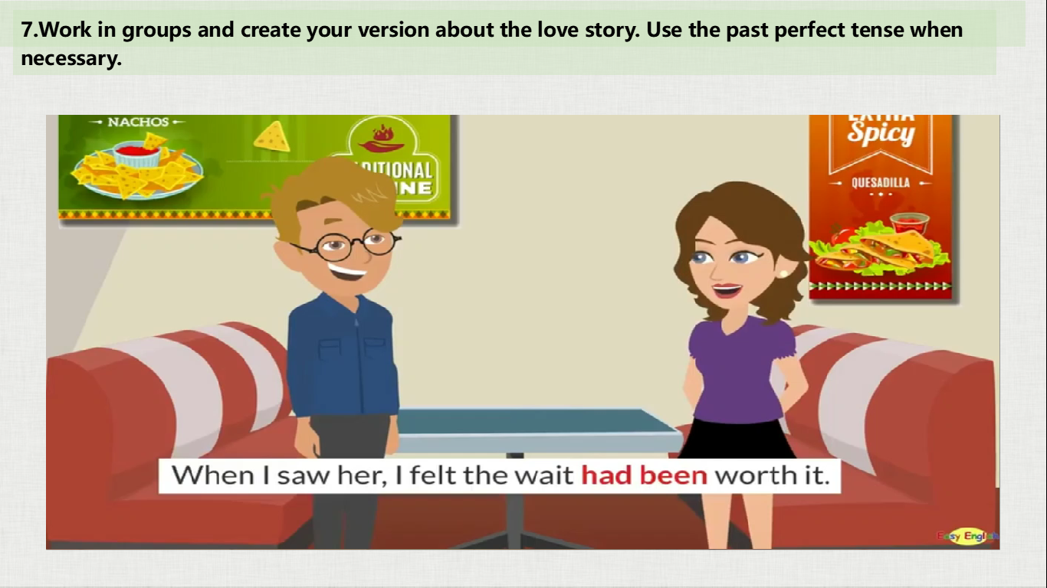
2. Create your version about the love story between Jake and Ann, which is an embarrassing yet happy-ending story. Use the past perfect tense when necessary.

Slide 26
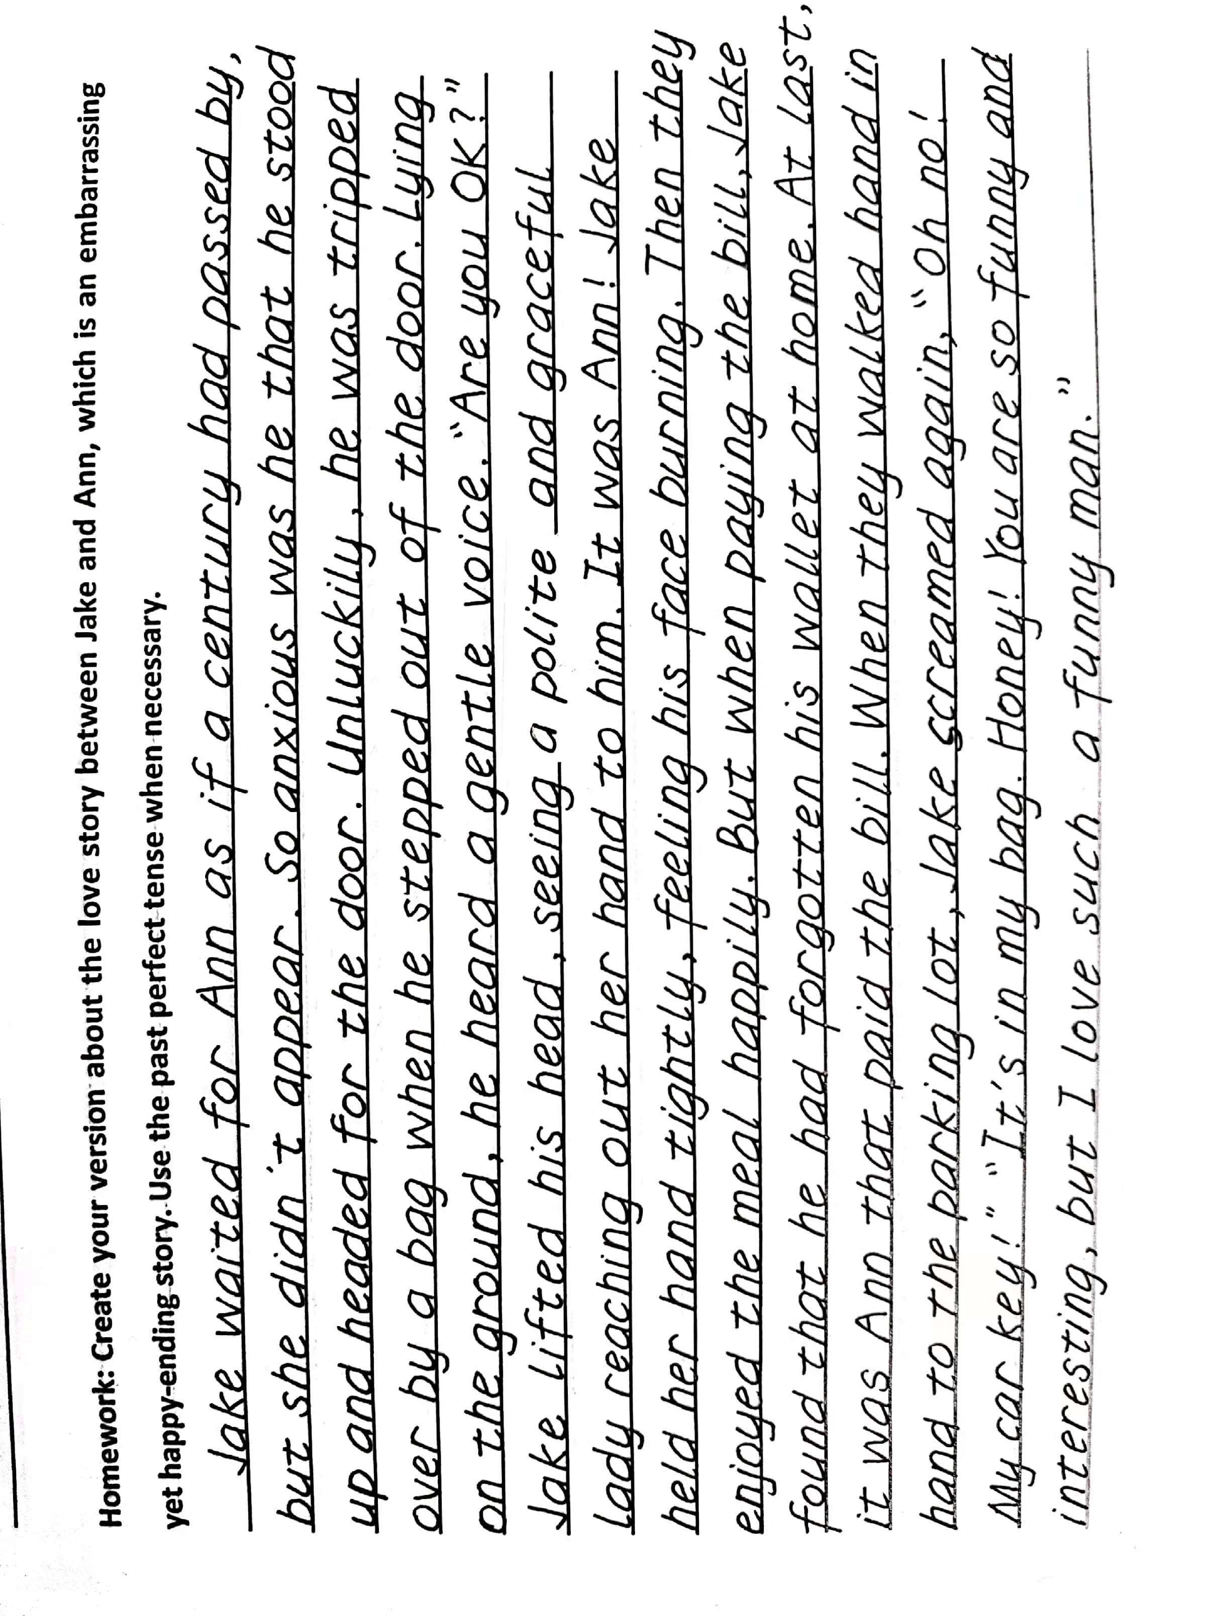
3.
4.Share your version.

Slide 27
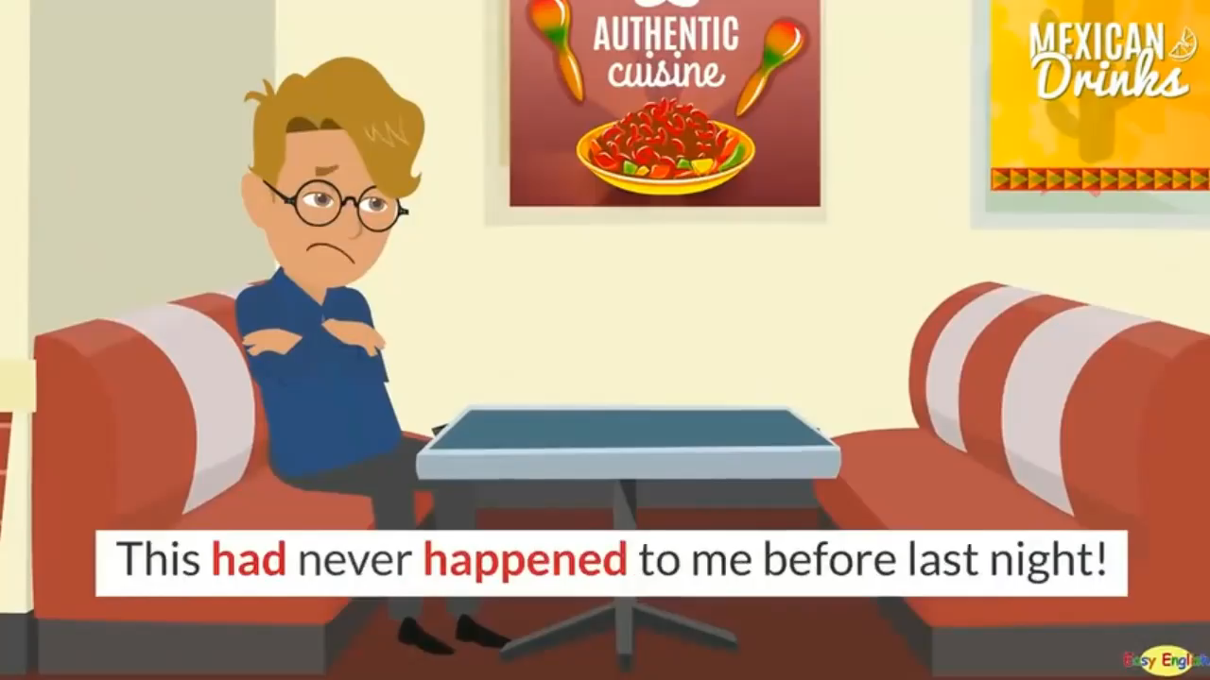
Another possible version:

Slide 28
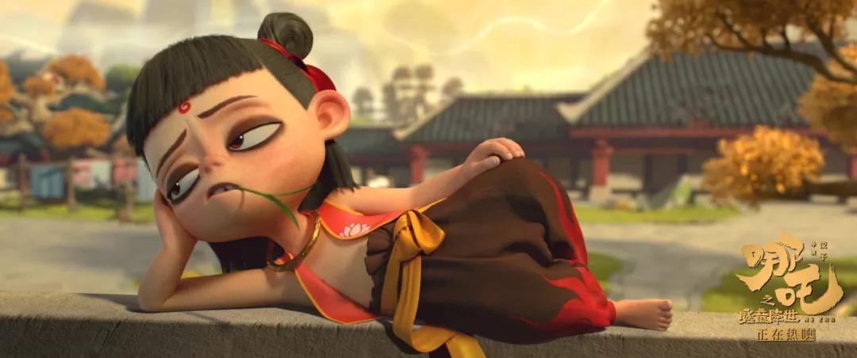
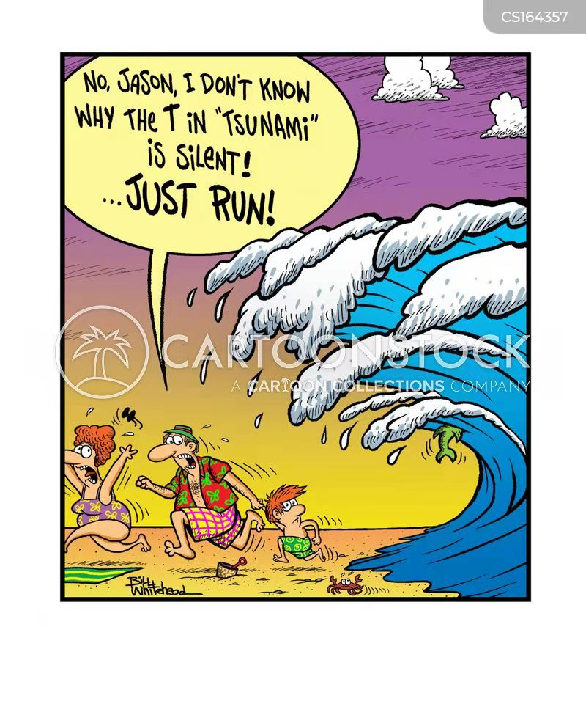
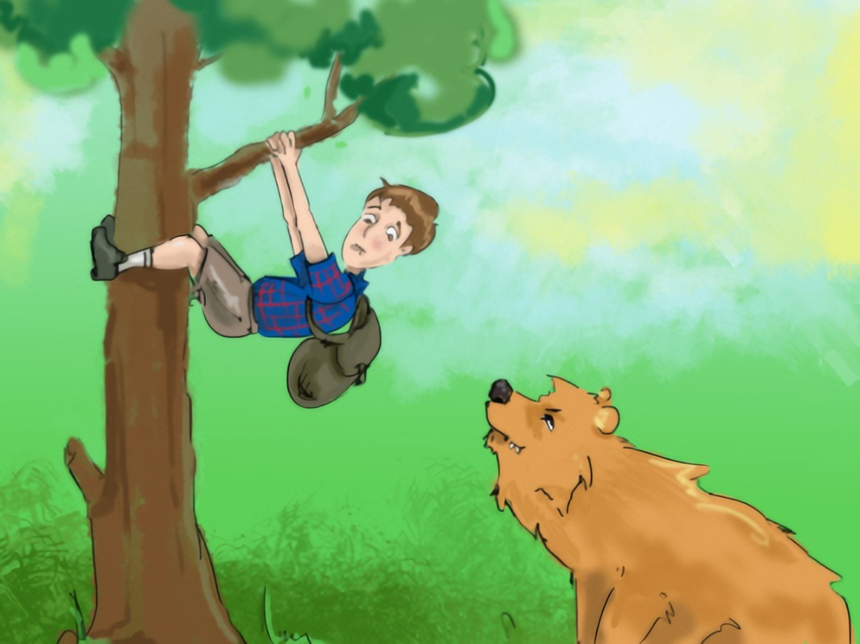
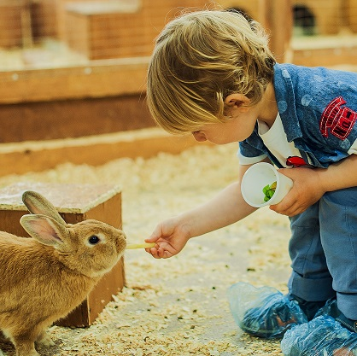
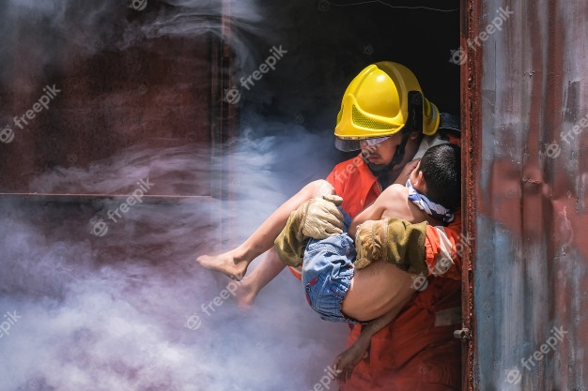
create a mini story about one of the pictures.
Use the past perfect tense when necessary.
Homework
2
3
1
4
5

Slide 29
Possible versions:
Picture 3:
It was the first time that Jason had paid a visit to a well-known sandy beach with his family. They had hoped to lie on the soft beach to be bathed in the cosy sunshine for a whole afternoon. However, no sooner had they lain on the warm and comfortable beach than they saw a huge wave dash to them. A tsunami! So violent was the tsunami that it nearly swallowed everything which was visible. Without hesitation, they squeezed every ounce of their strength to run. Fortunately, after a narrow escape, they all survived.
Picture 1:
By 2 p.m., Jack had walked in the forest for over five hours. Suddenly, he heard a big noise. He turned to find a bear staring at him. Grrrawrrrrrrr! The bear roared with rage! Its dripping jaws were open wide. Without hesitation, Jack climbed onto a tree to run for his life. Before he used his bear spray to drive away the bear, the beast had pinned him against the tree and held him there for about fifteen minutes.

Slide 30
Thank you!

