Slide 1

感恩遇见，相互成就，本课件资料仅供您个人参考、教学使用，严禁自行在网络传播，违者依知识产权法追究法律责任。
更多教学资源请关注
公众号：溯恩高中英语
知识产权声明

Slide 2
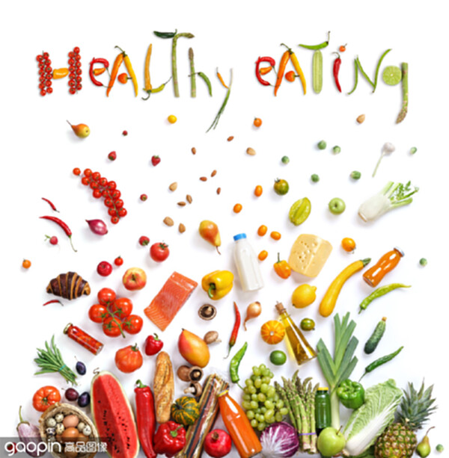
山东省鄄城县第一中学：Cynthia

Slide 3
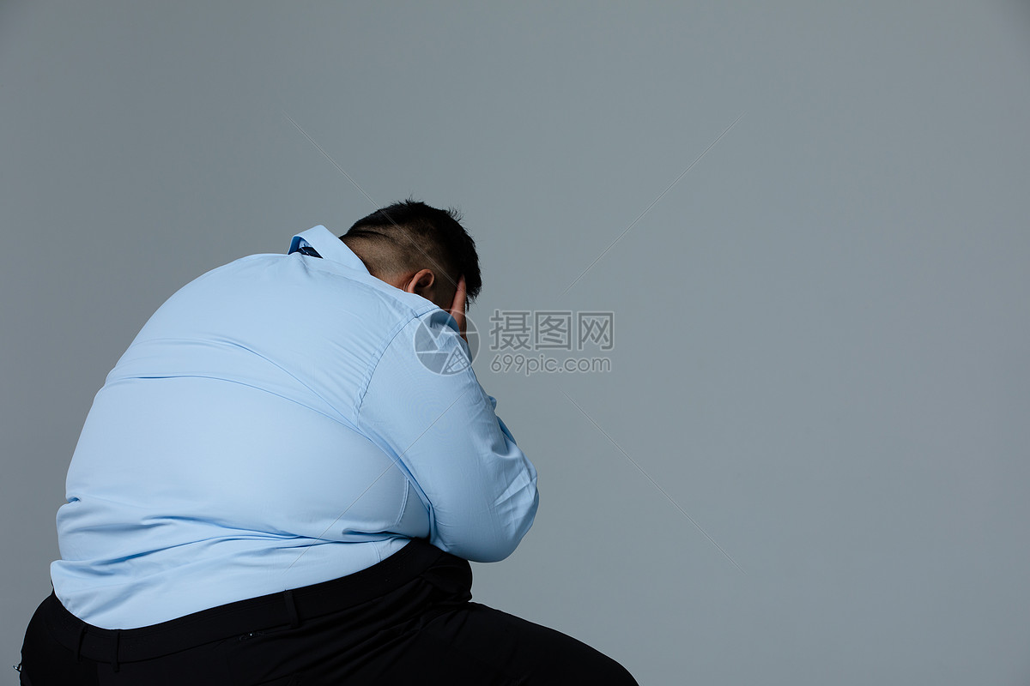
Can you use some words to describe his present feeling?
upset
low
What's his problem?
down
depressed
What leads to his problem?
healthy eating
discouraged
fat
weight
frustrated
eating
drinking
exercise
What's the main factor
among them?

Slide 4
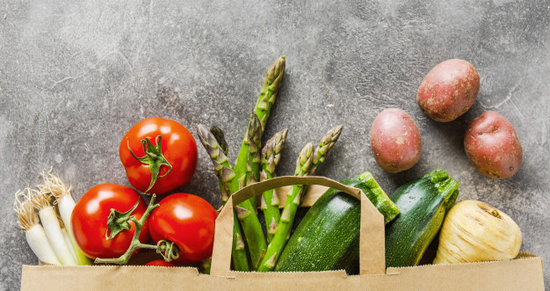
Task 1 : match the main idea
Para.1
Para.2 B.Reducing Sweets is Key.
Para.3 C.The Real Killer is Sugar.
Para.4 D.The Way You Look at Food is
most Important.
Para.5 E.Keep It Fresh and Balanced.
Read the passage and match each paragraph with its main idea.
A.Slow Eating and consistent
eating habits.

Slide 5
Task 2 :Details reading
Read Para1and Para2 ,and answer the following questions.
1.what's the topic sentence of Para1?
2.what are the key details that support the topic
sentence in Para1?
3.Where can we get sugar?
Para 1:The Real Killer is Sugar.
Para 2:Reducing Sweets is Key.

Slide 6

Task 2 :Details reading
what's the topic sentence of Para1?
However, there is increasing evidence that the real driver of poor health is not so much fatty food, as it is sugar.
1)The sugar does harm to our heart.
2)Heart disease and the sugar go hand in
hand.
what are the key details that support this piont?
Heart disease is the number one killer of Americans.
And in America, people who receive 25% of their daily calories or more through sugar are twice as likely to die from heart disease than people who receive less than 10% a day.This is true regardless of how healthy the rest of their diet might be.
sugar
25%
sugar
10%

Slide 7
3.Where can we get sugar?
Much of this extra sugar comes from sweets and sweet drinks.
what should we do?
Key point:
We should cut down on desserts and cut out sweet drinks altogether.

Slide 8
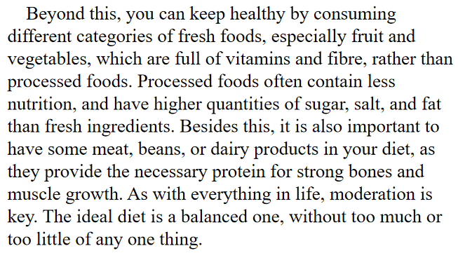
Para 3:Keep It Fresh and Balanced.
what suggestions about healthy eating can we get from Para3?
Key points:
1)consume different categories of fresh food
rather than processed foods
2)have some meat, beans, or dairy products
3) moderation is key.

Slide 9
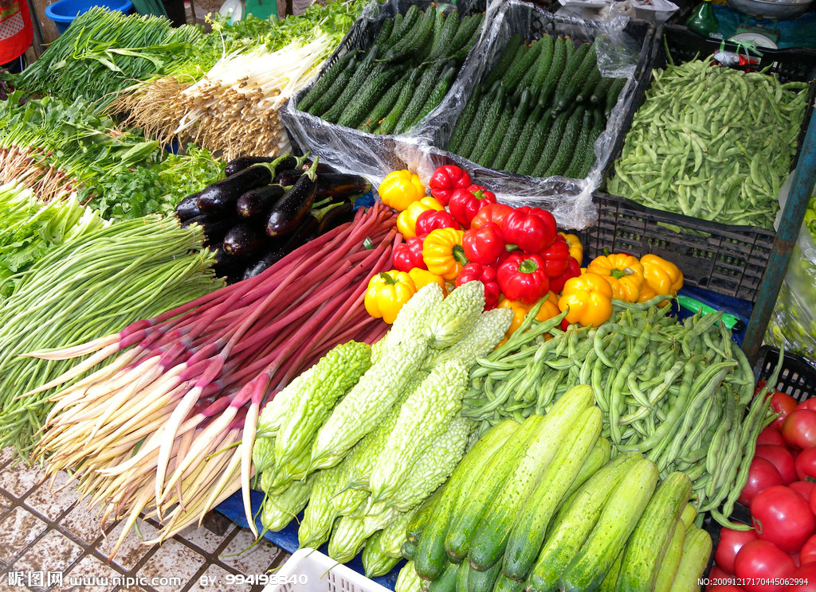
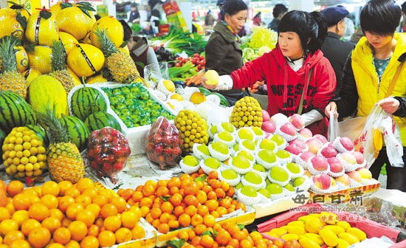
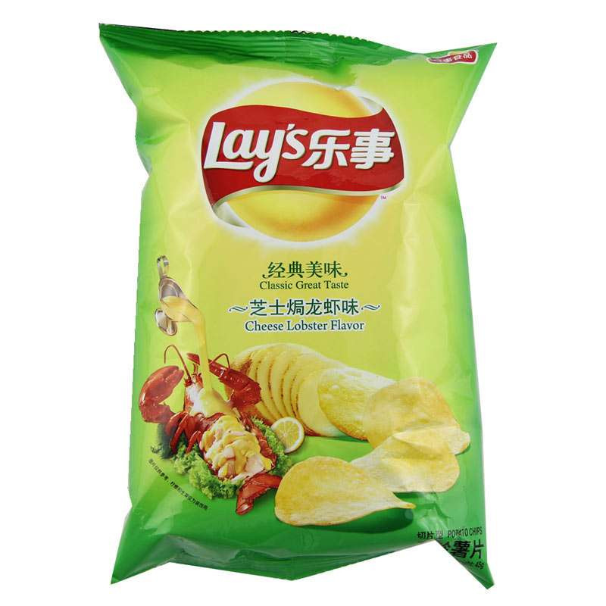

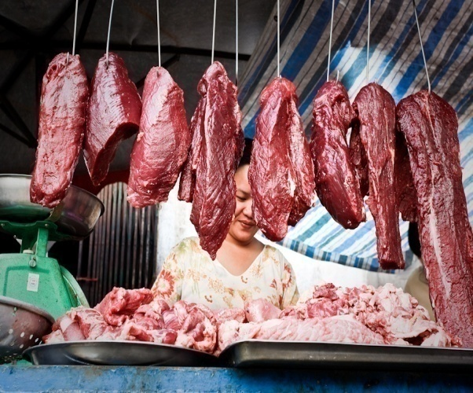

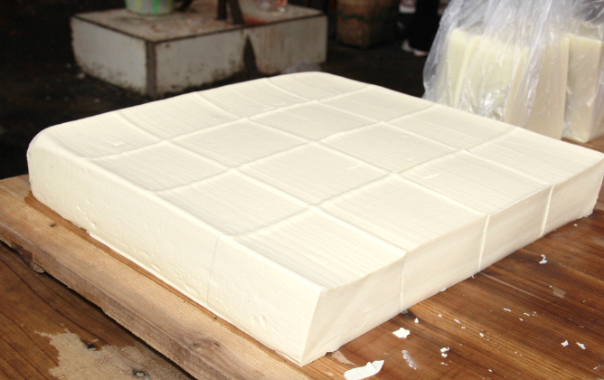
full of vitamins and fibre
＋
fresh food(fruit and vegetables)
1)contain less nutrition
2)have higher quantities of sugar,salt, and fat
＋
processed food
provide the necessary protein for strong bones and muscle growth.
＋
＋
meat,beans and dairy products

Slide 10
Para 3:Keep It Fresh and Balanced.
Appreciate language

Slide 11
Para 4:Slow Eating and consistent eating habits.
Read Para4 and fill in the blanks.
1.Eating slowly can make us_____________________,__________________and_____________________.
eat less food
digest food better
enjoy food more
eating a modest amount of food each time
Taking three meals a day at the same time
2._____________and____________are consistent eating habits.
Key points:
1)eat slowly
2)develop consistent eating habits

Slide 12
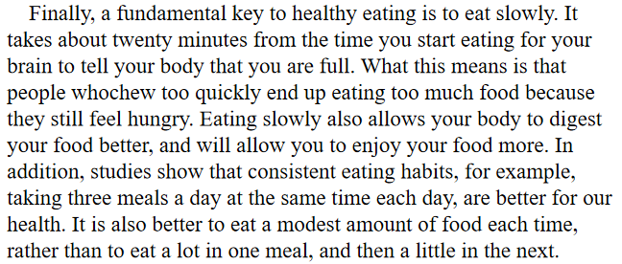
Appreciate language

Slide 13
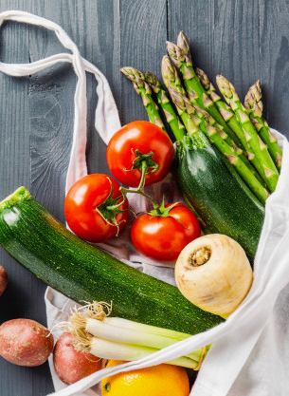
Para 5:The Way You Look at Food is Most Important.
What does it mean?
There is no one trick to healthy eating.Rather, healthy eating starts with having a healthy attitude towards food.
It is up to you to decide how you want to live,and to make the right decisions about your diet.
Key point:
have a healthy attitude towards food.

Slide 14
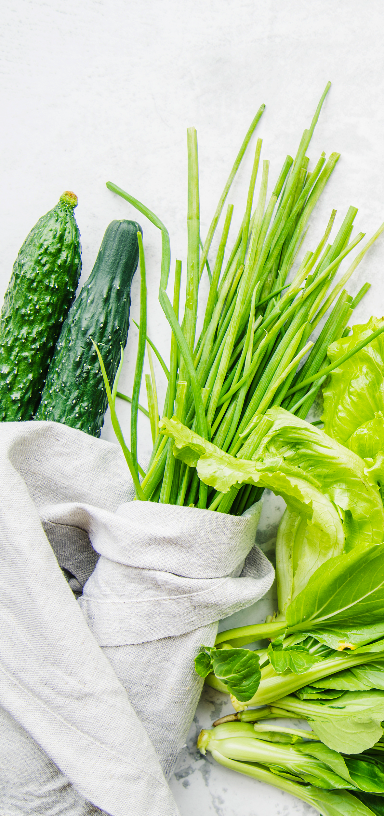
Task 3 :Summary
Make a list of healthy eating habits?
fruit and vegetables：
full of vitamins and fibre
processed food
1)contain less nutrition
2)have higher quantities of sugar,salt, and fat
meat,beans and dairy products
provide the necessary protein for strong bones and muscle growth.
1）consume fresh foods rather than processed foods
2）have some meat, beans, or dairy products
3）moderation is key
1)The sugar does harm
to our heart.
2)Heart disease and the
sugar go hand in hand.
sugar
fresh and balanced
cut down on dessert
cut out sweet drinks
sweet
eat slowly
slow
consistent
1）three meals a day at the same time each day
2）eat a modest amount of food
1）eat less food
2）digest food better
3）enjoy food more
attitude
have a healthy attitude towards food

Slide 15
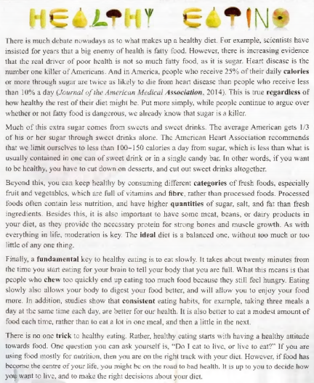
linking words
1.express reasons or evidence (listing)列举
2. show that contrasting(opposite\different)ideas are being introduced.
3.introduce another way of saying what was already mentioned in the previous sentence.
(restating)重申，重讲

Slide 16
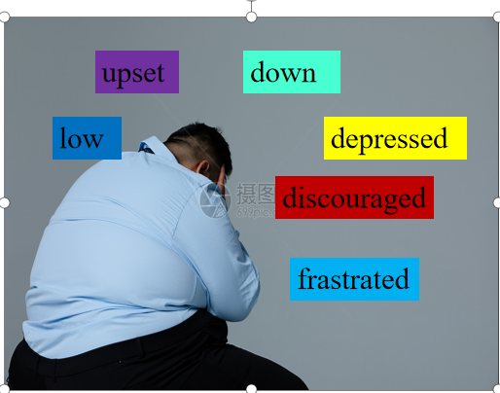
假如你是李华， 你的朋友王大力目前正因体重暴增而苦恼不已，来信向你咨询关于健康饮食的问题。请你给他写一封回信，介绍一下你的饮食习惯。内容包括：
1.很少吃甜食，基本不喝甜饮料；
2.饮食中蔬菜、水果居多，有少量的肉、蛋和奶制品；
3.一日三餐有规律。
注意：1.词数80左右
2.可以适当增加细节，以使行文连贯
Writing stucture:
Para1:Wang Dali's
problem+your
understanding
Para2:Your eating
habits
Para3:Your hope
谋篇：
第一段：
第二段：
第三段：
审题：
1.确定文体：
2.主体时态：
3.主体人称：

Slide 17
组内互评
Evaluation
A
B
C
D
总分
1.Be well organized
2.Have correct tense
3.Use what we have learned
in the reading beautifully
4.Be neat and beautiful
5.Use proper conjuctions
6.Use transitional sentences
（过渡句）
7.(spelling,punctuation and capitalization) Be correct.
8.Be worthy of being shared.

Slide 18
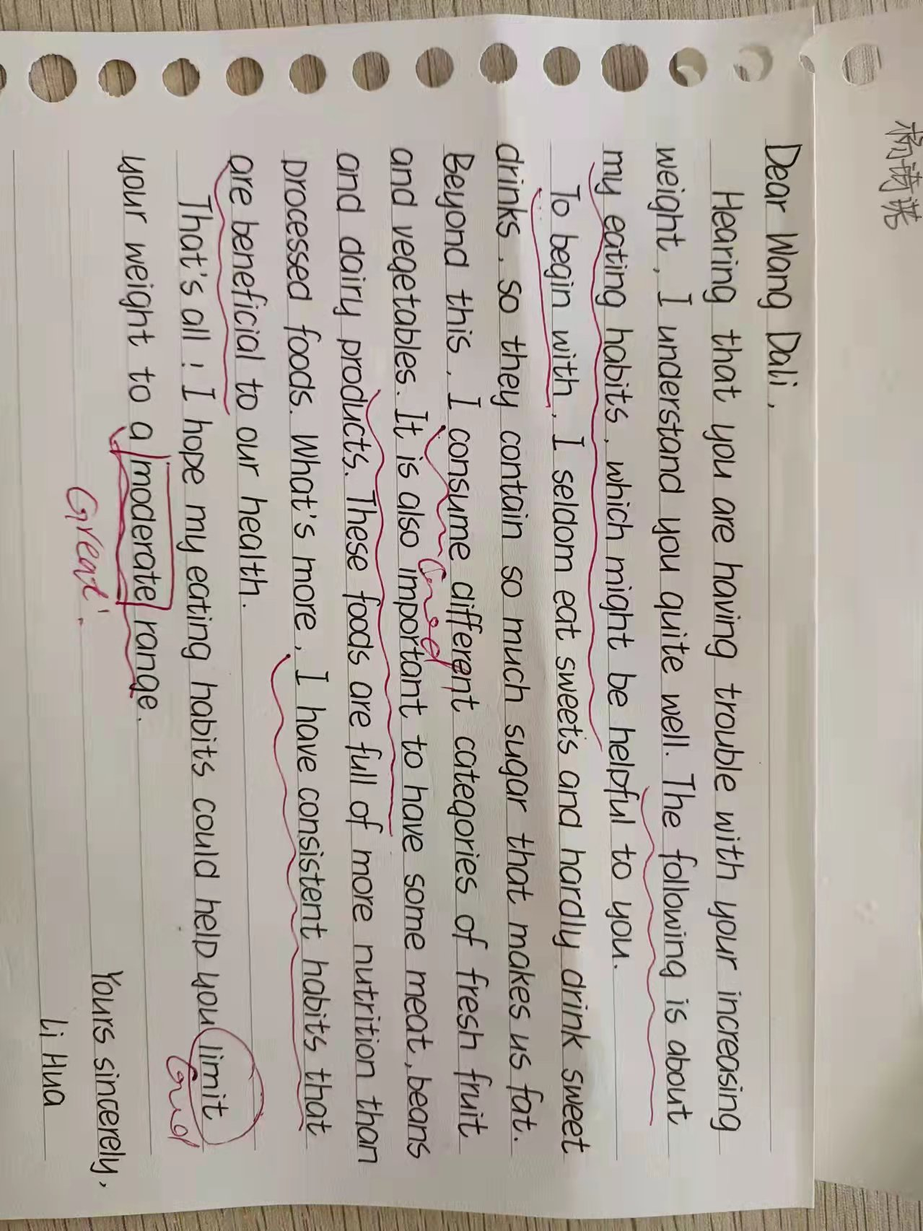

Slide 19
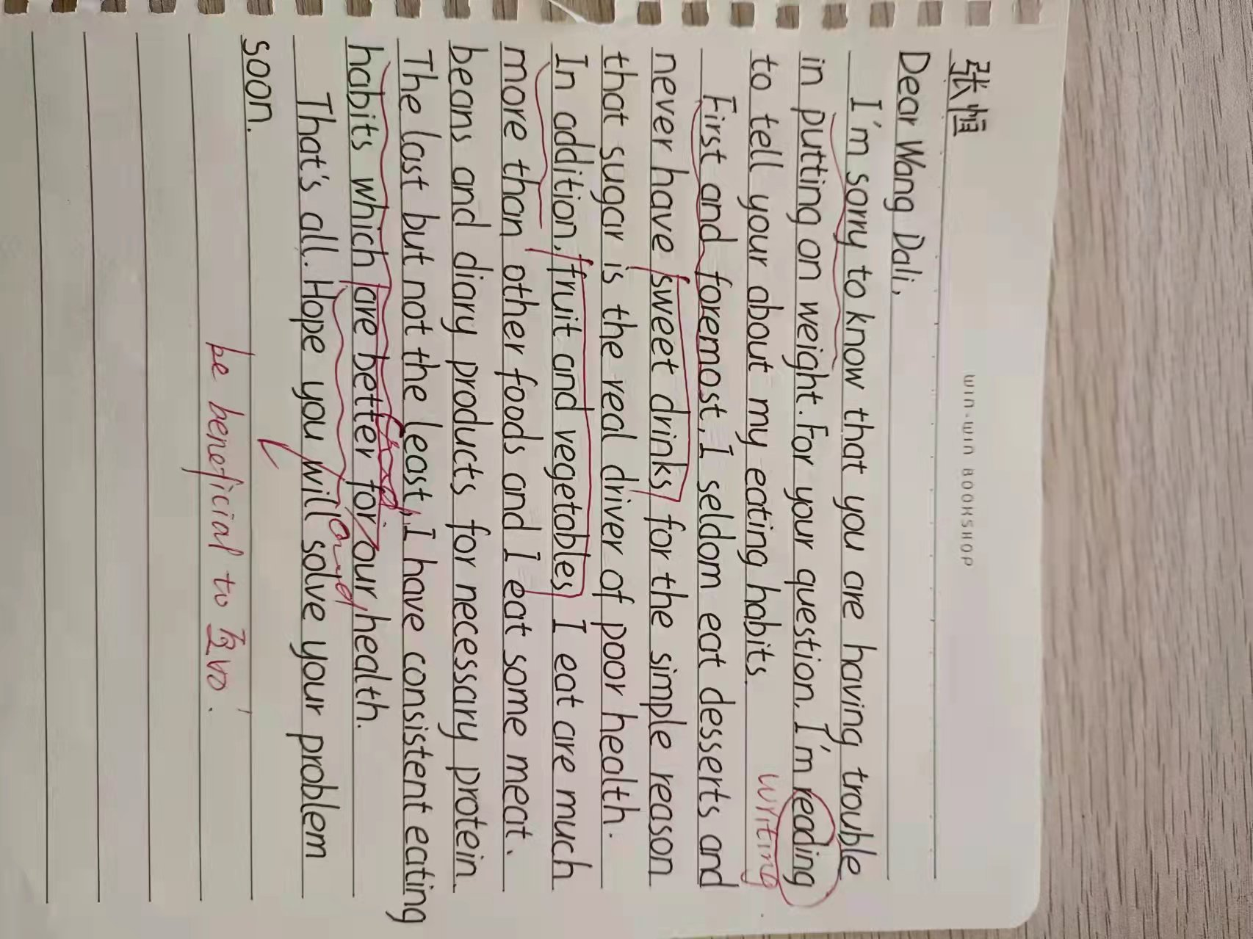

Slide 20
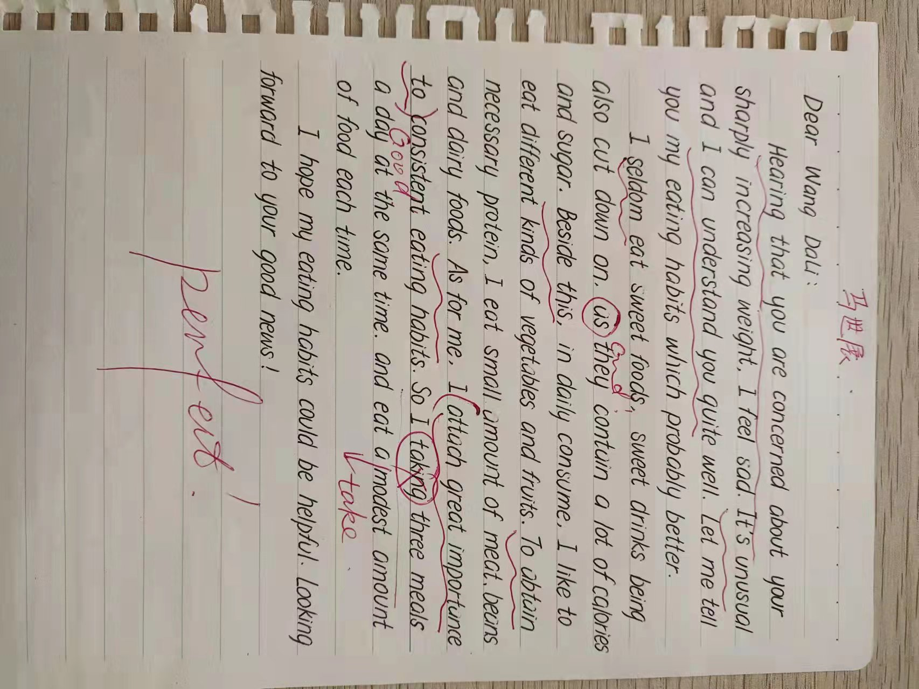

Slide 21
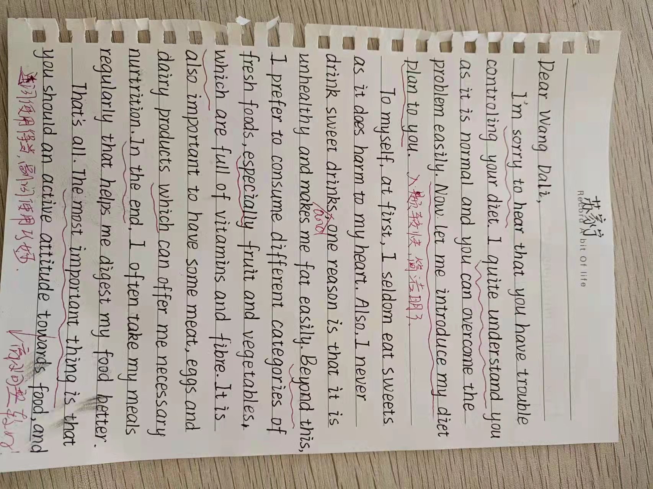

Slide 22
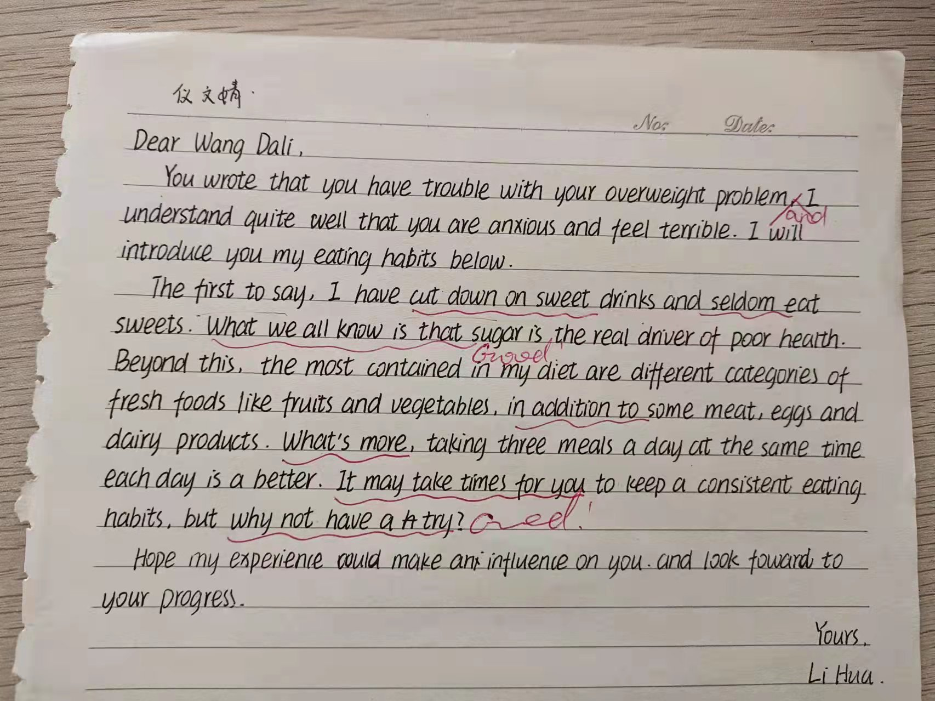

Slide 23
A possible version:
Dear Wang Li:
I am sorry to hear that you have been putting on weight recently and you are upset about it. I think your unhealthy diet is closely associated with your problem.
As for me , I have a healthy diet. Firstly, I take three meals a day at the same time each day, regardless of holidays. Secondly, I rarely consume sweet foods or sweet drinks. Most fundamentally, my diet contains quantities of fruit and green vegetables, which can provide me with necessary vitamins. Besides, modest amount of meat ,eggs
and dairy poducts are also included in my daily diet.
I hope you will have a healthy diet in the future and that your weight problem can be solved soon.
Yours,
Li Hua
▲the problem
▲your underanding
▲your eating habits
▲your hope

Slide 24

He who has health has hope and
he who has hope has everything.
May the health around you today and always!

