Slide 1

感恩遇见，相互成就，本课件资料仅供您个人参考、教学使用，严禁自行在网络传播，违者依知识产权法追究法律责任。
更多教学资源请关注
公众号：溯恩高中英语
知识产权声明

Slide 2
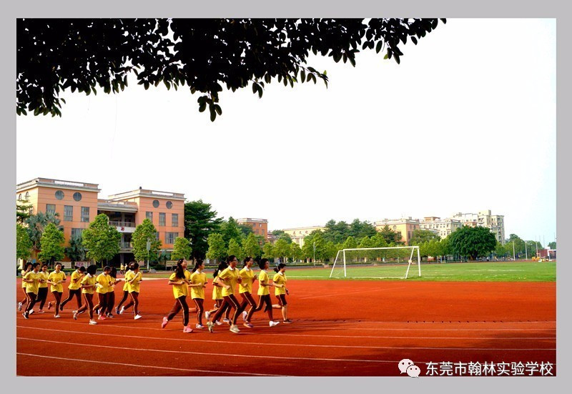

Welcome to my class
Nancy

Slide 3
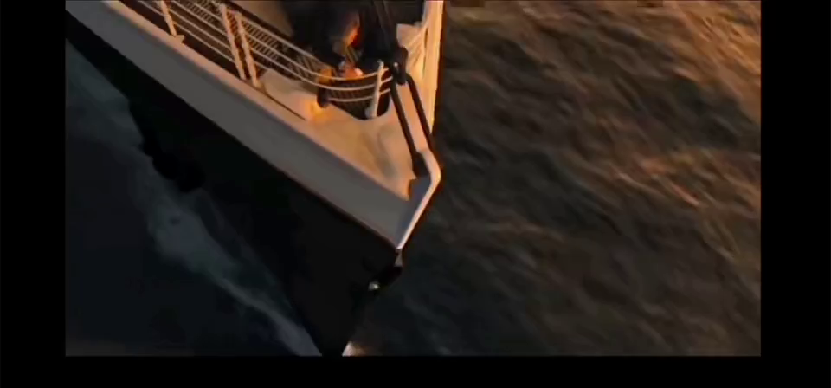
When Jack saw Rose walking towards him, he was very excited.
When Jack saw Rose walking towards him, a great sense of excitement took hold of him.

Slide 4

Learning aims
Review a classic film-Titanic
--How to show sentences
1. We can tell the difference between “telling” and “showing”.
2.We can appreciate “to show ”sentences
3. We can polish ordinary writings with “to show” sentences.

Slide 5
第五档(21-25)作文的描述：
1.与所给短文融洽度高，与所提供各段落、开头语衔接合理。
2.所使用语法结构和词汇丰富、准确，可能有些许错误，但完全不影响意义表达；
3.有效地使用了语句间的连接成分，使所续写短文结构紧凑；
4.词数充分，150词左右。评分细则规定少于130词的，从总分中减去2分；
内容
词汇语法
Linguistic（语言） description:
________, ________, _________, ___________
Emotion
Action
Speech
Environment
篇章结构

Slide 6
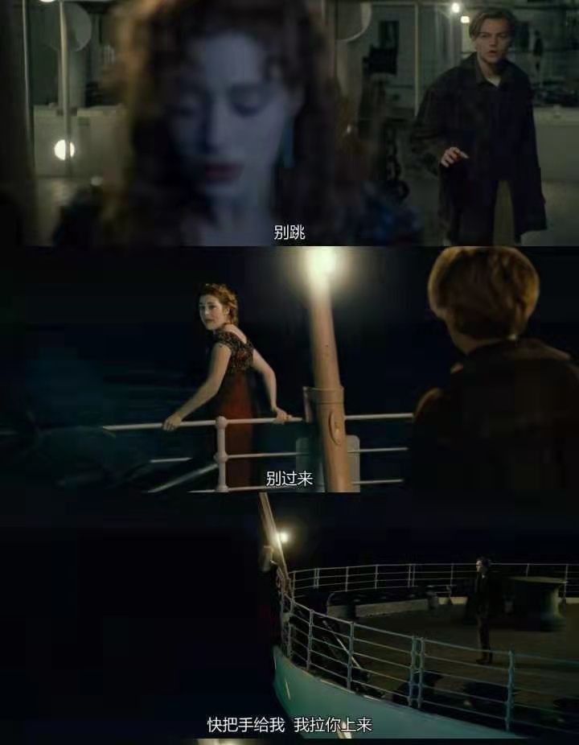

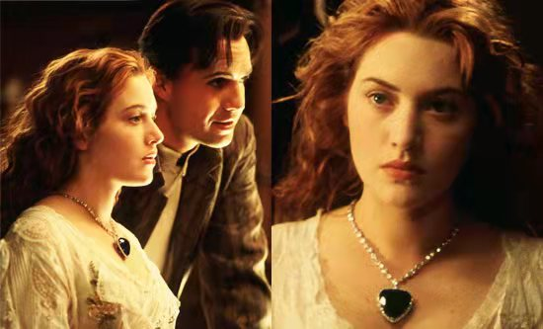
Let’s appreciate it
Scene Ⅰ—Beginning: when they met
1.On doing, vi.(具体动词)+in/with+n(情感)
2.独立主格（无灵主语）
3.v.ing结果状语
4. 动词三连动（V1,V2+V3）
When she heard the news,she was very sad and decided to suicide(自杀).When she determined to kill herself, Jack saved her.
utter； whisper; explain;
add; detail; stammer
On hearing the bad news, she howled(大吼) in pain and anger, a surge of despair completely taking control of her, making her determined to suicide. The moment Rose decided to jump off the deck（甲板）, Jack suddenly appeared, persuaded her and saved her.

Slide 7
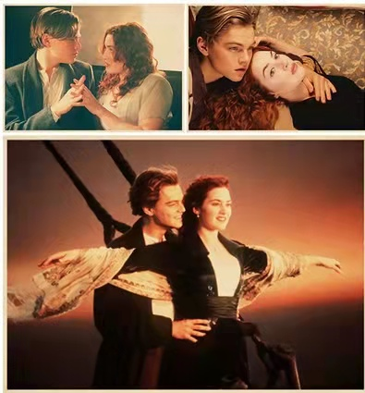
Scene Ⅱ—Development: when they loved
1.环境描写；独立主格（无灵主语）
2. v.ing伴随状语
3. 比喻（simile）
One night, they stood on the deck and enjoyed the freedom and beautiful sight together.
On a warm night, the breeze gently caressing（轻抚） their face, they stood on the deck, enjoying the freedom and the beautiful view as if they were the only people in the world.

Slide 8
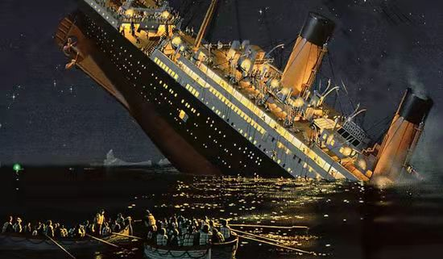
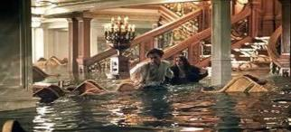
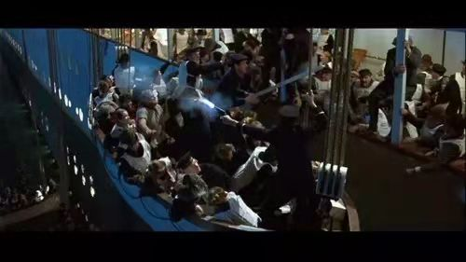
Scene Ⅲ—Climax: when they were trapped
The ship fell and passengers were very anxious. Rose was put to land on a lifeboat but she gave up the chance for she chose to stay with Jack.
1.无灵主语句
2. v.ing伴随状语；with复合结构
3. v.+with/in +n
When the ship fell, great anxiety flooded over the passengers , making them scream with tears of despair welling up in their eyes. Rose was put to land on a lifeboat but she gave up the chance with great determination for she chose to stay with Jack.

Slide 9
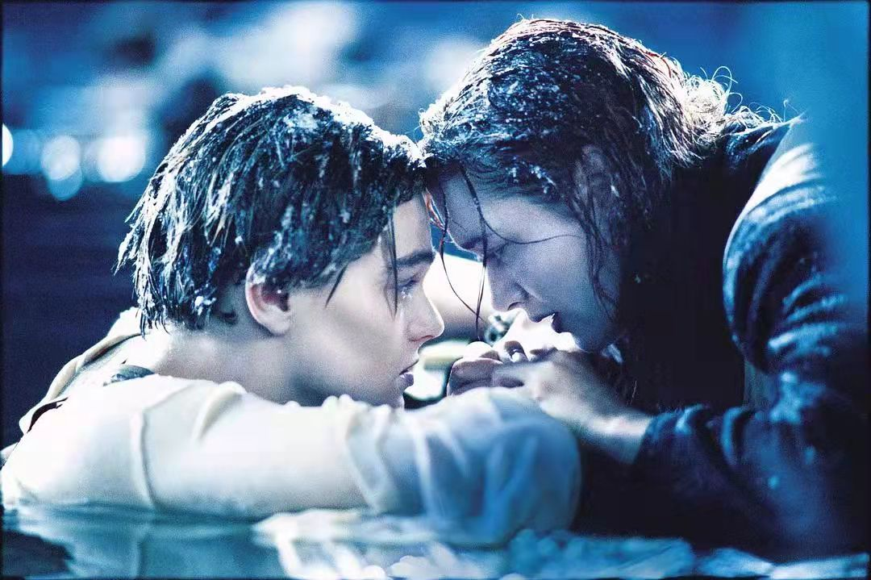
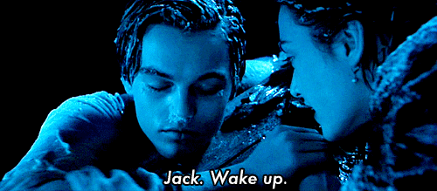
Scene Ⅳ—Ending: when they said goodbye
1.v.ing伴随状语
2. v.ing方式状语；比喻（simile）
3. 独立主格；形容词作状语
Jack held Rose’s hands tightly. However, due to the extreme cold, Jack died at last. Rose was very sad.
Jack held Rose’s hands tightly, keeping encouraging her. Unfortunately, due to the extreme cold, Jack died at last. Lying on the board and staring at Jack, Rose felt like she were floating in an ocean of sadness, tears streaming down her cheeks, helpless and hopeless.

Slide 10
Let’s sum up（to show sentences）
1.无灵主语句（feelings/n + engulf/ take control of... + sb）
2. 三连动（V1,V2+V3）
3.On doing sth, sb +v+ in/with +情感n
4.分词作状语（伴随，结果，原因，方式等）
5.独立主格（n+非谓语动词）
6.with 复合句（with+n/pron.+doing/done/to do）
7. adj.做状语(句首、句末均可)
8.比喻句（simile、metaphor）

Slide 11
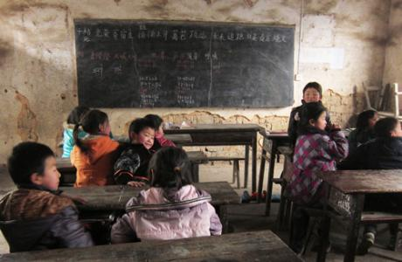
Let’s polish them!
When I entered the classroom with only shabby tables and chairs, I was shocked.（第三期报纸）
无灵主语句（feelings/n + engulf/ take control of... + sb）
Great shock took control of me the moment I entered the classroom with only some shabby tables and chairs.

Slide 12
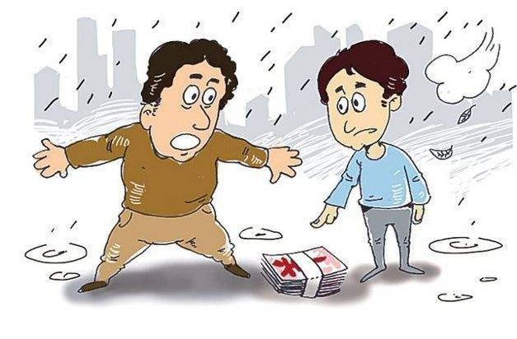
My father picked up the money and gave it to the man.（十月月考）
三连动（V1,V2+V3）
比喻句（simile-as if）
My father picked up the money, put it into the man’s hand and smiled at him as if saying, “Take it to buy the tickets.”

Slide 13
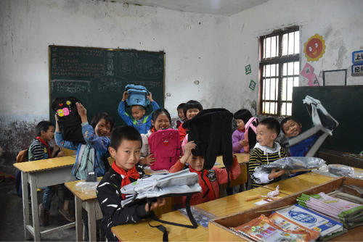
As soon as the children received their gifts ,they were very moved.
(十月月考)
On doing sth, sb +v+ in/with +情感n
On receiving our gifts, the children were deeply moved with tears blurring their eyes.
独立主格（n+非谓语动词）
On receiving our gifts, the children were deeply moved，tears blurring their eyes.

Slide 14
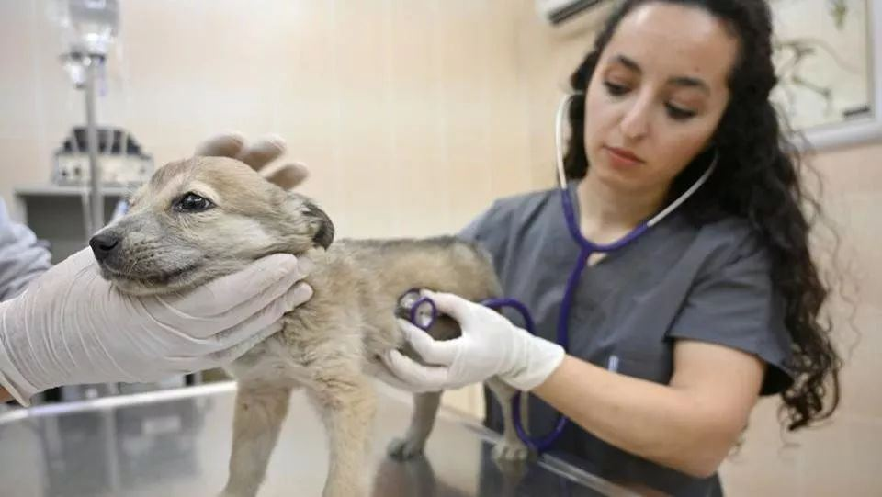
When I reached the vet’s office, I scooped(抱起) the dog and urged（催促） the vet to examine Shep.
（期中考试）
分词作状语（伴随，结果，原因，方式等）
On reaching the vet’s office, I scooped (抱起) the dog up in my arms, rushing to the vet and urging (催促) him to examine Shep.

Slide 15
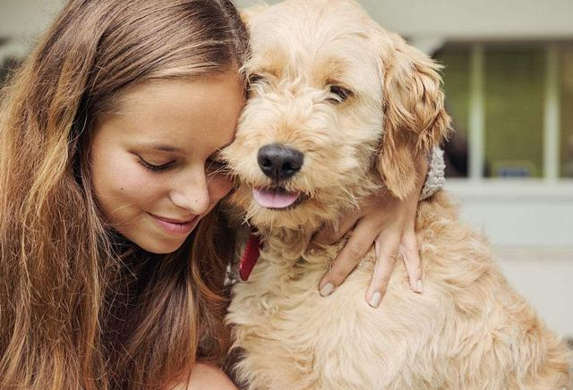
I was very relieved and happy, so I hugged the dog gently. (期中考试)
adj.做状语(句首、句末均可)
Relieved and rejoiced, I held Shep in my arms gently.

Slide 16
Let’s sum up（How to show sentences）
1.无灵主语句（feelings/n + engulf/ take control of... + sb）
2. 三连动（V1,V2+V3）
3.On doing sth, sb +v+ in/with +情感n
4.分词作状语（伴随，结果，原因，方式等）
5.独立主格（n+非谓语动词）
6.with 复合句（with+n/pron.+doing/done/to do）
7. adj.做状语(句首、句末均可)
8.比喻句（simile、metaphor）

