Slide 1


Unit 2
Studying Abroad:
Is it a good or a bad idea?

Slide 2




Nowadays, many vloggers who study abroad choose to share their daily life and academic study on social media platform, which shows a fresh and different life.
Have you ever considered studying abroad like them?

Slide 3


Is it necessary to study abroad? Why or why not?
Your point of view | Yes | No
Your reason (Arguments)

Slide 4

Studying Abroad:
Is it a good or a bad idea?

Slide 5

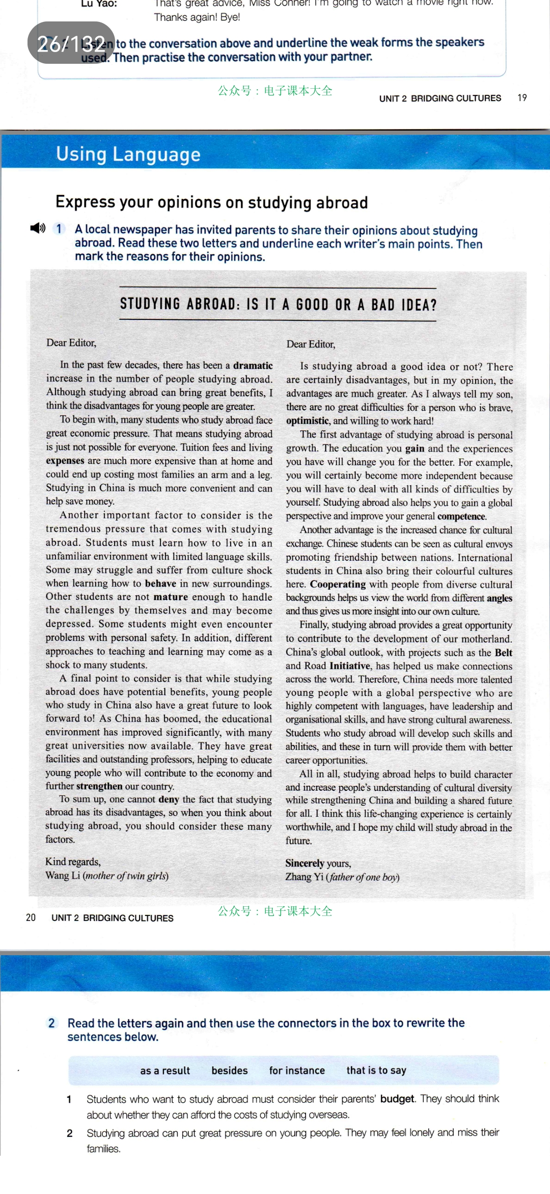

Read for text type
Skim the title and the passage quickly. What is the text type of this passage?
A. Narration
B. Expository writing
C. Argumentative letters

Slide 6
Read for text type
Greeting
Skim the title and the passage quickly. What is the text type of this passage?
Argumentative letters
Body
Close

Slide 7
Read for structure
Skim the passage quickly and work out the structure.
①
①
②
③
②
③
④
④
⑤
⑤

Slide 8
Read for structure
Skim the passage quickly and work out the structure.
①
Structure ?
Signposts (标识性语言)
Logical words
②
③
④
⑤

Slide 9
Read for details
Read the passage carefully and answer the following questions.
1. What is Wang Li’s point?
2. How does Wang Li develop her point?

Slide 10
Read for details
1. What is Wang Li’s point?
2. How does Wang Li develop her point?
Para.1 Introduction
great & sudden
Paragraph 1:
In the past few decades, there has been a dramatic increase in the number of people studying abroad. Although studying abroad can bring great benefits, I think the disadvantages for young people are greater.
Start with a fact
State an opinion

Slide 11
Read for details
1. What is Wang Li’s point?
2. How does Wang Li develop her point?
the amount of money that you spend on something
Para.2 Body
Paragraph 2:
To begin with, many students who study abroad face great economic pressure. That means studying abroad is just not possible for everyone. Tuition fees and living expenses are much more expensive than at home and could end up costing most families an arm and a leg. Studying in China is much more convenient and can help save money.
Reason 1
Evidence

Slide 12
Read for details
behave: to do things in a particular way
mature: behave in a sensible way, like an adult
1. What is Wang Li’s point?
2. How does Wang Li develop her point?
Para.3 Body
Paragraph 3:
Another important factor to consider is the tremendous pressure that comes with studying abroad. Students must learn how to live in an unfamiliar environment … Some may struggle and suffer from culture shock when learning how to behave in new surroundings. Other students are not mature enough … and may become depressed. Some students might encounter problems with personal safety. In addition, different approaches to teaching and learning may come as a shock to many students.
students
Reason 2
some
other students
Evidence
some students
In addition

Slide 13
Read for details
strengthen: to become stronger
1. What is Wang Li’s point?
2. How does Wang Li develop her point?
Para.4 Body
Paragraph 4:
A final point to consider is that while studying abroad does have potential benefits, young people who study in China also have a great future to look forward to! As China has boomed, the educational environment has improved significantly, with many great universities now available. They have great facilities and outstanding professors, helping to educate young people who will contribute to the economy and further strengthen our country.
Reason 3
Evidence

Slide 14
Read for details
1. What is Wang Li’s point?
2. How does Wang Li develop her point?
deny: to say that something is not true
Para.5 Conclusion
Paragraph 5:
To sum up, one cannot deny the fact that studying abroad has its disadvantages, so when you think about studying abroad, you should consider these many factors.
State a conclusion

Slide 15
Summary
How to write an argumentative essay
Start with a fact
State an opinion
Para.1 Introduction
Para.2 Argument 1
Reason 1
Evidence
Topic
Para.3 Argument 2
Reason 2
Evidence
Para.4 Argument 3
Reason 3
Evidence
Para.5 Conclusion
State a conclusion

Slide 16
Read for details
According to the summary, read Letter 2 again, then finish the table.
Para. | Argumentative structure | Key words or sentences in Letter 2
① | Start with a fact
 | State an opinion
② | Reason 1
③ | Reason 2
④ | Reason 3
⑤ | Conclusion

Slide 17
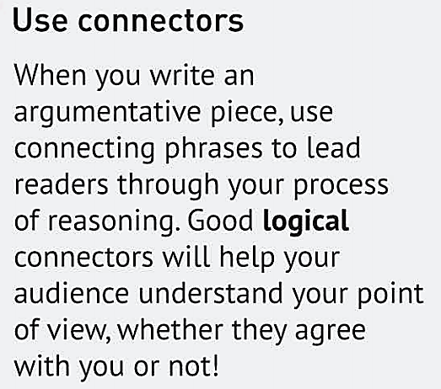
Read for language feature
Summarize the connectors used to show the different parts of the argument in the letters.

Slide 18
Read for language feature
 | Letter 1 | Letter 2
State an opinion
Give reasons and evidence to support an opinion
State a conclusion
in my opinion
to begin with in addition
therefore thus
for example such as
to sum up all in all

Slide 19
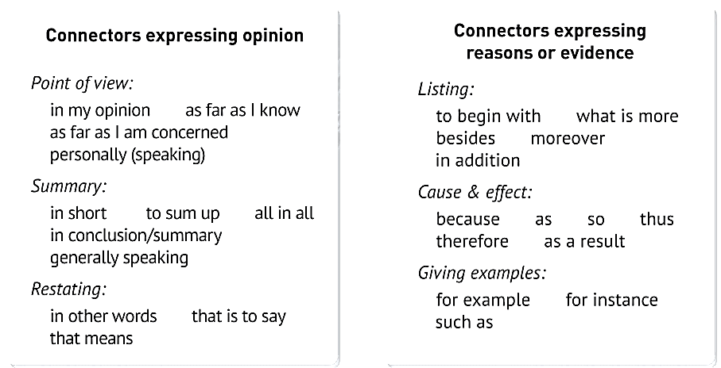
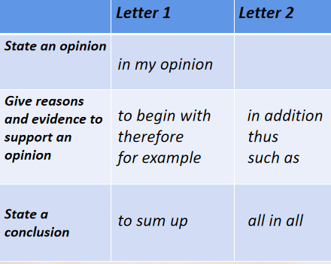
Read for language feature
Read the letters again, then use the connectors to rewrite the sentences below.
More expression

Slide 20
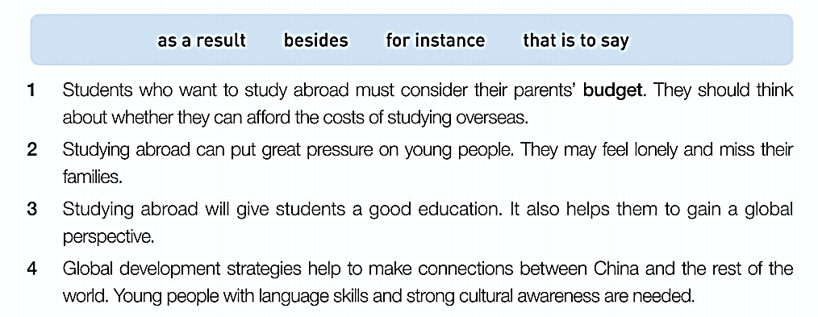
Read for language feature
Read the letters again, then use the connectors to rewrite the sentences below.

Slide 21
Read for language feature
Read the letters again, then use the connectors to rewrite the sentences below.
1. Students who want to study abroad must consider their parents’ budget. That is to say, they should think about whether they can afford the cost of studying overseas.
2. Studying abroad can put great pressure on young people. For instance, They may feel lonely and miss their families.
3. Studying abroad will give students a good education. Besides, it also helps them to gain a global perspective.
4. Global development strategies help to make connections between China and the rest of the world. As a result, young people with language skills and strong cultural awaness are needed.

Slide 22
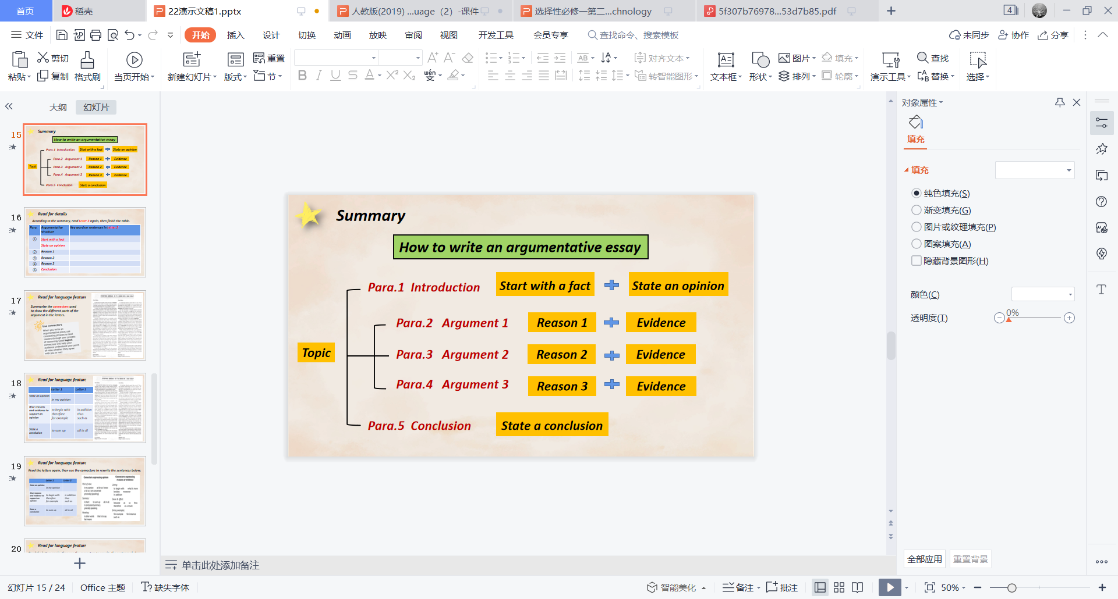

Group discussion for writing
Is it necessary to study abroad?

Slide 23
Evaluation
Use the checklist to help you review your letter.
Is your main idea clear?
Is the body of your letter logical and convincing?
Is your conclusion clear?
Have you used the connectors?
Are there any grammatical errors?

Slide 24
One possible version
Is it necessary to study abroad?
There are many advantages in studying abroad. To begin with, students who have studied abroad can expose themselves to the language surroundings there, which is beneficial to learning the foreign language well. In addition, they can learn much more advanced knowledge of science and technology from foreign countries, and at the same time broaden theri horizions. Last but not least, they can introduce Chinese culture to pople all over the world.
However, there are some disadvantages. Studying abroad means costing an arm and a leg, which may be a heavy burden for some families. What's more, being far away from their home country, they may feel lonely and homesick.
As far as I'm concerned, studying abroad is a good idea. Firstly, it can make the students more independent and learn to cooperate with others. Another advantage is that they can make friends with people from all over the world.

Slide 25

Thank you

