Slide 1

感恩遇见，相互成就，本课件资料仅供您个人参考、教学使用，严禁自行在网络传播，违者依知识产权法追究法律责任。
更多教学资源请关注
公众号：溯恩高中英语
知识产权声明

Slide 2


2021.12 “山水联盟”读后续写
——破旧的被褥
浙江省春晖中学
宣晔霏

Slide 3
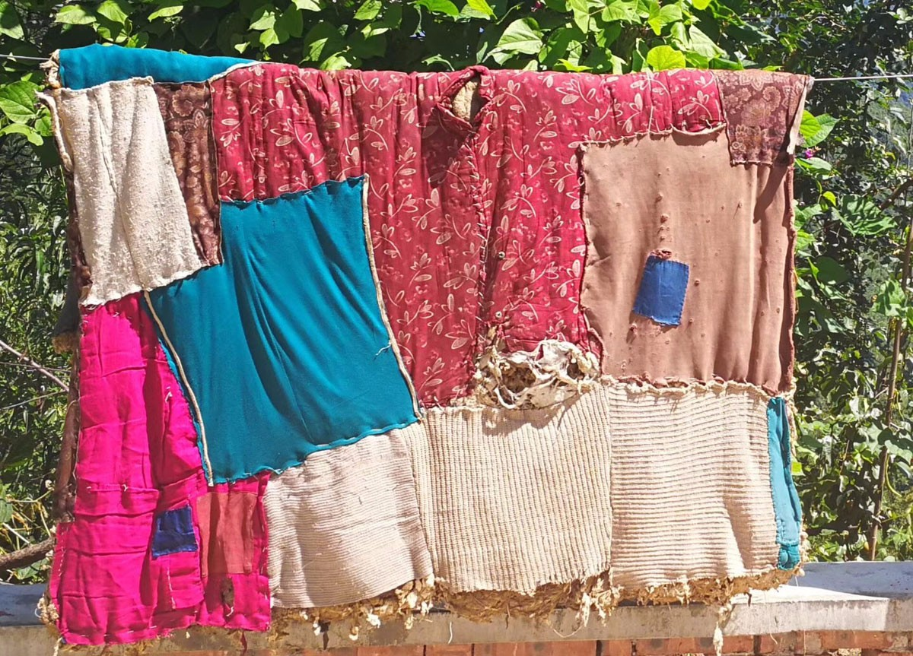
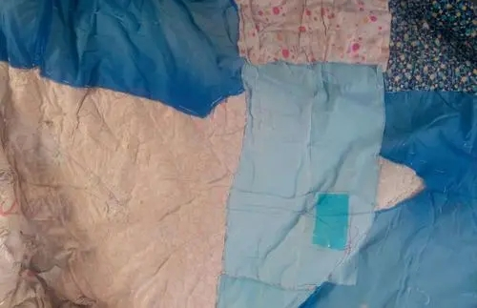
A worn-out quilt

Slide 4
Language accumulation:
1.I peered over my grandma’s shoulder as she sewed pieces of cloth together. The two pieces became one faster than I’d imagined. The colors, however, looked ugly when put together and none of the patterns matched. All the patches (补丁) on this blanket seemed to disagree.
2.“Grandma, that’s the ugliest quilt (棉被) I’ve ever seen.”
3.“Oh, sweetie, it’s warm and beautiful,” said Grandma, pointing to a pile of crazy patterned shirts and suits. “I can take these old clothes that Grandpa and I will never wear again and turn them into something useful and good. It’s not the quilts appearance but the love that sews it together that makes it beautiful. This quilt will keep you warm on a cold night like tonight. And I know that for a fact.” Grandma put her hand on my shoulder, “Not everyone is as lucky as we are. Here, put on your coat. We’ll get a second opinion about how ugly my quilts are.”
4.Grandma folded a finished quilt and tucked it into a shopping bag. Afterwards, we got in the car and drove downtown. The white snow turned grayer as we got to the city. Eventually, Grandma pulled up at a dark alley (胡同) and we got out of the car. The terrible smell of rotting garbage made me feel sick and pinch my nose shut. Grandma took my hand and led me to the street lamp. I could see the snow shimmering (发出微光) in the light.
5.Grandma paused. “There’s usually somebody down this alley. It’s quiet and out of the wind---a good place to stay on cold nights. A nice warm quilt might make it even better.”
6.The dark engulfed (吞没) Grandma and I as we stepped deep into the alley. The pavement was cracked and missing in spots. Chicken bones and stained boxes littered their way. And Grandma’s shoes made a loud sound with each step. Feeling frightened, I squeezed Grandma’s hand. Grandma squeezed my hand back. “It’s OK.” she smiled.
7.“Who’s there?” shouted a voice out of the darkness.

Slide 5
Read and think about the structure:
1.I peered over my grandma’s shoulder as she sewed pieces of cloth together. The two pieces became one faster than I’d imagined. The colors, however, looked ugly when put together and none of the patterns matched. All the patches (补丁) on this blanket seemed to disagree.
2.“Grandma, that’s the ugliest quilt (棉被) I’ve ever seen.”
3.“Oh, sweetie, it’s warm and beautiful,” said Grandma, pointing to a pile of crazy patterned shirts and suits. “I can take these old clothes that Grandpa and I will never wear again and turn them into something useful and good. It’s not the quilts appearance but the love that sews it together that makes it beautiful. This quilt will keep you warm on a cold night like tonight. And I know that for a fact.” Grandma put her hand on my shoulder, “Not everyone is as lucky as we are. Here, put on your coat. We’ll get a second opinion about how ugly my quilts are.”
4.Grandma folded a finished quilt and tucked it into a shopping bag. Afterwards, we got in the car and drove downtown. The white snow turned grayer as we got to the city. Eventually, Grandma pulled up at a dark alley (胡同) and we got out of the car. The terrible smell of rotting garbage made me feel sick and pinch my nose shut. Grandma took my hand and led me to the street lamp. I could see the snow shimmering (发出微光) in the light.
5.Grandma paused. “There’s usually somebody down this alley. It’s quiet and out of the wind---a good place to stay on cold nights. A nice warm quilt might make it even better.”
6.The dark engulfed (吞没) Grandma and I as we stepped deep into the alley. The pavement was cracked and missing in spots. Chicken bones and stained boxes littered their way. And Grandma’s shoes made a loud sound with each step. Feeling frightened, I squeezed Grandma’s hand. Grandma squeezed my hand back. “It’s OK.” she smiled.
7.“Who’s there?” shouted a voice out of the darkness.
Preparation
Part 1(para1-3):___________________
Arrival
Departure ＆
Part 2(para4-7):_______________________

Slide 6
1.I peered over my grandma’s shoulder as she sewed pieces of cloth together. The two pieces became one faster than I’d imagined. The colors, however, looked ugly when put together and none of the patterns matched. All the patches (补丁) on this blanket seemed to disagree.
2.“Grandma, that’s the ugliest quilt (棉被) I’ve ever seen.”
3.“Oh, sweetie, it’s warm and beautiful,” said Grandma, pointing to a pile of crazy patterned shirts and suits. “I can take these old clothes that Grandpa and I will never wear again and turn them into something useful and good. It’s not the quilts appearance but the love that sews it together that makes it beautiful. This quilt will keep you warm on a cold night like tonight.
And I know that for a fact.” Grandma put her hand on my shoulder, “Not everyone is as lucky as we are. Here, put on your coat. We’ll get a second opinion about how ugly my quilts are.”
Who:
Where:
What:
What fact?
为后文的续写做铺垫
Grandma and I
At home
Grandma was sewing pieces of cloth to make a quilt.
But I thought I was the ugliest quilt
What did grandma say?

Slide 7
4.Grandma folded a finished quilt and tucked it into a shopping bag. Afterwards, we got in the car and drove downtown. The white snow turned grayer as we got to the city. Eventually, Grandma pulled up at a dark alley (胡同) and we got out of the car. The terrible smell of rotting garbage made me feel sick and pinch my nose shut. Grandma took my hand and led me to the street lamp. I could see the snow shimmering (发出微光) in the light.
5.Grandma paused. “There’s usually somebody down this alley. It’s quiet and out of the wind---a good place to stay on cold nights. A nice warm quilt might make it even better.”
Where did we go?
How was the environment?
What did grandma say about it?
At a dark alley in the downtown
dark
dirty
poor
cold
thinly-populated
人烟稀少的
The white snow turned grayer
The terrible smell of rotting garbage
The street lamp with the snow shimmering
The quilt represents love, care and warmth

Slide 8
6.The dark engulfed (吞没) Grandma and I as we stepped deep into the alley. The pavement was cracked and missing in spots. Chicken bones and stained boxes littered their way. And Grandma’s shoes made a loud sound with each step. Feeling frightened, I squeezed Grandma’s hand. Grandma squeezed my hand back. “It’s OK.” she smiled.
7.“Who’s there?” shouted a voice out of the darkness.
Appreciate the description of the environment. What can you infer from it?
How did I and grandma feel?
the dark engulfed grandma
the pavement was cracked and missing in spots
chicken bones and stained boxes littered their way
grandma’s shoes made a loud sound with each step
黑暗吞没了奶奶
人行道上有裂缝，有些地方不见了
鸡骨头和染色的盒子散落在路上
奶奶每走一步都发出很大的响声
Theme?
Worn-out as the quilt is, it carries love and warmth.
Time goes by but love never fades away.
“I ” Frightened
Grandma: Frightened but optimistic

Slide 9
Paragraph 1:“I have a nice warm quilt, if you want it.”
What did grandma do?
What did the woman do?
How did she feel?
Paragraph 2:Back home, I found a worn-out quilt by accident in a cupboard.
What did I do?
What’s the story of the worn-out quilt?
What might be the ending?

Slide 10
One possible version:
Paragraph 1:“I have a nice warm quilt, if you want it.” said Grandma. After a while, a beam of light 一束光appeared and a lady walked out of the darkness. Grandma opened the shopping bag and pulled out the multicolored quilt. "That's pretty and it looks warm." The lady exclaimed and took the quilt, her eyes filled with tears of gratitude. As we walked back down the alley, I looked over my shoulder and saw the lady holding the quilt tightly to her face. "You're right, Grandma. That is a beautiful quilt." On our ride back home, the lady's grateful words were still ringing in my ears.
Paragraph 2:Back home, I found a worn-out quilt by accident in a cupboard. I asked Grandma curiously,“ Grandma, why is there a quilt here?“ After a moment of silence, Grandma began to share her own story. On a freezing night decades ago, as a poor young woman sleeping in the same alley, Grandma was offered a quilt, which warmed her up. She was determined to pass the love forward. That's why Grandma sewed the old clothes together and made quilts for those in need. After hearing the story, I gave Grandma the biggest hug ever I thought of all the clothes I didn't want to wear anymore and knew what Grandma and I would do the next morning.

Slide 11
Language consolidation:
从我奶奶的肩膀后面窥视
peer over my grandma’s shoulder
sew pieces of cloth together
All the patches (补丁) on this blanket seemed to disagree
a pile of crazy patterned shirts and suits
It’s not the quilts appearance but the love that sews it together that makes it beautiful.
The white snow turned grayer as we got to the city
pulled up at a dark alley
.
把一块块布缝在一起
所有的补丁在这个毯子上似乎格格不入
一堆样式疯狂的衬衫和西装
不是被子的外观，而是把它缝在一起的爱使它美丽。
白色的雪变得更灰了
驶入黑暗的小巷

Slide 12
Language consolidation:
腐烂垃圾的可怕气味让我感到恶心，捂紧了鼻子
The terrible smell of rotting garbage made me feel sick and pinch my nose shut.
the snow shimmering (发出微光) in the light.
The dark engulfed (吞没) Grandma
The pavement was cracked and missing in spots
Chicken bones and stained boxes littered their way.
I squeezed Grandma’s hand. Grandma squeezed my hand back
雪闪闪发光。
黑暗吞噬(吞没)奶奶
人行道上有裂缝，有些地方不见了
鸡骨头和染色的盒子散落在路上。
我握紧奶奶的手，奶奶也握紧我的手

Slide 13
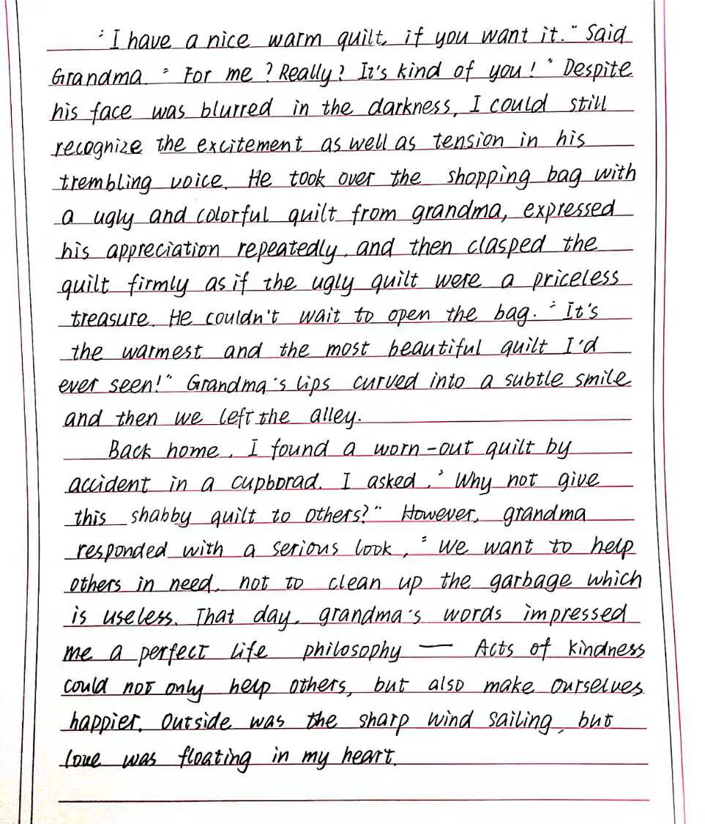
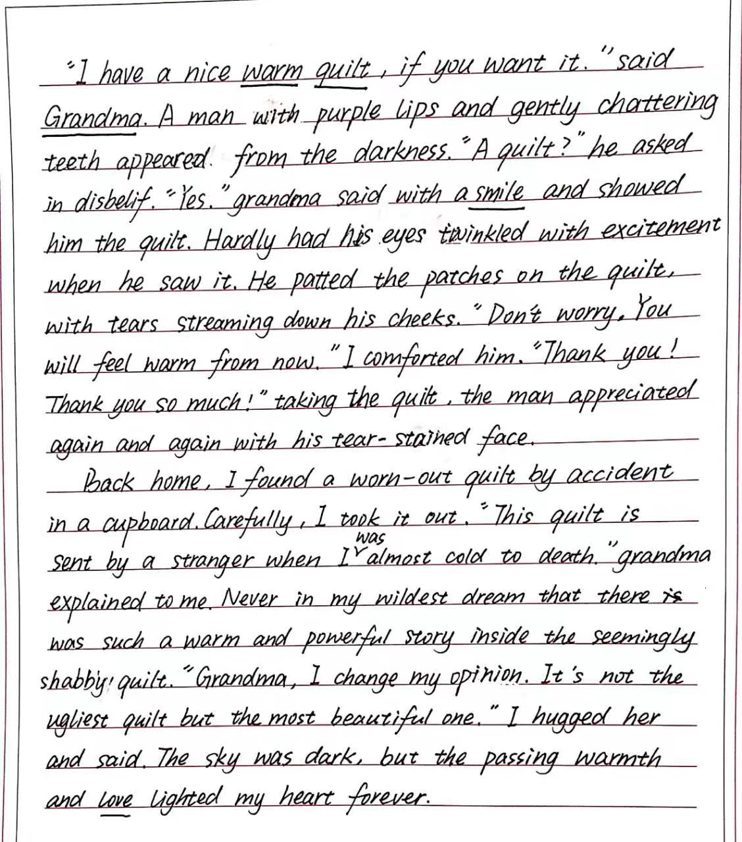
学生习作：

Slide 14
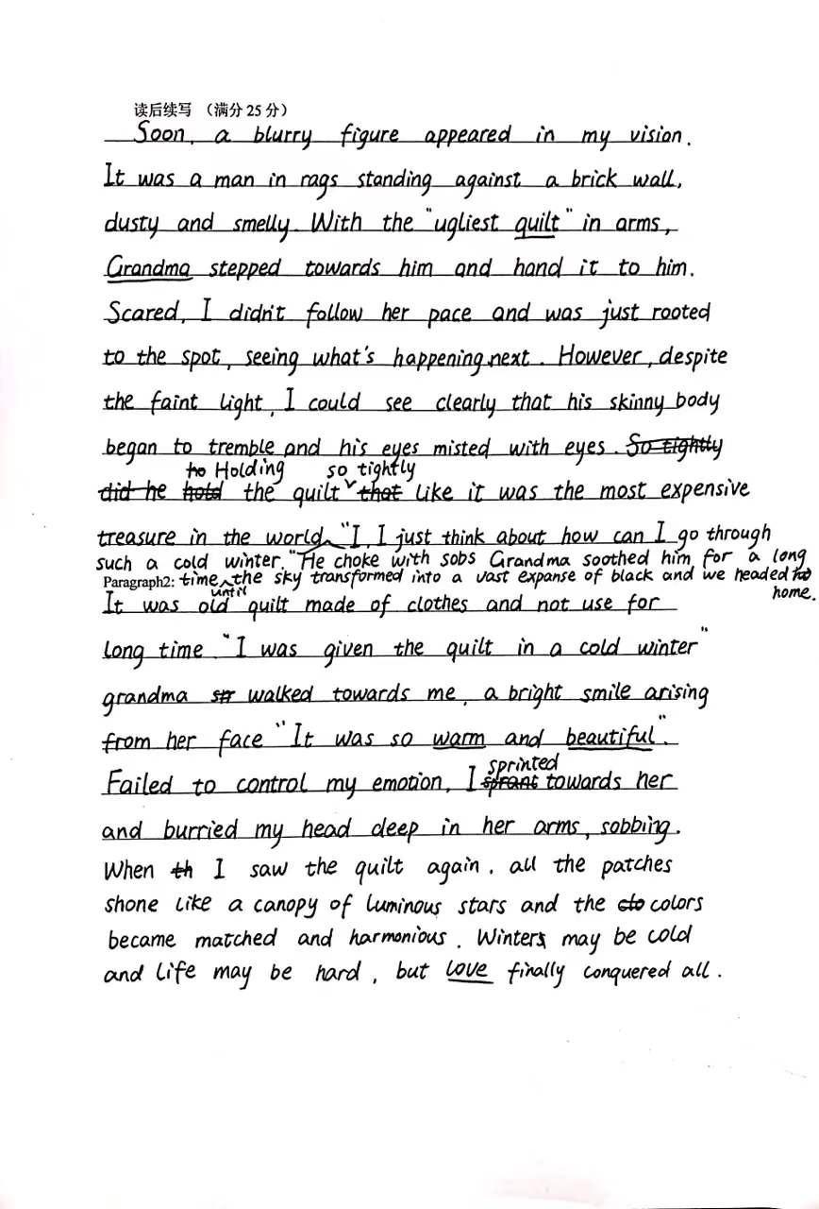
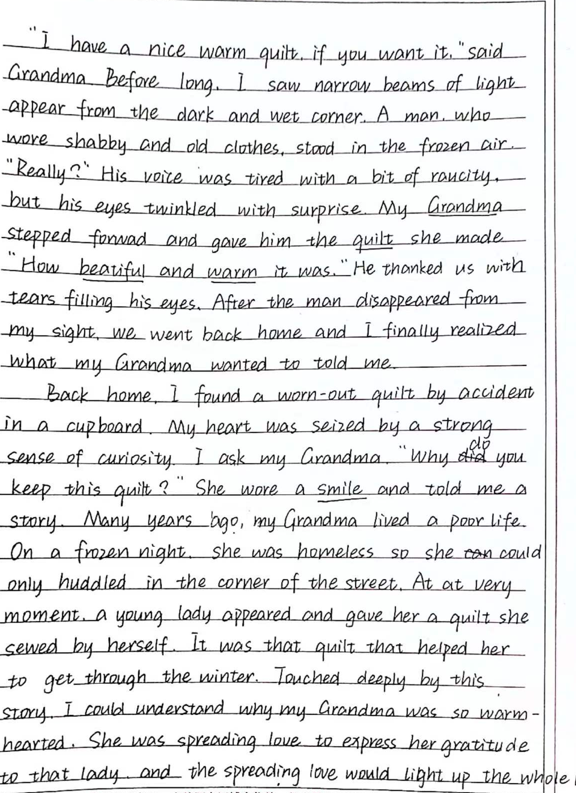
学生习作：

Slide 15
Thank you!

