Slide 1


感恩遇见，相互成就，本课件资料仅供您个人参考、教学使用，严禁自行在网络传播，违者依知识产权法追究法律责任。
更多教学资源请关注
公众号：溯恩高中英语
知识产权声明

Slide 2




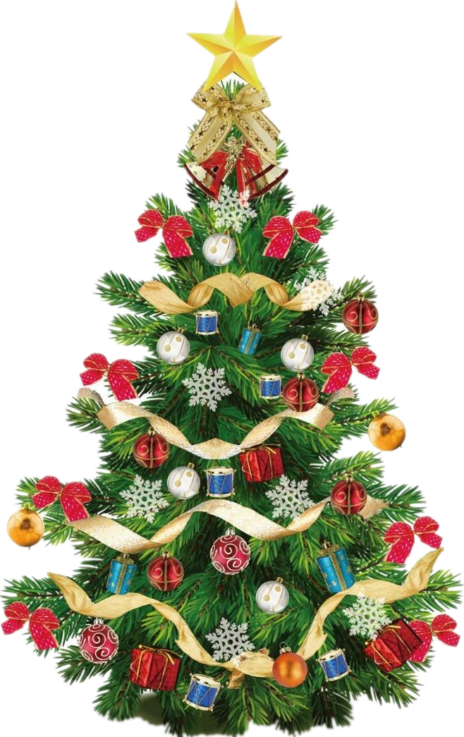
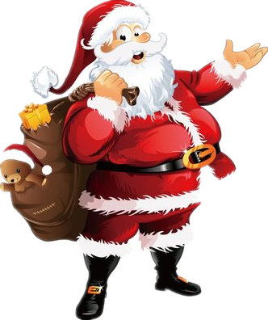
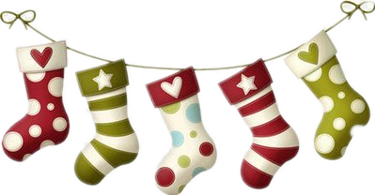
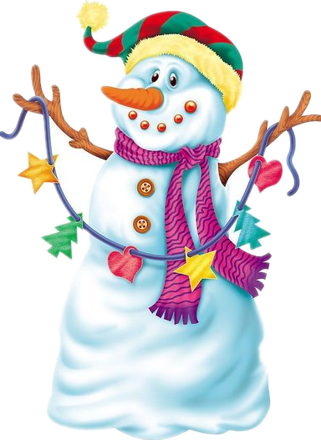
Merry Christmas!
高考题型开发
杭州市临平区杭州二中树兰高级中学 郭合英

Slide 3


Slide 4

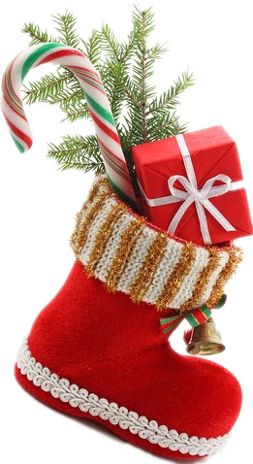

1
The origin of Christmas
The story concerning Christmas
2
CONTENTS
3
The customs of Christmas
The vocabulary and benediction concerning Christmas
4
5
The application concerning Christmas in the exams

Slide 5
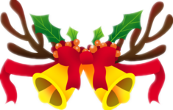


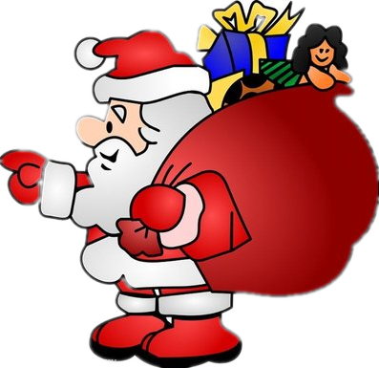
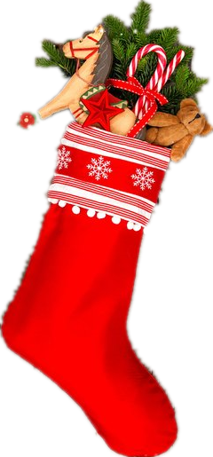
contents
The origin of Christmas
01

Slide 6
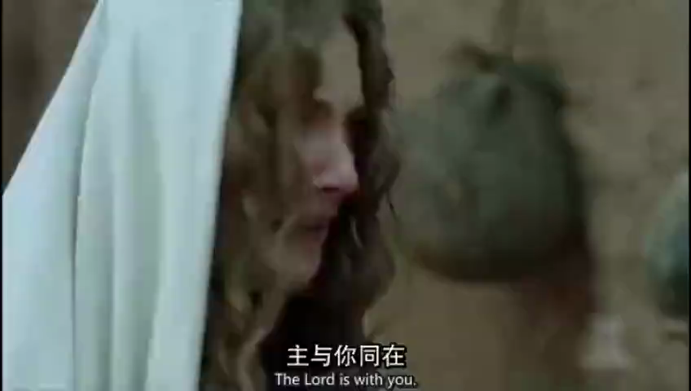

Slide 7
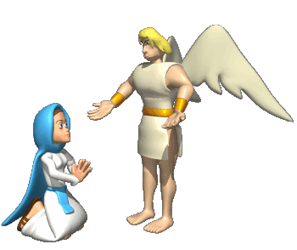
A long time ago, in a town called Nazareth, lived a young woman called Mary. One day she was visited by an angel named Gabriel. Gabriel told Mary that she was going to have a baby. The baby would be God’s son. Gabriel said that God wanted her to call the baby Jesus. Mary was engaged to a carpenter called Joseph. Mary told Joseph what Gabriel had told her. Joseph and Mary got married and prepared for the arrival of the special baby. When it was time for the baby to arrive, Mary and Joseph travelled to Bethlehem. It was a long journey, so Mary rode on a donkey. Joseph was from Bethlehem and they needed to go there to pay taxes. Bethlehem was very busy and Joseph and Mary could not find a place to stay. Eventually an innkeeper found them a place to rest in his stable. It was in this stable that the Baby Jesus was born. At the same time some shepherds were sitting on a hillside watching their sheep. An angel appeared in the sky. She told them not to be afraid. The angel told them that the son of God had been born in Bethlehem.

Slide 8
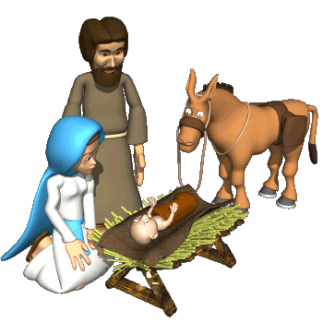
The shepherds walked to Bethlehem to see this special baby. Far away in the East three wise men saw a very bright star. They knew it meant that a new King had been born and followed the star to find him. The star led them all the way to Bethlehem. The wise men thought the baby would be in King Herod’s palace, so they went there first. Herod was curious about this new king and asked the wise men to let them know where he was. The wise men presented Baby Jesus with gifts of gold, frankincence and myrrh. That night, in their dreams, an angel warned them not to tell King Herod where Jesus was. When they awoke, they left for home and never returned to Herod’s Palace. Soon afterwards, Joseph also had a dream. An angel told him to take Mary and the baby away to Egypt as Herod wanted to kill Baby Jesus. In his search for the Baby Jesus, Herod ordered that all baby boys in Bethlehem be killed. But Joseph had made sure his new family were safe. He had already left Bethlehem and travelled to Egypt.

Slide 9
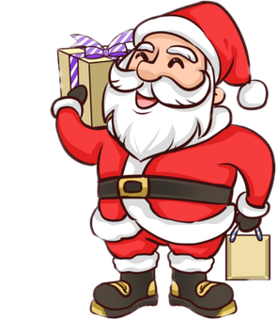
Choose the best answer.
1. What do the underlined words “be managed to” in the passage mean?
A. Marry sb. B. Marry…to sb.
C. Get married to sb. D. Be affianced to sb.
2. Whose child was Jesus?
A. He was Mary and Joseph’s child. B. He was the God’s child.
C. He was the angel’s child. D. He was the King’s child.
3. Where was Jesue born?
A. In the palace B. In an innkeeper’ house
C. In a barn D. On a hillside
4. Why did the King kill all the baby boys in Bethlehem?
A. Because he wanted to kill the three wise men.
B. Because he wanted to kill the Jesue.
C. Because he wanted to get even with the angel.
D. Because he wanted to make other baby girls afraid.

Slide 10
contents
The story concerning Christmas
02

Slide 11
语法填空
The beginning of Christmas
Legend has it that this day is the day of the birth of Jesus. the virgin Mary gave birth
1 Jesus in the stable. Jesus redeemed the world and 2 (crucify) with blood. To commemorate all that Jesus 3 （do) to save the world and his people from their sins. It is said that the day when he was born was December 25, therefore, the world set December 25 4 Christmas.
Christmas is short for "Christ's Mass". A Mass is a kind of Church service. 5 , Christmas is a religious festival. But many of the festivities of Christmas do not have anything 6 (do) with religion. Exchanging gifts and 7 (send) Christmas cards are the modern ways of celebrating the Christmas in the world.
Many years later, various Santa Claus images and Christmas tree shapes ___8____ (gradual) appeared. Nowadays, Christmas 9 (become) more popular all over the world, but for Christians, Christmas has given a sacred color different from ordinary people.
Christmas is the feast of 10 nativity of Jesus every year. It has become popular since Christmas cards appeared in 1846.
to
was crucified
had done
as
Therefore
sending
to do
gradually
has become
the

Slide 12
语法填空
The old man with the sack
Santa Claus, whose origins have disputed sources, is a corruption（误传） of the Dutch Sinterklaas, 1 means simply Saint Nicholas. Nicholas was Bishop of Myra (in modern day Turkey) in the 2 (four) century. Among other saintly attributes, he was 3 (note) for the care of Children, generosity, and the 4 (give) of gifts.
'Father Christmas' (or 'Santa Claus') has become the human face of Christmas. Pictures will be seen everywhere of the old man 5 long white beard, red coat, and bag of toys. Children 6 (teach) that he brings them presents the night before Christmas , and many children up to the age of 7 or 8 7 (real) believe this is true. In most countries, it is said that he lives near the North Pole, and arrives through the sky on a sledge 8 (pull) by a reindeer. He comes into houses down the chimney at midnight ____9____ (place) presents for the children in socks or bags by their beds or in front of the family Christmas tree.
In shops or at children's parties, someone will dress up as Father Christmas, ___10___ (hand) out small presents to children, or ask them what gifts they want for Christmas. Christmas can be a time of magic and excitement for children.
which
fourth
noted
giving
with
are taught
really
pulled
to place
handing

Slide 13
The legend of the Christmas stocking
Once upon a time there was a kind-hearted nobleman whose wife died of illness, leaving him and his three daughters in the world. The nobleman tried many inventions, ending up failing. 1 After that, his daughters had to cook, sew and clean in person.
2 The father became even more depressed because he could not afford to buy them dowries. One night, the girls hung their stockings over the fireplace to dry after washing and went to bed early. They didn't know the truth that their father was so worried. When Saint Nicholas learned of their father’s condition, he came to their house on the Christmas Eve. 3 . Then he took out three small bags filled with gold from his pocket, dropping them one by one down the chimney, right into the girls’ stockings.
The next morning, the girls woke up to find their stockings full of gold. ___4____
The nobleman was able to see his daughters get married, laughing happily.
5 Children in some countries have other similar customs, such as Children in France. They usually put shoes next to the fireplace and so on.
D
F
B
E
C

Slide 14
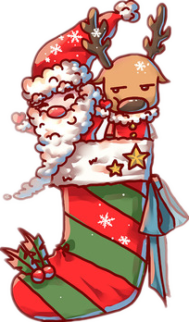
A. The next morning, the girls became happy because of the Christmas.
B. He looked through the window, found them asleep and noticed the
girls’ stockings.
C. Later, children all over the world inherited the tradition of hanging
Christmas stockings.
D. With the money running out, they had to move to a farmhouse.
E. It was enough for them to buy dowries.
F. As the years ticked by, the daughters reached the marriageable age.
G. Because he knew the truth.

Slide 15
Merry Christmas! Why “Merry” instead of “Happy”?
Christmas is one of the most beautiful holidays of all time. It is the day when Gods son was born on earth. But have you ever stopped to wonder where the phrase "Merry Christmas" actually comes from? 1 In a world where "Happy Easter" and "Happy Birthday" are the norm, that "merry" part of "Merry Christmas" is unique—to say the least.
No one is entirely certain of the answer, but there are several interesting theories.
Yes! It's important to note that "Happy Christmas" hasn't faded completely. ___2___ This is believed to be because "happy" took on a higher class connotation than "merry," which was associated with the rowdiness of the lower classes.
3 In fact, each year, Queen Elizabeth continues to wish her citizens a "Happy Christmas," rather than a merry one.
But "Merry Christmas" has been used since at least 1534 —a dated letter from bishop John Fisher to Henry VIII's chief minister Thomas Cromwell reveals as much. ___4____
For example, "We Wish You a Merry Christmas" was introduced in the 1500s.
G
A
B
F

Slide 16
Merry Christmas! Blithely do we use this phrase as greeting, farewell or exclamation of joy with little thought to the book that made it famous. Although it was in use from the 16th century, it was Charles Dickens ‘A Christmas Carol’published exactly 175 years ago that really popularized it.
So when did "Happy Christmas" become "Merry Christmas"?
5 "Happy" is a word that describes an inner emotional condition, while "merry" is more of a behavior descriptor—something active and maybe even raucous. Consider, for example, the free-spirited act of "merry-making" versus the state of simply "being happy."
C
A. And it's still widely used in England.
B. The royal family adopted "Happy Christmas" as their preferred greeting.
C. Historians believe it might boil down to a simple grammatical lesson.
D. The royal family was proud of their identity.
E. People believe it is popular with historians.
F. The English carol also uses the popular phrase.
G. After all, for most other holidays, we use the word "happy".

Slide 17
contents
The customs of Christmas
03

Slide 18
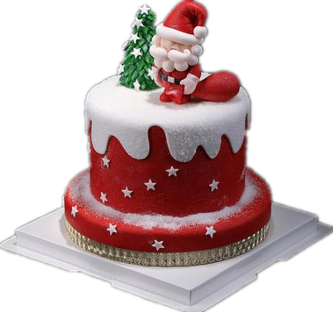
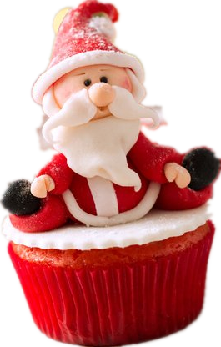
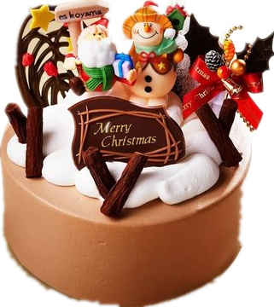
To complete sentences.
1. Preparation of the Christmas cake 烘烤圣诞蛋糕
that/which
This was an English tradition 1 started centuries ago. On Christmas eve, plum porridge
2 (serve) to the people. As years passed,
3 (vary) other things like dry fruits, honey and spices were used. Soon this porridge got ___4___
(replace) with the Christmas cake. Christmas cakes are made 5 (use) eggs, butter, confections, fruits, etc. Today a Christmas cake is an integral part of a Christmas menu.
was served
various
replaced
using

Slide 19
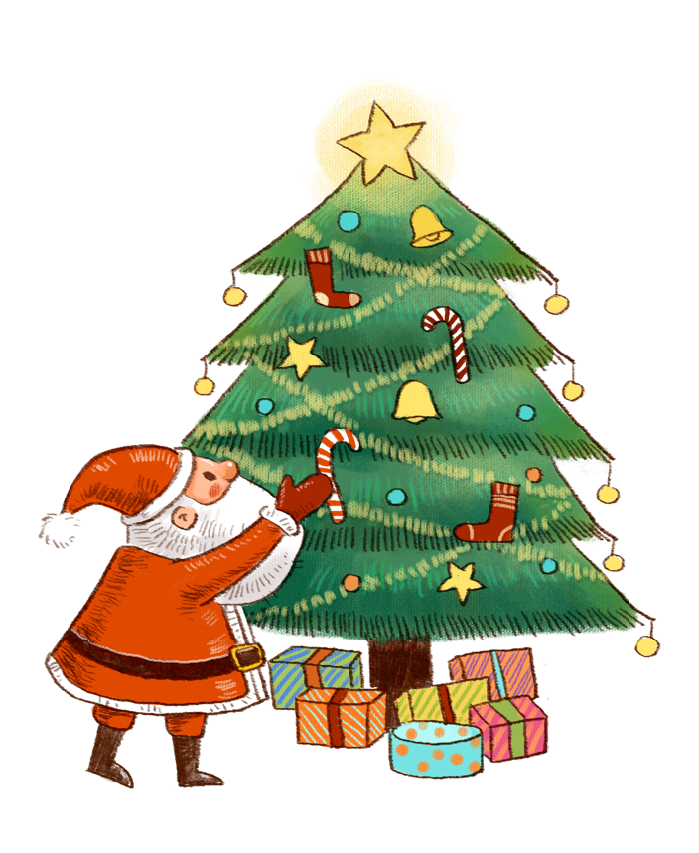
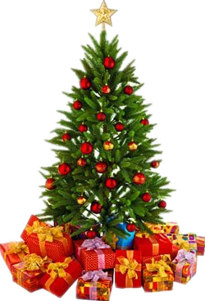
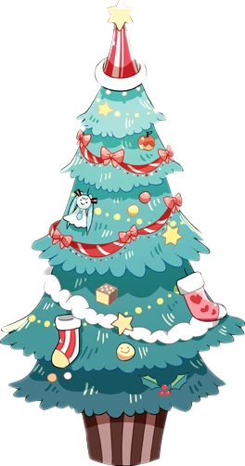
2. Decorating the Christmas tree 装扮圣诞树
decorating
This refers to the tradition of 1 (decorate) a pine tree using lights, tinsels, garlands, ornaments, candy canes, etc. Presents are bought and 2 (wrap), and 3 (traditional) placed under the Christmas tree on Christmas Eve.Today, a Christmas tree is an ___4____ (dispensable) part of Christmas celebration.
wrapped
traditionally
indispensable

Slide 20

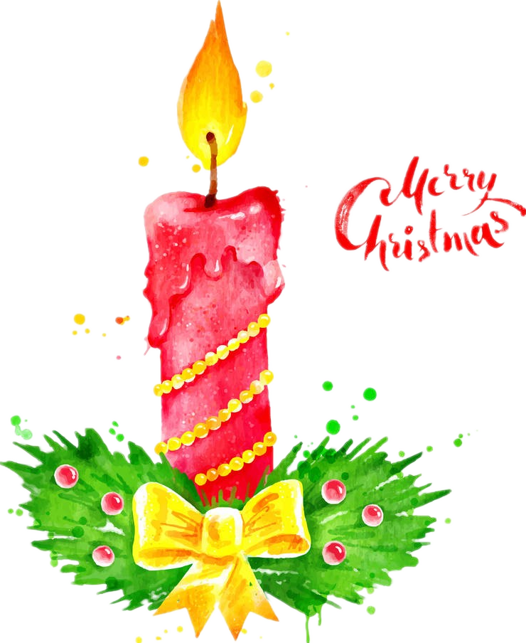

3. Lighting up the Christmas candle 点燃圣诞蜡烛
lighted
This refers to the tradition of placing a __1__ (light) candle outside houses during the Christmas season. A candle 2 (signify) hope as it brings light even to the 3 (dark) room. In the earlier times, when Christians were persecuted (迫害), they 4 （not allow）to practice prayers. Hence, a single candle used to ____5___ (place) outside the house as a sign that Christian prayers 6 (conduct) inside.
signifies
darkest
were not allowed
be placed
were being conducted

Slide 21
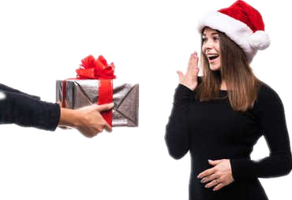

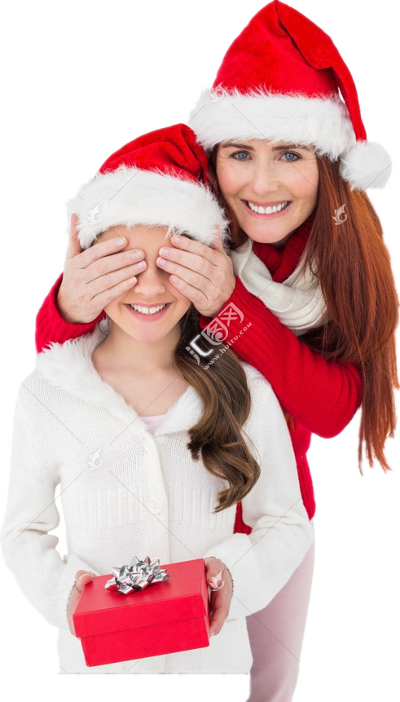
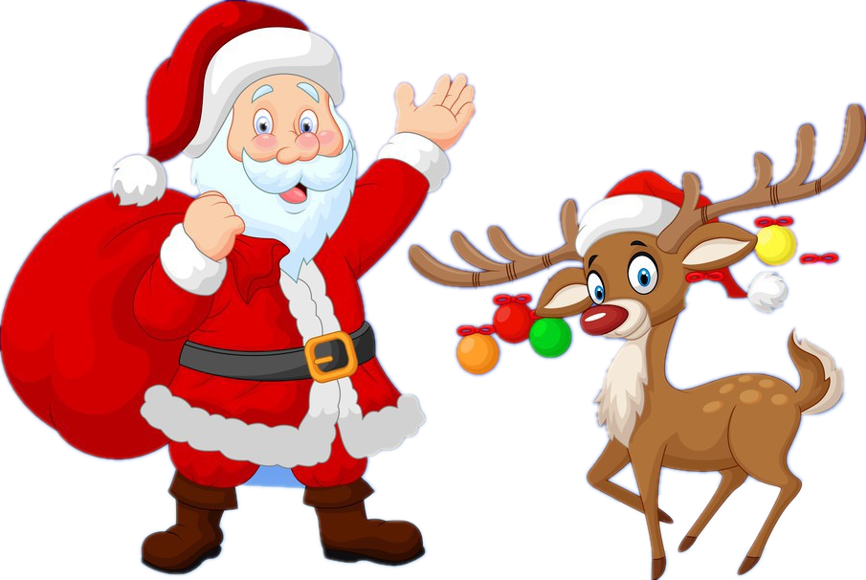
4. Sending gifts to loved ones 给亲友送礼物
This tradition comes from the story of the three wise men 1 got gifts for baby Jesus on Christmas. Every Christmas, gifts 2 (exchange) among loved ones, 3 (especial) children. The story of Santa Claus also comes from this tradition.
who/that
are exchanged
especially

Slide 22

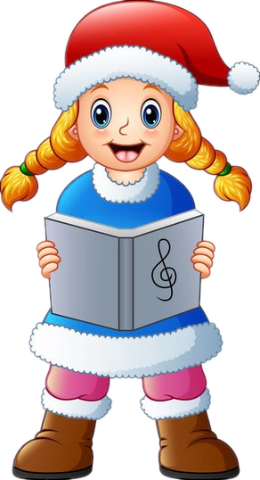
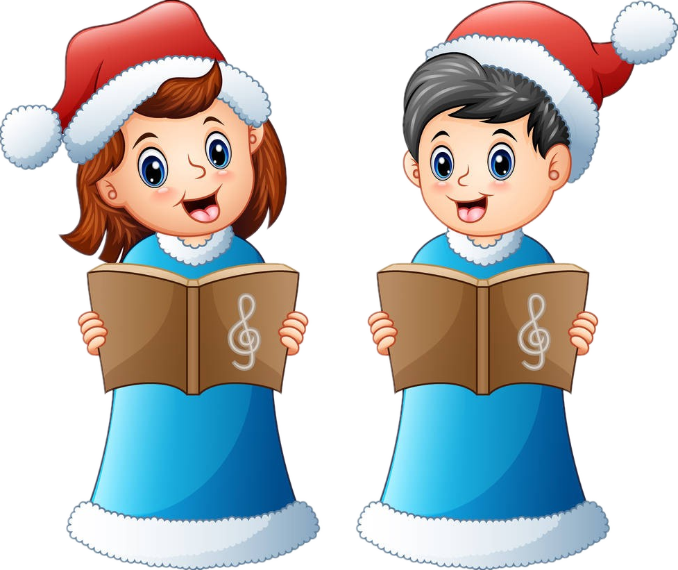
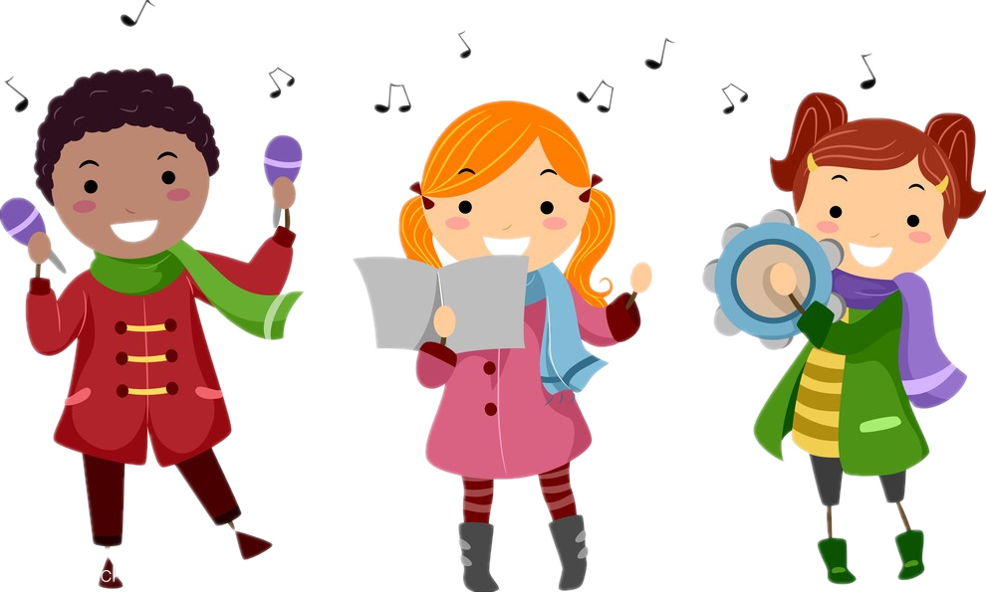

5. Singing Christmas carols 唱圣诞颂歌
The song of Christmas
It refers to the age-old custom of enchanting
1 number of traditional Christmas songs during the Christmas season. It adds ___2___ the joy and fun to the atmosphere. Different Christmas hymns or carols like The First Noel, Jingle Bells, Joy to the world, etc 3 (sing) every Christmas 4 a part of the Christmas celebration.
Jingle Bells
《铃儿响叮当》
a
to
Silent Night
《平安夜》
I Heard the Bells on Christmas Day
《圣诞钟声》
are sung
as
O Little Town of Bethlehem
《美哉小城，小伯利恒》
When Christmas Come To Town
《当圣诞节降临在小镇》

Slide 23

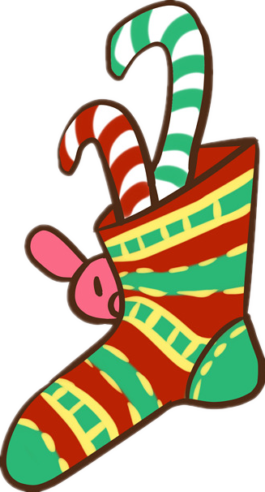
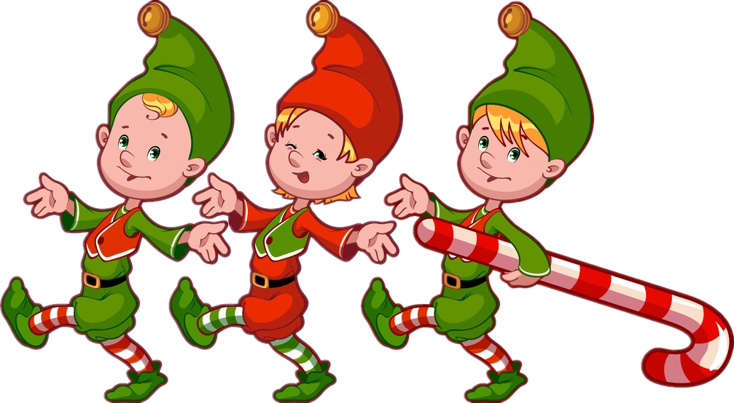
6. Distributing Christmas candies 分发圣诞糖果
This is one of the most wonderful ___1___ (tradition) of all. Christmas candies are distributed ___2___ neighbors during the Yuletide season. On the day of Christmas, all misunderstandings and grudges 3 (forget) and the community comes together 4 (celebrate) the birth of Christ.
traditions
to
are forgotten
to celebrate

Slide 24
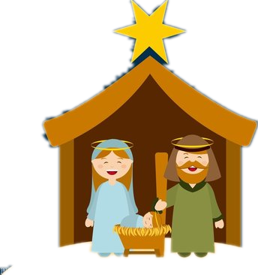
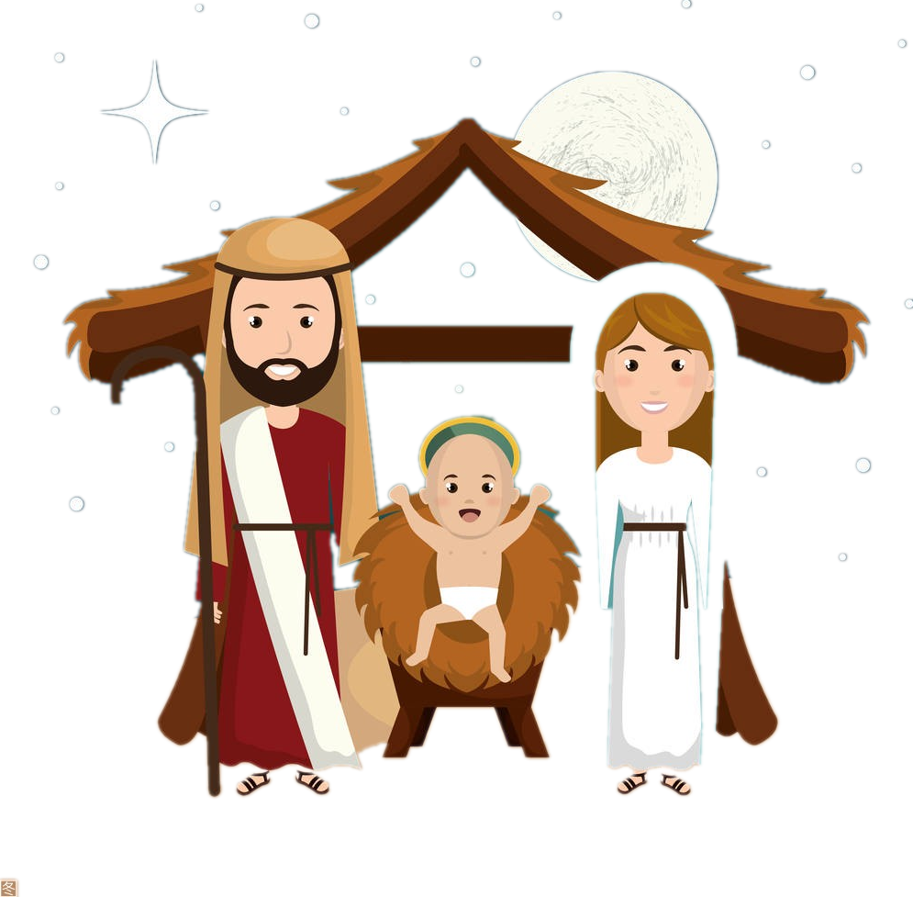

7. Making of Cribs 制作圣诞马槽
This is yet another age-old tradition of Christmas. A crib 1 (refer) to the Nativity Scene 2 is prepared using small statues. The 3 (one) crib ever was made outside a church of St. Francis of Assisi for children 4 (show) them how the Nativity scene was like. Since then, this tradition 5 (become) very popular.
refers
that/which
first
to show
has become

Slide 25
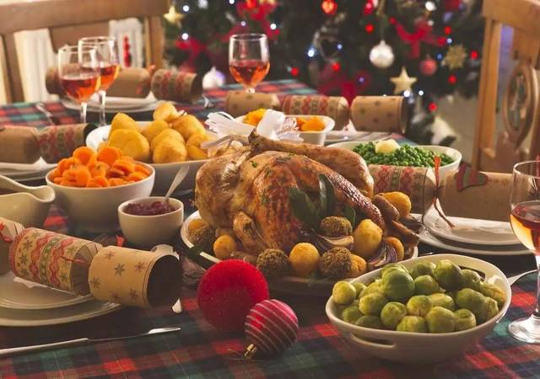
What do people eat for Christmas dinner in different countries?
Christmas is to Westerners what the Spring Festival is to the Chinese. A special Christmas family meal is 1 important part of the celebration for many, but 2 is actually served can vary 3 (great) from country to country. In England and many other countries 4 (influence) by its traditions, a standard Christmas meal would include turkey, ___5___ (potato), vegetables, sausages and gravy, followed by Christmas pudding or mince pies. In Poland and other parts of eastern Europe and Scandinavia, fish often 6 (provide) the traditional main course, but richer meat, such as lamb, 7 (serve) increasingly. Ham is the main meat in the Philippines, 8 in Germany, France and Austria, goose and pork are favored, 9 (make) them sell well. Beef, ham and chicken in __10__ (vary) recipes are popular throughout the world.
an
what
greatly
influenced
potatoes
provides
is served
while
making
various

Slide 26

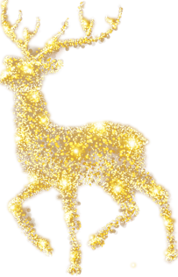
高考题型开发：七选五
When it comes to Christmas dinner, in Britain as in other parts of the world, there are strict traditions. 1 The first and most important thing to note is that the British Christmas dinner is not dinner at all. __2__
It used to be traditional to eat goose or duck for Christmas. 3 Around lunchtime on Christmas Day, most British families will sit down and tuck into roast turkey, roast potatoes and a bunch of vegetables, most commonly carrots, parsnips, turnip. Then there are the pigs in blankets (mini-sausages wrapped in bacon).
But it’s not over yet. 4 Some people opt instead for fresh cream, but you can’t really escape the booze, as that is the thing that was
on fire in the first place.
5 After then, people emerge a few hours later to
start on the leftovers.
D
G
B
E
A

Slide 27
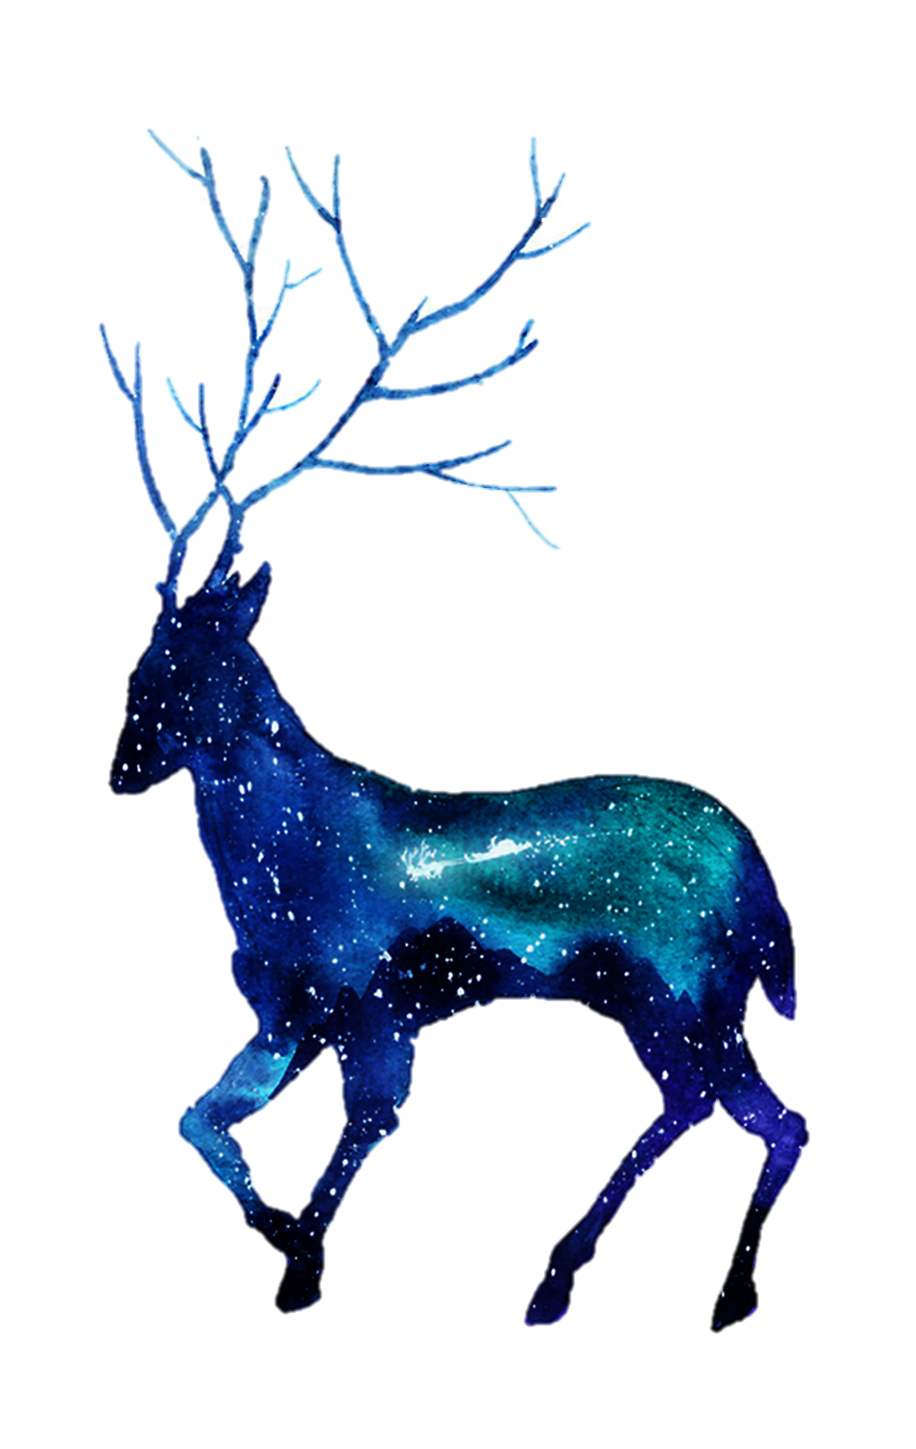
A. Eventually, it’s time to collapse in front of the TV.
B. Some people still do, but in the main it’s turkey, roasted and
served with stuffing.
C. But that’s all they should observe.
D. And most families adhere to them
E. Next, comes Christmas pudding, traditionally served on fire.
F. As you must eat them up.
G. It’s actually lunch.

Slide 28
contents
The vocabulary and benediction concerning Christmas
04

Slide 29
Some expressions related to Christmas
To complete the sentences
1. The story of Christmas trees
With the candle and adornment to decorate the fir or loosen up the evergreens, people consider it as part of the Christmas 1 (celebrate). Modern Christmas tree 2 (originate) from Germany. Modern switch 3 various cookies instead of holy bread, but also often add symbolic Christ candles. In addition, Christmas tower, __4__ is a wooden triangle structure, will be set up indoors. There are many small frame lattice 5 (place) the statue of Christ, minus evergreen tree decorated with branches, candles and a star.
celebration
originated
to
which
placed

Slide 30
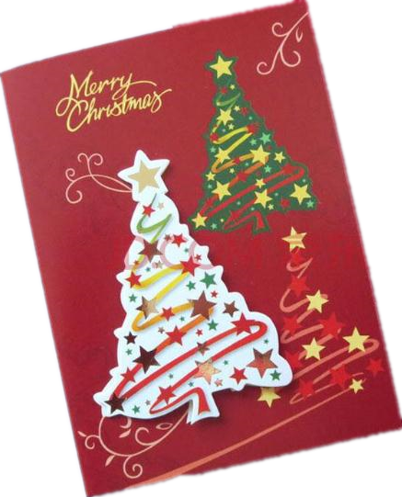
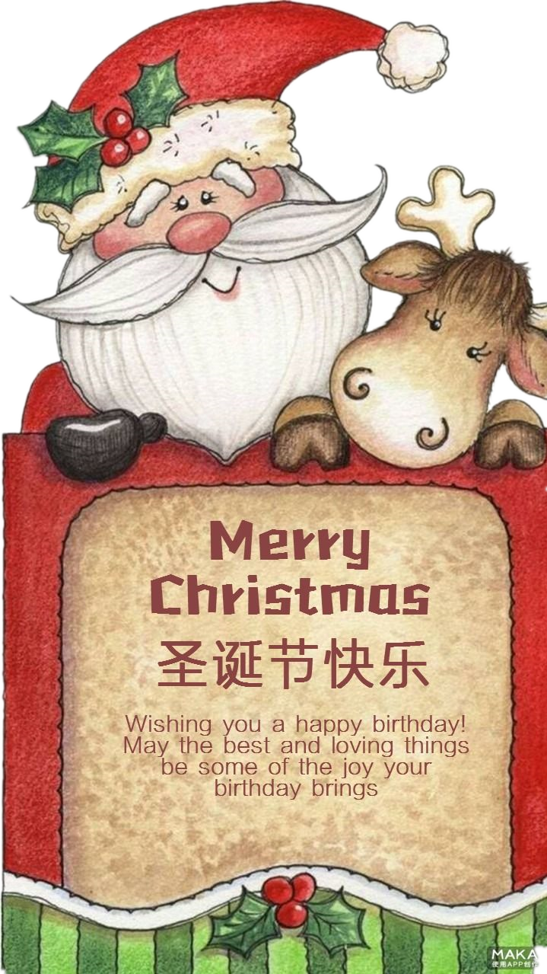
2. The story of Christmas cards
The custom of sending Christmas cards started in Britain in 1840 1 the first 'Penny Post' public postal deliveries began. ( 2 (help) by the new railway system, the public 3 (post) service was the 19th century's communication revolution, just as email is for us today.) As printing methods improved, Christmas cards 4 (produce) in large numbers from about 1860. They became even 5 popular in Britain when a card could be posted in an unsealed envelope for one half-penny-half the price of an ordinary letter.
when
Helped
postal
were produced
more

Slide 31
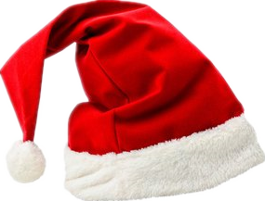
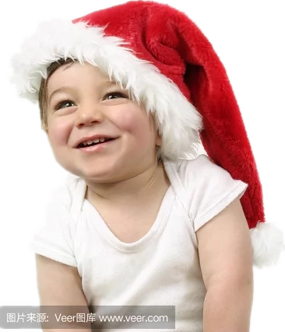
3. Christmas hat
Christmas hat is red. It is alleged that people ___1___ go to bed with it in the evening can keep warm in addition to 2 (sleep) well, the next day and you will also find there are much more too beloved gifts in that hat . It stars the __3__ (lead) role. Wherever you go, you can see
4 (variety) of Christmas hats.
who
sleeping
leading
varieties

Slide 32
4. Christmas stockings
Originally, it was a pair of large red socks ___1__ various sizes. Because Christmas stockings are used 2 (load) presents, they are children’s favorite things. At night, they will hang their socks by the bed, 3 (wait) for the next morning’s gifts.
with
to load
waiting

Slide 33
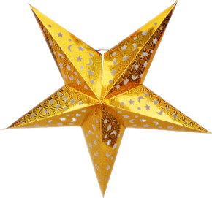



5. Stars and Lights
outside
Lights are common decorations inside and 1 the house at Christmas. Stars are also common decorations at Christmas time as a way 2 (remember) the bright star that led the wise men (Magi) 3 the baby Jesus. The lights are often of different colors and ___4___(turn) on at night.
In some cities there are contests 5 (see) who can put up 6 most beautiful display of lights around their house. People often drive around the city during the Christmas season to look at the lights and to sing Christmas 7 (carol).
to remember
to
are turned
to see
the
carols

Slide 34
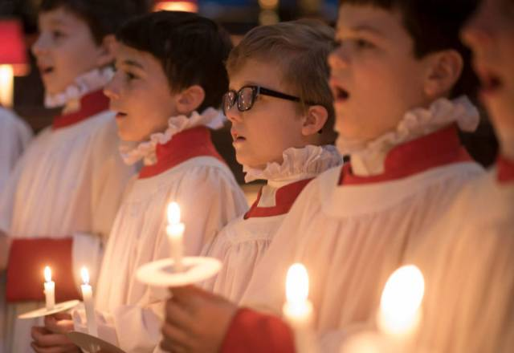
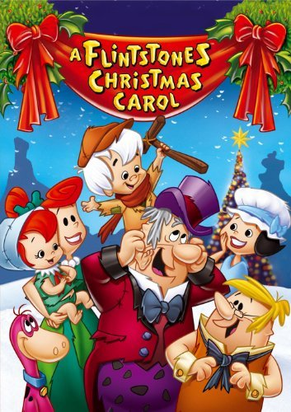
6. Christmas carols
Christmas carols are special songs ___1___ tell about the events of Jesus’ birth. The first Christmas songs 2 (write) in 400 AD. Carols, however, didn’t become really popular 3 the 1800s.
It is still common for groups of people, often from a neighborhood (街道), school or church to spend an evening 4 (walk) through a neighborhood singing Christmas carols. This is a fun way 5 (enjoy) the company of others and to share the joy of the season.
that
were written
until
walking
to enjoy

Slide 35
Christmas greetings: general use
Christmas is the most human and kindly of season, as the month of June with sunshine and the balmy breath of roses.
圣诞最有人情味，充满仁爱的时节，它如同阳光明媚、玫瑰吐露芬芳的六月
Much joy to you in the up coming year.May the warmest wishes, happy thoughts and friendly greetings come at Christmas and stay with you all the year through.
让温馨的祝愿、幸福的思念和友好的祝福，在圣诞佳节来到你身边，伴你左右。
At Christmas and always, may peace and love fill your heart, beauty fill your world,and contentment and joy fill your days.
圣诞的祝福，平日的希冀，愿你心境祥和、充满爱意，愿你的世界全是美满，愿你一切称心如意，快乐无比。

Slide 36


Christmas greetings: Friendship
May you find all the reasons to smile in this special season. Merry Christmas.
在这特殊的日子里，愿你事事顺心，永远绽放笑容，圣诞快乐。
There are so many gifts I want to give to you this Christmas. Peace, love, joy, happiness are all presents I am sending your way.
这个圣诞，我有好多礼物要送你。平安、爱、快乐、幸福全都打包送给你。
A Christmas greeting and good wishes to you who is thought about all the year through. Have a beautiful Christmas and a happy new year.
始终思念你，捎来圣诞佳节最美好的祝福，祝圣诞快乐，新年如意。

Slide 37
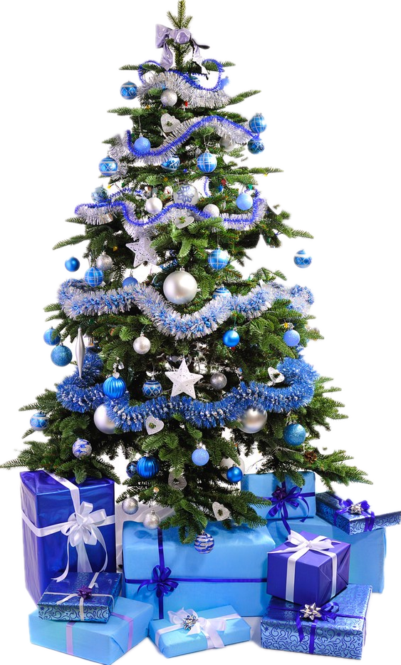
Christmas greetings: family
Because you are such loving parents, I know how fortunate I am to have you in my life. Thanks for everything. Merry Christmas.
因为你们是这样温暖有爱的父母，我知道我有多么幸运，能在生命中拥有你们。谢谢你们给我的一切。圣诞快乐。
Growing up in a house filled with love has been a splendid experience. Mom and Dad, may you feel my love for you this Christmas.
在这个充满爱的家庭里成长是一个太美妙的经历。爸爸妈妈，圣诞快乐，希望你们能感受到我对你们的爱。
I always felt I had the best parents in the world because you have done so much for me. All my love on Christmas.
我一直认为我的爸爸妈妈是全世界最好的，因为你们为我付出了那么多。圣诞节请接受我全心全意的爱。

Slide 38
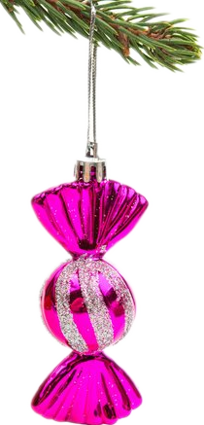
Christmas greetings: sweet love
Yesterday I baked a hundred cookies and decorated them with red and green sprinkles. All I need now is you.
昨天我烘焙了100块小饼干，撒上了红红绿绿的糖末。现在，就差你了.。
My wishes for you today are simple: warmth, comfort, joy, and me in your holiday stocking waiting for you to open it.
今天，我对你的祝愿很简单：希望你拥有温暖、舒适、快乐，还有我，装在你的圣诞袜里，等着你来打开呢！
You are as beautiful as an angel, as sweet as a Christmas cookie, and as loving as the whole season. Thank you for making my Christmas wonderful.
你美貌如天使，甜蜜如圣诞饼干，爱意满满如这美好的时节。谢谢有你在，让我的圣诞充满惊喜。

Slide 39
contents
The application concerning Christmas in the exams
05

Slide 40
读后续写(1) (满分25分)
阅读下面短文，根据所给情节进行续写，使之构成一个完整的故事。
The spot of red was what first caught Randy Heiss’s attention on December 16, 2018. He was hiking the remote land behind his farm in a small town near the U.S.-Mexico border, and there lying on the grass was a balloon. He walked toward it with his dog, thinking he should pick it up and throw it away.
That’s when he noticed the balloon’s string was attached to a piece of paper. “Dayami,” it read on one side, in a child’s writing. A hand-drawn bow accompanied the word. Heiss flipped the paper over. On the back he saw a numbered list, all in Spanish. His Spanish wasn’t very good, but he could see it was a Christmas list!
Heiss was charmed. He suspected that a child had tried to send Santa Claus a Christmas wish list by balloon, something he used to do himself when he was a kid. Nobody had ever returned the letters Heiss had sent, but he wondered whether he could find the girl who had sent this one.
It would be difficult, but Heiss had a few clues. About 20 miles to the southwest, just across the border, was the city of Nogales, Mexico, with a population of about a quarter million. Based on the wind direction, he was almost sure that was where it came from. Heiss brought the note home to his wife, who is fluent in Spanish and helped him translate the list. They determined that Dayami, probably a girl, had asked for a doll, a dollhouse, doll clothes and art supplies.
Heiss then posted his search about finding Dayami on Facebook, attaching photos, hoping some of his friends in Nogales might know the girl’s family. A few days passed with no results; Heiss worried that time was running out before Christmas. On December 19, 2018, he decided to send a private Facebook message to Radio Xeny, an AM radio station based in Nogales. To his surprise, someone from the station called him back right away and promised him to post his search on the station’s Facebook page immediately.

Slide 41
注意：
1.所续写短文的词数应为150左右；
2.应使用5个以上短文中标有下划线的关键词语；
3.续写部分分为两段，每段的开头语已为你写好；
4.续写完成后，请用下划线标出你所使用的关键词语。
Paragraph1:
The next morning, Heiss awoke to a message from Radio Xeny.___________________
Paragraph2:
Dayami’s eyes were wide open with wonder. ____________________________________

Slide 42
A possible answer
Para1:
The next morning, Heiss awoke to a message from Radio Xeny. They had located Dayami, an eight-year-old girl, and her family, who indeed lived in Nogales. Hearing the great news, Heiss changed his entire day and went to the shopping mall with his wife. They bought just about everything on Dayami’s list except for the dollhouse; it was sold out. Then the Heisses drove for 45 minutes, crossing the border into Nogales. They arrived at the Radio Xeny offices with presents by the armload and finally met the very excited little girl and her parents.
Para2:
Dayami's eyes were wide open with wonder. She had been writing a letter to Santa Claus and sending it by balloon for years, but this was the first time anyone had found the note. Not wanting to spoil Santa Claus for the girl, Heiss and his wife told her they were Santa’s helpers. With the sweetest smile of that Christmas season, the girl held the doll in her arms. What a miracle it was that Heiss spotted the balloon, let alone that he was able to locate Dayami and her family. For a day, that border fence melted away.

Slide 43
读后续写(2) (满分25分)
阅读下面短文，根据所给情节进行续写，使之构成一个完整的故事。
A light drizzle was falling as my sister Jill and I ran out of the church, eager to get home and play with the presents that Santa
had left for us and our baby sister, Sharon. Across the street was a gas station where the Greyhound bus stopped. It was closed for
Christmas, but I noticed a family standing outside, huddled under the narrow overhang to keep dry.
Once we got home, there was barely time to enjoy our presents. We had to go off to our grandparents' house for our annual
Christmas dinner. As we drove down the highway through town, I noticed that the family was still there, standing outside the closed
gas station.
My father was driving very slowly down the highway. The closer we got to the turn off for my grandparents' house, the slower
the car went. Suddenly, my father U-turned in the middle of the road and said, “I can't stand it!”
“What?” asked my mother.
“It's those people back there at the Pan Am, standing in the rain. They've got children. It's Christmas. I can't stand it.”
When my father pulled into the service station, I saw that there were five of them: the parents and three children - two girls and a
small boy.
My father rolled down his window. “Merry Christmas,” he said.
“Howdy,” the man replied.
“You waiting on the bus?” my father asked.
The man said yes . They wanted to Birmingham.
“Well, that bus isn't going to come along for several hours, and you're getting wet standing here. Winborn's just a couple miles up
the road. They've got a shed with a cover there, and some benches,” my father said. “Why don't you all get in the car and I'll run
you up there.”
The man thought about it for a moment, and then they climbed into the car. They had no luggage, only the clothes they were
wearing.
Once they settled in, my father looked back over his shoulder and asked the children if Santa had found them yet. Three glum
faces mutely gave him his answer.

Slide 44
注意：
1. 所续写短文的词数应为150左右;
2. 至少使用5个短文中标有下划线的关键词语;
3. 续写部分分为两段，每段的开头语已为你写好;
4. 续写完成后，请用下划线标出你所使用的关键词语。
Paragraph 1
My father said, ______________________________________________
Paragraph 2
When we got out of the car at our house, __________________________

Slide 45
A possible answer
My father said, winking at my mother, “Dear, do you remember? we came across Santa when working out in the park this morning. He told us he was especially wrapped in business and that he had difficulty in finding all of the children. Therefore, he asked us to do him a favor to send the presents to each child.” To meet my father halfway, my mother added with a hint of citrus, “You bet! There are so many presents left at my home. We have no choice but to go home to fetch them, sending them to each child. ” Upon hearing the news, being over the moon, the three children grinned from ear to ear, clapping their hands and singing in the back seat, with the laughter lingering in the car.
When we got out of the car at our house, the three children ran into the house like an arrow off a string and straight to the toys that were spread out under the Christmas tree. Picking out their favorite toys that should have belonged to us, they bounced and giggled with delight, hugging them to their bosom. Their happiness infecting us, we joined them, including the adult parents. Dancing and singing around the Christmas tree, we observed the special Christmas, the laughter reverberating on the Christmas morning. It dawned on me that bringing happiness to others is the real happiness.

Slide 46


