Slide 1

感恩遇见，相互成就，本课件资料仅供您个人参考、教学使用，严禁自行在网络传播，违者依知识产权法追究法律责任。
更多教学资源请关注
公众号：溯恩高中英语
知识产权声明

Slide 2
Welcome to Yuanyuan’s Class!
Notes:
Good morning everyone! My name is Yuanyuan. I am glad to study with you in this class. Aren’t you?

Slide 3
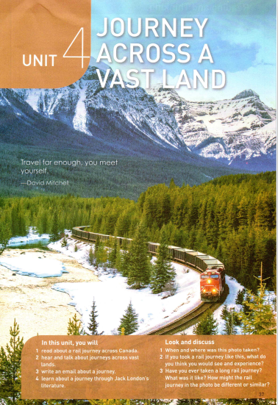
Journey across a Vast Land
OCB2U4 Reading and Thinking
Yuanyuan Li
Nov. 25th, 2021
Notes:
When we mention ”a vast land”, what country would you think of?

Slide 4
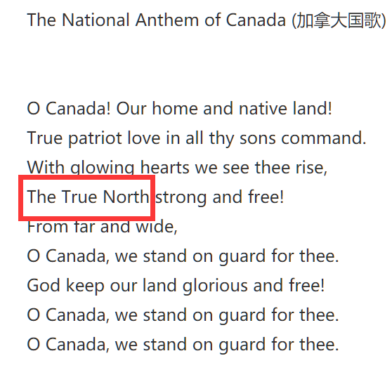

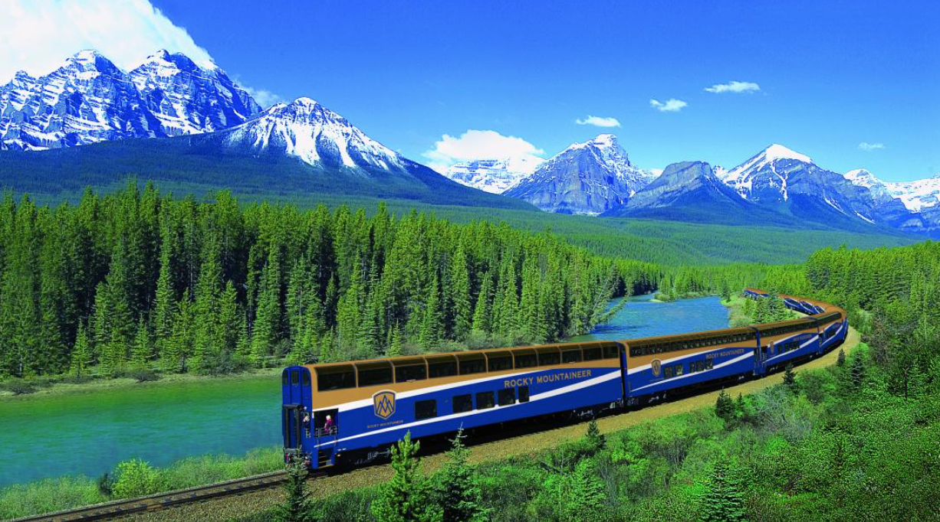
Warm-up
How much do you know about Canada?
Area: the _______ largest country in the world.
Official language: _________ and _________
Capital city: ________.
Alternative name: _______________
second
English
French
Ottawa
The True North
2. What do you know about rail journeys?
Take a long time
Designed routes
See more and experience more
Notes:
How much do you know about Canada?
What kind of transport will you choose to go travel across a vast land? (post possible answers)
What do you know about rail journeys?
Today, we are going to explore a rail journey across the vast land.

Slide 5
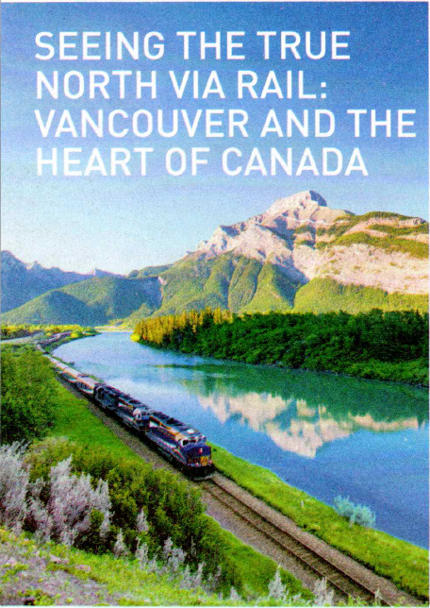
Predict
Based on the picture and the title, what can you know about the journey?
Notes:
My question will be: where is the heart of Canada? What can be seen along the journey.

Slide 6
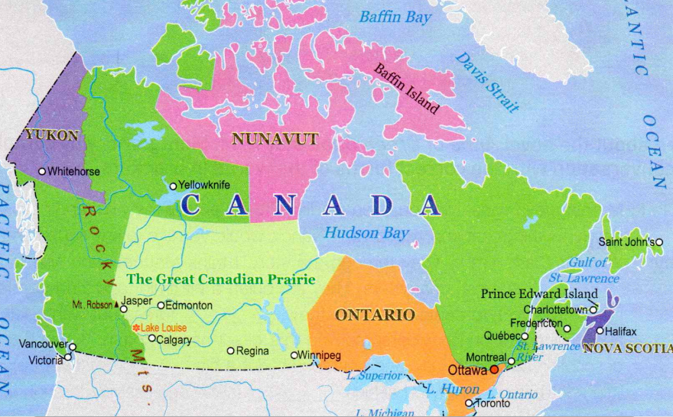


Read for main idea
Read the 1st paragraph, and find out the basic information about the trip.
Brief introduction about the trip
who
why
where
how | First by________, then via _______
feeling
What is the genre of the text?
Li Daiyu and her cousin Liu Qian
A travel journal
To visit their cousins
How is the text organized?
Halifax on the Atlantic Coast
air
rail
In time and space order
Excited
By discourse markers!
Main idea: Li Daiyu and Liu Qian were excited to take a rail journey from Vancouver to visit their cousins in Halifax.
Notes:
Shall we get started? Let’s get our journey started.
Let’s read the 1st paragraph, and find out the basic information about the journey (齐读)
Can you use one sentence to summarize the main idea?

Slide 7
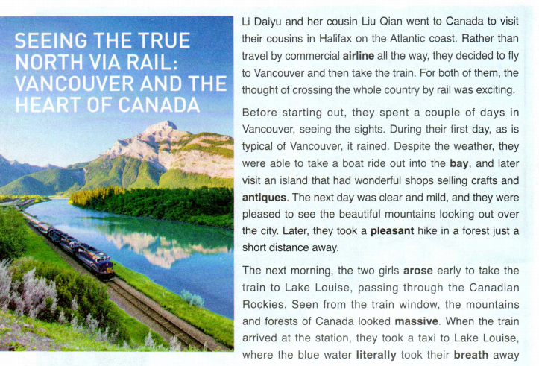
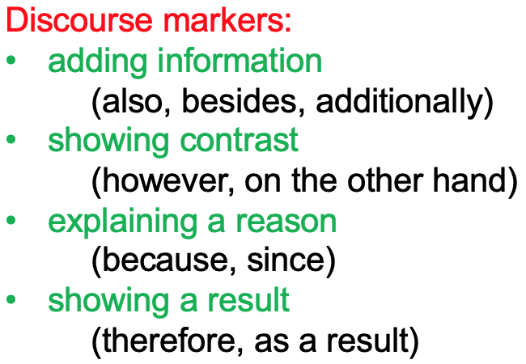
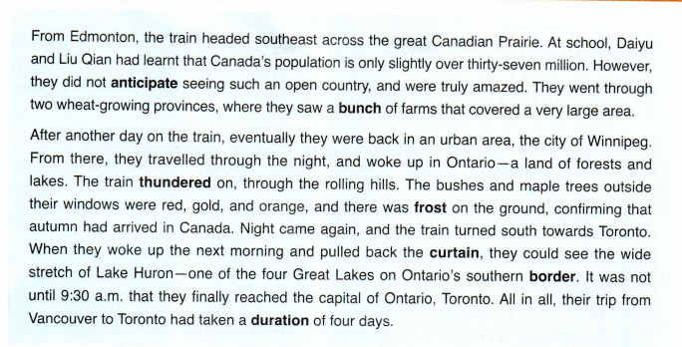
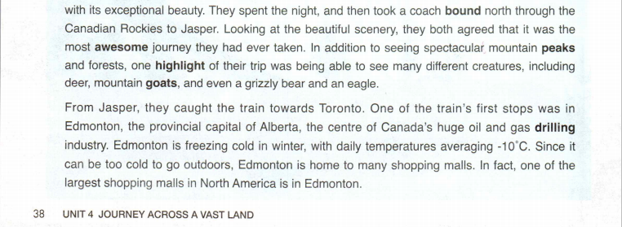







Read for travel route
Based on the discourse markers, find out the places they have travelled.
China--Vancouver--Lake Louise--Jasper--Edmonton--Canadian Prairie--Winnipeg--Ontario--Toronto
discourse markers
Notes:
Let’s follow the discourse markers and find out the places they have been.
If you are to find “places”, what kind of words should you pay attention to? Capitalized words.

Slide 8















Notes:
Let’s see their travel routes.
As you can see… their journey starts from the east coast to the west coast.
Now can you answer the question I raise at the beginning? What is the heart of Canada?
And now let’s come to the second question. What did they see?

Slide 9
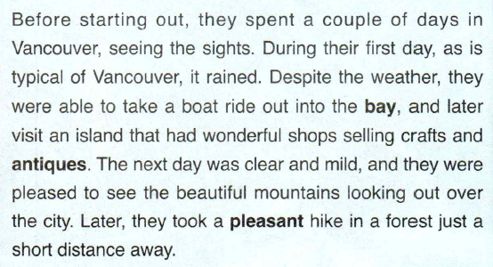


Read for the travel experience
Read the 2nd paragraph and find out:
  what they saw/learnt/did
  how they felt (if any)
Take a boat ride
Visit an island
Take a hike in a forest
Shops selling crafts and antiques
Beautiful mountains looking out…
It’s your turn!
China
Vancouver
pleased
Notes:
Let’s read the 2nd paragraph and find out: what did they see/do/learn; how did they feel.
Where is their first stop?
What did they do?
What did they see?
How did they feel?
What is their next stop? It’s your turn!

Slide 10
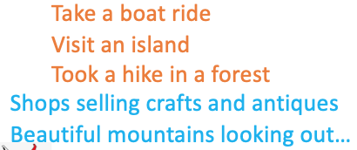
Read para. 3-6. Draw a mind map about their travel experience. Your map should include the following information:
What they saw/did/learnt
How they felt (if any)
G1-3: Lake Louise—Edmonton (para. 3-4)
G4-6: Canadian Prairie—Toronto (para. 5-6)
pleased
_________________
China
Vancouver
Lake Louise
_________________
_________________
_________________
Canadian Prairie
Edmonton
Jasper
_________________
_________________
_________________
Winnipeg
Ontario
Toronto
Notes:
Read para. 3-6. Draw a mind map… Let’s separate the class into two groups: G1-3; G4-6.

Slide 11
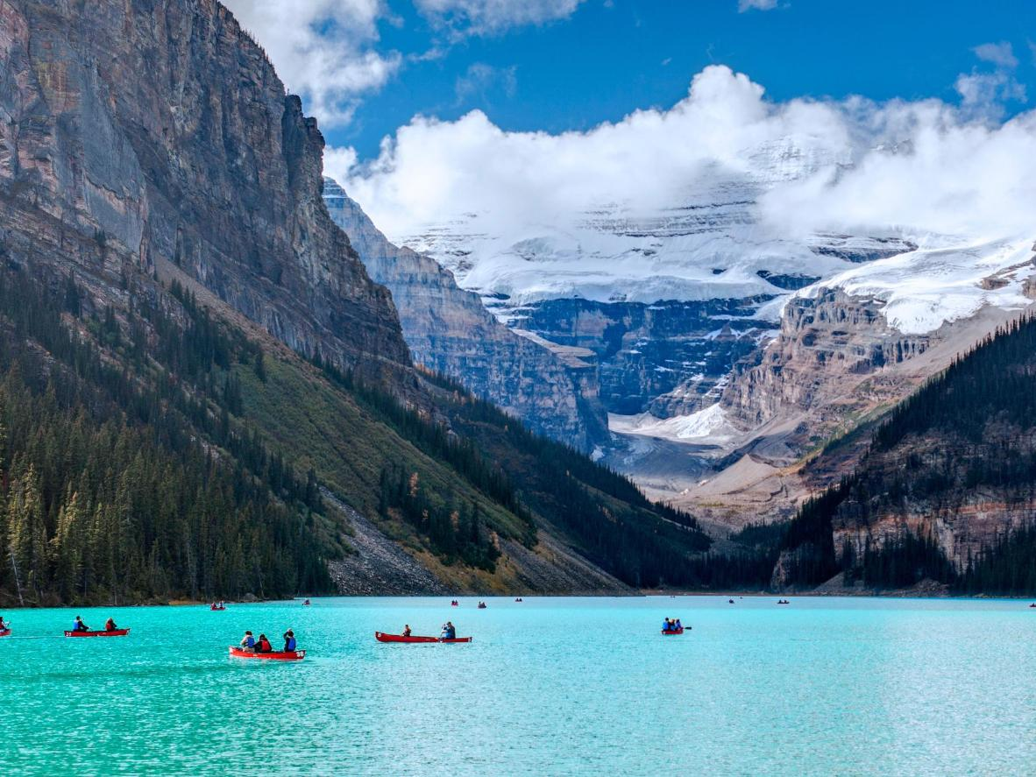
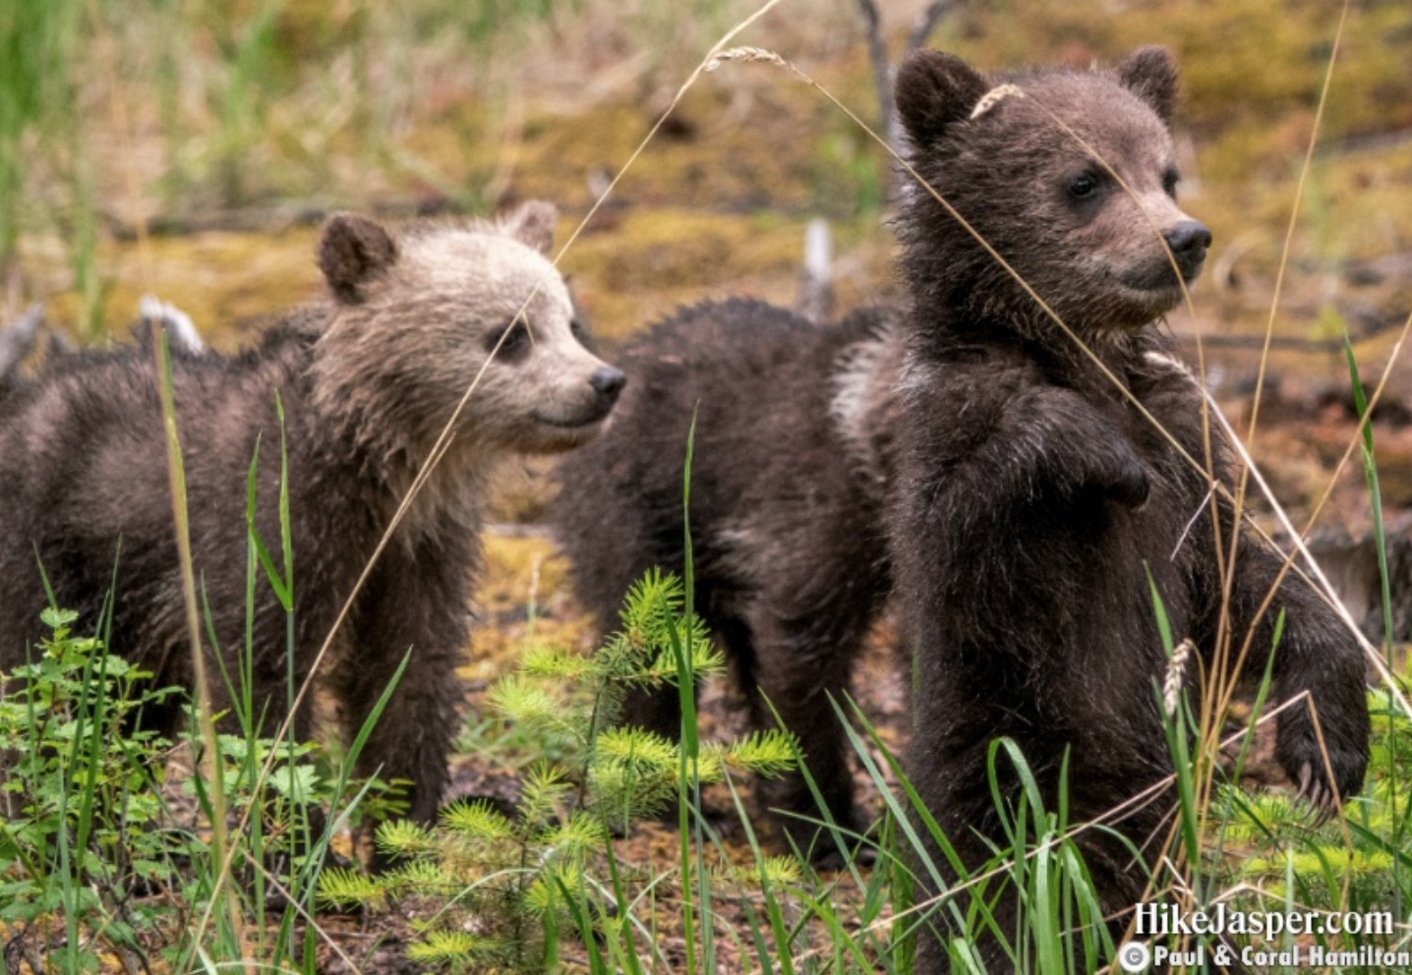
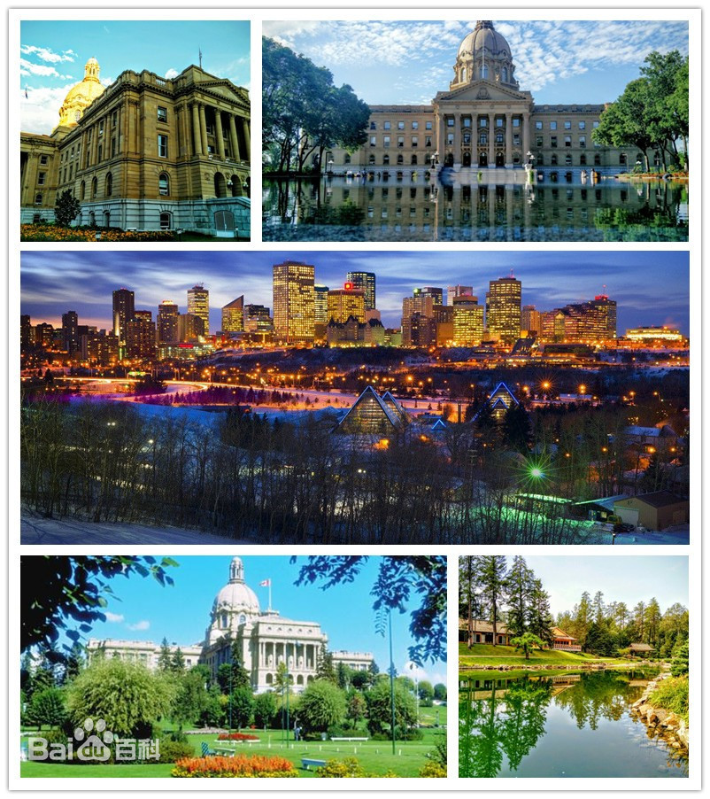
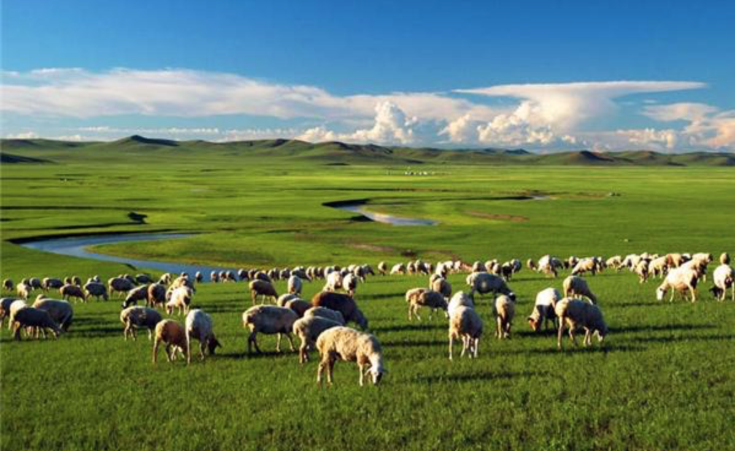
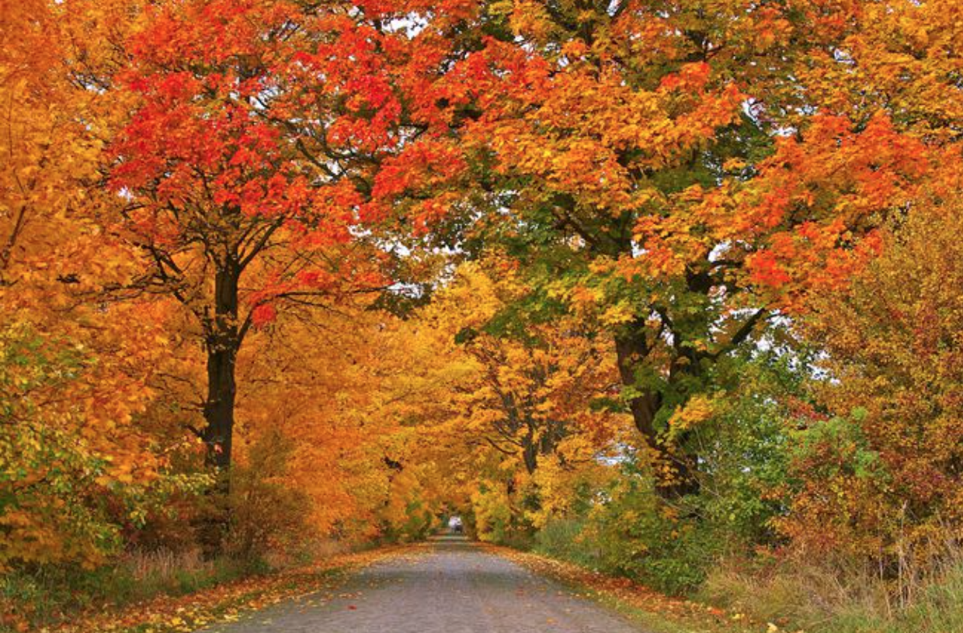
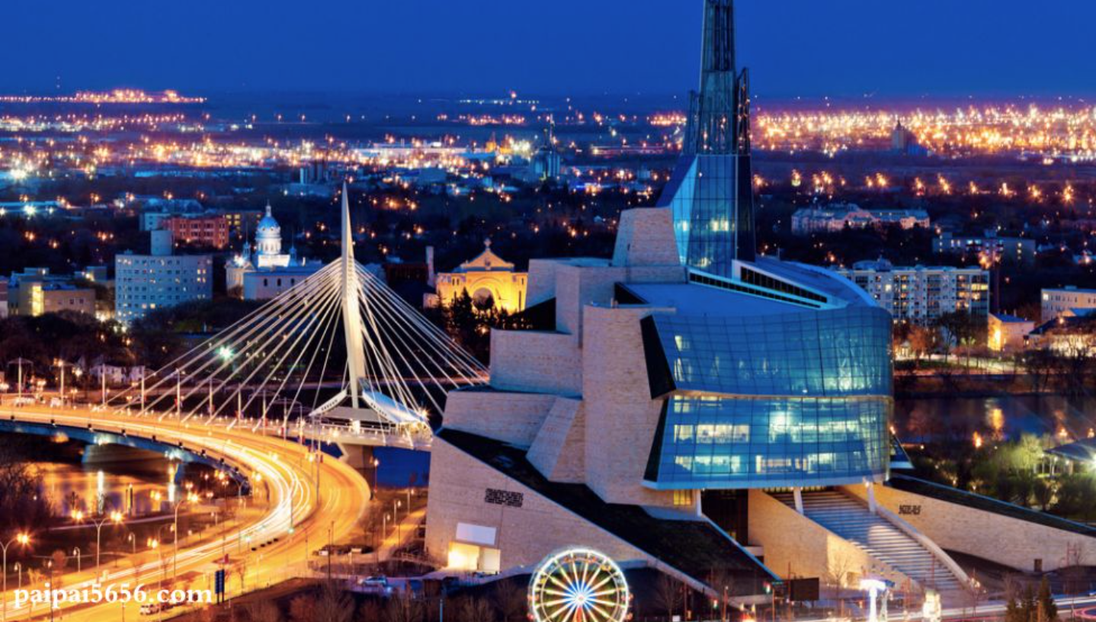
Lake Louise
Jasper
Read para. 3-6. Draw a mind map about their travel experience. Your map should include the following information:
What they saw/did/learnt
How they felt (if any)
G1-3: Lake Louise—Edmonton (para. 3-4)
G4-6: Canadian Prairie—Toronto (para. 5-6)
pleased
_________________
China
Vancouver
Lake Louise
Canadian Prairie
Edmonton
_________________
_________________
_________________
Winnipeg
Canadian Prairie
Edmonton
Jasper
_________________
_________________
_________________
Winnipeg
Ontario
Toronto
Ontario
Notes:
Time is up! Now it’s your show time! XXX could you introduce your map based on the above information? You can start with… After…., they arrive… and they feel?
You may include other details if you want.
Well done! You’ve done an amazing job! My emotion is just like Li Daiyu and XXX’s!

Slide 12
discuss
Based on what they saw and learnt, what do you think they have gained from the journey?
What did they see/do | What did they gain
Wonderful shops selling crafts and antiques
Beautiful mountains looking out over the city A forest a short distance away
Massive mountains and forests Blue water with exceptional beauty
Spectacular mountain peaks and forests; Highlight: different creatures
Center of Canada’s oil and gas drilling industry Home to many shopping malls
An amazing open country 2 wheat-growing provinces; a bunch of large farms
A land of forests and lakes; Rolling hills; red, gold, orange bushes and maple trees
A wide stretch of Lake Huron
Satisfy needs for shopping
Experience a land where human and nature live in harmony
enjoy a land with grand sceneries;
Admire the nature power and beauty.
Discover a land highly developed in agriculture and industry.
Notes:
Except for the direct description, where else can you find their feelings? 板书：from the descriptive adjectives)
From the above information, what kind of country is Canada?
红框：a country with beautiful and grand sceneries; human and nature live in harmony
蓝框：highly developed in agriculture and industry
橙框：highly civilized
组织和规划能力！

Slide 13
Share in pairs
Share with your partner your travel experience of a long journey, including following information:
the places you visited
what you saw/did/learnt
how you felt
What you have gained
Notes:
前面的输入要支撑后面的输出
能否只保留一个discussion的问题？还是两个都要呢？

Slide 14
Travel far enough, you meet yourself.
——David Mitchell
“It is better to travel ten thousand miles than to read ten thousand books. ”
Notes:
Now ladies and gentleman, can you summarize the meaning of a long journey. When we travel far enough, we might understand ourselves and the world around us better. And it’s that time that you meet yourself!!

Slide 15
Assignment
Write down your travel experience of a long journey, including following information:
the places you visited
what you saw/did/learnt
how you felt
What you have gained.
The rail journey across the vast land really makes a difference to me. _______________________________________________________________________
_______________________________________________________________________
_______________________________________________________________________
_______________________________________________________________________
_______________________________________________________________________
Notes:
前面的输入要支撑后面的输出
能否只保留一个discussion的问题？还是两个都要呢？

Slide 16
Sample
The rail journey across the vast land really makes a difference to me. While I spent only a few hours in Toronto, an economic centre of Canada, it has left a profound impression on me. (topic sentence) It is a city with breath-taking natural scenery, where I admired the astonishing shores of Lake Ontario and misty clouds rising from the Great Niagara Falls. After that, I got a chance to witness the modern buildings and old-fashioned cars speeding by at the same time, glancing the combination of traditions and advance of this city. At dusk, we met your old friend Lin Fei over dinner in downtown Chinatown, the largest one in Toronto. Not only did she take us to taste delicious Chinese food, but she also introduced a lot about the Chinatown to us .
It is in Toronto that we felt at home with tasting Chinese food and meeting Chinese people. It also allowed me to appreciate the works served by nature as well as made by humans in one city. If I have another chance to travel to Toronto, I will definitely plan more time on it to have a better visit.

Slide 17
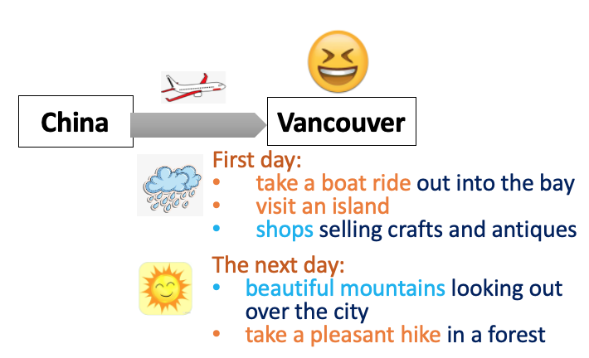
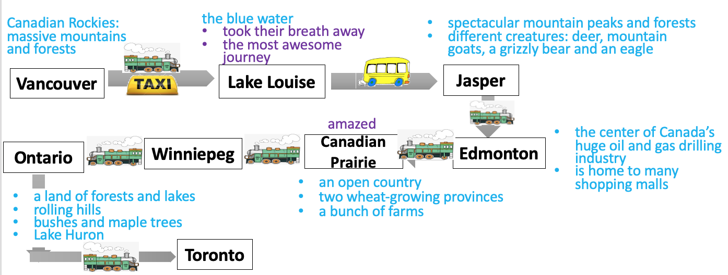
Read the whole passage again. Draw a map about their travel experience. Your map should include the following information (if any).
  where they travelled
  what they did
  what they saw
  how they felt

Slide 18
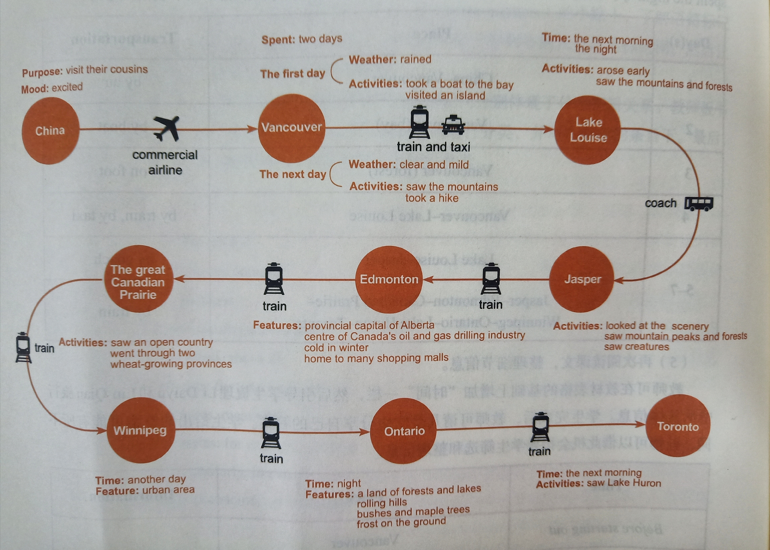
Read for the travel experience
Notes:
这个是板书的样态，可以不呈现给学生
分组呈现学生的作业？

Slide 19
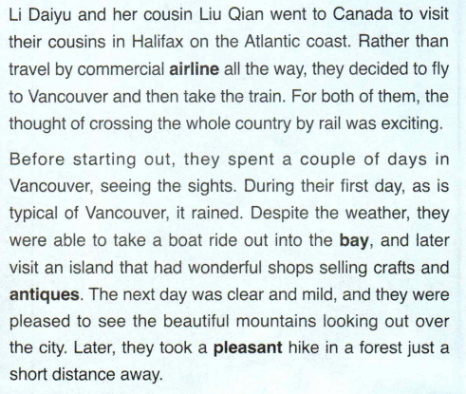
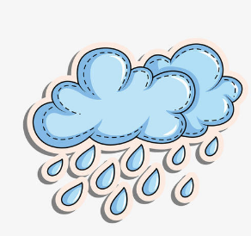

China
Vancouver
First day:
take a boat ride out into the bay
visit an island
shops selling crafts and antiques
The next day:
beautiful mountains looking out over the city
take a pleasant hike in a forest
Notes:
Based on the picture and the title, what is the text probably about?
Read the 1st paragraph, and find out the following information
Can you tell the main idea of the passage based on the introduction?
追问：Why seeing? what does the True North refer to? Why is Vancouver mentioned?

Slide 20
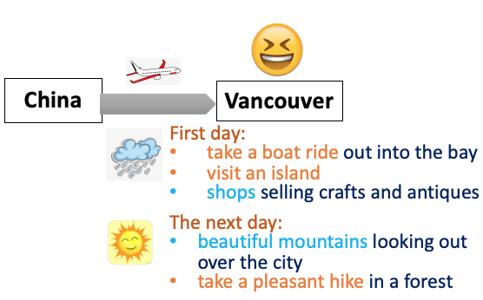
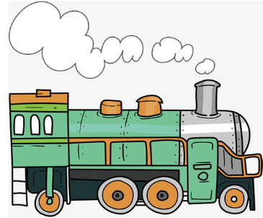


Canadian Rockies:
massive mountains and forests
the blue water
took their breath away
the most awesome journey
spectacular mountain peaks and forests
different creatures: deer, mountain goats, a grizzly bear and an eagle
Vancouver
Lake Louise
Jasper
amazed
the center of Canada’s huge oil and gas drilling industry
is home to many shopping malls
Ontario
Winniepeg
Canadian Prairie
Edmonton
an open country
two wheat-growing provinces
a bunch of farms
a land of forests and lakes
rolling hills
bushes and maple trees
Lake Huron
Toronto
Notes:
Based on the picture and the title, what is the text probably about?
Read the 1st paragraph, and find out the following information
Can you tell the main idea of the passage based on the introduction?
追问：Why seeing? what does the True North refer to? Why is Vancouver mentioned?

