Slide 1

感恩遇见，相互成就，本课件资料仅供您个人参考、教学使用，严禁自行在网络传播，违者依知识产权法追究法律责任。
更多教学资源请关注
公众号：溯恩高中英语
知识产权声明

Slide 2
Unit 2 Bridging Cultures
Using Language 1
Chinese Language Learning Abroad
-BY Lily

Slide 3
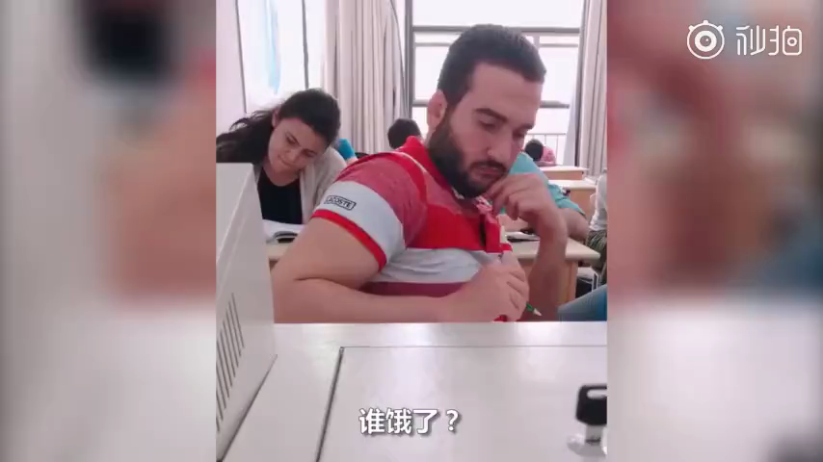
Foreign friends are learning Chinese.

Slide 4



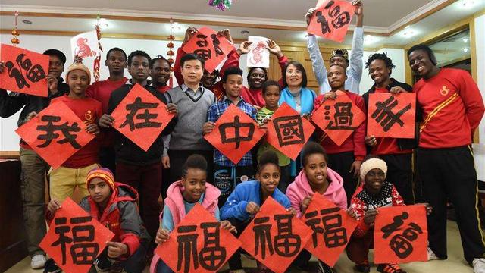
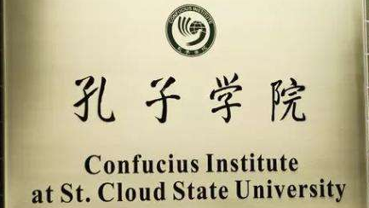
How do people from other countries learn Chinese culture?

Slide 5
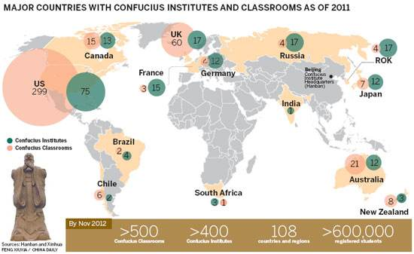
What do you know about the Confucius Institute?

Slide 6
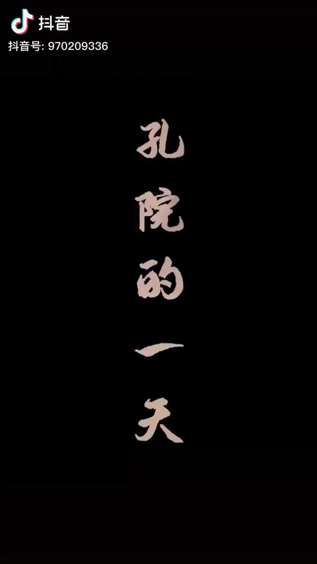
What can you do in the Confucius Institute?

Slide 7
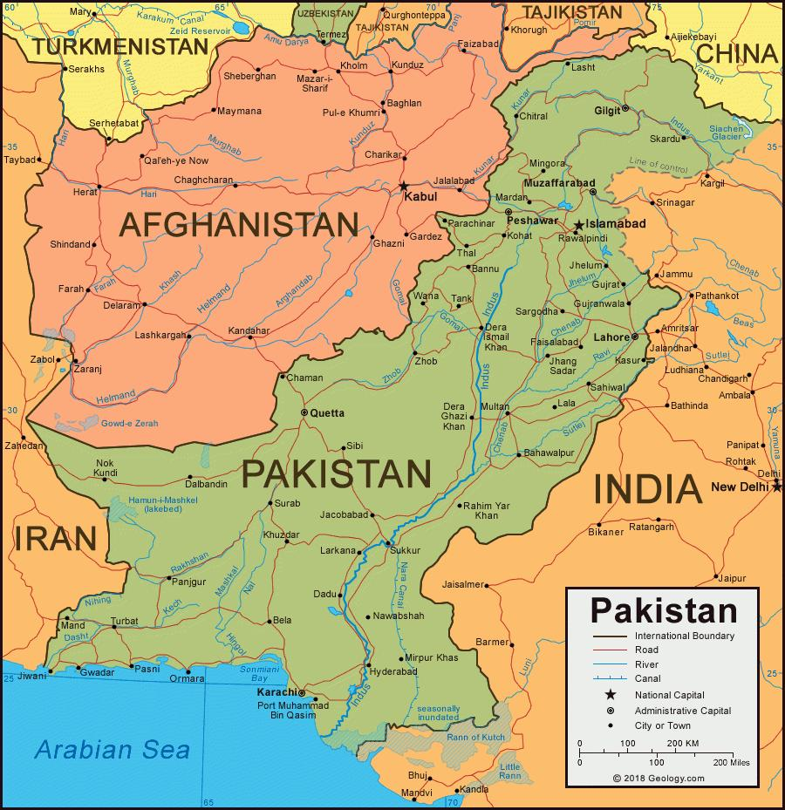



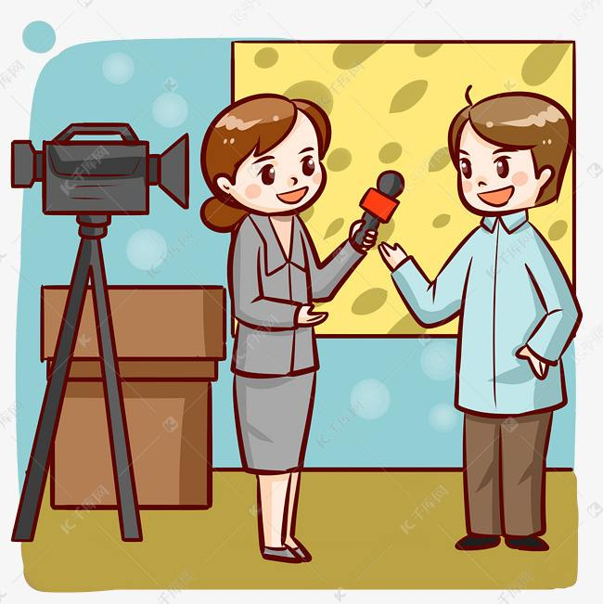
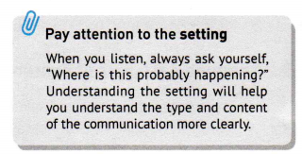

for the setting.
(who)___________________________________________________ are talking about (what)_________________________________
in (where) ________________________.
A host and a Chinese teacher named Aisha Khan
Chinese learning in the Confucius Institute
in Karachi, Pakistan

Slide 8

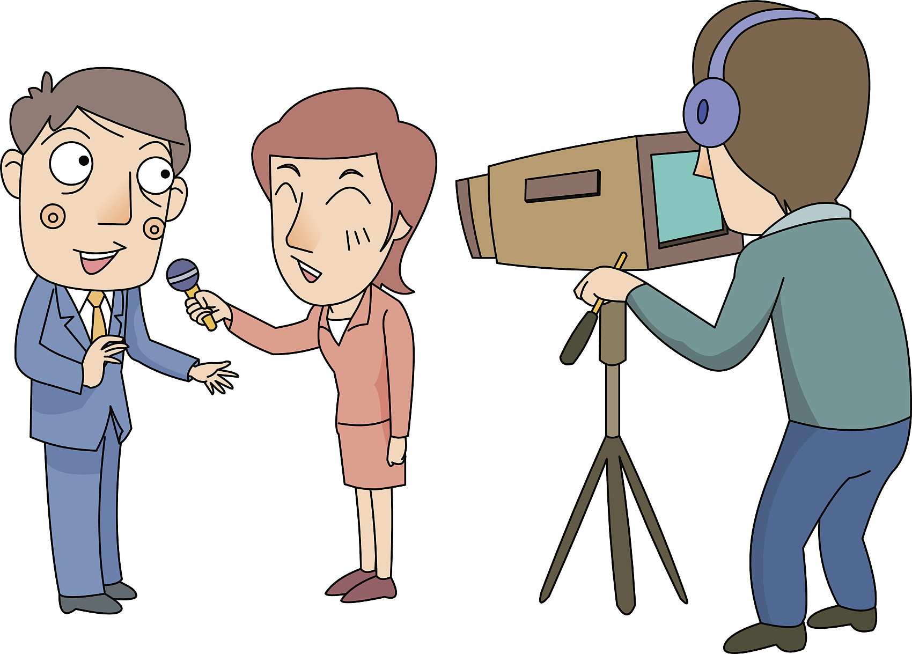
Interview Topic: Chinese learning in the Confucius Institute
Possible Questions | Answers
e.g: Q 1:Why do you choose to be a teacher in Confucius Institute?
If you were the host, what questions would you raise to interview the teacher from Confucius Institute in Pakistan?

Slide 9
Interview Topic: Chinese learning in the Confucius Institute
Possible Questions | Answers
e.g: Q 1:Why do you choose to be a teacher in Confucius Institute?
1. Aisha followed a good Chinese teacher and wanted to carry on her work.
2. Although it’s small at first, it has become bigger and a centre for Chinese activities and a bridge to China.
Q 2: What’s the Confucius Institute in Pakistan like?
Q 3:What do Pakistani think of learning Chinese?
3. They think learning Chinese is important and beneficial to their future.
Q 4: What do you feel about your job ?
4. Aisha feels satisfied with her job.

Slide 10
for detailed information.
1. Aisha followed a good Chinese teacher and wanted to carry on her work.
Because Ms Hu not only taught them language but also Chinese culture and invited her to make and eat dumplings home, which made her feel a part of Ms hu’s family.
Q1: Why does Aisha feel Ms Hu is a good teacher and why does she want to carry on her work?
2. Pakistani students think learning Chinese is important and beneficial to their future.
Q2: Why do students think learning Chinese is important and beneficial ?
Because the trade between China and Pakistan has increased and learning Chinese can help break down the barriers and find a job at Chinese companies.

Slide 11
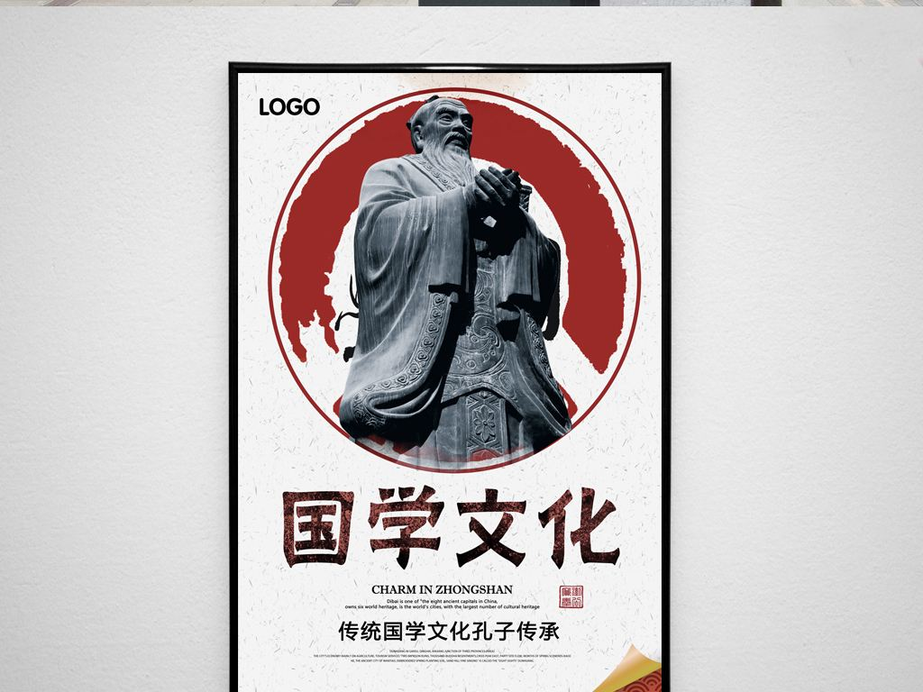

Finish the Poster for the Confucius Institute
Welcome to the Confucius Institute.
Learn to _____________ and all about ______________!
Our institute has grown! We started with __________________ __________ but now we have many more. It is a centre for _________________. You can learn and practise fascinating Chinese traditions. Knowledge of the Chinese language and culture is important because of increasing ___________________________ . Many students go on to great jobs in _____________________.
Join us today to help break down language and _______________, and bring the world together!
speak Chinese
Chinese culture
a few students and teachers
Chinese activities
trade between China and Pakistan
Chinese companies
cultural barriers

Slide 12
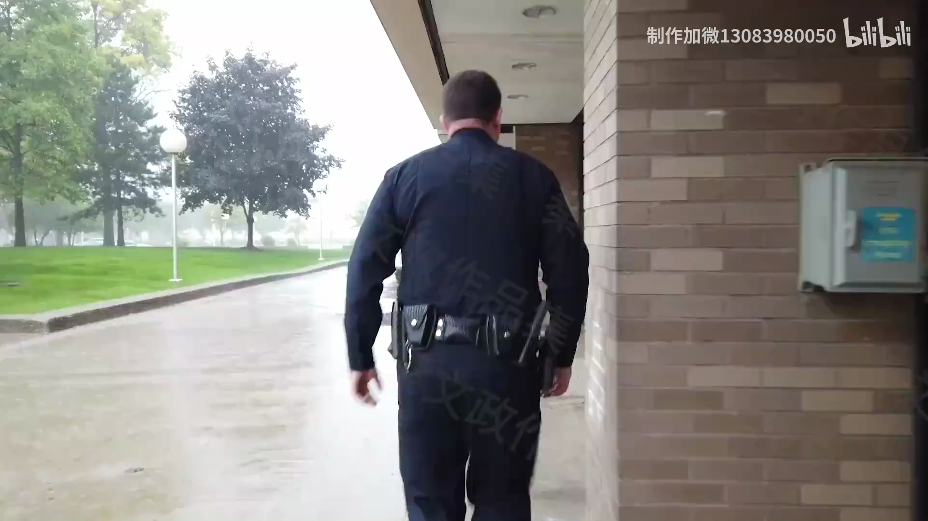
Why do foreign friends are learning Chinese?

Slide 13

Why do foreign friends are learning Chinese?

Slide 14

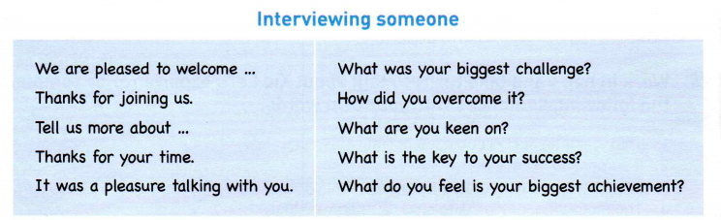
Interviewing someone and
Imagine you're interviewing a student at a Confucius Institute in another country about his or her experience.
1. Brainstorm the questions for the interviewer and possible answers.
2. Then role-play the interview.
3. Use the phrases and questions in the box to help you.

Slide 15


A: Hi, Jane. Welcome to the show! B: Thanks for inviting me. A: Tell us, what was your biggest challenge in learning Chinese at the
beginning? B: Well, suppose it was difficult to grasp the tones at first. A: I bet! Did joining the Confucius Institute help overcome this
problem? B: Absolutely! Getting involved with Chinese cultural activities there
definitely helped a lot...

Slide 16


Read the conversation and answer the questions：
1. What problem is Lu Yao having?
He is having a problem with an English listening task.
2. What may be the cause of the problem?
He couldn’t identify the weak forms in listening.
3. How can he solve his problem?
He should pay more attention to the weak forms, watch some movies, and study how the weak forms are used.

Slide 17
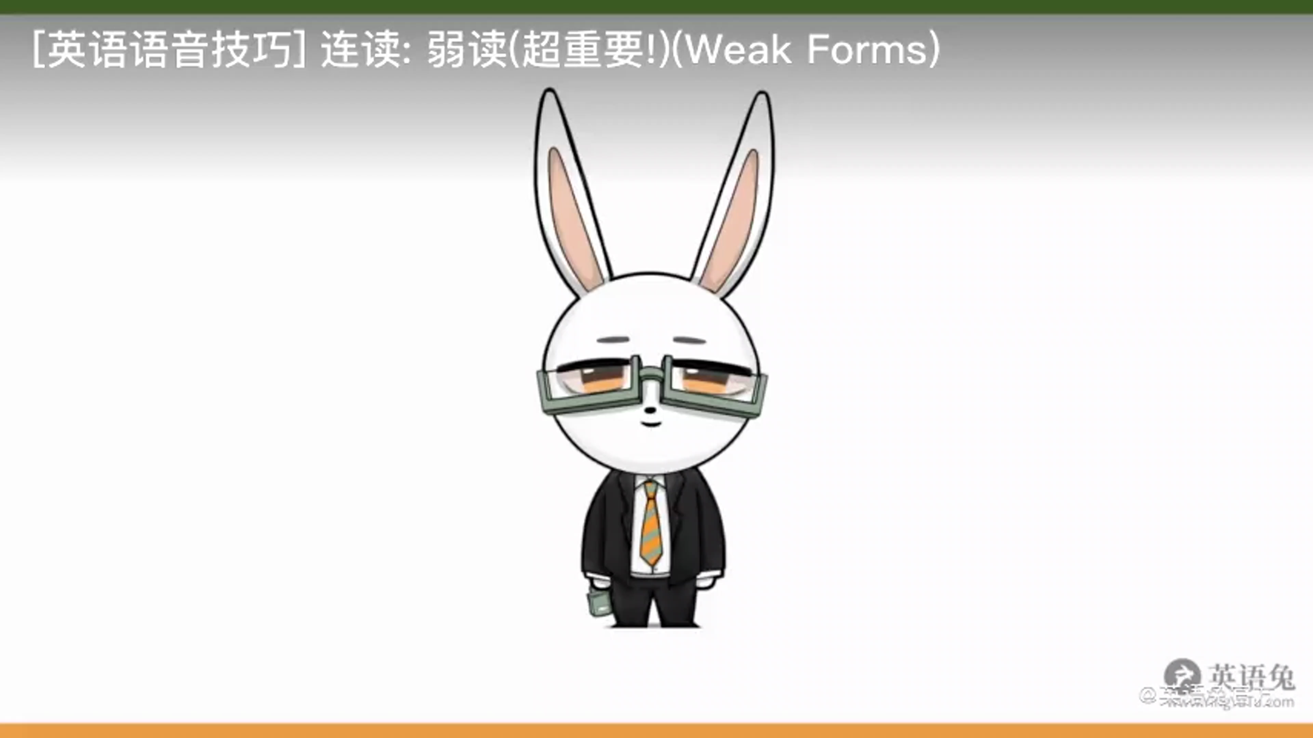
the weak forms

Slide 18
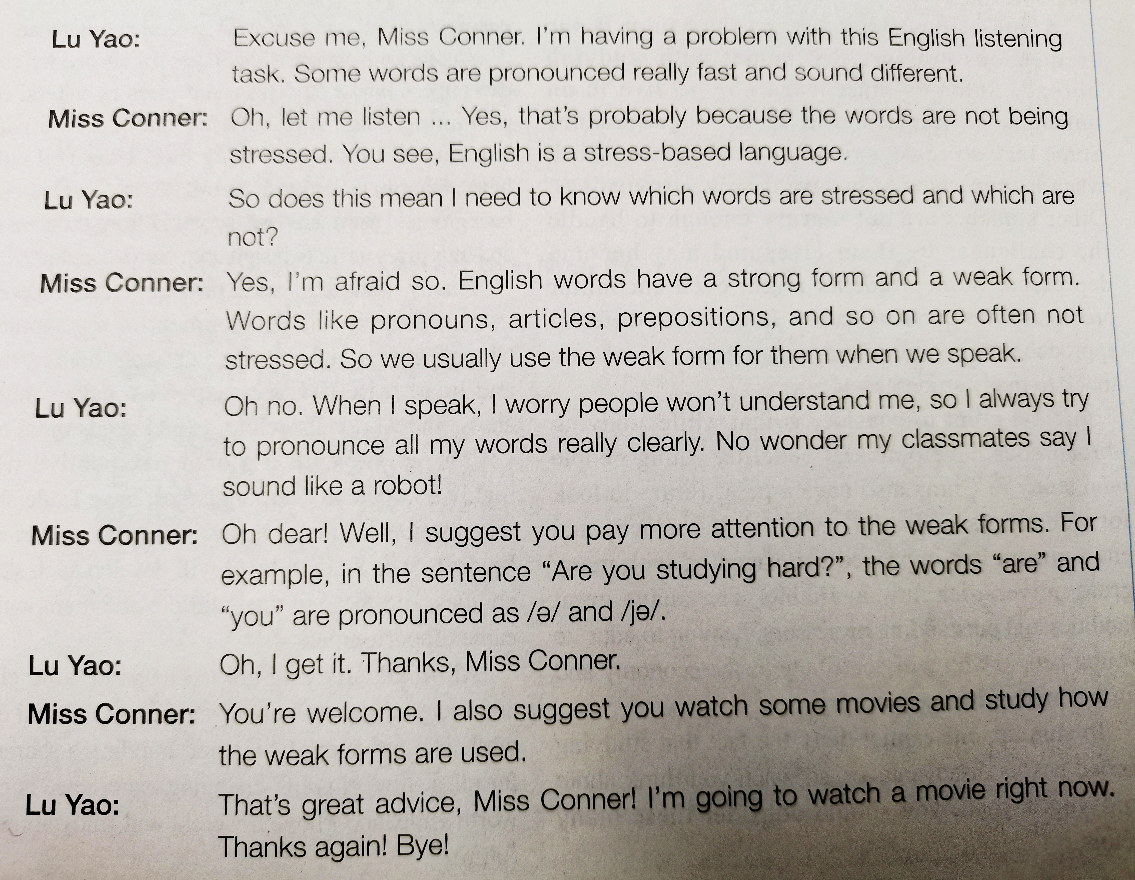
Listen to the conversation and underline the weak forms the speakers used. Then practice the conversation with your partner.

Slide 19
Thanks!
-By Lily

