Slide 1

感恩遇见，相互成就，本课件资料仅供您个人参考、教学使用，严禁自行在网络传播，违者依知识产权法追究法律责任。
更多教学资源请关注
公众号：溯恩高中英语
知识产权声明

Slide 2

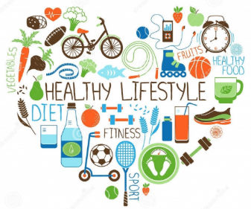
Healthy lifestyle——Reading and Thinking
Learn to develop good health habits
Notes:
www.515ppt.com

Slide 3



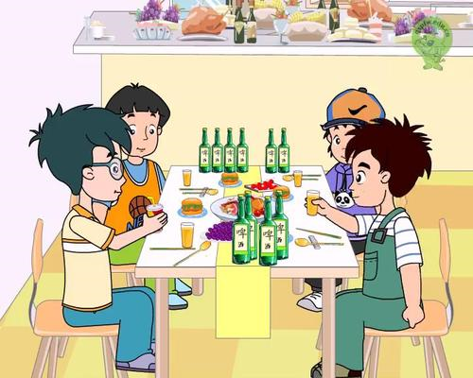
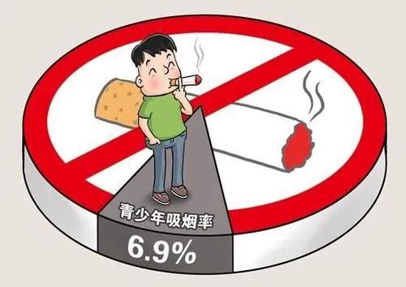

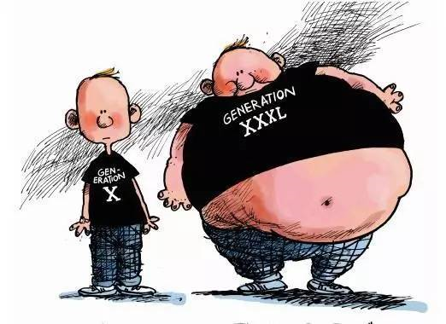

Lead in：Brainstorm
Think about unhealthy/bad habits of teenagers as many as you can.
Do you think bad habits are easy to change?
What can you do to correct these bad habits?
absorbed in computer games
alcohol abuse(drinking)
Now, let's read a passage to find out the answer.
staying up late
excessive diet
smoking

Slide 4
Reading for genre(text type)
Habits for a heathy lifestyle
Skim the title and the passage quickly .
What is text type of the passage?
A. Narration B.Exposition C.Argumentation
Who are the target audience of the text and what is the purpose of the author's writing the passage?
Teenagers, especially those who want to change bad habits
To introduce how habits are formed and how to change bad habits and create new ones.

Slide 5
Reading for the main ideas
01
01
Find the main idea of a paragraph The main idea is sometimes stated in either the opening or closing sentence. If not, look for another “standout” sentence, or summarise the paragraph in your mind by asking yourself, “What is it mainly about?”
Read the passage and match the main idea with the paragraph accordingly.
A
How to change a bad habit and create good ones
B
The cycle of how habits are formed
C
Young people have the power to build a healthy life full of good habits.
D
Changing habits gradually
E
What a habit is and to change habits is not easy
F
Why bad teenage habits should be changed

Slide 6

As teenagers grow up, they become more independent and start making their own decisions. However, during this period, it can be easy for some of them to form bad habits. These bad habits, if left unchecked, could lead to more serious ones when they become adults. For example some of them may become involved in tobacco or alcohol abuse, which can lead to physical and mental health problems. To prevent harmful habits like these from dominating a teenager's life is essential. They must learn to recognise bad habits early and make appropriate changes.
Paragraph 1
“teenagers”
“however”
“must ... make changes”
F Why bad teenage habits should be changed.
Tips：
Look for topic sentence & standout sentence.
F Why bad teenage habits should be changed.
Tips：
Look for topic sentence & standout sentence.

Slide 7
To change bad habits is never easy, even with many attempts. There is a famous saying based on the philosophy of Aristotle: "We are what we repeatedly do." In many ways, our lifestyle is the sum of choices we have made. We make a choice to do something, and then we repeat it over and over again. Soon that choice becomes automatic and forms a habit that is much harder to change. The good news is that we can change, if we understand how habits work.
Paragraph 2
Topic sentence
Leading to the next paragraph
E What a habit is and to change habits is not easy
Tips：
Look for topic sentence

Slide 8
Paragraph 3-4
According to modern psychology, we must first learn about the"habit cycle", which works like this:
Firstly, there is "cue", an action, event, or situation that acts as a signal to do something.
Secondly, there is a "routine", the regular action you take in response to the cue.
Thirdly, there is a "reward", the good thing or feeling we get from the routine.
For example, when we feel unhappy (cue), we eat lots of unhealthy snacks (routine), which makes us feel happy (reward) The reward makes us much more likely to continue the cycle, and the bad habit of relying on unhealthy snacks is formed.
Topic sentence
B The cycle of how habits are formed
Tips：Look for topic sentence

Slide 9
To facilitate a positive change in our bad habits, we must first examine our bad habit cycles and then try to adapt them. We can do this by combining the information from our habit cycles with our own positive ideas. For example, we could try to replace a negative routine with something more positive. So, when we feel unhappy again (cue), rather than eat snacks, we could listen to some of our favourite music instead (routine), which will make us feel relaxed (reward). Aside from changing bad habits, we can also use the habit cycle to create good habits. For example, when we come to an escalator(cue), our normal routine is to ride it, but we could change this routine into something more positive by taking the stairs instead.
Paragraph 5
Topic sentence
Standout sentence
A How to change a bad habit and create good ones
Tips：Look for topic sentence & standout sentence.

Slide 10
Paragraph 6
Many of us try to change bad habits quickly and if we are not successful straight away, we often become pessimistic and give up. In fact, the most successful way to change is not suddenly, but over a period of time. As the Chinese philosopher Lao Zi wrote, "A journey of a thousand miles begins with a single step. "One step seems small, but it is essential. To reach the goal of change, a person must show some discipline and repeatedly take many small steps. After all, it is not easy to break bad habits .
Standout sentence
D Changing habits gradually.
Tips：
Look for standout sentence.

Slide 11
Paragraph 7
For young people, there is plenty of time to change bad habits. However, there is no"magic pill" or delete button that will help you; you have to think about your bad habits and decide on some changes. You have the power to build a happy and healthy life full of good habits!
“young people”
Topic sentence
C Young people have the power to build a healthy life full of good habits.
Tips： Look for topic sentence

Slide 12
Reading for structure
Reading for the main ideas
Paragraph 1 Why bad teenage habits should be changed.
Why
Paragraph 2 What a habit is and to change habits is not easy
Paragraph 3-4 The cycle of how habits are formed
How
Paragraph 5 How to change a bad habit and create good ones
Paragraph 6 Changing habits gradually.
Paragraph 7 Young people have the power to build a healthy life full of good habits.
Summary

Slide 13
Structure
Habits for a healthy lifestyle:
✔ Main idea:
We should build a healthy life.
Para. 1
no easy way to change bad habits
Para. 3-6
reasons why we should change bad habits
Para. 2
how to change bad habits into good ones
Para. 3-4
Para. 5-6
Para. 7
young people’s power
habit cycle
what to do
cue, routine and reward
how to facilitate a positive change in our bad ones
change bad habits gradually

Slide 14
Reading for details
Paragraph 1
Reading for structure
As teenagers grow up, they become more independent and start making their own decisions. However, during this period, it can be easy for some of them to form bad habits. These bad habits, if left unchecked, could lead to more serious ones when they become adults. For example some of them may become involved in tobacco or alcohol abuse, which can lead to physical and mental health problems. To prevent harmful habits like these from dominating a teenager's life is essential. They must learn to recognise bad habits early and make appropriate changes.
How does the author develop the paragragh?
start with a fact
As teenagers grow up, they become more independent and start making their own decisions.
However, during this period, it can be easy for some of them to form bad habits. These bad habits, if left unchecked, could lead to more serious ones when they become adults.
For example some of them may become involved in tobacco or alcohol abuse, which can lead to physical and mental health problems.
state an opinion
By giving an example
Change

Slide 15
Reading for details
Reading for details
Paragraph 2
To change bad habits is never easy, even with many attempts. There is a famous saying based on the philosophy of Aristotle: "We are what we repeatedly do." In many ways, our lifestyle is the sum of choices we have made. We make a choice to do something, and then we repeat it over and over again. Soon that choice becomes automatic and forms a habit that is much harder to change. The good news is that we can change, if we understand how habits work.
How does the author develop the paragragh?
There is a famous saying based on the philosophy of Aristotle: "We are what we repeatedly do."
By citing a quotation
Q1: What characteristics does a habit have?
What does the quotation"We are what we repeatedly do " mean？我们重复的行为造就了我们.
In many ways, our lifestyle is the sum of choices we have made. We make a choice to do something, and then we repeat it over and over again. Soon that choice becomes automatic and forms a habit that is much harder to change.
repetition
Q2: Why is it hard to change a habit?
automatic
The good news is that we can change, if we understand how habits work.
Because we usually don’t understand how habit works.
harder to change

Slide 16



Reading for details
Reading for details
Paragraph 3-4
According to modern psychology, we must first learn about the"habit cycle", which works like this:
Firstly, there is "cue", an action, event, or situation that acts as a signal to do something.
Secondly, there is a "routine", the regular action you take in response to the cue.
Thirdly, there is a "reward", the good thing or feeling we get from the routine.
For example, when we feel unhappy (cue), we eat lots of unhealthy snacks (routine), which makes us feel happy (reward) The reward makes us much more likely to continue the cycle, and the bad habit of relying on unhealthy snacks is formed.
Q1：What are the three stages of habit cycle？
Q2: How does the author further explain the"habit cycle"?
Firstly, there is "cue"...
Secondly, there is a "routine"...
Thirdly, there is a "reward",....
ROUTINE
__________
Make it more logical
CUE
_______
REWARD
_________
For example, when we feel unhappy ...
Make it more convincing
By giving an example

Slide 17



ROU TINE
__________
Think of one bad habit and write down the cue, routine, and reward. Then come up with an idea of how to break the bad habit.
CUE
_______
REWARD
________
 | Example | Your example
Cue | Unhappy | ...
Routine | eat lots of unhealthy snacks | ...
Reward | feel happy | ...
Advice to change | ... | ...

Slide 18
Reading for details
Reading for details
Paragraph 5
Paragraph 5
To facilitate a positive change in our bad habits, we must first examine our bad habit cycles and then try to adapt them. We can do this by combining the information from our habit cycles with our own positive ideas. For example, we could try to replace a negative routine with something more positive. So, when we feel unhappy again (cue), rather than eat snacks, we could listen to some of our favourite music instead (routine), which will make us feel relaxed (reward). Aside from changing bad habits, we can also use the habit cycle to create good habits. For example, when we come to an escalator(cue), our normal routine is to ride it, but we could change this routine into something more positive by taking the stairs instead.
Read to work out the author’s opinion on the application of the habit cycle.
How does the author develop the paragragh?
Q1: What’s the author’s opinion? How do you know that?
“Aside from changing bad habits, we can also use the habit cycle to create good ones.”
Q2: What’s the function of the above sentence?
It concludes the former information and introduces the following.
By giving an example

Slide 19
Reading for details
Reading for details
Paragraph 6
Many of us try to change bad habits quickly and if we are not successful straight away, we often become pessimistic and give up. In fact, the most successful way to change is not suddenly, but over a period of time. As the Chinese philosopher Lao Zi wrote, "A journey of a thousand miles begins with a single step. "One step seems small, but it is essential. To reach the goal of change, a person must show some discipline and repeatedly take many small steps. After all, it is not easy to break bad habits .
Q1: With the habit cycle, do you think bad habits can be changed right away? No
Q2: What else are needed? Read the passage and underline the key words.
time
In fact, the most successful way to change is not suddenly, but over a period of time. As the Chinese philosopher Lao Zi wrote, "A journey of a thousand miles begins with a single step. "One step seems small, but it is essential. To reach the goal of change, a person must show some discipline and repeatedly take many small steps.
Discipline and efforts
How does the author develop the paragragh?
As the Chinese philosopher Lao Zi wrote, "A journey of a thousand miles begins with a single step. "
By citing a quotation

Slide 20
Reading for details
Paragraph 7
For young people, there is plenty of time to change bad habits. However, there is no"magic pill" or delete button that will help you; you have to think about your bad habits and decide on some changes. You have the power to build a happy and healthy life full of good habits!
QWhat is this paragragh mainly about？
For young there is plenty of time to change bad habits... You have the power to build a happy and healthy life full of good habits!
function
help teenagers change their bad habits and live a healthy lifestyle
to appeal to young people including teenagers to change bad habits and live a happy and healthy life
strengthen our resolve to tackle the seemingly tough problems in our lives.
What is the writing purpose? Work in pairs and figure it out.

Slide 21
Retell the text according to the graphic organizer.
Bad habits, if left unchecked, could ______________________ when teenagers become adults.
＊first examine their bad habit cycles and then try to adapt them __________ _________________________________
_________________________________.
＊use the habit cycle to ________________.
by combining the information from their habit cycles with their own positive ideas
lead to more serious ones
Reasons for changing bad habits
create good habits
bad habit
We make a choice and repeat it over and over again. Soon _________ ___________________
__________________
Ways to change bad habits
that choice becomes automatic and forms a habit
How a habit is formed
Tips:
＊The most successful way to change bad habits is __________ ______________________.
＊Teenagers must show _______
___________ and repeatedly take many small steps.
Three steps of the habit cycle
not suddenly, but over a period of time
some
＊Firstly, there is a “cue” that acts as _______________________________.
＊Secondly, there is a “routine”, the regular action _____________________________.
＊Thirdly, there is the “reward”, ________ _____________________ ______________.
discipline
a signal to do something
you take in response to the cue
the good thing or feeling we get from the routine

Slide 22
Interview
Suppose you are the reporter of school newspaper， you are interviewing an expert named Oscar Wilde on teenager problems , make a dialogue between you and the expert on how to change bad habits and live a happy life.
S: Hello, everyone ,I’m the host of Sophia. Today, it is a great honor for us to invite the famous expert in teenager problems .Welcome , Doctor Oscar.
Oscar: Hi ,Sophia, thank you for inviting me .
S: We have been expecting to ask you some questions on how to change some bad habits and live a happy life , shall we start?
….

Slide 23
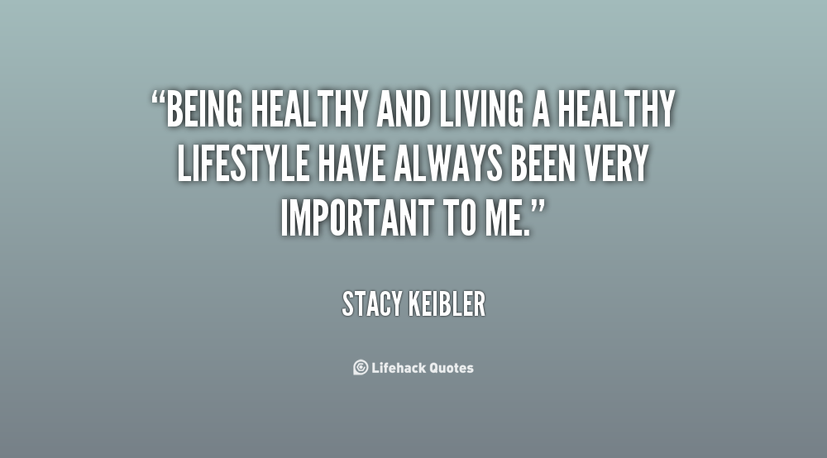

Living a healthy lifestyle will only deprive you of poor health, laziness and fat.

