Slide 1


感恩遇见，相互成就，本课件资料仅供您个人参考、教学使用，严禁自行在网络传播，违者依知识产权法追究法律责任。
更多教学资源请关注
公众号：溯恩高中英语
知识产权声明

Slide 2

The Week
Dec 18th-24th, 2021

Slide 3


1. The Benefits of Emotional Support Animals
抚慰心灵的动物

Slide 4
语篇填空
（《读者文摘》2021年12月 & 2022年1月双月刊 52页）
significantly
For many people, owning a dog or cat can ___________ (significant) alleviate depression, _______ (anxious), and loneliness, according to research into the benefits of emotional support animals. ________________ these animals aren’t trained to do anything ____ regular pets don’t do, they hold special therapeutic (治疗的) significance for people who struggle with their psychological health. In ___ Ohio-based study, patients who adopted a dog or cat from a shelter ________ (report) faring (进展) _____ (good), on average, 12 months later. __________ (depend) upon what the laws are where you live, you might be able ______ (get) your mental health care provider to certify your companion as an emotional support animal. This certification could entitle you to _________ (privilege) such as access to airplane cabins and pet-free apartments.
anxiety
Although / Though
that
an
reported
better
Depending
to get
privileges

Slide 5
词语讲解
1. alleviate: to make sth less severe 减轻；缓解
A number of measures were taken to alleviate the problem.
采取了一系列措施缓解这个问题。
2. certify: to state officially, especially in writing, that sth is true 证明；证实
certification: the act of certifying sth 证明；鉴定
He was certified dead on arrival. 他送到时被证实已死亡。
翻译句子
这个机构致力于减少世界上的饥饿和疾病。
The organization works to alleviate world hunger and disease.
翻译句子
他递给她一张纸，证明她健康状况良好。
He handed her a piece of paper certifying (that) she was in good health.

Slide 6
长难句分析
1. Depending upon what the laws are where you live, you might be able to get your mental health care provider to certify your companion as an emotional support animal.
分析：本句中的depending upon相当于according to的用法，作介词词组；depending on后的what the laws are为 _____ 从句，where you live为 _________ 从句。
宾语
地点状语
翻译
根据你生活的地方的法律，你可能会让你的精神健康护理人员证明你的伙伴是一种情感支持动物。
2. Although these animals aren’t trained to do anything that regular pets don’t do, they hold special therapeutic significance for people who struggle with their psychological health.
让步
分析：本句整体是一个although引导的 ______ 状语从句，状语从句中包含一个that引导的 _________，主句中包含一个who引导的 __________。
定语从句
定语从句
翻译
虽然这些动物没有被训练去做任何普通宠物不会做的事情，但它们对那些与心理健康作斗争的人有特殊的治疗意义。

Slide 7
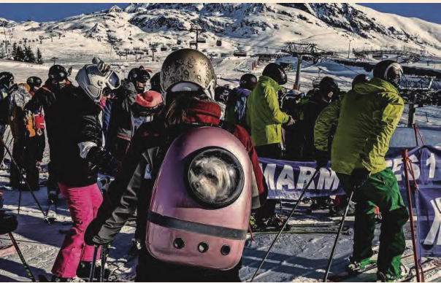
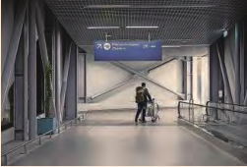
2. Travel Curbs Send Chill through Tourism Industry
旅游限制使旅游业陷入寒冬
LEFT, dog’s life: a skier carries her pet in a backpack at Alpe d’Huez, France, this month. RIGHT, all quiet at Thessaloniki airport, Greece

Slide 8
语篇填空
（《金融时报》周末美国版 2021年12月19日 4页）
The Christmas holiday plans of millions of Europeans __________________ (throw) into doubt by the Omicron variant that has dealt a heavy blow to the winter sports industry across the continent.
After months of __________ (general) free movement for vaccinated adults, EU governments have unilaterally started placing new entry ______________ (requirement) on travelers, even within the union’s borderless travel area.
France has taken the most radical step by banning tourist travel to and ______ the UK, which is battling an Omicron-fuelled surge in Covid-19 infections, ________ (cause) the cancellation of thousands of ski holidays and trips to second homes in the country.
Several Eurostar trains from London to Paris sold out on Thursday and yesterday ____ people rushed to travel before ____ deadline today. But hoteliers at the Morzine resort in the French Alps were inundated with cancellations after the announcement. Sara Burdon, communications manager at the Morzine tourism office, __________ (describe) it as “the worst kind of timing”.
With half of the customers ______ (go) and no government support, Burdon said she expected the impact would be even _____________ (severe) than last winter.
have been thrown
generally
requirements
from
causing
as
the
described
gone
more severe

Slide 9
词语讲解
unilaterally: something is done by only one person, group, or country involved in a situation, without the agreement of others. adv. 单方面地
Apple could not unilaterally introduce a code that weakens the iPhone.
苹果就不能单方面引入削弱iPhone的代码。
__________________________________________________________
2. radical: in favour of thorough and complete political or social change
adj. 激进的；极端的；彻底的；完全的
He likes to present himself as a radical politician.
他喜欢表现出一副激进政治家的样子。
______________________________________________________________
翻译句子
父亲单方面决定带全家去印第安纳州度暑假。
The dad decided unilaterally to take his family to Indiana for summer holiday.
翻译句子
这位王室成员在成年后的大部分时间一直在宣扬激进的理念。
The royal member has been promoting radical ideas for most of his adult life.

Slide 10
长难句分析
France has taken the most radical step by banning tourist travel to and from the UK, which is battling an Omicron-fuelled surge in Covid-19 infections, caus-ing the cancellation of thousands of ski holidays and trips to second homes in the country.
分析：本句是一个which引导的非限制性定语从句，which指代_______; “by banning …the UK”是现在分词结构作_________ ；“causing … the in the country”是现在分词结构表_________。
the UK
方式状语
结果状语
翻译
法国采取了最激进的措施，禁止游客往返英国。目前，英国正全面抵抗奥密克戎变异株，此役情导致数千人取消了滑雪和前往英国第二家园度假。
这部电影背后的团队使用最新技术来创造数字化的动物，他们花了数千万美元在技术上，记录演员的表演。
仿写
The team behind the movie used the latest technology to create digitalized animals, spending tens of millions of dollars on technology that records an actor’s performance.

Slide 11
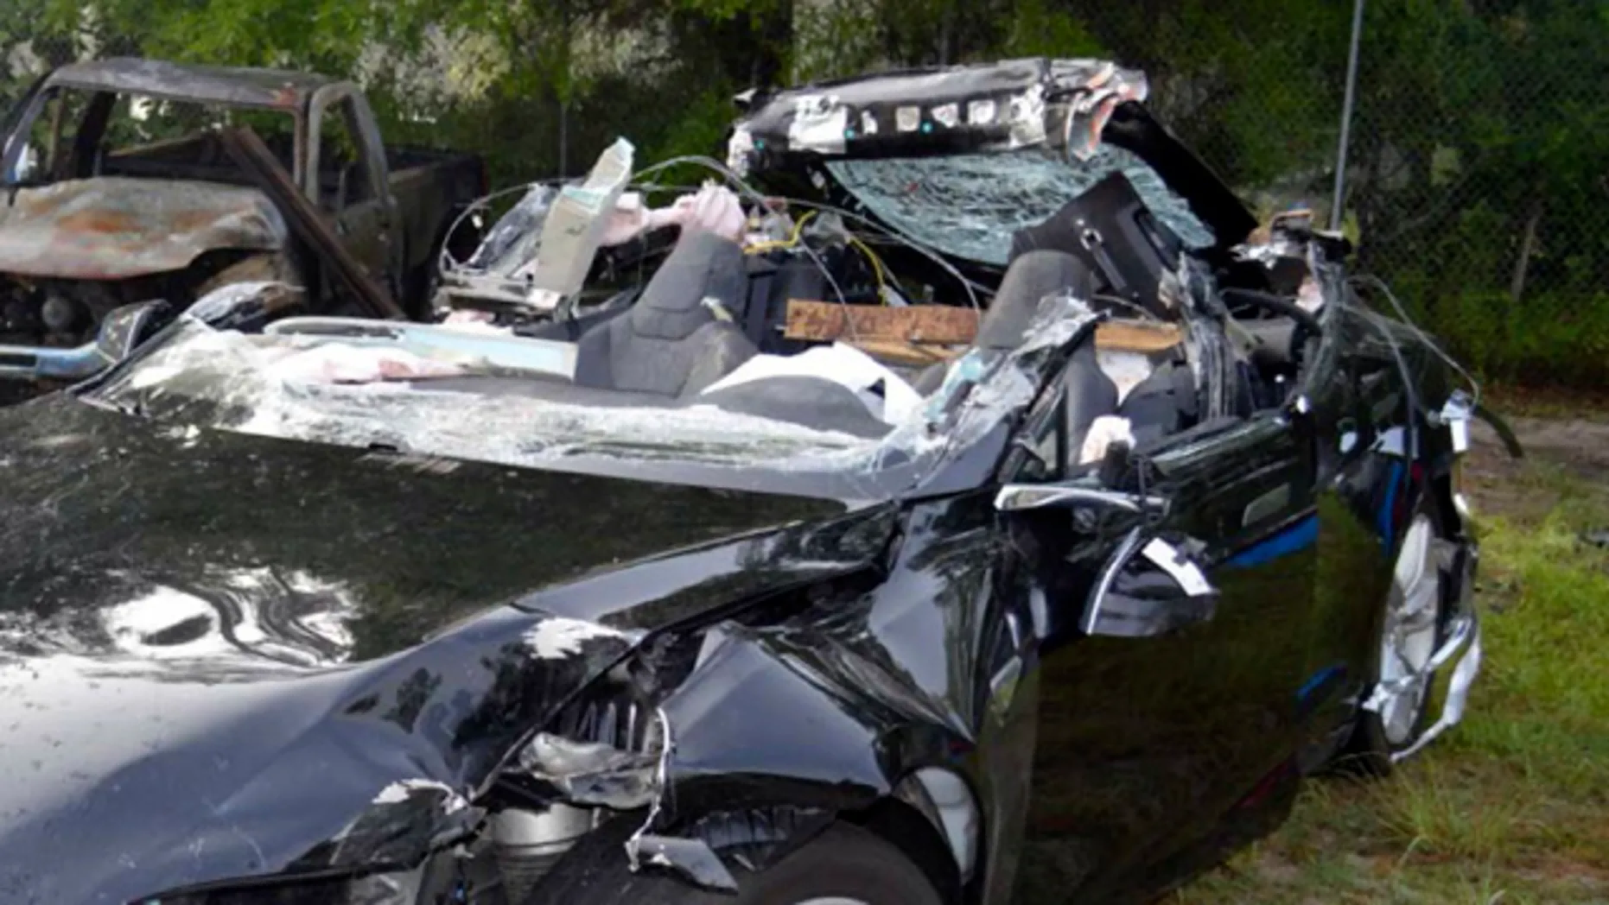
3. Self-driving cars: A wrong turn on the way to utopia
特斯拉自动驾驶汽车真的安全吗？

Slide 12
语篇填空
（《周刊报道》2021年12月24日 20页）
truly
Listening to Tesla chief Elon Musk over the years, it was easy to think that “_____ (true) autonomous driving was nearly at hand,” said Cade Metz and Neal Boudette in The New York Times. As early as 2016, Musk boasted that “all Tesla vehicles _______ (leave) the factory have the hardware necessary for Level 5 autonomy.” But regulators say Musk has exaggerated the system’s excellence. Since 2017, Tesla ________ (sell) an expensive upgrade, _____ (call) Full Self Driving, which includes ___ ability for the car to steer, brake, and accelerate on highways. More recent updates enable the Tesla to “respond to traffic lights and stop signs” ___ its own and “change lanes without being prompted.” But a 2016 ___________ (promotion) video showcasing the technology was staged, and the public never saw that “the car hit a roadside barrier.” Tesla is now under ____________ (investugate) after at least 12 ________ (accident), one fatal, in ______ Teslas using Autopilot drove into parked emergency vehicles.
leaving
has sold
called
the
on
promotional
investigation
accidents
which

Slide 13
词语讲解
1. exaggerate: to make sth. seem better, worse etc than it really is 夸张；夸大
These figures exaggerate the loss of competitiveness.
这些数字夸大了竞争力的下降。
2. prompt: to make sth. happen 促使；导致；激起
His speech prompted an angry outburst from a man in the crowd.
他的讲话激起了人群中一男子的愤怒。
翻译句子
我一连三天睡不着，我没有夸张。
I couldn’t sleep for three days and I’m not exaggerating.
翻译句子
他的评论促使我进一步了解情况。
His comments prompted me to find out more about the situation.

Slide 14
长难句分析
Since 2017, Tesla has sold an expensive upgrade, called Full Self Driving, which includes the ability for the car to steer, brake, and accelerate on highways.
分析：本句主语Tesla，谓语动词 _______，宾语__________________，宾语后的called Full Self Driving为过去分词作_________， _____ 从句which includes ... on highways修饰宾语an expensive upgrade。
has sold
an expensive upgrade
后置定语
定语
自2017年以来，特斯拉出售了一款昂贵的升级产品，名为全自动驾驶，包括在高速公路上转向、刹车和加速的能力。
翻译
从去年开始，杰克读了J.K.罗琳写的《哈利·波特》，这本书吸引了来自世界各地很多孩子。
仿写
Since last year, Jack has read Harry Potter, written by J.K. Rowling, which attracts a lot of children from all over the world.

Slide 15
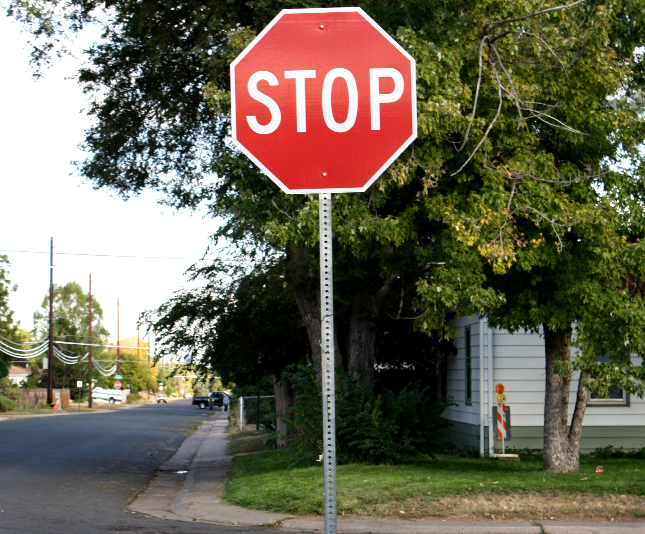
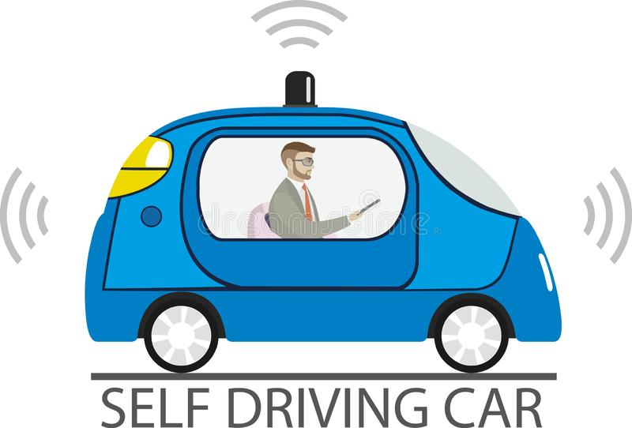
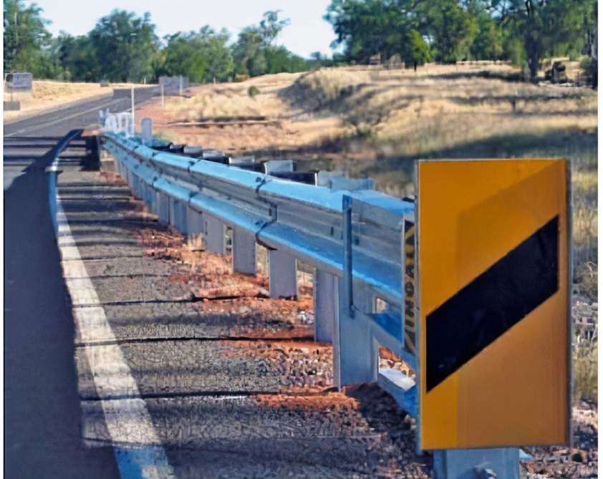
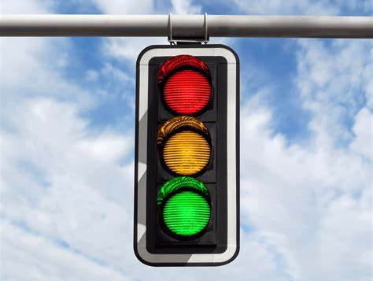
交通车辆相关词汇
auto (=automobile) n.汽车
vehicle n.交通工具；车辆
autonomous driving自动驾驶
Full Self Driving 全自动驾驶
automation n.自动化
autopilot n.自动驾驶仪
steer v.驾驶
brake v. 刹车
accelerate v.加速
lane n.车道
stop sign 停车标志
roadside barrier路侧护栏
traffic lights交通信号灯

Slide 16
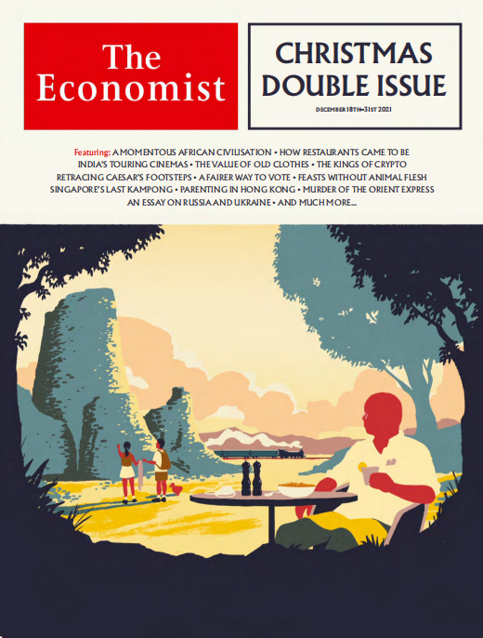
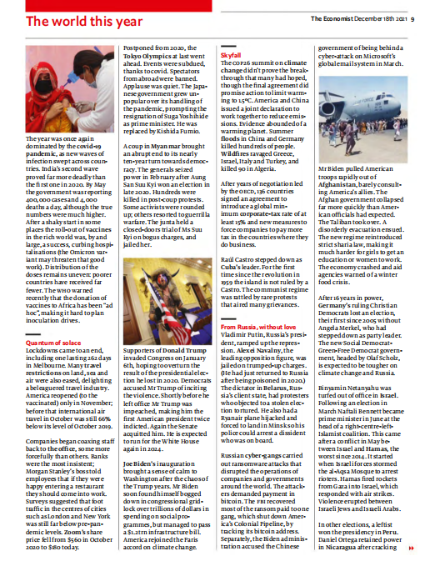
4. The World This Year 系列文章 《经济学人》2021年12月18日刊 9-10页

Slide 17
The World This Year 系列文章之一
（《经济学人》2021年12月18日刊 9页）
The year was once again dominated by the covid-19 pandemic, as new waves of infection swept across countries. India’s second wave proved far more deadly than the first one in 2020. By May the government was reporting 400,000 cases and 4,000 deaths a day, although the true numbers were much higher. After a shaky start in some places the roll-out of vaccines in the rich world was, by and large, a success, curbing hospitalisations (the Omicron variant may threaten that goodwork). Distribution of the doses remains uneven: poorer countries have received far fewer.
roll-out n. 启动
by and large 总的来说
curb v. 控制
翻译
随着新一波感染席卷各国，这一年再次受到新冠大流行的影响。事实证明，印度的第二波疫情比2020年的第一波致命得多。到5月，印度政府每天报告约40万感染病例和4000死亡病例，尽管真实数字要高得多。在某些地方开局不稳之后，富裕国家启动的疫苗接种计划大体上是成功的，减少了住院率（奥密克戎变体可能会威胁到这个好势头）。疫苗分布仍然不均衡：较贫穷的国家接受的剂量要少得多。

Slide 18

The World This Year 系列文章之二
（《经济学人》2021年12月18日刊 9页）
Postponed from 2020, the Tokyo Olympics at last went ahead. Events were subdued, thanks to covid. Spectators from abroad were banned. Applause was quiet. The Japanese government grew unpopular over its handling of the pandemic, prompting the resignation of Suga Yoshihide as prime minister. He was replaced by Kishiida Fumio.
postpone v. 推迟
subdue v. 压制
prompt v. 促使
推迟的2020年东京奥运会终于举行。由于疫情影响，奥运赛事遭缩水。国外观众禁止现场观赛。赛场上掌声寥寥。日本政府因对疫情处理不力而备受诟病，促使菅义伟辞去首相职务，由岸田文雄接替。
翻译

Slide 19
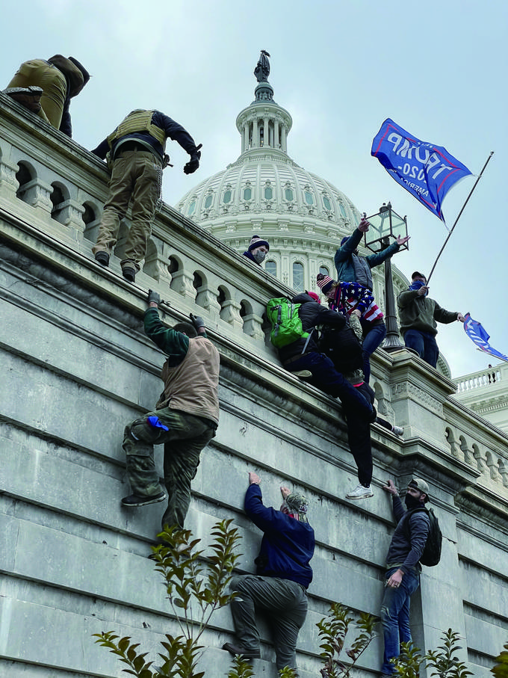
The World This Year 系列文章之三
（《经济学人》2021年12月18日刊 9页）
Supporters of Donald Trump invaded Congress on January 6th, hoping to overturn the result of the presidential election he lost in 2020. Democrats accused Mr Trump of inciting the violence. Shortly before he left office Mr Trump was impeached, making him the first American president twice indicted. Again the Senate acquitted him. He is expected to run for the White House again in 2024.
impeach v. 弹劾
indict v. 起诉
acquit v. 宣判…无罪
翻译
唐纳德·特朗普的支持者于1月6日入侵国会，希望推翻他在2020年输掉的总统选举结果。民主党指责特朗普煽动暴力。特朗普离任前不久遭到弹劾，这使他成为第一位被起诉两次的美国总统。参议院再次宣布他无罪。预计他将在2024年再次竞选总统。

Slide 20
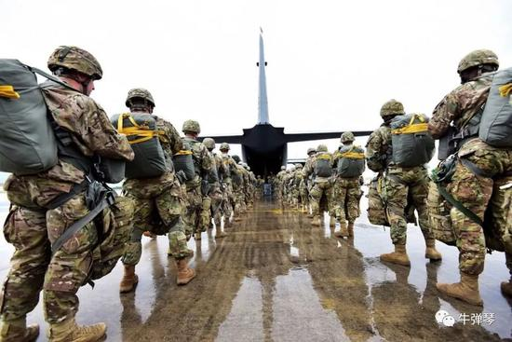
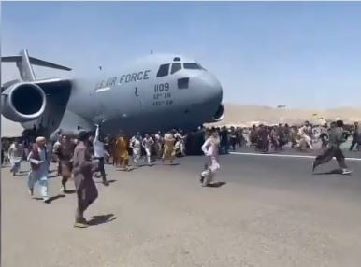
The World This Year 系列文章之四
（《经济学人》2021年12月18日刊 9页）
Mr Biden pulled American troops rapidly out of Afghanistan, barely consulting America’s allies. The Afghan government collapsed far more quickly than American officials had expected. The Taliban took over. A disorderly evacuation ensued. The new regime reintroduced strict sharia law, making it much harder for girls to get an education or women to work. The economy crashed and aid agencies warned of a winter food crisis.
ensue v. 接着发生
regime n. 政权
翻译
拜登总统几乎没有咨询美国的盟友，就迅速将美军撤出阿富汗。阿富汗政府垮台的速度比美国官员预期的要快得多。塔利班接管了政权。随后进行了无序的疏散。新政权重新引入了严格的伊斯兰教法，使女孩接受教育或妇女工作变得更加困难。阿富汗经济崩溃，援助机构警告冬季可能迎来粮食危机。

Slide 21
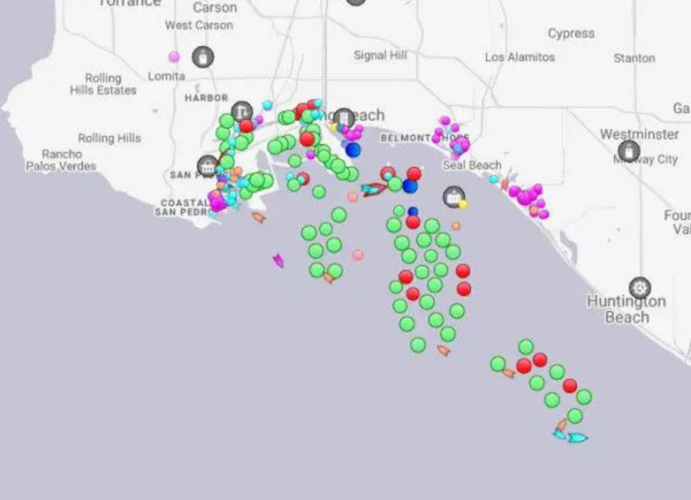
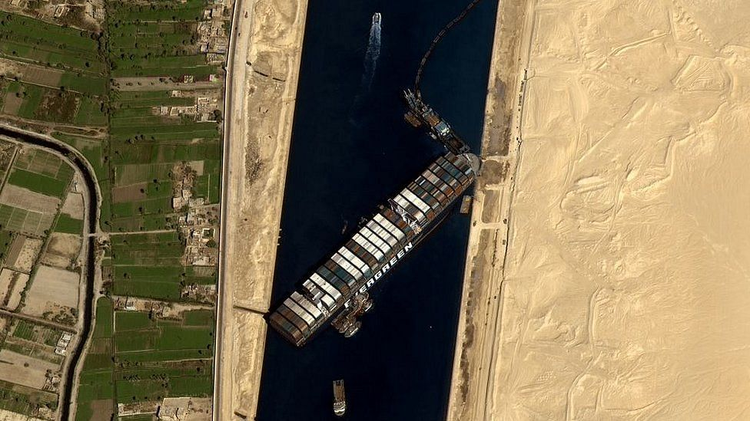
The World This Year 系列文章之五
（《经济学人》2021年12月18日刊 10页）
Supply-chain snarl-ups added to the inflation headaches. Ships off the coast of Los Angeles, for example, queued in record numbers trying to unload their goods. In March the Ever Given, a container ship, got wedged in the Suez Canal, blocking 369 other ships trying to traverse the waterway. The Ever Given was freed within a week, but didn’t reach its destination port, Rotterdam, until July.
snarl-up n. 混乱
wedge v. 楔牢
traverse v. 穿越
翻译
供应链混乱加剧了通胀问题。例如，洛杉矶海岸附近有创纪录数量的船只排队试图卸货。3月，一艘集装箱船天赐号被困在苏伊士运河中，阻挡了其它369艘试图穿越水道的船只。天赐号在一周内脱困，但直到7月才抵达目的地港口鹿特丹。

Slide 22

The World This Year 系列文章之六
（《经济学人》2021年12月18日刊 10页）
“No Time to Die”, the last outing for Daniel Craig as James Bond, was finally released in cinemas, having been postponed three times during the pandemic. The film has become Hollywood’s biggest hit during the covid era. Its box-office takings were dwarfed, however, by the year’s biggest grossers: “The Battle at Lake Changjin”and “Hi, Mom”, both made in China.
dwarf v. 使相形见绌
gross v. 总共赚得
《无暇赴死》是丹尼尔·克雷格饰演詹姆斯·邦德的最后一场演出，在疫情期间被三度推迟，终于在电影院上映。这部电影已成为好莱坞在新冠时期最热门的影片。然而，与今年最卖座的两部中国制作的电影《长津湖》和《你好，李焕英》的票房收入相比，《无暇赴死》的票房收入相形见绌。
翻译

Slide 23
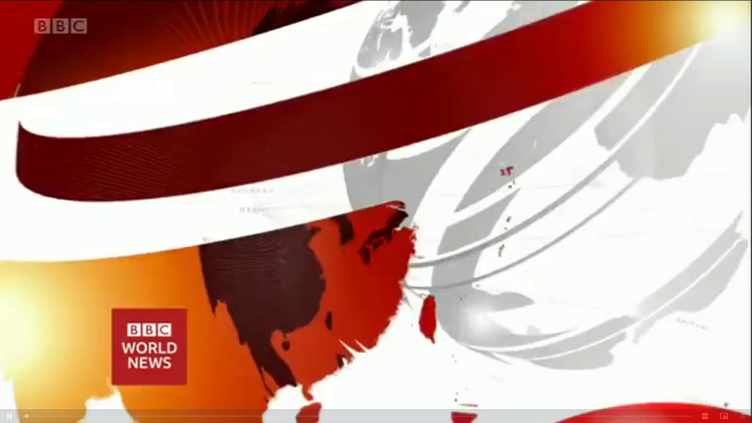
5. BBC一分钟新闻听写填空 One-minute World 12/20/21

Slide 24

听写
听写
worldwide
Concerns growing _________ over this rapid spread of the Omicron variant of coronavirus, France, Italy, the United Kingdom and South Africa are among the countries to have recorded their _______ ever daily numbers of _________.
President Biden has announced the U.S federal government will _____ the entire cost of the 30 days of cleanup in the state of Kentucky after Friday's devastating tornadoes. Mr Biden described the __________ there is almost ____________.
EU leaders are holding their last summit of the year in Brussels soon. Coronavirus and ____________ are expected to be up for discussion. But Russia's actions on the border with Ukraine are likely to ______ prominently.
People in the southern Philippines are preparing for the arrival of super typhoon Rai. Winds of more than ____________________ are expected along with heavy rain. Thousands of people are _________________.
highest
infections
cover
destruction
beyond belief
energy prices
feature
165 kilometers per hour
leaving their homes

Slide 25
词语讲解
1. feature: to have an important part in sth 起重要作用；占重要地位
Olive oil and garlic feature prominently in his recipes.
橄榄油和大蒜在他的食谱中显得很重要。
全球气候变暖问题将会在会议中着重讨论。
_______________________________________________________
2. prominent: very noticeable or being an important part of sth else
显著的；突出的
Here the window plays a prominent part in the design.
这里窗户在设计中起着非常重要的作用。
这则报道刊登在头版的显著位置。
__________________________________________________
翻译句子
The issue of global warming will feature prominently in the conference.
翻译句子
The story was given a prominent position on the front page.

Slide 26
长难句分析
Concerns growing worldwide over this rapid spread of the Omicron variant of coronavirus, France, Italy, the United Kingdom and South Africa are among the countries to have recorded their highest ever daily numbers of infections.
分析：本句中“Concerns growing... coronavirus”是__________结构; “to have recorded... infections”是_______ 结构作_________。
独立主格
不定式
后置定语
翻译
世界范围内对奥密克戎冠状病毒变种的这种快速传播的担忧日益加剧，法国、意大利、英国和南非等国都记录了有史以来最高的每日感染人数。
仿写
近年来，人们越来越关注世界各地发生的极端天气模式，气候变化成为科学家和普通民众关注的几大问题之一。
Concerns growing over the extreme weather patterns that have occurred around the world in recent years, climate change is among several major issues to have drawn the attention of scientists as well as common people.

