Slide 1

感恩遇见，相互成就，本课件资料仅供您个人参考、教学使用，严禁自行在网络传播，违者依知识产权法追究法律责任。
更多教学资源请关注
公众号：溯恩高中英语
知识产权声明

Slide 2


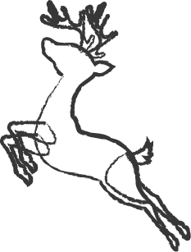

2021年12月北斗星盟高二联考读后续写讲评
Christmas Day in the Morning
陈星可 浙江省天台中学

Slide 3
CONTENTS
Story understanding and language learning
Plot designing
Language accumulation
Work appreciation

Slide 4

The given part of the story
It was the night before Christmas and Rob was lying in bed, thinking about the next day. His family was poor, living entirely on the farm they ran, and most of the excitement of Christmas was in the turkey they had raised themselves and pumpkin pies his mother made. He rolled over to look at his old watch- it was two o'clock. Three hours later, his father would call him to get up, even if it was Christmas.
His father never talked about loving him- he had no time for such things. There was always so much to do on the farm. “Or, maybe, he just doesn’t love me,” Rob thought. He had a reason to think so. At 5o’clock every morning, his father would call him to get up and help with the farm work. He had to go to the barn(棚) to hold the milking pails(挤奶桶) steadily when his father was milking the cow. He had to help put the tools in place and do the cleaning after the milking. He hated it that he had to do all these things at so early time.
He was not the only one awake at this night. He heard his parents whispering in the next room. “Mary, I hate to call Rob in the mornings. He’s growing so fast

Slide 5
The given part of the story
and he needs his sleep. If you could see how he sleeps when I go in to wake him up! I wish I could manage alone.”
“Well, you can’t, Adam.” His mothers voice was gentle, Besides, he isn’t a child anymore. It's time he took his turn.”
“Yes,” his father said slowly. “But I do hate to wake him.”
When he heard these words, something in him spoke: his father loved him! He had never thought of that before, taking for granted the tie of their blood. Now that he knew his father loved him, he had to do something different on this Christmas. He did save and buy them each something every year,but he wished he had a better present for his father instead of the usual tie from the ten-cent store.
Paragraph 1: A good idea suddenly struck him. _________________________
Paragraph 2:It being almost five, he rushed back to his room and jumped into bed, waiting to be woken up. ___________________________________________

Slide 6
About the author：Pearl S. Buck（赛珍珠）
Well-known author, Pearl S. Buck wrote multiple books and short stories throughout her lifetime, many of which focused on her experiences in China. She was also a strong advocate of women’s rights and civil rights and was dedicated to supporting the welfare of Asian children.
Born into a family of missionaries on June 26, 1892, Pearl spent her first few months in West Virginia. However, soon after her birth, her parents returned to Zhanjiang, China, where they stayed for many years. Following that, she and her family traveled to and from China many times. It was her early life and experiences in China that formed the bases of much of her writing, including East Wind: West Wind and The Good Earth. Beause of her achievements, she received numerous awards in literature.
Buck died on March 6, 1973, leaving a legacy of literature and philanthropy. She wrote over seventy books, which include novels, translations of Chinese literature, children’s literature, and biographies.

Slide 7
Understanding the story
Rob’s family was poor, 1._______ lived entirely on the farm they ran and the only excitement of Christmas was a farm-raised turkey and home-made pumpkin pies. Every morning, he would 2.____________(wake) up early by his father to help 3._______ the milking and cleaning in the barn, which made him 4._________ (convince) that his father didn’t love him at all.
One early Christmas morning, 5.___________, Rob was awake and by accident learned through his 6.___________(parent) whisper that his father was actually loving him. He was unwilling to wake him up so early 7.________ Rog was growing fast these days and hoped that he 8.__________(he) could manage the work alone. Somewhat touched, he decided to do something different as 9._______ present to his father instead of the usual tie from the ten-cent store. His mind 10.________ (work) fast, an idea popped into his mind.
who
be waken
with
convinced
however
parents’
as
himself
a
working

Slide 8
Learning language
1.经营一家农场
2.喂养火鸡
3.翻身
4.有理由做某事
无缘无故地
5.帮助干农场上的活
6.把...放就位
7.不想干某事
8.该轮到某人了
9.把...想当然
10.既然
11.突然学到一个主意
12.等着被叫醒
1.run/manage a farm
2.raise the turkey
3. roll over
4.have a reason to do sth.
for no reason
5.help with the farmwork
6.put... in place
7.hate to do sth.
8.take one’s turn
9.take... for granted
10.now that
11.It struck/hit sb. that...
12.wait to be waken up

Slide 9
Designing the plot-- Underlined words
Rob
father
barn
Christmas
present
love
get up
milking
manage
different
1.Rob decided to milk the cows before Dad woke up, making it a different present to his father.
2.Instantly, he jumped out of the bed, pulled on the clothes and slipped out into the barn.
3.Though the milking alone was a challenge, little Rob managed it well,with the cows’ perfect cooperation.
4. Throwing himself into Dad’s arms, he said “Merry Christmas, Dad! I love you”
5.The barn was so quiet, with cows looking at Rob, sleepy and confused.
Tip1:根据划线词可以判断情节的基本走向：Rob独立挤牛奶来作为圣诞礼物送给爸爸，回报爸爸的爱。
Tip2:抽象名词present可以作为续写升华部分的出发点和归结点。
Tip3:尽可能多的使用划线词可以有效防止情节的走偏。

Slide 10
Designing the plot-- first sentences-- Q & A
Paragraph 1: A good idea suddenly struck him. _________________________
Paragraph 2:It being almost five, he rushed back to his room and jumped into bed, waiting to be woken up. ___________________________________________
Q1:What was the good idea？And the reason or the purpose?
Q2: How did he put the idea into practice?
She went to the barn.
Q3: How did he feel about what he had done?
逆推法
Q1: Did his father come to wake him up? Why?
Q2: How did father react to what he had found in the barn?
Q3: How did Rob feel about the present? And what was in his mind

Slide 11
Designing the plot-- first sentences-- Q & A
Paragraph 1: A good idea suddenly struck him. _________________________
Q1:What was the good idea？And the reason or the purpose?
Why not give his father a special present, out there in the barn?
“Maybe I can do all the work father does every morning so that father can have a relaxing Christmas,” Rob thought to himself.
“I can do all the work in the barn in advance, as a different present to Dad,” Rob said to himself, excitement filling his heart.
The thought struck him like a silver dagger. Why should he not give his father a special gift too?

Slide 12
Designing the plot-- first sentences-- Q & A
Paragraph 1: A good idea suddenly struck him. _________________________
Q2: How did he put the idea into practice?
He got up and put on his clothes. He crept downstairs, careful of the creaky boards, and let himself out. The cows looked at him, sleepy and surprised. It was early for them, too.
Instantly, he jumped out of bed, pulled on his clothes and slipped out into the barn.
Immediately, he threw on his clothes in the dark, carefully opened the door and tiptoed out to the barn, careful enough not to awake his parents.

Slide 13
Designing the plot-- first sentences-- Q & A
Paragraph 1: A good idea suddenly struck him. _________________________
Q2: How did he put the idea into practice?
He had never milked all alone before, but it seemed almost easy. He smiled and milked steadily, two strong streams rushing into the pail, frothing and fragrant.
The task went more easily than he had ever known it to go before. It was something else, a gift to his father who loved him. He finished, the two milk cans were full, and he covered them and closed the milkhouse door carefully.
And the next two hours witnessed the boy busy work in the barn: carefully putting the pails in a steady position and milking the cows one by one. With the milking done, he cautiously placed the tools back in place and did the cleaning.

Slide 14
Designing the plot-- first sentences-- Q & A
Paragraph 1: A good idea suddenly struck him. _________________________
Q3: How did he feel about what he had done?
Looking around at the barn, Rob couldn’t help smiling, satisfaction and pride written all over his face. He could even imagine father’s surprised scream.
Back in his room he had only a minute to pull off his clothes in the darkness and jump into bed, for he heard his father up.
Imagining how father would react when he found what he had done, he couldn’t help smiling.
Looking at the watch, he found it was almost five. So he immediately slipped back to his bedroom and onto the bed, so excited and expectant that he lay wide awake.

Slide 15
Designing the plot-- first sentences-- Q & A
Paragraph 2:It being almost five, he rushed back to his room and jumped into bed, waiting to be woken up. ___________________________________________
Q1: Did his father come to wake him up? Why?
As usual, father came into Rob’s room and called Rob, gently but unwillingly.
Unwilling to disturb his Rob at so early time, especially when it was Christmas, he went to barn without Rob, attemptinh to manage it alone.
Pretending to be asleep, he didn’t open his eyes until his father called his name.
Wondering why his father didn’t wake him up as usual, he lay in bed, closely minding the approaching steps.
“ Rob!” His father called, “We have to get up, even if it is Christmas. I’ll get things started.” Rob lay still, laughing to himself. In just a few minutes his father would know. His dancing heart was ready to jump from his body.

Slide 16
Designing the plot-- first sentences-- Q & A
Paragraph 2:It being almost five, he rushed back to his room and jumped into bed, waiting to be woken up. ___________________________________________
Q2: How did father react to what he had found in the barn?
The minutes were endless—ten, fifteen, he did not know how many—then he heard his father’s footsteps again. The door opened and he lay still. His father was laughing a queer sobbing sort of laugh.
When they got to the barn, what greeted them really made father puzzled, but soon he came to understand the whole thing. Proudly and gently, he patted Rob on the shoulder, saying this was the best Christmas present he had ever received from Rob.
When he opened the barn door, what greeted him was that all the work was done and all the tools in place, which took him by amazement. And the next moment saw his son running into his arms, “Merry Christmas, dad. I love you.”

Slide 17
Design the plot-- first sentences-- Q & A
Paragraph 2:It being almost five, he rushed back to his room and jumped into bed, waiting to be woken up. ___________________________________________
Q3: How did Rob feel about the present? And what was in his mind?
His heart was bursting with love. Oh, what a Christmas, and how his heart had nearly burst again with shyness and pride as his father told his mother and made the younger children listen about how he, Rob, had got up all by himself.
Feeling himself grown up, Rob decided to help more on the farm and give his father a surprise every Christmas ahead.
He found his father had clutched him in a great hug. He felt his father’s arms go around him. “Thank you. Nobody ever did a nicer thing. ”

Slide 18
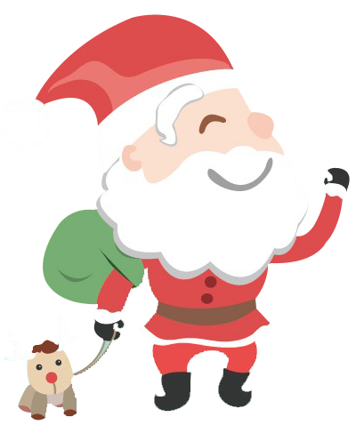
Language accumulation ---兴奋
Seeing such extraordinary beauty, every cell in my body woke up. It was like discovering a new dimension of life.
When the host announced that she won the prize, her eyes twinkled with excitement.
Her heart was thumping/beating with excitement.
My heart was pounding/ ringing/ echoing in my ears.
His dancing heart was ready to jump from his body.
The excitement built up inside of me as breakfast went on.
She burst/erupted/jumped with excitement/joy.
She laughed, her eyes shining/ sparking/ sparkling/ glistening/ glowing with excitement.
He could hardly conceal/contain his excitement and gave me an enormous hug.
Beaming/Brimming with joy, She shared the cheering news with me.
The game had the crowd on the edge of their seats.

Slide 19
参考范文：
A good idea suddenly struck him. Why not give his father a special present, out there in the barn? He quickly got up and crept downstairs on tiptoes. The cows looked at him, sleepy and surprised. It was early for them too, but they behaved well, as though they knew it was Christmas. Rob had never milked all alone before, but the task went more easily than he had ever known before. He smiled and milked steadily, two strong streams rushing into the pail, fresh and fragrant. Finishing all the milking and cleaning, he went out of the barn and closed the door behind him. 98
It being almost five, he rushed back to his room and jumped into bed, waiting to be woken up. “ Rob!” His father called, “We have to get up, even if it is Christmas. I’ll get things started.” Rob lay still, laughing to himself. In just a few minutes his father would know. His dancing heart was ready to jump from his body. The minutes were endless - ten, fifteen, he did not know how many -- and he heard his father’s footsteps again. “Rob!” His father was laughing, a queer sobbing sort of laugh. “It’s for Christmas, Dad!” He found his father had clutched him in a great hug. He felt his father’s arms go around him. “Thank you. Nobody ever did a nicer thing. ” 105

Slide 20
下水作文 ：
A good idea suddenly struck him. “I can do what father does every morning before he wakes up,” Rob thought to himself, excitement filling his heart. Instantly, he jumped out of bed, pulled on his clothes and slipped out into the barn. And the next two hours witnessed the boy busy work in the barn: carefully putting the pails in a steady position and milking the cows one by one. With the milking done, he cautiously placed the tools back in place and did the cleaning. Looking around at the barn, Rob couldn’t help smiling, satisfaction and pride written all over his face. He could even imagine father’s surprised scream. 103
点评：
可以给以第五档的分数（21-25）
1.与所给短文融合度高，与所提供的各段落开头语衔接合理。
2.使用分词作状语、独立主格结构、with复合结构等高级语法结构，句式多样。
3.instantly，pull on, witness, in place, cautiously等高级词汇的运用，增加了表达的丰富性。
4.And the next two hours witnessed the boy时空转换手段的有效运用，使短文结构紧凑，读起来更为流畅。

Slide 21
下水作文：
It being almost five, he rushed back to his room and jumped into bed, waiting to be woken up. As usual, father came into Rob’s room. Pretending to be asleep, he didn’t open his eyes until his father called his name. When they got to the barn, what greeted them really made father puzzled, but soon he came to understand the whole thing. Proudly and gently, he patted Rob on the shoulder, saying this was the best Christmas present he had ever received from Rob. With an excited “Merry Christmas, dad. I love you!”, he threw himself into father’s arms. Feeling himself grown up, Rob decided to help more on the farm and give his father a surprise every Christmas ahead. 103
点评：
可以给以第五档的分数（21-25）
1.与所给短文融合度高，与所提供的各段落开头语衔接合理。
2.使用分词作状语、名词性从句、修饰性副词置于句首等高级语法结构，句式多样。
3.greet, threw himself into father’s arms, every Christmas ahead等高级词汇的运用，增加了表达的丰富性。
4.采用“展望未来式”的手来走位文本的结尾，有着积极向上的意义。

Slide 22
更多圣诞节话题读后续写1：2021年3月“七彩阳光”高三下返校联考
The Wilsons were having dinner. The food was left from their Thanksgiving dinner two days before：turkey soup and turkey meat mixed with potatoes . Eleven-year-old Angelina asked，”Are we having turkey ice cream, too?” Her father replied, “Angelina, have you forgotten that I had no job for a whole year? Now I have work again. You should be very thankful.” “I'm sorry I said that about the turkey! But unless I get a new dress，I will not look good for the Christmas Festival.” Angelina murmured.
The Festival was the winter holiday celebration of a group she belonged to: the Avalon Girls' Service Club. They wrote cheerful cards for hospital patients. They cooked meals for the homeless .But the Christmas Festival was different . The girls wore party clothes and many people came to see them perform. Angelina had only a plain gray dress that she had worn to the event last year .And now it was a little too short. Angelina appealed to her parents to buy one for her, a beautiful red dress in Forbes' Store. Her mother sighed, “Well, we can not buy it. We have to be careful. You never know when I might lose my job.”

Slide 23
更多圣诞节话题读后续写1：2021年3月“七彩阳光”高三下返校联考
All hope was not gone.There was a sign in the Forbes’ store window that said” layaway(分期付款)”. Angelina pulled ten worn dollar bills from her coat pocket .She ran to the store and begged the salesperson, Mrs.Harding, to hold ’her’ dress for her. ”Ok. But you must come back in two weeks to pay the rest” Angelina felt like jumping into the air. She was so happy that she told Mrs. Harding about the Avalon Service Club's work and its Christmas party .
Then, Angelina shook and suffered in the cold wind looking for work. Finally, Angelina got a job making new clothing for dolls. Angelina was excellent at sewing. Sure enough, the dolls' dresses turned out beautiful. She got twenty dollars. Still，she was far from having enough money for her dress . She felt helpless as the final payment date arrived .
She returned sadly to Forbes' Store, “I don't have enough money for the dress.” Then she saw Mrs.Harding's eyes were red. She looked like she had been crying .She said the store was closing and she was losing her job.

Slide 24
参考范文：
Suddenly, Mrs Harding said that she would pay the rest of the money so Angelia could have it. This commitment made Angelia ecstatic , her heart thumping wildly. The fantastic scene of her peers in the club surrounding her and casting envious and worshiping look over at the Christmas party flashed across her mind. Her face flushed and eyes sparkled. Giggles and chuckles were to sound when a depressed face with red eyes reflected into her eyes. She shivered with a gust of chill instantly running down her spine. She felt a little ashamed for her momentary selfish thought of beautifying herself regardless of the hard situation of Mrs Harding. Her accepting heart withdrew. “Thank you very much indeed for your kindness! Mrs Harding!” said Angelia, “Merry Christmas to you and good luck for your job hunting!” She strode out.

Slide 25
参考范文：
Outside, Angelina saw a man who looked like Santa Claus was asking people for money to help poor people. Standing in the hard blowing wind and fluttering dense snowflakes, he was seen busy warmly greeting and saying “Thank you! Merry Christmas!” to the pedestrians dropping money in the charity box, a face brimming with happiness. “Donate it or keep it for myself？”she pondered, with a conflicting heart, holding tightly the twenty- dollar bill she had earned by sewing hard doll clothing, “The former will go to the needy people for life necessities and the latter, the long-expected dress , maybe, is just to show off.” The haunting red-eyed Mrs Harding as well as the amazingly similar-seeming life scene where her father had been laid off determined her choice. She stepped up and gave him her money in the admiring look of the Santa Claus and other donators. Snowflakes were still dancing along with her dream of children all wearing beautiful dresses. Melodious Christmas songs were on and on!

Slide 26
更多圣诞节话题读后续写2：A Christmas present
Several years ago, I was living in New York and working for an airline, so I never got back home for Christmas. My Christmas was happy too with some other colleagues around. But in my heart I was sad because I couldn't stay with my family. Sometimes my colleagues would say our Christmas was filled with tears. But this Christmas was different. I was lucky. I had the whole day off, which meant I could stay with my family on Christmas Eve.
When Christmas morning came, I awoke to a small hand rubbing my face. “Dad, Merry Christmas!” was all my younger son had time to say. He seemed to be racing against time. I knew he was hunting for gifts with his brother eagerly. I got downstairs just to see the two little boys’ faces as they looked at the pocket rockets Santa Claus had left them. I realized that the real Christmas was for the children who had deep belief in the amazing power of Santa Claus. At first, their fingers went almost shyly over their toys. When their inspection (检查) had been completed, the two boys ensured that the gifts were really delivered by Santa Claus and they dragged everything into the center of the living room.

Slide 27
更多圣诞节话题读后续写2：
Delight flooded the room. As their mother began giving out gifts, I smiled to myself, wondering how my unexpected gifts this year would be received. With so many Christmas spent outside, I had prepared so many gifts for my children and together with my wife I hid them in several secret places. But the children were excellent detectives and they found all of them. They were happily opening packages constantly thanking considerate Santa Claus for his kindness and ability to know their desires. But I had not received a single one. I knew they had forgotten my existence with my absence from their Christmas these years.
Paragraph 1: I had to admit that my disappointment was growing steadily. ______ ________________________________________________________
Paragraph 2: Suddenly my wife walked up to me. ____________________ _______________________________________________________

Slide 28
参考范文：
I had to admit that my disappointment was growing steadily. I was wondering whether I could get a gift when my younger son ran to me, who was really kind enough to save my face. He asked me to admire his gift which he deeply believed was carefully chosen by Santa Claus. He said happily that he would share some of the gifts of his and allow me to choose one from them. I thanked him from the bottom of my heart, still feeling disappointed.
Suddenly my wife walked up to me. It seemed that she had guessed how I felt. She asked me to look at the Christmas tree which was decorated with so many boxes. I thought she was showing off her efforts on the decoration but she took off a small box and passed it to me, smiling and saying it was for me. I opened it and saw a letter which read “We will never forget you. Merry Christmas!” Under the letter was a watch which was clicking with delight. I was moved to tears.

Slide 29
更多圣诞节话题读后续写3：A Christmas present
It was the late 1930s, and things were tough. Mum had a hard time raising us on her own in our small community of New Westminster, BC. My dad had drowned in Pitt Lake, five years ago.
Looking back, I realized what Mum went through sending us kids to school. Every morning she would put a new piece of cardboard (纸板) in our shoes, because our soles (鞋底) were worn out. When we got home, Mum would have “French bread” ready for us. Constant moving was typical for my family in those times. Rent was 25 dollars a month, but Mum couldn’t pay it, and we knew we would be evicted (驱逐) right after Christmas on the first of January.
Christmas was approaching, and we would get a twenty-five-dollar Christmas cheque from social services. The inspector (检查员) came to our house, and searched it from top to bottom to be sure we didn’t have any food hidden away. When he didn't find any, he handed the cheque to Mum. Mum said that instead of buying food, she would use the 25 dollars to pay back rent,making sure that all of us would have a roof over our heads for a little while longer. She told us then there

Slide 30
更多圣诞节话题读后续写3：
would be nothing for Christmas.
Unknown to Mum, I had been selling Christmas tree, removing snow, and doing different jobs to earn enough money to buy a new pair of boots. Boots that weren’t worn out, boots with no cardboard in the soles. I knew exactly which boots I wanted. They were Ten-inch Top Genuine Pierre Paris and they had a price of 23 dollars.
Well, the big day came on the afternoon of Christmas Eve. I was excited as I hurried up the road to the shoe store. But on the way I noticed a house with Christmas lights and decorations. It was then that I realized at our house, we had no lights, no decorations, nor any money for Christmas sweets. I knew that we would have no turkey or ham for Christmas, and I felt sad.
Paragraph1: As I continued walking I began to reconsider my plan. __________ __________________________________________________________________
Paragraph2: With great excitement and tears in my eyes, I rushed back home. __ __________________________________________________________________

Slide 31
参考范文：
As I continued walking I began to reconsider my plan. A ripple of guilt spread across my mind: I was going to buy a new pair of boots while my mother was home in tears, worrying about the approaching Christmas and the accommodation. Oh, no! That was not what I desired! Seeing a grocery store nearby, I headed in without hesitation. With the money I had earned, I bought lights, decorations and a turkey rather than the boots.
With great excitement and tears in my eyes, I rushed back home. I could hardly wait to see my mother's face! When Mum opened the door, some of the groceries fell inside onto the floor, and she just stood there, dumbfounded目瞪口呆的. Learning what had happened, Mum was so touched that she tightly gathered me into her arms, murmuring, “Thank you! Honey!” Holding back the tears, I said, “Merry Christmas!”That day I got enough hugs and kisses from Mum to last two life times.

Slide 32

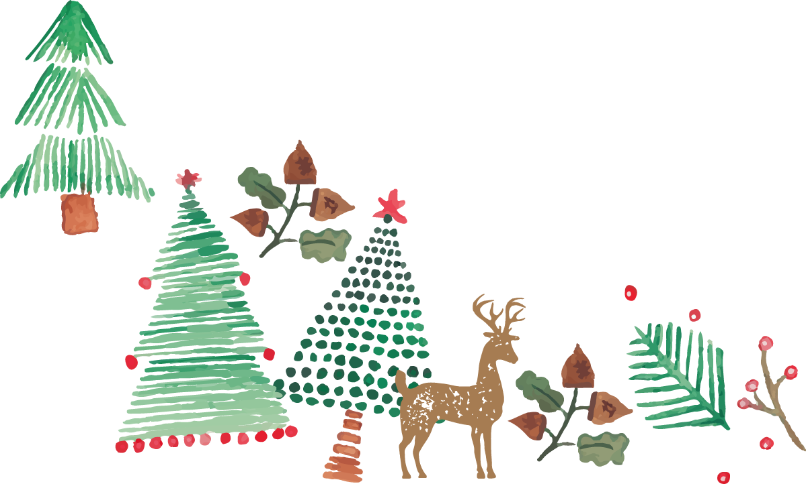
Thank you
MERRY CHRISTMAS

