Slide 1

感恩遇见，相互成就，本课件资料仅供您个人参考、教学使用，严禁自行在网络传播，违者依知识产权法追究法律责任。
更多教学资源请关注
公众号：溯恩高中英语
知识产权声明

Slide 2
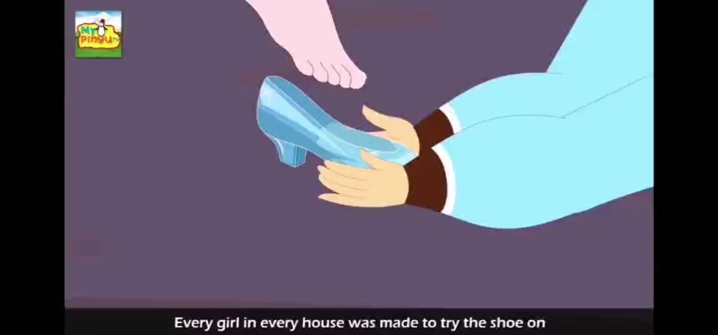

Slide 3
Micro skill in writing
—Inanimate subjects
Nancy

Slide 4
Learning objectives
[inˈænimit]
1.To know what inanimate subject is
2.To have a knowledge of four different types of inanimate subjects
3.To apply inanimate subject to writing properly.

Slide 5
高考优秀作文评分标准
应用文：（13分-15分）
1.完全完成了试题规定的任务，.内容完整，条理清楚；
2.交际得体，表达时充分考虑到了交际对象的需要；
3.体现出较强的语言运用能力
读后续写（21分-25分）：
1.与所给短文融洽度高，与所提供各段落、开头语衔接合理。
2.所使用语法结构和词汇丰富、准确，可能有些许错误，但完全不影响意义表达；
3.有效地使用了语句间的连接成分，使所续写短文结构紧凑；
4.词数充分，150词左右。评分细则规定少于130词的，从总分中减去2分；
language：
rich
diverse

Slide 6

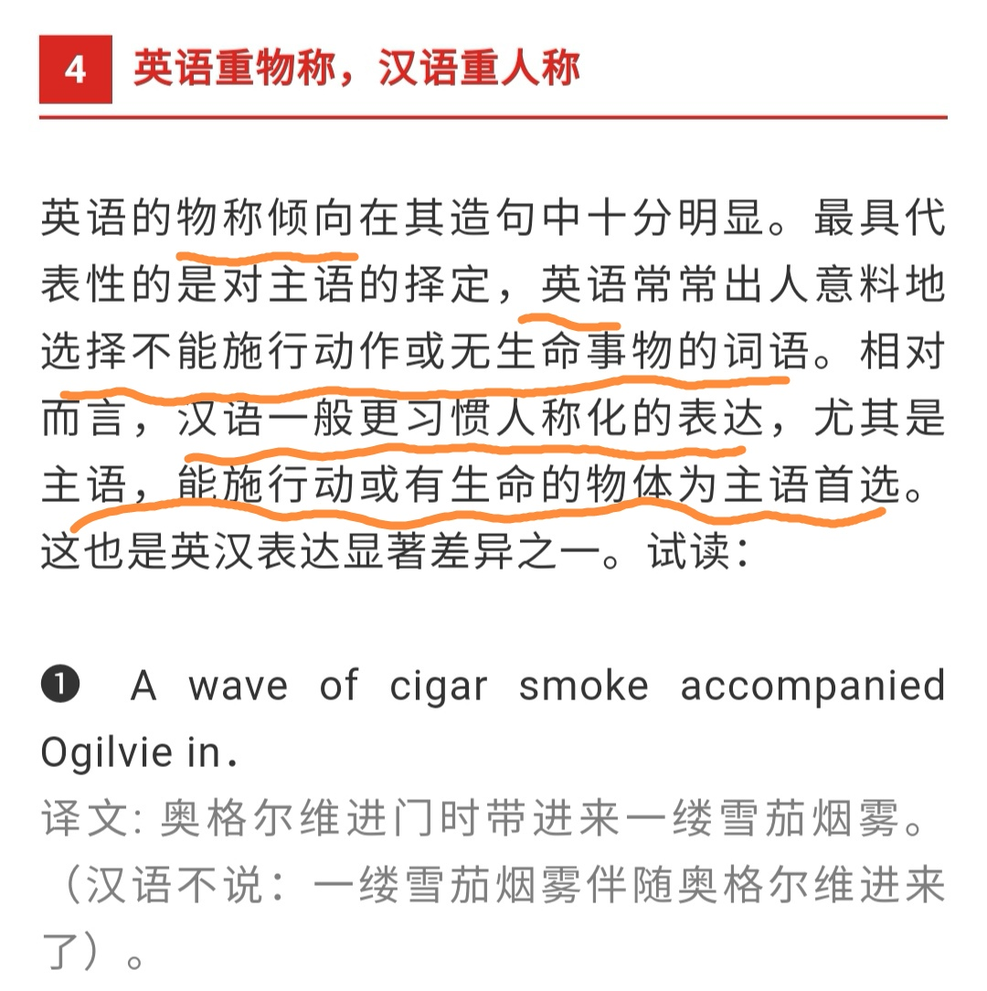
What is inanimate subject?
inanimate:
not alive in the way that people, animals and plants are.
[inˈænimit]
sentence pattern:inanimate subject+ animate verb

Slide 7

(2019年全国一卷作文范文)
Dear Li Hua,
I am Li Hua, an exchange student from China . Delighted to learn that volunteer students are wanted for a Chinese painting exhibition, I'm writing to apply for it.
The reasons for my application are as follows. First of all,having been exposed to foreign teachers since a young age, I can communicate freely with others in English. What's more, years of being monitor makes me a brilliant organizer, which will help a lot to keep the exhibition in order. The most important factor is that my related knowledge will undoubtedly help the audience learn more about the unique Chinese art form.
All in all, my sense of responsibility makes me a qualified volunteer. I'd appreciate it if you could take my application into consideration.

Slide 8
(2017浙江高考读后续写范文)
The car abruptly stopped in front of him.A woman hurriedly opened the door and stretched out her hand, shouting, “Get in!” Mac grabbed her hand without hesitation, leaving his bicycle lying on the road and jumped into the car. The moment he shut the door, he caught the glimpse of the fierce eyes and hungry look of the wolf by the door. A cold feeling crept over his heart and made him shiver. However, the car had left the wolf far behind, which made him sigh with relief. Mac thanked Paul and Becky and afterwards they pulled over by the road to wait for Mac's friends.
A few minutes later, the two other cyclists arrived. As soon as they met, his friends worried look faded away. “Where have you been? We saw your bicycle on the road.” His friend asked and these words like a ray of sunshine warmed his heart. After Mac explained to them, they said farewell to Paul and Becky in sincerely indebtedness. On the way home, night breeze made him at ease and he couldn't wait to share his experience with his wife and children and show the kindness of the world.

Slide 9
身心和情感状态的名词
feelings and emotions as the inanimate subjects
行为或动作意义的名词
behaviors or actions as the inanimate subjects
4 types
（inanimate
subjects）
具体或抽象事物的名词
concrete or abstract nouns as the inanimate subjects
时间和地点名词
Time and place as the inanimate subjects

Slide 10
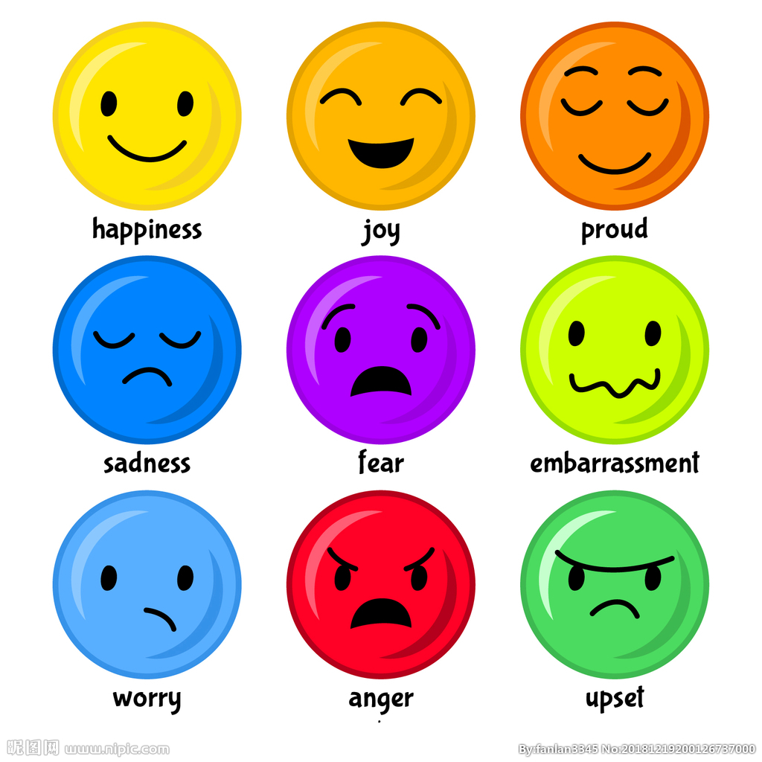
1. feelings and emotions as the inanimate subjects
sentence patterns:
feelings + take hold of/ seize/ get control of/ creep on/engulf Sb.
Examples:
1. 他忽然怒从心头起。
2. 我突然害怕起来。
3.我逐渐感到恐惧。
Then a burst of anger got control of him.
A sense of fear seized/took hold of me.
A feeling of terror slowly crept on her

Slide 11
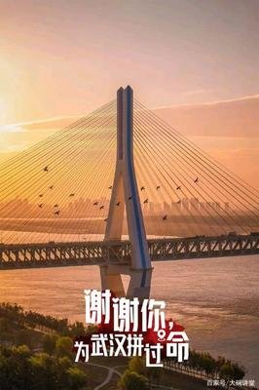
2. Concrete or abstract nouns as the inanimate subjects
sentence patterns:
n.+ 得失型动词（gain/get/save/fail/slip/elude/escape）+Sb/sth
Examples:
1. 我非常感谢大家对武汉的付出。
2. 这个地方因这处美景出名。
Words fail to express my gratitude to everyone helping Wuhan.
The beautiful scenery gained the place quite a reputation.

Slide 12
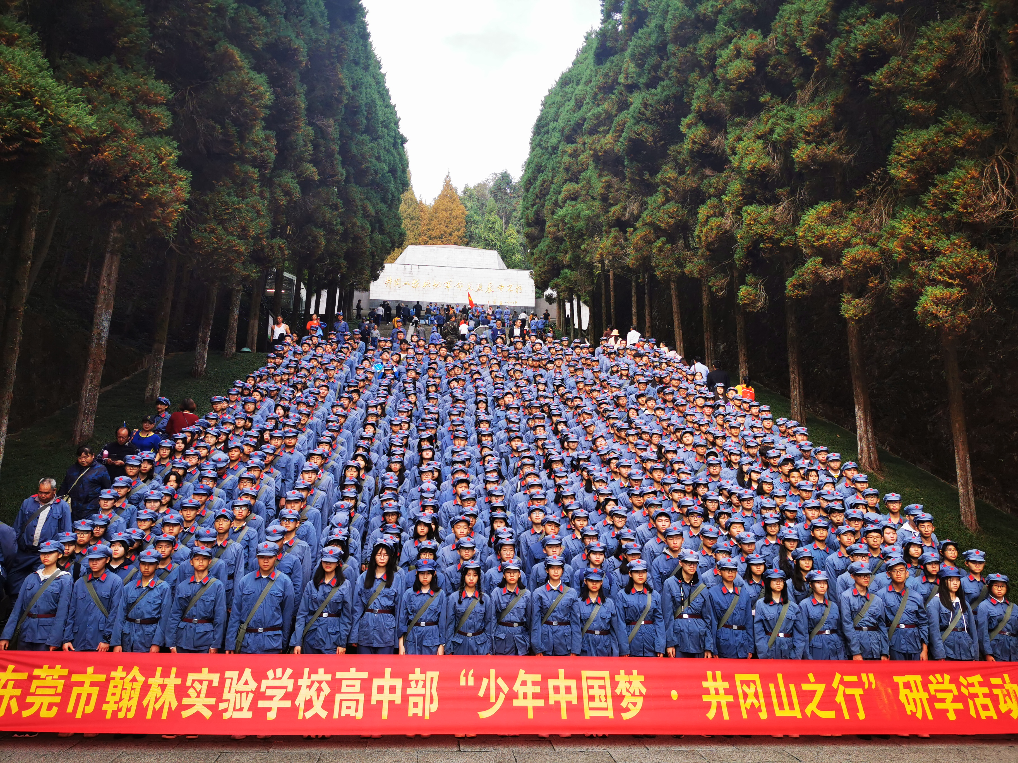
3. behaviors or actions as the inanimate subjects
sentence patterns:
n./doing sth+ remind/make/let/drive+sb...
Examples:
1. 一看到这张照片我就想起了难忘的井冈山之旅。
2. 专注于看书使他忘记了时间。
The sight of the picture reminds me of the unforgettable trip to Jinggangshan.
Being absorbed in books made him forget the time.

Slide 13
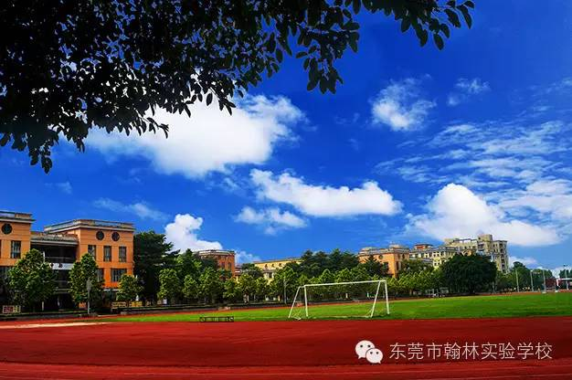
4. Time and place as the inanimate subjects
sentence patterns: time/place + see/ witness/ find/ tell
Examples:
1. 过去十六年里，翰林实验学校发生了巨大的变化
2. 上周我们进行了拔河比赛。
3. 小男孩黄昏时刻在河岸边徘徊。
The past sixteen years has witnessed fast development of Hanlin Experimental school.
Last week saw the launch of tug-of- war
competition among all classes.
The dusk found a boy wandering along the bank.

Slide 14
Matching(choose the proper verbs)
1 门关不上。
The door __________ to close.
2. 这可怜的家庭遇到许多麻烦事。
A lot of trouble __________ the poor family.
3.. 我突然有个好主意。
A splendid idea suddenly __________ me.
4.第一次见到他女朋友时，他说不出话来。
The first time he met his girlfriend, words ______ him.
5.一想到面试，我就害怕。
Thought of the interview _______ me _______ fear.
6.顺着小路，我们来到了一个小村庄。
The path ______ us _______ a tiny village.
drive
puzzle
visit
fail
pop into
lead to
refuse
fill with

Slide 15
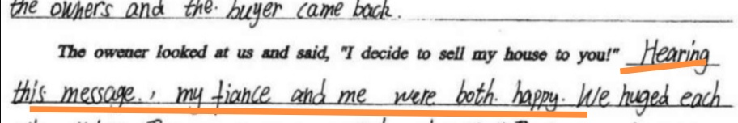
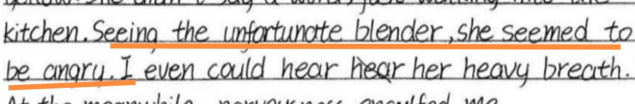
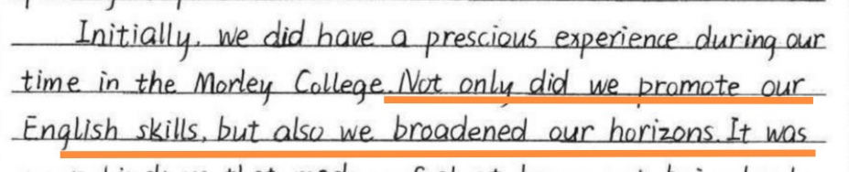
Polishing(use inanimate subjects)
十月月考
The insant they heard it, a burst of joy took hold of my fiance and me.
第八周周测
The sight of the messy blender twisted my mom's face with rage.
期中考试
Not merely did visiting your campus promote our English, but also it broadened our horizons.

Slide 16
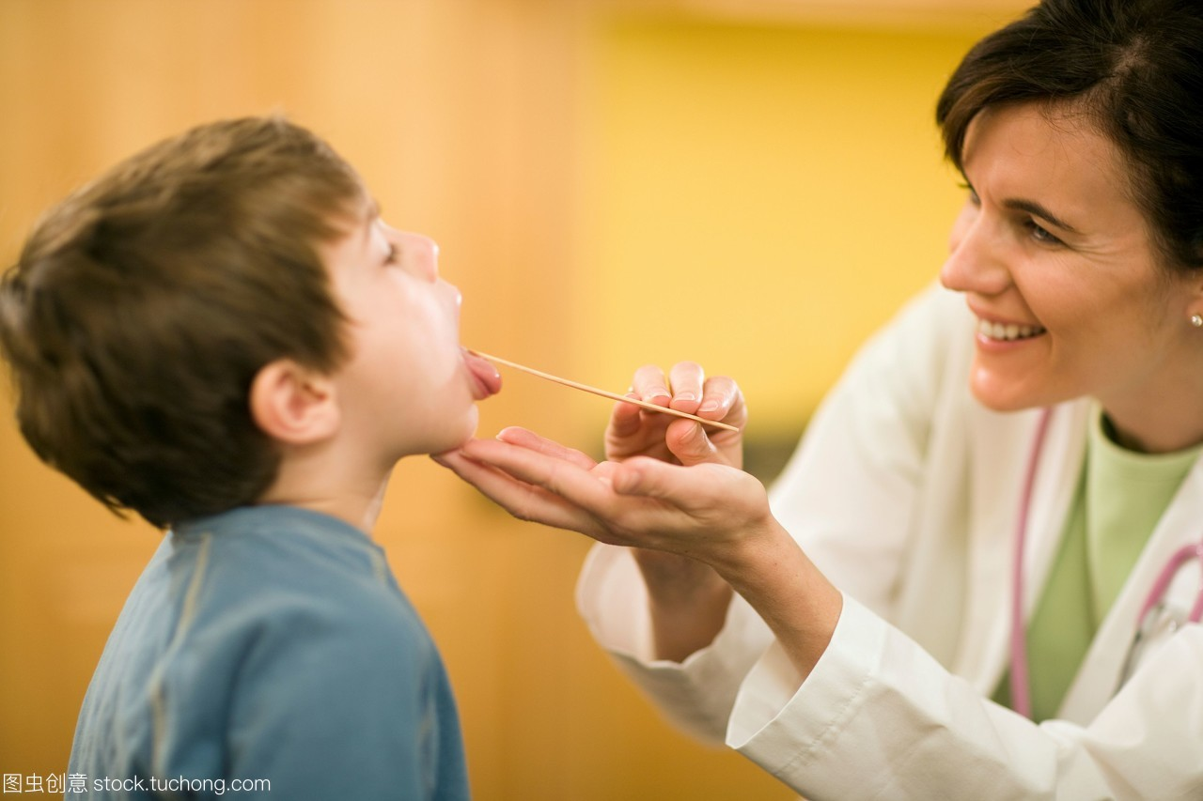
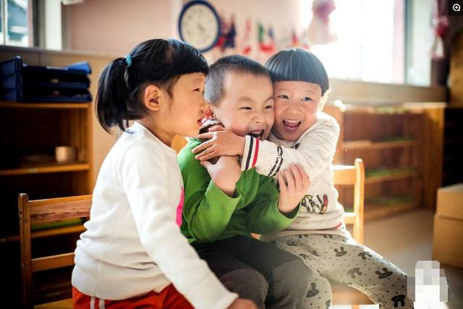
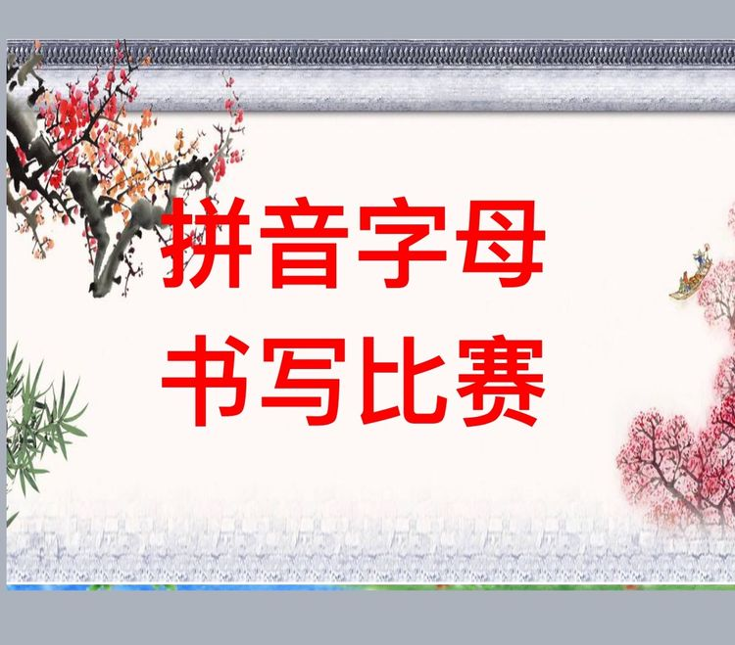
Translation: translate all the sentences into English
1.当医生给Mike检查的时候，他变得越来越紧张。（金考卷）
Mike's anxiety intensified（加剧） when the doctor checked his tongue.
2.很快，房间里充满着他们的欢声笑语，他们开心地一起玩耍就像多年的好朋友一样。（惠州联考）
Fairly soon, laughter filled the whole house and they three played so merrily as if they had been good friends for years.
3.首先，通过这个活动你不仅可以拓宽眼界，而且还可以更深入了解中国文化。（九月月考）
Primarily, not only will the competition broaden your horizons, but also it will help you take a deeper insight into the extensive and profound Chinese culture.

Slide 17
Let's sum up!
sentence patterns 1:
feelings + take hold of/ seize/ get control of/ creep on/engulf Sb.
sentence patterns 2:
n.+ 得失型动词（gain/get/save/fail/slip/elude/escape）+Sb/sth
sentence patterns 3:
n./doing sth+ remind/make/let/drive+sb...
sentence patterns 4 :
time/place + see/ witness/ find/ tell

Slide 18
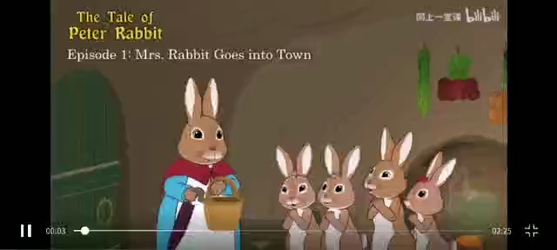

Slide 19
Let’s predict what would happen next?
The unlucky Peter:
The moment Peter entered the farmer’s garden, the cruel farmer caught sight of him.What did he feel at that moment?
At that precise moment, a sense of fear completely took control of him.That’s to say, words failed to express Peter’s panic at that time.
Why?
Because the farmer’s appearance reminded him of his mother words of his father’s miserable experience in this gardern.
What did his father experience in the gardern?
To our great sadness, the garden witnessed Peter’s father’s death.

