Slide 1

感恩遇见，相互成就，本课件资料仅供您个人参考、教学使用，严禁自行在网络传播，违者依知识产权法追究法律责任。
更多教学资源请关注
公众号：溯恩高中英语
知识产权声明

Slide 2
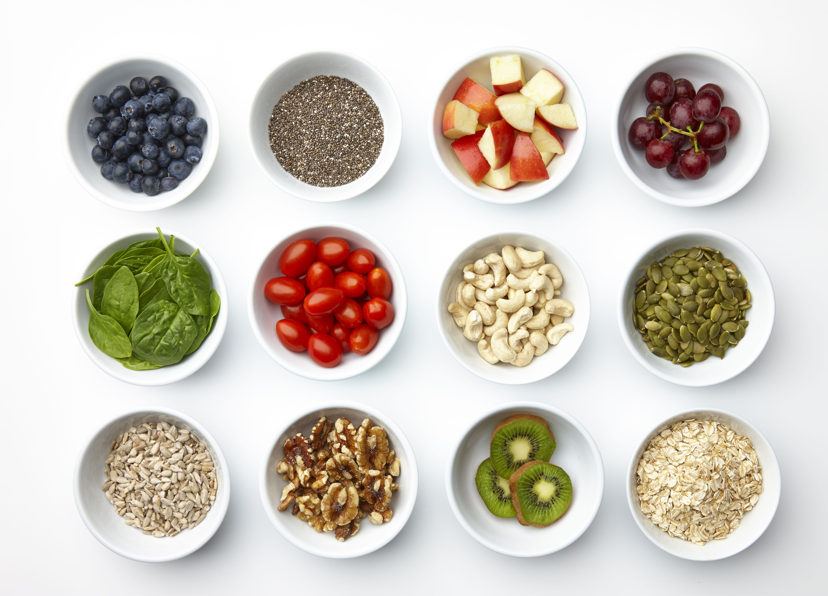
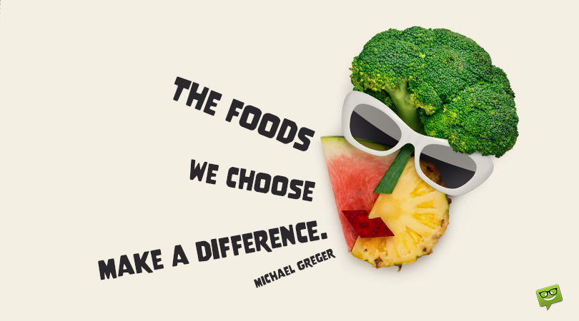
Unit 3
Healthy Eating

Slide 3
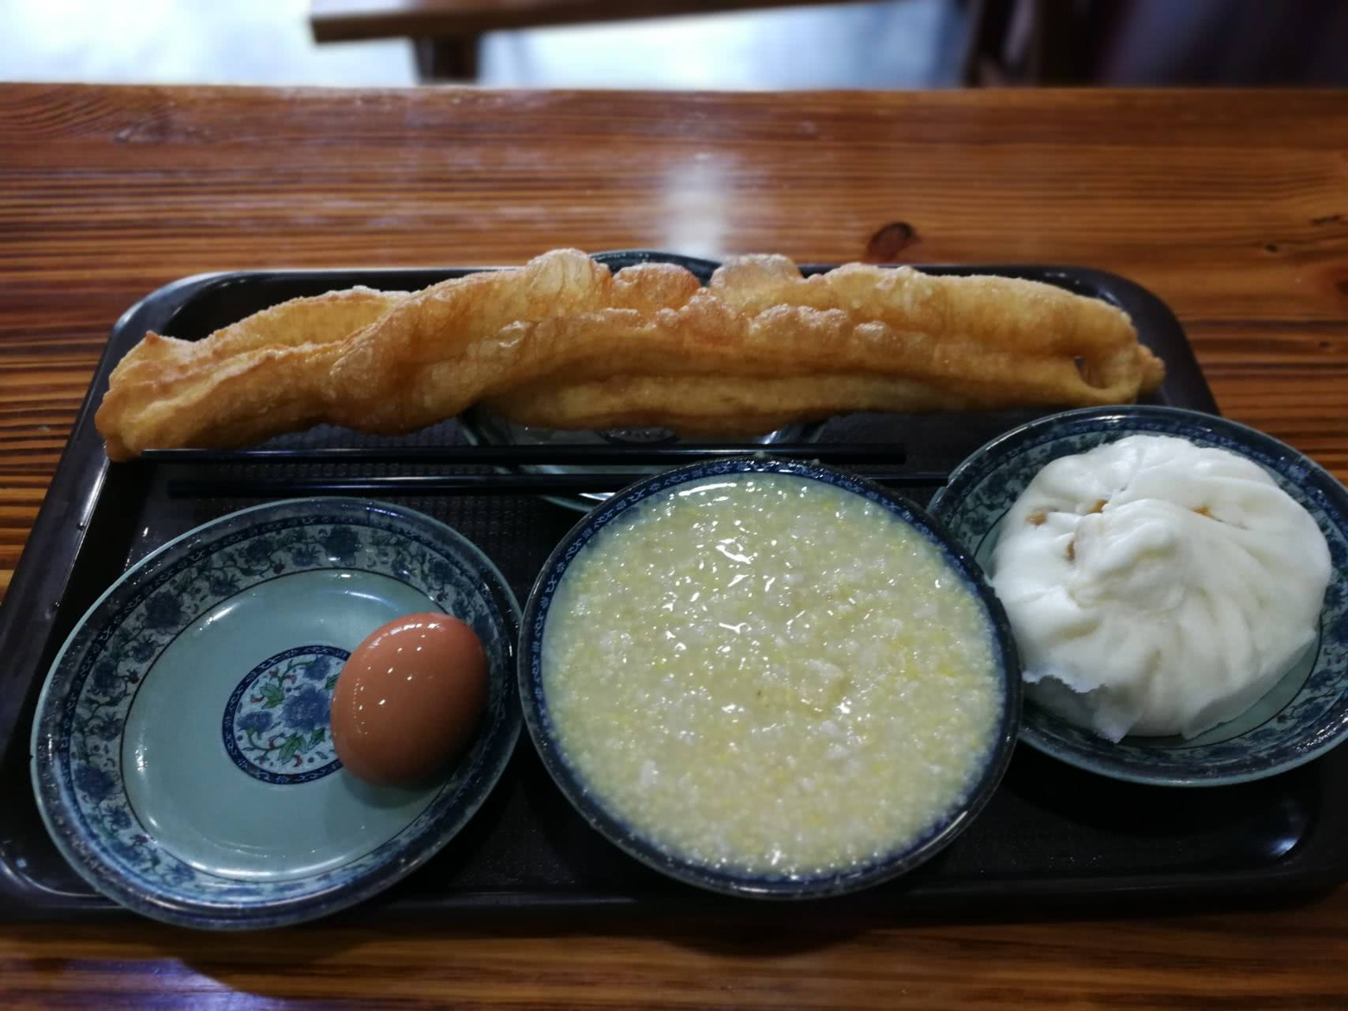
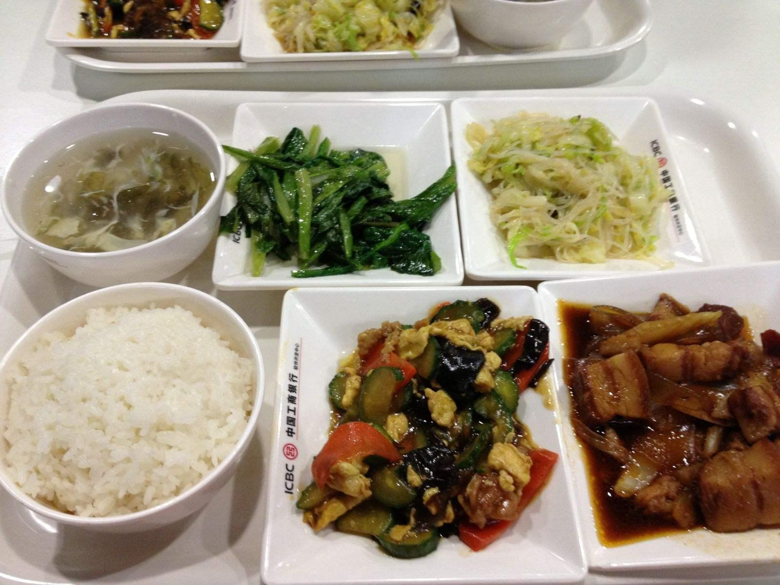
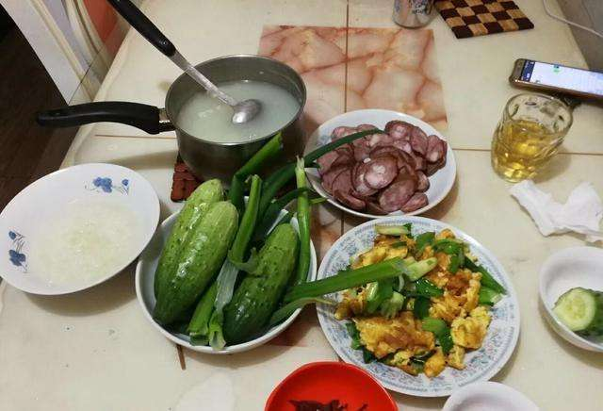
Mine Three Meals of a Day
Breakfast
Lunch
Supper
Is it a healthy diet or not?
What do you think makes up a healthy diet?
What are some rules for healthy eating?

Slide 4

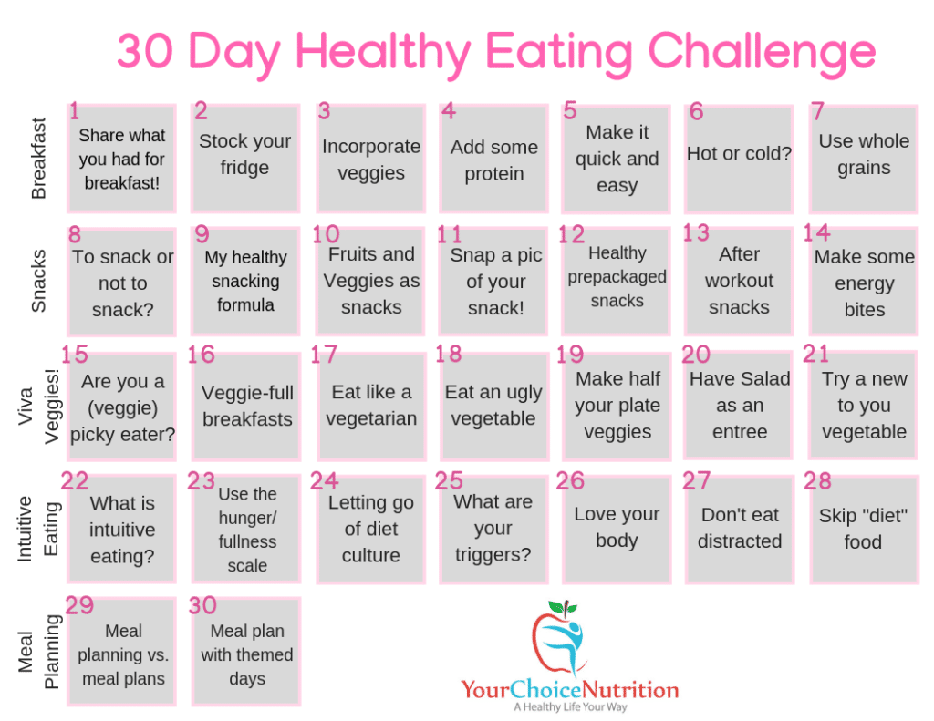
When talking about healthy eating, what comes to your mind first?
Don’t eat too much.
Eat slowly.
Eat more fruits and vegetables.
Drink plenty of water.
Don’t skip breakfast.
Don’t eat food high in fat and sugar.
...

Slide 5
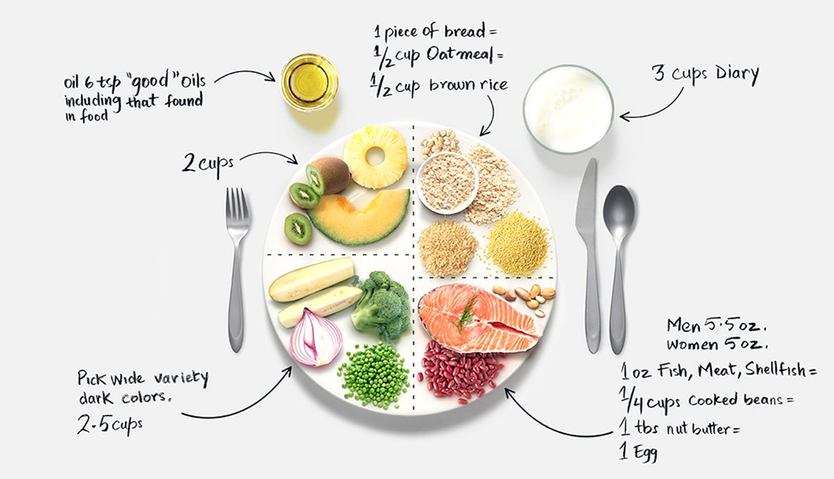
The eatwell plate should consist of ....

Slide 6
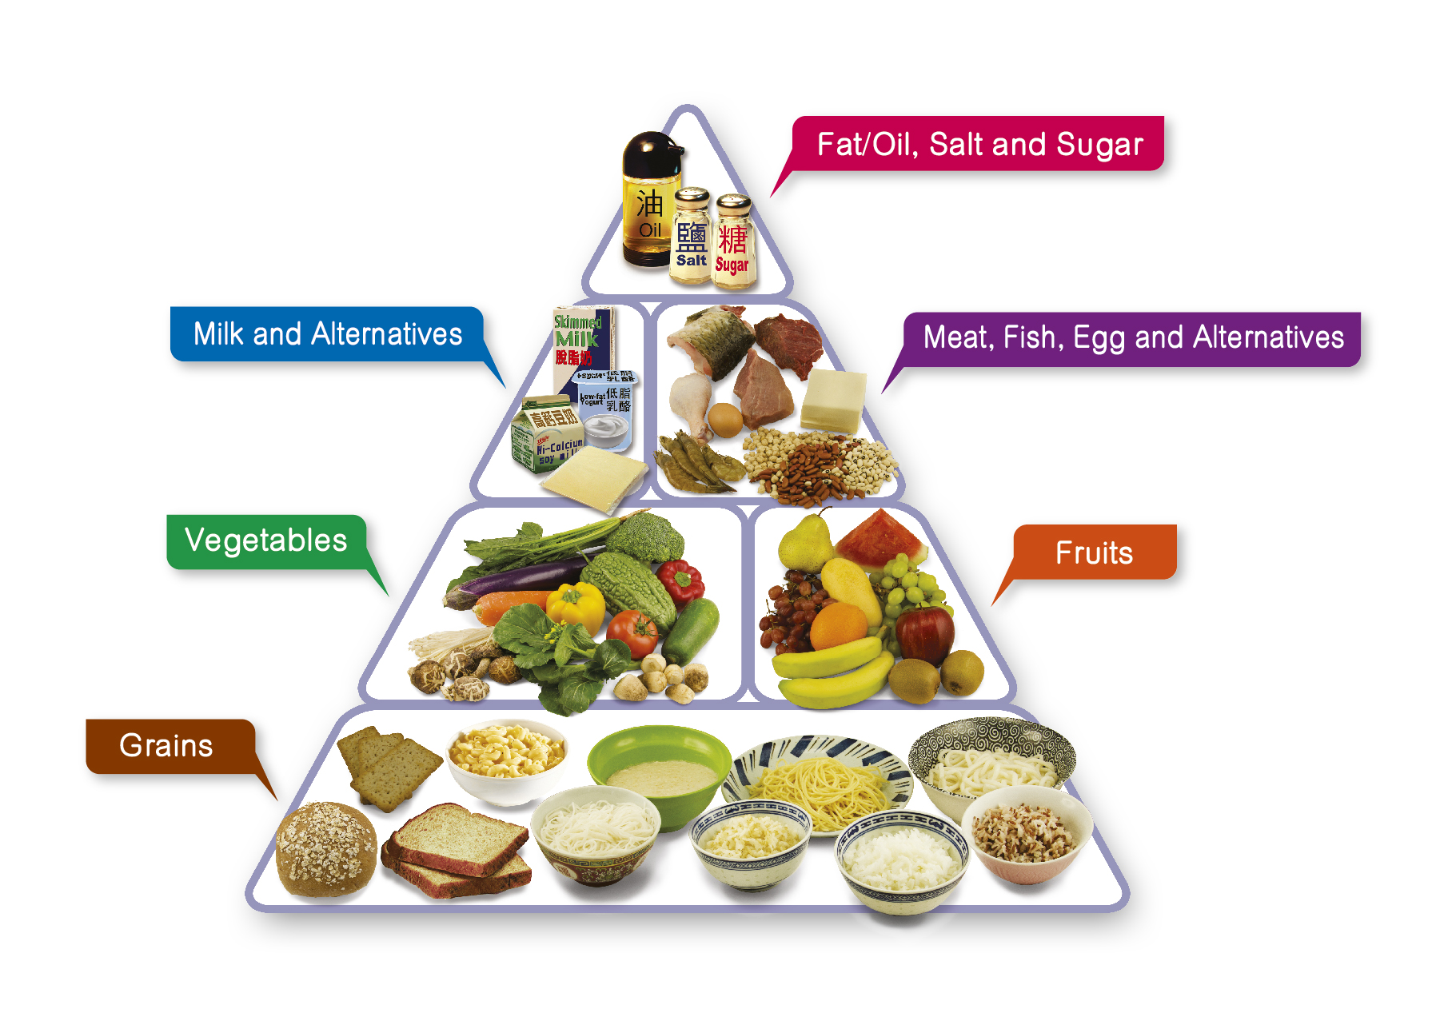
What is a balanced diet?
Food Pyramids
Is it when all the meals weigh the same?
Is it when you eat the same food in every meal?
Is it when you eat the same amounts of all foods?
Is it when you eat your meals balanced on a see-saw?

Slide 7
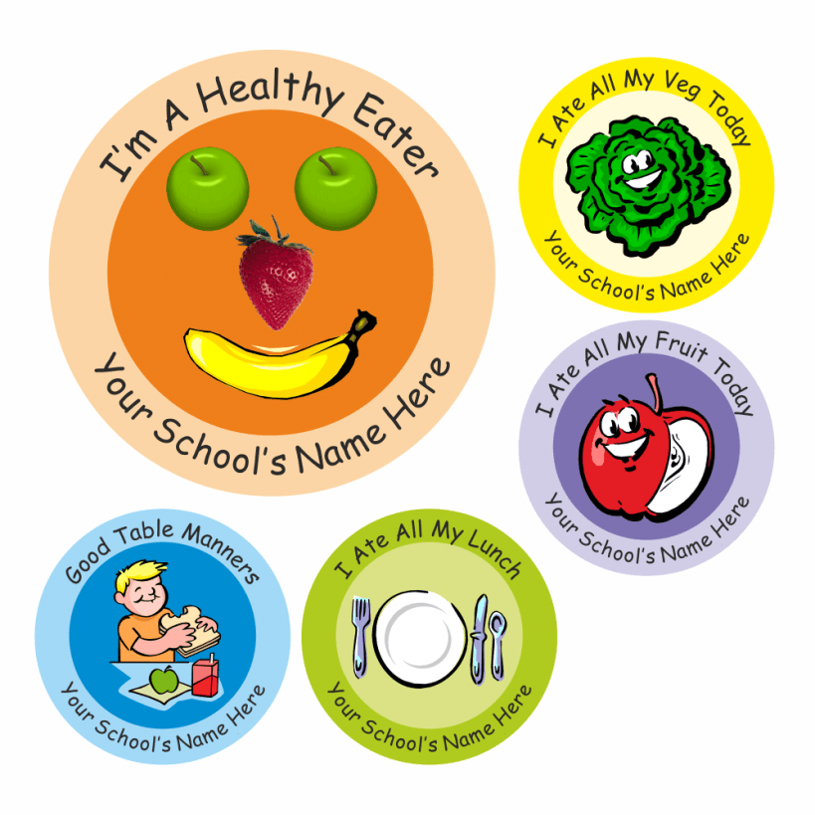
Activity 1: Read for the main idea
Read the passage and then match the subheadings with the paragraphs.
Para.1
Para.2
Para.3 Para.4 Para.5
A. Slow Eating is Good.
B. Reducing Sweets is Key.
C. The Real Killer is Sugar.
D. The Way You treat food matters.
E. Keep It Fresh and Balanced.

Slide 8
Activity 2: Read for structure
Read the passage and then match the subheadings with the paragraphs.
Theme / Topic
Ideas
Supporting details
1. The Real Killer is Sugar.
2. Reducing Sweets is Key.
3. Keep It Fresh and Balanced.
4. Slow Eating is Good.
5. The Way You treat food matters.
Healthy Eating

Slide 9
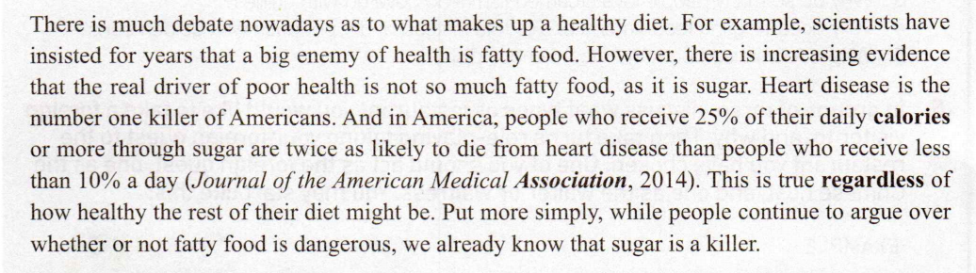
Activity 3: Read for language features
1. What are the key details that support each point?
Para.1
Point of view
Detail

Slide 10
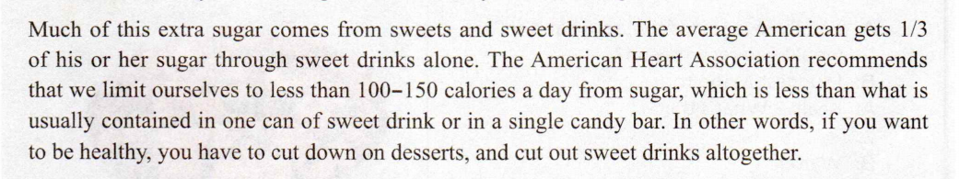
Activity 3: Read for language features
1. What are the key details that support each point?
Para.2
Point of view
Detail

Slide 11
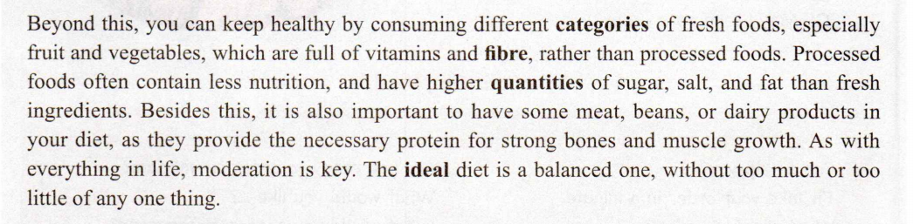
Activity 3: Read for language features
1. What are the key details that support each point?
Para.3
Point of view
Detail 1
Detail 2

Slide 12
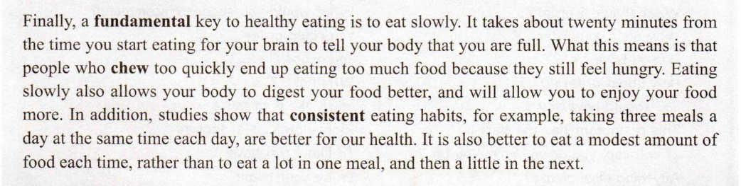
Activity 3: Read for language features
1. What are the key details that support each point?
Para.4
Point of view
Detail 1
Detail 2

Slide 13
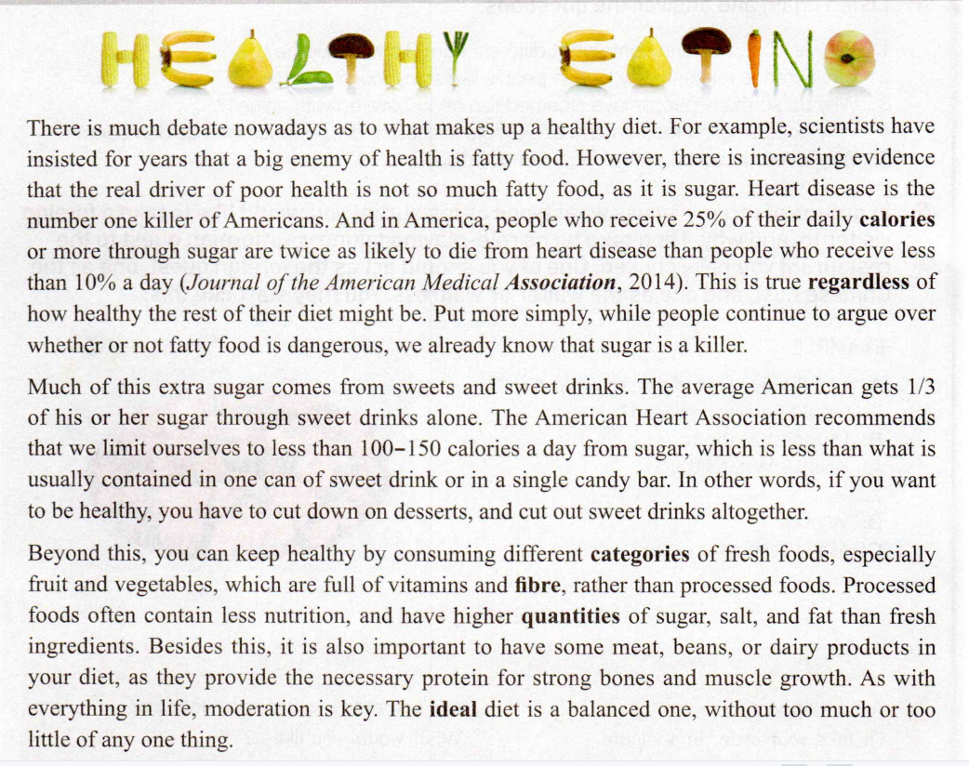
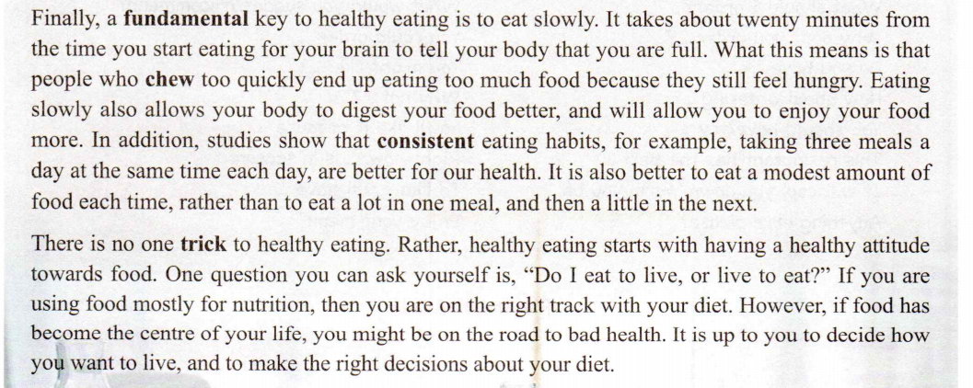
Activity 3: Read for language features
2. Find the linking words in the passage that introduce another way of saying what was already mentioned in the previous sentence.
What this means is that...
Put more simply,...
In other words,...

Slide 14
Activity 3: Read for language features
3. Find the linking words in the passage which show that contrasting ideas are being introduced.
However,...
rather than
Rather,...
rather than

Slide 15
Activity 3: Read for language features
Summary
Writer’s purpose | More expressions of the Linking words
To introduce another way of saying what was already mentioned
To show that contrasting ideas are being introduced
To list or add information
To give example
to put more simply, in other words, what this means is that, that is (to say),to put this in another way, in simple words/terms, or rather,…
however, while, rather than, rather, but, on the contrary, instead, conversely, whereas, on the other hand, unlike, nevertheless, otherwise, in contrast,…
Besides, also, in addition, what is more, moreover,…
for example,for instance,such as,…

Slide 16
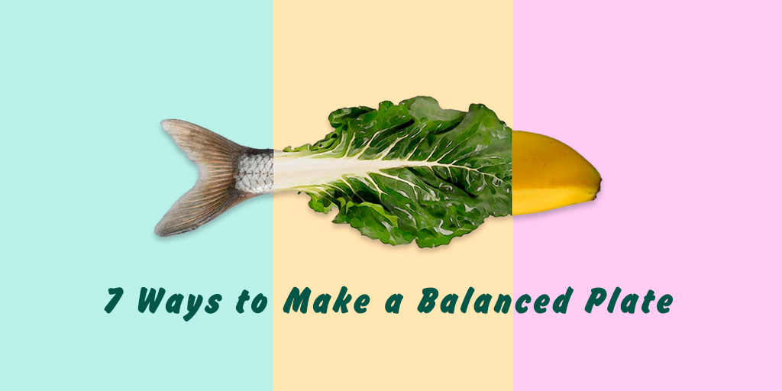
Summary: Make a list of healthy eating habits
consume fresh foods
rather than processed foods
cut down on dessert
cut out sweet drinks
sweet
healthy
consistent eating habits
three meals a day at the same time each dayeat a modest amount of food
eat slowly
consistent
slow

Slide 17
Your Three Meals of a Day ?
Breakfast
Lunch
Supper
What about your three meals of a day?
Whether they are healthy or not?
What are your eating habits?

Slide 18
Activity 4: Group Discussion
Step 1: Write down everything you eat and drank over the last three days. And share your ideas about your eating habits, whether they are healthy or not?
Step 2: Compare what you have had over the last three days with the advice written in the article, and any facts about diet and nutrition that you know to be true. Make two lists：
·A list of your good eating habits
·A list of your bad eating habits
Step 3: If you have bad eating habits，make a list of things you can do to get rid of them.

Slide 19
Activity 5: Writing
Use what you have learnt and discussed to write an essay about your own diet.
Use your notes to write your essay. You can start like this:
Overall, I think I have healthy/unhealthy eating habits. As for the things that I am doing right, ... Still, I should improve my eating habits by...

Slide 20
Sample Writing
Overall, I think I have healthy eating habits. As for the things that I am doing right, I am eating a variety of healthy foods and trying to eat fresh food as much as possible.
After noting down what I have eaten over the last three days, I can see lots of healthy and nutritious things on the list, such as fish, eggs, fruit, and salad. Put simply, most of my diet contains food that is good for my body. The fruit and vegetables that I eat are full of vitamins and minerals. And they contain much more nutrition than processed foods. Fresh food is also lower in sugar, salt, and fat.
However, I do have some bad eating habits. There are some foods that I should not eat too much of. For example, rice and bread are healthy, but eating too much can create too much unused energy and cause me to gain weight and feel tired. I also really like eating pre-made steamed buns and tomato soup from the store, but I now know they contain far too much sugar, salt, and fat. Also, some types of meat contain a lot of fat, so I should be careful with how much I consume. The same goes for the pancakes I buy on the street. They are delicious, but they are by no means healthy, and I should be careful with how often I consume them.

Slide 21
In addition to the above, I also sometimes find myself too busy and forget to eat. I also have a hard time refusing sweets from others, even though I know they are bad for me.
I should improve my bad eating habits by always taking the time to eat, even if I’m busy. I should have set times every day when I stop working and just eat. I could prepare some healthy dishes in advance that I can eat when I’m too busy, because this will give me more control over the sorts of things I eat. I should also avoid eating in front of the TV, as it is too easy to eat too much that way. And, of course, I also need to say no to sweets!
After reading the article entitled“HEALTHY EATING”, I now better understand how to eat more healthily and improve my food choices. I hope to follow a balanced diet, without too much or too little of any one thing. I think this is a key tip for healthy eating. And I think healthy eating starts with having a healthy attitude. It is up to me to make the right decisions about my diet, and I have decided to be healthier and happier!

Slide 22
Thank you

