Slide 1

感恩遇见，相互成就，本课件资料仅供您个人参考、教学使用，严禁自行在网络传播，违者依知识产权法追究法律责任。
更多教学资源请关注
公众号：溯恩高中英语
知识产权声明

Slide 2
Unit 1 Science and scientists
Using language 2
Write about what makes a great scientist

Slide 3
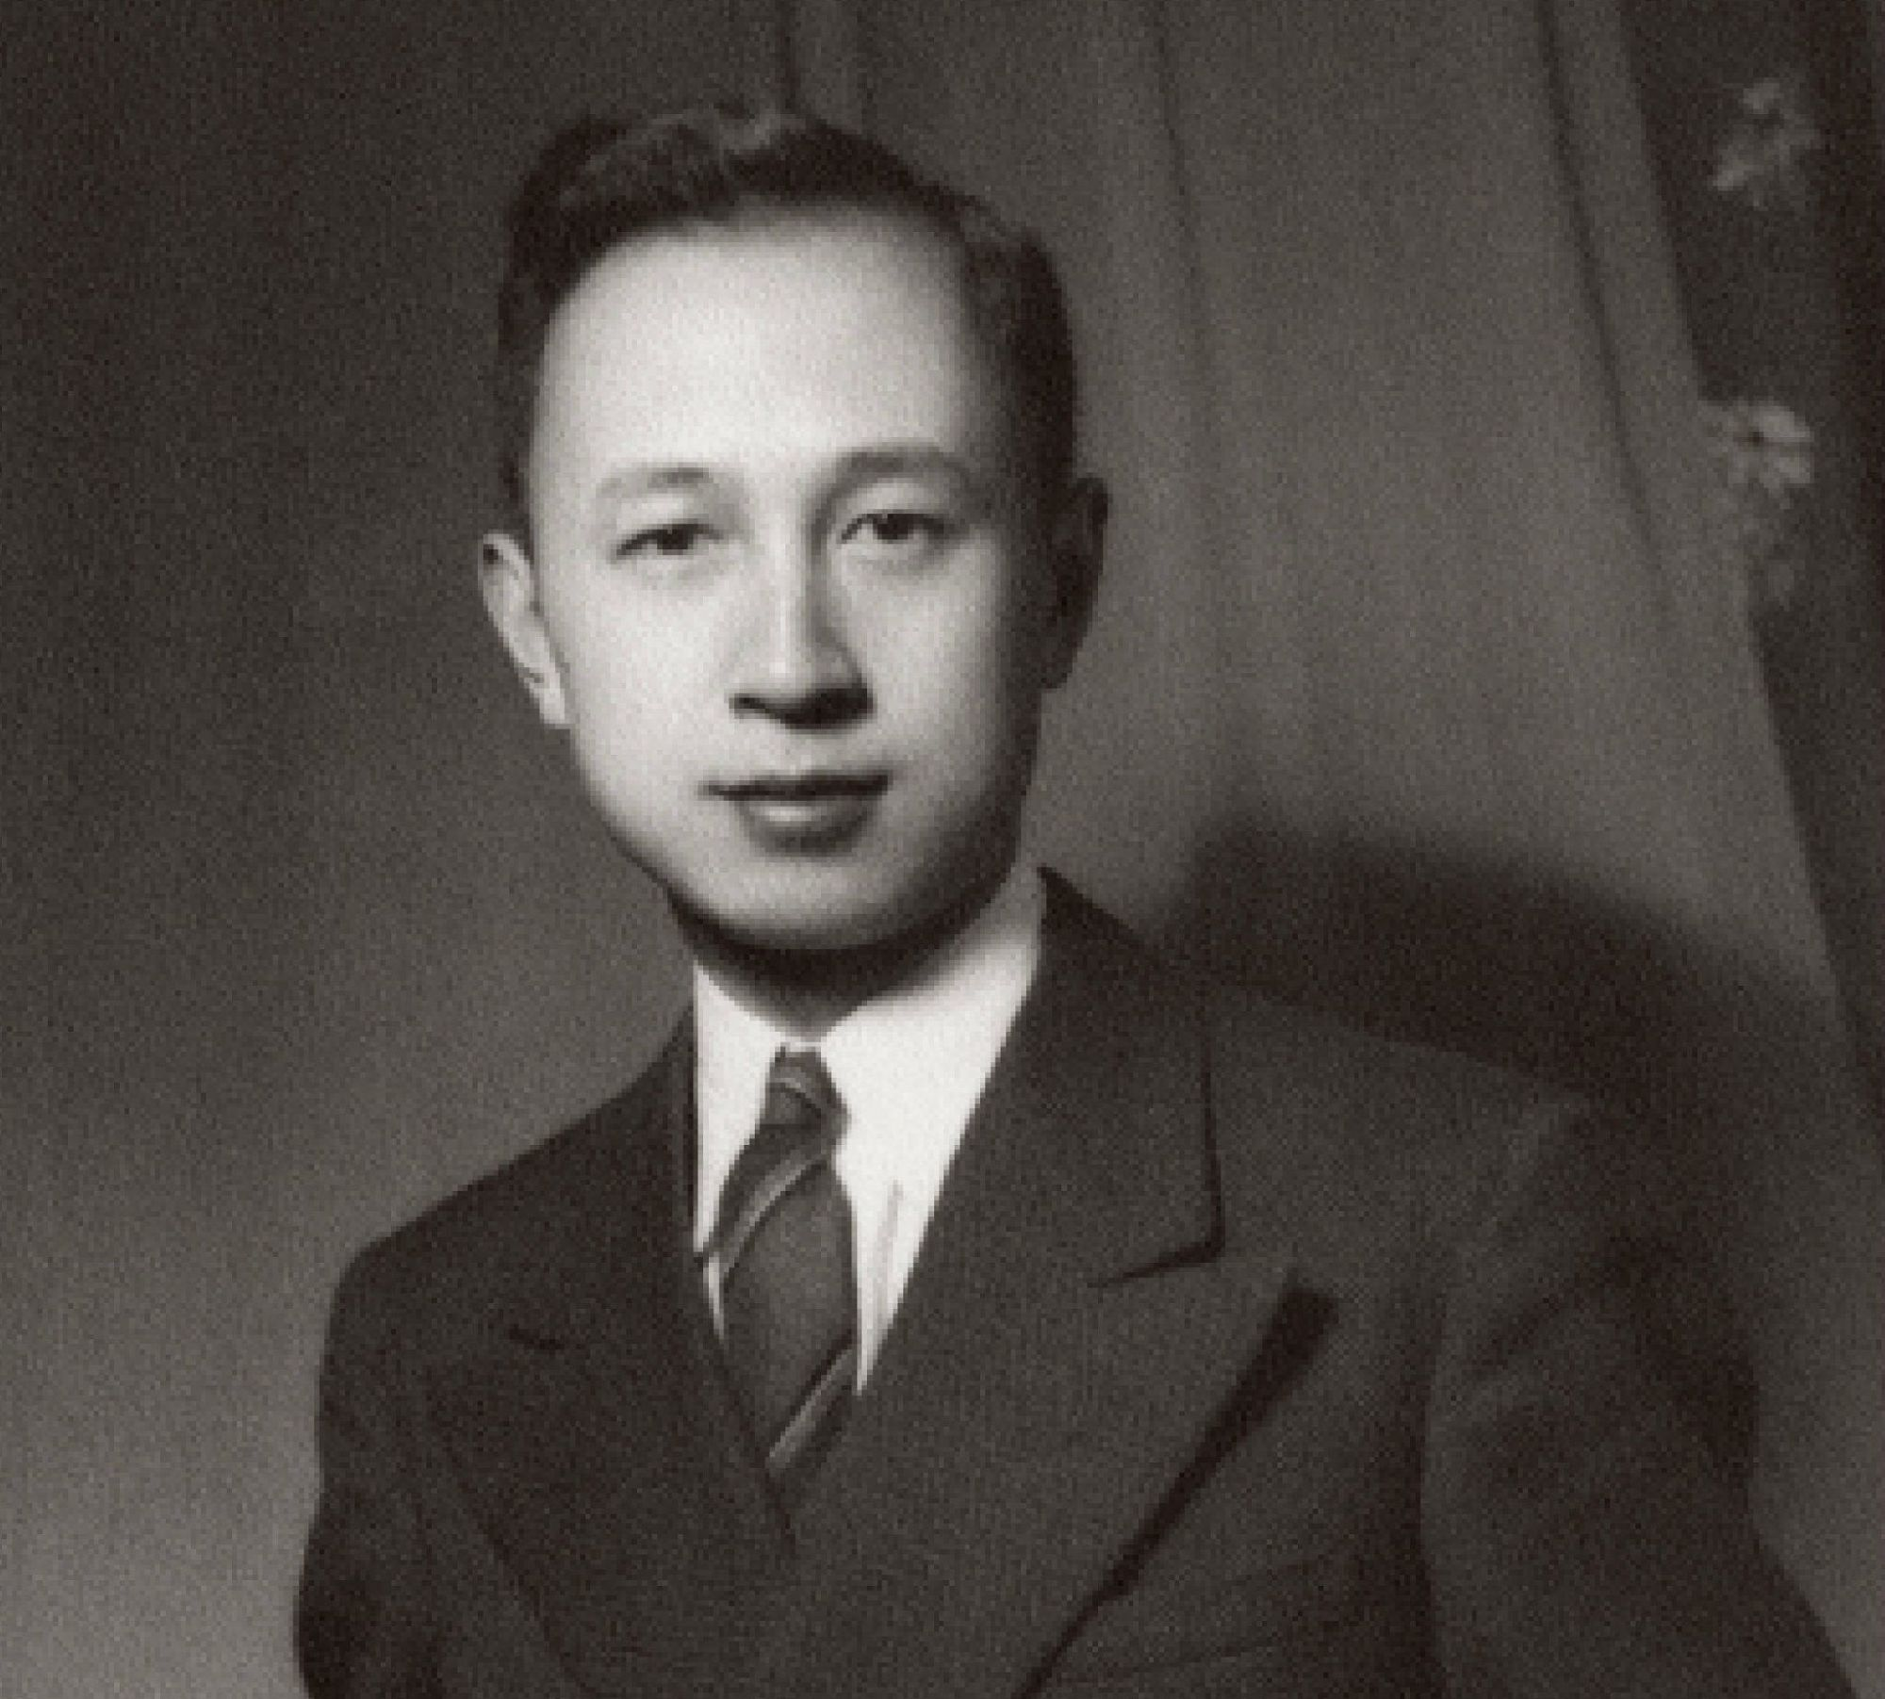
Lead-in
—— “Can we Chinese possibly make missiles?”
—— “Why not? We Chinese are able to make the same things that other people make.”

Slide 4
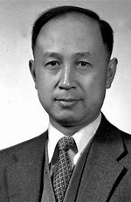
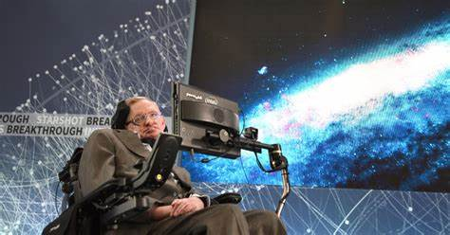
Read for the main idea and structure
biography
The Father of China's Aerospace
A World of Pure Thought

Slide 5
The Father of China's Aerospace
His personality
Para. 1
General description of Qian Xuesen
Para. 2-5
His death and people’s appreciation of him
Para. 6
Para. 7
His personal history and accomplishments

Slide 6
A World of Pure Thought
Para. 1
His claim to fame
Para. 2
Characteristics that made him great
Para. 3
Physical description of Stephen Hawking

Slide 7
biography
General description of Qian Xuesen
description
Physical description of Stephen Hawking
description
Introduction
His personal history and accomplishments
His claim to fame
life story
main achievements
personalities and qualities
His personality
His death and people’s appreciation of him
Characteristics that made him great

Slide 8
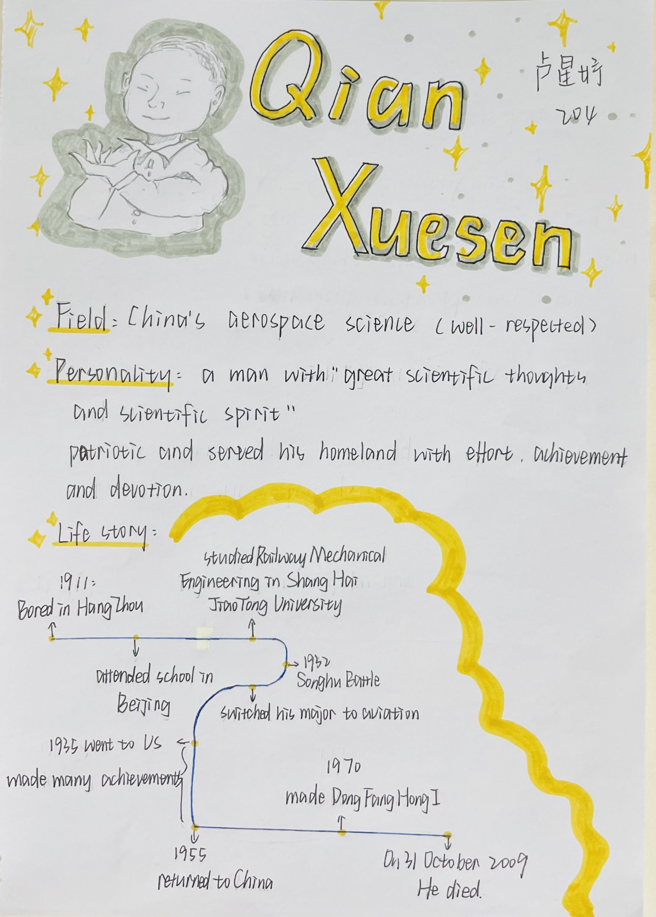
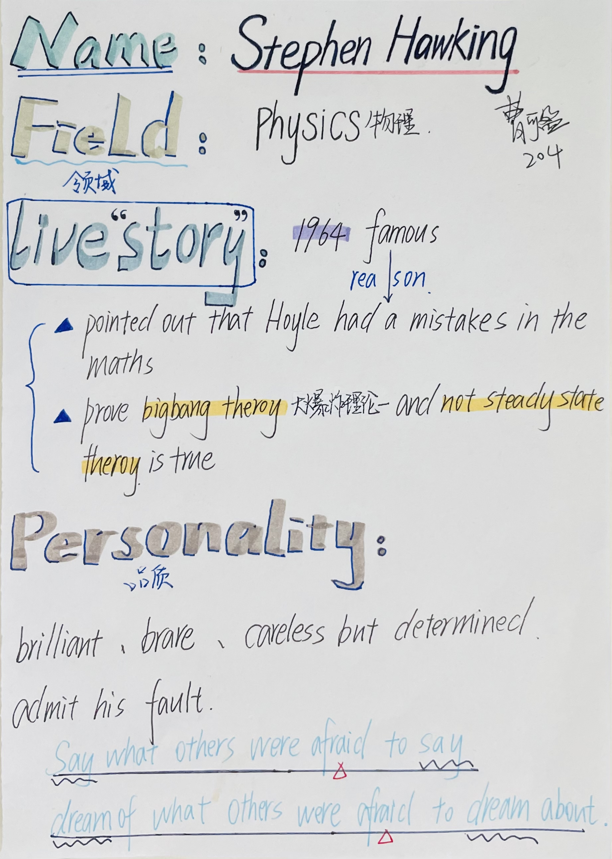
character cards designed by Lu Xingyu and Cao Keying

Slide 9
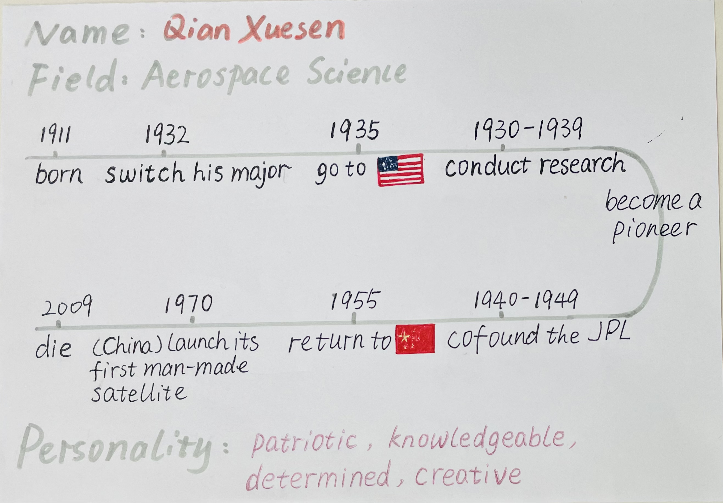
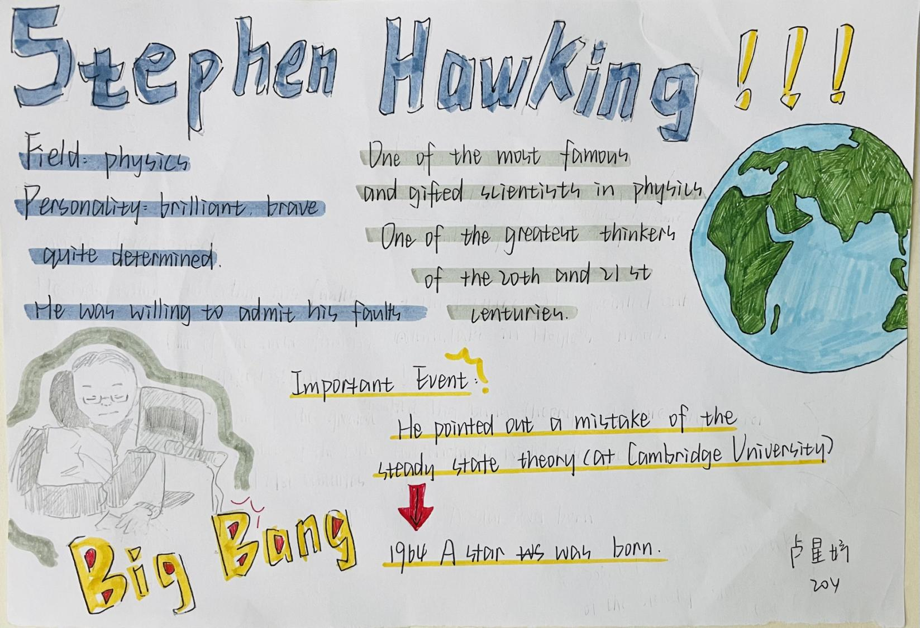
life story (important events)
personalities

Slide 10
Read for details
personalities and qualities
scientist |  | examples
 | professional
conducted important research;

Slide 11
linking words and phrases | functions
①born in Hangzhou in 1911, after the Songhu Battle broke out in 1932, over the course of the 1930s and 1940s, during the 1930s, in the 1940s, in 1955, at that time;
②however, nevertheless;
③besides, furthermore;
④because;
⑤above all;
to show time and space
to show contrast
to add something
to show cause and effect
to draw a conclusion

Slide 12
What are similarities of these two scientists?
Status
Achievements
Outstanding personalities
Scientific spirits:
* Serving one's country
* Pursuing the truth
* Fulfiling personal values

Slide 13

Work in groups
Discuss
What do you think a great scientist need most? Why?
professional knowledge logical reasoning
research methods the questioning mind
leadership patriotism
devotion determination
imagination creativity
inspiration talent ...

Slide 14
The definition of scientific spirit is, above all else, the questioning mind. Take Stephen Hawking for example. He was sensitive enough to grasp a problem and challenged the steady state theory as a young man. Furthermore, he believed in the findings enough to bravely present them, prove and perfect them. The scientific spirit is to look squarely, ask questions and never give up trying.

Slide 15
Homework
(1) Design character cards for Yuan Longping, Tu Youyou, Albert Einstein or John Snow.
(2) Micro-writing: Choose one personal quality a scientist must have to be successful and write a short paragraph.
What impresses me most is...
What matters to a scientist is (not...but...)
My reasons are as follows...
The definition of scientific spirit is...
Take ... for example.
...play(s) a crucial/ significant role in...

Slide 16
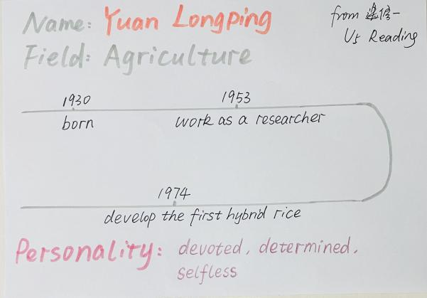
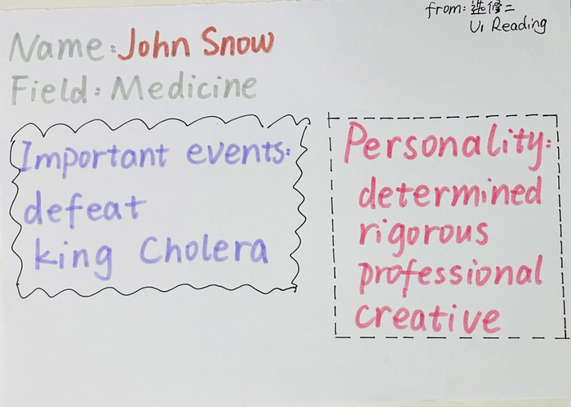
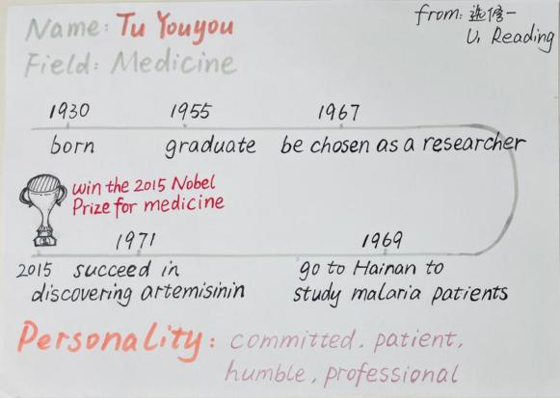
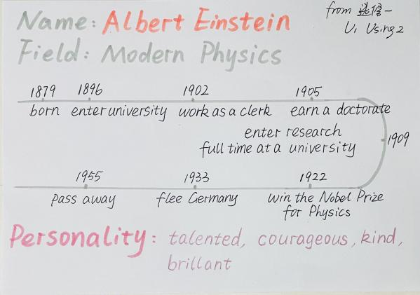
Present in groups
Share your character cards and micro-writing in class.

Slide 17
Great scientists have some common characteristics: they are knowledgeable, gifted and self-sacrificing for the greater good of the country or humanity, brave and determined. What impresses me most is Tu Youyou’s devotion and perseverance in discovering artemisinin. She has spent 40 year’ time on scientific research. Thus science is never about instant success.

Slide 18
What matters to a scientist is also leadership and patriotism. We can see this in Qian Xuesen’s life, pioneering to another country to work with and inspire like-minded people in his field and to collaborate on their work. We can see it in his vigour to return to China and lead their aerospace programme through its birthing stages.

Slide 19
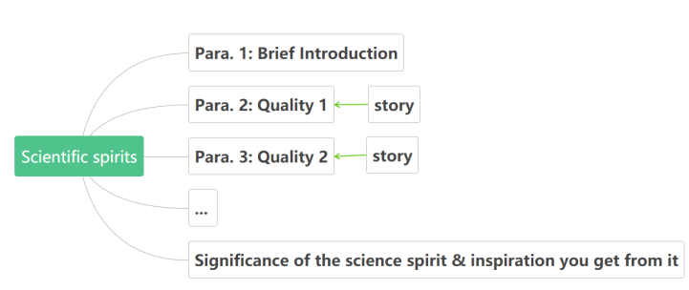
Write
Write an essay about the scientific spirit. Step 1: discuss about the framework of the essay

Slide 20
Step 2: organize the body in time order and use linking words and phrases
Step 3: work by yourself to write an essay about the scientific spirit

Slide 21
Step 4: Exchange and revise.
Does the writer explain clearly the personal qualities that make up the scientific spirit? Does the writer give examples from the lives of the scientist(s) to illustrate the points? Does the writer describe the personality of a great scientist? Does the writer use appropriate linking words and phrases to tie the ideas together? Does the writer use separate paragraphs, each with its own function?

Slide 22
Homework
Learn more about scientific spirit with the help of the following websites.
https://www.scientificamerican.com/
www.scientific.news/

Slide 23
Thanks!

