Slide 1


感恩遇见，相互成就，本课件资料仅供您个人参考、教学使用，严禁自行在网络传播，违者依知识产权法追究法律责任。
更多教学资源请关注
公众号：溯恩高中英语
知识产权声明

Slide 2

The Week
Dec 25th-31st, 2021

Slide 3
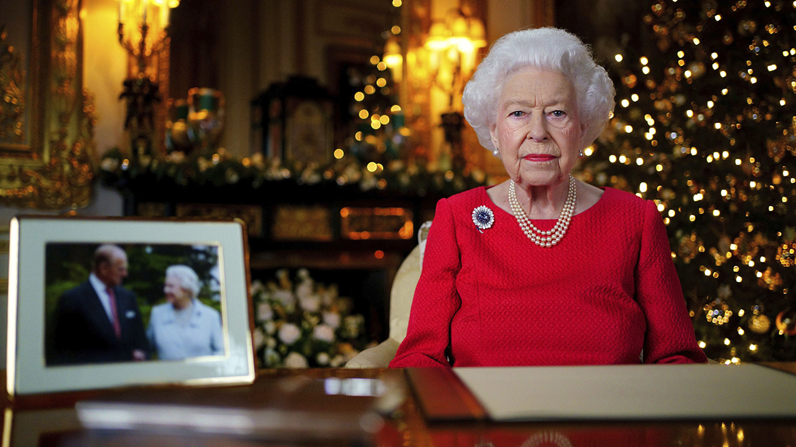
1. Britons tune in for queen’s Christmas message, which notes shared losses
英国女王圣诞致辞
Queen Elizabeth II records her holiday message alongside a wedding anniversary photo of her with Prince Philip. Philip died in April at age 99, and royal watchers noted that pinned to the queen’s Christmas dress this year was a sapphire brooch she wore on their honeymoon.

Slide 4
语篇填空
（《华盛顿邮报》2021年12月26日 A22版面）
A combination of health issues and coronavirus restrictions ________ (keep) Queen Elizabeth II from public engagements since October, but the 95-year-old monarch made __ brief appearance in British homes on Saturday afternoon, _________ (speak) about her own grief in an _________ (especial) personal Christmas Day message.
The annual address ____________ (record) in advance at Windsor Castle. In her speech, Elizabeth paid tribute to her late husband, Prince Philip, _____ died in April at age 99. While delivering her remarks, the queen sat at a desk alongside a framed photograph of herself with Philip, ______ (take) in 2007 to mark their 60th wedding anniversary. She said she empathized with others who had lost loved ones and acknowledged the ongoing impact of the pandemic. As usual, she commented ____ some of the news from the royal family over the past year, including the births of four great-grandchildren.
Every Christmas, millions in Britain ____ in 54 Commonwealth nations tune in _______ (hear) the monarch deliver her Christmas message.
has kept
a
speaking
especially
was recorded
who
taken
on
and
to hear

Slide 5
词语讲解
1. empathize: to understand another person’s feelings and experiences, especially because you have been in a similar situation 有同感；产生共鸣；表同情
I empathize with people who have the same family problems that I have.
我同情那些和我有同样家庭问题的人。
2. acknowledge: to accept that sth is ture 承认（属实）
The government has acknowledged the problem.
政府承认了该问题。
翻译句子
我非常同情生活在那些地段的人们。
I clearly empathize with the people who live in those neighborhoods.
翻译句子
他拒不承认改革的必要性。
He refused to acknowledge the need for reform.

Slide 6
长难句分析
A combination of health issues and coronavirus restrictions has kept Queen Elizabeth II from public engagements since October, but the 95-year-old monarch made a brief appearance in British homes on Saturday afternoon, speaking about her own grief in an especially personal Christmas Day message.
分析：本句中是一个并列句，第一个句子的主语是_____________；第二个句子中的“speaking about ... message”为现在分词结构作_________。
A combination
伴随状语
自10月以来，健康问题和新冠限制措施使得伊丽莎白二世女王无法参加公开活动，但这位95岁的君主于周六下午在英国家中短暂露面，在特别私人的圣诞节致辞中讲述了她自己的悲痛。
翻译

Slide 7
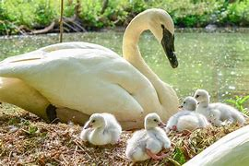
2. Get creative to help swans in need of a name
给天鹅取个名吧！

Slide 8
语篇填空
（《泰晤士报》2021年12月28日 23页）
If you can think of a better name for an __________ (danger) swan than Swanny, then conservationists need your help.
Bewick swans are remarkable _______ (visit) to the UK’s wetlands who arrive like clock-work out of the cold, winter skies every year. Experts at Slimbridge _______________ (name) Bewick swans for the past 60 years, ________ (build) a vast family tree of swan “dynasties” that has provided invaluable data on their ________ (survive) rates. Numbers have dropped since the study started and there are fewer than 21,000 in the wild.
The birds are identified ________ (visual) by their unique bill patterns, so they cannot be named until their bill pattern _________ (form). Now conservationists are appealing to Times readers to help them name ____ new family of swans that flew in last week. “One of the fun elements of our work is naming them,” Dr Julia Newth, ______ is leading conservation efforts, said. “We do this to keep track of each one and to help keep a record of where they fit into each swan family. It can be hard to come up _____ new names so we would love Times readers to help.”
endangered
visitors
have been naming
building
survival
visually
is formed
a
who
with

Slide 9
词语讲解
1. invaluable: extremely useful; indispensable 极为珍贵的，极其有用的，无价的；不可缺少的
I gained invaluable experience over that year. 那年我获得了十分宝贵的经验。
2. bill: a mouthpart (such as the beak of a turtle) that resembles a bird’s bill 喙
The bird’s bill is red, which is appealing. 这种鸟的喙是红色的，很吸引人。
翻译句子
这本书对于高校学生将有重大价值。
The book will be invaluable for students in higher education.
翻译句子
他们在森林里寻找不同颜色喙的鸟。
They searched the forest for birds with different colored bills.

Slide 10
选词填空
用以下词(组)的适当形式完成句子。
1. His blood pressure had _________ severely, which made his family anxious.
2. We urge Congress to increase farmland ____________.
3. The beetles are on the list of ___________ species.
4. _____________ your efforts and write down how you feel.
5. Supervisors must ________ the reasons for poor performance.
6. It’s courage and determination that makes him such a __________ character.
endangered remarkable drop identify conservation keep track of
dropped
conservation
endangered
Keep track of
identify
remarkable

Slide 11
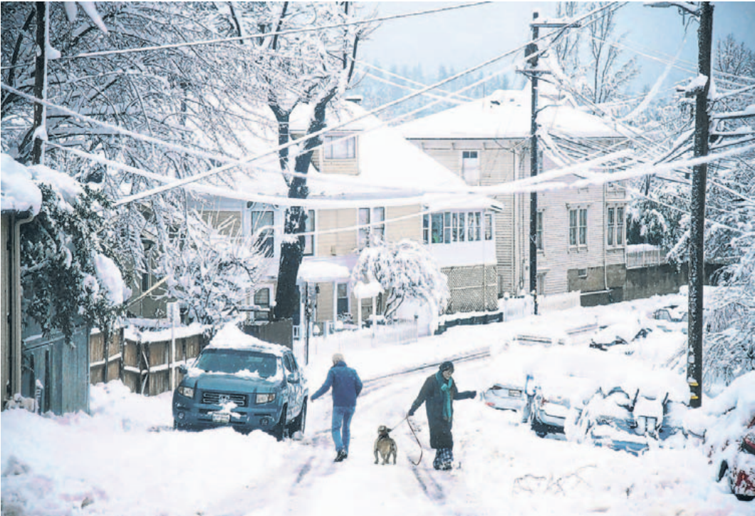
3. Storm Dumps Heavy Snowfall On Western U.S., Closes Roads
美国西部遭遇强降雪
Residents navigated a street Monday in Nevada County, Calif.
Snow made driving dangerous in the area.

Slide 12
语篇填空
（《华尔街日报》2021年12月28日 A3版面）
Snow pummeled the Pacific Northwest, California and other parts of the West Coast over the weekend and Monday, leading to ____________ (cancel), road closures and avalanche (雪崩) warnings in the region.
In Seattle, _____ snow isn’t common this time of year, 6 ______ (inch) fell between Sunday and Monday. Residents there ___________ (warn) that uncovered pipes could freeze or burst as temperatures remain below freezing. On Monday, 15% of the flights in Seattle were canceled because of the snow. Portland, Ore., was experiencing similar weather, with icy conditions _______ (make) roads potentially dangerous for driving. Temperatures are expected ________ (remain) below freezing this week in Portland, where temperatures are ________ (typical) in the 40s during December.
In the Sierra Nevada, the snow made driving dangerous, with most roads in the area ______ (close). Sections of Highway 395 in Nevada were also shut due ___ whiteout conditions. Heavy snowfall and strong winds caused avalanche warnings to be issued in the Central Sierra Nevada and the Eastern Sierra. ___________ (mountain) parts of Idaho and Utah were also at high risk of avalanches.
cancel(l)ations
where
inches
were warned
making
to remain
typically
closed
to
Mountainous

Slide 13
词语讲解
1. navigate: to find which way you need to go when you are travelling from one place to another 导航，确定…的方向
Early explorers used to navigate by the stars.
早期的探险家过去常靠星星来导航。
2. pummel: to keep hitting sb/sth hard 连续猛击；反复拳打
He pummelled the pillow with his fists. 他用双拳不停地捶打枕头。
翻译句子
我们设法在森林中找到了路。
We managed to navigate our way through the forest.
翻译句子
那小偷被愤怒的人群推搡并痛打。
The thief was pushed and pummeled by an angry crowd.

Slide 14
长难句分析
Snow pummeled the Pacific Northwest, California and other parts of the West Coast over the weekend and Monday, leading to flight cancellations, road closures and avalanche warnings in the region.
分析：本句主语snow，谓语动词 _________，宾语the Pacific ... the West Coast，leading to ... in the region 为_________ 作_____状语。
pummeled
现在分词
结果
周末和周一，大雪袭击了太平洋西北部、加州和西海岸其他地区，导致该地区航班取消、道路封闭和雪崩警报。
翻译
今年7月，洪水给中国中部的河南省造成了巨大的损失，使许多人无家可归。
仿写
In July this year, the flood caused great damage to central China’s Henan province, leaving many people homeless.

Slide 15
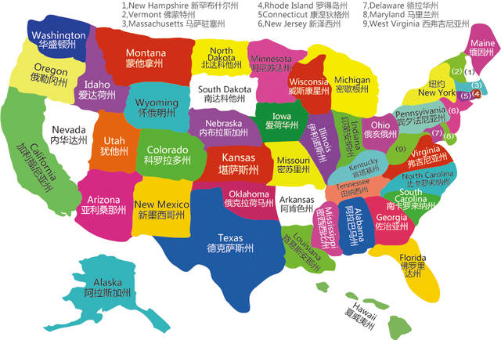
美国西部相关州和城市
California 加利福尼亚州
Sierra Nevada 内华达山脉（位于加利福尼亚州）
Seattle 西雅图（华盛顿州Washington港口）
Portland 波特兰（俄勒冈州最大的城市）
Oregon 俄勒冈州
Nevada 内华达州
Idaho 爱达荷州
Utah 犹他州

Slide 16
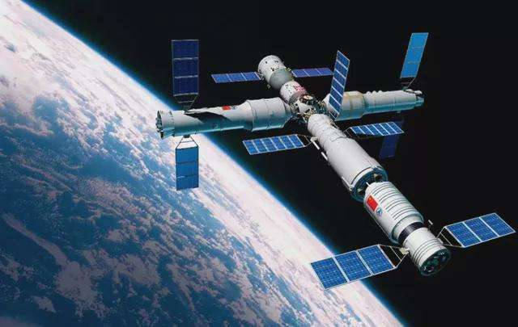
4. Two SpaceX satellites came close to Tiangong space station
美国卫星两次接近中国空间站，外交部回应

Slide 17
语篇填空
（《卫报》2021年12月29日 25页）
China has accused the US ___ ignoring international treaty obligations and engaging in ___________ (responsible) and unsafe conduct in outer space after two near misses between the Chinese space station and satellites operated by Elon Musk’s SpaceX company.
Zhao Lijian , ___ foreign ministry spokesperson, said yesterday that China “urges the US to act responsibly” after incidents involving SpaceX’s Starlink satellites, which he said _________ (pose) a serious threat to the lives and safety of _________ (astronaut).
In a note to the UN Committee on the Peaceful Uses of Outer Space earlier this month, China said Tiangong, its new space station, ______ is expected to become _____ (full) operational in 2022, had to manoeuvre (操控) ________ (avoid) one Starlink satellite in July and another in October.
China’s note to the UN space agency in Vienna _____ (say) state parties to the outer space treaty, which is the foundation of international space law, “bear international responsibility” for activities _______ (carry) out by both government and non-governmental bodies in space.
of
irresponsible
a
had posed
astronauts
which
fully
to avoid
said
carried

Slide 18
熟词生义讲解
1. pose: to create a threat, problem, etc. that has to be dealt with 造成（威胁、问题等）；引起；产生
The task poses no special problems. 这项任务不会造成特别的问题。
2. note: an official letter from the representative of one government to another （外交文书）照会；通牒
Foreign Ministry spokesman Zhao Lijian made the remarks while confirming that China's permanent mission to the United Nations had submitted a note verbale to the UN secretary-general for safety reasons earlier this month.
翻译句子
这会对环境造成威胁。
This could pose a threat to the environment.
外交部发言人赵立坚在确认中国常驻联合国代表团本月早些时候就安全问题向联合国秘书长提交了一份普通照会时发表了上述言论。

Slide 19
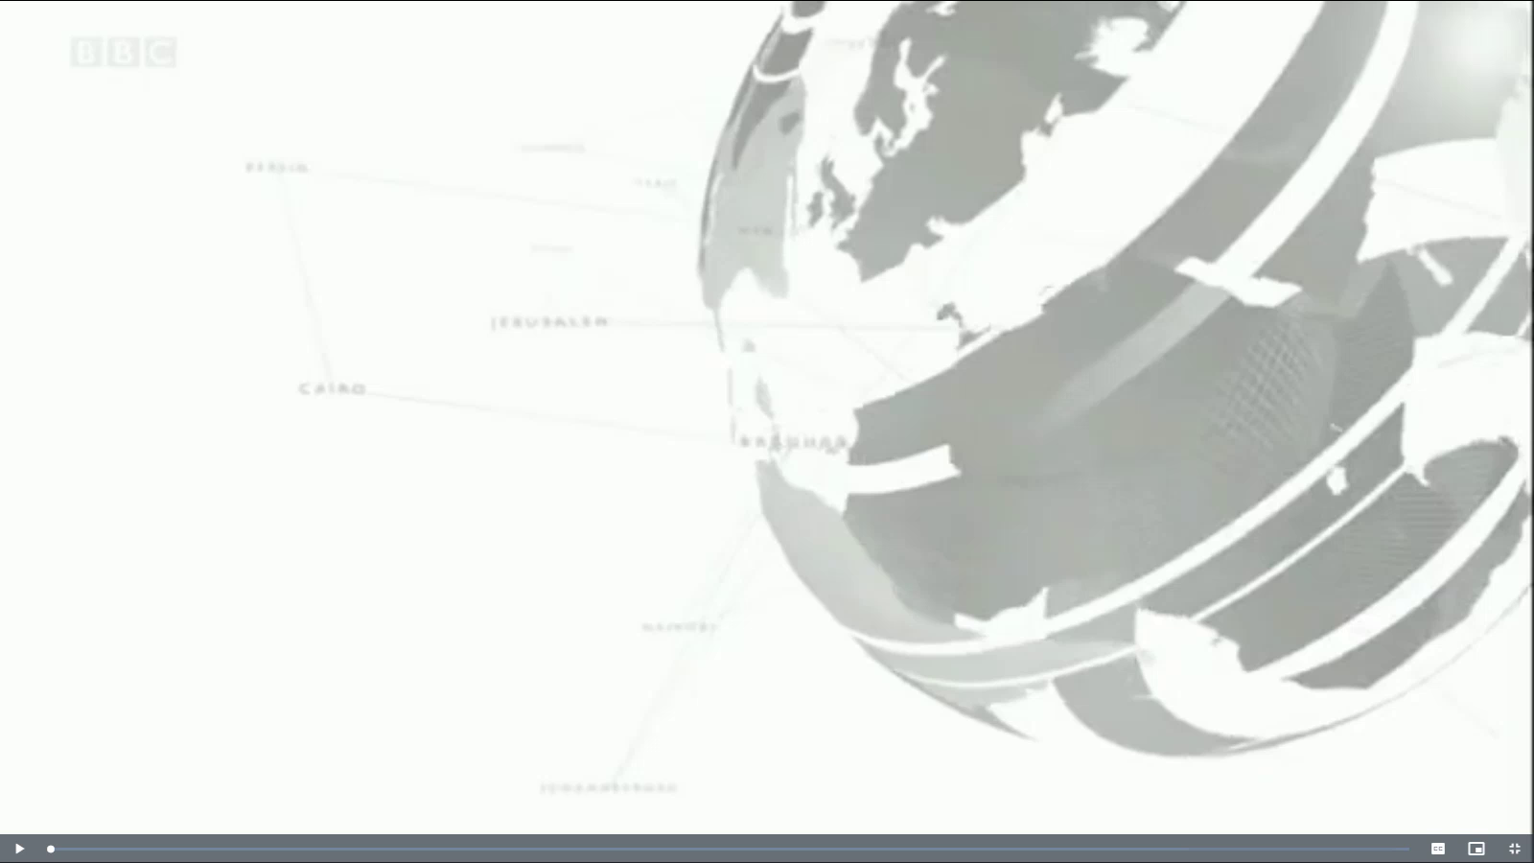
5. BBC一分钟新闻听写填空 One-minute World 12/28/21

Slide 20

听写
听写
Christmas
Millions around the world face travel disruption over _________ as the surge in Omicron variant cases sees thousands of flights cancelled due to _____________. United Airlines says it’s _________ those passengers affected before they arrive at the airport.
Christmas celebrations have __________ in Bethlehem (伯利恒,耶稣诞生地) culminating (以…结束) in a Mass (弥撒) at the church of the Nativity built at the site where Jesus is said to have been born. Earlier in his Christmas Eve Mass, Pope Francis ________ more solidarity with those _____________ around the world.
And _______________ are underway for the launch of a rocket carrying a space telescope that could _________ our understanding of the universe. The rocket carrying the James Webb Space Telescope (詹姆斯韦伯太空望远镜) will _______ from French Guiana later this Saturday. It's the ________ to the Hubble Space Telescope (哈勃太空望远镜).
staff shortages
contacting
taken place
called for
living in poverty
final preparations
transform
take off
successor

Slide 21
词语讲解
1. disruption: When there is disruption of an event, system, or process, it is prevented from continuing or operating in a normal way. 中断；扰乱；混乱
The strike caused serious disruptions.
罢工造成了严重的混乱。
铁路罢工使该国港口陷入了一片混乱。
_______________________________________________
2. solidarity: ~ (with sb) support by one person or group of people for another because they share feelings, opinions, aims, etc. 团结；齐心协力；相互支持
Demonstrations were held as a gesture of solidarity with the hunger strikers.
人们举行示威游行，以表示对绝食抗议者的支持。
为了显示和领袖的同心同德，支持者们希望明天举行游行。
____________________________________________________________
翻译句子
The rail strike caused major disruptions at the country’s ports.
翻译句子
Supporters want to march tomorrow to show solidarity with their leaders.

Slide 22
长难句分析
Millions around the world face travel disruption over Christmas as the surge in Omicron variant cases sees thousands of flights cancelled due to staff shortages.
分析：本句中“Million... Chrismas”是_____; “as ... staff shortages”是 “as”引导的_____________，“see”在句中意为“_____”, 是一种_____修辞手法。
主句
原因状语从句
目睹
拟人
翻译
圣诞节期间，由于奥密克戎变异株感染案例激增，成千上万的航班因员工短缺而取消，全球数百万人面临旅行中断。
Christmas celebrations have taken place in Bethlehem culminating in a Mass at the church of the Nativity built at the site where Jesus is said to have been born.
分析：本句中 “culminating in a Mass”是_________结构作________; “built at the site”是________ 结构作________修饰 “the church of the Nativity”；“where Jesus ... born”是________修饰_______。
现在分词
伴随状语
过去分词
后置定语
定语从句
the site
翻译
圣诞节庆祝活动在伯利恒举行，最后的一个项目是在据称耶稣诞生的地方建造的主诞教堂里举行的弥撒活动。

