Slide 1

感恩遇见，相互成就，本课件资料仅供您个人参考、教学使用，严禁自行在网络传播，违者依知识产权法追究法律责任。
更多教学资源请关注
公众号：溯恩高中英语
知识产权声明

Slide 2

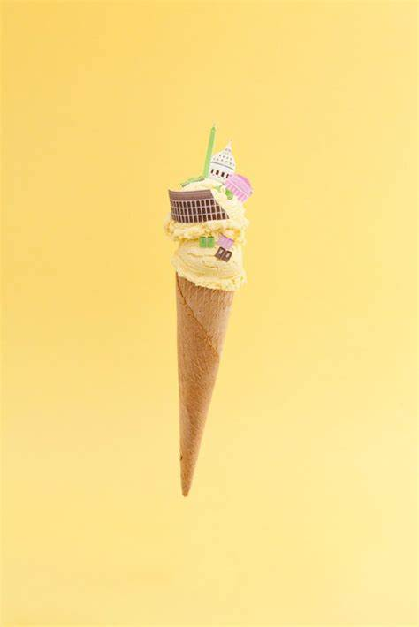
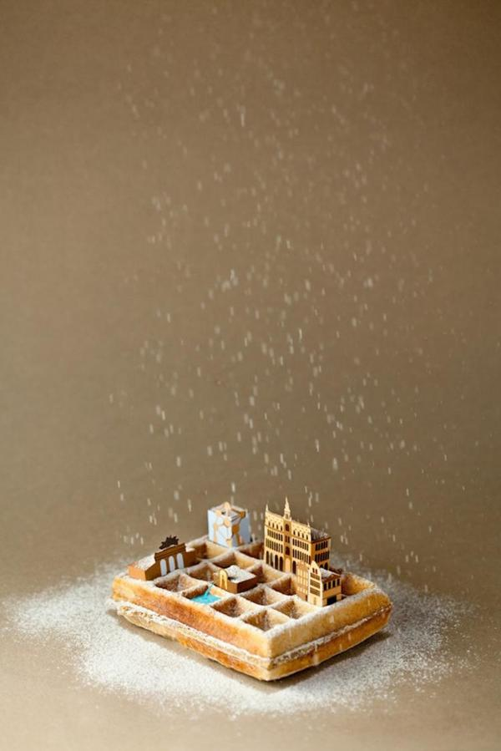
Unit 3
Reading and thinking
Food and Culture

Slide 3

New York-based photographer Henry Hargreaves and food stylist Caitlin Levin created snapshots of countries using 'iconic' delicacies from each region. Commenting on their latest project, they write “These maps show how food has traveled the globe. This project speaks to the universality of how food unites people.”
Let’s enjoy the feast for the senses !

Slide 4
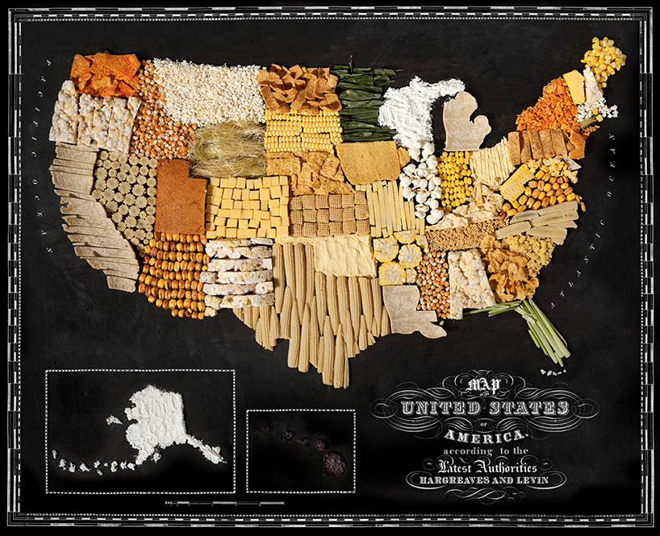
The U.S. is crafted from corn.

Slide 5
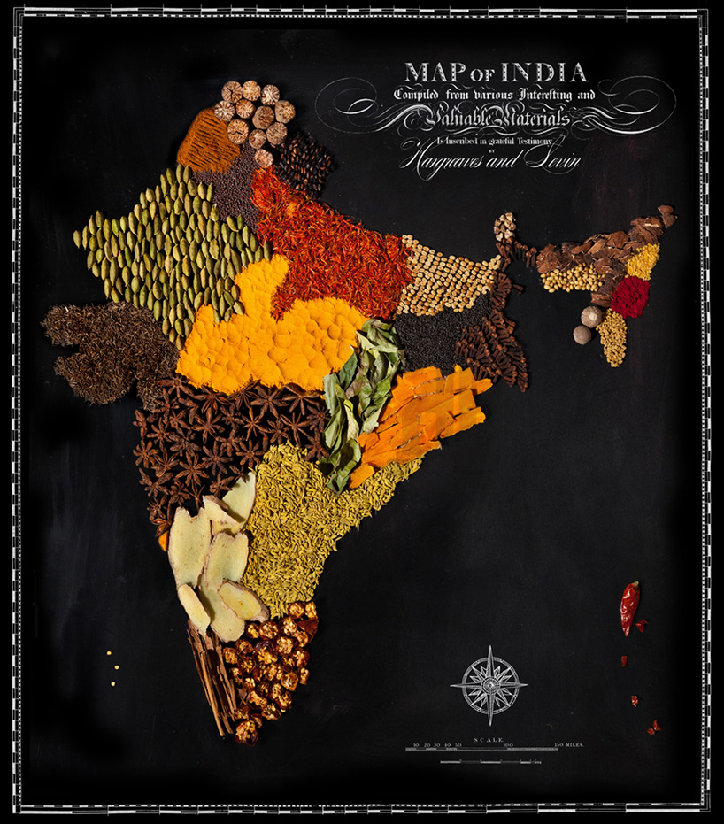
Spices including cardamom pods, chili flakes and cinnamon sticks were used to create this map of India.
小豆蔻豆荚、红辣椒片、肉桂棒

Slide 6
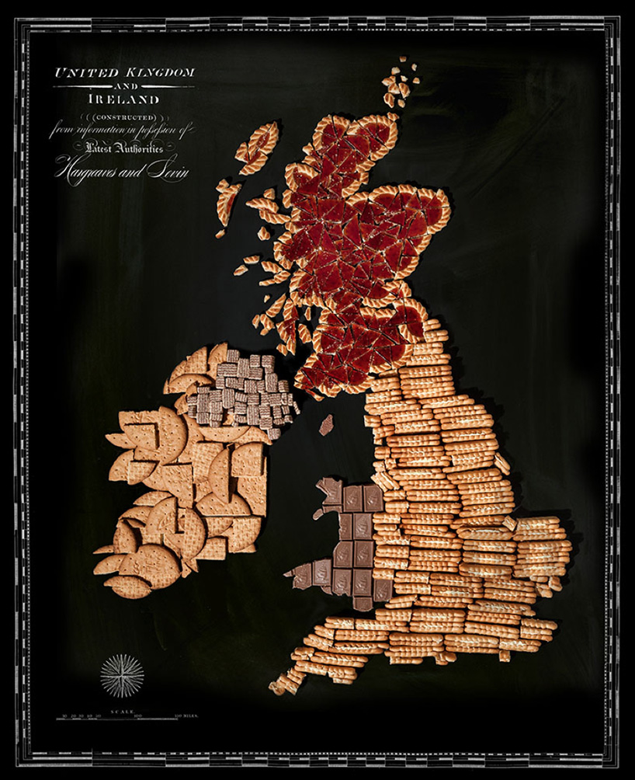
Chocolate, jam and cream-filled biscuits were used for the UK.

Slide 7
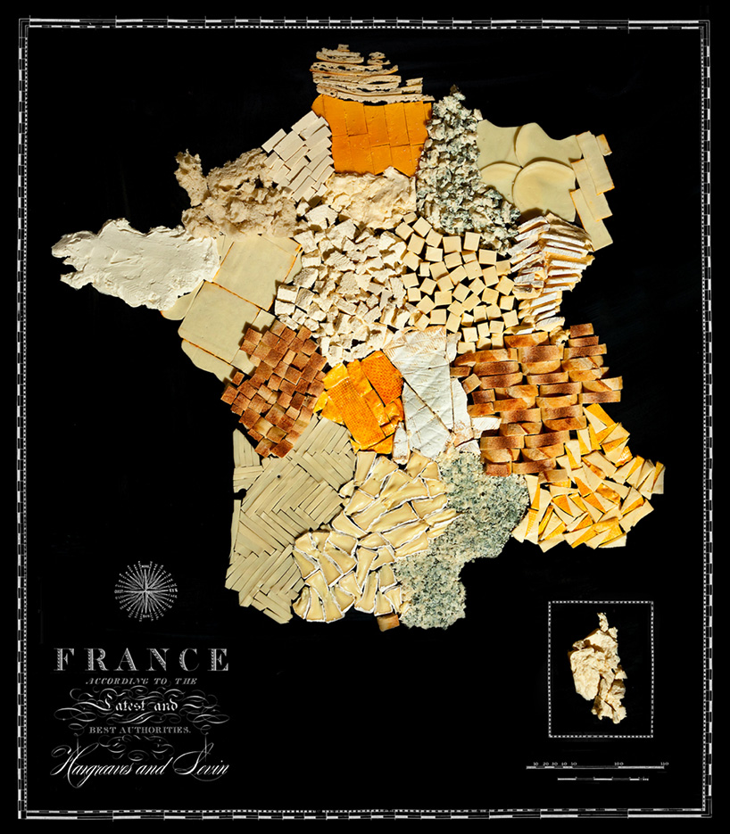
The artists used cheese and biscuits to make this map of France.

Slide 8
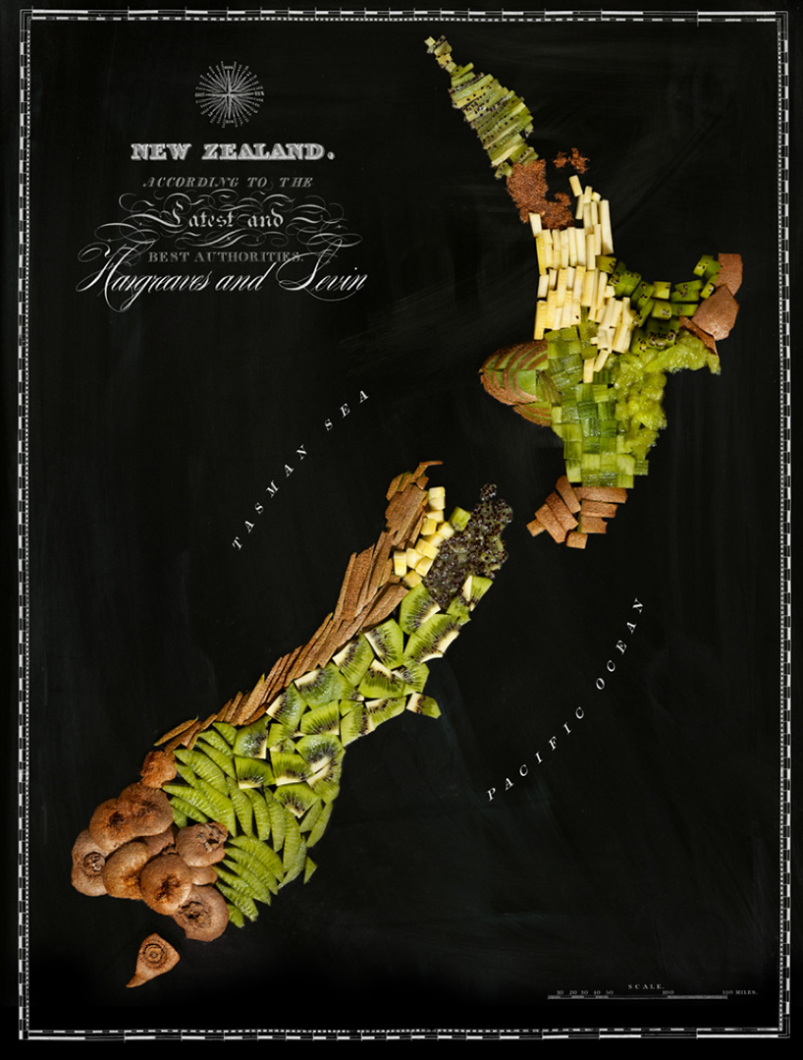
For Mr Hargreaves' home country, New Zealand, kiwi fruits were chopped up and molded into shape.

Slide 9
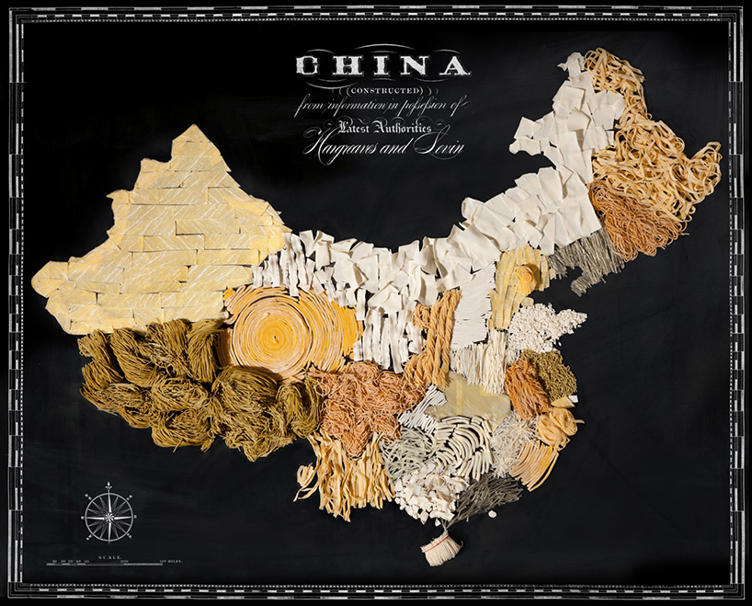
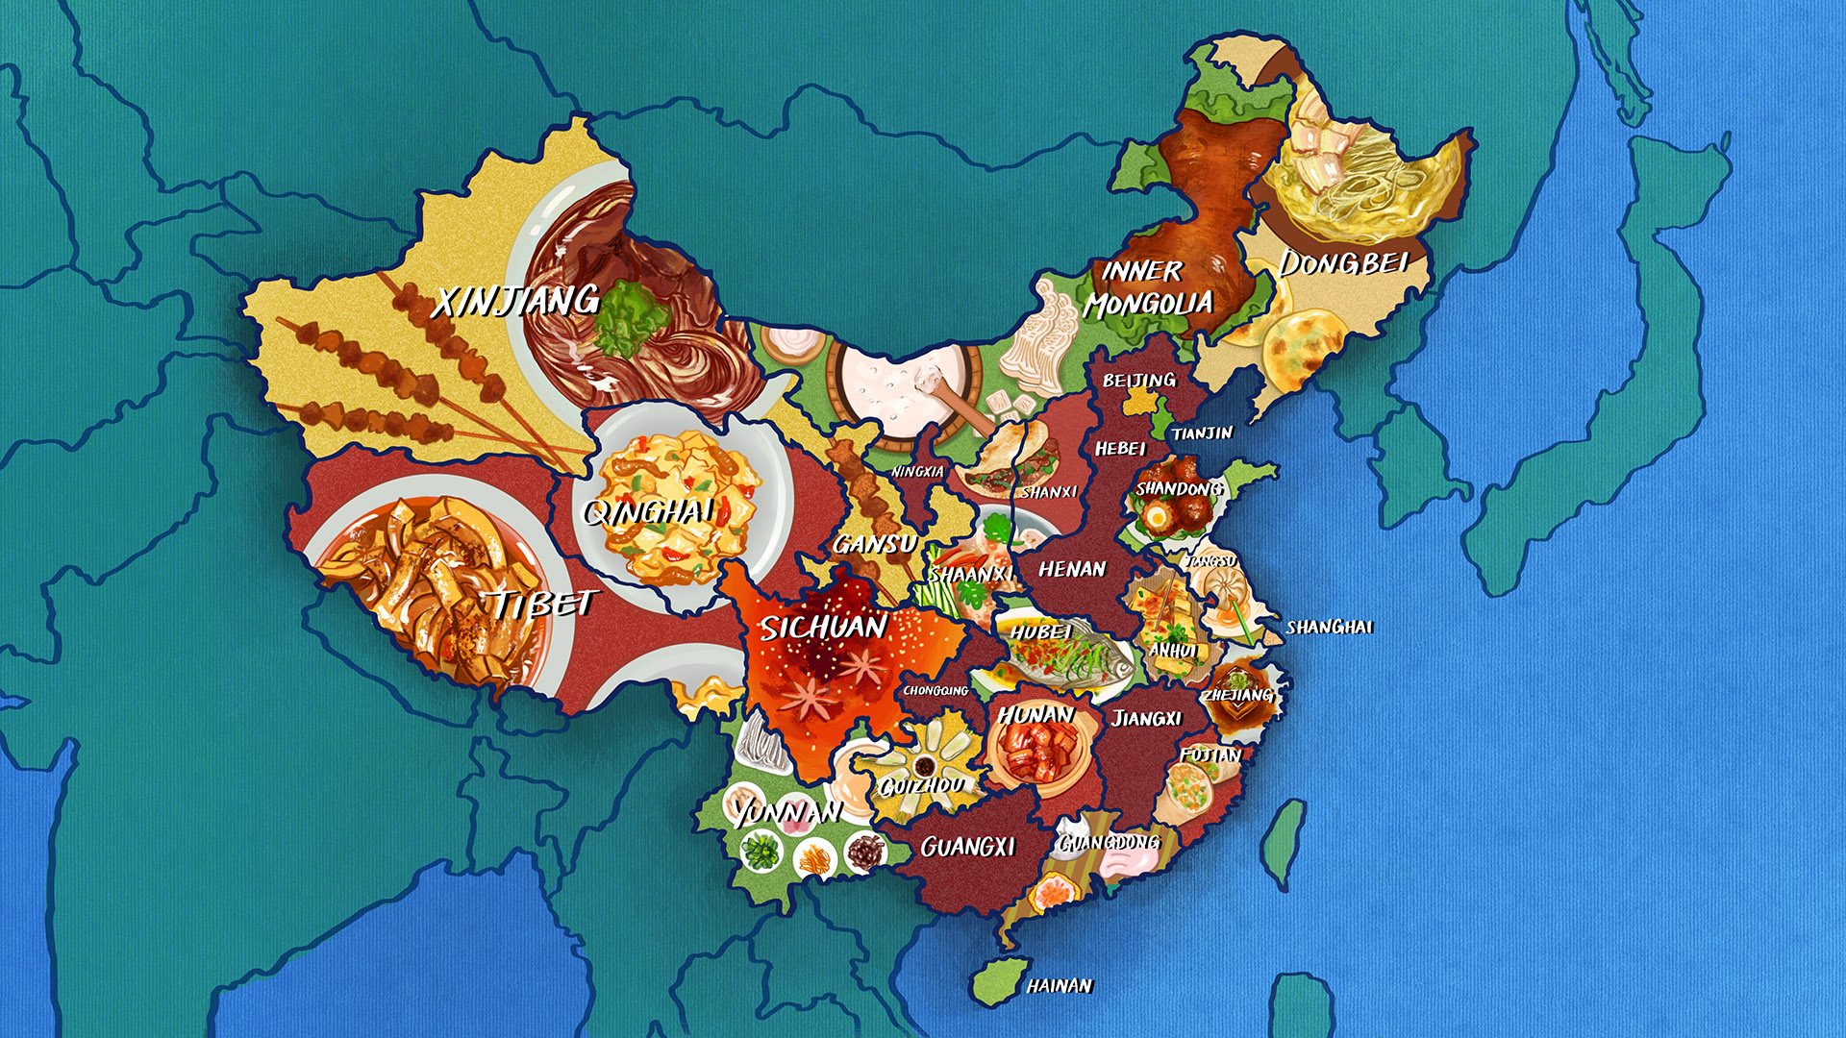
How many kinds of Chinese cuisines in China?
How can these cuisine be described?
Why are there so many cuisines?

Slide 10
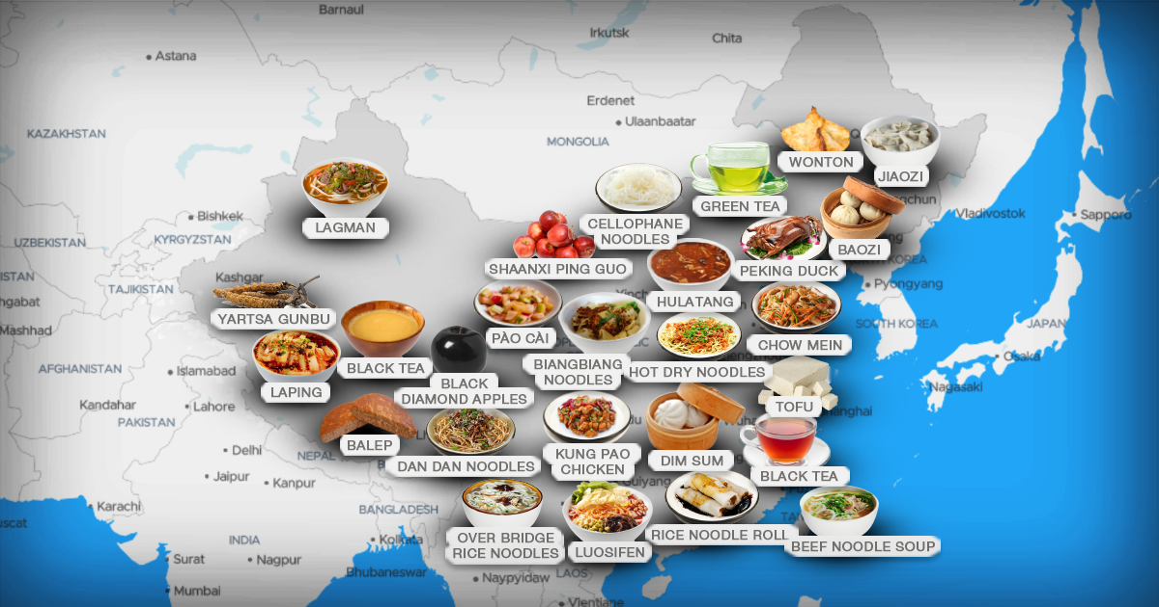
Throughout the country, there is a great diversity of cuisine. China’s vast territory and long history have given birth to distinct regional cuisines.

Slide 11
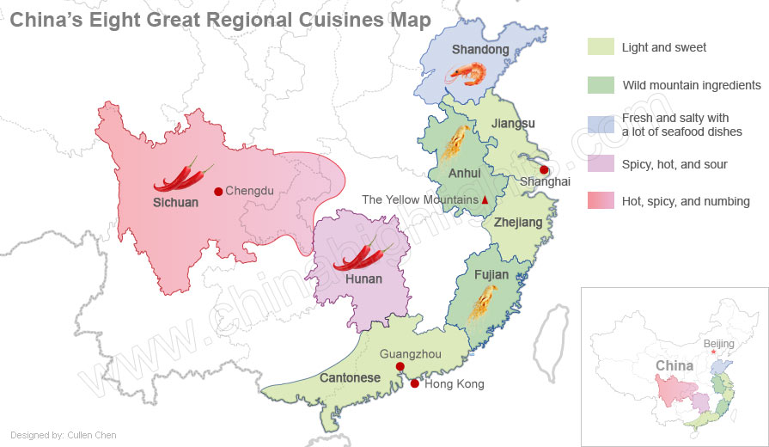
8 regional cuisines
Different regions
Various weather conditions
Different cultures
Different personalities

Slide 12
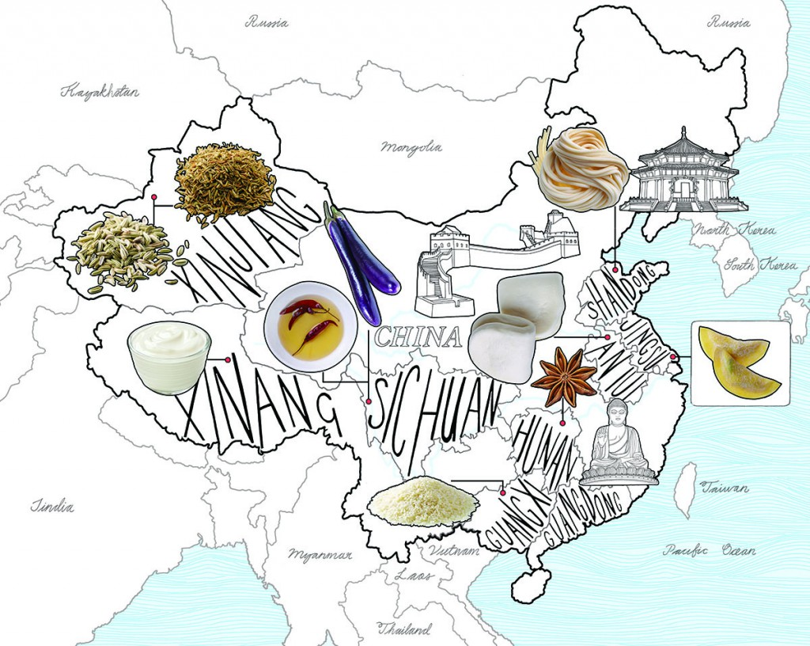
Culture and Cuisine
Q1: What do you think the text is about?
Q2: How do you understand “You are what you eat”?

Slide 13


Activity 1: Read to check
Q1: What do you think the text is about?
The text mainly talks about ___________________________.
Q2: How do you understand “You are what you eat”?
★ The food we are eating or we enjoy cooking relates a lot to our personality, character, and culture.

Slide 14
Activity 2: Read for the main idea
Match the main idea with each paragraph.
Para.1
Para.2
Para.3
Para.4
Para.5
Para.6
Para.7
A. Famous food in Xinjiang.
B. Famous food in Shandong.
C. Experience of food in South China.
D. Culture and cuisine go hand in hand.
E. Experience of Chinese dish in America.
F. Experience of Sichuan food in Beijing.
G. You are what you eat.

Slide 15
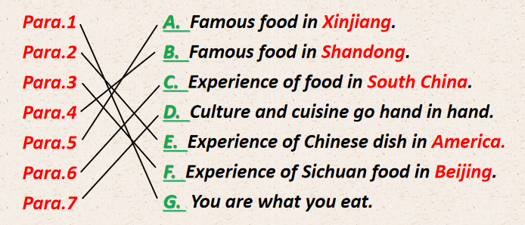
Activity 2: Read for the main idea
Match the main idea with each paragraph.
General
Particular
General

Slide 16
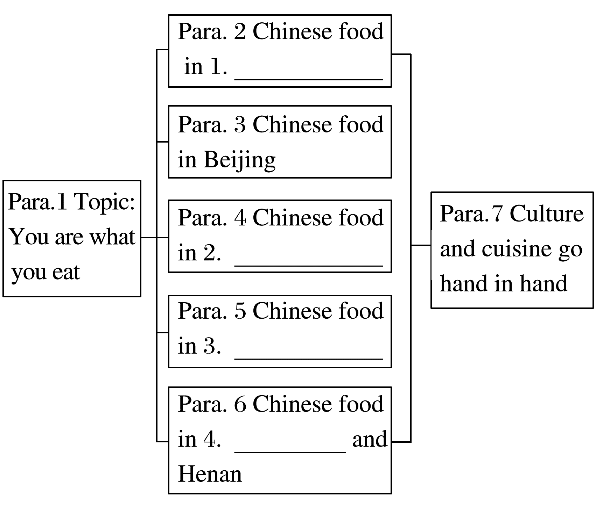
Activity 2: Read for the structure
How is the passage developed?
America
Shandong
Xinjiang
Guangdong

Slide 17
Activity 3: Read for information
Read Para.2 carefully and answer the following questions.
What is America’s most popular Chinese dish?
And what can the dish tell us about Americans?
Certainly, in many ways this seems to be true. Chinese cuisine is a case in point. Prior to coming to China, my only experience with Chinese cooking was in America, with Chinese food that had been changed to suit American tastes. For example, America’s most popular Chinese dish is General Tso’s chicken, which consists of fried chicken covered in a sweet sauce, flavoured with hot red peppers. This is probably not an authentic Chinese recipe, however, so it cannot tell us much about the Chinese. On the other hand, it does tell us a lot about Americans. It tells us, for example, that Americans love bold, simple flavours. And, since the dish was also invented recently, it tells us that Americans are not afraid to try new foods.

Slide 18
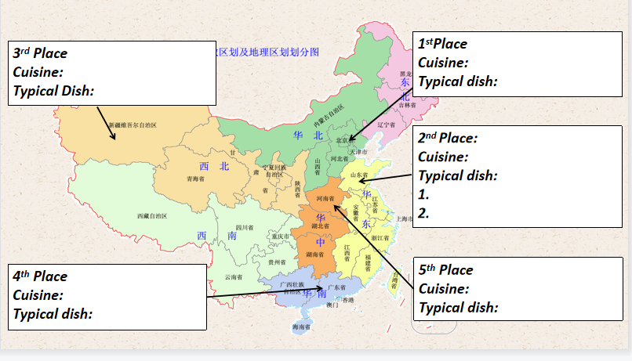
Activity 3: Read for information
Read Para.3-6 carefully and complete the table.

Slide 19
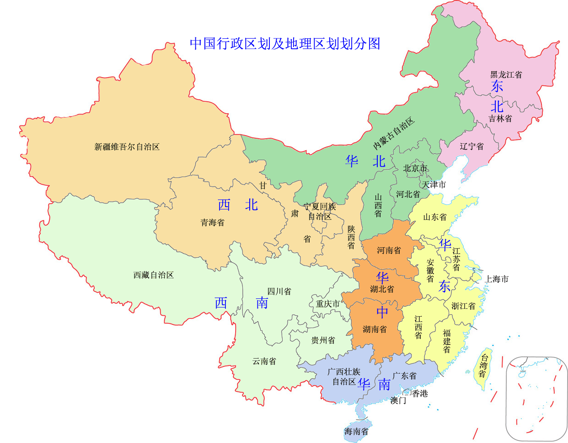
3rd Place
Cuisine:
Typical Dish:
Xinjiang and Inner
Mongolian cuisine
1stPlace
Cuisine:
Typical dish:
Beijing
Sichuan cuisine
Boiled or roasted
meat,such as lamb kebab
dishes with Sichuan pepercorns
Shandong
2nd Place:
Cuisine:
Typical dish:
1.
2.
Shandong cuisine
Boiled dumplings + vinegar
Pancake rolls stuffed with
sliced Chinese green onions
South China
5th Place
Cuisine:
Typical dish:
4th Place
Cuisine:
Typical dish:
Guangdong cuisine
Henan cuisine
Stewed noodles
dim sum

Slide 20
Consolidation
Work in pairs. Ask and answer the questions.
S1: Where did the write experience....? S2: ....
S1: Which dish impresses the writer most in...? S2: ....
S1: What do we know about people in ... according to their food? S2: ....
S1: What is the personality of people in ...? S2: ....
S1: Why is ... the typical dish in ...? S2: ....

Slide 21
Activity 3: Read for information
Read Para.2 carefully and answer the following questions.
What can the food local people consume tell us?
What is the main idea of Para.7? How do you understand it?
At a minimum, the kinds of food local people consume tell us what they grow in their region, what kinds of lives they lead, and what they like and do not like. Could we also say, for example, that those who like bold flavours are bold themselves? Or, that those who like spicy food tend to have a hot temper? Maybe. Maybe not. What we can say, however, is that culture and cuisine go hand in hand, and if you do not experience one, you can never really know the other.

Slide 22
Activity 4: Critical thinking
Discuss the following questions with your partner.
1. Do you think “culture and cuisine go hand in hand”? Give your reasons.
Cuisine in certain place can tell us what the local people like to eat, grow or dislike.
The food flavor they eat the food features they cook also well demonstrate the personality, characters or culture of the local people.

Slide 23
Activity 4: Critical thinking
Discuss the following questions with your partner.
2. Imagine that it is true that people's personalities are closely linked to the foods they eat. What does eating the following foods tell you about a person?
spicy food vegetarian food junk food seafood sweets chocolate rice noodles onion garlic bacon ham sausage cabbage mushroom bean curd
Possibly, people who like spicy food love excitement and new experiences. And people who like junk food like to enjoy life without worrying about the future.

Slide 24
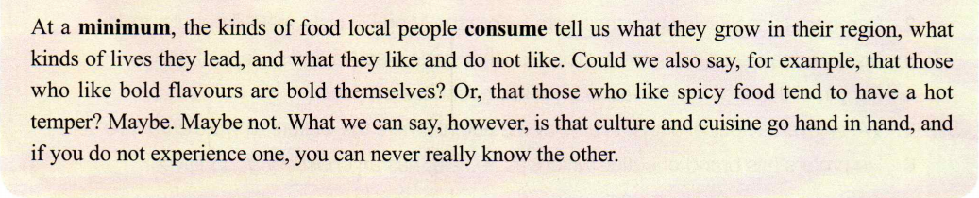
Activity 5: Read for language
Where can we find the topic paragraph?
Which is the topic sentence?
The last paragragh
Expressions to show writer’s opinion:
but/ however/ yet/ in fact
Expressions to summary & clarify the topic:
In short/conclusion
What we can say/conclude is that...

Slide 25
Activity 5: Read for language
Understand cause and effect.
Do people in different places share the same food or different kinds of food?
Do people in different places share the same culture or different cultures?
People are in different places. As a result, people share different kinds of food.
Cause
Effect
Relationship ?

Slide 26
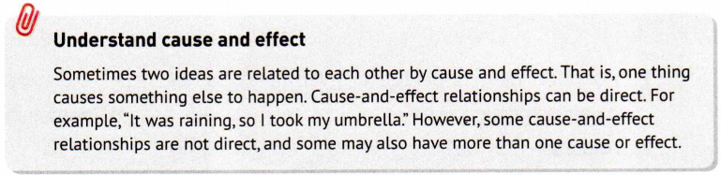
Activity 5: Read for language
Understand cause and effect.
People are in different places. As a result, people share different kinds of food.
Cause
Effect
Relationship ?

Slide 27
Activity 5: Read for language
Match the causes to the effects.
Effect
A: The chef just began filling our table with the best food we had ever eaten.
B: Their traditional foods are what you can cook over an open fire.
C: Chinese food in America is changed to suit American tastes.
Cause
1.The flavor preferences of Americans often differ from those of the Chinese
2.We had no idea how to order food.
3.These groups traditionally wandered the open range on horses.
Try to find more cause and effect sentences in the pqssage.

Slide 28
Summary
actually
Most people relate “You are what you eat” to healthy eating. It 1 (actual) refers to personality, character, and culture. Chinese cuisine is a case in point. When introduced to America, it 2 (change) to suit American tastes, which tells us Americans like trying new foods.
Later, I visited China and 3 (experience) authentic Chinese food. In Beijing, we ate in a restaurant where the chef treated us to dinner 4 (consist) of Sichuan peppercorns. It was wonderful but what was even more important was the friendship. In Shandong Province, we had 5 (boil) dumplings with vinegar. I found making dumplings is always an affair with the whole family. In South China and central China, I experienced local dishes from Guangdong’s elegant dim sum to the 6 (exception) stewed noodles in Henan. Through food, Chinese people everywhere show friendship and kindness. At 7 minimum, the kinds of food 8 (consume) by local people tell us what they grow in their region, what kinds of lives they lead, and 9 they like and do not like.
All in all, culture and cuisine go hand 10 hand, and if you do not experience one, you can never really know the other.
is changed
experienced
consisting
boiled
exceptional
a
consumed
what
in

Slide 29
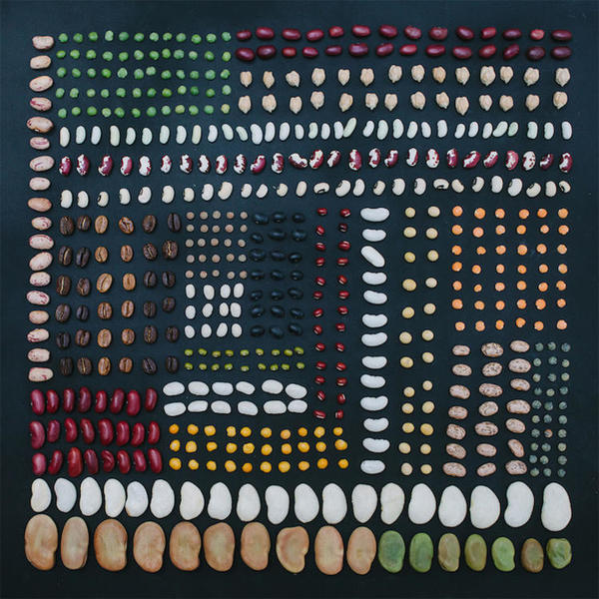
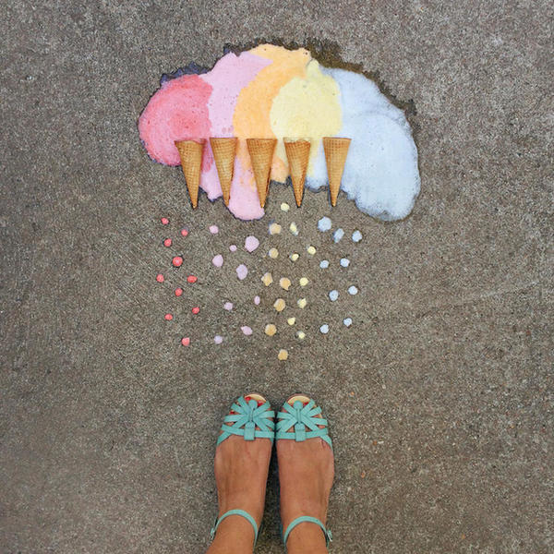
Read the culture and ead about the culture and cuisine by reading the article and pictures
Thank you

