Slide 1

感恩遇见，相互成就，本课件资料仅供您个人参考、教学使用，严禁自行在网络传播，违者依知识产权法追究法律责任。
更多教学资源请关注
公众号：溯恩高中英语
知识产权声明

Slide 2

Unit 2 Healthy lifestyle Learning About Language Discover useful structures to-infinitive as the subject
选择性必修 第三册

Slide 3
What are the functions of the colored parts in the sentences?
Lead in
The Infinitive is the subject of the sentence!
1 To change bad habits is never easy.
2
It took extra time to do the job properly.
To join the People’s Liberation Army,
it is required for men to shave off their beards.
3
4
It was not polite to disturb your neighbors with loud music
last night.
The Infinitive is the real subject of the sentence!

Slide 4
Find more infinitives in the reading passage.
To prevent harmful habits like these from dominating a teenager’s life is essential.
It can be easy for some of them to form bad habits.
It is not easy to break bad habits.
The Infinitives are the subjects of the sentences!

Slide 5
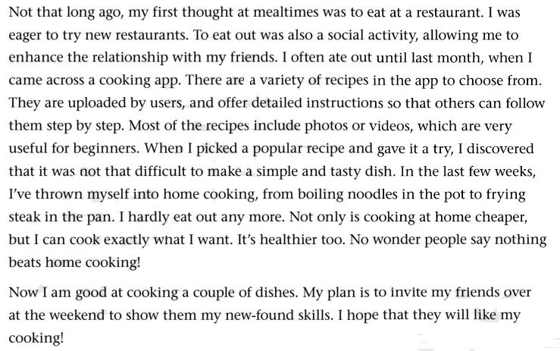
A Exploring the rules
Below is a blog entry about eating out and eating at home. Find the sentences that use to-infinitives as subjects and fill in the table below.

Slide 6

A Exploring the rules
Below is a blog entry about eating out and eating at home. Find the sentences that use to-infinitives as subjects and fill in the table below.
To-infinitives as subjects | To eat out was also a social activity, ...
..., it was not that difficult to make a simple and tasty dish.
When the to-infinitive is used as a subject, we usually use the preparatory subject at the beginning of the sentence.
it

Slide 7
A Exploring the rules
Part 1
Infinitive as the subject of the sentence:
Be Singular form
Example 1: To help others is our duty.
Subject
Predicative
Example 2: To get good grade requires a lot of hard work.
Subject
Verb
Object
Singular form

Slide 8
Grammar
A Exploring the rules
Part 2
Infinitive as the real subject of the sentence:
It is +adj.+(for sb) to do （describing sth.)
(adj: easy ,difficult, comfortable, pleasant, light, heavy,dangerous， tiresome, interesting , fit)
It is important for everyone to learn English well in our rapidly developing world.
It is +adj.+(of sb) to do (descrbing a person)
(adj: kind, good, nice, wise, unwise, clever, silly, stupid, foolish, careless, rude, polite, naughty)
It is nice of you to give me such advice.

Slide 9
A Exploring the rules
Part 2
Grammar
It is +n.+ to do sth.
( an honour, our duty, a pity, a shame)
It is an honour to be invited to contribute to your magazine.
It takes/took sb some time to do sth.
It takes me quite a long time to understand the meaning of the painting.

Slide 10





Exercise
important/avoid/passive cigarette smoking
It is important to avoid passive cigarette smoking.
Join the words to make full sentences using the infinitive.
will take/nutrition specialist/a balanced diet menu/
make /an hour/for you.
It will take a nutrition specialist an hour to make a balanced
diet menu for you.
useful/turn to/fitness consultant/for advice
It is useful to turn to a fitness consultant for advice.
illegal /dangerous/take /drugs
It is illegal and dangerous to take drugs.
harmful /often /skip /breakfast
It is harmful to often skip breakfast.
Join the sentences to make a paragraph. You can add your own sentences if necessary to make your paragraph more meaningful.

Slide 11

To keep healthy and get rid of bad habits, sometimes it is also a good idea to get professional help. A nutrition specialist will take an hour to make a balanced diet menu for you. It is also useful to turn to a fitness consultant for advice.
You can also help yourself with some common sense. For example, it is harmful to skip breakfast too often. It is important to avoid passive cigarette smoking. And, of course, it is dangerous to take illegal drugs too.

Slide 12

begin with, be in control of, make a choice,
decide on, make up one‘s mind
Complete the conversations with the correct forms of the phrases in the box.
1 A: Hello, doctor. I want to lose weight, but I just can’t seem to do it. What can you do to help me?
B: Well, first, it’s necessary to _____________what you eat. Cut out all fatty food and sugary drinks, and eat more fruit and vegetables.
2. A:I really need to _________ a way to exercise more. I could use a fitness app, but my phone’s full.
B: So delete a few files. I’m sure the app doesn’t take up much space.
3. A: Before exercising, always do a few warm-ups to___________.
B: I know. But then I always feel too tired to continue!
4. A:Should I go for the pizza or the fried chicken? I hate ________________ like these. You know what - I’m going to eat both!
B:Wow! Don’t eat too much junk food - you’ll get fat. I’ve actually _________________ to go on a diet, so I’ll just stick to the fruit salad.
be in control of
decide on
begin with
making choices
made up my mind

Slide 13
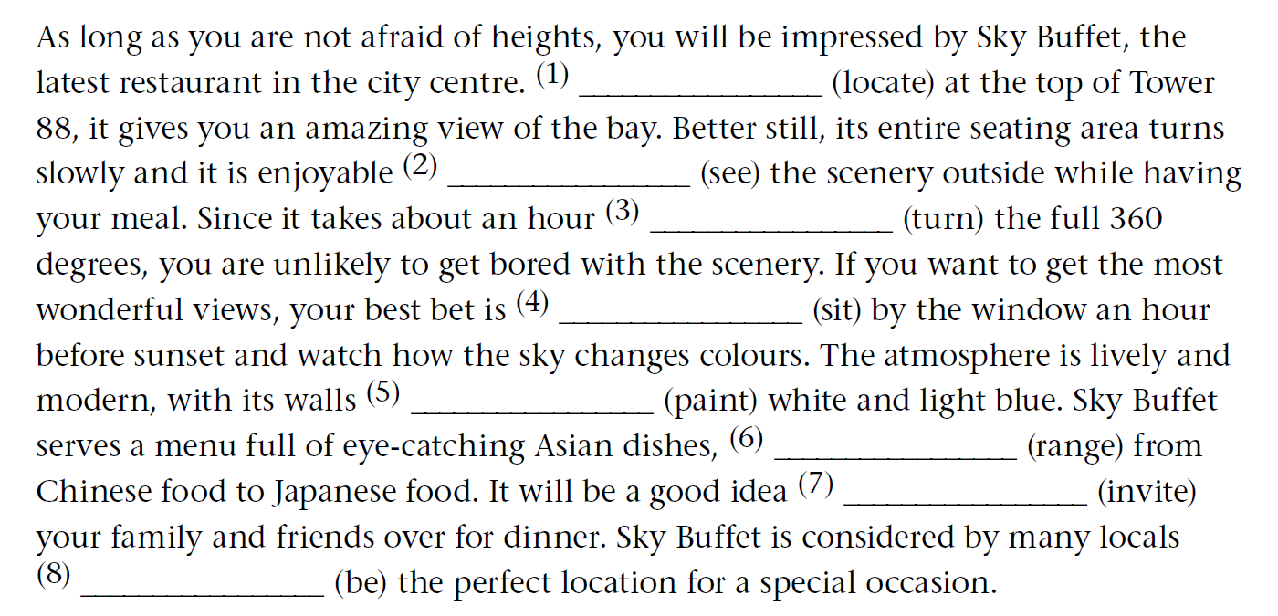
B Applying the rules
Complete the article with the correct forms of the verbs in the brackets.
Located
to see
to turn
to sit
painted
ranging
to invite
to be

Slide 14

B Applying the rules
Imagine your friend has taken you out to dinner at Sky Buffet. Write a thank-you note to your friend, offering to return the favour by inviting him or her to your home for dinner next weekend. Remember to use to-infinitives. Use the expressions below to help you.
I am writing to … I have always wanted to …
It was so kind of you to … I would like/love to …
It was wonderful to … My plan is to …
Expression

Slide 15
B Applying the rules
Sample answer
Dear Tom,
I am writing to thank you for taking me to Sky Buffet. It was so kind of you to invite me and book a table by the window. It was wonderful to see the city scenery and watch the beautiful sunset. I have always wanted to give Sky Buffet a try, and it certainly lived up to my expectations! Do you have any arrangements next weekend? My plan is to invite you over to my home for dinner next Saturday. The view won’t be as good as at Sky Buffet but I would like to cook you something special to thank you.
Yours,
Mary

Slide 16

Thanks for Listening

