Slide 1

感恩遇见，相互成就，本课件资料仅供您个人参考、教学使用，严禁自行在网络传播，违者依知识产权法追究法律责任。
更多教学资源请关注
公众号：溯恩高中英语
知识产权声明

Slide 2

Unit 2 Healthy Lifestyle---
Period 4 Using Language 1
Giving advice on changing bad habits
人教 选择性必修 第三册

Slide 3





01
Review:
ROUTINE
__________
How can a choice
lead to a habit?
CUE
_______
REWARD
_________

Slide 4
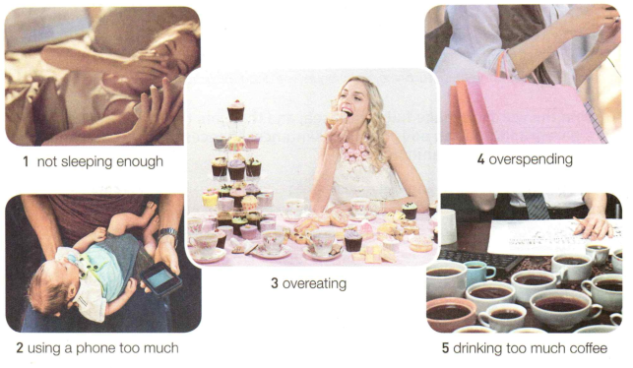
02
Pre-listening
Activity 1:Lead-in
Look at the pictures. What choices or preferences make it easier for people to develop these bad habits?

Slide 5

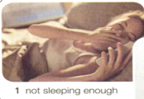
Questions :
Q1:What is the person doing ?
Q2:What is her problem?
Q3:What is the possible cause of her bad habit ?
Q4:What advice would you give regarding her bad habit?
References:
Holding the phone in bed
yawning
tired
be accustomed to taking her phone before going to bed
Advice: ...

Slide 6
Activity 2:Prediction
Skim the contents of the listening given materials especially Exercises 2,3 and 5 and predict what you are to going to listen .
Two students are asking for the expert’s advice about some problems.

Slide 7

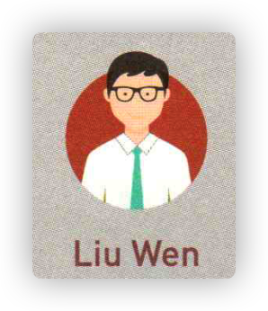
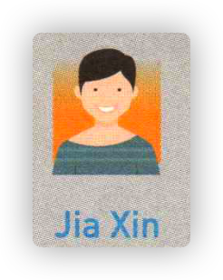


03
Listening for the problems
Has trouble sleeping because uses phone before going to sleep
Student1 :
Problem
Depressed about being a little overweight
Student2:
Problem

Slide 8
04
Listening for the details
Listen again to the conversation and complete the chart below.
 | Student 1 | Student 2
Cue
Routine
Advice
Finishing dinner
Going to bed
picking up the phone
picking up the phone
Don’t keep phone in room so you won’t pick it up before bed
Walk outside for just 5 minutes

Slide 9



Activity 3: Language focus One
S1: Hello. I have trouble sleeping. It often takes me a long time to fall asleep at night. It’s affecting my schoolwork because I’m always tired in the daytime.
S2: Hi. I feel depressed about being a little overweight. I want to exercise every night after dinner, but I always just pick up my phone. What can I do?
What sentences are used to express problems?

Slide 10
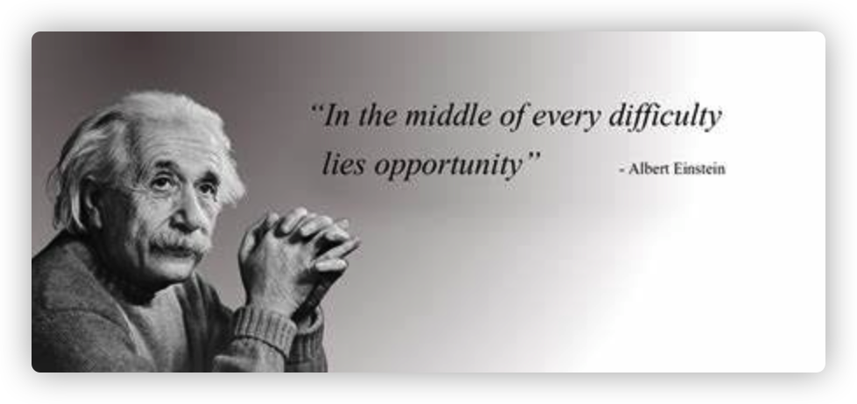
Expressions
I am having a lot of trouble in …
My biggest headache is….
For me, …. is my biggest problem
Can you think of other expressions?

Slide 11

retell
I’m having a lot of trouble sleeping.
I find it difficult/challenging to...
I find it really a challenge/headache for me to...
I have been struggling with...
I have difficulty/problems in...
I really have no idea how to...
What troubles/bothers me most is...
My biggest headache is...
My top challenge is...
....… is a big difficulty/ challenge/ struggle for me

Slide 12
Activity 4: Language focus Two
..., don’t keep your
phone in your
bedroom at night.
01
What expressions does Doctor use to give suggestions?
02
...you must take small steps to begin with.
03
...make the routine to turn off your phone and walk outside - for just five minutes.
Can you think of other expressions to give advice?
Notes:
www.515ppt.com

Slide 13
I recommend that…
I think you should…
You'd better...
you are supposed to...
Why don't you...
It will certainly help a lot if you...
It is advisable(可取的；合理的) to...
How about...
I'd like to suggest...
It might be a good idea to...
I think it wise of you to… because …
It would be much better if you...
In addition to that, wouldn't it be a good idea to …?

Slide 14
Decide whether these statements from the conversation are facts (F) or opinions (O).
Discuss the opinions with a partner and see if you agree on them.
1. ___ It was a really interesting talk.
2. ___ It often takes me half an hour to fall
asleep at night.
3. ___ You look tired. Not enough sleep, right?
4. ___ It is affecting my school work.
5. ___ I failed in all my school subjects this
semester.
6. ___ I usually pick up my phone.
7. ___ I think the phone is the problem.
8. ___ A five-minute walk is so easy that it is
hard to say no!
O
F
O
F
F
F
O
O
Distinguish facts from opinions
It is important to know whether what the speakers say is a fact or an opinion. An opinion is a subjective statement and a fact is objective. A fact is what really is true, while an opinion is what you believe, often using phrases like “I think/believe”, “in my opinion”, “to me” and so on.

Slide 15
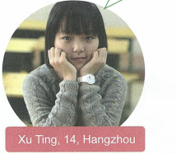
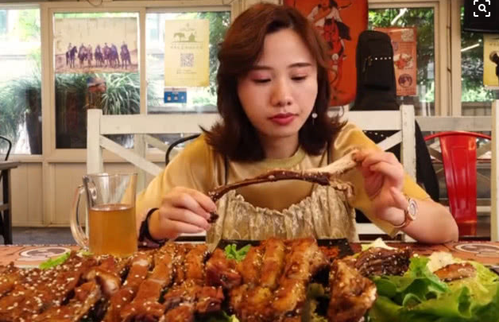
Activity 5:Speaking
They need your help!
Choose a person below to give advice and have a conversation with your partner about it..
Choosing to eat when feeling bored or depressed, which leads to overeating.

Slide 16

Choosing to stay up too late playing computer games .

Slide 17

Staying up too late and not sleeping enough and it leads to drinking too much coffee the next day.

Slide 18
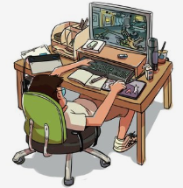
Being addicted to online
games and choosing to stay up too late playing computer games .

Slide 19
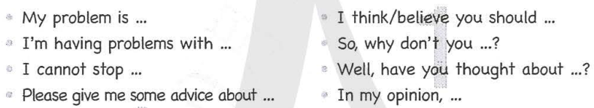
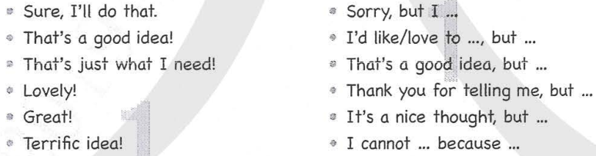
References
Asking for and giving advice
Accepting and refusing advice

Slide 20
A: Hi. I have been struggling with the addiction to online games. I find it difficult to get rid of the bad habit .
B: Yeah. Me too. I always stay up late to play computer games. It’s affecting my schoolwork because I’m always tired in thedaytime.
C:To create a good habit is the same as creating a bad one, but you must take small steps to begin with.
A: Could you offer me some advice?
C:Personally, your cue is going to bed, make sure to turn off your computer or put the computer or cellphone in another room.
A: What can I do next?
C: In my opinion, you should spend your time on something more active instead. Make it a routine to do some exercise before going to bed .
B: OK, sure, I’ll try that.
A: That’s a nice thought, but I don’t really enjoy exercising.
C: Hmm. How about reading more books instead?
A: All right, maybe I can try that.

Slide 21
The End
THANKYOU

