Slide 1

感恩遇见，相互成就，本课件资料仅供您个人参考、教学使用，严禁自行在网络传播，违者依知识产权法追究法律责任。
更多教学资源请关注
公众号：溯恩高中英语
知识产权声明

Slide 2

2022年1月
浙江高考英语应用文讲评
浙江省慈溪中学 宋浩颖 李晓燕

Slide 3

试题回顾（考生回忆版）
你在中国-爱尔兰文化节上认识了一个朋友，名叫Chris，现在他已回国，请你给他写一封邮件：
    回忆活动经历
    分享个人收获
    希望保持联系
注意：
1. 词数80词左右；
2. 可以适当增加细节，以使行文连贯。

Slide 4

审题
文体：邮件（分享回忆）
交际对象：朋友
主题语境：人与社会（跨文化交流）
框架结构：首段 (写作背景)
中段 (要点1 +要点2) 尾段 (要点3)
内容要点：文化节活动+个人收获
你在中国-爱尔兰文化节上认识了一个朋友，名叫Chris，现在他已回国，请你给他写一封邮件：
    回忆活动经历
    分享个人收获
    希望保持联系
语言风格：自然流畅、不应过于正式
注意与宣传稿、报道等较正式文体风格进行区分

Slide 5
首段
Greetings & background information
Happy time has wings! I miss so much all the fun we had in the China-Ireland Culture Festival last month.
I’ve missed you so much since you went back to Ireland. Never will I forget the wonderful days we spent in the China-Ireland culture festival.
Hope you had a safe journey home. I’m still savoring the great fun we had in the China-Ireland Cultural Exchange Festival.
tip：以朋友、文化节为契机自然引入，语言应自然流畅

Slide 6
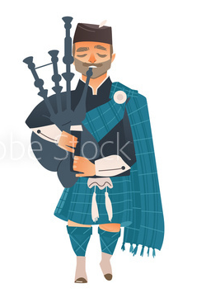
要点1
中国-爱尔兰文化节相关活动
Chinese calligraphy displays
the exhibition of traditional Chinese and Irish artworks
music performances/ Ireland traditional music concert
Chinese lion dance/Irish dance
Chinese and Irish literature
the grand parade/evening gala
tip：活动内容可联系中国传统文化与爱尔兰文化，具体写作时可加入细节，如Mo Yan, Oscar Wilde

Slide 7
要点1
回忆活动经历
Together we appreciated the finest arts from Beijing Opera to the Irish dance. We attended the literature forum where many talented writers like Mo Yan and Oscar Wilde were discussed.
How I miss the splendid music performances and the grand parade we joined in our national costumes!
I still remember how Chinese lion dance and Irish musical held us entirely in their power.
Tip 1: 朋友已经回国，此处为回忆，时态应用一般过去时
Tip 2: 将文化活动细节化，丰富内容

Slide 8
要点1
回忆活动经历
Together we appreciated the finest arts from Beijing Opera to the Irish dance. We attended the literature forum where many talented writers like Mo Yan and Oscar Wilde were discussed.
Tip 3: 写作对象为朋友，语言风格应与宣传稿与报道进行区分
The festival included various activities ranging from an ancient poetry recitation contest to a week-long exhibition, where hundreds of students' traditional Chinese painting and calligraphy works were on display.
报道语言风格

Slide 9
要点2
分享个人收获
Those activities gave me a rare glimpse of Ireland and furthered my understanding of Chinese culture, which will be engraved in my memory. However, it is the precious friendship with you that I treasure most.
During the festival, I not only gained an overall view of culture differences, but also obtained wonderful memories and friendships worth cherishing forever.
The festival truly brought us closer in all aspects.
tip：收获可从文化交流与友谊两方面展开

Slide 10
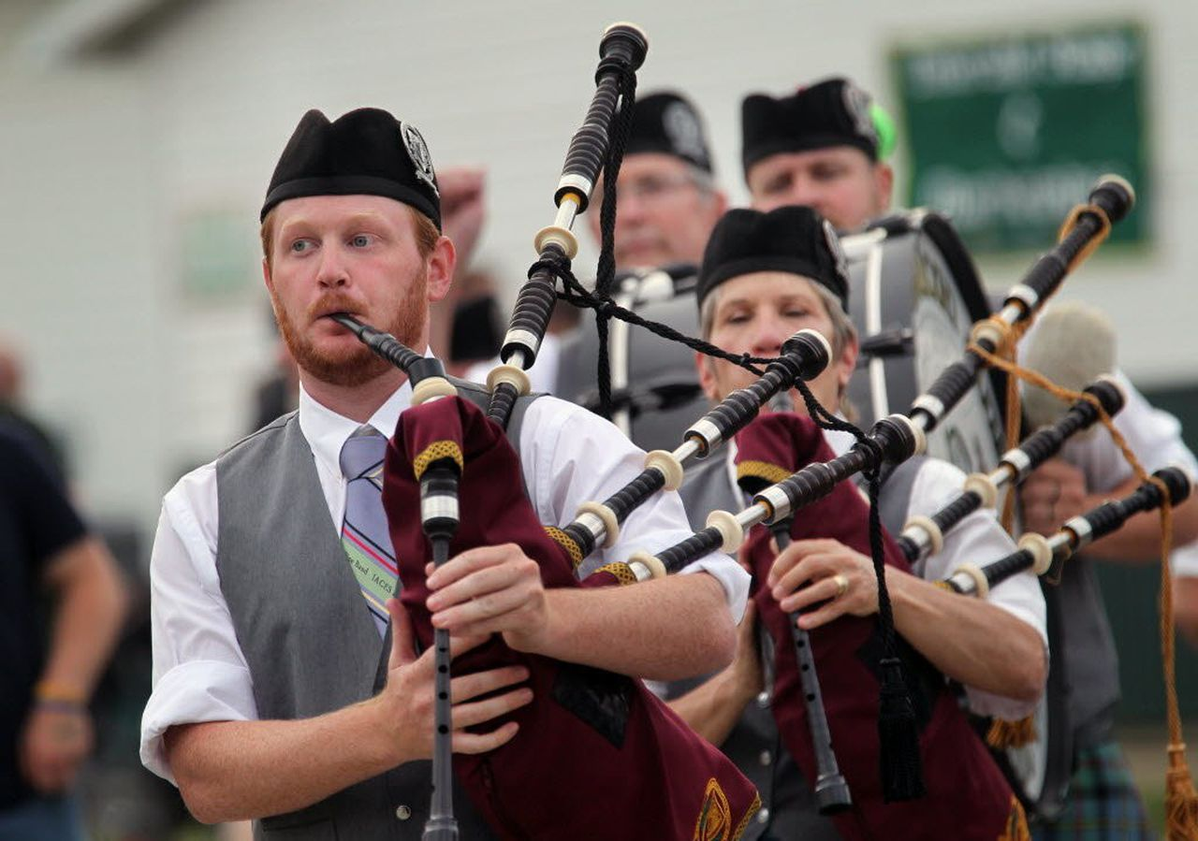
尾段
希望保持联系
Keep in touch and hope to see you again.
Please do keep in touch. Best wishes!

Slide 11
possible version I
Dear Chris,
Happy time has wings! I miss so much all the fun we had in the China-Ireland Culture Festival last month.
Together we appreciated the finest arts from Beijing Opera to the Irish dance. We attended the literature forum where many talented writers like Mo Yan and Oscar Wilde were discussed. Those activities gave me a rare glimpse of Ireland and furthered my understanding of Chinese culture, which will be engraved in my memory. However, it is the precious friendship with you that I treasure most.
Please do keep in touch. Best wishes!
Yours,
Li Hua

Slide 12
possible version II
Dear Chris,
I’ve missed you so much since you went back to Ireland. What wonderful days we had in the China-Ireland Culture Festival!
It was so much fun when we together enjoyed the grand parade wearing our national costumes and appreciated the splendid Chinese lion dance. And I can still remember some moves you taught me about Irish dance! I was literally fascinated by the diversity of Irish culture. But more importantly, the festival brought me lovely memories and friendships worth cherishing forever.
Keep in touch and hope to see you again.
Yours,
Li Hua

Slide 13
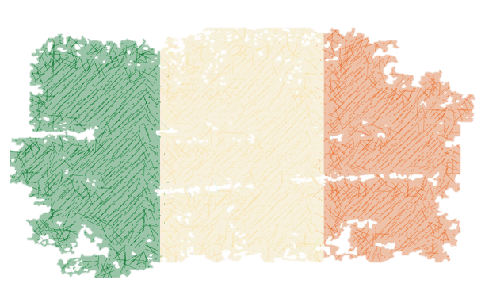
THANKS!

