Slide 1

感恩遇见，相互成就，本课件资料仅供您个人参考、教学使用，严禁自行在网络传播，违者依知识产权法追究法律责任。
更多教学资源请关注
公众号：溯恩高中英语
知识产权声明

Slide 2

The Week
Jan 1st-7th, 2022

Slide 3
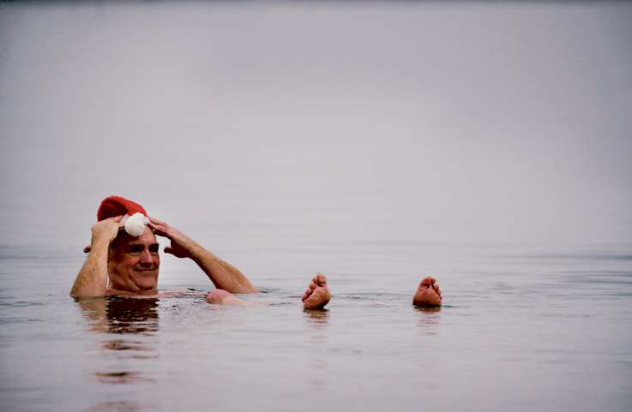
1. Diving Right into the New Year
一头扎进新的一年
Tim Regan floated in the water during the annual polar plunge.

Slide 4
语篇填空
（《波士顿环球报》2022年1月2日 B1 & B4 版面）
In thick fog and the occasional drop of rain, the L Street Brownies’ annual polar plunge (极地冬泳) was held on Saturday morning, ________ (draw) hundreds of New Year’s Day revelers into chilly Dorchester Bay.
The water temperature was 47.5 degrees, just a little ________ (warm) than the air temperature of 46 degrees, according to the National Weather Service. Around 9 a.m., dozens of people dived into the water, many ________ (wear) colorful costumes,
while a few brave men were bare chested. As the water splashed around them, they let ____ screams, a familiar echo on New Year’s Day in South Boston.
The traditional plunge differed _______ (slight) this year. The crowd was much larger than the _____ that gathered last year, when the COVID-19 pandemic kept people out of the water. Last year, people participated in a less __________ (organize) fashion.
There were still ______ (sign) of the pandemic. Some participants appeared to keep their distance from other groups before they went into the water. Multiple people said friends who had encouraged them to plunge or _____ had planned to join them, _______ (stay) home due to COVID-19 exposure or infection.
drawing
warmer
wearing
out
slightly
one
organized
signs
who
stayed

Slide 5
长难句分析 1
Around 9 a.m., dozens of people dived into the water, many wearing colorful costumes, while a few brave men were bare chested.
分析：本句中是一个并列句，第一个句子的主语是_______________，句子中的 “many wearing colorful costumes” 为_______________；第二个句子的主语是_______________。
dozens of people
独立主格结构
a few brave men
翻译
上午9点左右，数十人跳入水中，许多人穿着五颜六色的服装，一些勇敢的男子光着膀子。
仿写
操场上许多男生在做运动，一些在踢足球，而有几个女生在散步。
Many boys are doing sports on the playground, some playing football, while some girls are taking a walk.

Slide 6
长难句分析 2
The crowd was much larger than the one that gathered last year, when the COVID-19 pandemic kept people out of the water.
分析: 本句是一个复合句，第一个从句是 _____ 引导的定语从句修饰先行词one；第二个从句是 ______ 引导的定语从句修饰先行词last year。
that
when
翻译
这次聚集的人比去年要多得多，当时新冠大流行使人们远离水。
今年的暴风雪比去年袭击我们小镇的那场暴风雪要严重得多，那场暴风雪造成了几人受伤，但没有人死亡。
仿写
The snowstorm this year is much worse than the one that hit our small town last year, which caused a few injuries but no deaths.

Slide 7
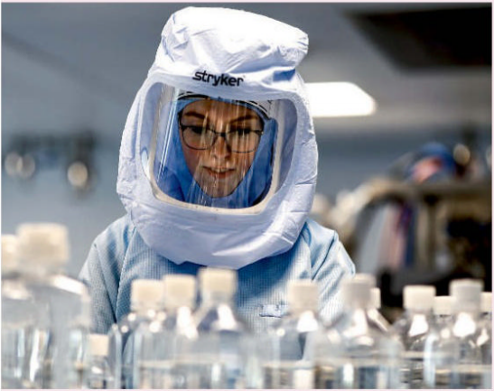
2. mRNA technology may treat stubborn diseases
mRNA技术可治疗顽疾
A BioNTechworker tests the procedures for making mRNA.

Slide 8
语篇填空
（《新科学家》2022年1月1日 9页）
when
2022 could be the year _____ we find out whether mRNA vaccine technology can be used for a lot more ____ just making vaccines. The hope is that it can also get our bodies to produce drugs that are otherwise very expensive to make, _______ (open) the door to treating a vast number of _________ (condition).
mRNAs are _________ (essential) genetically coded recipes that tell cells in our body how to make proteins. In the case of mRNA vaccines, the mRNAs code for viral proteins that provoke __ immune response. During the coronavirus pandemic, many people have received the Pfizer/BioNTech or Moderna mRNA vaccines, and these ______________ (find) to be very safe and ________ (effect). This success has given a big boost to efforts to develop other mRNA vaccines for everything from cancers to herpes (疱疹). mRNAs can code for just about any protein, so the same basic technology might also allow us to develop all kinds of _________ (treat).
The potential of mRNA drugs is enormous. mRNAs could slash both development times and costs by setting our bodies _______ (work) on the difficult and time-consuming job of manufacturing the required proteins instead.
than
opening
conditions
essentially
an
have been found
effective
treatments
to work

Slide 9
词语讲解
1. provoke: to cause a particular reaction or have a particular effect 激起；引起
The announcement provoked a storm of protest. 这个声明激起了抗议的风潮。
2. slash: to reduce sth by a large amount 大幅削减；大大降低
Car makers could be forced to slash prices. 汽车制造商可能会被迫大幅降价。
The workforce has been slashed by half. 职工人数裁减了一半。
翻译句子
这篇文章旨在引发讨论。
The article was intended to provoke discussion.
翻译句子
市长将不得不削减该市明年的预算。
The mayor will have to slash the city’s next year’s budget.

Slide 10
长难句分析
The hope is that it can also get our bodies to produce drugs that are otherwise very expensive to make, opening the door to treating a vast number of conditions.
分析：本句是一个复合句，整体是一个_____ 从句，该从句中又包含一个______________从句，以及一个现在分词作_________ 的结构。
表语
that引导的定语
结果状语
希望它还可以让我们的身体生产出成本非常昂贵的药物，为治疗大量疾病打开大门。
翻译
我的计划是全家去参观一座追溯到汉朝的历史建筑，这让我妹妹非常兴奋。
仿写
My plan is that my family will pay a visit to a historic building which dates back to the Han Dynasty, making my sister very excited.

Slide 11
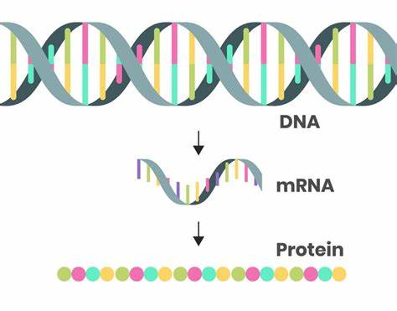
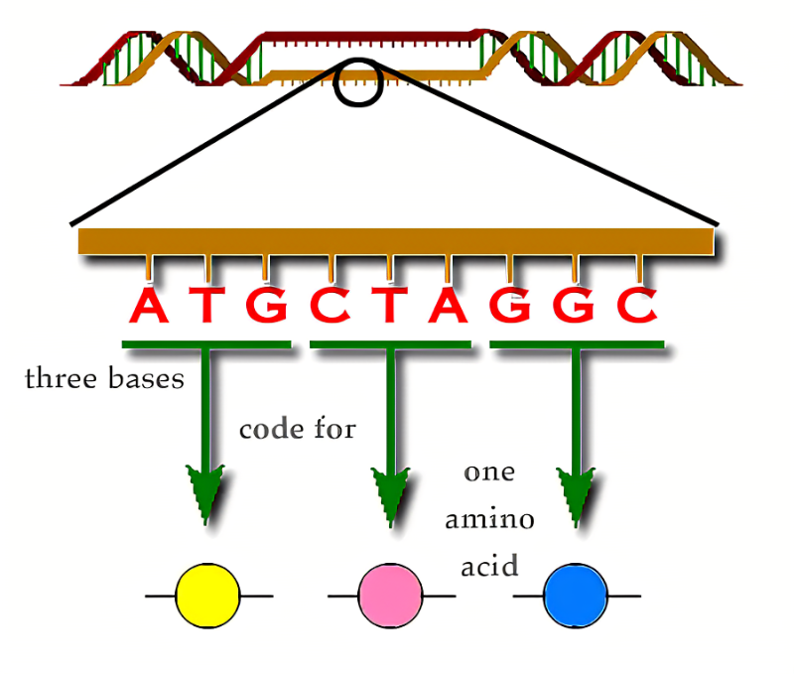
生物医药相关词汇
mRNA 信使核糖核酸（Messenger RNA）
vaccine n.疫苗
genetically coded recipe 基因编码方法
cell n.细胞
protein n.蛋白质
immune response 免疫反应（机体对抗原的应答）
coronavirus pandemic 冠状病毒流行病

Slide 12
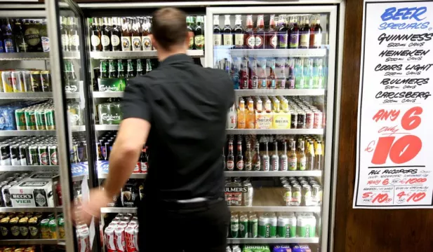
3. Ireland Sets Base Price On Alcohol To Curb Use
爱尔兰为限制饮酒设置底价

Slide 13
语篇填空
（《纽约时报》2022年1月5日 A10版面）
Ireland’s government imposed a minimum unit price on alcoholic beverages (饮料) on Tuesday, one of a few nations to introduce such a rule as a public health measure _______ (intend) to curb binge drinking and reduce alcohol-related health _____ (issue).
___ rule means stores, restaurants and pubs must now sell drinks containing alcohol for no less than about 10 cents per gram of the substance. Officials said the measure was aimed __ making cheaper, _______ (strong) alcoholic products less readily available, __________ (particular) for young people and heavy drinkers.
Advocacy groups and public health experts called the measure — part of legislation enacted in 2018 __________ included limitations on the labeling and marketing of alcoholic beverages — an important step toward combating alcohol abuse in Ireland. ________, some critics of the measure said it would unfairly penalize poorer people and those struggling with alcohol abuse.
The move was a significant breakthrough for public health advocates and ________ (indicate) a growing consensus in Ireland that action needed to be taken to stem alcohol misuse and alcohol-related _______ (ill) such as cirrhosis of the liver (肝硬化), Dr. Lesch said. He added that other countries were also struggling with similar problems.
intended
issues
The
at
stronger
particularly
that / which
However
indicated
illnesses

Slide 14
词语讲解1
1. impose: to introduce a new law, rule, tax, etc. 强制实行
United States has imposed more financial sanctions on Iranians.
美国对伊朗施加了进一步金融制裁。
2. curb: to control or limit sth, especially sth bad 控制，抑制
He needs to learn to curb his temper. 他得学着控制自己的脾气。
翻译句子
当局开始对燃油征收一项新税。
The authorities imposed a new tax on fuel.
翻译句子
饥饿与贫穷会百般抑制人类的潜能。
Hunger and poverty curb human potential in every possible way.

Slide 15
词语讲解2
3. enact: to pass a law 通过（法律）
The authorities failed to enact a law allowing unrestricted emigration.
当局未能通过一项允许自由移民出境的法律。
4. penalize: to put sb at a disadvantage by treating them unfairly 置于不利地位
The new law appears to penalize the poorest members of society.
新法规似乎不利于社会中的最贫困者。
翻译句子
政府应该颁布法律来保护环境。
The governments should enact laws to protect the environment.
翻译句子
目前的税收制度对穷人不利。
The present tax system penalizes poor people.

Slide 16
长难句分析
Ireland’s government imposed a minimum unit price on alcoholic beverages on Tuesday, one of a few nations to introduce such a rule as a public health measure intended to curb binge drinking and reduce alcohol-related health issues.
分析：本句是一个复杂的简单句，one of a few nations ... health issues结构为Ireland的 _______，该结构中的过去分词intended to...health issues作measures的 _________。
同位语
后置定语
周二，爱尔兰政府对含酒精饮料实施了最低单价，这是少数几个出台这一规定的国家之一，作为一项公共卫生措施，旨在遏制酗酒，减少与酒精有关的健康问题。
翻译

Slide 17
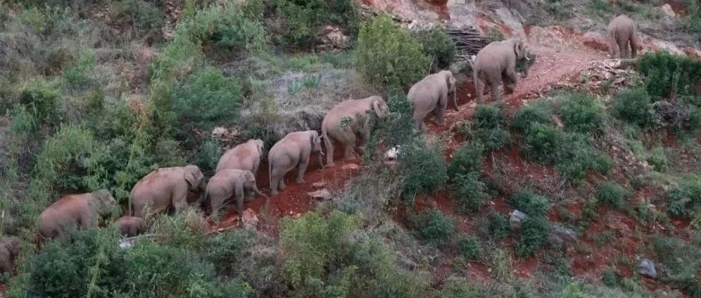
4. 16 Asian Elephants Moving North 一路“象”北
Part I

Slide 18
语篇填空
（《国家地理》2022年1月刊 110-111页（Part I））
As the family of 16 Asian elephants started moving north, no one knew ______ they were heading, or why. At first, no one thought much about it. Elephants sometimes stray beyond the boundaries of Xishuang-banna National Nature Reserve, in southwestern China’s Yunnan Province, ____ they always return.
Not this time.
_____ the course of 16 months they crop-raided, mud-bathed, and road-tripped 300 miles north to the provincial capital of Kunming, ____ sprawling city of eight million people. Along the way they became ______ (globe) celebrities—and presented a conundrum (难题) for government officials. The elephants were racking up about a half million dollars in damage, and there ____ (be) the ever present risk of an elephant ________ (charge) a curious onlooker.
The simple answer would be to tranquilize (使平静) the giant mammals and transport ______ back to the reserve. But that would be risky for this group, ________ (especial) the three calves. Instead, officials mobilized an emergency task force _______ (keep) everyone, elephants and humans alike, safe.
where
but
Over
a
global
was
charging
them
especially
to keep

Slide 19
词语讲解
1. sprawl: to spread in an untidy way; to cover a large area 蔓延；拓展；延伸
If we continue to sprawl across the land, we're in for a terrible future.
如果继续扩展地盘的话，我们将来就会遇到大麻烦。
2. charge: to move quickly and aggresively towards sb or sth 猛冲；猛攻
He charged through the door to my mother's office.
他冲出门，往我母亲的办公室跑去。
翻译句子
小镇顺着湖的边缘扩展。
The town sprawled along the side of the lake.
翻译句子
他冲进我的房间，要求知道发生了什么事。
He came charging into my room and demanded to know what was going on.

Slide 20
句子翻译
Over the course of 16 months they crop-raided, mud-bathed, and road-tripped 300 miles north to the provincial capital of Kunming, a sprawling city of eight million people.
翻译
在16个月的时间里，他们破坏了农作物，洗了泥浴，沿着公路旅行一路向北走了300多英里，到达了拥有800万人口的省会昆明市。
The elephants were racking up about a half million dollars in damage, and there was the ever present risk of an elephant charging a curious onlooker.
翻译
大象造成了大约 50 万美元的损失，而且随时存在大象冲撞好奇的旁观者的风险。
Officials mobilized an emergency task force to keep everyone, elephants and humans alike, safe.
翻译
（政府）官员动员了一个紧急工作小组来确保包括大象和人类在内的所有生命的安全。

Slide 21

5. 美联社一分钟新闻听写填空 AP News Minute 01/04/22
wildfire
Investigators in Colorado are trying to determine what caused a _______ to destroy nearly 1,000 homes and buildings between Denver and Boulder. The fire ________ Thursday. At least two people remained ______ early Monday.
__________ ripped through South Africa's parliament complex in Cape Town. The fire ______ from a separate building to the National Assembly building, where the country's parliament now sits.
Defense Secretary Lloyd Austin announced that he's tested _______ for the coronavirus. Austin said he has experienced _____________ while quarantining at home, and plans to attend meetings _______.
The COVID-19 pandemic and _____________ both took their toll on ________ over the holiday weekend. FlightAware says that thousands of flights were cancelled in the US and around the world both Saturday and Sunday.
broke out
missing
A major fire
spread
positive
mild symptoms
virtually
winter weather
air travel

Slide 22
词语讲解
1. rip through/into: to go very quickly and violently through or into sb/sth
（快速而猛烈地）钻入，穿透
A bullet ripped through his shoulder.
一颗子弹穿透了他的肩头。
2. take a toll on: to have a bad effect on sb/sth; to cause a lot of damage, death, suffering, etc. 产生恶果；造成重大损失（或伤亡、灾害等）
The recession is taking its toll on the housing markets.
经济衰退正使住房市场遭受着重大损失。
翻译句子
超过30个龙卷风穿过了美国的六个州。
Over 30 tornadoes ripped through 6 US states.
翻译句子
冬天对你的健康不利。
Winter takes its toll on your health.

Slide 23
句子翻译
Investigators in Colorado are trying to determine what caused a wildfire to destroy nearly 1,000 homes and buildings between Denver and Boulder.
科罗拉多州的调查人员正试图确定导致山火摧毁丹佛和博尔德之间近1000座房屋和建筑物的原因。
翻译
The fire spread from a separate building to the National Assembly (国民议会) building, where the country's parliament now sits.
火灾从一栋单独的建筑物蔓延到国民议会大楼，该国议会现在就坐落在那里。
翻译
Austin said he has experienced mild symptoms while quarantining at home, and plans to attend meetings virtually.
翻译
奥斯汀说，他在家隔离时出现了轻微症状，并计划以虚拟方式参加会议。

