Slide 1

感恩遇见，相互成就，本课件资料仅供您个人参考、教学使用，严禁自行在网络传播，违者依知识产权法追究法律责任。
更多教学资源请关注
公众号：溯恩高中英语
知识产权声明

Slide 2


2022年1月高考浙江英语应用文讲评
January 2022 College Entrance Examination of Zhejiang English practical writing comments
融文化共情，
促有效交际
桐乡市高级中学 俞莺婕常山一中 吴俊峰

Slide 3
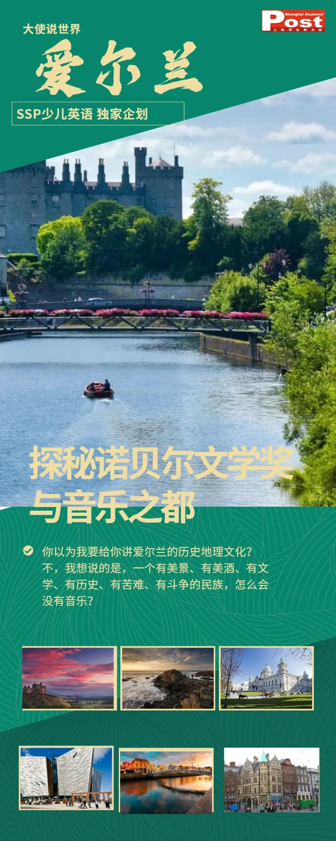
01
Part One
基于文化多元的
文明与交流

Slide 4
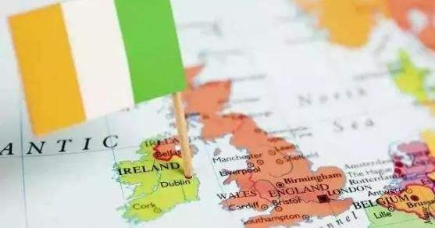
About Ireland
Ireland is an island nation on the westernmost edge of Europe. It is the continent's second largest island (after Great Britain). The Republic of Ireland occupies 80 percent of this landmass, while a large chunk of land in the north is part of the United Kingdom.
爱尔兰是欧洲最西边的一个岛国。它是欧洲大陆的第二大岛（仅次于英国）。爱尔兰共和国占这块陆地的80％，而北部的大片土地是英国的一部分。
爱尔兰共和国（Republic of Ireland），简称“爱尔兰”（Ireland），是一个西欧的议会共和制国家，位于欧洲西部爱尔兰岛的中南部，西临大西洋，东靠爱尔兰海，与英国隔海相望，东北与英国的北爱尔兰接壤，是北美通向欧洲的通道，，首都是都柏林
爱尔兰自然环境保持得相当好，素有“翡翠岛国”之称，全国绿树成荫，河流纵横。草地遍布，所以又有“绿岛”和“绿宝石”之称。这里不仅有美丽的自然风光，还有古老的凯尔特文化和热情好客的人民。

Slide 5
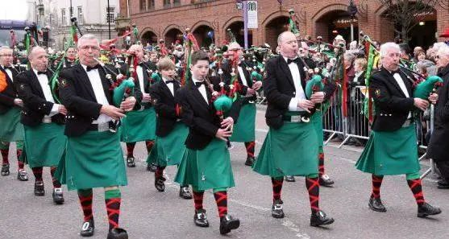
圣帕特里克节（St. Patrick's Day）
St. Patrick's Day is celebrated every March 17. It is usually packed with parades, good luck charms, and all things green. The event started as a religious holiday, but over time it's become a celebration of Irish culture. Today people wear green and eat green foods to celebrate this day.
圣帕特里克节每年3月17日举行庆祝活动。它通常包含游行，幸运符，所有的东西都是绿色的。该活动始于宗教节日，但随着时间的推移，它成为了爱尔兰的文化庆典。今天人们穿绿色食品，吃绿色食品来庆祝这一天。
圣帕特里克节（St. Patrick's Day）是为了纪念爱尔兰守护神圣帕特里克。这一节日5世纪末期起源于爱尔兰，如今已成为爱尔兰的国庆节。随着爱尔兰后裔遍布世界各地，现在，圣帕特里克节已经渐渐在一些国家成为节日。圣帕特里克节的传统颜色为绿色。

Slide 6
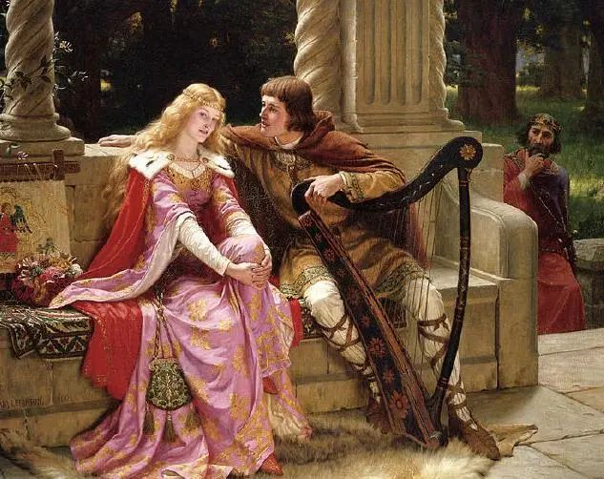
About the Nobel Prize in Literature关于诺贝尔文学奖
在爱尔兰的百年间诞生了4位诺贝尔文学巨匠：叶芝、萧伯纳、贝克特、希尼。爱尔兰人风趣、深邃，在人类精神的深处写下惊奇。
In Ireland, four Nobel literature giants were born in a hundred years: Yeats, George Bernard Shaw, Beckett, Heaney. The Irish are funny and profound, writing wonder in the depths of the human spirit.
经典文学人物：
Tristan and Iseult——特里斯坦和伊索尔特
This is a tragic story of the adulterous love between the Cornish knight Tristan (Tristram) and the Irish princess Iseult (Isolde). It's a legend made popular during the 12th century through French medieval poetry, and inspired by archetypal Celtic legends. It has become an influential romance and tragedy, retold in numerous sources with as many variations.
这是康沃尔骑士特里斯坦与爱尔兰公主伊索特(伊索德)之间的爱情悲剧。这是一个在12世纪通过法国中世纪诗歌流行起来的传说，灵感来自于典型的凯尔特传说。它已经成为一种有影响的浪漫和悲剧，在无数的来源中被重新讲述了许多变化。

Slide 7
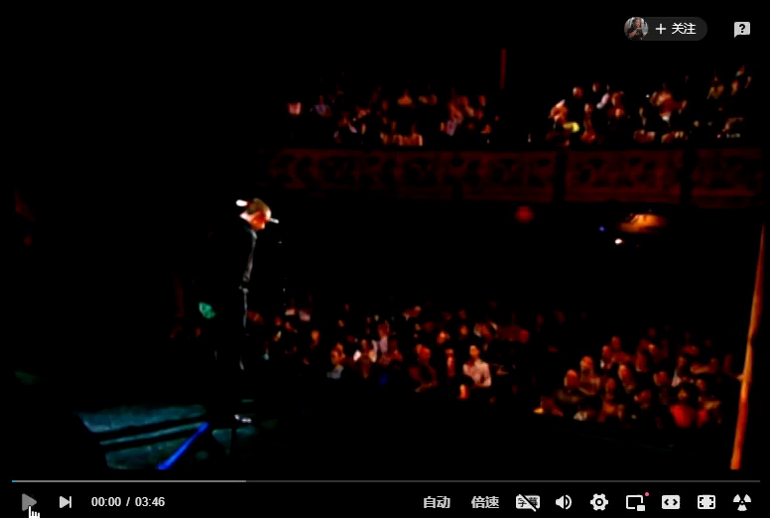
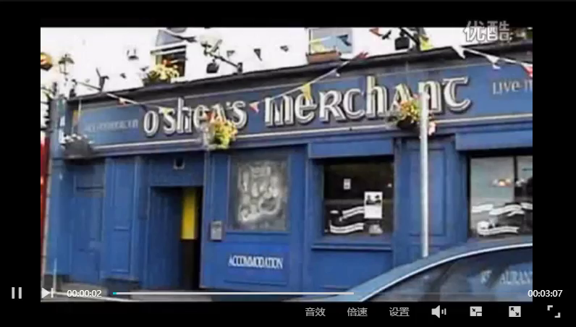
Irish music
Sean nos
Like literature, music has its roots in ancient Irish culture. Perhaps the oldest form of music is that embodied by the sean nos or “old style” of singing. Traditionally, sean nos is sung by the unaccompanied voice. The singer will often close his eyes and hold one hand behind his ear, to hear himself better. The words are always in Irish. Usually the last line is spoken,not sung.
Pipe music
The Irish pipe is distinctive. Unlike the Scottish bagpipe, which is blown, the Irish pipe is played by holding the airbag under the arm and pumping it with the elbow. In tone, the Irish pipes are quieter and more musical than those of the Scots, which are employed as war-pipes.

Slide 8
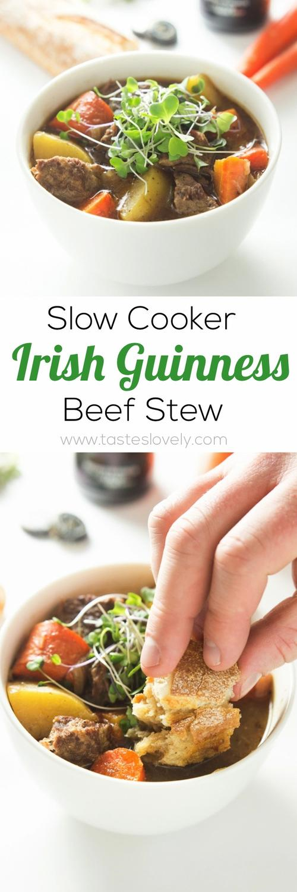

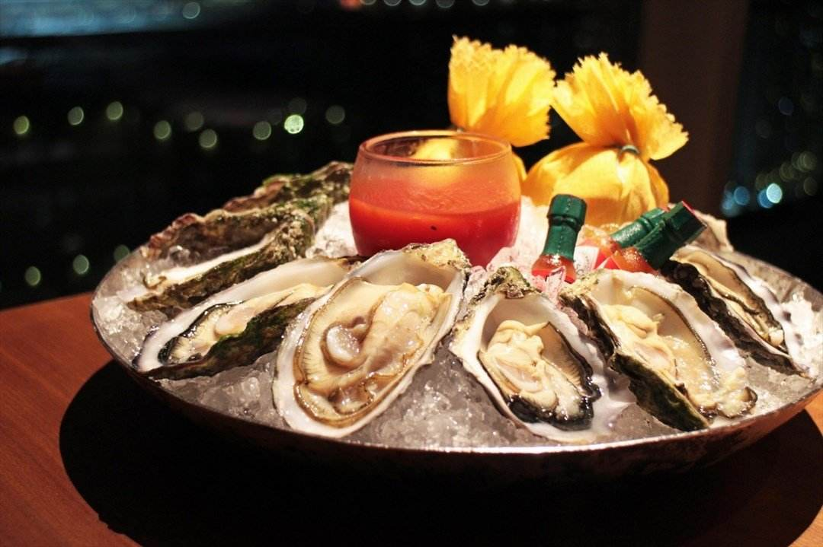
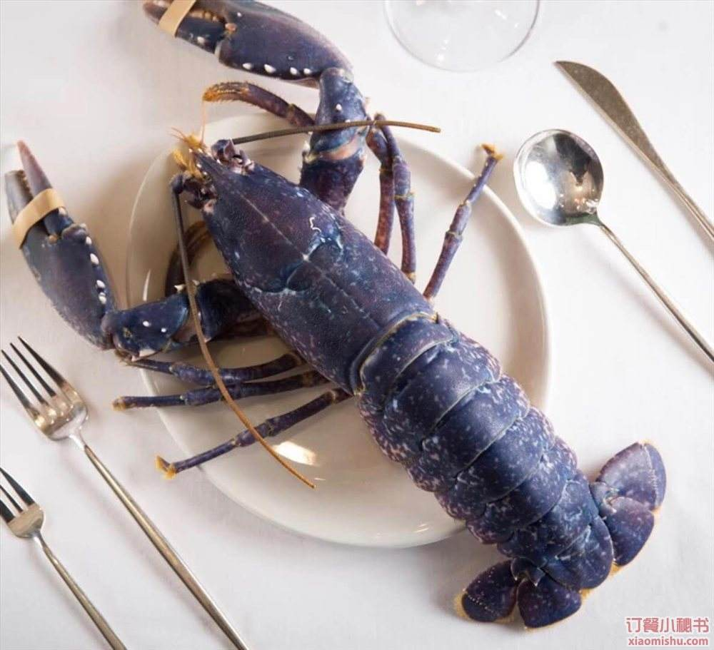
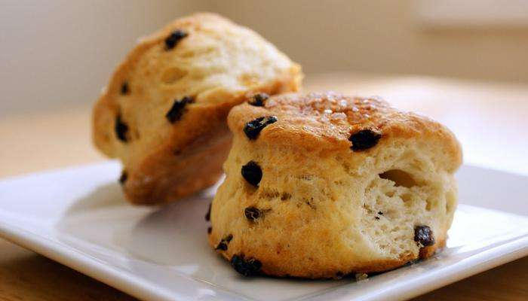
Irish food
Food in Ireland is fresh, tasty and made with a contemporary twist.
When it comes to food on the island of Ireland, you need to start at the very beginning. The purity of the natural produce here has made the island one of the most talked-about food destinations in Europe, with an emphasis on artisan cheese, exceptional beef and lamb and fresh-off-the-boat seafood.
Irish stew
Irish steak
oyster
lobster
scone

Slide 9
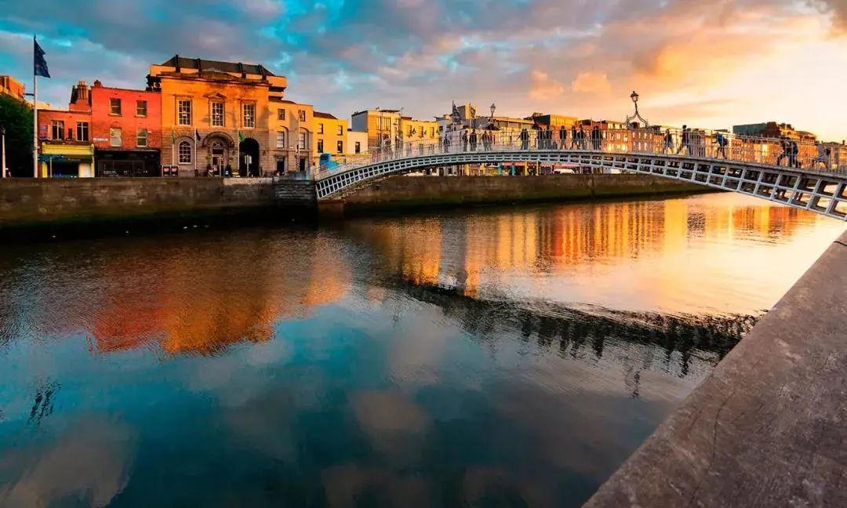
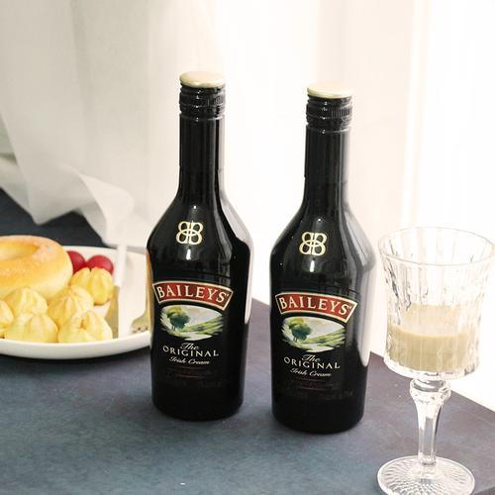
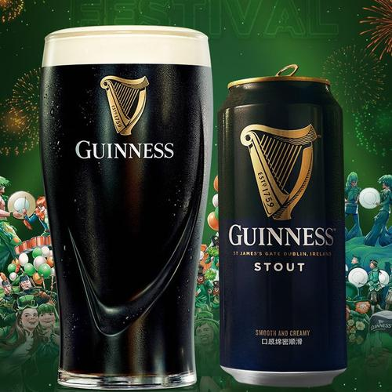
Dublin都柏林
Liffey river (利菲河) quietly across the city of Dublin, is the lifeline of the city, flowing time situation. Liffey river is always the stream never stops flowing visitors. North of the river, there is a typical white Rome building, is the government building.
在都柏林当然还要做的一件事情就是去参观一下健力士啤酒中心(GUINNESS HOPSTORE),并顺便品尝一杯闻名的健力士黑啤。
爱尔兰有很多美酒，黑啤Guinness，果酒Bulmers，甜酒Baileys，威士忌Jameson等等。Irish Pub也是散布在全世界。喝酒是一种放松也是一种社交，也像是爱尔兰人根生蒂固的一种生活方式。

Slide 10
02
Part Two
基于回归教材的
语料与重构

Slide 11
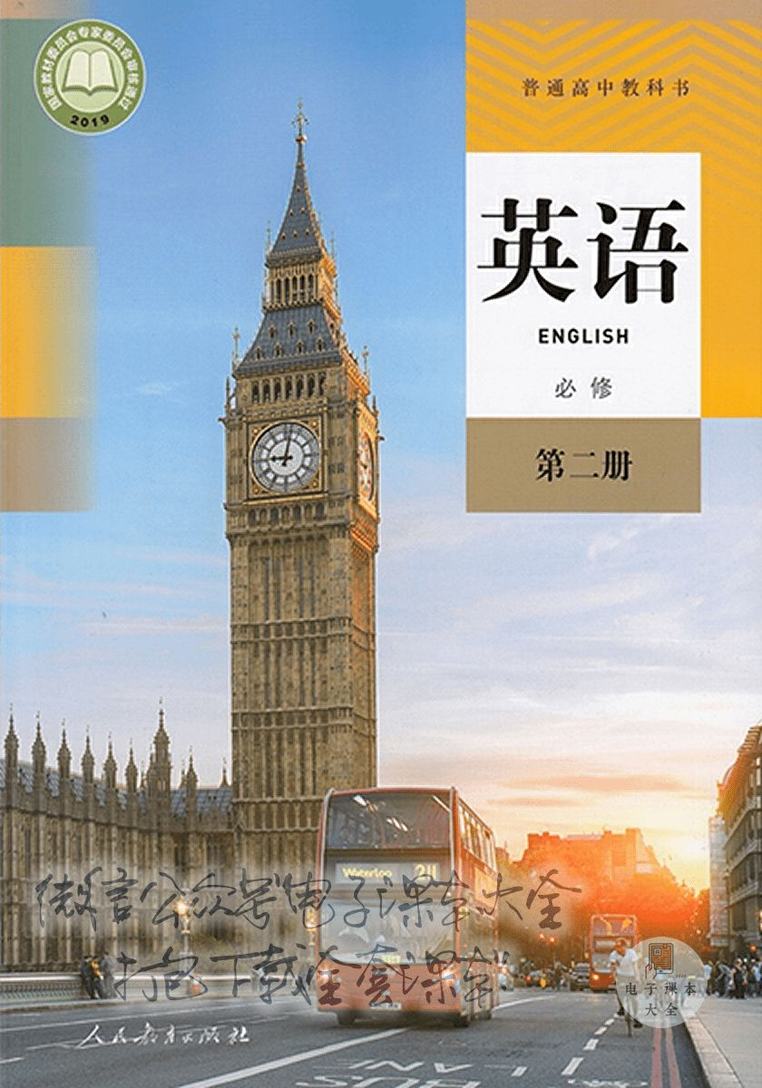
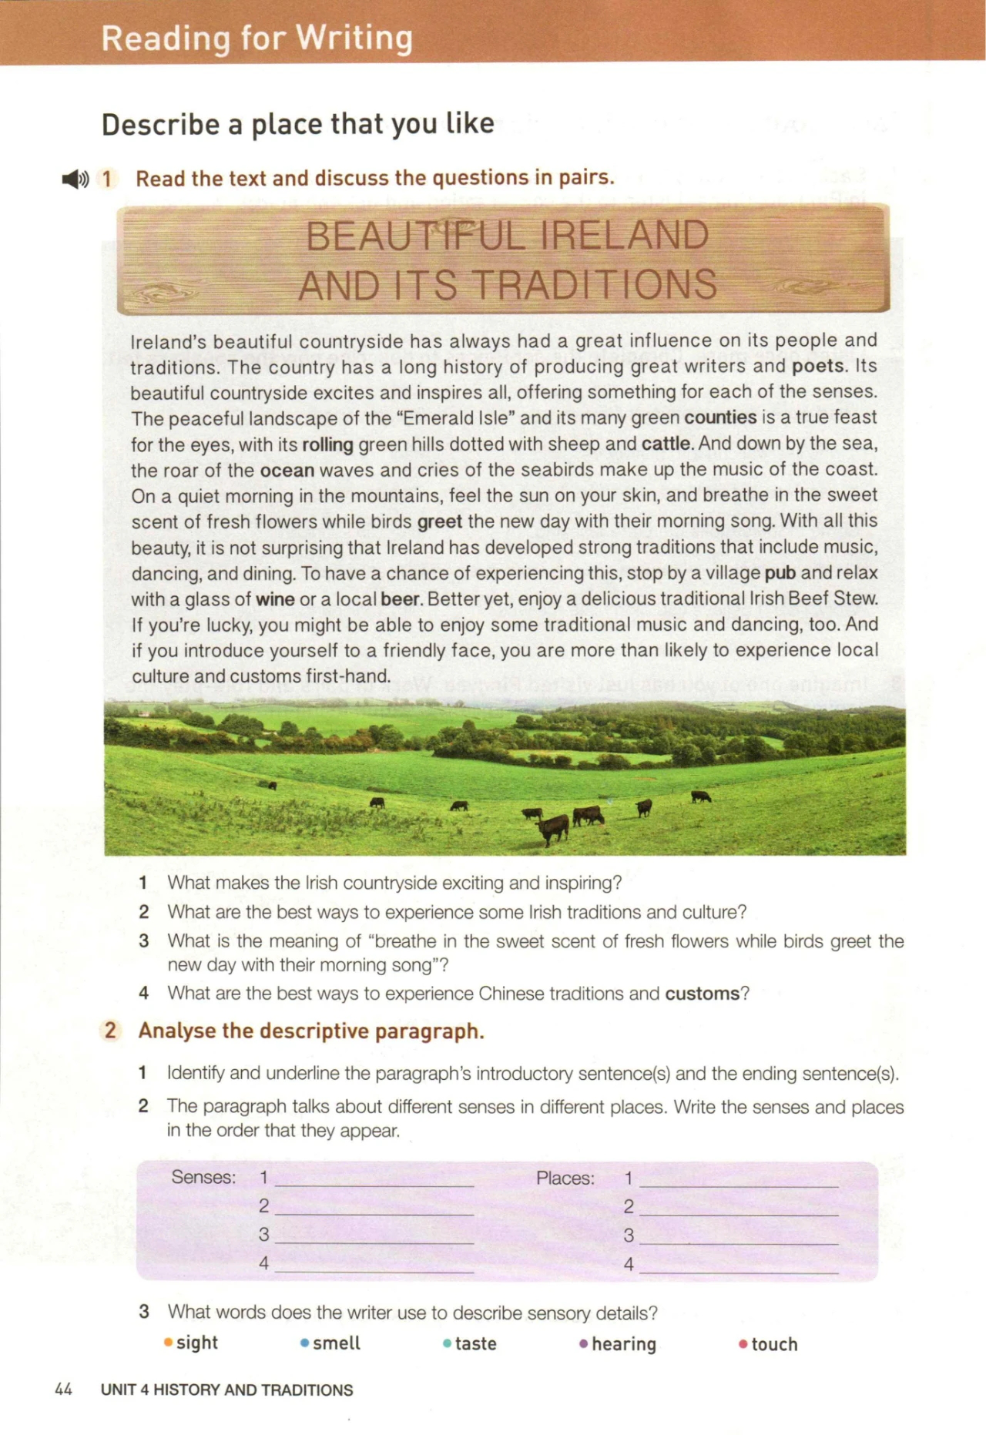
人教版新教材B2U4 Reading for writing
回忆活动类语料

Slide 12
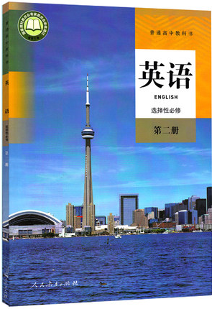
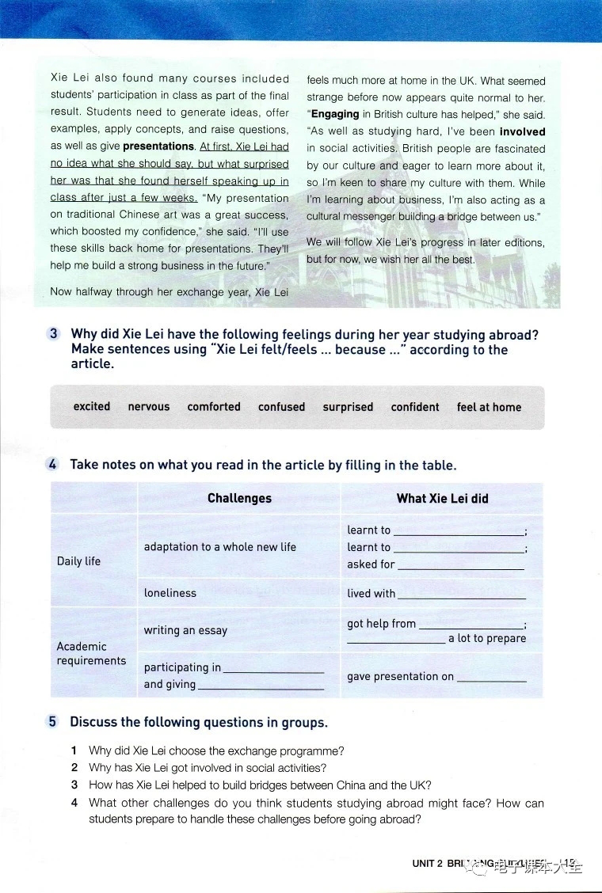
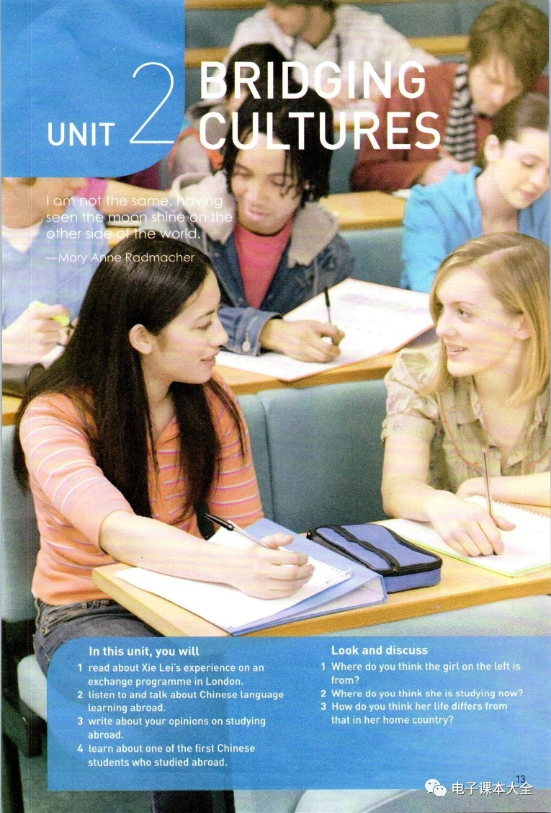
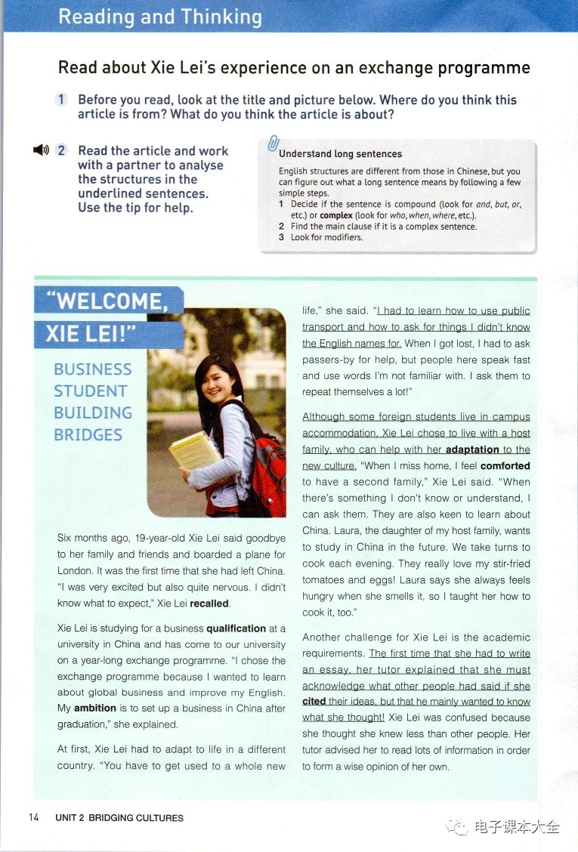
人教版新教材S2U2 Reading and Thinking
回忆活动类语料
个人收获类语料

Slide 13
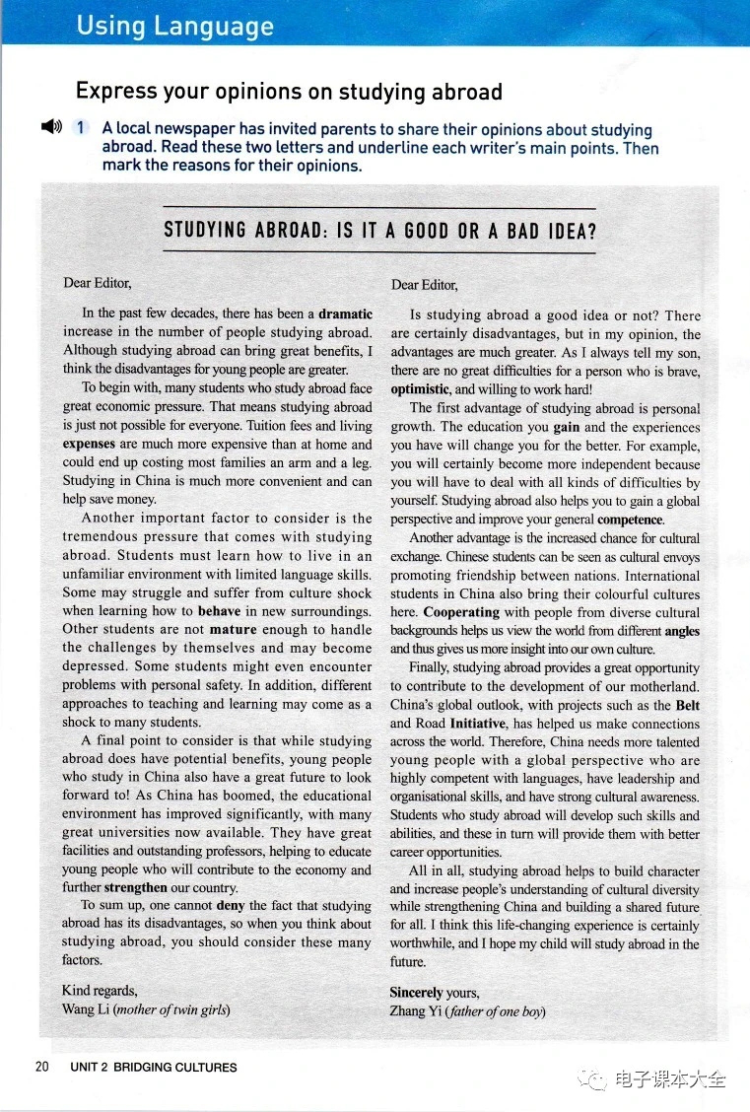
人教版新教材S2U2 Reading and Thinking
个人收获类语料

Slide 14
回归教材找语料
回忆活动类
1.喝一杯酒或者本地啤酒放松
2.享受一些传统音乐和舞蹈
3.爱尔兰有着包括音乐、舞蹈、饮食在内的显著的传统。
4.关于中国传统艺术的展示
1.relax with a glass of wine or a local beer
2.enjoy some traditional music and dancing
3.Ireland has developed strong traditions that include music, dancing and dining.
4.presentation on traditional Chinese art

Slide 15
回归教材找语料
个人收获类
1.增强自信 2.文化使者 3.增进国际友谊 4.从不同视角看待世界 5.对自己的文化有深入的了解 6.获得全球视野
7.构建人类命运共同体 8.增进人们对文化多样性的理解
9.作为文化交流使者在中外文化之间架起一座桥梁
1.boost my confidence 2.cultural envoy 3.promote friendship between nations
4.view the world from a different angle 5.give sb more insight into one’s culture
6.gain a global perspective 7.build a shared future for all
8.increse people’s understanding of cultural diversity
9.act as a cultural messenger building a bridge between cultures

Slide 16
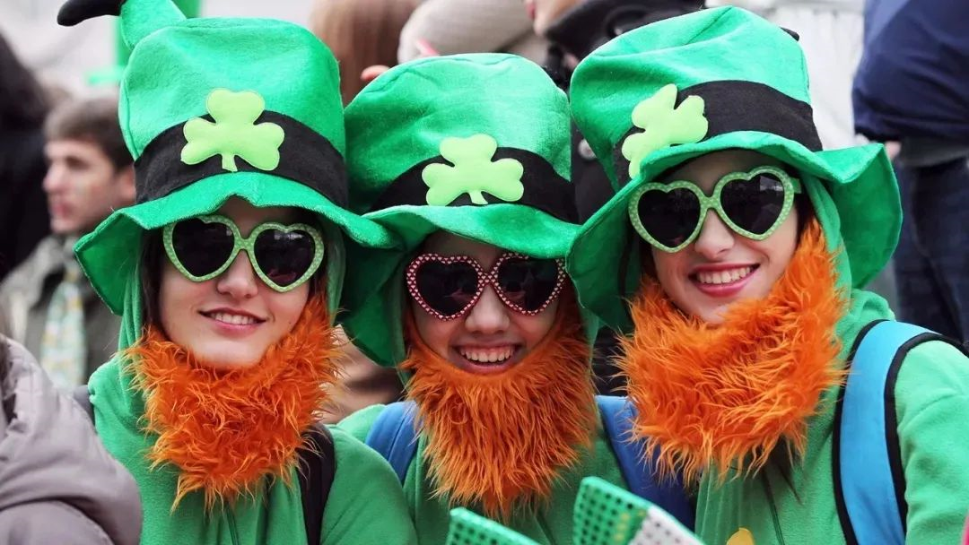
03
Part Three
基于文化共情的
审题与构思

Slide 17

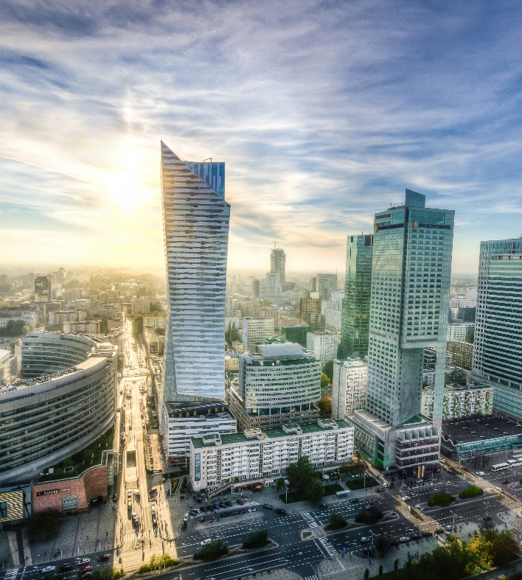
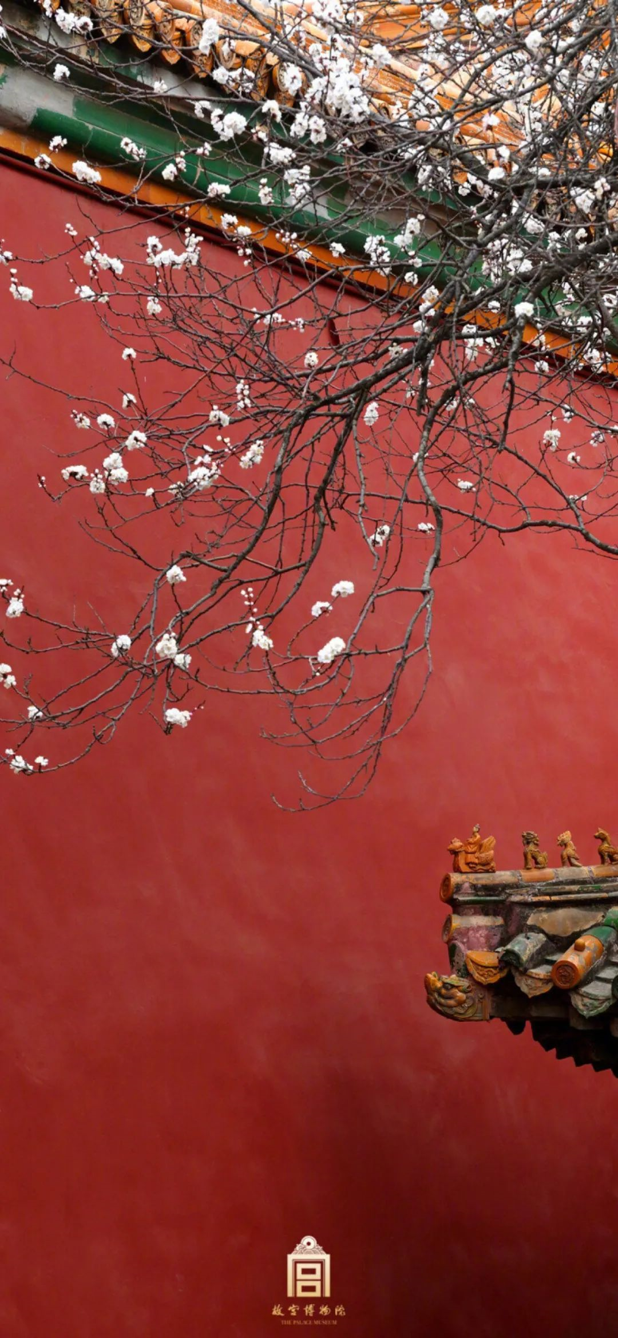
Cultural empathy 文化共情
Willingness
Truth
Equality
The most important factor to display cultural empathy was to keep an open mind. Equality and tolerance are the premise of mutual appreciation of the unique charm of another culture from an unbiased perspective.
展现文化共情的最重要因素是保持开放的心态。平等和包容是是相互欣赏对方文化独特魅力的前提。
Cultural empathy refers to the willingness and the ability to understand another culture，which is a precious quality in the trans-cultural communication.
文化共情是理解另一种文化的意愿和能力，是跨文化交际中一种宝贵的品质。
Cultural empathy stands for constant exploration for the truth about another culture, opening up a window for the communication and understanding between the East and the West.
文化共情是指不断探索另一种文化的真相，为东西方之间的交流和理解打开一扇窗。

Slide 18
基于文化共情的审题与构思
李华与Chris在中国-爱尔兰文化节相互认识，并成为朋友。
交际对象
进一步加深彼此友谊，加强文化互动和两国文化理解
有效交际
交际目的
假如你是李华，在“中国-爱尔兰文化节”活动中结识了爱尔兰朋友Chris，现在他已回国，请你给他写一封邮件，内容包括：
1. 回忆活动经历；
2. 分享个人收获；
3. 希望保持联系。
1. 回忆活动经历（双方的活动有趣且有情）
2. 分享个人收获（个人对爱尔兰文化具体而真实的了解和热爱）
3. 希望保持联系（互访，互学）
交际内容
交际原则
从全球文明的整体性视野，以文化共情（开放包容，相互欣赏，彼此吸引），促进友情， 增强交流。

Slide 19
首段—— 问候+背景
Greetings:
假如你是李华，在“中国-爱尔兰文化节”活动中结识了爱尔兰朋友Chris，现在他已回国，请你给他写封邮件
How is everything going?
I hope everything goes well with you.
I hope this letter finds you well.
Background:
It has been a month since we got acquainted in the Sino-Irish Culture Festival, but the cherished memories are kept fresh in my mind.
Despite the separation since our acquaintance in the Sino-Irish Culture Festival, cherished memories came crowding in on my mind.

Slide 20

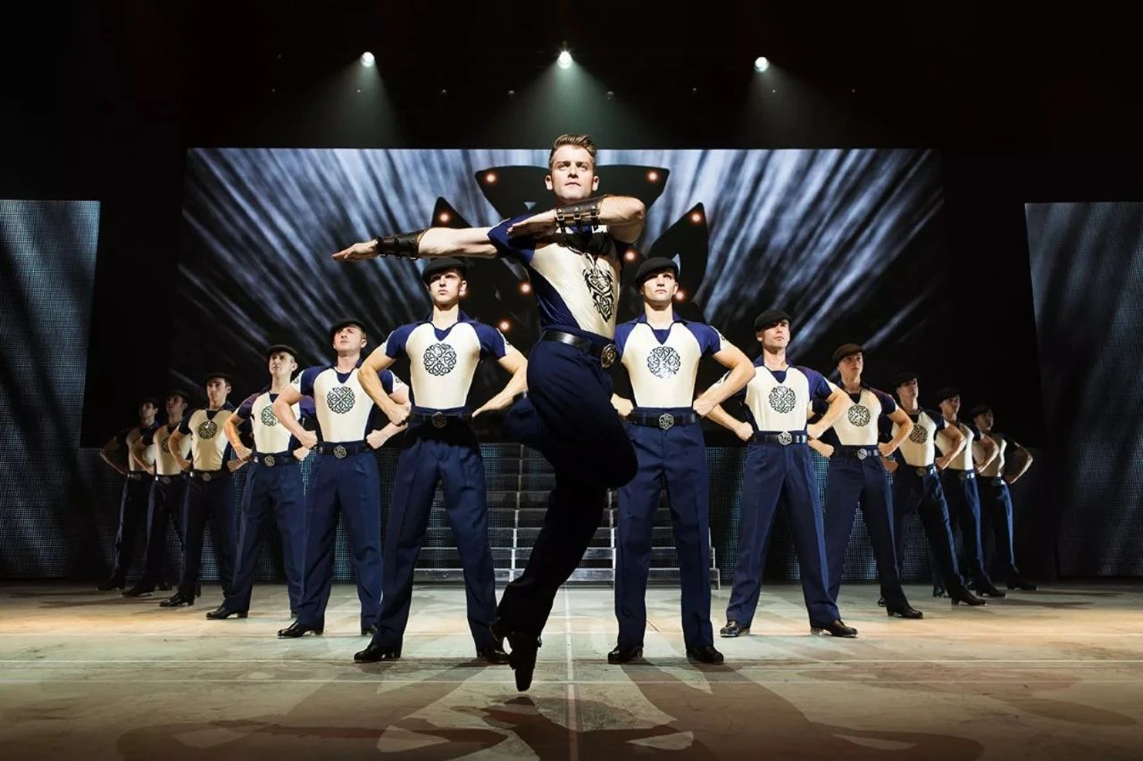
要点拓展1—— 问候+背景
1. 回忆活动经历
What activities will be launched on the culture festival?
2. 分享个人收获
music
Featured Irish culture
3. 希望保持联系
Irish traditional Sean-Nos songs (an old style of songs sung by unaccoumpanied voice)
pipe music (played by holding the airbag under the arm and pumping it with the elbow)
The traditional dancing of Ireland is known as the "jig_{(快步舞)}" or "Irish Step Dancing_{(爱尔兰踢踏舞)}".

Slide 21


要点拓展1—— 回忆活动经历
1. 回忆活动经历
What activities will be launched on the culture festival?
2. 分享个人收获
sports
Featured Irish culture
3. 希望保持联系
hurling (爱尔兰式曲棍球) (the most native sport, one of the oldest field sports in the world, as well as the fastest)
soccer
rugby football
sailing
tennis
running

Slide 22
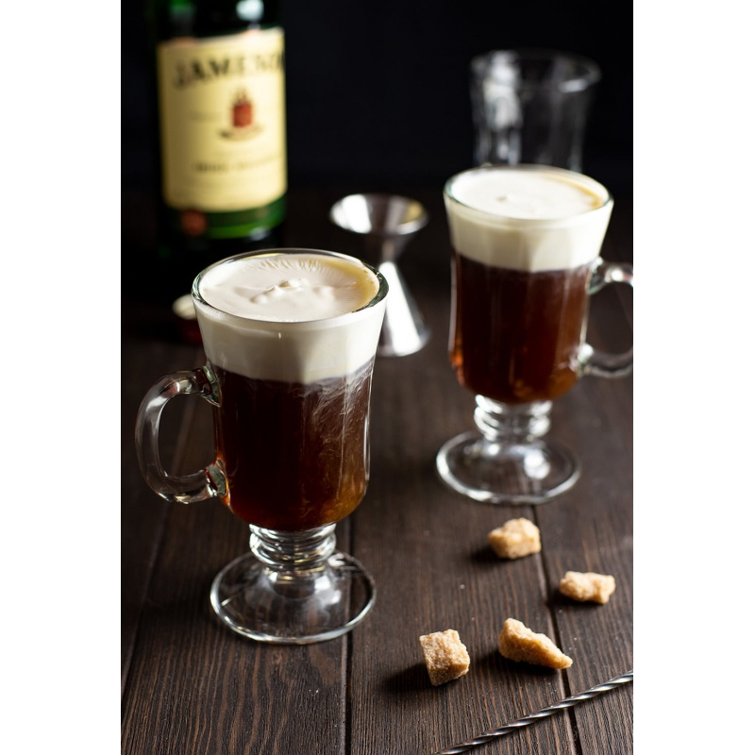
要点拓展1—— 回忆活动经历
1. 回忆活动经历
What activities will be launched on the culture festival?
2. 分享个人收获
food and drinks
Featured Irish culture
Irish Beef Stew (炖牛肉) B2U4 R&W
Irish steak
seafood (oyster, lobster 爱尔兰蓝龙虾)
scone(司康饼)
wine
local beer
Irish Whiskey
Guinness 健力士黑麦啤酒
Baileys 百利甜酒
Irish coffee (cocktail)
3. 希望保持联系

Slide 23
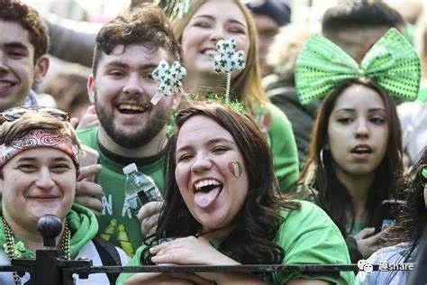
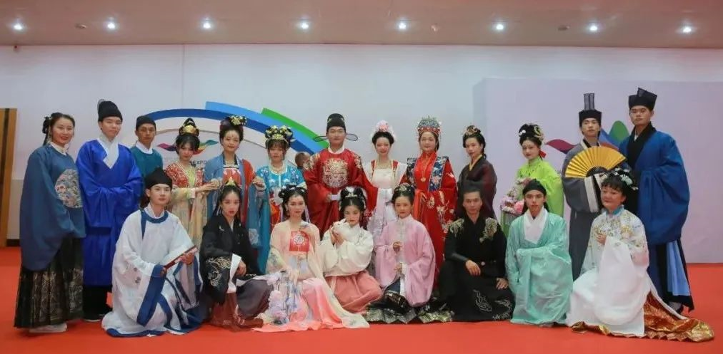
要点拓展1—— 回忆活动经历
1. 回忆活动经历
What activities will be launched on the culture festival?
2. 分享个人收获
Common activities
common activities (five senses)
3. 希望保持联系
exhibitions of visual art and movies
traditional musical intruments performance
performances of operas and musicals（音乐剧）
traditional ethnic costume (民族服装) display
a food fair offering a distinctive flavour of local cuisines

Slide 24
要点拓展2——分享 个人收获（部分佳句选自溯恩外教下水作文）
Which kind of personal harvest will spark Chris’ empathy(共鸣) ?
Such a cultural event not only deepened my insight into the exotic Irish culture, but also boosted my confidence in the time-honored domestic culture.（找人类文明共同体）
I wish to visit Ireland one day enjoying a bear over Irish musicals as you have appreciated our tea. （找感官共同刺激点）
个人 收获
Our conversation over how the green-themed St. Patrick celebration reminds me of the significance of green jade, and embroidery in Chinese culture still resonates with me. (找文化共同点)
Plus, it was such a fantastic way to socialize, I have made many fond connections, including you!（找社交同龄人）

Slide 25

要点拓展3—— 希望保持联系 (尾段)
1. 回忆活动经历
Why will Lihua hope to keep in touch with Chris?
2. 分享个人所得
Further communication
For further understanding and communication.
3. 希望保持联系
Hopefully, we can keep in touch as cultural envoys/messengers!
Hopefully, we can stay in contact for further communication!
Let us stay in contact, hope I will see you soon when I visit Ireland!
Let’s remain in contact for mutual appreciation of the charm of cultural diversity.

Slide 26
A possible version（俞莺婕、吴俊峰老师下水作文）
Dear Chris,
How’s everything going? Despite the separation since our acquaintance in the Sino-Irish Culture Festival, cherished memories came crowding in on my mind.
Happy laughters and cheerful applauses flowing, we participated in diverse activities ranging from exhibitions of visual art to distinctive music and dances of both countries(双方活动). Personally, I was most fascinated by the classic Irish dance with fancy footwork and the pipe music serving as an audio-visual feast. Undeniably, such a cultural event not only deepened my insight into the exotic Irish culture, but also boosted my confidence in the time-honored domestic culture（个人收获）.
Hopefully, we can keep in touch as cultural envoys!
Yours,
Li Hua

Slide 27
Thank You!

