Slide 1

感恩遇见，相互成就，本课件资料仅供您个人参考、教学使用，严禁自行在网络传播，违者依知识产权法追究法律责任。
更多教学资源请关注
公众号：溯恩高中英语
知识产权声明

Slide 2
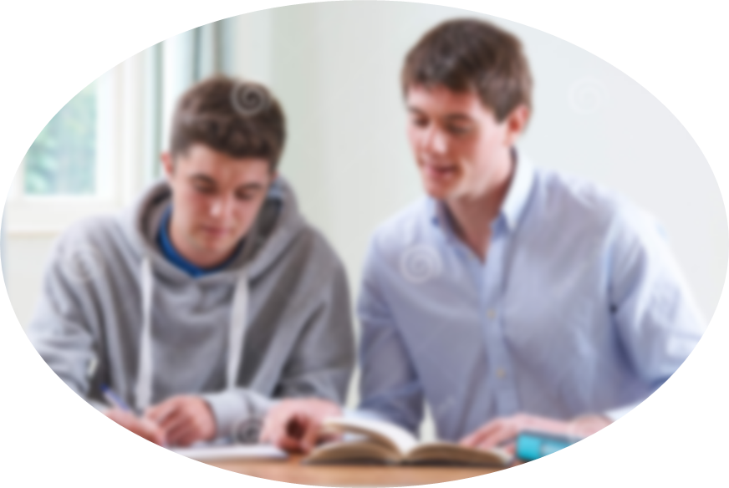
2022年1月浙江高考英语读后续写试题分析
——挖掘协同因素 力争续文高分
浙江省杭州高级中学
何瑱悦

Slide 3
高考真题
第二节(满分25分) 阅读下面材料，根据其内容和所给段落开头语续写两段，使之构成一篇完整的短文。
When Dr. Henderson was assigning(指定) project mates for his psychology class, I secretly hoped that he would pair me with my best friend or at least a classmate I could have some fun with. Above all, I hoped he wouldn’t assign me to work with the fiercely competitive and extremely serious fellow who always wore dark clothes and apparently had a personality to match. As fate(命运) would have it, Dr. Henderson very deliberately matched everyone in class and announced that I would be working with the one person in class I wanted to avoid.
I went up to my new teammate and introduced myself. He looked at me as though I weren’t there. I felt he treated me as though I would hold him back and probably make him fail to get an A in the course. He wasn’t mean or abusive; he just gave me the impression he could do whatever project we dreamed up better if he did it alone.
Needless to say, I didn’t look forward to an entire team of being brushed off, but I tried to make the best of it and didn’t say anything for fear that I would make things worse.
The project required each team to develop a hypothesis(假设), set up an experiment to test the hypothesis, do the statistical analysis and present the findings. Whatever grade the team received would be shared by both students.
When my teammate and I met to discuss our project, I was uneasy. Here was this challenging student who had a reputation for single-mindedness and good grades—the exact opposite of me. I actually wanted to drop the class at one point, but stopped short because I didn’t want to give him the satisfaction of my chickening out. I decided to stick to it no matter what.
After long discussions we somehow agreed to do a study on the psychological well-being of teenagers. I wasn’t sure what it meant exactly, but at least we had a topic.
Para.1 We started to meet regularly to draw up our plans.
Para.2 Then one day I got word that he was admitted to the hospital for a serious disease.

Slide 4
Read for basic information
(Para.1) When Dr. Henderson was assigning(指定) project mates for his psychology class, I secretly hoped that he would pair me with my best friend or at least a classmate I could have some fun with. Above all, I hoped he wouldn’t assign me to work with the fiercely competitive and extremely serious fellow who always wore dark clothes and apparently had a personality to match. As fate(命运) would have it, Dr. Henderson very deliberately matched everyone in class and announced that I would be working with the one person in class I wanted to avoid.
Who
What
When
Where
Dr. Henderson, I, my teammate
I was paired with my classmate to do a project.
at the beginning of Dr. Henderson’s psychology class
in the school

Slide 5
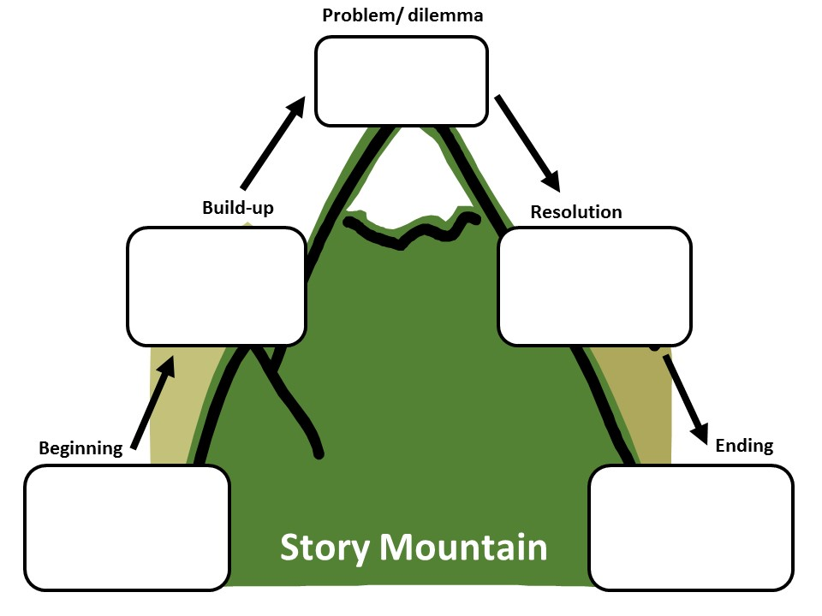
Read for plots
How did I feel?
Although outmatched, I still decided to stick to the project.
I: uneasy; determined
I introduced myself to my teammate.
I: felt slighted
My teammate: unwilling to cooperate
?
I: unwilling to be paired with him
Dr. Henderson paired me with my classmate.
?

Slide 6
Read for character
When Dr. Henderson was assigning(指定) project mates for his psychology class, I secretly hoped that he would pair me with my best friend or at least a classmate I could have some fun with. Above all, I hoped he wouldn’t assign me to work with the fiercely competitive and extremely serious fellow who always wore dark clothes and apparently had a personality to match. As fate(命运) would have it, Dr. Henderson very deliberately matched everyone in class and announced that I would be working with the one person in class I wanted to avoid.
I went up to my new teammate and introduced myself. He looked at me as though I weren’t there. I felt he treated me as though I would hold him back and probably make him fail to get an A in the course. He wasn’t mean or abusive; he just gave me the impression he could do whatever project we dreamed up better if he did it alone.
Needless to say, I didn’t look forward to an entire team of being brushed off, but I tried to make the best of it and didn’t say anything for fear that I would make things worse.
The project required each team to develop a hypothesis(假设), set up an experiment to test the hypothesis, do the statistical analysis and present the findings. Whatever grade the team received would be shared by both students.
When my teammate and I met to discuss our project, I was uneasy. Here was this challenging student who had a reputation for single-mindedness and good grades—the exact opposite of me. I actually wanted to drop the class at one point, but stopped short because I didn’t want to give him the satisfaction of my chickening out. I decided to stick to it no matter what.
After long discussions we somehow agreed to do a study on the psychological well-being of teenagers. I wasn’t sure what it meant exactly, but at least we had a topic.
academically outstanding; serious; a little arrogant; determined; uncooperative
My teammate
I
average; determined

Slide 7
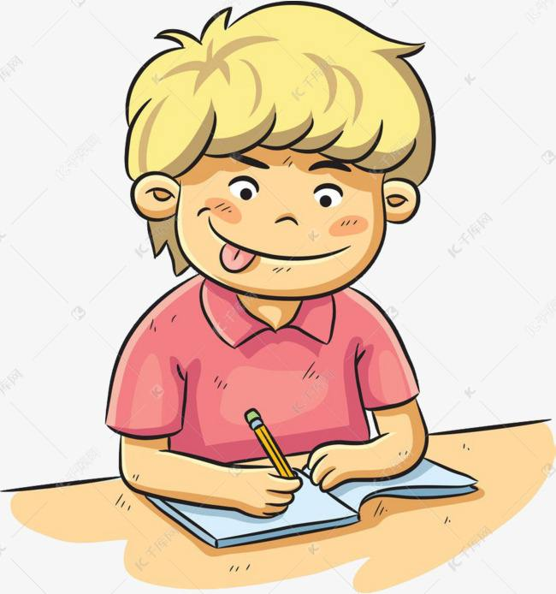

Read for theme
主题协同
learn to cooperate with each other
win respect & develop the friendship
academically outstanding;
serious;
a little arrogant;
determined
uncooperative
average;
determined

Slide 8
What’s the ending of the story?
about the project
about our relationship
主题协同
(Para.1)We started to meet regularly to draw up our plans.
(Para.2)Then one day I got words that he was admitted to the hospital for a serious disease.
Tip 1: Make use of the theme, or the writing purpose to predict the ending of the story.
possible ending
We succeeded in finishing the project.
I won his respect and we developed friendship.
theme
learn to cooperate with each other
win respect & develop the friendship

Slide 9
Design the plots
How did I feel?
Although outmatched,
I still decided to stick to the project.
I: uneasy;
determined
I introduced myself to my teammate.
I: felt slighted
My teammate: unwilling to cooperate
?
I: happy; satisfied
My teammate:
grateful
I: unwilling to be paired with him
Dr. Henderson paired me with my classmate.
We succeeded in finishing the project.
I won his respect &
we developed friendship.

Slide 10
Design the plots
情节协同
(Para.1)We started to meet regularly to draw up our plans.
(Para.2)Then one day I got words that he was admitted to the hospital for a serious disease.
Possible plot:
We gradually learnt to cooperate.
Tip 2: The ending of the story, and the 1st sentence of Para.2 can help you determine the ending of Para.1 .
We succeeded in finishing the project.
I won his respect and we developed friendship.

Slide 11
Design the plots
情节协同
(Para.1)We started to meet regularly to draw up our plans.
(Para.2)Then one day I got words that he was admitted to the hospital for a serious disease.
How did we draw up our plans?
Did we cooperate well?
How did we feel at the meeting?
We gradually learnt to cooperate.
How was my reaction to him?
How did I finish the project?
What was his reaction to my work?
We succeeded in finishing the project.
I won his respect and we developed friendship.

Slide 12
Design the plots
How did I feel?
情节协同
Although outmatched,
I still decided to stick to the project.
I: uneasy;
determined
I: uneasy–determined
My teammate:
arrogant–uneasy
I introduced myself to my teammate.
(Para.1)We didn’t work well with each other at the beginning, but learned to cooperate later.
(Para.2) I finished the project alone.
I: felt slighted
My teammate: unwilling to cooperate
I: happy; satisfied
My teammate:
grateful
I: unwilling to be paired with him
We succeeded in finishing the project.
I won his respect &
we developed friendship.
Dr. Gullickson paired me with my classmate.

Slide 13
Possible version
Para.1
We started to meet regularly to draw up our plans. As expected, my ideas were completely eclipsed by his intelligence during our first few meetings and it seemed that there was no way that I could make a contribution to the project. However, my self-esteem wouldn’t allow me to yield to the challenge and I took a more active part in the test of the hypothesis. Days and nights witnessed my devotion to observing teenagers around us and interviewing them patiently and logically. My dedication gradually melted my teammate’s heart and his attitudes towards me began to change. He was no more an ice cube unwilling to discuss, and instead he listened attentively to my ideas and adopted some from time to time. It was the first time that I had perceived that we could be called a team. Everything seemed to go on so smoothly.
定语从句
情感协同
无灵主语
拟人
比喻
语言协同

Slide 14
Possible version
Para.2
Then one day I got word that he was admitted to the hospital for a serious disease. The moment I arrive at his ward, his pale face and tired look told everything. What surprised me even more was that he still inquired about the progress of our project and begged me to finish it alone. At the sight of this pitiful boy’s pleading look, I bet no one would refuse. It was exactly at that moment that I made up my mind I would spare no effort to achieve a satisfying shared grade. In the following days, my teammate’s single-minded pursuit of academic excellence supported me in checking the statistics and having a rehearsal for a thousand times. Finally the moment to present our findings came. From Dr. Gullickson’s expression, I could tell our project was a huge success. When asked about the secret of our successful project, I grinned, exposing a set of amazingly white teeth and answered without hesitation,“Cooperation!” I just couldn’t wait to tell my teammate our shared triumph!
名词短语引导时间状语从句
情感协同
强调句
情感协同
语言协同
长短句结合
省略句
现在分词作状语
主题协同

Slide 15
Appreciate the language
语言协同
①Above all, I hoped he wouldn’t assign me to work with the fiercely competitive, extremely serious fellow who always wore dark clothes and apparently had a personality to match.
②He wasn’t mean or abusive.
③Here was this challenging student who had a reputation for single-mindedness and good grades—the exact opposite of me.
have a personality to match :
have strong character
abusive adj.
rude and offensive
single-mindedness n. determination
Tip 3: Choose precise words, especially adjectives to describe a person.

Slide 16
Appreciate the language
语言协同
fiercely adv.
very
①Above all, I hoped he wouldn’t assign me to work with the intense, fiercely competitive, extremely serious fellow who always wore dark clothes and apparently had a personality to match.
②…, I secretly hoped he would pair me with one of my good friends or at least a classmate I could have some fun with.
③…,Dr. Gullickson very deliberately matched everyone in class and announced that I would be working with the one person in class I wanted to avoid.
④ …,we somehow agreed to do a study on the psychology of teenagers’ health.
⑤I actually wanted to drop the class at one point, but stopped short because…
⑥I wasn’t sure what it meant exactly…
apparently adv.
according to the way sth. appears
short adv.
before the time expected or arranged; before the natural time
Tip 4: Adverbials exploit the richness of tone and shades of meaning.

Slide 17
Practice
apparently short somehow fiercely(extremely)
secretly deliberately exactly
I’m afraid I’m going to have to stop you _______ there, as time is running out.
With her luggage in her hands, the girl stood looking round in all directions, but _____________ no one had come to meet her.
After a long silence, she said she collected her wits ________ and gestured him to a chair.
At the airport, he found almost everybody shunned and laughed at him __________. “I felt as if I had nothing on,” he wrote.
She’s been _____________ ignoring him all day, which made him boil with anger.
She oftentimes knows what I'm going to say even before I do, and most of the time she knows ________ when not to say anything to me at all.
We were thrown into the water, and Dad was struggling aimlessly. At that moment, I felt ___________ protective of him.
short
apparently
somehow
secretly
deliberately
exactly
fiercely

Slide 18
Appreciate the language
grade point average
take a nosedive
be brushed off
develop the hypothesis
present the findings
have a reputation for…
chicken out
绩点
急转直下
被忽视；被打发
提出假设
展示成果
有…的名声
因胆怯而决定不做

Slide 19
Appreciate the language
Can you translate them into Chinese?
I felt [he treated me (as though I would hold him back and probably cause his grade-point average to take a nosedive)].
feel引导的宾语从句内有as though引导方式状语从句
Needless to say, I didn’t look forward to an entire team of being brushed off, [but I tried to make the best of it and didn’t say anything, (lest I make things worse)].
lest引导状语从句，意为“以防”，从句中的谓语动词需用虚拟语气， should可省略
I actually wanted to drop the class at one point, [but stopped short (because I didn’t want to give him the satisfaction of my chickening out)].
but引导并列句中有because引导的原因状语从句

Slide 20
Appreciate the language
Excerpted from An Unluckily Hero by Tong Lu
We started to meet regularly to formulate our plans, and every time I felt the project was more his than mine. The more we met, the more I resented his intelligence and his ability to cut through to the core issues. And I was aware he was much more advanced than I. He knew technical things and approached every detail with great singularity of purpose.
I, on the other hand, must have seemed naive, with little to offer. At one point I summoned up my courage and asked him why he seemed so uptight and serious. To my surprise, he replied that he didn’t have time for small talk or petty people and things that would waste his time. He even went on to say that he didn’t have any friends because most so called friends were just a distraction. But, he added, when he did choose someone to be his friend, they would be a friend for life. I was floored by his cold and cynical response. Right then and there, I realized the end of the semester couldn’t come soon enough.
As the semester wore on, we tried to fashion a simple yet elegant experiment. Part of our job was to select students who had volunteered to be subjects for our project. I decided to devote myself to the task of working with the subjects, while he developed the scientific model. I put in my two cents’ worth whenever I could, but I still felt he was the driving force.
approach:
to deal with it or think about it in that way 处理
be floored by:
unable to respond to it because you are so surprised by it 使…惊奇
put in one’s two cents’ worth
to give your opinion about sth., even if other people do not want to hear it 发表意见（即使别人不想听）

Slide 21
Appreciate the language
Excerpted from An Unluckily Hero by Tong Lu
Then one day I got word that he was in the hospital. Apparently, he had been admitted for a hemorrhaging ulcer. The stress of getting the best grades, holding down a job and helping his girlfriend through the medical crisis she was going through had taken its toll on him.
When I visited him in the hospital, I noticed for the first time a sense of vulnerability on the face of my stoic lab mate. I knew that he was aware that I could blow the experiment, and our shared grade would shatter his lofty G. P. A. and possibly derail his chances for graduate school. I assured him I would not let him down and he should only concentrate on getting better. I would do my best. We both knew I’d have to do better than my best.
I had a formidable task ahead of me. I was in over my head, running the statistical data. I poured more time and energy into that project than I had ever done on any assignment in my life. I was not going to let him see me fail and have it reflect on him. I was working the graveyard shift at my job, so I used whatever quiet time from midnight to 6 a. m. to work on the project. The work consumed me. There was a sense of challenge that completely overtook me. The question remained: Was I up to it？
take its toll on sb.:
to have a bad effect on sb.
Sudden panic overtook her.

Slide 22
Appreciate the language
Excerpted from An Unluckily Hero by Tong Lu
Eventually, the semester came to a close, and each team had to present its findings in front of the assembled class. When it was our turn, I did my level best to present his scientific methodology with my showmanship. To my amazement, we were awarded an A！
When I told my lab mate about our shared triumph, he smiled and thanked me for carrying on. Something connected then. Something special. It had to do with trust and the exhilaration of sharing a common prize.
We have stayed close throughout the years. He went on to achieve a doctorate. He also went on to marry his college girlfriend.
I learned more than statistical analysis and experimental procedures that semester. My life has been enhanced by our encounter and challenged by this man, who became my unlikely hero.
And in the end, he was right: we have become friends for life.
Try to polish your writing after appreciating the work.

Slide 23
Thank You!

