Slide 1

感恩遇见，相互成就，本课件资料仅供您个人参考、教学使用，严禁自行在网络传播，违者依知识产权法追究法律责任。
更多教学资源请关注
公众号：溯恩高中英语
知识产权声明

Slide 2

The Week
Jan 8th-14th, 2022

Slide 3

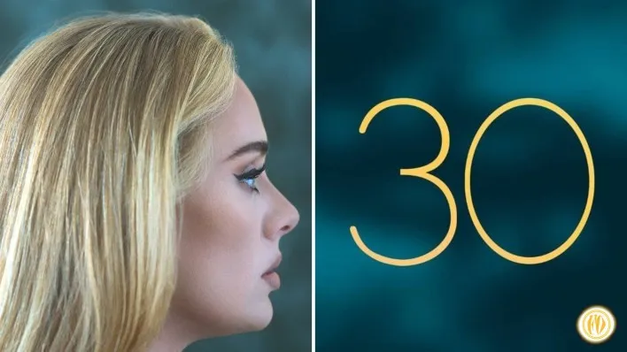
1. Adele’s Return To Glory
阿黛尔携新专霸气回归
The wait for “30” was worth it — the singer’s fourth album is her best ever.

Slide 4

语篇填空
（《滚石》2022年1月刊 70页Reviews Music）
when
Adele was born with big feelings, and ever since the day ______ she first stepped into a recording studio, she ________ (be) brilliant at sharing them with the world. If you were expecting this woman’s divorce album to be a smooth ride, you’re in the wrong place.
Adele has never sounded more ferocious _____ she does on the album 30 — more alive to her own feelings, more virtuosic (艺术名家的) at shaping them into songs in the key of her own bad life. It’s her ________ (tough), most powerful album yet. She travels her own Via Dolorosa (痛苦之路), _______ (walk) a treacherous path of heartache, motherhood, boozy (嗜酒的) despair, and loneliness.
This has been Adele’s first album since the collapse of her ________ (marry). But it’s also her turning-30 statement, so she’s navigating a host of turbulent _________ (emotion) transitions.
Adele’s voice is a tank division that can tap dance — the more mature she gets as an artist, the more finesse (灵巧) she brings to the microphone, without __________ (sacrifice) any of her primal (原始的) firepower. In the hit “Easy on Me”, she pauses midsong to linger on the first note of “easy” so long ____ you feel like you might pass out, even though you can tell she isn’t breaking ___ sweat.
has been
than
toughest
walking
marriage
emotional
sacrificing
that
a

Slide 5
词语讲解1
1. ferocious: very aggressive or violent; very strong 凶残的；激烈的
By its very nature a lion is ferocious. 狮子本性凶残。
Ferocious winds are roaring past the peaks. 狂风呼啸着吹过山峰。
2. turbulent: in which there are a lot of sudden changes 动荡的；混乱的
1815 was a turbulent year for France. 1815年对法国来说是动荡不安的一年。
翻译句子
狂风仿佛要把船撕成碎片似的。
The ferocious winds seemed about to tear the ship to pieces.
翻译句子
在每个时代，向成人期过渡的这段时期都是动荡不安的。
In every age the transition to adulthood is a turbulent time.

Slide 6
词语讲解2
3. transition: the process of changing from one state or condition to another 过渡
We need to ensure a smooth transition between the old system and the new one. 我们得确保新旧制度间的平稳过渡。
4. linger: to continue to exist for longer than expected 继续存留
The smell of the gas oil lingered in the house. 房子里仍有煤气油的气味。
The custom lingers on in this region. 这种风俗在这个地区仍然存在。
翻译句子
青春期是童年与成年之间的过渡时期。
Adolescence is the period of transition between childhood and adulthood.
翻译句子
他两眼落在她身上，显出极大的兴趣。
His eyes lingered on her with great interest.

Slide 7
句子翻译
She travels her own Via Dolorosa, walking a treacherous path of heartache, motherhood, boozy despair, and loneliness.
Via Dolorosa 痛苦之路
treacherous adj.危险的
boozy adj.嗜酒的
她踏上了她自己的痛苦之路，走过了一条充满心痛、母性、醉酒绝望和孤独的危险道路。
翻译
Adele’s voice is a tank division that can tap dance — the more mature she gets as an artist, the more finesse she brings to the microphone, without sacrificing any of her primal firepower.
division n.(军队) 师
tap dance 跳踢踏舞
finesse n.技巧
primal adj.原始的
阿黛尔的声音像一个可以跳踢踏舞的坦克师——她作为一名艺术家越成熟，她对麦克风的技巧就越娴熟，而不会牺牲她的任何原始力量。
翻译

Slide 8
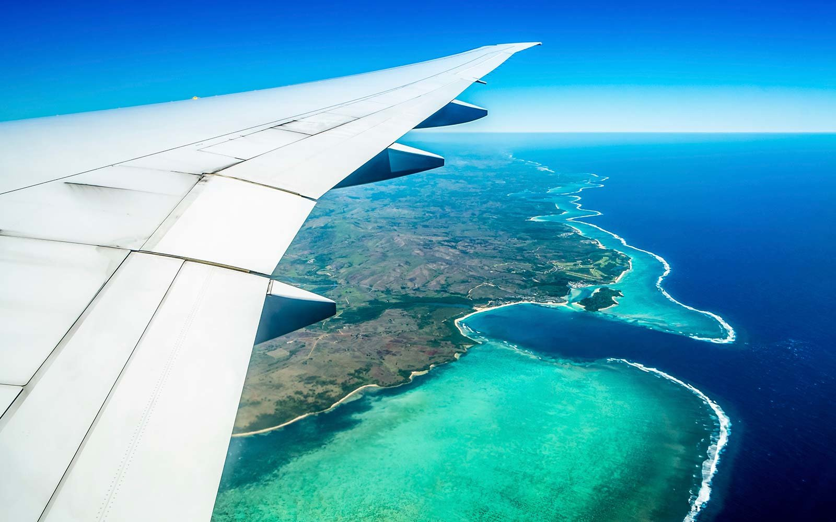
2. “The best part was watching everyone smile”
后天下之乐而乐
Traveling during treatment

Slide 9
语篇填空
（《今日美国》2022年1月10日 1B & 2B 版面）
People joke about needing a vacation after a vacation. _____ Stephanie Lee was serious. My friend from high school needed a few days after returning from vacation _______ she had the energy to tell me about her trip. The first thing I asked was how long she was gone. It was “only” four days.
“Only” is Stephanie’s least favorite four-letter word right now. In October, an oncologist (肿瘤学家) told ____ 32-year-old she could “only” expect to live another three to six months. I remembered Facebook updates about her _________ (shrink) tumors. In a sea of pandemic-related __________ (complain), those positive posts solicited hundreds of likes.
“This October we found it in my brain,” Stephanie _____ (tell) me via phone a few days after returning from San Diego. ________ (initial), they tried to raise money for trip on her GoFundMe page. Ultimately, it __________ (make) possible by the Jack & Jill Late Stage Cancer Foundation.
When I asked ______ her favorite part of their trip was, her answer caught me off guard: “The best part was _________ (watch) everyone smile. I wanted to make memories with my kids and partner.”
But
before
the
shrinking
complaints
told
Initially
was made
what
watching

Slide 10
词汇讲解
1. solicit: to ask sb for sth, such as support, money, or information
索求，请求…给予（援助、钱或信息）
They were planning to solicit funds from a number of organizations.
他们正计划向一些机构募集资金。
2. off guard: not careful or prepared for sth difficult or dangerous
不警惕；不提防；不警戒
Her betrayal took me completely off guard. 她的背叛让我完全措手不及。
翻译句子
公务员以提供便利来索取礼物或金钱作为交换是非法的。
It is illegal for public officials to solicit gifts or money in exchange for favors.
翻译句子
这个变化让我措手不及。
The change has caught me off guard.

Slide 11
选词填空
用以下词(组)的适当形式完成句子。
1. That extension is busy __________. Can you hold?
2. I can’t be doing with people who _________ all the time.
3. ________ the system was offline for a number of days.
4. The lawyer’s innocent question was designed to catch the witness _________.
5. After years of good growth, the economy will _______ this year.
6. The divorce __________ led to his ruin.
complain ultimately right now shrink initially off guard
right now
complain
Initially
off guard
shrink
ultimately

Slide 12
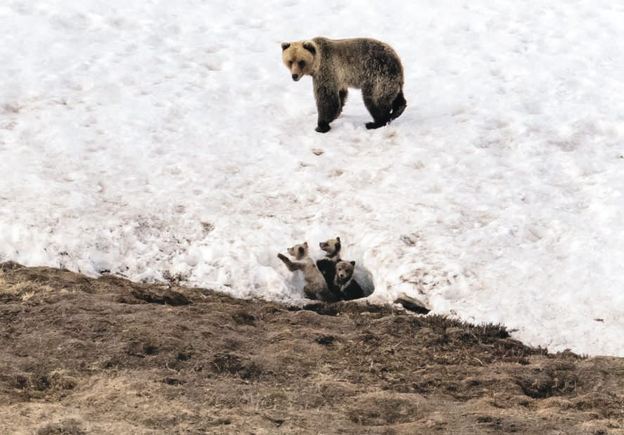
3. Warming permafrost puts Arctic infrastructure at risk
当冻土不再冻时……
A bear watches her three cubs in North Slope Borough, Alaska.

Slide 13
语篇填空
（《华盛顿邮报》2022年1月12日 A13 版面）
The warming of the Arctic’s frozen grounds has already suffered a range of ________ (disaster) on its hardy residents: paved roads that look like ribbons fluttering in a breeze.
In coming decades, the shifting terrain (地形) that accompanies the warming of the permafrost ________ (cause) by climate change will put more such human-made struc-tures ____ risk. Nearly 70 percent of the infrastructure in the Northern Hemisphere’s permafrost regions — __________ (include) at least 120,000 buildings and nearly 25,000 miles of roads — ___________ (locate) in areas with high potential for thaw of near-surface permafrost by 2050.
Scientists reached this in six papers __________ were reviews and syntheses (综合) of research by groups of scientists in several countries ________ the polar region.
Permafrost covers about 5 million to 7 million square miles in the Arctic and ______ (store) nearly 1.9 trillion tons of frozen and thawing carbon, one of the studies noted. _____ it warms and becomes more unstable, it not only threatens the human-made structures, but the melting releases carbon into the atmosphere that has been locked in ice for millennia, ________ (far) worsening climate change.
disasters
caused
at
including
are located
that / which
around
stores
As
further

Slide 14
词汇讲解
1. permafrost: a layer of soil that is permanently frozen, in very cold regions of the world （寒带）永冻土层；永冻层
The roots don’t grow deep, so the permafrost doesn’t interfere with their growth. 根长得不深，所以永久冻土不会影响它们的生长。
2. thaw: to turn back into water after being frozen
（结冰后）解冻，融化，融解
The snow is beginning to thaw. 雪已开始融化。
翻译句子
由于冻土融化，陆地会失去吸水性。
As the permafrost melts, the land loses its capacity to absorb water.
翻译句子
天气太冷了，积雪都没机会融化。
It was so cold that the snow had no chance to thaw.

Slide 15
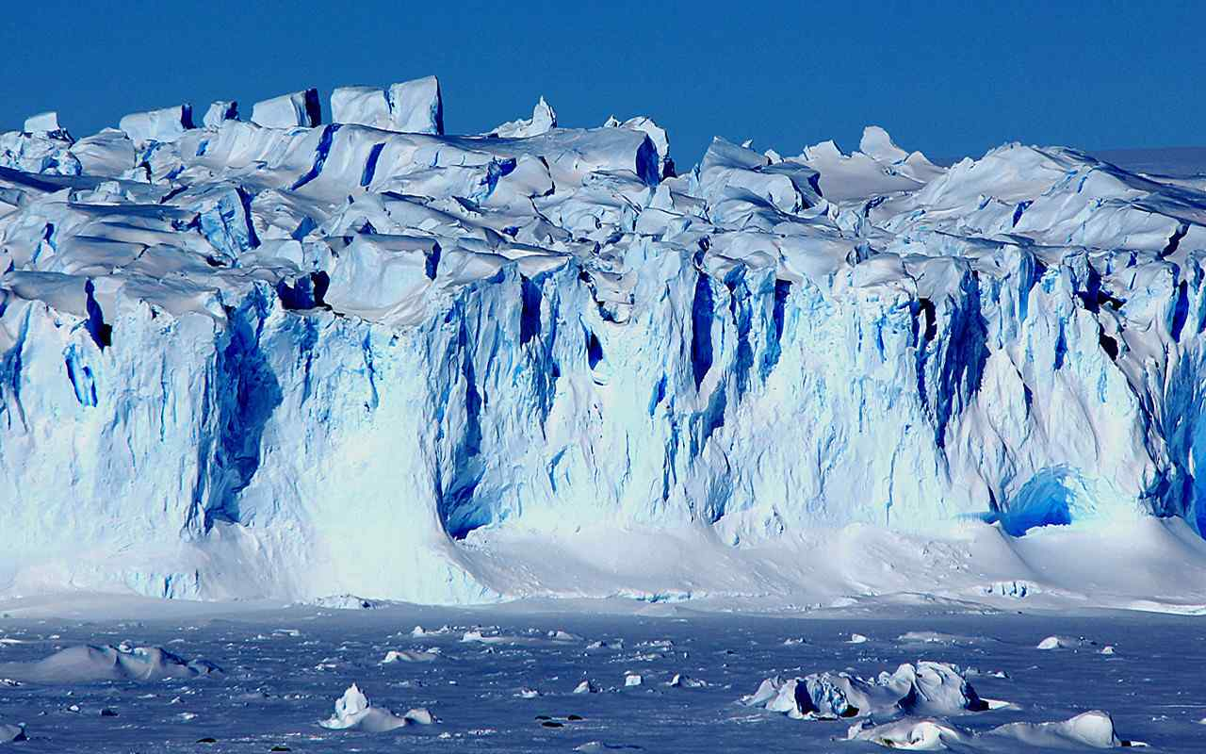
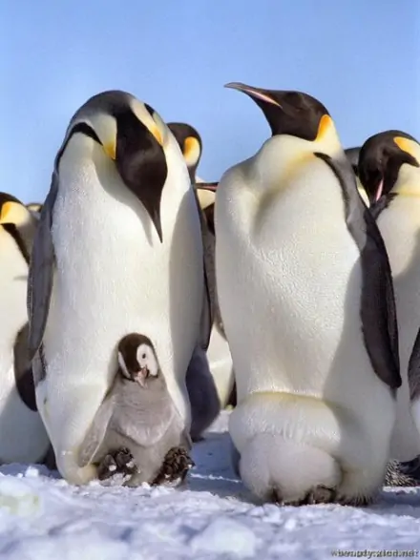
南北极相关词汇
the North Pole; the Arctic Pole 北极
the South Pole; Antarctica 南极
polar bear 北极熊
reindeer 驯鹿
seal 海豹
emperor penguin 帝企鹅
polar day 极昼
polar night 极夜
polar light 极光
glacier 冰川
frozen soil 冻土
permafrost 多年冻土；永久冻结带
ozone 臭氧
ozone hole 臭氧层空洞
the Inuit 因纽特人

Slide 16
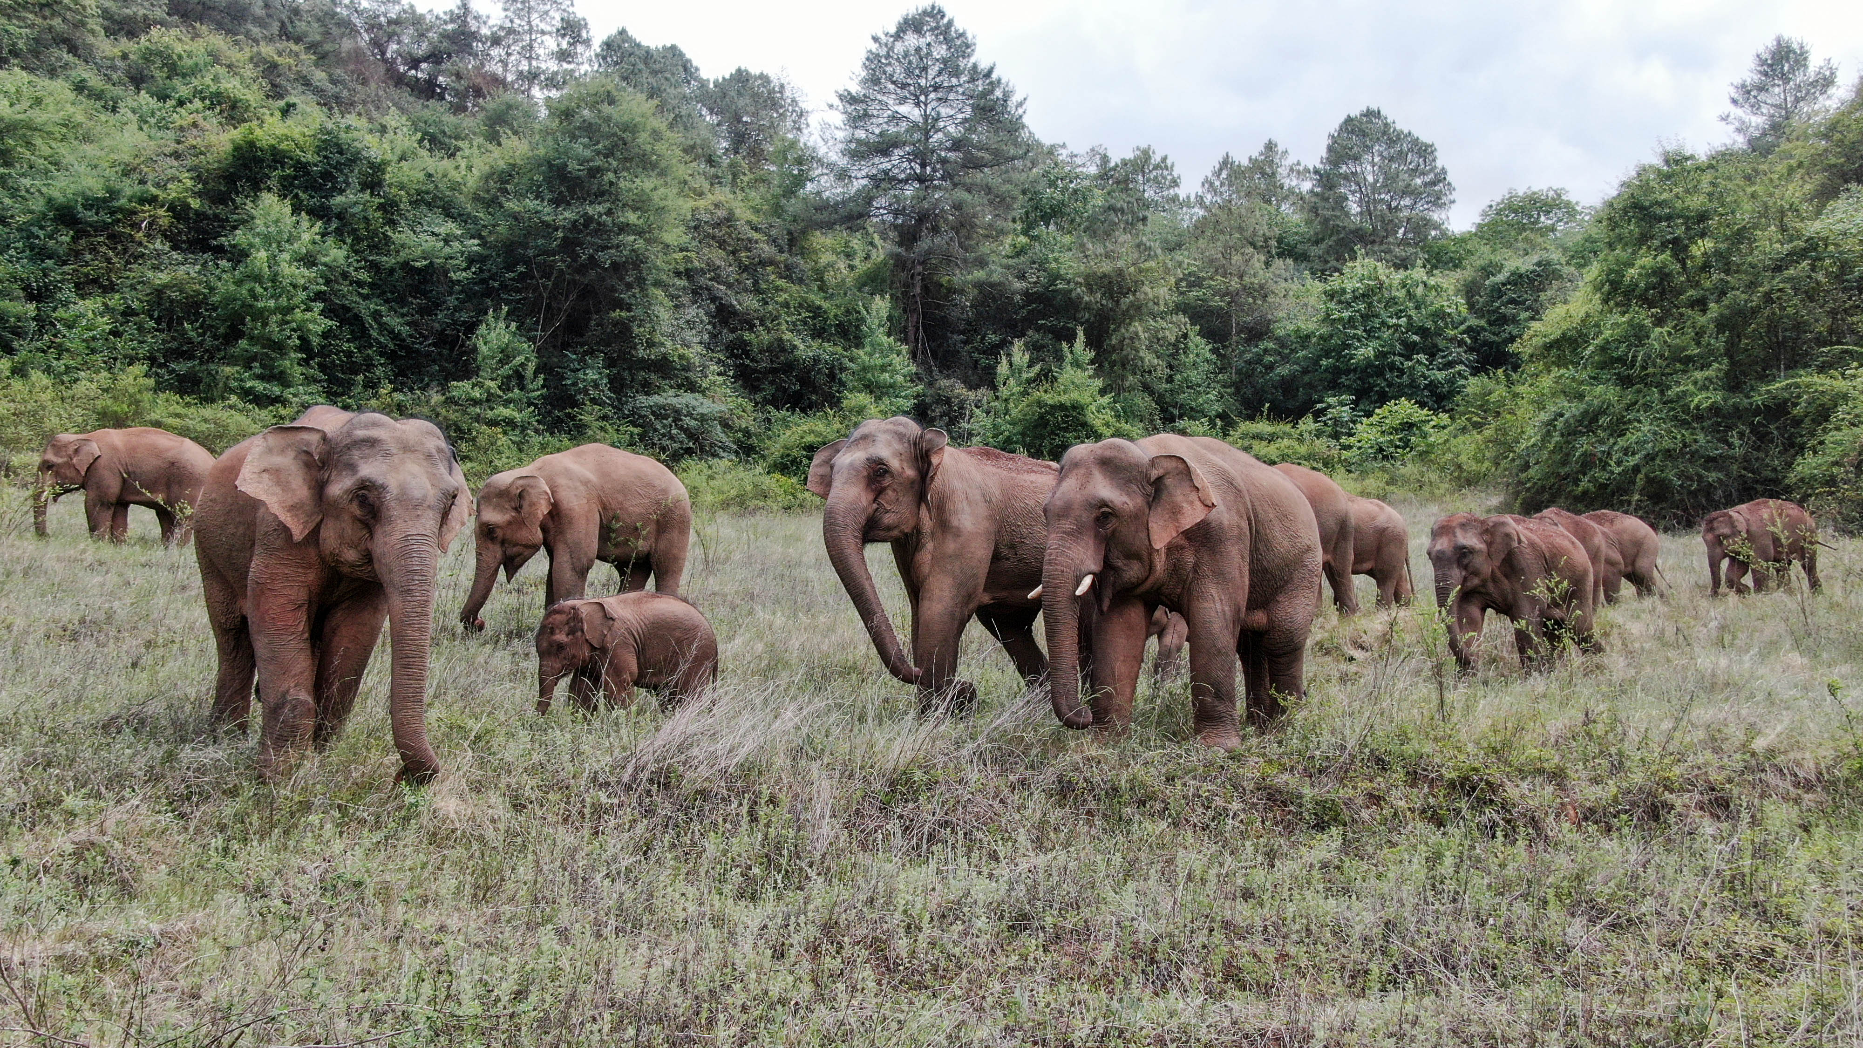
4. 16 Asian Elephants Moving North 一路“象”北
Part II

Slide 17
语篇填空
（《国家地理》2022年1月刊 110-111页（Part II））
Drones tracked the elephants’ every move. Tons of corn, pineapples, and bananas _________ (use) as bait to lure them away from towns. Electric fences, road barriers, and new pathways steered them toward safer routes. These measures _________ (ultimate) involved tens of thousands of people at a cost equal ___ hundreds of thousands of dollars.
By November the elephants in China _________ (make) their way back home and were in good condition, the National Forestry and Grassland Administration said. It’s still not clear ____ they left in the first place, ___ one theory is that as elephant ________ (number) in Yunnan Province have increased, the animals have needed to expand their territory.
That could be considered good news for this __________ (endanger) species. But the story of the elephants’ trek demonstrates something else too: that the world we created and the world nature created ____ (be) inextricably bound, for better or for ______ (bad).
were used
ultimately
to
had made
why
but
numbers
endangered
are
worse

Slide 18
词语讲解
1. lure: to persuade or trick sb to go somewhere or to do sth by promising them a reward 劝诱；引诱；诱惑
Young people are lured to the city by the prospect of a job and money.
年轻人希望打工赚钱，从而被诱惑到城市。
2. demonstrate: to show sth clearly by giving proof or evidence 证明；说明
The study also demonstrated a direct link between obesity and mortality.
该研究还表明了肥胖症和死亡率之间存在直接的联系。
翻译句子
他们没有意识到自己正被诱入圈套。
They did not realise that they were being lured into a trap.
翻译句子
结果证明，我们的运动正在发挥作用。
These results demonstrate that our campaign is working.

Slide 19
长难句分析
It’s still not clear why they left in the first place, but one theory is that as elephant numbers in Yunnan Province have increased, the animals have needed to expand their territory.
形式主语
分析：本句中是一个并列句，第一个句子中的“it”是________，真正的主语是___________________________；第二个句子的主语是___________，“that as elephant numbers ... their territory”是____从句，它又包含一个“as”引导的_____ 从句。
“why they left in the first place”
“one theory”
表语
状语
目前尚不清楚它们最初为何离开，但有一种理论认为，随着云南省大象数量的增加，这些动物需要扩大自己的领地。
翻译

Slide 20

听写
科学美国人：科学60秒 60-Second Science 01/10/22
Look! Up in the sky! It's a bird! It's a plane!
Yes, it's a plane. On ____________ odds are you'll see several contrails (飞行轨迹), some slowly spreading out to form high, cirrus (卷云) clouds. Air travel just ____________—and the atmosphere is starting to notice.
The act of burning kerosene (煤油) and other aviation fuels to power jet engines and propellers means carbon dioxide emissions, among ____________________. And that CO2, plus water vapor and the like is deposited high in the atmosphere, where it contributes ______________ to global warming.
The world's nations have spent years trying to _________________ to restrain air travel emissions. And this week the International Civil Aviation Organization, the ICAO, a U.N. body, agreed on a plan to do just that—that won't _________ until 2020. Hence the flyby in Montreal of a chartered plane trailing the banner: "Can't Spell Procrastination without ICAO."
Solutions exist for airplane emissions, ___________ low-carbon biofuels (生物燃料) to more _______ engines and ______ plane bodies. If an airplane ______________________ can fly across the U.S. , there's reason to believe air traffic can be cleaned up, and soon.
any given day
keeps growing
other types of pollution
most effectively
come up with a way
take effect
ranging from
efficient
lighter
powered only by sunshine

Slide 21
词语讲解
1. odds: the degree to which sth is likely to happen
（事物发生的）可能性，概率，几率，机会
What are the odds he won’t turn up?
他不会露面的可能性有多大？
2. restrain: to stop sth that is growing or increasing from becoming too large
抑制；控制
In the 1970s, the government tried to restrain corruption.
在20世纪70年代，政府曾经试图打击腐败。
翻译句子
你很可能会失败。
The odds are that you are going to fail.
翻译句子
政府正在采取措施控制人口增长。
The government is taking steps to restrain population growth.

Slide 22
句子翻译
On any given day odds are you'll see several contrails (飞行轨迹), some slowly spreading out to form high, cirrus (卷云) clouds.
翻译
在任何一天，你都可能会看到几条（飞机）凝结尾迹，其中一些会慢慢散开，形成高高的卷云。
And that CO2, plus water vapor and the like is deposited high in the atmosphere, where it contributes most effectively to global warming.
翻译
而那些二氧化碳加上水蒸气等类似气体会沉积在大气高层，在那儿它们对全球变暖的影响最大。
Solutions exist for airplane emissions, ranging from low-carbon biofuels (生物燃料) to more efficient engines and lighter plane bodies.
翻译
飞机尾气排放的解决方案已经存在，如低碳生物燃料、更高效的发动机和更轻的飞机机身。

