Slide 1

感恩遇见，相互成就，本课件资料仅供您个人参考、教学使用，严禁自行在网络传播，违者依知识产权法追究法律责任。
更多教学资源请关注
公众号：溯恩高中英语
知识产权声明

Slide 2
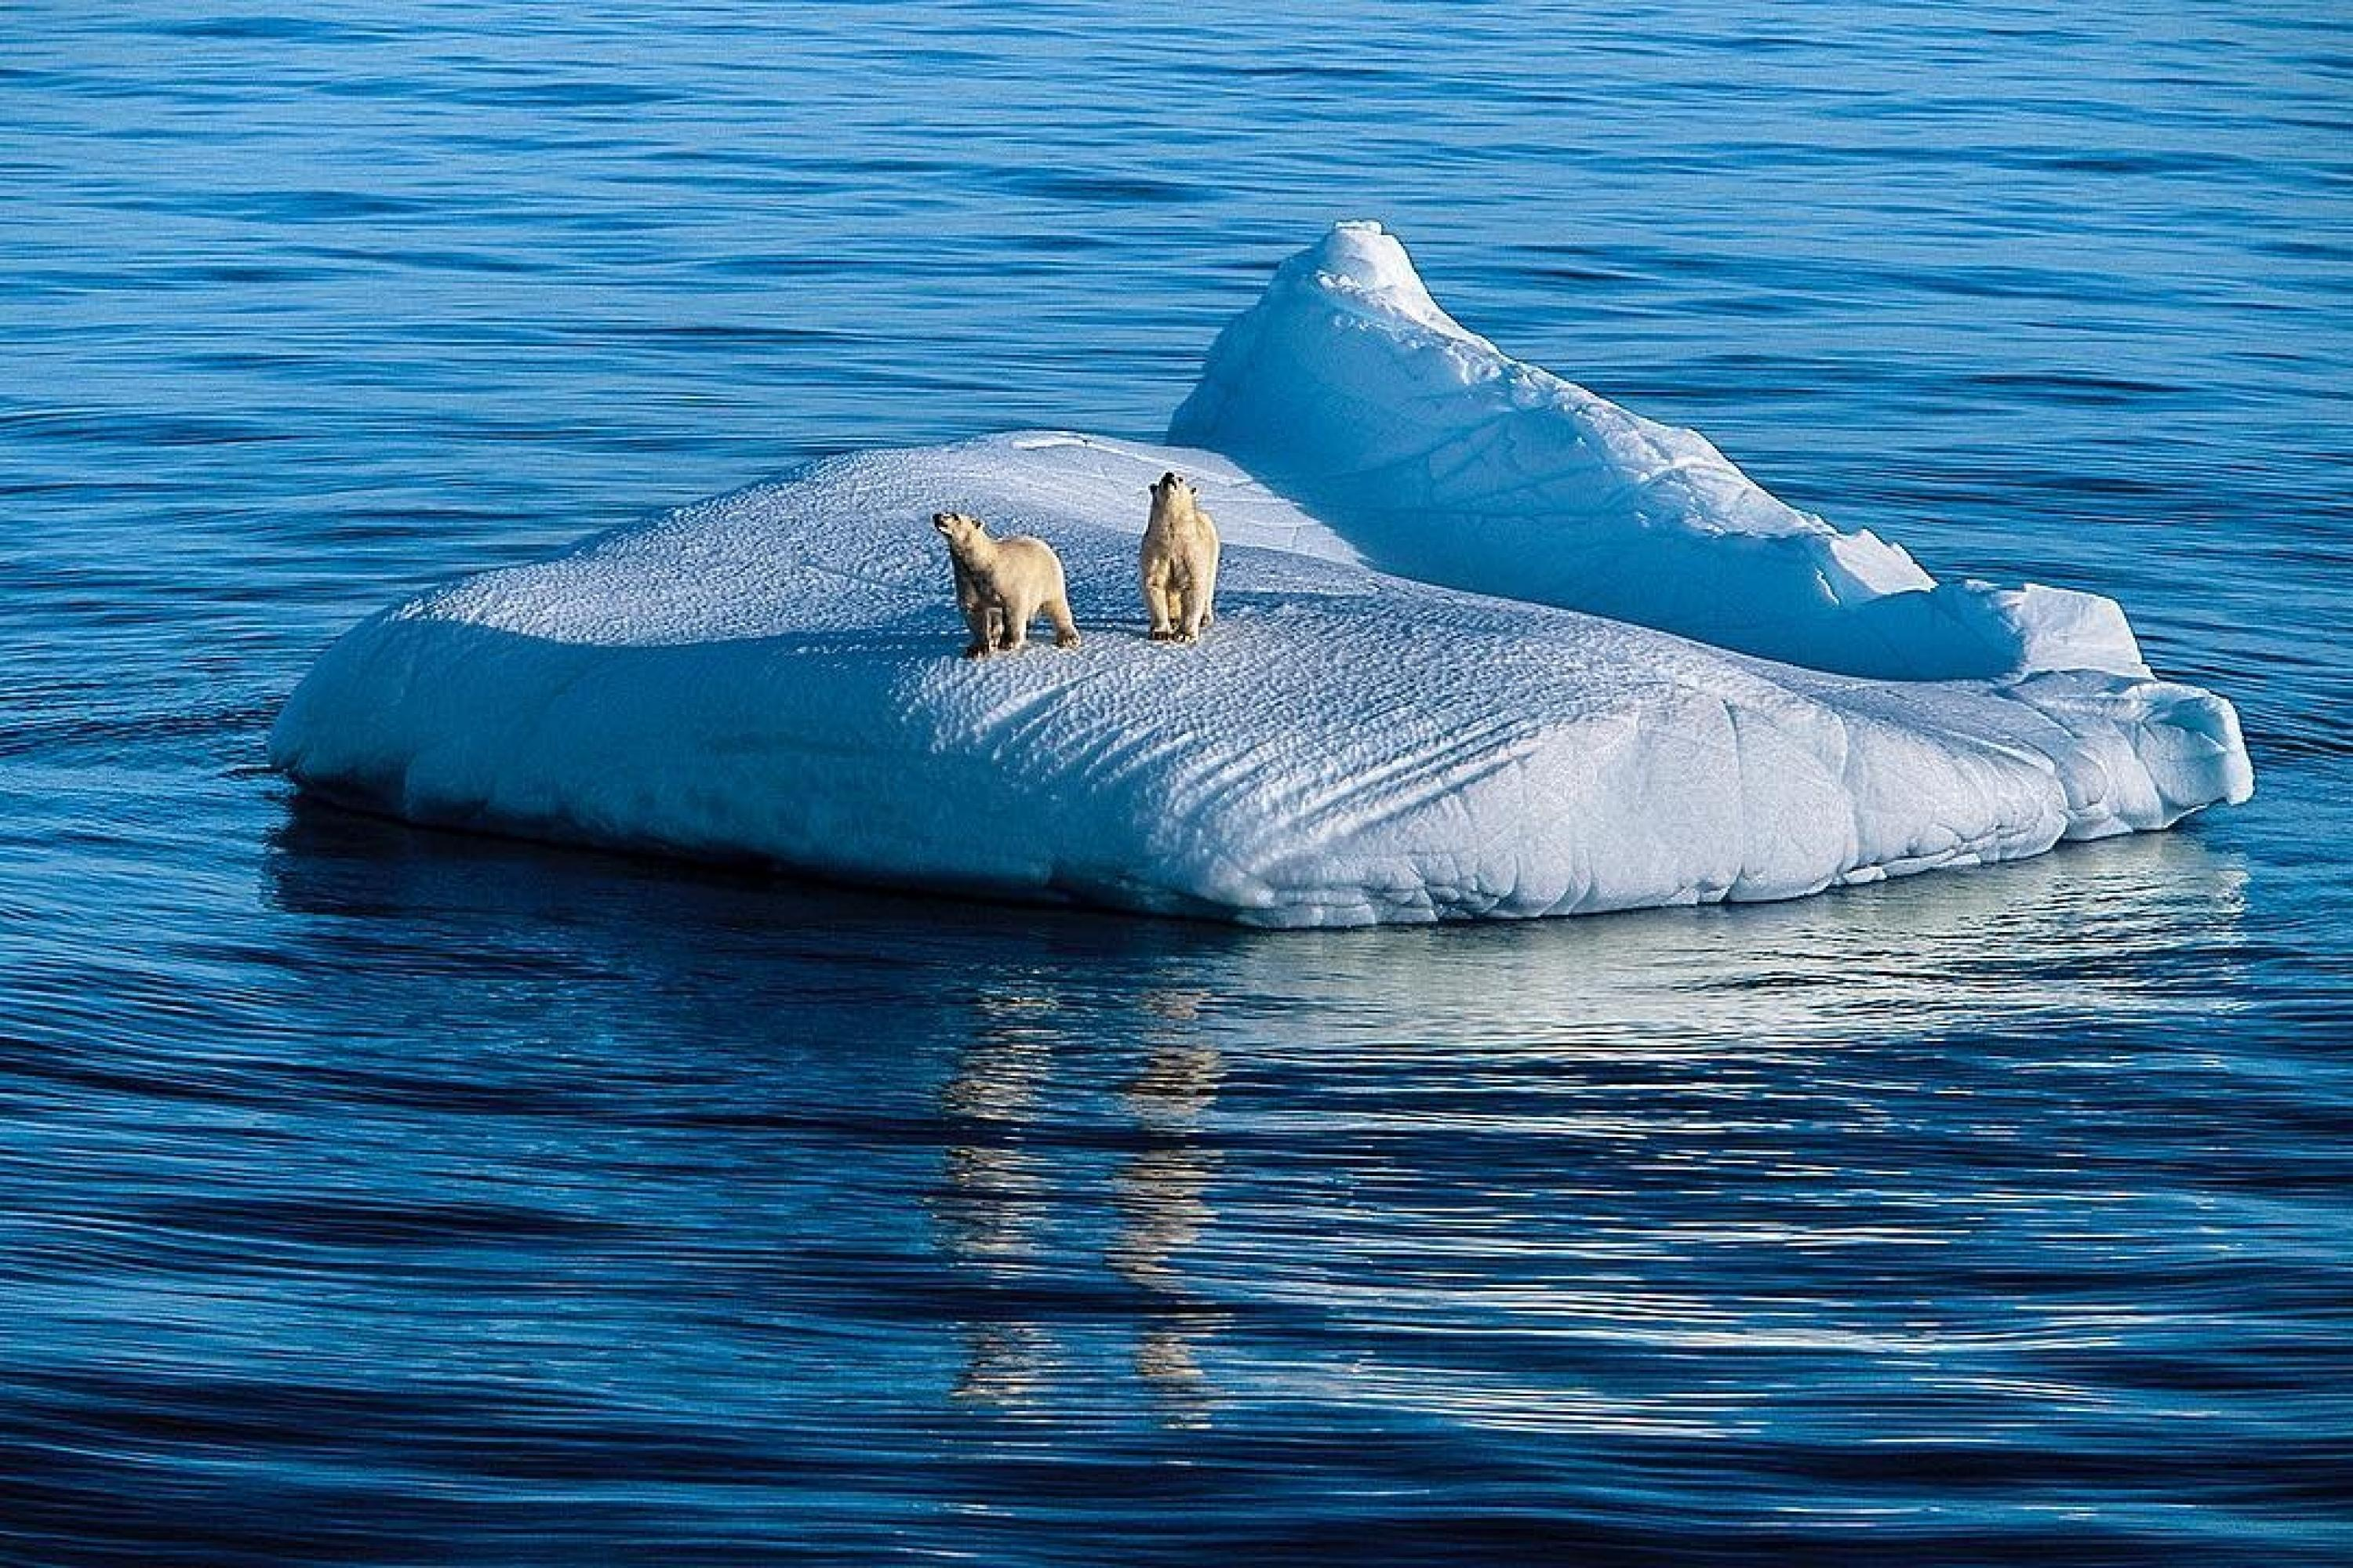
Book 6 Unit 3 Environmental Protection
罗欣捷
东莞市第二高级中学

Slide 3
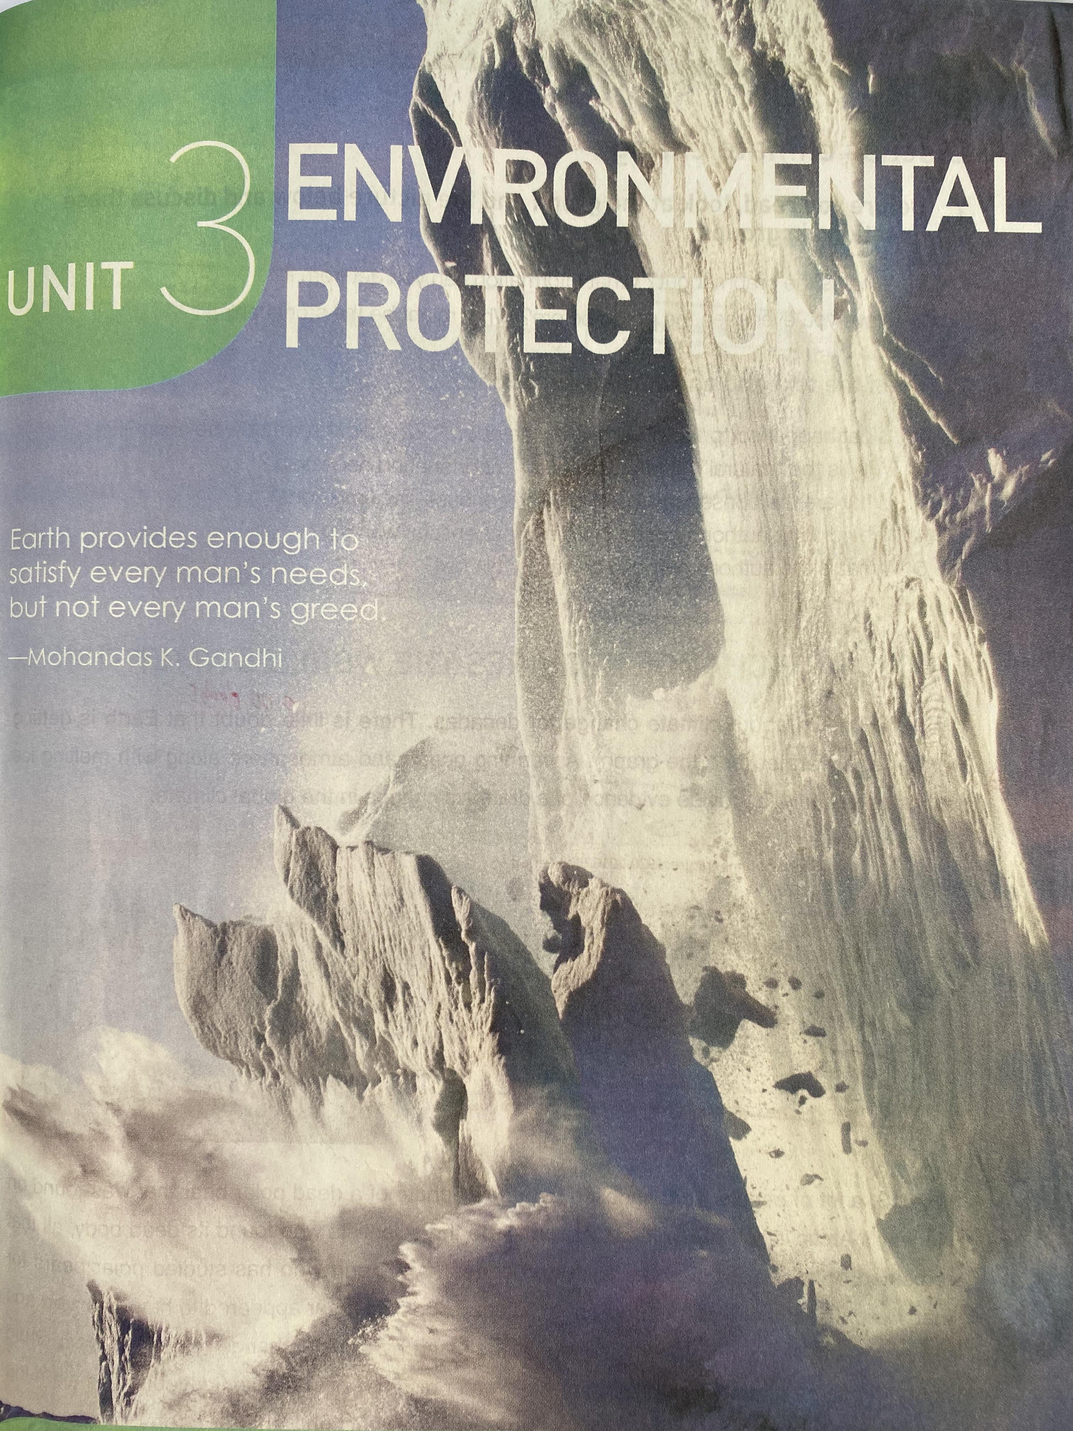
Look and discuss
1. What’s happening in the photo?
The photo is of a large piece of ice breaking off a large glacier or ice sheet.
2. Where do you think this photo was taken?
This photo was taken in either the Arctic or Antarctica.
3. What does this photo make you think of?
The photo makes me think of the problem of global warming.

Slide 4
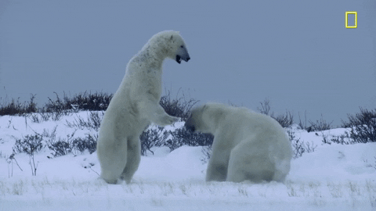
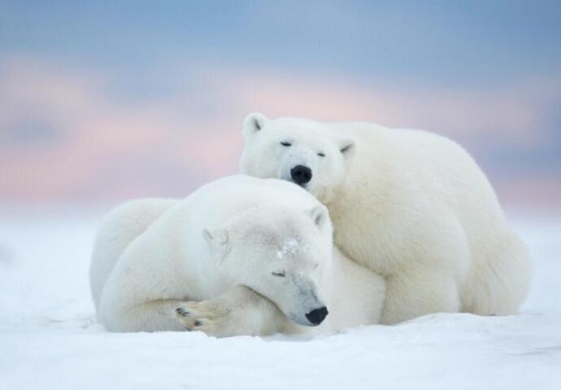
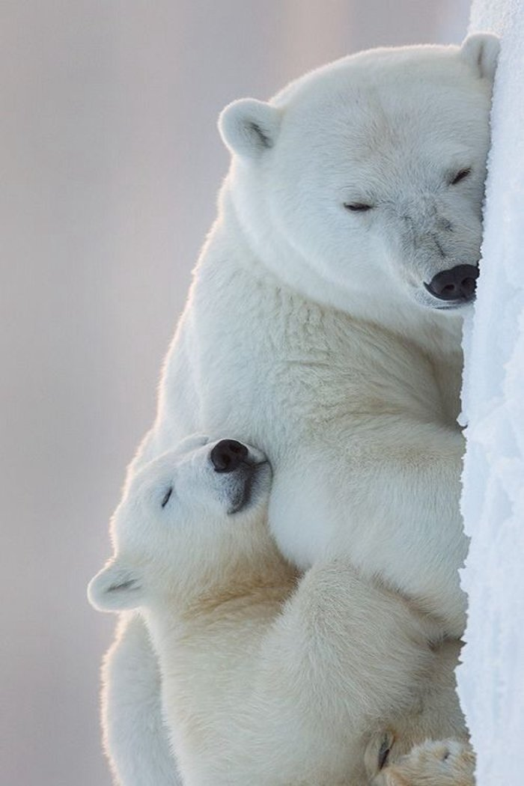
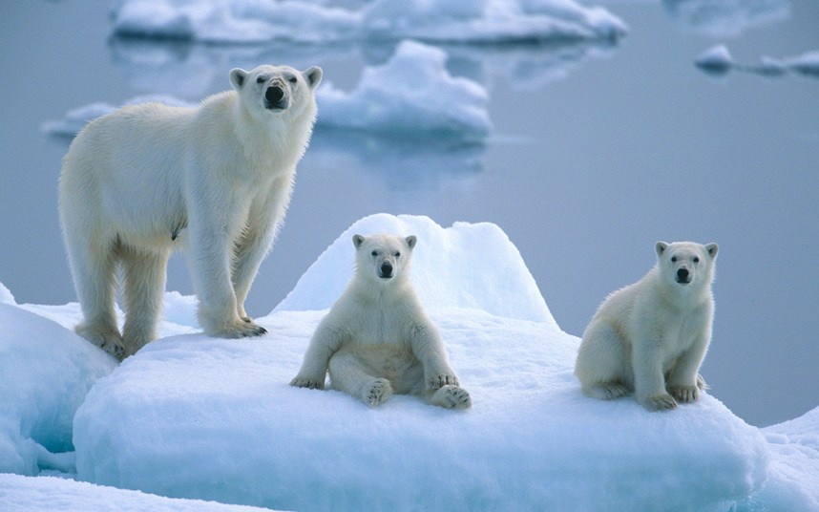
Pre-reading: Lead in
Before

Slide 5
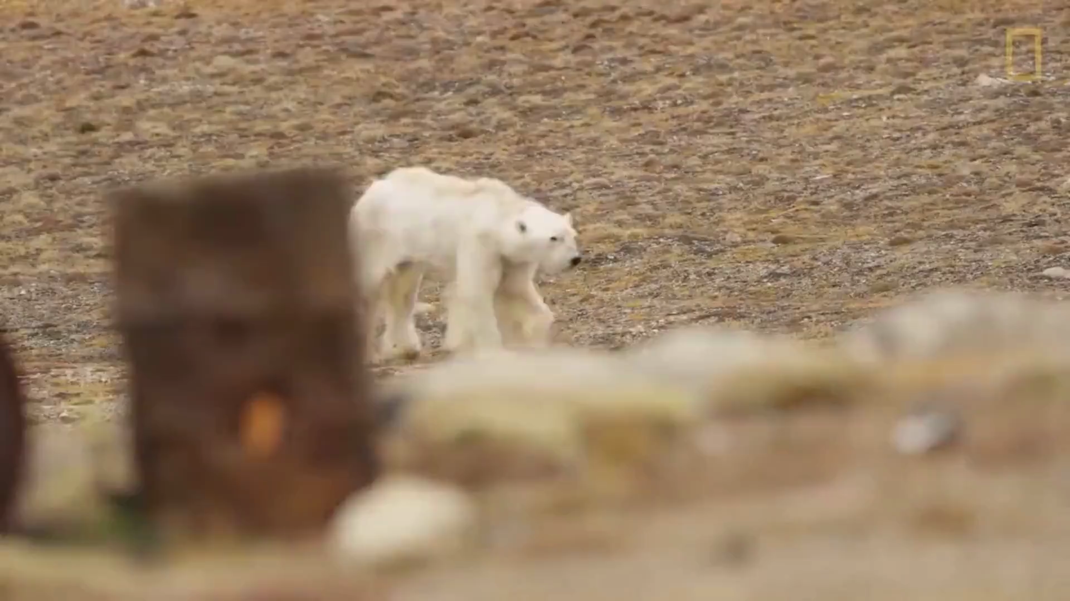
Pre-reading: Lead in
What happened to the polar bear in the video?

Slide 6
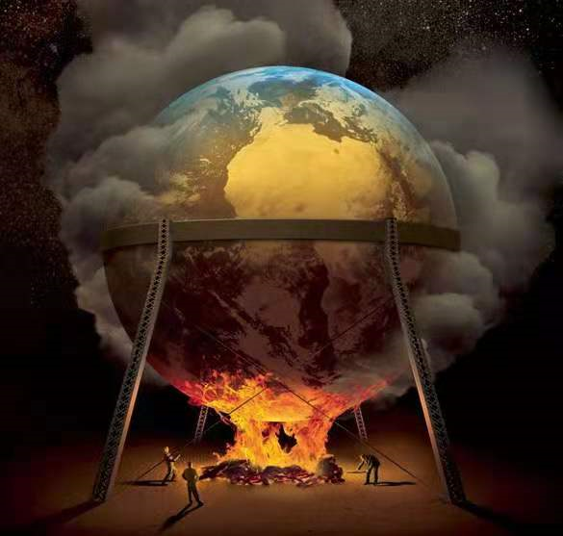
While-Reading
CLIMATE CHANGE REQUIRES THE WORLD’S ATTENTION

Slide 7
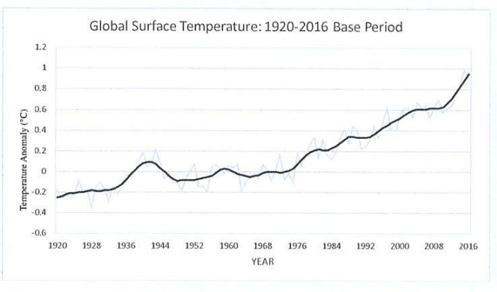
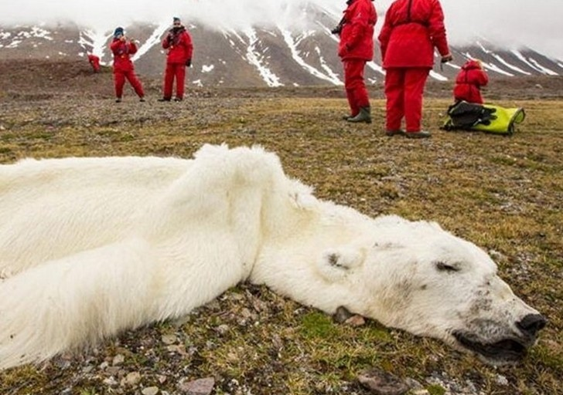
While-reading: read for the text type
CLIMATE CHANGE REQUIRES THE WORLD’S ATTENTION
1. What's the type of this text?
A. News report.
B. Biography.
C. Expository essay.
D. Argumentation.
2. What's its purpose?
To inform readers of climate change.
To persuade readers to focus on climate change problem.
Expository essay
The authors sometimes use some graphs or diagrams in their essays in order to convince their readers. These graphs and diagrams often come from scientific reasearch reports and other reliable resources.

Slide 8
While-reading: make a prediction
1. What is the graph about? What information can you get from it?
2. What do you think might have caused the polar bear’s death?
The graph shows the change in the Global Surface Temperature between 1920 and 2016. It shows the temperature anomaly（平均气温距平值 ）. The Earth is getting warmer and warmer.

Slide 9
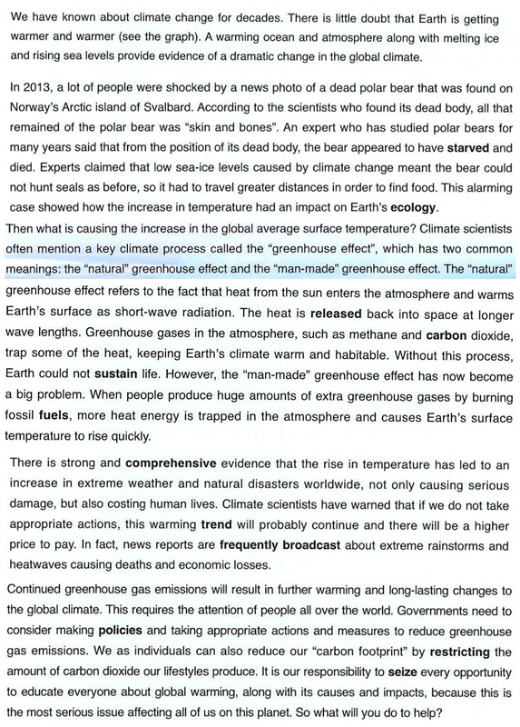
While-reading: read for the structure
Search for the topic sentence of each paragraph

Slide 10
Expository essay
Para 1 &2
The __________ of dramatic climate change that had an impact on Earth’s ecology.
Evidence
evidence
Para 3
The ________ of the increase in the global average surface temperature.
Cause
cause
Para 4
The ____________ of the rise in temperature.
Consequences
consequences
Para 5
The __________ to reducing greenhouse gas emissions.
Solutions
solutions

Slide 11
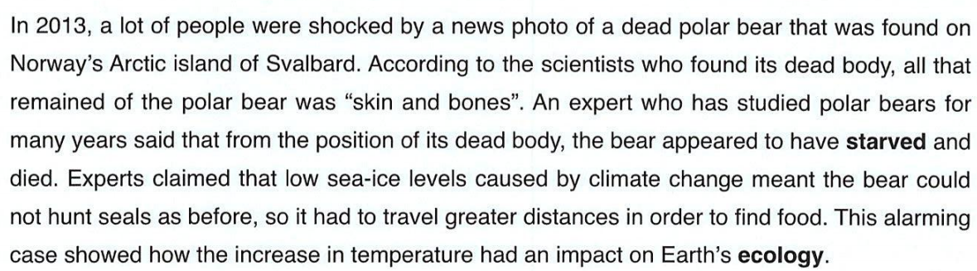
While-reading: read for the content
Para 2
Jigsaw reading: Cause & Effect
1. climate change
2. had to travel greater distances to find food
3. bears could not hunt
4. its dead body found
5. low sea-ice levels
6. starved to death
climate change → low sea-ice levels → bears could not hunt → had to travel greater distances to find food → starved to death→ its dead body found

Slide 12
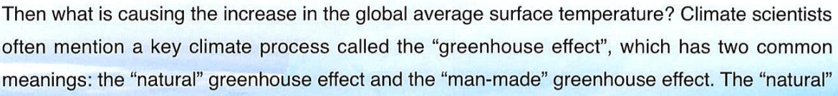
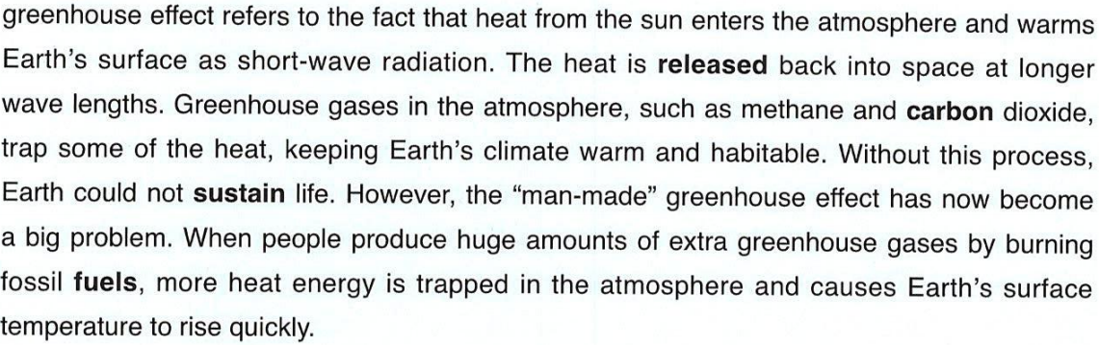
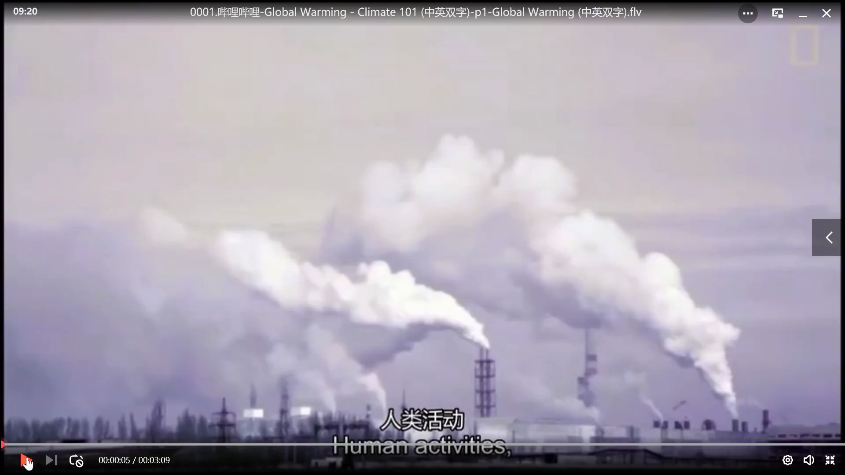
Para 3
______ greenhouse effet
keeping Earth’s climate _____________________
natural
warm and habitable
Greenhouse effect
________ greenhouse effect
causing Earth’s surface temperature _____________
man-made
to rise quickly

Slide 13
Create a diagram describing how the greenhouse effect works in natural and man-induced situations. (Para 3)
Function: brainstorm ideas,
map out processes,
show cause and effect relationships,
explain a new idea or concept,
visualise the problems,
demonstrate the creative thinking and problem-solving ...

Slide 14
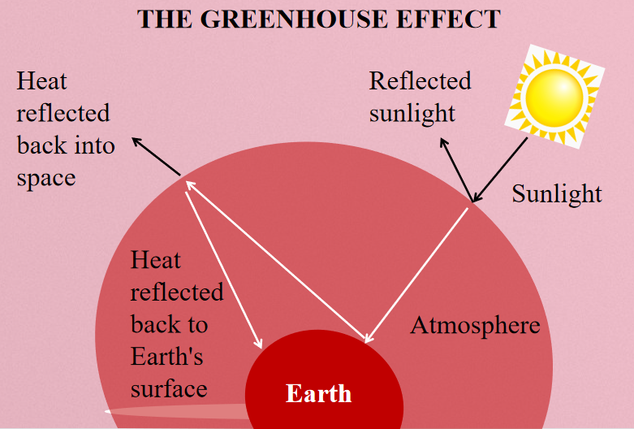

Slide 15
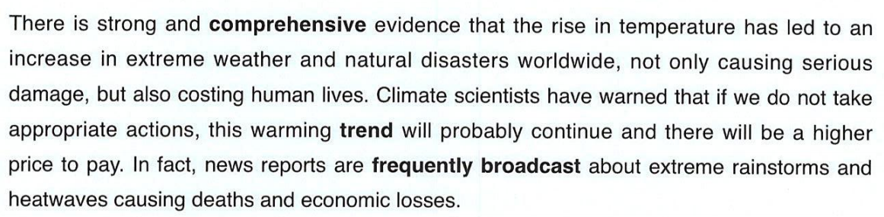
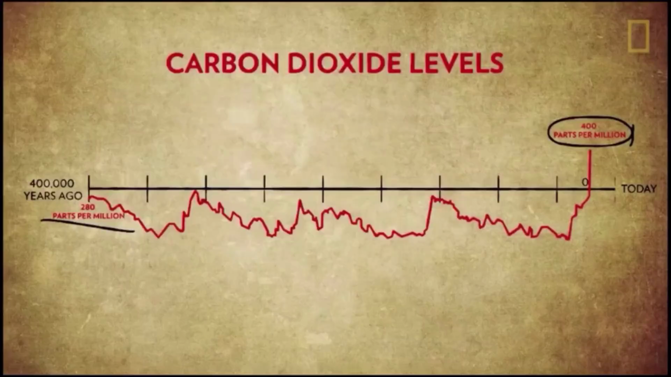
Para 4
example
extreme rainstorms, heat waves
The rise in temperature
extreme weather/ natural disasters
led to
serious damage, costing human lives, economic losses
results

Slide 16
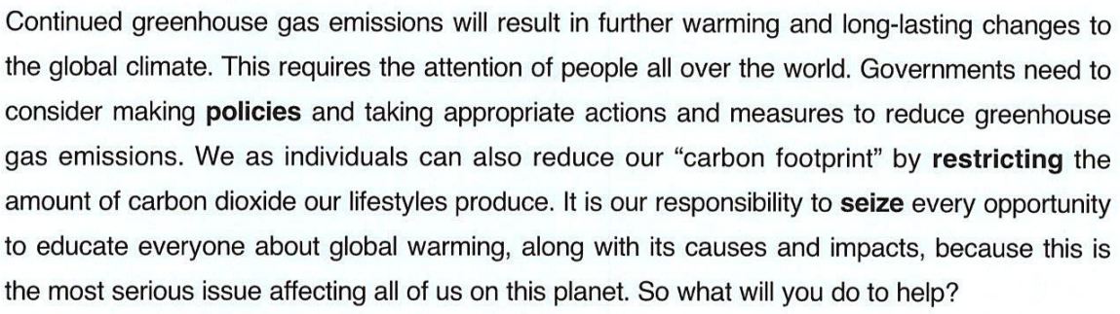

Para 5
“Carbon footprint”

Slide 17
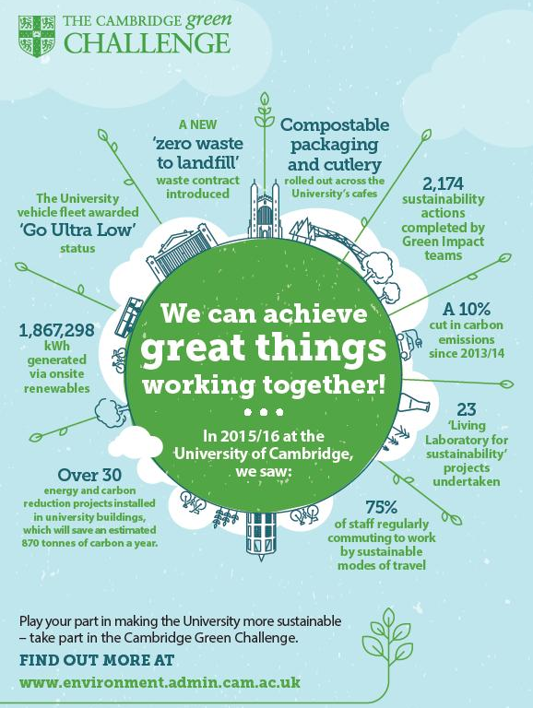

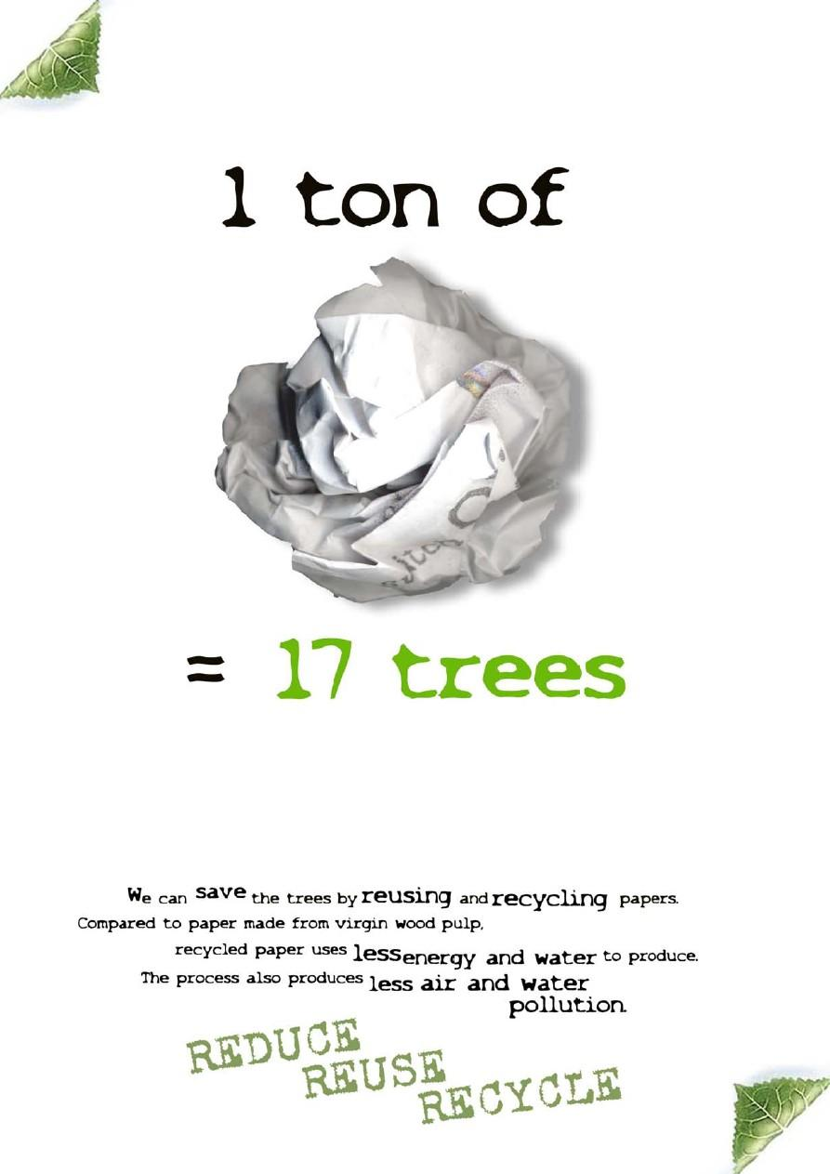
Post-reading: to make a poster
So what will you do to help?

Slide 18
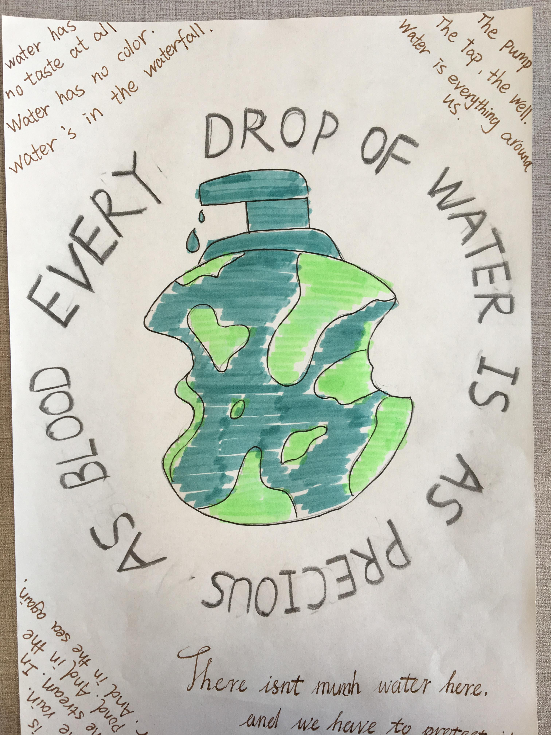
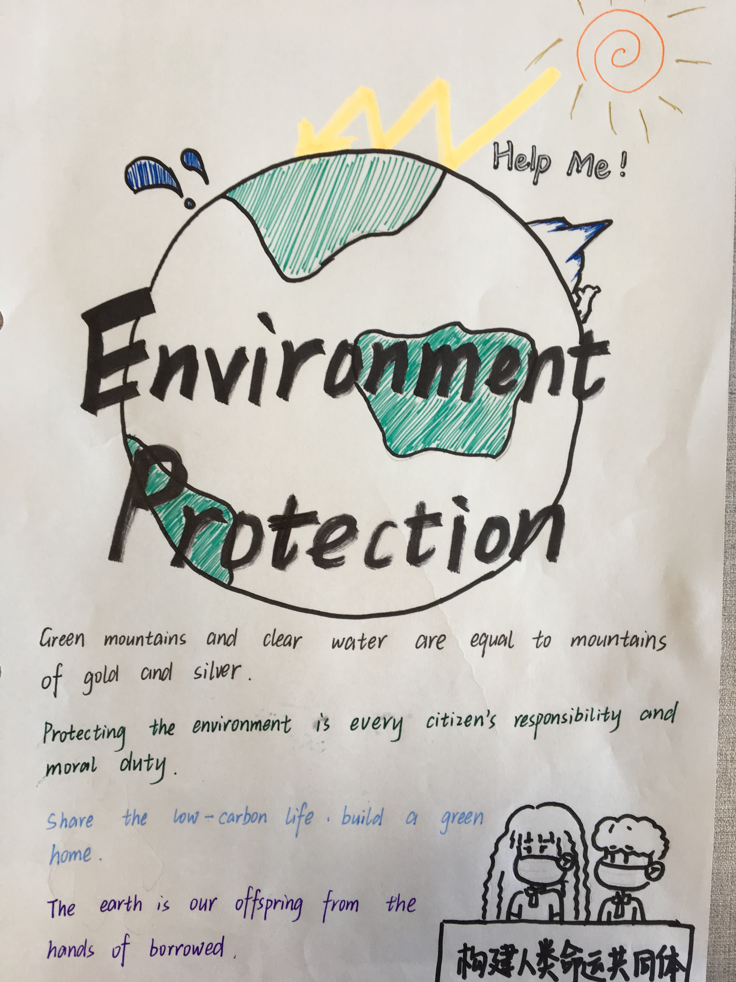
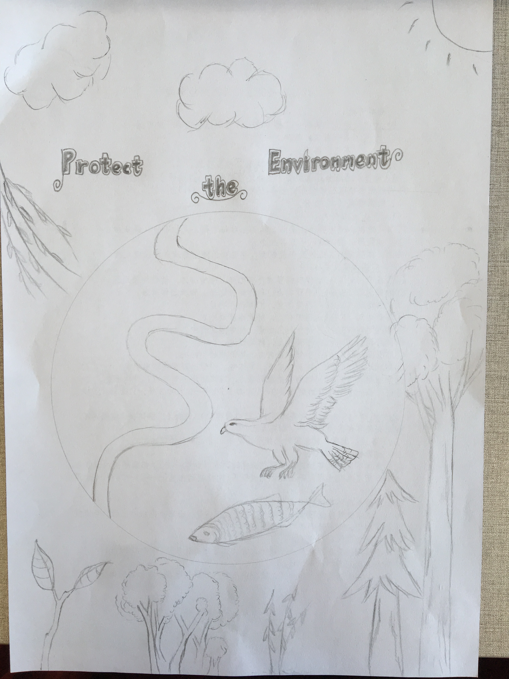
Post-reading: to make a poster
Students’ works

Slide 19

Homework
1. To make the poster with your group members and make a presentation next time.
2. To review the structure of expository essay.

