Slide 1


感恩遇见，相互成就，本课件资料仅供您个人参考、教学使用，严禁自行在网络传播，违者依知识产权法追究法律责任。
更多教学资源请关注
公众号：溯恩高中英语
知识产权声明

Slide 2
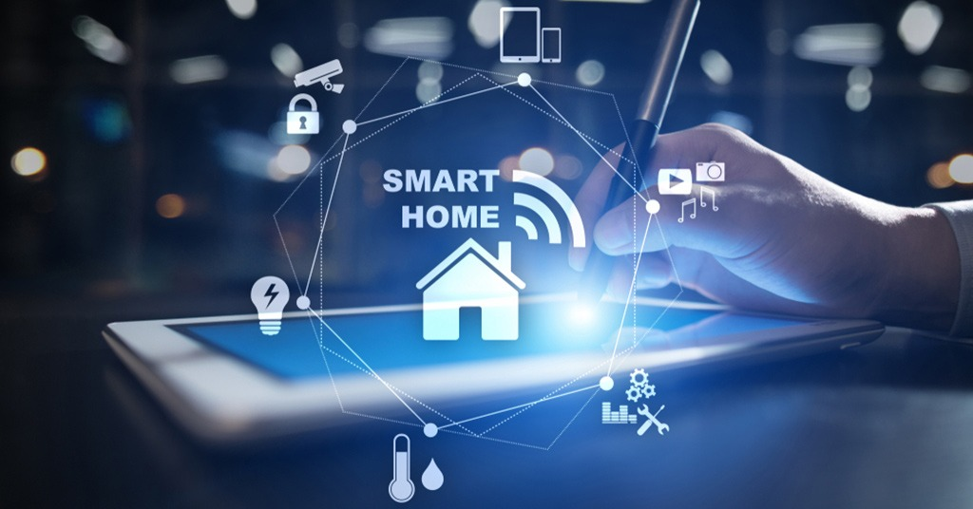
杭四中

Slide 3
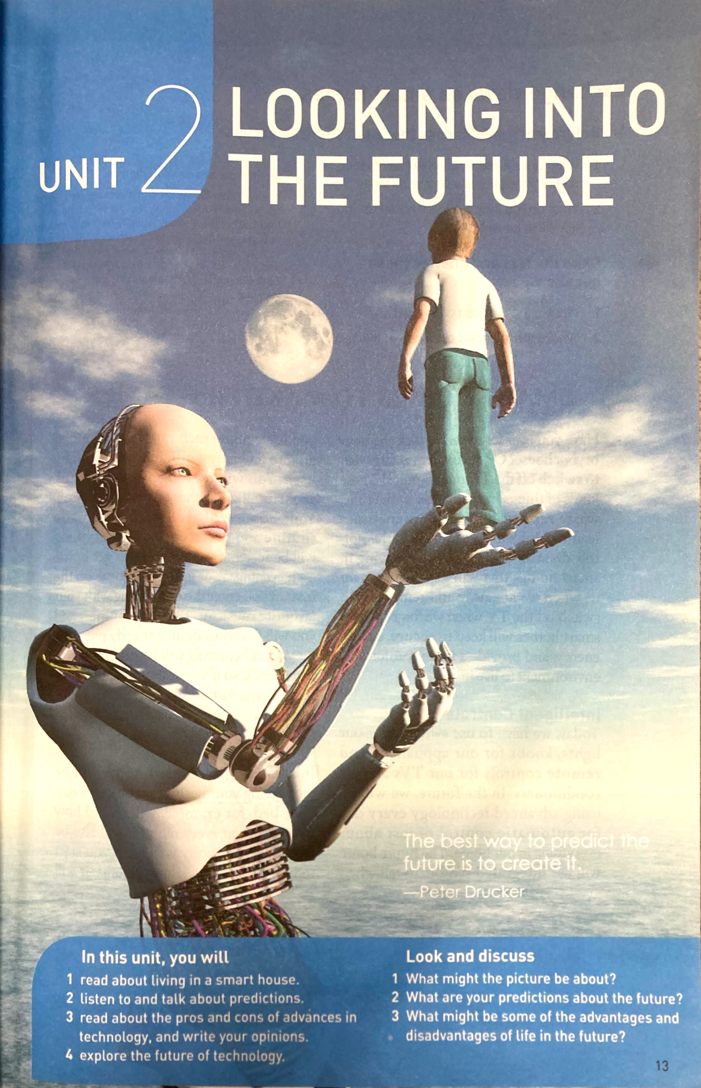
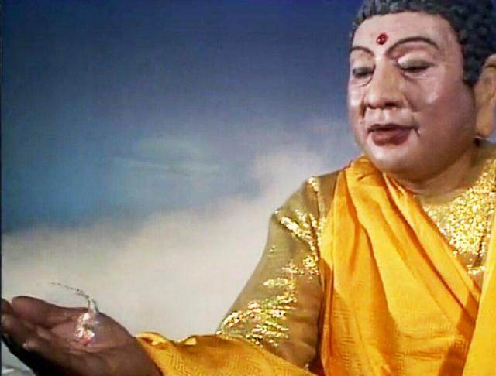
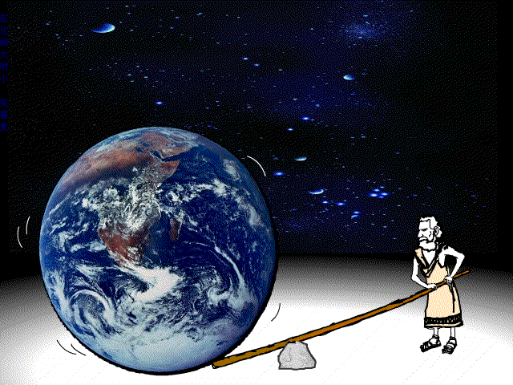
Buddha
Smart
Homes To Make Life
Easier
The best way to predict
the future is to create it
---Peter Drucker
lever

Slide 4
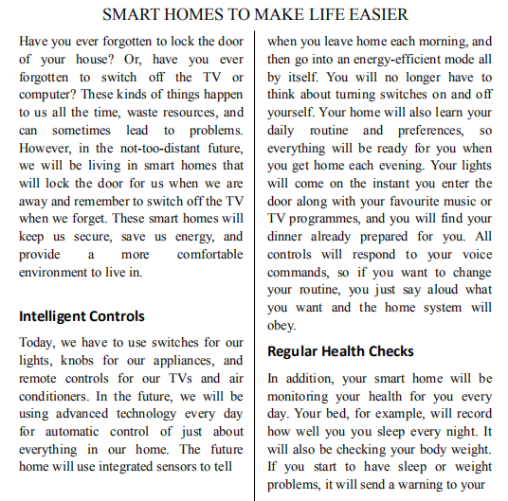
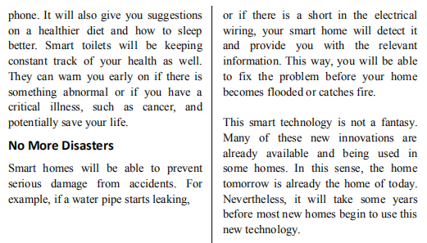
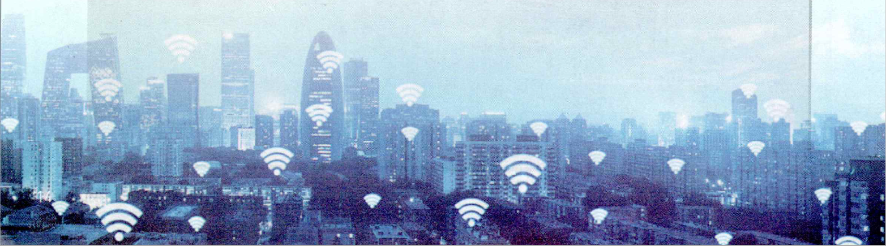
Read for Structure
General statement
Title
General introduction to the advantages of smart homes
Supporting details
Conclusion
Intelligent Controls
Regular Health Checks
No More Disasters
This smart technology is not a fantasy.

Slide 5
Read for Details
To introduce the topic
To arouse the readers' attention or interest
Have you ever forgotten to lock the door of your house? Or, have you ever forgotten to switch off the TV or computers? These kinds of things happen to us all the time, waste resources, and can sometimes lead to problems. However, in the not-too-distant future, we will be living in smart homes that will lock the door for us when we are away and remember to switch off the TV when we forget. These smart homes will keep us secure, save us energy, and provide a more comfortable environment to live in.
problems
However
CONTRAST
benefits

Slide 6
Pair-work
Student A: Ask questions about the topic given
Student B: Answer student A’s questions accordingly
Student A & B: Find the structure of the paragraph
Read for Details

Slide 7
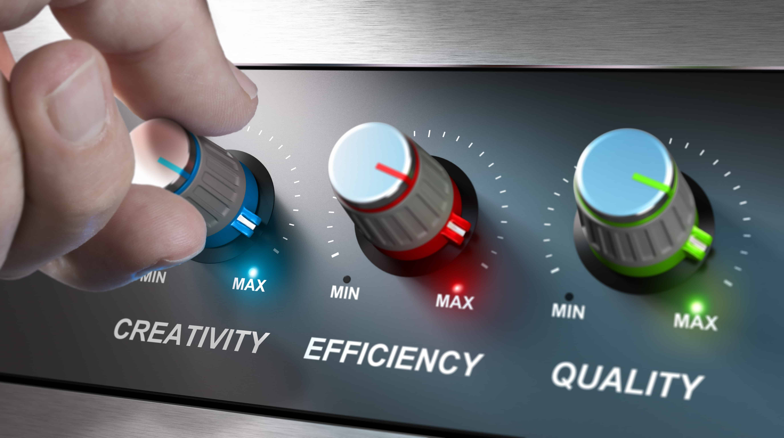
Intelligent Controls
Today, we have to use switches, knobs and remote controls.
In the future, we will be using advanced technology every day.
The future home will use integrated sensors…
Your home will also learn your daily routines and preferences…
All controls will respond to voice commands…
contrast
Examples

Slide 8
Regular Health Check
In addition, your smart home will be monitoring your health for you every day.
Your bed, for example, will record how well you sleep every night.
Smart toilets will be keeping constant track of your health as well.
Topic sentence
Example I
Example II

Slide 9
No More Disasters
Smart homes will be able to prevent serious damage from accidents.
For example, if a water pipe starts leaking, or if there is a short in the electrical wiring…
This way, you will be able to fix the problem…
Topic sentence
Examples
Conclusion

Slide 10
Read for Details
This smart technology is not a fantasy. Many of these new innovations are already available and being used in some homes. In this sense, the home of tomorrow is already the home of today. Nevertheless, it will take some years before most new homes begin to use this new technology.
Disadvantages?

Slide 11
Make a Report
Work in a group of four and talk about the smart phone and its advantages and disadvantages
1. You can use the structure (contrast + examples + conclusion) learnt in class.
2. You can start with this topic sentence “The smart phone is a double-edged sword.”

Slide 12
The smart phone is a double-edged sword. When I was a kid, I used to do a lot of reading in my leisure time. But now my eyes are glued to my phone wherever I go because not only can I chat with friends instantly and make video call on it, I can even make transactions and play games with just a tap of my figures. On the one hand, it sends us unlimited amounts of information. We don't have to wait. Our devices ring, vibrate and light up with the latest news from family, friends and around the world. On the other hand, this immediate access to information may become an addiction. And it may make some people feel lonely, anxious and depressed.
We need to make full advantage of the smart phone and avoid getting addicted to it.
Topic sentence
Contrast
Advantages & Disadvantages
(Examples)
Conclusion

