Slide 1


感恩遇见，相互成就，本课件资料仅供您个人参考、教学使用，严禁自行在网络传播，违者依知识产权法追究法律责任。
更多教学资源请关注
公众号：溯恩高中英语
知识产权声明

Slide 2
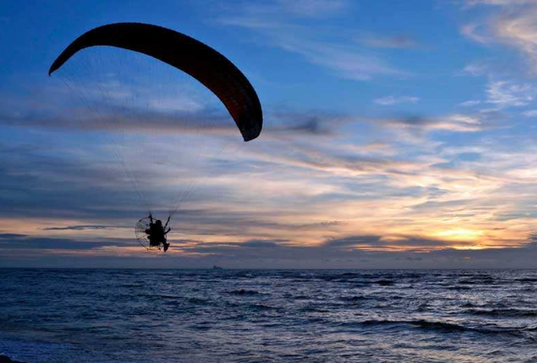
Unit 5 First Aid
Video Time
选择性必修2
Unit 5 First Aid
Video Time
杭州二中许丽君

Slide 3

In this class, you will
get the key facts about Para-Life Rescue and its founder, Ruy Marra;
list the correct order of steps of Para-Life rescue service;
talk about paramotors’ advantages over traditional forms of water rescue along with its disadvantages.
improve listening and talking skills by watching some videos.

Slide 4

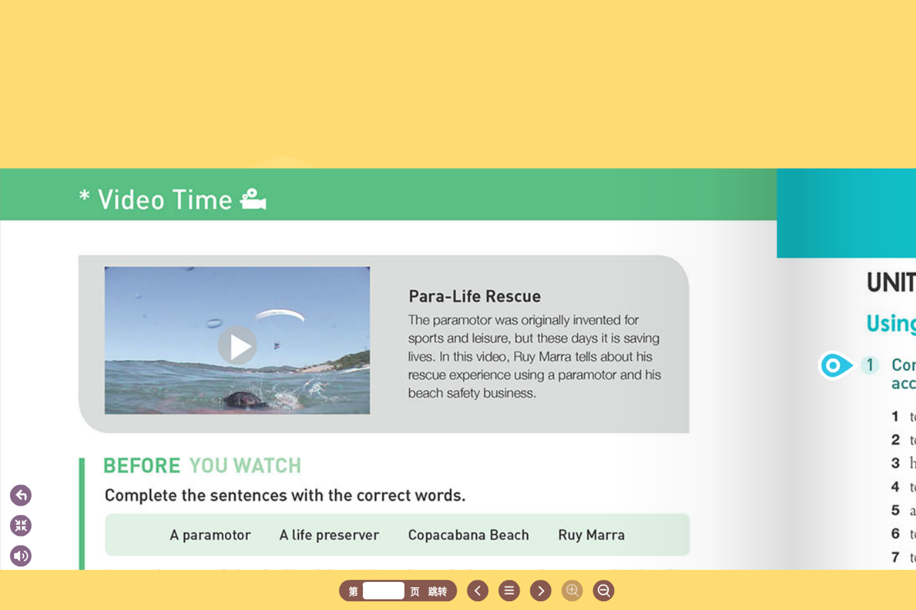
Look at the picture. What can you see in the sky? Do you know what this device is called? What do you think it is used for?
a paramotor
（动力伞）

Slide 5
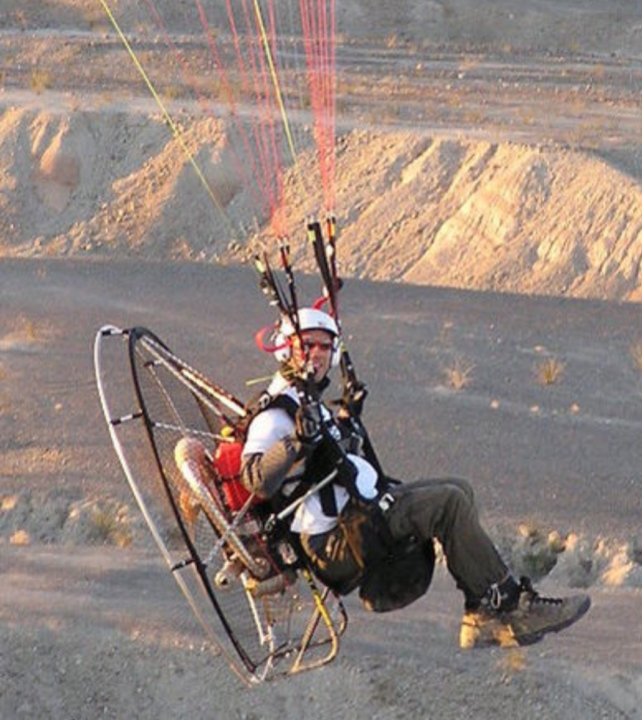
1. What is paramotor?
Paramotor consists of a fame that combines the motor, propeller, harness (with integrated seat) and cage. It provides two attachment points for the risers of a paraglider wing that allows for powered flight.

Slide 6
2. What do you think the device in the sky is used for?
Can you guess how it works?
3. What do you think the video is about?
Para-Life Rescue
The paramotor was originally invented for sports and leisure, but these days it is saving lives. In this video, Ruy Marra tells about his rescue experience using a paramotor and his beach safety business.

Slide 7
Before you watch
Complete the sentences with the correct words.
A paramotor, A life preserver, Copacabana Beach, Ruy Marra
1 ____ is a type of aircraft with a lightweight engine and a large
propeller(螺旋桨) strapped to the pilot.
2 ____ is in Brazil.
3 ____ is a man who started the Para-Life rescue service business in 1995.
4 ____ is something that can be worn in the water to prevent you from sinking.

Slide 8
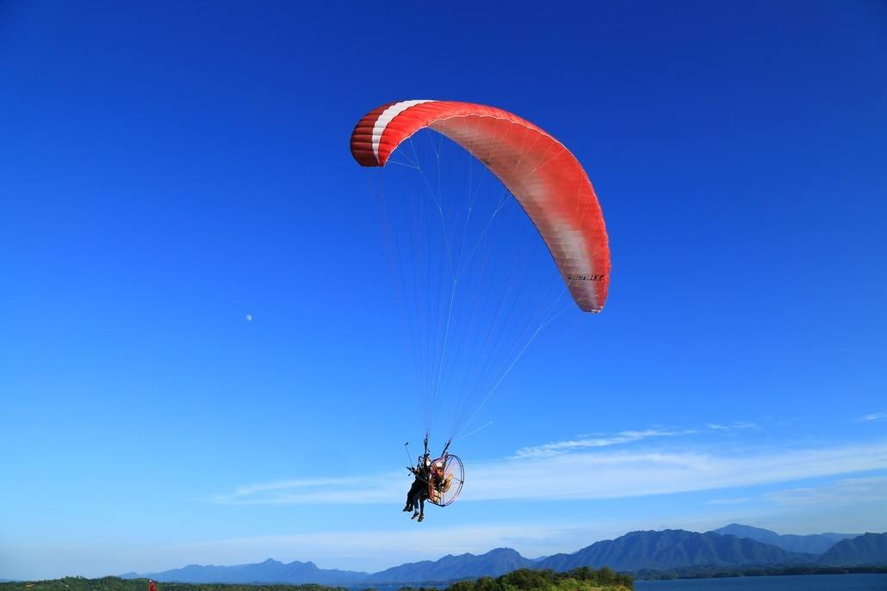
Before you watch
A paramotor, A life preserver, Copacabana Beach, Ruy Marra
1 ____________ is a type of aircraft with a lightweight engine and a large propeller(螺旋桨) strapped to the pilot.
A paramotor

Slide 9
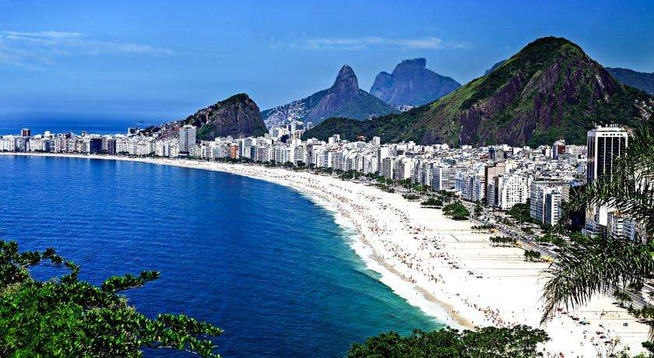
Before you watch
A paramotor, A life preserver, Copacabana Beach, Ruy Marra
2 _________________ is in Brazil.
Copacabana Beach

Slide 10
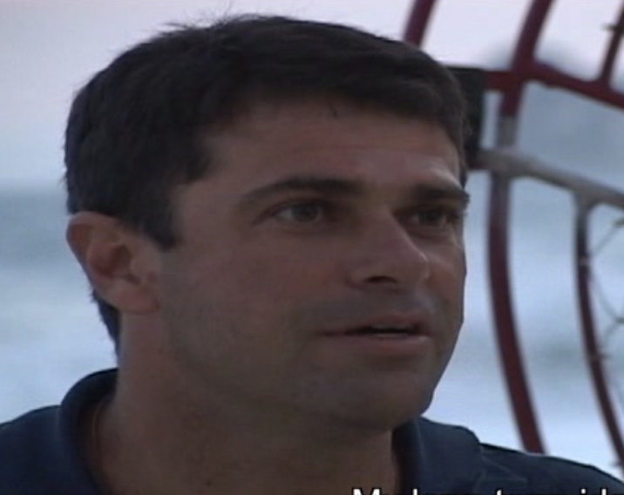
Before you watch
A paramotor, A life preserver, Copacabana Beach, Ruy Marra
3 ___________ is a man who started the Para-Life rescue service business in 1995.
Ruy Marra

Slide 11
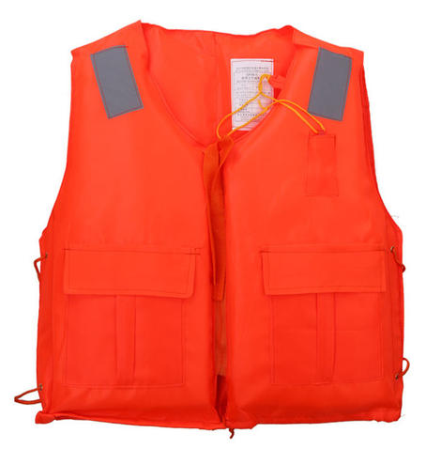
Before you watch
A paramotor, A life preserver, Copacabana Beach, Ruy Marra
A life preserver
4 ______________ is something that can be worn in the water to prevent you from sinking.

Slide 12
While you watch
1 Decide if the following statements are true (T) or false (F).
1. ( ) Marra has a staff of twenty people working for him.
2. ( ) Marra’s company has saved the lives of more than eighty people.
3. ( ) Marra did not need government approval to set up his company.
4. ( ) Marra communicates with the paramotor pilots through two-way
radios.
5. ( ) A rip current(离岸流，裂流) is a dangerous flow of water that
moves away from the beach.

Slide 13
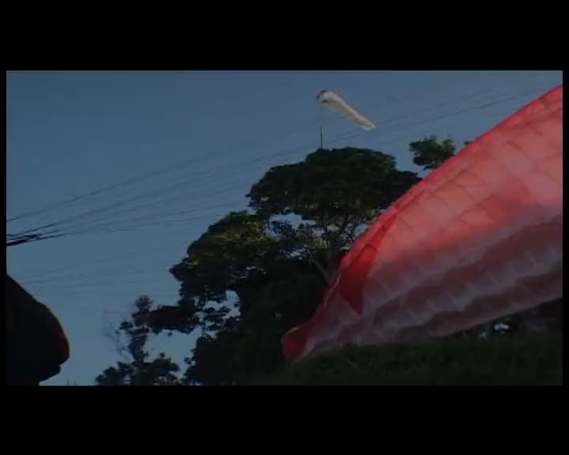
While you watch

Slide 14
While you watch
1 Decide if the following statements are true (T) or false (F).
1. ( ) Marra has a staff of twenty people working for him.
T
T
( ) Marra’s company has saved the lives of more than eighty people.
( ) Marra did not need government approval to set up his company.
F
( ) Marra communicates with the paramotor pilots through two-way radios.
F
( ) A rip current(离岸流，裂流) is a dangerous flow of water that moves away from the beach.
T

Slide 15
While you watch
2 Number the following steps in the correct order.
___ The pilot calls the lifeguard.
___ The pilot manoeuvres close enough to drop the life preserver to the swimmer.
___ The pilot sees a victim.
___ Para-Life pilots strap themselves into the paramotor.
___ The pilot then continues to fly above the victim until the lifeguards arrive.
___ The pilot flies against the wind to reduce flight speed.

Slide 16
While you watch

Slide 17
While you watch
2 Number the following steps in the correct order.
___ The pilot calls the lifeguard.
___ The pilot manoeuvres close enough to drop the life preserver to the swimmer.
___ The pilot sees a victim.
___ Para-Life pilots strap themselves into the paramotor.
___ The pilot then continues to fly above the victim until the lifeguards arrive.
___ The pilot flies against the wind to reduce flight speed.
3
5
2
1
6
4

Slide 18
After you watch
Think about the following questions.
What are some advantages of paramotors over traditional forms of water rescue?
As a business, how might the Para-Life rescue service make money? Is it right to charge victims for rescue? If so, how much should they be charged? What if they cannot pay?
What other interesting or new kinds of rescue are there? How do they work?

Slide 19
After you watch
What are some advantages of paramotors over traditional forms of water rescue?
The main advantage is the ability to spot the person who is in trouble and get there quickly. The main disadvantage is that the paramotor cannot land and pick the person up.

Slide 20
After you watch
As a business, how might the Para-Life rescue service make money? Is it right to charge victims for rescue? If so, how much should they be charged? What if they cannot pay?
It could make money through a contract with the government. While it does not seem right to charge the victims money, in fact ambulance services, docotrs, nurses, and hospitals charge victims money all the time. If people are charged money, it should be based on the time and expense required to rescue them, but that amount is hard to determine. As the victim would be billed after the rescue, if the victim cannot pay it will be just like any other bill the victim might have.

Slide 21
After you watch
What other interesting or new kinds of rescue are there? How do they work?
One kind of rescue involves dogs that can sniff out people trapped in buildings after an earthquake. The dog just wanders over the ruined building sniffing the ground. If it smells a person, it makes a sign or begins to bark. Rescuers then know where to dig. As a person can survive for as long as three days without water, so long as the person can breathe and is not too badly injured there is still a good chance of rescue in this situation.

Slide 22

1. Surf the Internet for more information about Para-Life Rescue.
2. Do a survey about a new kind of rescue, and figure out the correct order of the steps in the rescue service.

Slide 23

Thank you for listening

