Slide 1

感恩遇见，相互成就，本课件资料仅供您个人参考、教学使用，严禁自行在网络传播，违者依知识产权法追究法律责任。
更多教学资源请关注
公众号：溯恩高中英语
知识产权声明

Slide 2
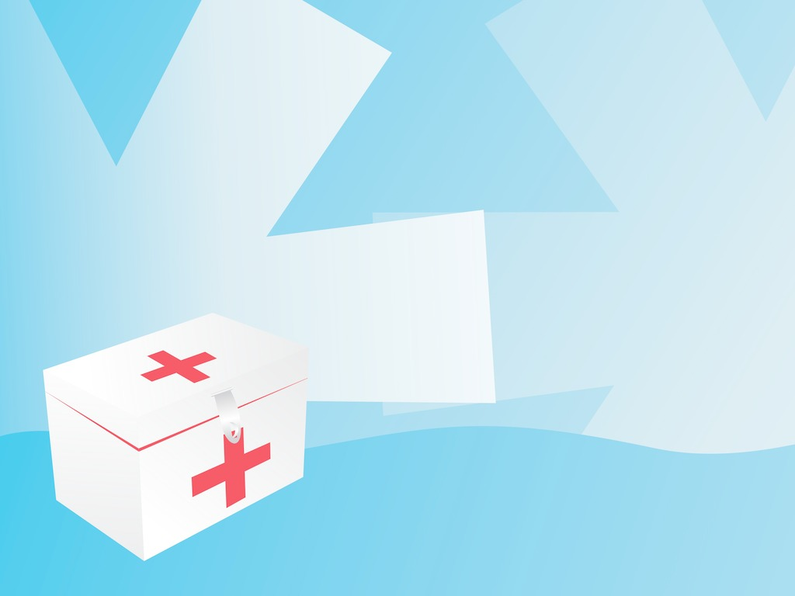
选择性必修2
Unit 5 First Aid
Assessing your progress
杭州二中许丽君

Slide 3


To check your study of grammar and vocabulary in this unit by doing some exercises.
Learn and teach others about first aid
Research how to perform first aid for the medical emergency.
Make an instruction leaflet for giving first aid for the emergency.

Slide 4


Testing Yourself
Circle the correct word in each sentence.
1. The cloth/fabric of this bag is soft and light. What is it made of?
2. The Red Cross is looking for volunteers who are concerned about the welfare/happiness of their fellow men.
3. When Lisa noticed the fire, she rushed to grab/grasp the fire extinguisher outside the door of the flat.

Slide 5
Testing Yourself
Circle the correct word in each sentence.
4. These trousers are too loose/lose --- I'm having trouble keeping them up.
5. After the theft, the police were called to investigate the accident/incident.
6. I heard desperate/serious cries for help when I walked past that old building. I reacted quickly by rushing into the building.

Slide 6
Testing Yourself
Circle the correct word in each sentence.
7. John's alarm didn't go off, so he slept in and was awoken by the radiations/rays of sunlight coming in through his window.
8. We should always do what we can to take care of the elderly/old and any others who might be in need.

Slide 7

Complete the passage with the correct forms of the verbs in the box. Why did the accident occur? How should we try to avoid accidents in life?
Testing Yourself
get return ride sit slow throw try turn walk want
__________ for long hours every day in an office for several years, Nancy Jones felt that she was getting out of shape and decided that she needed to get some exercise.
Having sat

Slide 8
Testing Yourself
get return ride sit slow throw try turn walk want
So, instead of going to and from work every day by bus, she started riding a bike because _______ was an enjoyable activity for her. One night she had to work till late and it was foggy outside when she left the office. Her bike did not have a light, so _________ home by bike would be dangerous. ______ _______ (not) to risk having her bike stolen,
riding
returning
Not
wanting

Slide 9
Testing Yourself
get return ride sit slow throw try turn walk want
however, she decided to ride it home anyway. The first few kilometres had plenty of street lights, but _______ onto a side road in the suburbs she found herself in the dark. _________ down, she tried to see in front of her, but it was impossible. Then without warning, her bike hit a rock, _________ her to the ground. _______ to get up, she discovered that her ankle was
turning
Slowing
throwing
Trying

Slide 10
Testing Yourself
get return ride sit slow throw try turn walk want
broken. Unable to stand or walk, she found herself in alarming pain. Fortunately, she was able to call an ambulance with her mobile phone, and they took her to a hospital. However, it was several months before her ankle recovered and she found ________ easy again. ________ a gym membership near her office, Nancy decided that there were other ways of keeping fit.
walking
Getting

Slide 11
Testing Yourself
Why did the accident occur?
Nancy fell off her bike because she was riding on a dark road on a foggy night and her bike did not have a light. Nancy risked riding home because she did not want her bike to get stolen.
How should we try to avoid accidents in life?
We should try to avoid accidents by loving ourselves more than our possessions, and paying better attention to the risks and dangers around us.

Slide 12
Reflecting
1. What did you learn about first aid that you didn't know before?
2. What do you think we should be like if we want to work as a first-aid doctor or volunteer?
3. What could we do to warn people of various dangers and to prepare them for different emergencies?

Slide 13

Reflecting
4. Has the unit encouraged you in any way to want to look after the welfare of others?
5. Overall, I thought this unit was
◻ interesting ◻ useful
◻ so-so ◻ difficult.

Slide 14
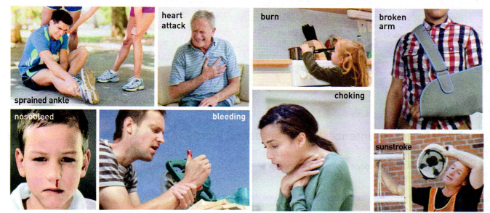
Project
Project 1：Learn and teach others about first aids
1. In groups, choose one of the medical emergencies in the photos below.

Slide 15
Project
2. Research how to perform first aid for that medical emergency.
3. Make an instruction leaflet for giving first aid for that emergency. Include illustrations for any points that are not clear.
4. Combine all the leaflets to make a first-aid manual for your class.

Slide 16
Project
Providing an example
Nosebleed
Bleeding from the blood vessels in the nose.
Common causes
Nosebleed is not always related to an underlying condition. It may be caused by:
Trauma
Blowing your nose very hard
Dry air
Nose picking

Slide 17
Project
an example-Nosebleed
Treatment
Self-treatment: Self -care steps that may be helpful in some less- serious cases:
Keep the head higher than the level of the heart
Stay upright, do not lie down
Hold the nose for at least five minutes. Repeat if necessary
Apply ice to the nose
Pinch all the soft parts of the nose together between the thumb and index finger
Blow nose as little as possible and only very gently
Keep the house humidified
Follow the instructions that come with nasal decongestants（n.减充血剂） – overusing can cause nosebleeds

Slide 18
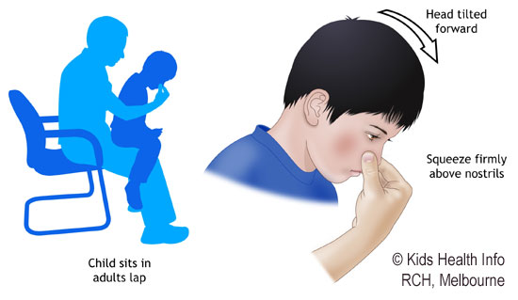
Project
an example-Nosebleed
See a doctor if you notice:
If child below two years has a nosebleed
Nosebleeds come and go regularly

Slide 19
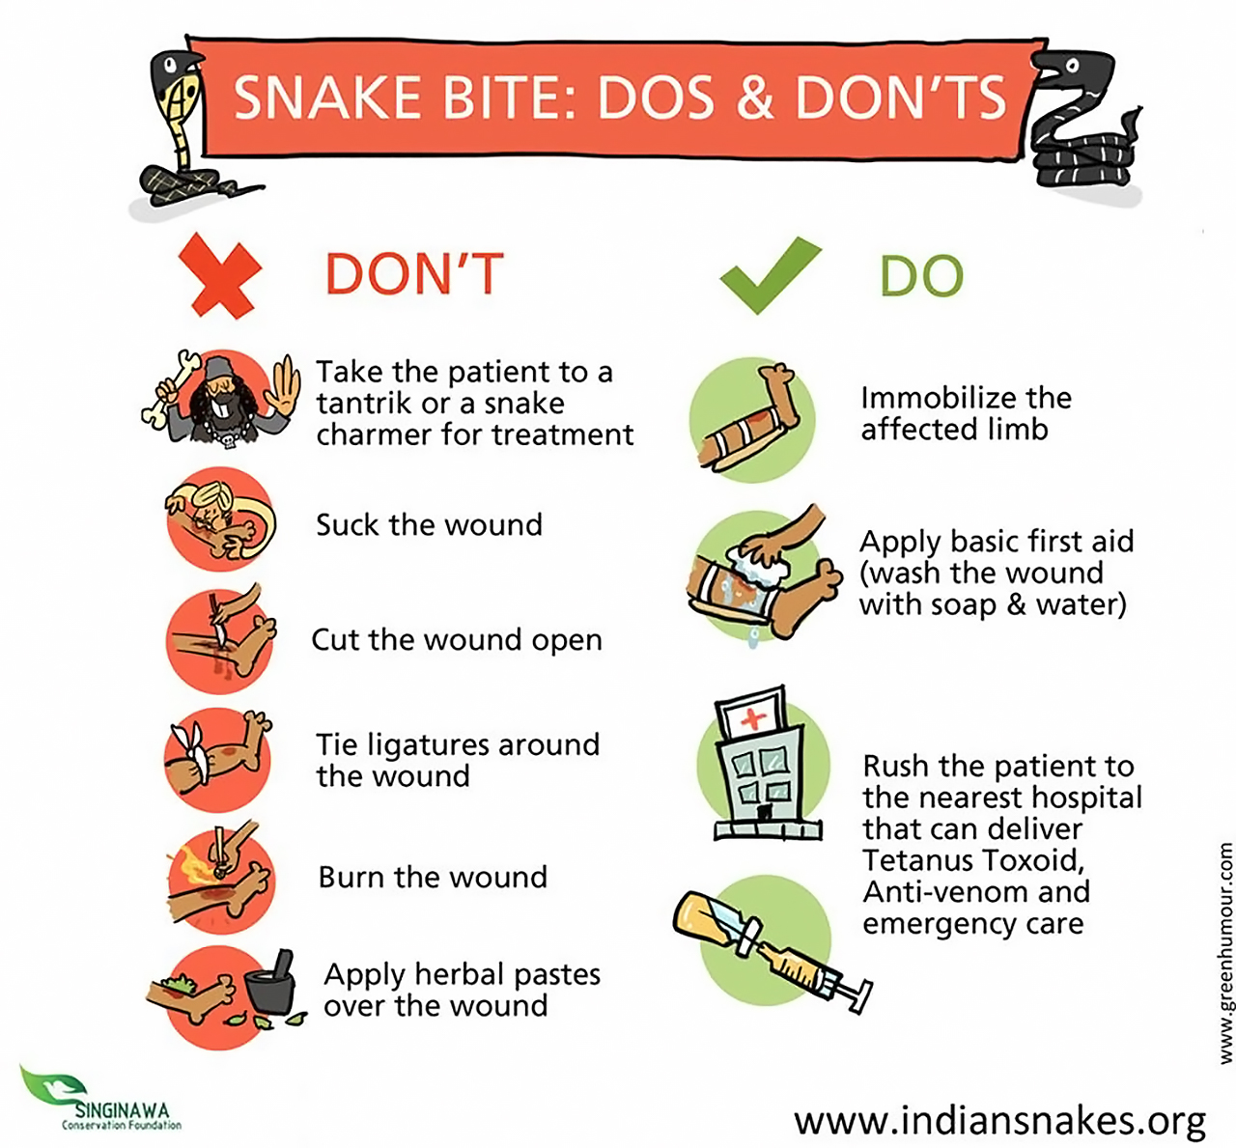
Project
Make an instruction leaflet-Snake Bite

Slide 20

Project
Make an instruction leaflet-Common Allergies

Slide 21
Assignment
Choose one of the medical emergencies in the photos above to make an instruction leaflet.
Combine all the leaflet to make a first-aid manual for our class.

Slide 22


