Slide 1

感恩遇见，相互成就，本课件资料仅供您个人参考、教学使用，严禁自行在网络传播，违者依知识产权法追究法律责任。
更多教学资源请关注
公众号：溯恩高中英语
知识产权声明

Slide 2

Reading and writing (Workbook)
The Strange Tale of
the Milu Deer
浙江省台州中学 叶婷婷

Slide 3
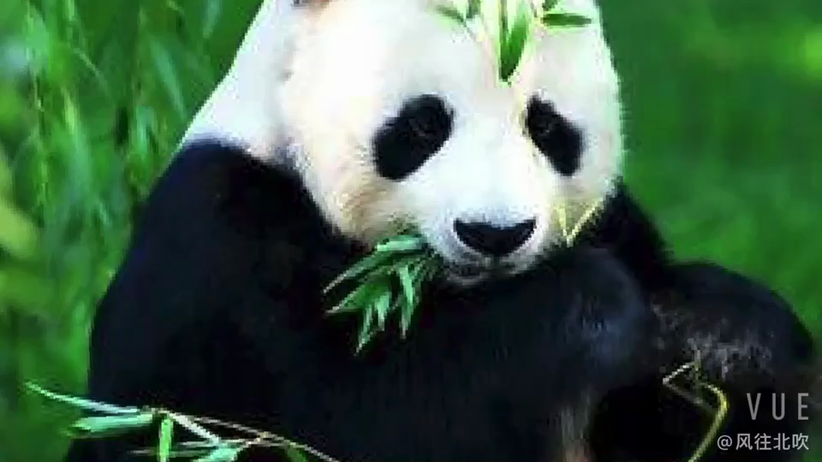

Slide 4
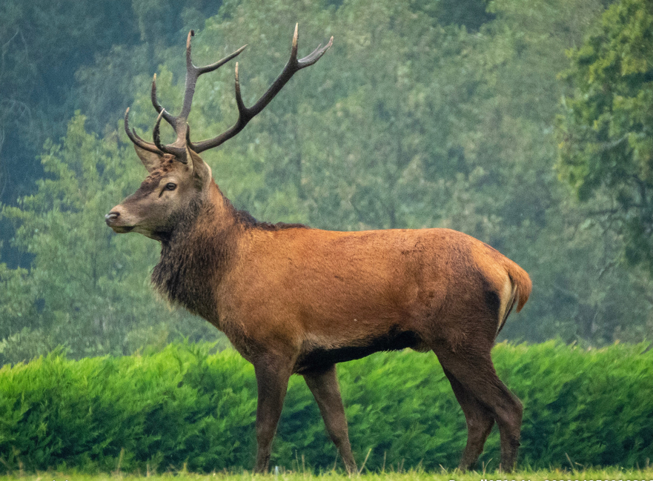
The milu deer

Slide 5
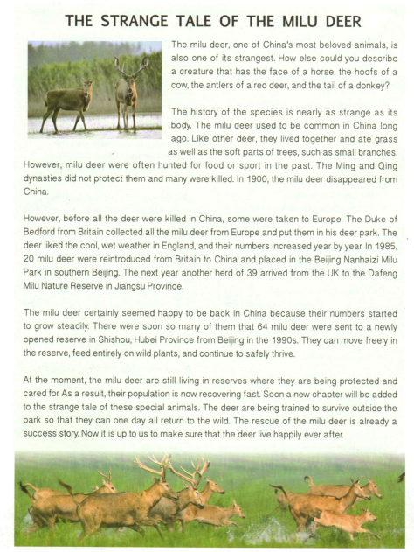
Read for gist
strange body (appearance)
strange history
(in order of time)

Slide 6
Read for information & language
population is recovering
numbers grow steadily
are being trained...
Progress
Soon
are being protected & cared for
sent to a newly-opened reserve
At the moment
Efforts
put in...Milu Nature Reserve
In the 1990s
reintroduced & put in the...Milu Park
The next year
hunted/killed...
disappeared
In 1985
not protected
Situation
Reasons
In 1900
In the Ming and Qing Dynasty

Slide 7

Further thinking
What can be learned about wildlife protection from the success story of the milu deer ?
* People should raise the awareness of protecting the wildlife.
* The government should take effective measures, such as setting up reserves and stopping/forbidding illegal hunting.
* Volunteers are needed to protect and care for the wildlife.
* Different countries can work together to protect the wildlife .
* ...

Slide 8
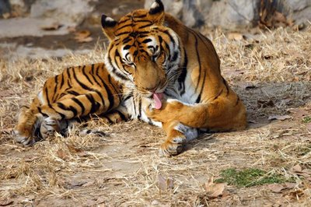
Writing
South China Tigers are in great danger of extinction. There are few, if any, in the wild. The last confirmed sighting was over twenty years ago. There are currently about 100 living tigers---most are in Chinese zoos and breeding centers.
They need help!

Slide 9

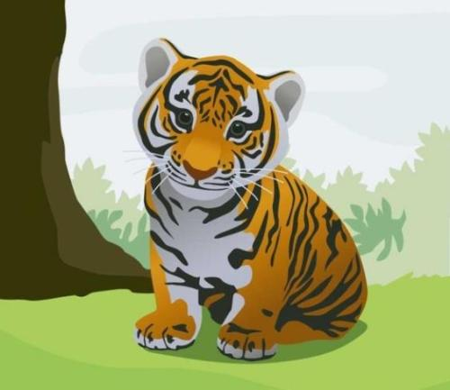
Letter-writing
Write a letter asking the WWF for help.

Slide 10
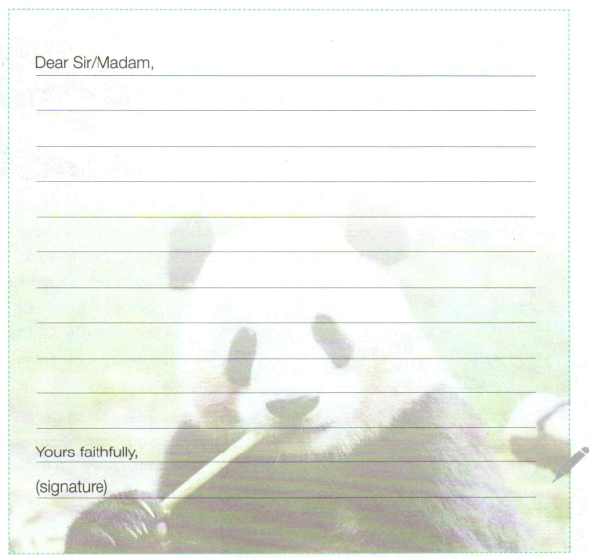
Letter-writing---outline
greeting
Dear Sir/Madam,
* writing purpose (ask for help)
beginning
* serious situation
body
* reasons for extinction
* efforts to rescue them
ending
* expectations for help
Yours faithfully,

Slide 11
Letter-writing---beginning
* writing purpose (ask for help)
Dear Sir/Madam,
I'm writing to ask/seek for your help
I'm Li Hua, a student from China.
to rescue South China Tigers.

Slide 12
Letter-writing---body
South China Tigers
Situation:___________________________________________
disappear; in danger of dying out/disappearing/extinction;
population drop at an alarming rate ; face serious threats from humans; endangered species;
Reasons:___________________________________________
not protected; illegally hunted/killed for their valuable fur/skin/bones; the living spaces become smaller; their habitats threatened; habitat loss;

Slide 13
Letter-writing---body
South China Tigers
Situation+ Reasons:__________________________
South China Tigers are in danger of extinction due to illegal hunting and habitat loss.

Slide 14
Letter-writing---body
South China Tigers
Efforts:___________________________________________
*raise the awareness; turn to the social media for help; put out information; post pictures to stir up emotions;...
* take effective measures; start national protection programmes; stops/forbids/prohibits people hunting and buying...; gather volunteers to watch over...; ...

Slide 15
Letter-writing---body
South China Tigers
Efforts:___________________________________________
* We can/should...
* It would be beneficial/better if we could…
* It would help/contribute a lot if we could ... * I would like to suggest/recommend that… * It would be a good idea if we could...
*...

Slide 16
Letter-writing---body
South China Tigers
Efforts:___________________________________________
* We can/should...
* It would be beneficial/better if we could… * I would like to suggest/recommend that… * It would be a good idea if we could...
*...
*raise the awareness; turn to the social media for help; put out information; post pictures to stir up emotions;...
* take effective measures; start national protection programmes; stops/forbids/prohibits people hunting and buying...; gather volunteers to watch over...; ...

Slide 17
Letter-writing---body
South China Tigers
Efforts:___________________________________________
We should raise people's awareness by turning to the social media for help. We can put out enough informaiton on the website to stir up people's interest in saving the tigers. Also, it would contribute a lot if we could post some pictures to remind people of their serious situations.

Slide 18
Letter-writing---ending
* expectations for help
I sincerely hope you will take my proposals into consideration and help to protect these animals for their benefit and for the benefit of us all.

Slide 19

Letter-writing
Dear Sir/ Madam, I'm Li Hua, a student from China. I'm writing to ask you for help in saving South China Tigers.
I sincerely hope you will take my proposals into consideration and help to protect these animals for their benefit and for the benefit of us all. Yours faithfully,

Slide 20
Assignment
1.Review the topic-related language we've learned.
2.Complete and polish the letter.

Slide 21


Slide 22
Sample writing
Dear Sir/ Madam, I'm Li Hua, a student from China. I'm writing to ask you for help in saving South China Tigers.
Their population is dropping at an alarming rate as their living spaces are becoming smaller and smaller due to the cutting of trees. Also, they are being hunted illegally for their valuable fur, skin and bones.
Personally, some efforts can be made to help rescue the endangered tigers. Above all, We should raise people's awareness by turning to the social media for help. We can put out enough informaiton on the website to stir up people's interest in saving the tigers. We can also post some pictures to remind people of their serious situations. What's more, governments of different countries must play a part. It would be a good idea if they could help pass laws to stop people hunting and buying tiger products. Only when buying stops will the hunting be stopped completely. More importantly, they can start national protection programmes, where nature reserves are set up to place the endangered species and voluntees are gathered to watch over them. If possible, the govenment can also train the tigers outside the reserve so that they can one day all return to the wild.
I sincerely hope you will take my proposals into consideration and help to protect these animals for their benefit and for the benefit of us all.
Yours faithfully,

