Slide 1

感恩遇见，相互成就，本课件资料仅供您个人参考、教学使用，严禁自行在网络传播，违者依知识产权法追究法律责任。
更多教学资源请关注
公众号：溯恩高中英语
知识产权声明

Slide 2
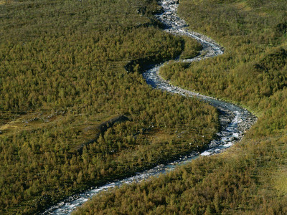
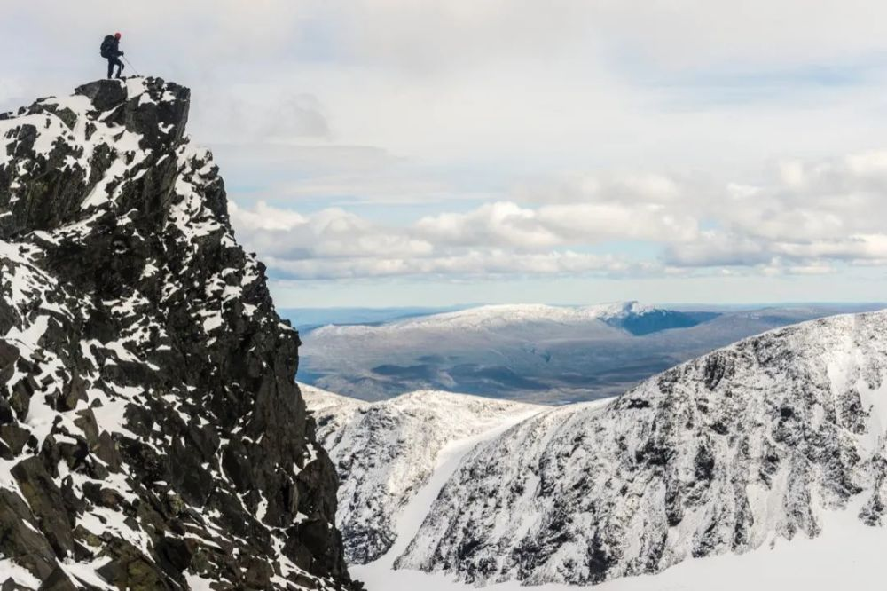
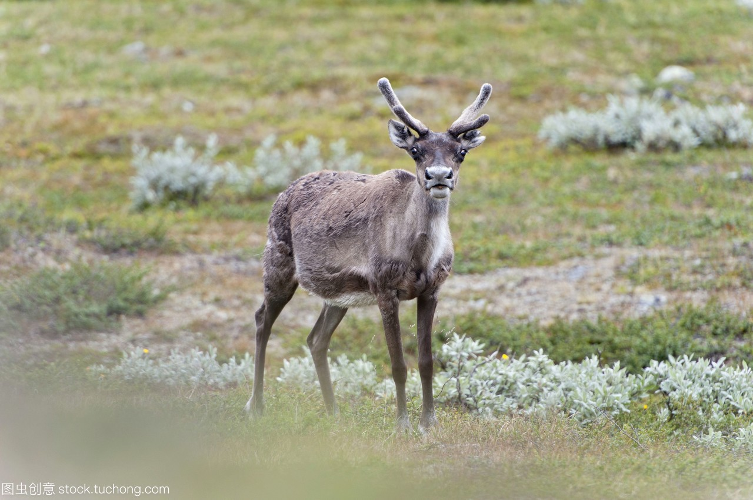

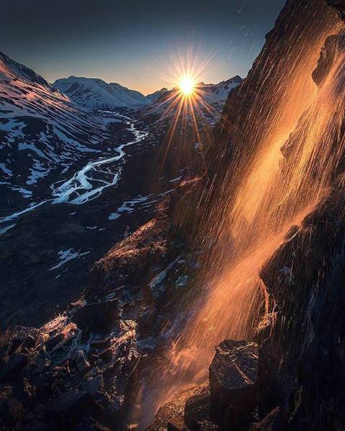
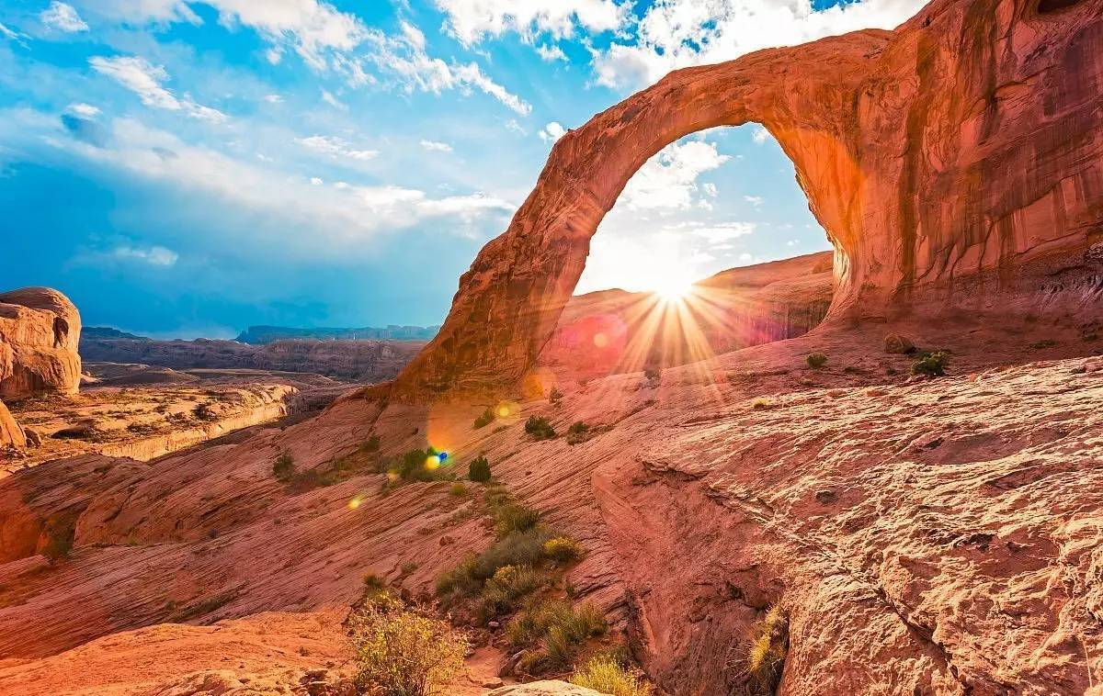
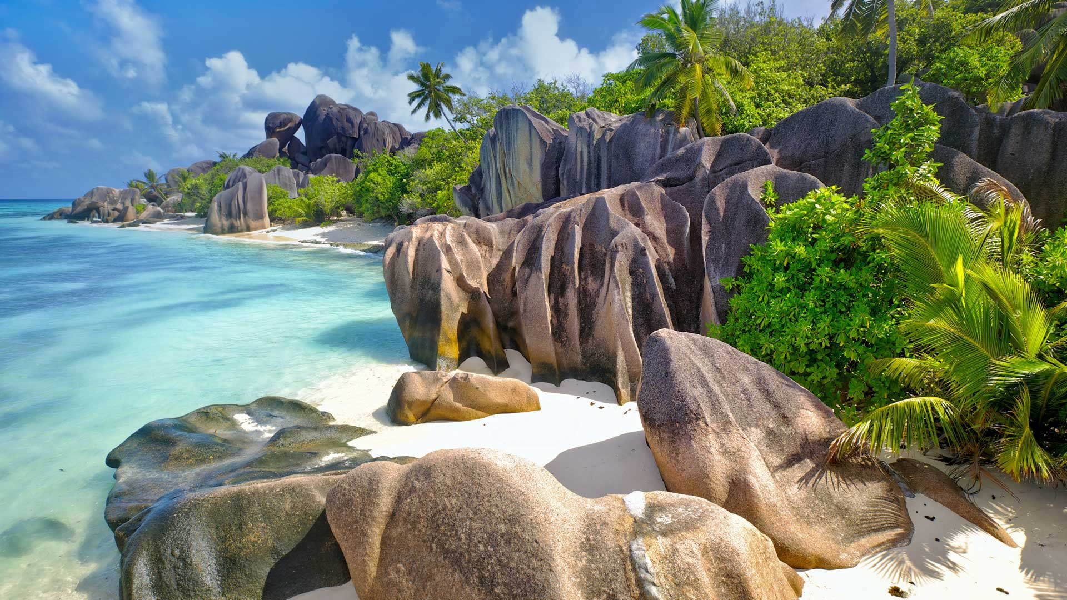
Sarek National ParkSarek National Park--Europe’s Hidden Natural Treasure

Slide 3
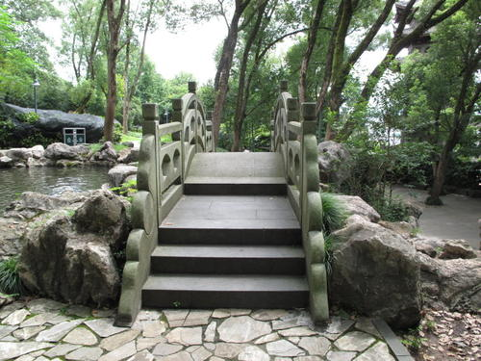
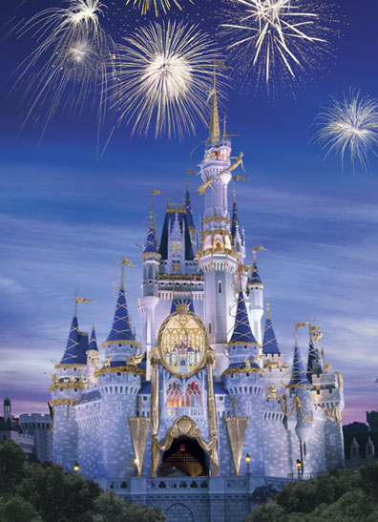
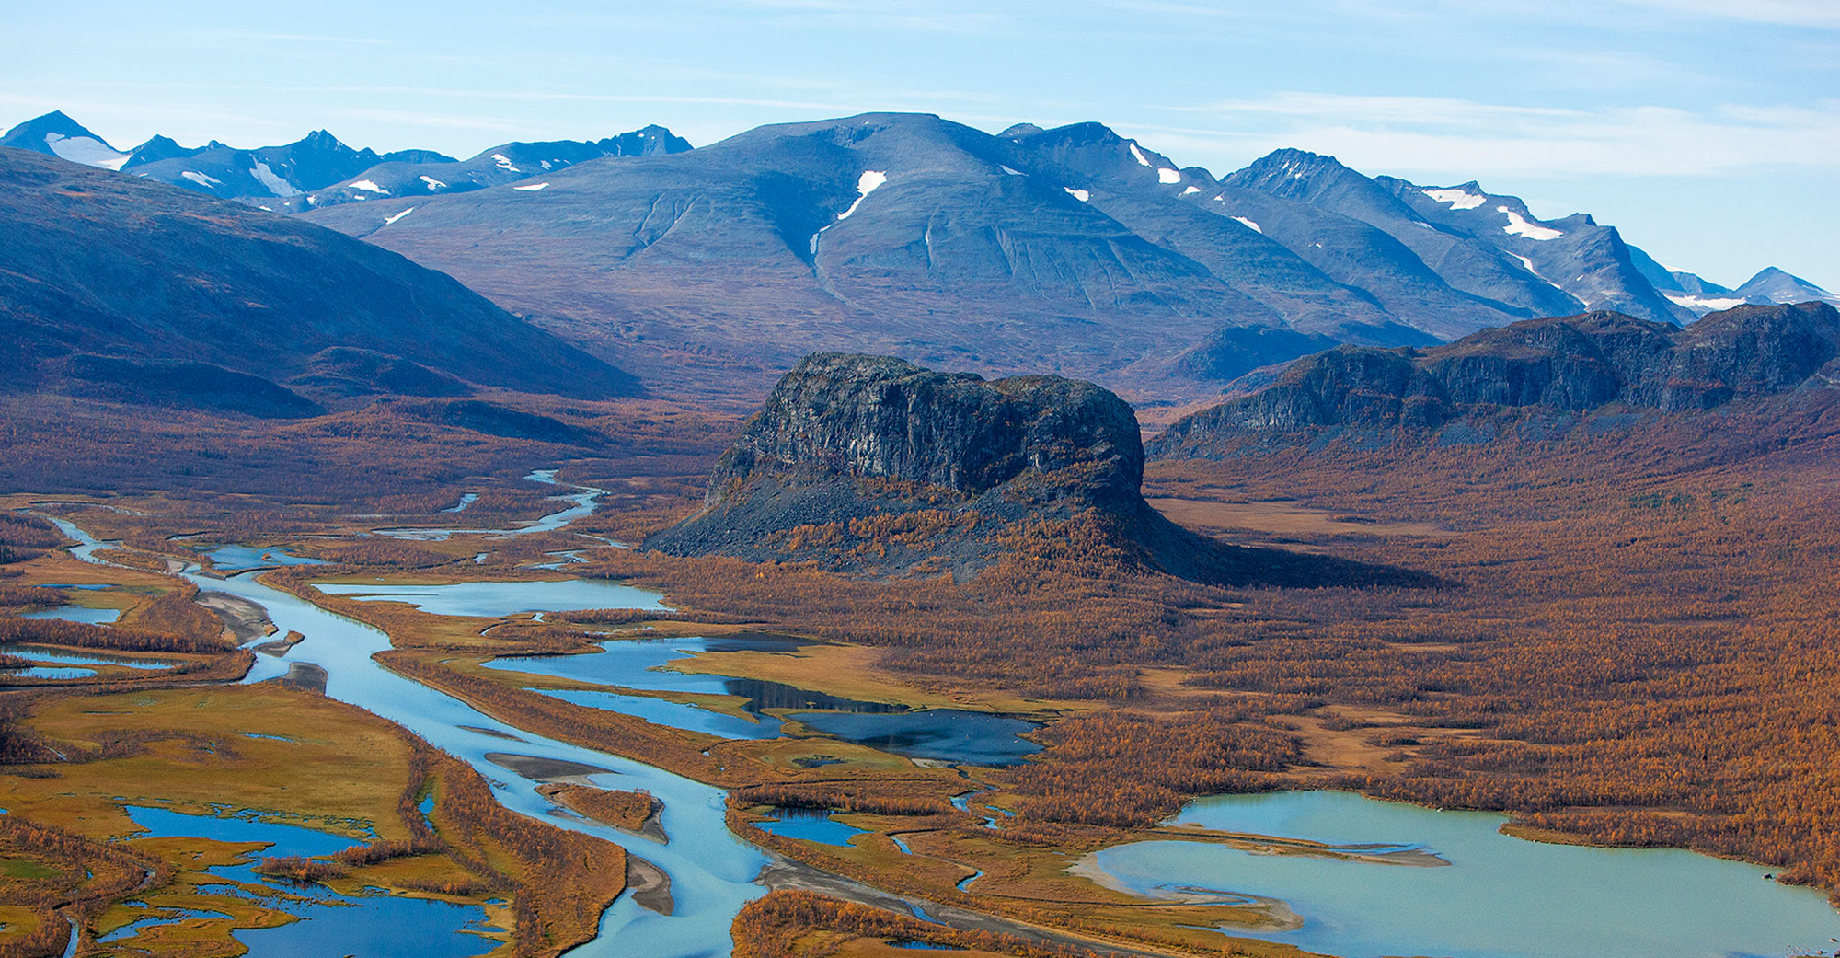
a traditional park
for
_____________
a theme park
for
______________
a national park
for
______________
entertainment
?
relaxation

Slide 4
Prediction
Sarek National Park
--- Europe’s Hidden Natural Tresure
Sarek National Park
Why is it a hidden natural treasure?

Slide 5
Reading
Paragraph 1 A Land of Mountains and Ice
Paragraph 2 Man at Peace with Nature
Paragraph 3 A Land of Adventure
Paragraph 4 A Summer Where the Sun Never Sleeps

Slide 6
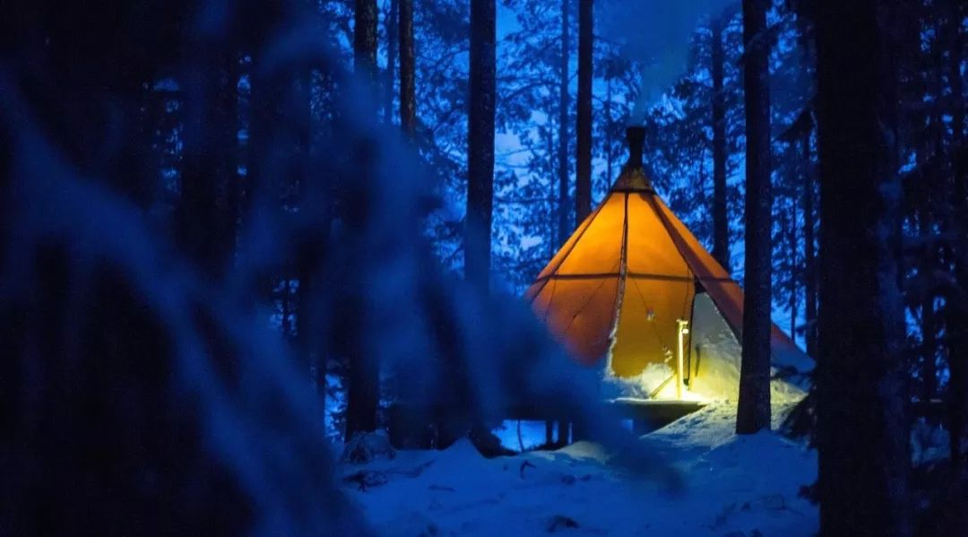
Para. 1 A Summer Where the Sun Never Sleeps
I wake up to the sound of the wind buffeting the cloth of my tent. Even though the sun is brightly shining, telling whether it is morning or night is impossible. I’m above the Arctic Circle, where in summer the sun never sets. Checking my watch, I see that it is 7: 30 a.m. I leave my tent and walk over to the mountain edge. Spreading out before me, branches of the Rapa River flow through the valley below. I’m in the remote far north of Sweden in Sarek National Park, a place with no roads or towns.
where in summer the sun never sets
Appreciate the natural and breathtaking scenery
Location: _______________________________________
In the remote far north of Sweden in Sarek National park
Weather:______________________________
The wind buffeting, the sun shining brightly
Sights:___________________________
Mountain edge, Rapa River, the valley

Slide 7
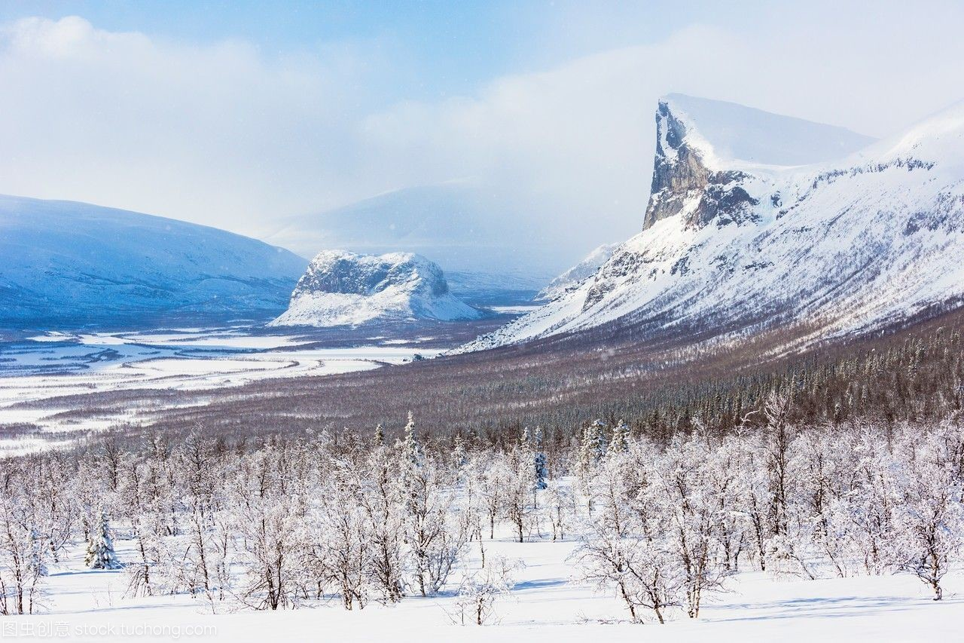
Para. 2 A Land of Mountain and Ice
In the order of time
mountains
used to
vast sheets of ice
Around 9, 000 years
Sarke’s mountains used to be covered by vast sheets of ice. Around 9, 000 years ago, this ice melted, leaving behind about 100 glaciers. Soon after, reindeer began to arrive. Following the reindeer were the Sami people, who made this territory their home. Getting here is quite difficult, so apart from the Sami very few people have ever seen Sarek. In 1909, Sarek was made a national park in order to keep the land in its natural state. Though the Sami are allowed to continue their traditional way of life in the park, no one else can live here, and all new development is banned within park boundaries. At the far side of the valley, an ancient Sami cottage is visible. Close by, there are a few reindeer feeding on grass.
Soon after
Following
In 1909
Provide historical and scientific value
be covered by
ice melted
reindeer arrived
followed by Sami people
was made a national park

Slide 8
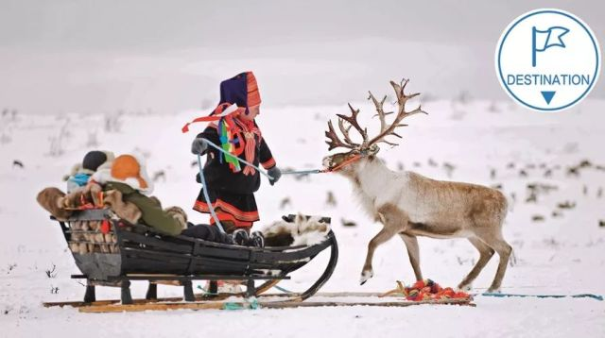
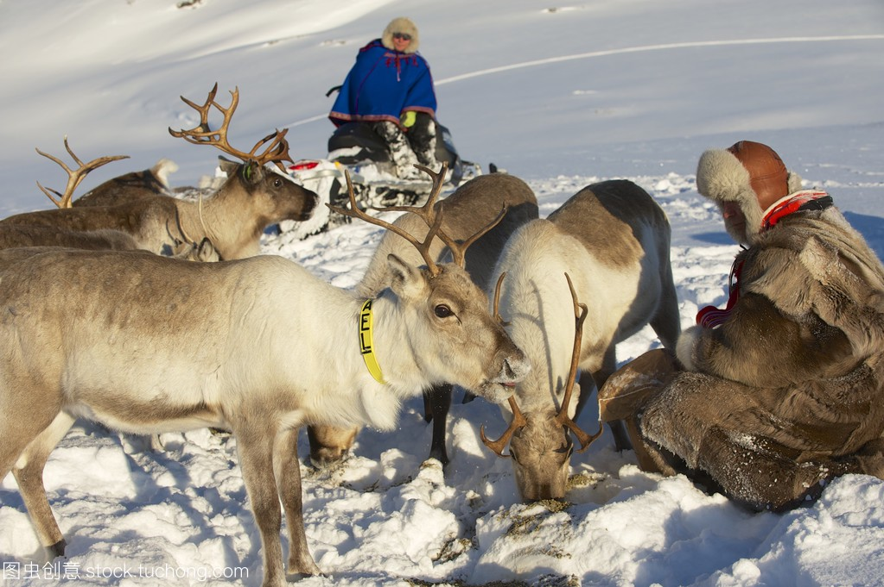
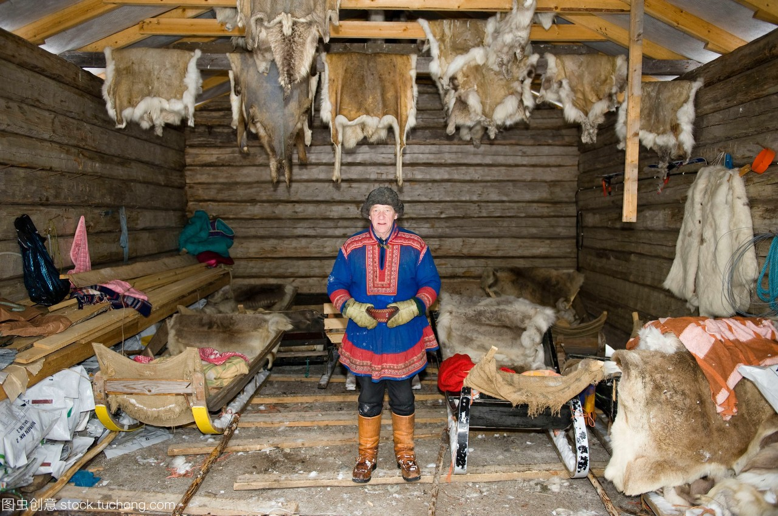
Para. 3 Man at Peace with Nature
looking after reindeer was a way of life for the Sami.
For hundreds of years, looking after reindeer was a way of life for the Sami. They used the reindeer’s meat for food, their bones for tools, and their skin for making clothes and tents. Since reindeer were always on the move, the Sami would pick up their tents and accompany them. Today, most Sami have houses in villages near Sarek and live a modern life just like their neighbours. But every spring, a small number of Sami still follow their reindeer into the valleys of Sarek, living in tents or old cottages and enjoying their traditions. I am not a Sami, but in Sarek I’ve adopted some of their habits. For example, this morning my breakfast is flat bread warmed over a fire, dried reindeer meat, and some sweet and sour berries that I found growing near my tent.
Since reindeer were always on the move, the Sami would pick
up their tents and accompany them
build up an ideal home for both sami and reindeer

Slide 9

for hundreds of years
today
looking after reindeer
adjustments
live a modern life
used the reindeer’s meat for food,
their bones for tools,
and their skin for making clothes and tents.
still follow their reindeer into the valleys
pick up their tents and accompany them
living in tents or old cottages and enjoying their traditions
pass down
a platform for Sami to maintain superior traditions as well as enjoy modern convenience
Even visitors can adopt some of their habit

Slide 10
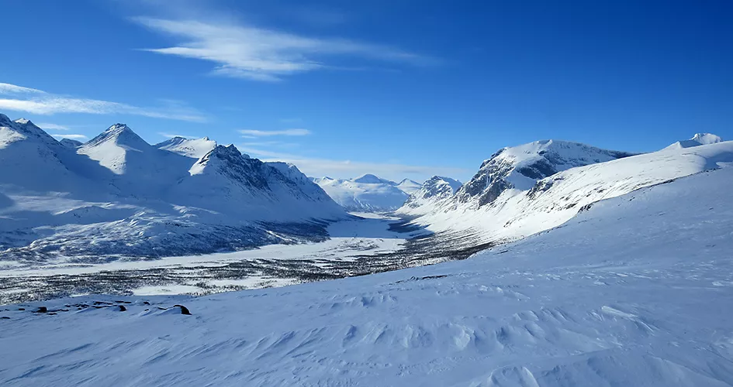
Para. 4 A Land of Adventure
set out again
After breakfast, I pack my bag and set out again. Since I must carry all of my food and supplies with me, my bag weighs about 30 kilograms. If today is anything like yesterday, it will be full of sweat and hard work as I hike over this difficult land to my destination on the other side of the valley. However, I cannot complain. Being in such a beautiful and wild place makes me feel blessed to be alive. Here I am, alone under this broad sky, breathing the fresh air, and enjoying this great adventure. What could be better?
hike over this difficult land
adventure
Offer an opportunity to explore nature as well as purify our hearts

Slide 11
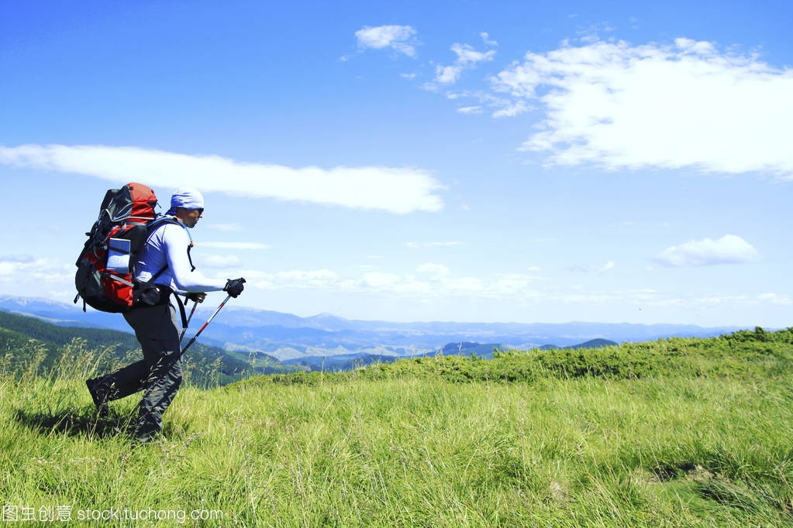
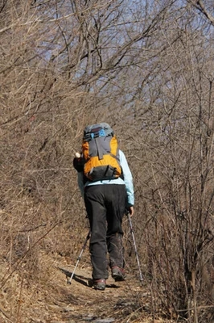
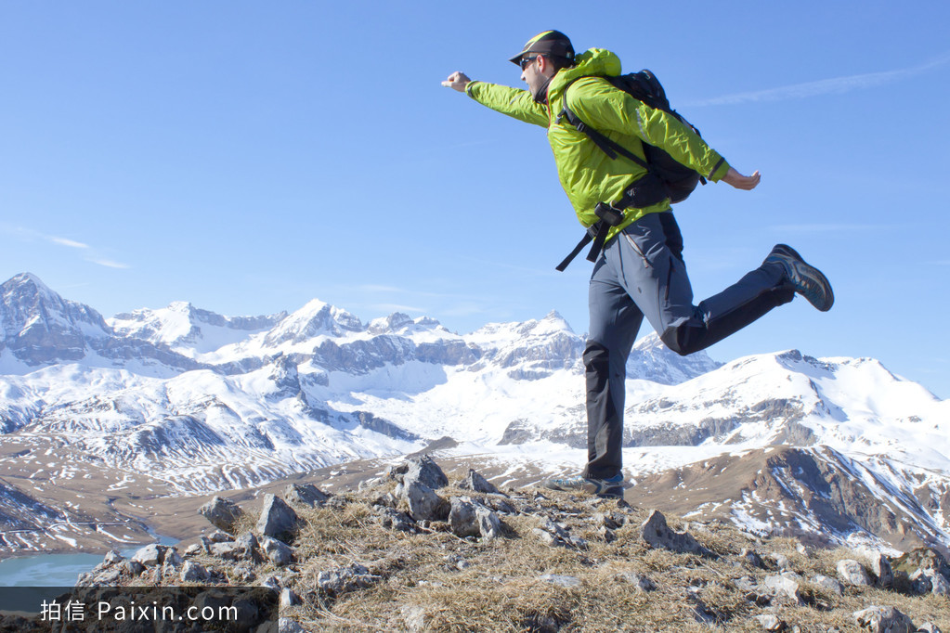
I can’t complain
My bag weighs about 30 kilograms.
It will be full of sweat and hard work
I feel blessed to be alive.
I hike over this difficult land to my destination on the other side of the valley.
Great adventure
such a beautiful and wild place
a feast for my eyes as well as mind
alone under this broad sky
breathing the fresh air
A fascinating park
enjoying this great adventure

Slide 12
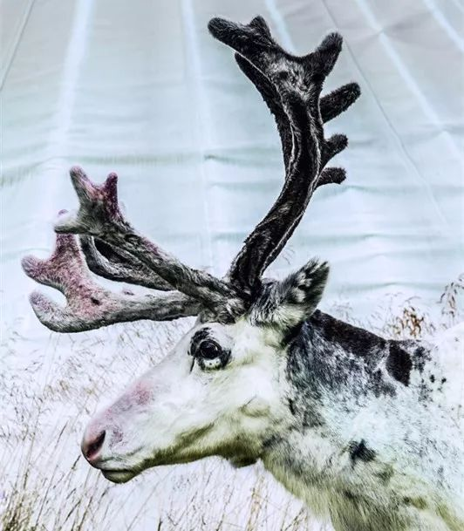
Discussion
1. Can you find hidden treasure in the Sarek national park? Please find them out and share with us?
2. Why do we establish so many national parks?

Slide 13
Thinking
What is a national park in your mind?
A national park is not a playground. It’s a sanctuary for nature and for humans who will accept nature on nature’s own terms. -- Michale Frome

Slide 14
Homework
Based on what we have learned, prepare a presentation for 5 minutes about a national park in China.

Slide 15
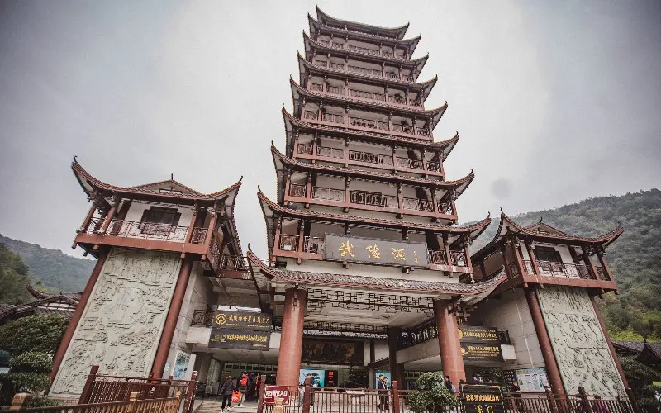
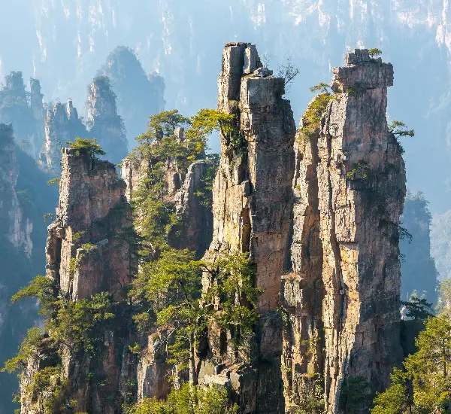
Wulingyuan National Park — Zhangjiajie's Precipitous Pillars
It is usually the only one of China's national parks to make it to a top-in-the-world list. It features some awesome towering geology, alongside rich wildlife. Zhangjiajie National Forest Park makes up most of it. Its inspiration for the floating rocks in Avatar has added to its fame.

Slide 16
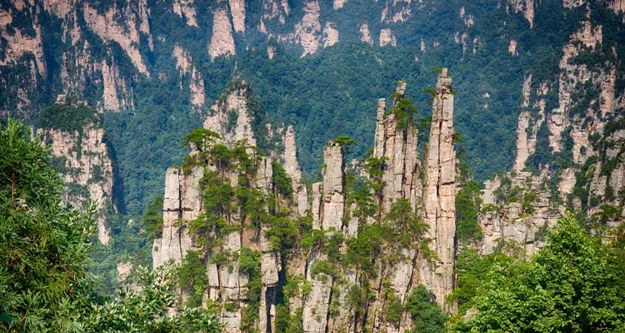
Features
Wulingyuan has a peculiar natural landscape, which features sandstone mesas（平顶山）, dense forests, and deep ravines(沟壑). This is the stuff of traditional Chinese landscape paintings.
The five most spectacular sights are the unusual peaks, deep canyons, beautiful waters, thick forests, and mysterious caves.

Slide 17
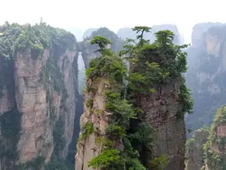
The peculiar peaks refer to the 3,000 or more mountain peaks made of quartz sandstones. The three representative peaks are Camel Peak, Drunk Stone Peak, and Five Finger Peak, which are elegant and magnificent.
The deep canyons refer to 32 canyons, each more than 2,000 meters in length. The most famous ones are Jinxi Canyon, Shentang Canyon, and 10-Li Gallery Canyon.
The beautiful water refers to the more than 800 waterscapes in the scenic area, including streams, springs, lakes, pools, and waterfalls.
Caves of different shapes can be found here. The most outstanding is Yellow Dragon Cave, which contains beautiful stalactites.
The rural landscapes also attract a lot of visitors.
The local farmers are hospitable and you may visit
their homes.

