Slide 1

感恩遇见，相互成就，本课件资料仅供您个人参考、教学使用，严禁自行在网络传播，违者依知识产权法追究法律责任。
更多教学资源请关注
公众号：溯恩高中英语
知识产权声明

Slide 2

The Week
Jan 15th-21st, 2022

Slide 3
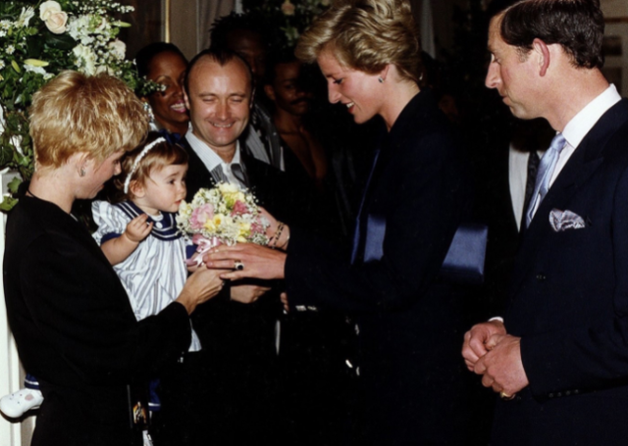
1. Lilly Collins On Her Blooming Bad Behaviour As a Child
莉莉·柯林斯自爆曾是个熊孩子！

Slide 4
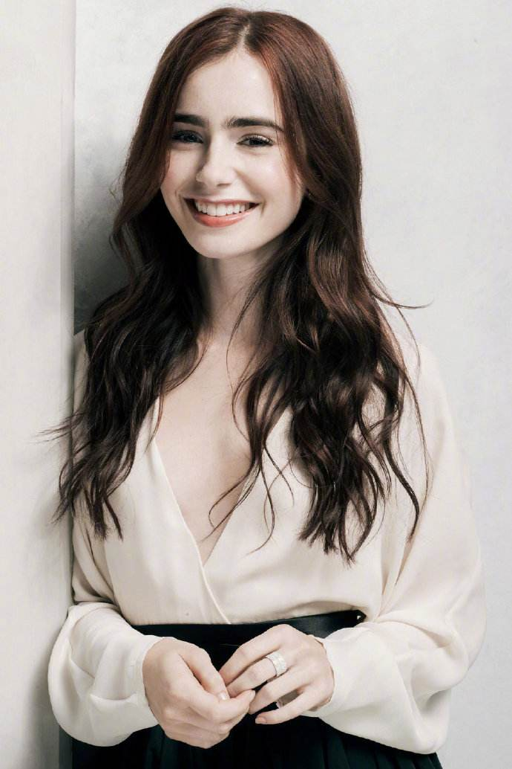

Lilly Collins

Slide 5

语篇填空
（《Hello!》2022年1月17日刊 31页）
has been
While Emily in Paris ________ (be) Lily Collins’s most high-profile role to date, after making her first TV appearance ____ (age) two – and being the daughter of musician Phil Collins – she is certainly no stranger to the spotlight.
aged
But it is not just scenes she has been stealing from a young age: as a toddler (学步儿童), she once presented the Princess of Wales ____ a bouquet of flowers, only ______ (take) them back a second later. “I’ve been told this is ____ happened,” she told chat-show host James Corden last week. “That’s my mom and my dad and I and it’s at a Prince’s Trust event and I’m giving Diana _______ (flower). But the second that she went to take them, I then tried to pull them back.” It wasn’t only Diana who ____ (feel) the wrath of Lily, however. “I was playing with some toys with Prince Charles and I proceeded to throw something at him, like throw a toy telephone at his head,” she added. “I guess I had a ________ (tend) to do naughty things as a two-year-old.”
_________ (thank), the only tantrums in Lily’s life now are the screen antics (滑稽动作) of the characters in Emily in Paris, in ______ she stars with Ashley Park.
with
to take
what
flowers
felt
tendency
Thankfully
which

Slide 6
词汇讲解1
1. high-profile: receiving or involving a lot of attention and discussion on television, in newspapers, etc. 高调的；备受瞩目的
This high-profile case dates back to 1991.
这个备受瞩目的案件可以追溯到1991年。
2. wrath: extreme anger 盛怒；愤怒
His crimes provoked the wrath of the people.他的罪行激起了人民的愤怒。
翻译句子
他是最新一个被感染的知名人物。
He’s the latest high-profile figure to become infected.
翻译句子
国王不公正的法律引起很大的民怨。
The king’s unjust laws raised a great wrath among the people.

Slide 7
词汇讲解2
3. proceed: to do sth next, after having done sth else first 接着做；继而做
He took off his coat and proceeded to undo his boots.
他脱下外套，接着开始脱靴子。
4. tantrum: a sudden short period of angry, unreasonable behaviour, especially in a child （尤指儿童）耍脾气
She throws a tantrum when she can’t have the toy she wants.
当她得不到她想要的玩具时，她就大发脾气。
翻译句子
他概述了他的计划，接着又进行了较详细的解释。
He outlined his plans and then proceeded to explain them in more detail.
翻译句子
他立刻大发脾气，像个孩子一样尖叫。
He immediately threw a tantrum, screaming like a child.

Slide 8
句子翻译
While Emily in Paris has been Lily Collins’s most high-profile role to date, after making her first TV appearance aged two – and being the daughter of musician Phil Collins – she is certainly no stranger to the spotlight.
翻译
虽然《艾米丽在巴黎》是莉莉·柯林斯迄今为止最引人注目的角色，但在她两岁时首次出现在电视上——并且是音乐家菲尔·柯林斯的女儿——之后，她对聚光灯显然并不陌生。
Thankfully, the only tantrums in Lily’s life now are the screen antics (滑稽动作) of the characters in Emily in Paris, in which she stars with Ashley Park.
翻译
值得庆幸的是，现在莉莉生活中唯一的发脾气是电视剧《艾米丽在巴黎》中角色的滑稽动作，她和阿什利·帕克主演了这部电影。

Slide 9
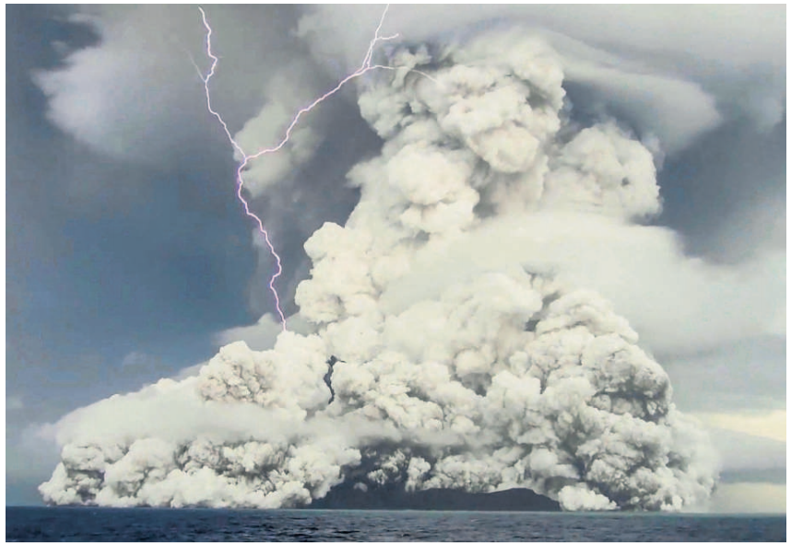
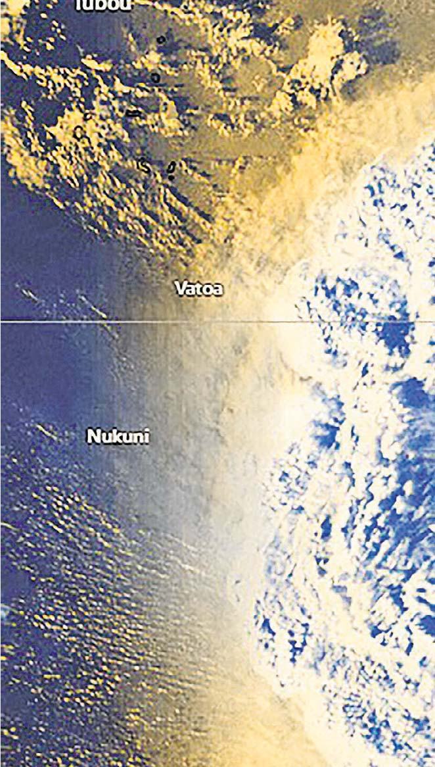
2. An eruption like a bomb blast, and water poured into Tongan homes
海底火山爆发，汤加全境失联！

Slide 10
语篇填空
（《泰晤士报》2022年1月16日 16页）
when
___ incredible satellite image showed the moment _____ an underwater volcano erupted yesterday, _______ (cause) rolling tsunami waves and downpours of water-filled ash to pound the Pacific island nation of Tonga.
On the ground the afternoon skies turned dark within _______ (minute) after lots of gas, smoke and ash ripped through the ocean surface and spiralled into vast debris (碎片) clouds more than ten miles high. _______ (terrify) residents fled by foot and car for higher terrain (地势). Some thought bombs ___________ (explode) as sonic booms (音爆) crackled during the eight-minute eruption. The explosion _________ (hear) across the South Pacific before tsunami waves several feet high lashed the island chains of Fiji and Vanuatu.
The extent of the destruction and casualties was not clear last night because communications had collapsed on the main island of Tongatapu. The New Zealand military offered _________ (assist) and may fly reconnaissance (侦察) missions at first light __ the cloud allows. Local airfields were reported to be out ___ action.
An
causing
minutes
Terrified
had exploded
was heard
assistance
if
of

Slide 11
词汇讲解
1. spiral: to move in continuous circles, going upwards or downwards 螺旋式上升（或下降）；盘旋上升（或下降）
The plane spiralled down to the ground. 飞机盘旋降落。
2. collapse: to fall down suddenly; to fail suddenly or completely 倒塌；崩溃
The roof collapsed under the weight of snow. 房顶在雪的重压下突然塌了。
The luxury car market has collapsed. 豪华车市场已经崩溃。
翻译句子
树叶在寒冷的秋风中从树上盘旋而下。
The leaves spiral down from the trees in the cold autumn wind.
翻译句子
我以为没有我整个项目就会崩溃。
I thought that without me the whole project would collapse.

Slide 12
长难句分析
An incredible satellite image showed the moment when an underwater volcano erupted yesterday, causing rolling tsunami waves and downpours of water-filled ash to pound the Pacific island nation of Tonga.
moment
分析：本句整体是个定语从句，先行词是 _______，在从句an underwater volcano erupted yesterday中作 _________，因此用关系副词when连接；此外，本句中的causing... the Pacific island nation of Tonga结构为_________作_____状语。
时间状语
现在分词
结果
翻译
一张令人难以置信的卫星图像显示了昨天水下火山喷发的那一刻，该火山爆发引发了翻滚的海啸和倾盆大雨般的火山灰袭击太平洋岛国汤加。
仿写
他永远不会忘记唐山大地震的那一天，地震造成许多人无家可归。
He will never forget the day when the earthquake struck Tangshan, leaving many people homeless.

Slide 13
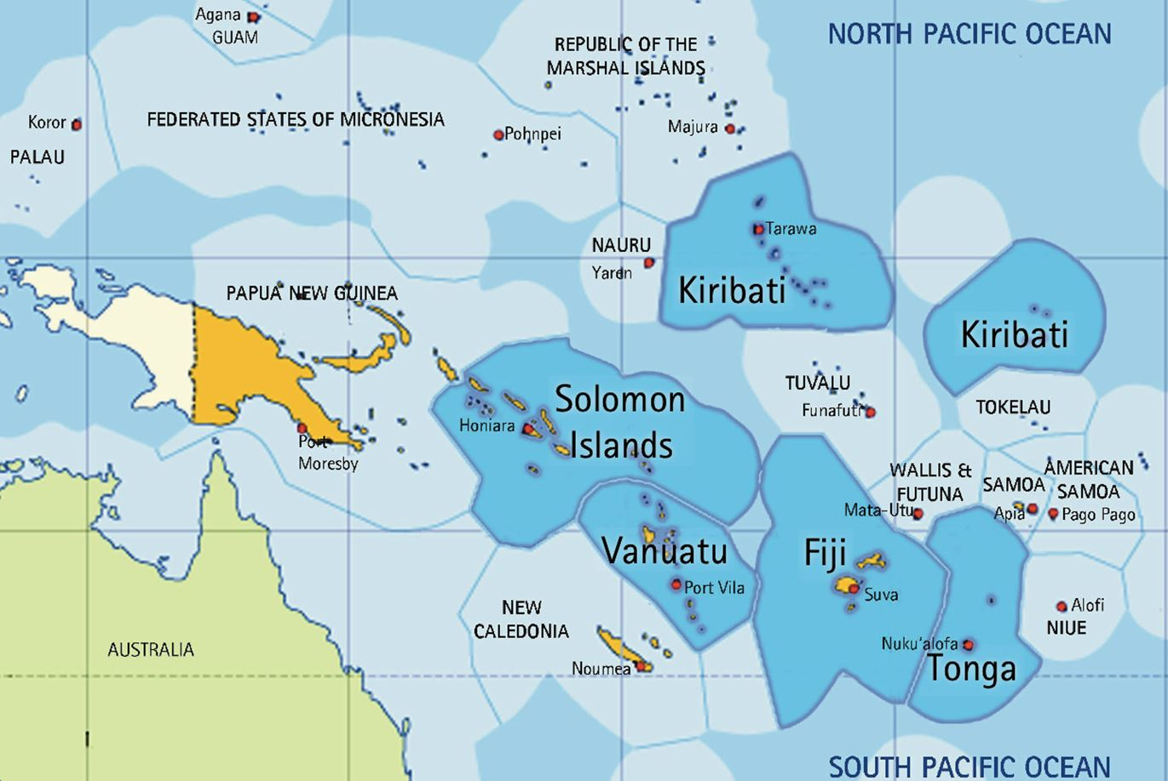



太平洋岛国相关词汇
Pacific island nation 太平洋岛国
island chain（海洋）岛链；列岛
Tonga 汤加（南太平洋岛国）
Fiji 斐济（太平洋西南部岛国）
Vanuatu 瓦努阿图（南太平洋岛国）
Tonga
Fiji
Vanuatu

Slide 14
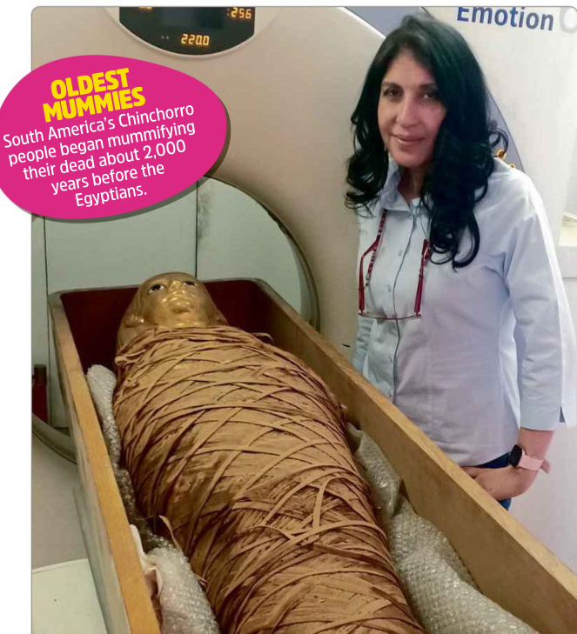
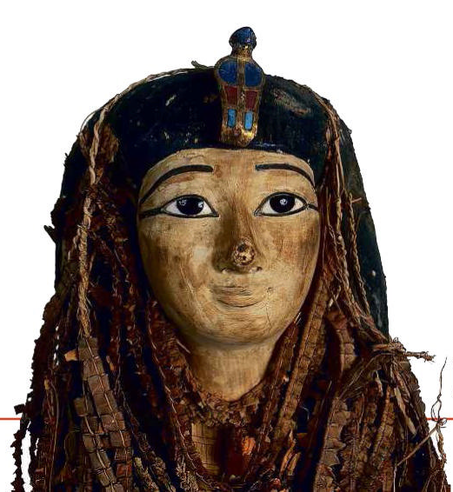
3. Ancient mummy digitally “unwrapped”
用数字技术“揭开”古代木乃伊
Amenhotep I will certainly not be the last mummy to be digitally “unwrapped”

Slide 15
语篇填空
（《青少年周刊》2022年1月15日 14页 ）
Researchers have _________ (digital) peered inside the ancient mummy of an Egyptian pharaoh (ruler) to learn his secrets. They used modern technology to avoid __________ （damage) the bandages that have enclosed his body for 3,500 years.
A mummy is the body of a person or animal _____ has been deliberately preserved after death. Many cultures throughout history have created mummies, but the most famous come from ancient Egypt. The practice _________ (see) as a way to help a dead person reach the afterlife.
One of the best __________ (preserve) mummies ever found is that of the pharaoh Amenhotep I, who ruled Egypt from around 1525BC to 1504BC. Discovered in 1881, his remains were ____ well preserved that they have never been unwrapped. Now, _________ , scientists Sahar Saleem and Zahi Hawass from Cairo University, in Egypt, have taken a look inside the mummy for the first time using ___ CT scanner—a machine that uses X-ray to reveal hidden ________ (detail) inside objects, as if it ____________ (slice) through them. The scans revealed Amenhotep I was about 35 years old when he died, and stood around 169 centimeters tall.
digitally
damaging
that
was seen
preserved
so
however
a
details
were slicing

Slide 16
词汇讲解
1. peer: to look keenly or with difficulty at someone or something
盯着看，费力地看
Blake screwed up his eyes, trying to peer through the fog.
布莱克眯起双眼，尽力透过大雾凝视。
2. slice: to cut it into thin pieces 把 (食物) 切成薄片
Helen sliced the cake. 海伦把蛋糕切成了薄片。
翻译句子
我一直在费力地看一份不知所云的电脑打印稿。
I had been peering at a computer print-out that made no sense at all.
翻译句子
他想让厨师把它们切得更薄，炸得更久一些。
He wanted the cook to slice them thinner and fry them longer.

Slide 17
长难句分析
Now, however, scientists Sahar Saleem and Zahi Hawass from Cairo University , in Egypt, have taken a look inside the mummy for the first time using a CT scanner — a machine that uses X-ray to reveal hidden details inside objects, as if it were slicing through them.
分析:本句是一个复合句，第一个句子中的主语是__________，谓语是__________；其中“that uses X-ray to reveal hidden details inside objects”是修饰 “a machine” 的__________；“as if it were slicing through them”是______从句，“were slicing ”此处是_________ 。
scientists
have taken
定语从句
状语
虚拟语气
翻译
然而，现在，来自埃及开罗大学的科学家萨哈尔·萨利姆和扎希·哈瓦斯首次使用CT扫描仪对木乃伊内部进行了观察。CT扫描仪是一种利用x射线揭示物体内部隐藏细节的机器，就像在切割物体一样。

Slide 18
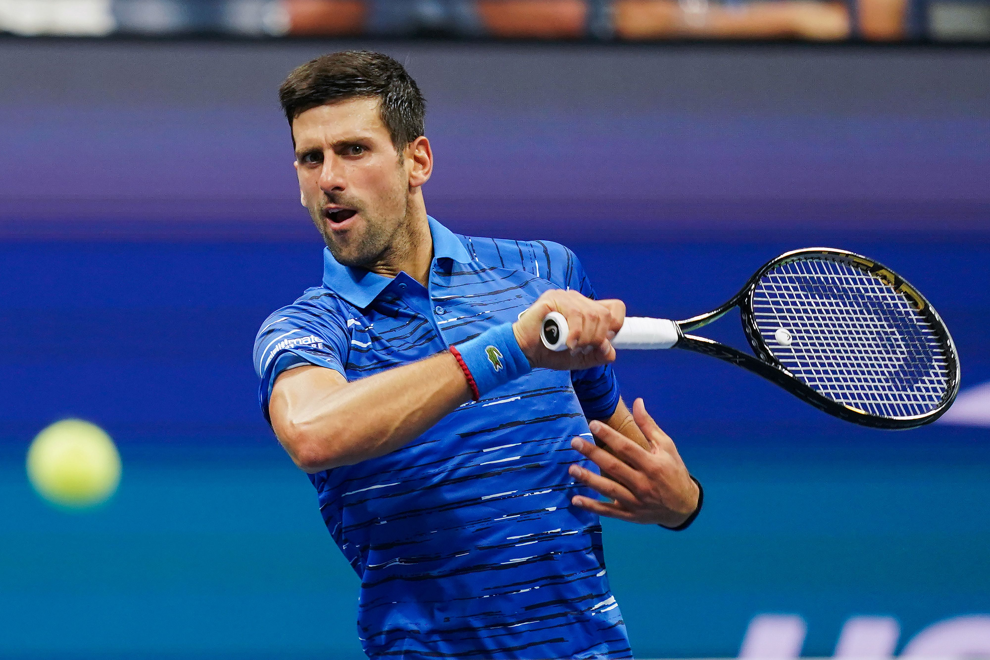
4. Djokovic VS Australia 德约科维奇 澳网之旅不容乐观

Slide 19
语篇填空
（《经济学人》2022年1月15-21日刊 32-33页）
whether / if
best
It is still up in the air ___________ Novak Djokovic, the world’s _____ (good) tennis player and perhaps its most famous anti-vaxxer, will compete ___ the Australian Open, the tournament which brought him to Melbourne and starts on January 17th.
The state government of Victoria, ______ the tournament is held, approved his medical exemption (豁免) from vaccination, thus ________ (allow) him to enter the country, on the grounds that he had ________ (recent) recovered from covid-19. The country’s prime minister supported this decision. Then, after a public outcry (强烈的抗议), he changed his mind. When Mr Djokovic landed in Melbourne on January 5th he ____________ (detain) for eight hours before officials cancelled his visa on the grounds that he is unvaccinated, and ____ (send) him to the Park Hotel to await deportation (驱逐出境).
On January 10th a federal judge overturned that decision, released him from detention and ordered the government ______ (pay) his legal fees.
The immigration minister was considering using discretionary powers to cancel Mr Djokovic’s visa ___ second time. If he uses those powers to deport Mr Djokovic, the 34-year-old could be banned from returning to Australia for three years.
in
where
allowing
recently
was detained
sent
to pay
a

Slide 20
熟词生义讲解
1. up in the air: not yet decided 悬而未决
He told reporters today that the president's trip to Moscow is up in the air.
今天他告诉记者们总统是否前往莫斯科尚未确定。
2. ground: a good or true reason for saying, doing or believing sth
充分的理由；根据（常用复数）
The case was dismissed on the grounds that there was not enough evidence.
此案以缺乏足够的证据为由被驳回。
翻译句子
我们的旅行计划尚未决定。
Our travel plans are still up in the air.
翻译句子
你没有理由抱怨。
You have no grounds for complaint.

Slide 21
长难句分析 1
It is still up in the air whether Novak Djokovic, the world’s best tennis player and perhaps its most famous anti-vaxxer, will compete in the Australian Open, the tournament which brought him to Melbourne and starts on January 17th.
分析：本句中是一个复合句，“It”是________，真正的主语是____________________________________________________；“the world’s... anti-vaxxer”和“the tournament... 17th”是_______；“which brought... 17th”是_____ 从句，修饰先行词_____________。
形式主语
“whether Novak Djokovic will compete in the Australian Open”
同位语
定语
the tournament
世界上最好的网球运动员、也许也是最著名的反疫苗人士诺瓦克·德约科维奇是否将参加澳网还悬而未决，这项将于1月17日开始的赛事把他带到了墨尔本。
翻译

Slide 22
长难句分析 2
The state government of Victoria, where the tournament is held, approved his medical exemption (豁免) from vaccination, thus allowing him to enter the country, on the grounds that he had recently recovered from covid-19.
分析：本句中是一个复合句，“where the tournament is held”是____________从句，修饰先行词_______；“allowing him to enter the country”是_________结构作_________。
非限制性定语
Victoria
现在分词
结果状语
翻译
比赛举办地维多利亚州的政府批准了他免于接种疫苗的医疗豁免，从而允许他进入该国，理由是他最近得过新冠肺炎，现已康复。
仿写
彼得接下来四年就读的伦敦大学学院招生办公室给了他全额奖学金，大大减轻了他的经济压力。
The admissions office of University College London, where Peter will study for the next four years, gave him a full scholarship, greatly reducing his financial pressure.

Slide 23
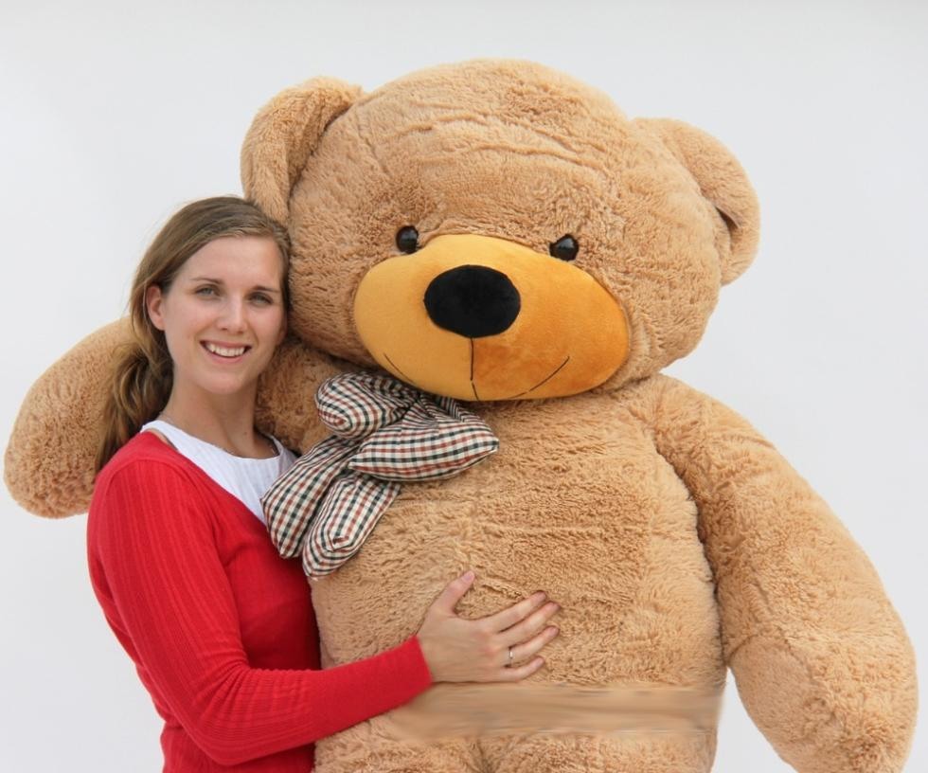
5. BBC随身英语听写填空 Take-away English 01/17/22
A Teddy Bear for Life 为什么大人也爱泰迪熊？

Slide 24

听写 Part I
One thing we always remember from our _________ is our favourite teddy bear. This soft, ragged toy was our comfort and __________. As we grow up, we normally give up our childish ways, and our furry friend often _______ in storage or at a jumble sale.
But that's not the case for everyone. It seems that some _________ continue to need their cuddly toy ____________. One sleep survey suggested a tenth of people in the UK need a teddy bear in bed. And for some adults, soft toys remain an essential presence—they take them _______________.
A cuddly toy can come in many forms—animals, strange shapes or just a piece of stuffed material. But it's the teddy bear __________ that seems to have an enduring appeal—it gives us a nostalgic feeling and a ________ of our younger days.
Writing for the BBC, historian David Cannadine says, "Perhaps it's that bears _________ the happy security of a childhood friend who never changes or ____________."
childhood
companion
ends up
grown-ups
by their sides
wherever they go
in particular
reminder
represent
lets you down

Slide 25
听写 Part II
For whatever reason, teddies ________ both children and adults of all ages. The teddy bear is much _________ these days, and they've become something that we don't just grow up with—people buy them as adults too. There are shops which sell only teddy bears, there are teddy bear museums in many countries, and teddy bear _______ regularly _________ around the world.
While our soft toys offer us a kind of comfort blanket, some experts say it's nothing _______________. It's sometimes good to _______ the constraints of adult life and be a big kid again. And research commissioned by Barclaycard in the UK found 44% of adults have _________ playthings they enjoyed as children because they bring back ______________. Colouring books, cuddly toys and board games were ___________.
So, if you're still _______ your teddy a secret, don't worry—you're not alone!
appeal to
celebrated
festivals
take place
to be ashamed of
let go of
purchased
happy memories
top of the list
keeping

Slide 26
词汇讲解
1.nostalgic: causing sb to think affectionately about the past
使人怀念过去的；引起怀旧之情的
Somehow the place even smelt wonderfully nostalgic.
不知为什么，这个地方竟透出一种浓郁的怀旧气息。
2.constraint: (on sth) a thing that limits or restricts sth, or your freedom to do sth
限制；限定；约束
Their decision to abandon the trip was made because of financial constraints.
他们决定放弃这次出游是因为财力有限。
翻译句子
我很怀念我成长的地方。
I feel quite nostalgic for the place where I grew up.
翻译句子
水资源匮乏将是制约该地区发展的一个主要因素。
Water shortages in the area will be the main constraint on development.

Slide 27
长难句分析
Research commissioned by Barclaycard in the UK found 44% of adults have purchased playthings they enjoyed as children because they bring back happy memories.
分析：本句是一个复合句，“44% of... memories”是________，其中“they enjoyed as children”是________，修饰先行词_________；“because... memories”是_____________。主语“Research”后的“commissioned by Barclaycard in the UK”是过去分词结构作_________。
宾语从句
定语从句
playthings
原因状语从句
后置定语
翻译
巴克莱卡在英国委托进行的一项研究发现，44%的成年人购买了他们小时候喜欢的玩具，因为它们能唤起美好的回忆。
仿写
我们的科学老师推荐的这本书指出，我们称之为家园的星球正处于崩溃的边缘，因为人类没有好好照顾它。
The book recommended by our science teacher points out that the planet we call home is at breaking point because humans are not taking good care of it.

