Slide 1


感恩遇见，相互成就，本课件资料仅供您个人参考、教学使用，严禁自行在网络传播，违者依知识产权法追究法律责任。
更多教学资源请关注
公众号：溯恩高中英语
知识产权声明

Slide 2

UNIT 3 Environmental Protection
UNIT 3 Environmental Protection
---- Using language (2) write a report
东莞市第六高级中学
钱盈

Slide 3

Lead in: Video time

Slide 4
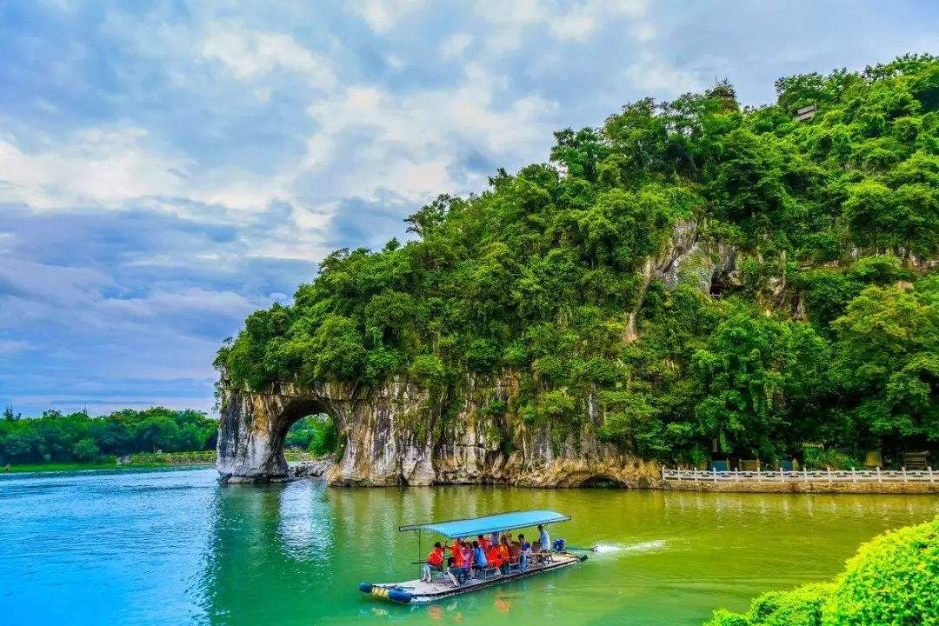
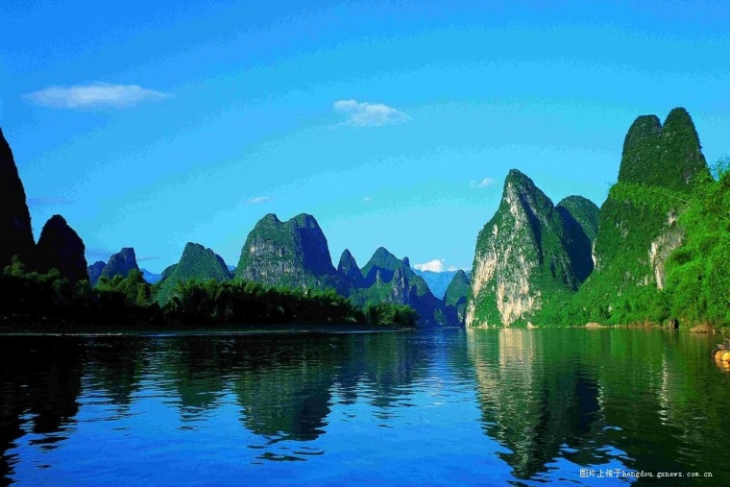
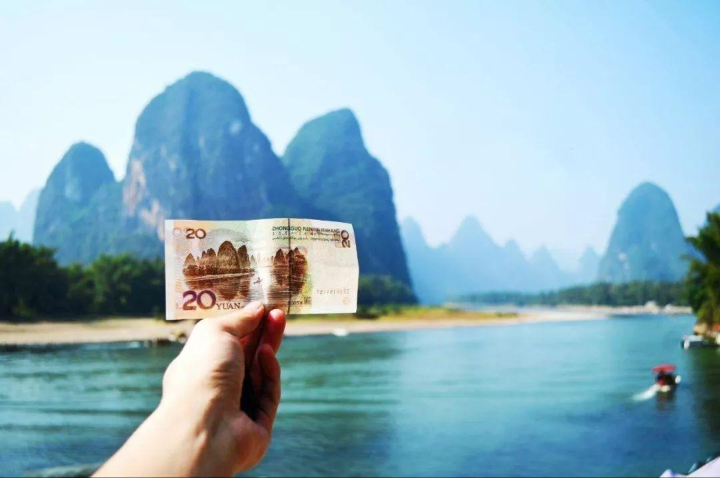

Lead in

Slide 5
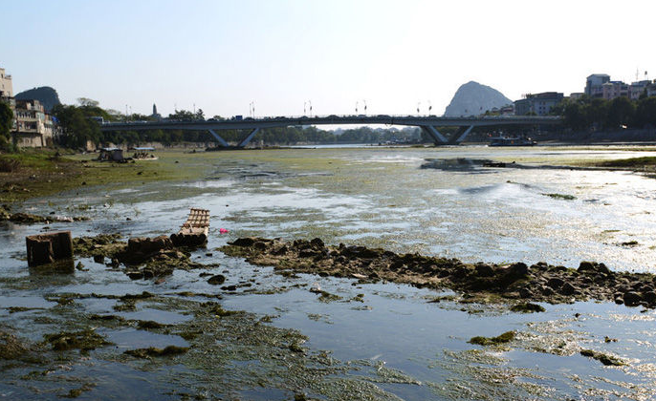
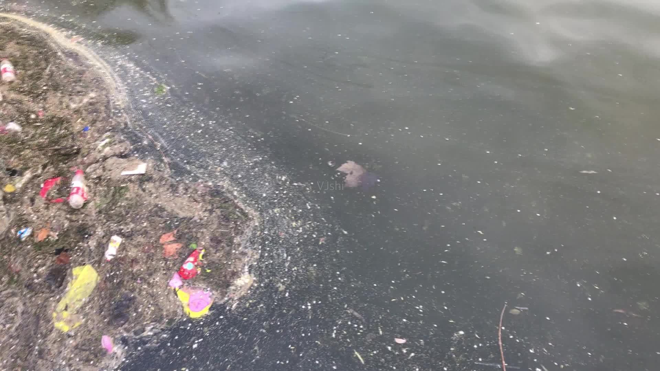
Lead in
What do you think might have caused water pollution in the Li River?

Slide 6
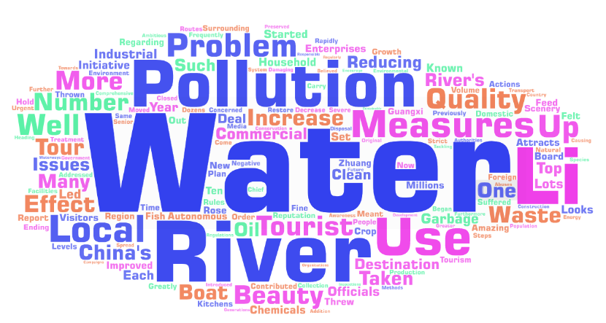
Pre-reading: View & Predict
Reducing Water Pollution in the Li River

Slide 7
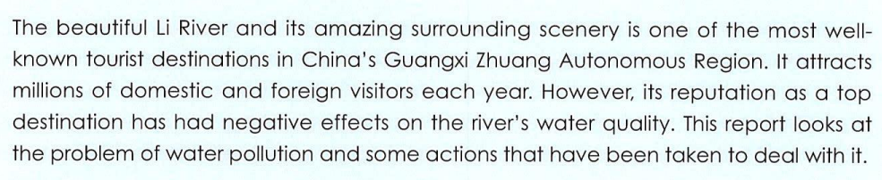
Skim for text type and main idea
Para. 1
Topic sentence:
The first or last sentence of each paragraph
Transitional words: but, however …
A report
The water pollution and measures taken to deal with it in the Li River.

Slide 8
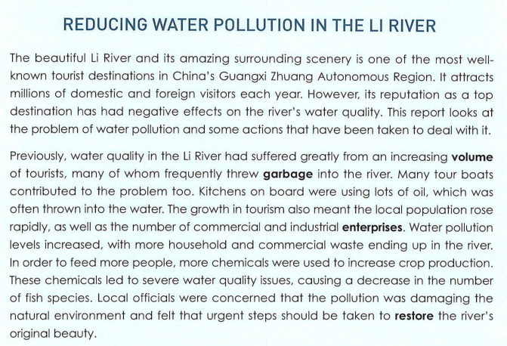
Skim for the structure
Topic
Problem

Slide 9
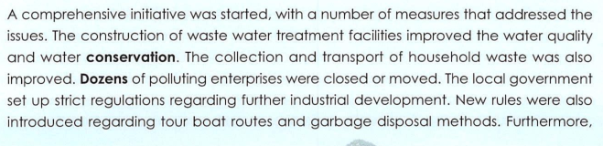
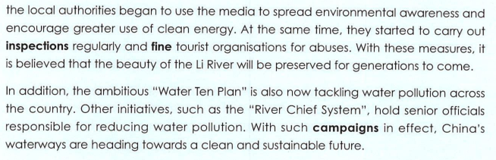
Skim for the structure
Measures
Plan

Slide 10
Skim for the structure
Para. 2-4
Para. 1
Introducing the Topic
Problem
Para. 2
Describing the
Measures
Para. 3
Presenting some
Para. 4
Plan
Presenting further
Problem – solution pattern
“问题 – 解决”型文本

Slide 11
Scan for details (Para. 2 & 3)
Share your mind map about the factors that caused pollution and measures taken to deal with it.
Increasing tourists
water pollution
measures

Slide 12
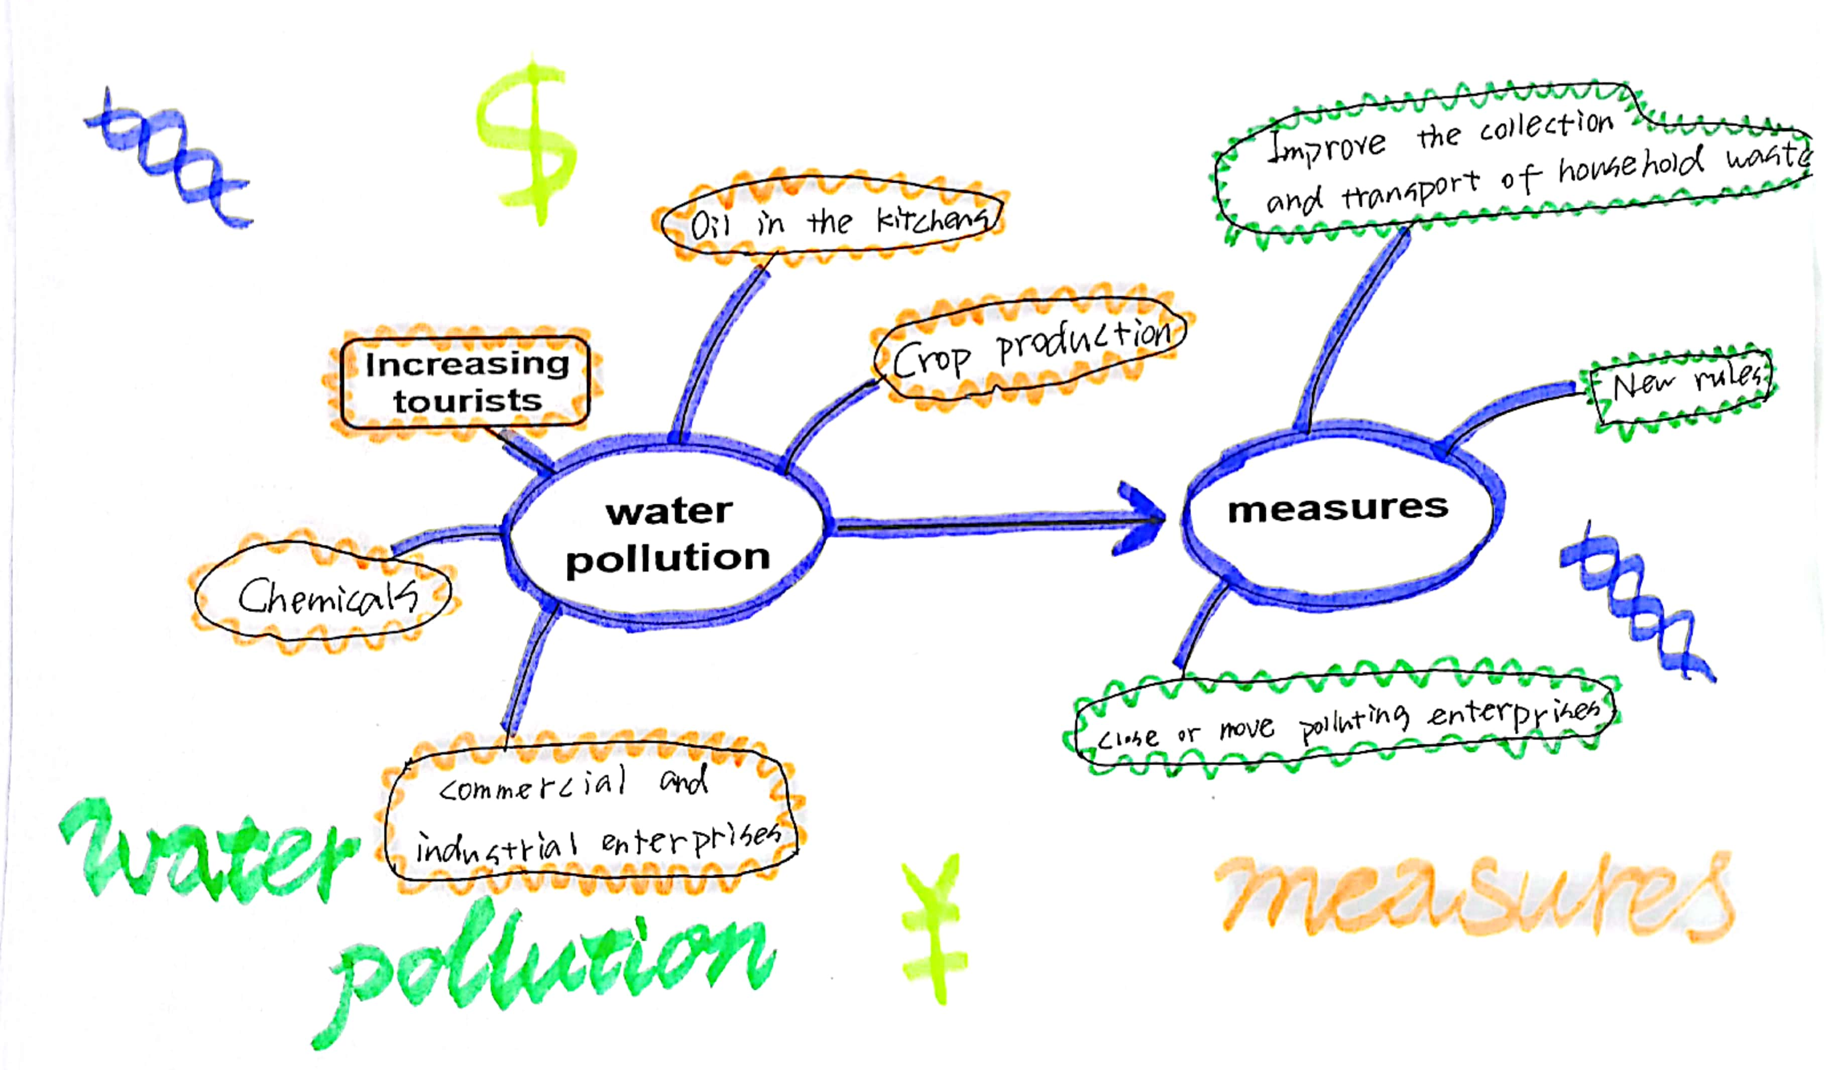
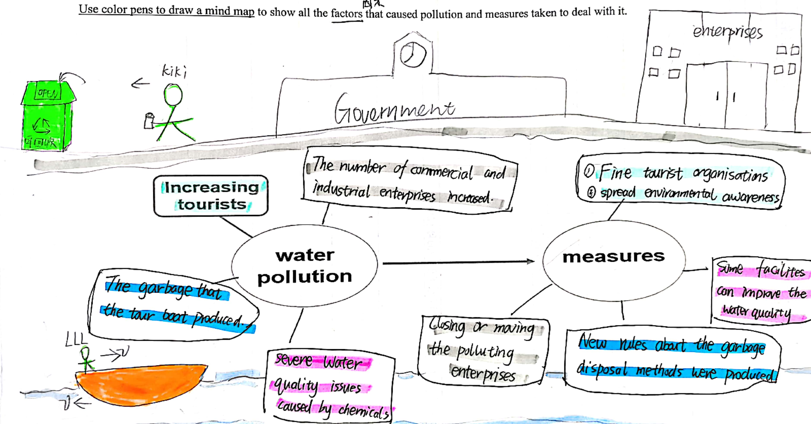
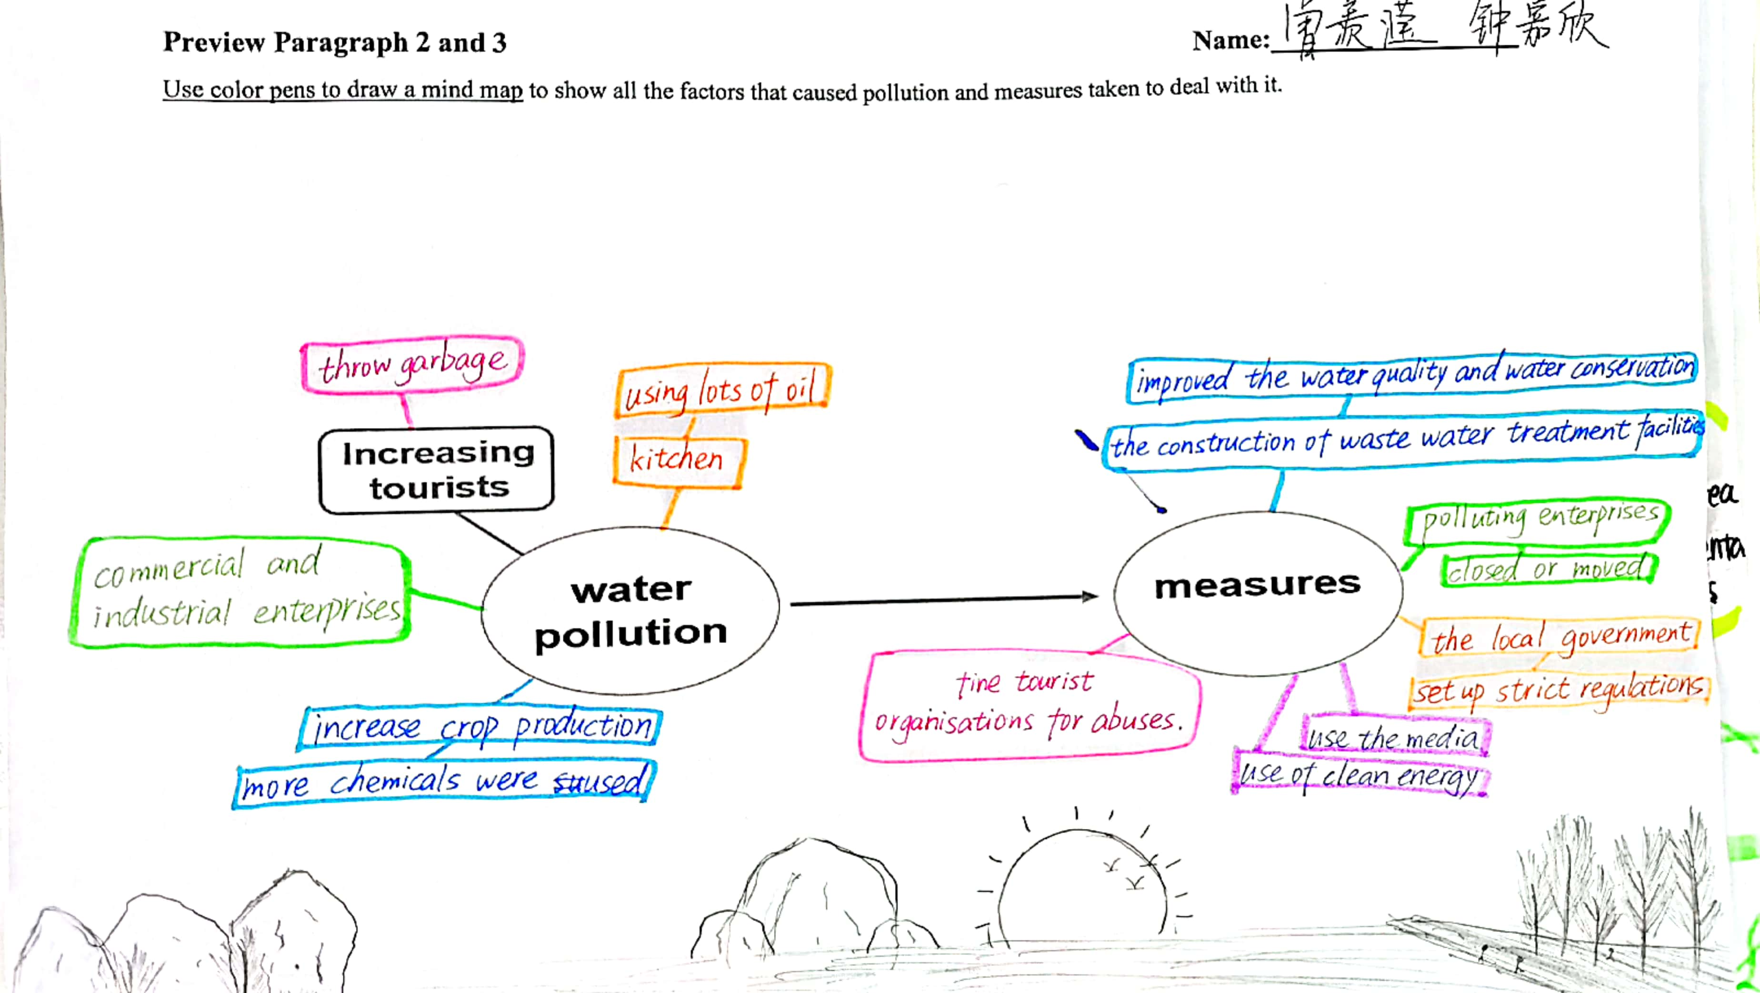
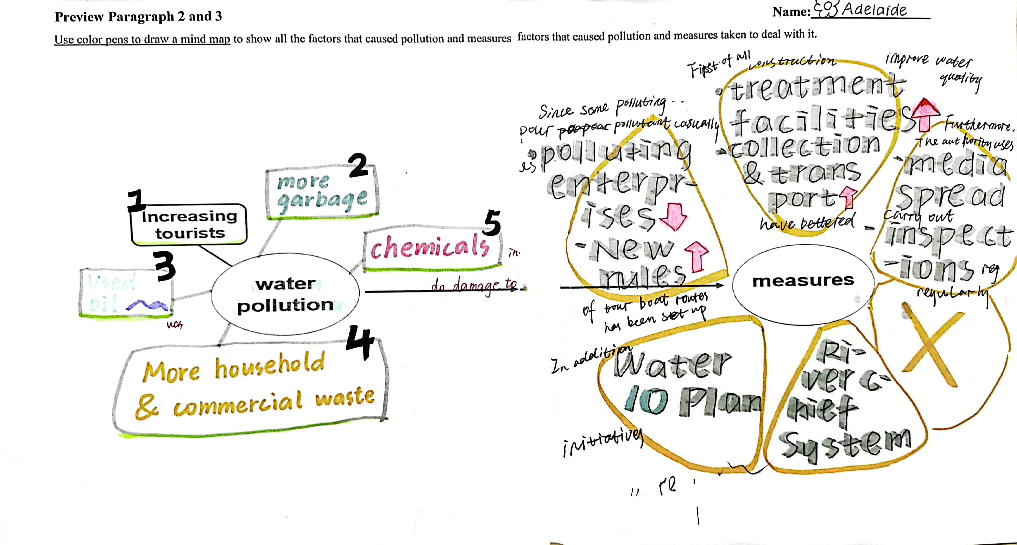
Students’ mind map

Slide 13

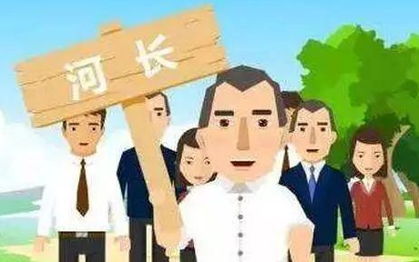

Scan for details (Para. 4)
Presenting further Plan
Water Ten Plan
River Chief System

Slide 14
With these measures, it’s believed that the beauty of the Li River will be preserved for generations to come.

Slide 15
Scan for language features (Para. 3)
1.The construction of waste water treatment facilities improve the water quality.
2.The collection and transport of household waste was also improved.
3.Polluting enterprises were closed or moved.
4.Strict regulations were set up and new rules were also introduced
5.The local authorities began to use the media to spread environmental awareness
6.They carried out regular inspections and fined tourist organizations for abuse
variety of verbs
passive voice

Slide 16



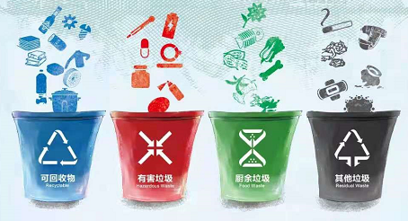
Pre-writing: Background
To create a thriving Dongguan(品质东莞), since last year, Dongguan has carried out Three-year Action Plan for Rubbish Classification (东莞市生活垃圾分类三年行动方案2020-2022).

Slide 17
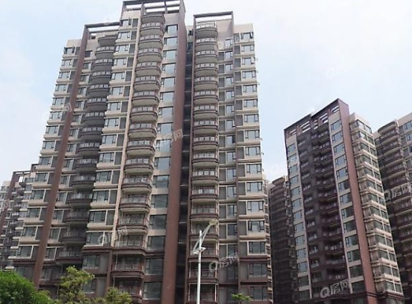
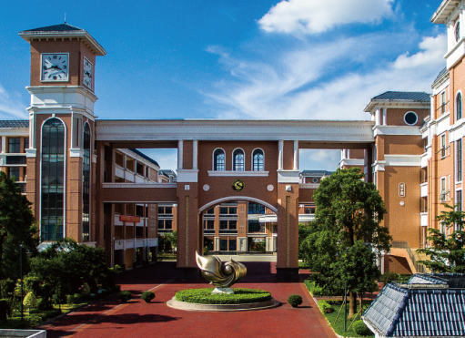
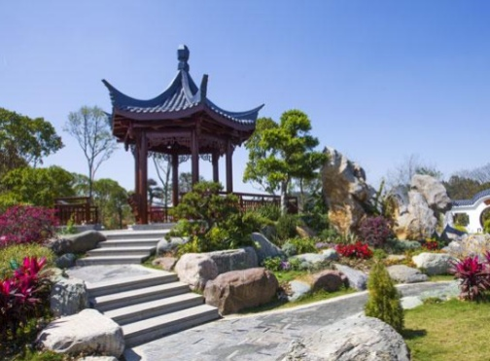
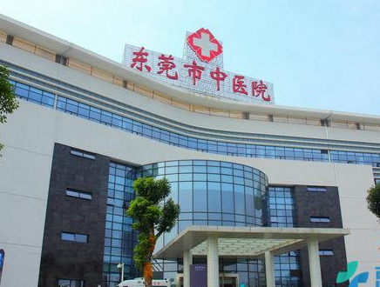
Task: Write a report on rubbish classification
This Action Plan has been carried out in different places across Dongguan.
Suppose you are one of the representatives from places below, and write a report to introduce how you have fulfilled this Action Plan and attend the Online Exchange Conference.
Songshan
Lake
Park
Hospital
hospital
community
school
park

Slide 18
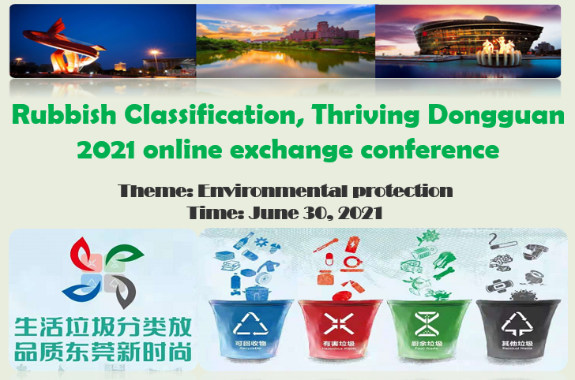
Pre-writing: Background

Slide 19
Pre-writing: Brainstorm for ideas
Rubblish items
Causes
Measures

Slide 20
Pre-writing: Brainstorm for ideas
Rubblish items
Causes
Measures
Paper
Plastic bag
Bottle
Can
Food waste
Medical waste
Lack awareness
No enough dustbins
No rules and regulations
Organize activities
Put up posters
Equip facilities
Have class meetings
Hold lectures

Slide 21
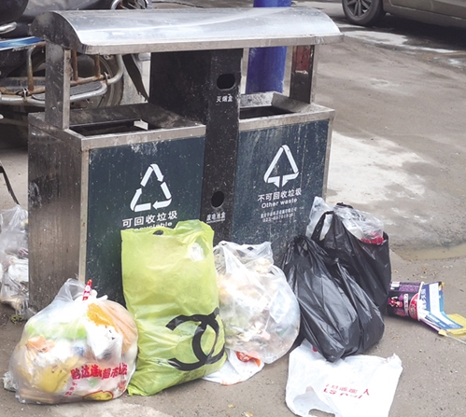
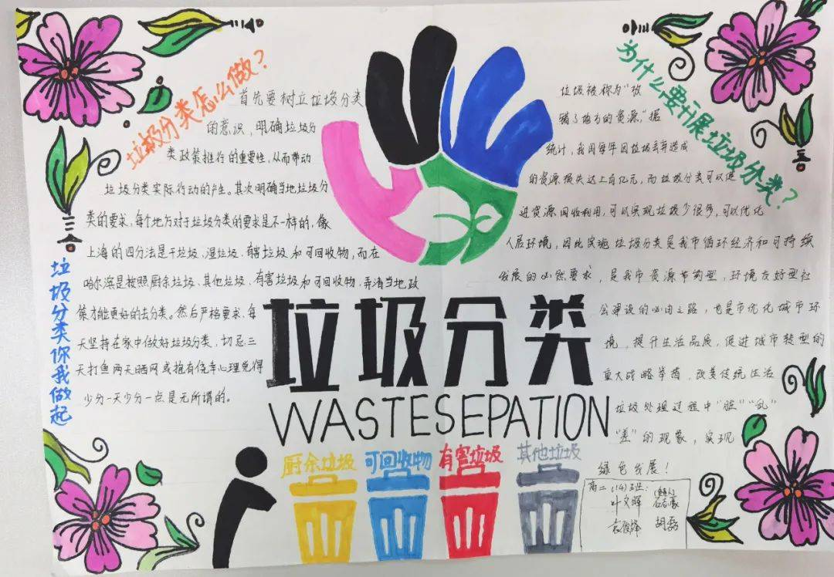
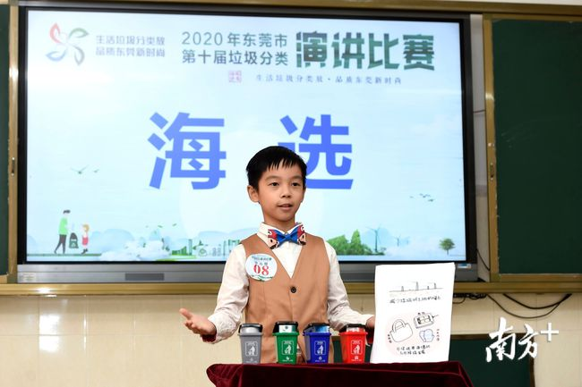
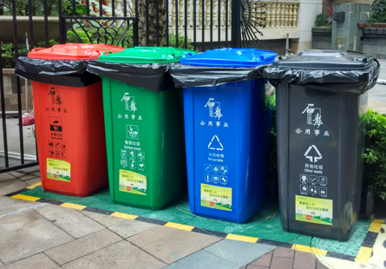
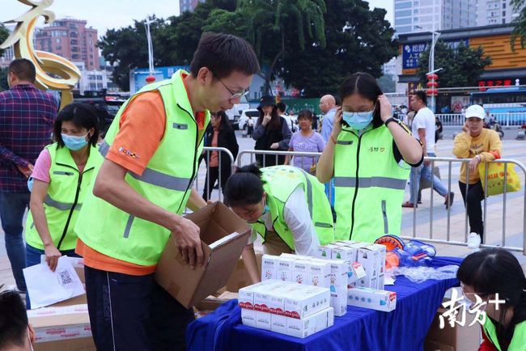
More ideas for reference
Rubbish items | Cigarette butts, glass bottles, plastic bags, used paper, plastic bottle caps, glass pieces, plastic straws, soft drink cans, plastic bottles, food waste, medical waste …
Causes | A lack of awareness, dustbin facilities, rules, regulations …
Measures | equip dustbin facilities, intelligent dustbins … set up waste recycling online reservation system hold poster design and speech contest organize community activities to experience rubbish classification have class meeting, deliver lectures on rubbish classification and hold volunteer activities

Slide 22
While-writing: A Writing circle
Group work:
Choose one place: community, school, park, hospital …
Write a report on the rubbish classification.
Each member write a part on the separate color paper and put them together to make a complete report.
Topic
Problem
Plan
Measures
Finish your own task by yourself (5mins)
Share what you’ve done and make a complete report together (2mins)

Slide 23
Assessment
Checklists |  | Excellent | Good | Average
Structure & Content | Is the report complete? (TPMP) Does the writer describe the environment issue clearly? Do the measures sound effective?
Language | Grammar, Punctuation, Spelling Verbs, passive voice Sentence patterns
Community
Songshan
Lake
Hospital

Slide 24
Speaking: Share your report

Slide 25
Summary
How to write a report
How to evaluate a report
Topic
Structure
Content
Problem
Measures
Language
Plan

Slide 26
Assignment
Compulsory: Polish your group report and upload them on a social media platform and share online.
Optional: Design a poster about “Rubbish Classification, Thriving Dongguan” with your group members.
Community
Songshan
Lake
Hospital

Slide 27

Always remember:
“
Earth provides enough to satisfy every man’s needs, but not every man’s greed.
---- Mohandas K. Gandi
”

Slide 28
Thank you for your listening!

