Slide 1

感恩遇见，相互成就，本课件资料仅供您个人参考、教学使用，严禁自行在网络传播，违者依知识产权法追究法律责任。
更多教学资源请关注
公众号：溯恩高中英语
知识产权声明

Slide 2
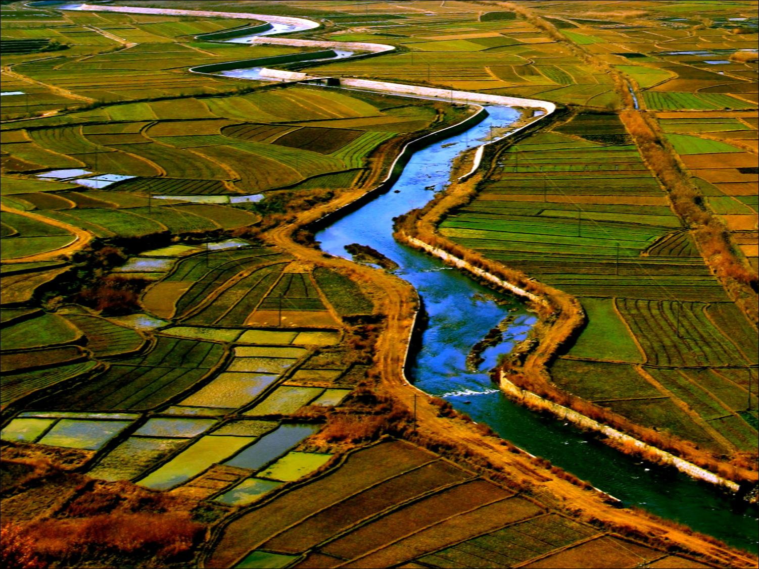
UNIT 5 WORKING THE LAND
Reading for writing

Slide 3
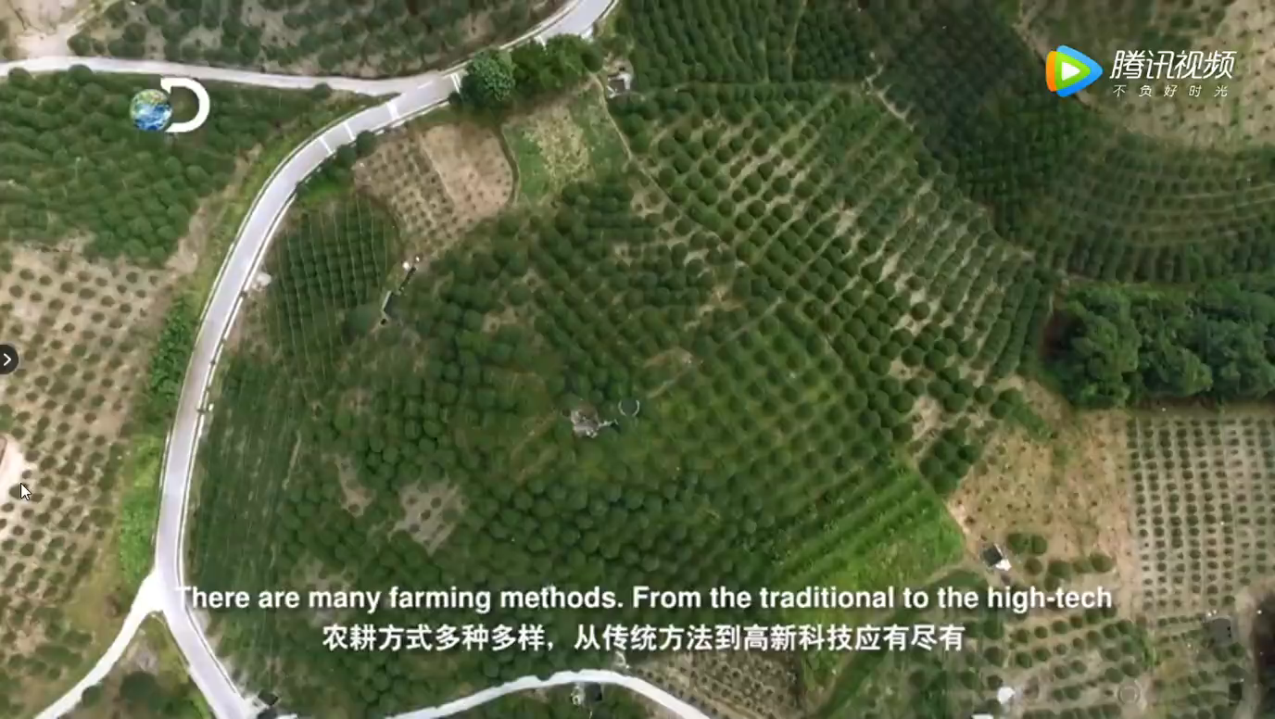
Task 1: Lead-in
What does the video talk about ?

Slide 4
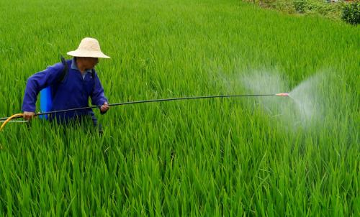
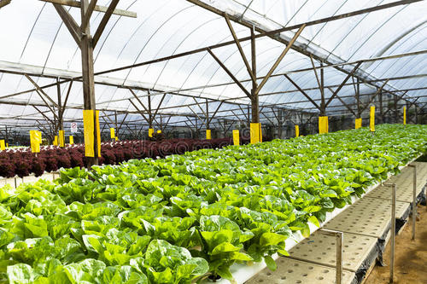
Evaluate chemical farming and organic farming
CHEMICAL VERSUS ORGANIC FARMING
_______
VS

Slide 5
Task 2: Skimming and scanning
advantages
advantages
Chemical farming
Organic farming
VS
Group 1
Group 2
disadvantages
disadvantages

Slide 6
Task 2: Skimming and scanning
fight crop disease and increase production
advantages
kill harmful bacteria and insects
serve high demand for food around the world
(high yields)
Chemical farming
harm both the land and people’s health
disadvantages
kill helpful bacteria and insects
not rich in nutrition and flavour

Slide 7
Task 2: Skimming and scanning
without using any chemicals
advantages
keep the soil rich and free of disease
rich in nutrition and flavour
Organic farming
nowhere near able to meet the need of food
( low production )
disadvantages

Slide 8
Task 2: Skimming and scanning
How does the author express his opinion ?
What kind of words or phrases does he use ?
however
for example
in addittion
in turn
in fact
as well
for instance
therefore
Try to use these words or phrases to make your essay more smooth and logical.

Slide 9
Task 2: Reading
part
main idea
Para. 1-2
Chemical farming
structure
Para. 3-4
Organic farming
Para. 5
Writer’s opinion

Slide 10
Task 3: Brainstorming
What other advantages and disadvantages can you think of ?
Discuss in groups and then make a list.
①②③
…
①②③
…
advantages
advantages
Organic farming
VS
Chemical farming
①②③
…
①②③
…
disadvantages
disadvantages

Slide 11
Task 3: Brainstorming
Chemical farming
advantages
disadvantages
in widespread use
more side effects
lower cost compared to organic farming
less developed technology

Slide 12
Task 3: Brainstorming
Organic farming
advantages
disadvantages
produce food of higher quality
higher cost of producing food
high technology
greater effort required to farm
policy support

Slide 13
Task 4: Writing
Which farming do you support ?
Chemical or organic farming ?
Write an argumentative essay(议论文) to show your opinion.

Slide 14
Task 4: Writing
Argumentative essay
——stating an opinion
(议论文——个人观点陈述类)
Structure
Part 1. Topic sentence (opinion/attitude)
Part 2. Points and details
1）advantages
2）transitional words（过渡词）
Part 3. Conclusion (meaning/influence)

Slide 15
Word and sentence patterns for writing
In my opinion, I’m in favor of…
As far as I’m concerned, I prefer …
From my point of view, I support…
Topic sentence
To begin with/ First of all
Firstly/Secondly/…./Lastly
Last but not least/ Finally
Points
In conclusion, …
In a word, …
All in all, …
Conclusion
For example / instance , …
However, …
… , but also …
In addition, …
In turn, …
In fact, …
On one hand…
On the other hand…
Transitional words

Slide 16
Task 4: Writing
In my opinion, I support…_______________
Firstly, (advantage 1 & detail)
______________________________________
Secondly, (advantage 2 & detail)
______________________________________
Finally, (advantage 3 & detail)
______________________________________
All in all, ______________________________
Example
advantages
advantages
Chemical farming
VS
Organic farming
disadvantages
disadvantages

Slide 17
Task 4: Writing
Appreciation of students’ compositions

Slide 18
Task 4: Writing ( sample )
In my opinion, organic farming is preferable to chemical farming because of the benefits to the environment and people. (Topic sentence)
To begin with, organic farming keeps the soil rich. For instance, natural waste from animals are used as fertilisers, making the soil richer in minerals. (Points and details)
And then chemicals harm the land and health of people. As we all know, chemicals can stay in soil and underground water, which in turn will affect humans. (Points and details)
Finally, organic food is generally more nutritious. There was a case of watermelons exploding because chemicals had been used in them. So they contained too much water and tasteless. (Point and detail)
In conclusion, I would like to suggest buying organic food. The price is a little higher, but the small price we pay extra will bring us huge rewards in the end. (Conclusion)

Slide 19
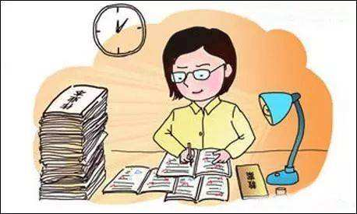
Task 4: Writing
Evaluating & Editing
Various expressions and clear structure can be used to make your writing better.

Slide 20
Task 6: Creative thinking
What will farming become in the future ?

Slide 21
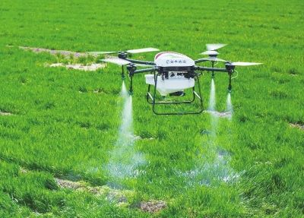
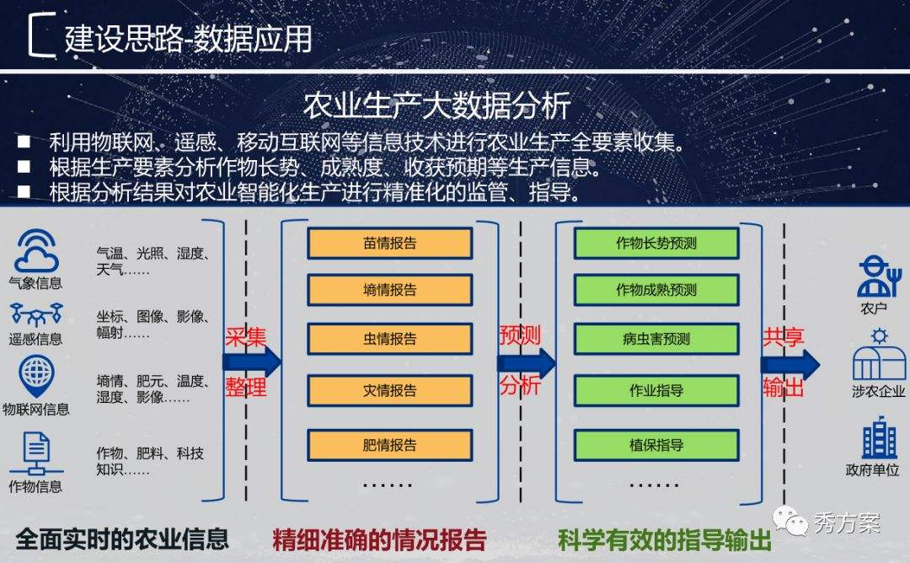
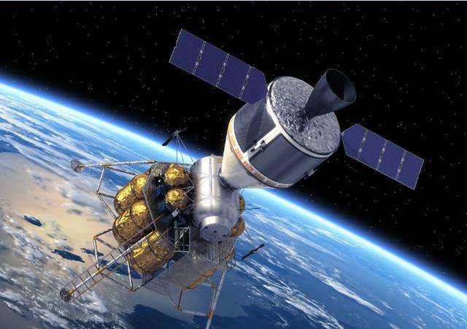
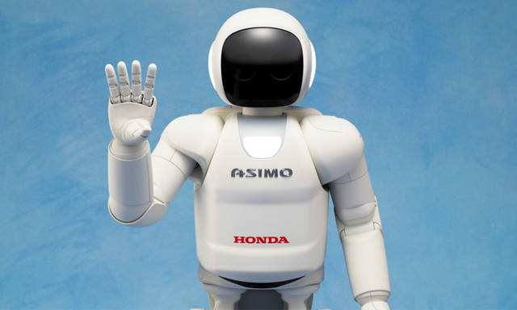
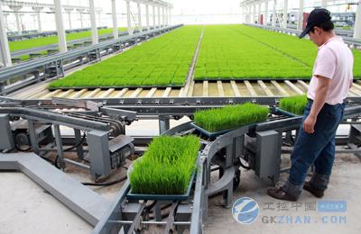
Task 5: Creative thinking
Intelligent Agriculture
（智慧农业）

Slide 22
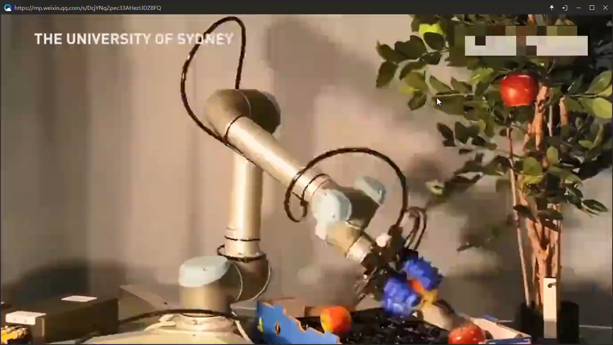
Task 5: Creative thinking

Slide 23

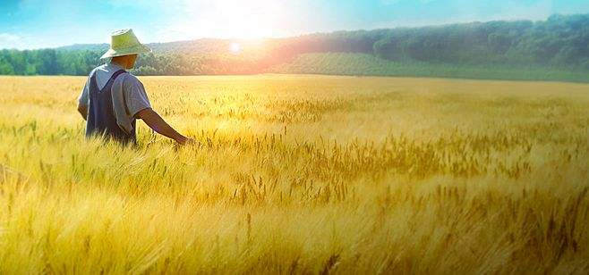
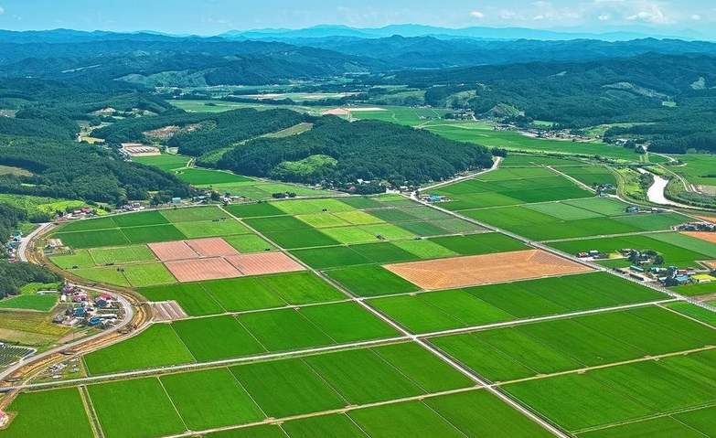
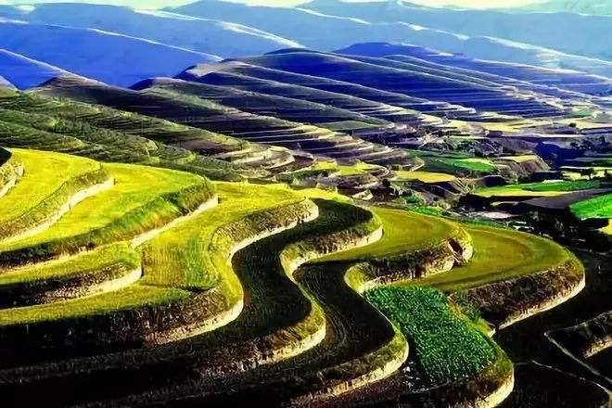
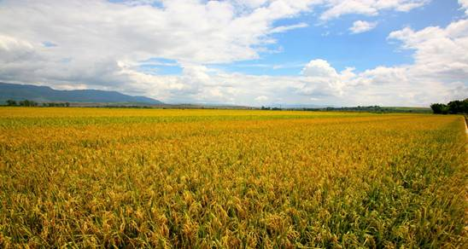
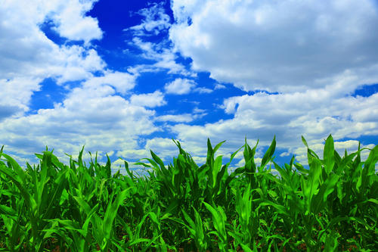

Slide 24
Task 6: Homework
Polish your writing by changing different words, sentence patterns and clauses and adding some details to make your essay better in structure and expression.

Slide 25
Thanks for your listening !

