Slide 1

感恩遇见，相互成就，本课件资料仅供您个人参考、教学使用，严禁自行在网络传播，违者依知识产权法追究法律责任。
更多教学资源请关注
公众号：溯恩高中英语
知识产权声明

Slide 2



Reading for writing
Write a blog about
English
study
Fang
Fang Hui

Slide 3

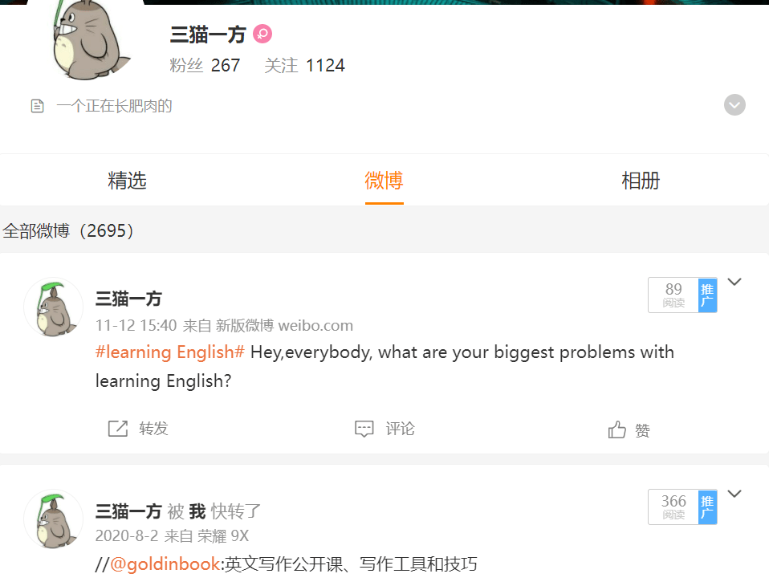

A Post
A piece of writing, image, or other items of content published online.
If you post information on the Internet, you make the information available to other people on the Internet.

Slide 4



READING
Present examples of difficulties with learning English and related advice.

Slide 5

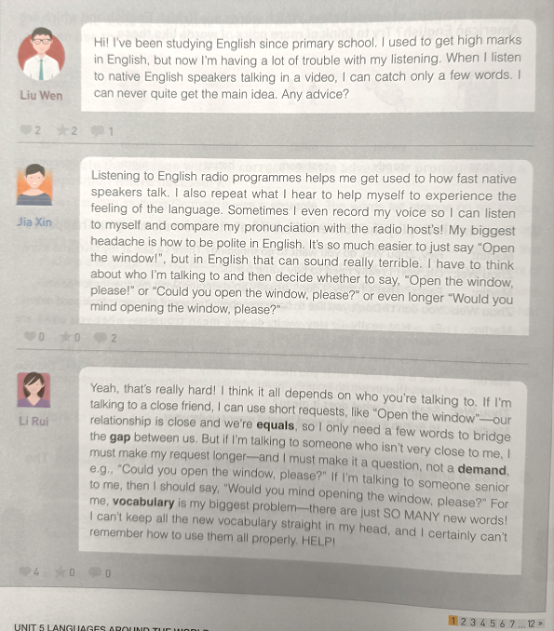
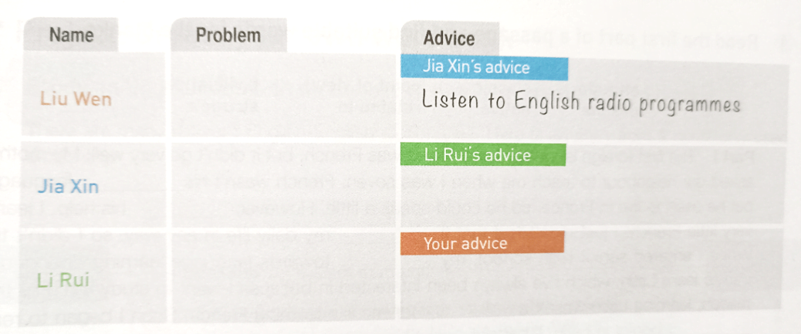
Read these posts from an online forum and fill in the table on page 67.

Slide 6
Underline
Underline
Find out their problems and advice
（前四个纹理为矢量素材，可直接通过更改形状填充更改颜色）
He’s having trouble with listening
repeat what you hear,
record your voice and compare to the radio host's
I don’t know how to…
I can’t...
...is a big difficulty for me.
The problem you describle should be
brief and specific.
His biggest headache is how to be
polite in English
short requests for close friends
longer requests for people not so close
more polite phrases for people senior to you
For her, vocabulary is her biggest problem.
Your advice

Slide 7



Your advice
to Li Rui
How to remember new words
Use a modal verb
Make it into a question
Put yourself in the person’s position
Make a suggestion
Advise in a stronger way
A.
You should start with simple words.
5
simple ways to give advice
You should/shouldn’t….
You ought to do…/ You ought not to do…
By doing so, you’ll have a sense of accomplishment.
The advice you give should be
practical
&
reasonable
Why don’t you…?/ why not do…?
How about doing…?
B.
You’d better read a novel.
In this way, you will..
By doing so,…
That way, you will..
If you do so, you may…
so that; so; because;…
If I were you, I would do….
I would suggest doing …
I would recommend doing/recommend you to
You had (You’d) better
It is important for you to ….
It’s a good idea/choice to…
Show your reason

Slide 8

FOR
Writing

Slide 9







Write a blog post
The organisation
Language features of a blog
Jia Xin: Listening to English radio programmes helps me get used to how fast native speakers talk. I also repeat what I hear to help myself to experience the feeling of the language. Sometimes I even record my voice so I can listen to myself and compare my pronunciation with the radio host’ s! My biggest headache is how to be polite in English. It’s so much easier to just say “Open the window!”, but in English that can sound really terrible. I have to think about who I’m talking to and then decide whether to say, “Open the window, please!” or “Could you open the window please?” or even longer “Would you mind opening the window, please?”
practical
Listening to English radio programmes helps me get used to how fast native speakers talk. I also repeat what I hear to help myself to experience the feeling of the language. Sometimes I even record my voice so I can listen to myself and compare my pronunciation with the radio host’ s!
Give your advice
Write in a conversational tone
(It feels like you're having a chat with your reader)
reasonable
informal
Use simple, easy to understand words
Use “You” and “I”
Use “I’m;he’s..” rather than “I am; he is…”
Use “anyway, well, I/you know…” instead of “first,second,thirdly,what’s more…”
Use short and simple sentences
Use examples or your personal experience
Use active voice
Ask questions
My biggest headache is how to be polite in English. It’s so much easier to just say “Open the window!”, but in English that can sound really terrible. I have to think about who I’m talking to and then decide whether to say, “Open the window, please!” or “Could you open the window please?” or even longer “Would you mind opening the window, please?”
Describe your problem
brief
specific
Ask for help!
brief
Any advice? HELP!

Slide 10

Exchange your drafts and assess each other’s work
The checklist
General content
Does the writer give a clear description of the problem?
Is the advice clearly explained?
Does the writer use pronouns to refer to things or people correctly?
Does the writer use correct spelling, punctuation?
Does the writer give reasons for the advice?
Does the writer use proper expressions to give suggestions?
Are there any grammar mistakes?
Basic writing skills
Is the handwriting easy to read?

Slide 11
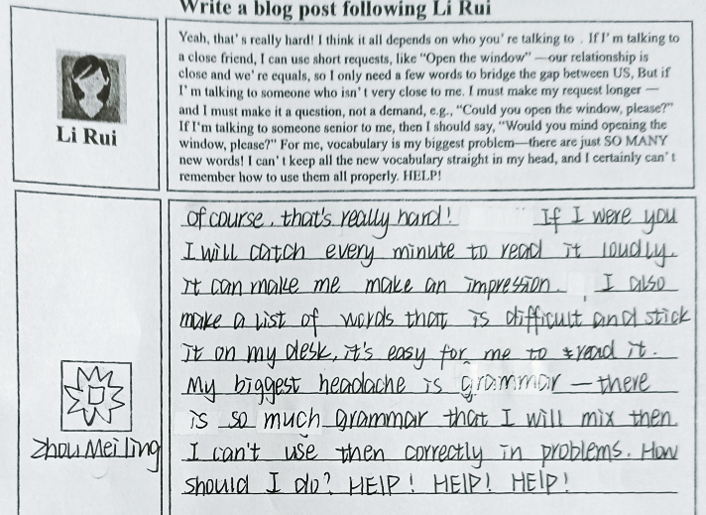
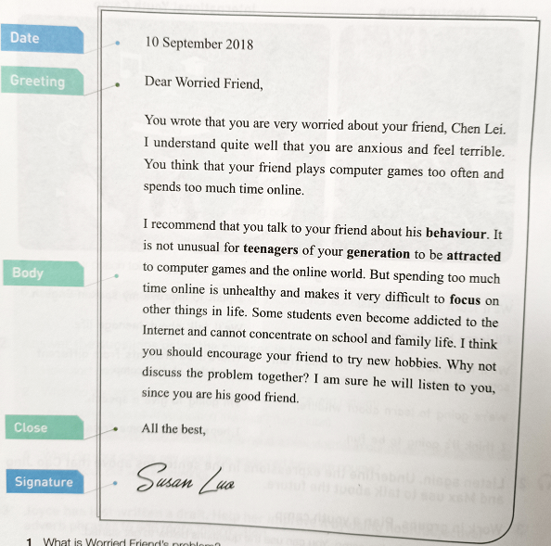
Giving advice
.
.
A blog
A letter
informal
formal
A fixed format
posted immediately
homework

Slide 12






homework:
►Write a letter of advice to one of your posts.
God= no homework
B
GOD
A
D
C
E
GOD
F
Quit

Slide 13
homework
►Write a letter of advice
to________________.
(Review ways and tips for writing a letter of advice.)
(Pay attention to your writing tone!)
BYE

Slide 14
Subscribe me

Slide 15

THANK YOU

Slide 16
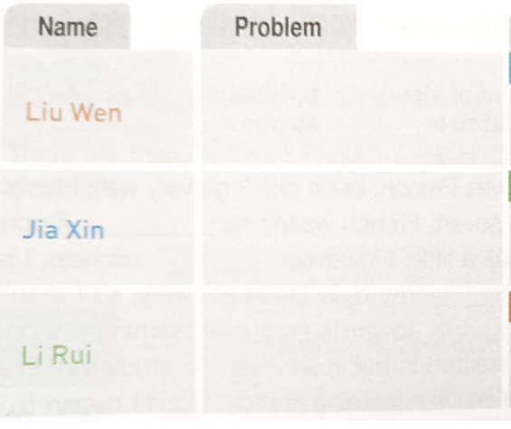

What is your problem in learning English?
Find out the expressions related to the difficulties in learning English
I’m having a lot of trouble with..
I can catch only a few words
I can never quite get the main idea
Keep it brief
Keeping it brief will increase your chance of getting a response
I don’t know how to…
My biggest headache is how to..
….can sound really terrible.
I have to think about…
Explain briefly
Briefly explained what you have tried, and why it didn’t seem to work.
Liu Wen: Hi! I've been studying English since primary school. I used to get high marks in English, but now I’ m having a lot of trouble with my listening. When I listen to native English speakers talking in a video, I can catch only a few words. I can never quite get the main idea. Any advice?
..is a big difficulty for me.
Be specific with what advice you want.
For me, vocabulary is my biggest problem.
I can’t keep all the new words.
I can’t remember how to use them correctly.
Keeping it short and to the point will increase your chances of receiving a reply.
I (also) have difficulty in…

Slide 17

How to write a blog of giving advice
（前四个纹理为矢量素材，可直接通过更改形状填充更改颜色）
1. Don't judge them.
2. Remove your own opinion.
When you give advice, the idea is to give someone the advice to make their own decision, not make the decision for them.
3. Be honest.
It's okay to say "I know how you feel", or something like "You're right to be upset about that" .
4. Express confidence in them
5. Avoid strong language.

Slide 18
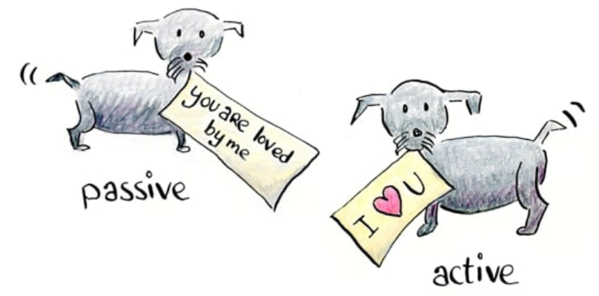
But if I’ m talking to someone who isn’ t very close to me. I must make my request longer一and I must make it a question, not a demand, e.g., “Could you open the window, please?” If I‘m talking to someone senior to me, then I should say, “Would you mind opening the window, please?” For me, vocabulary is my biggest problem—there are just SO MANY new words! I can’ t keep all the new vocabulary straight in my head, and I certainly can’ t remember how to use them all properly. HELP!
How to write in a conservational way?
Liu Wen: Hi! I've been studying English since primary school. I used to get high marks in English, but now I’ m having a lot of trouble with my listening. When I listen to native English speakers talking in a video, I can catch only a few words. I can never quite get the main idea. Any advice?
use “I ” and “You”
use “I’m, he’s” rather than “I am.,he is”
use active voice
ask questions
use examples or personal experience

Slide 19
What is your problem in learning English?
Find out the expressions related to the difficulties in learning English
I’m having a lot of trouble with..
I can catch only a few words
I can never quite get the main idea
I don’t know how to…
My biggest headache is how to..
….can sound really terrible.
I have to think about…
Liu Wen: Hi! I've been studying English since primary school. I used to get high marks in English, but now I’ m having a lot of trouble with my listening. When I listen to native English speakers talking in a video, I can catch only a few words. I can never quite get the main idea. Any advice?
..is a big difficulty for me.
For me, vocabulary is my biggest problem.
I can’t keep all the new words.
I can’t remember how to use them correctly.
I (also) have difficulty in…

Slide 20
WRITING
Consolidate the previous activities by writing a blog post about a difficulty with learning English and outlining possible solutions.

