Slide 1

感恩遇见，相互成就，本课件资料仅供您个人参考、教学使用，严禁自行在网络传播，违者依知识产权法追究法律责任。
更多教学资源请关注
公众号：溯恩高中英语
知识产权声明

Slide 2
Unit 2 MORALS AND VIRTUES
Reading and Thinking
By Lavender

Slide 3
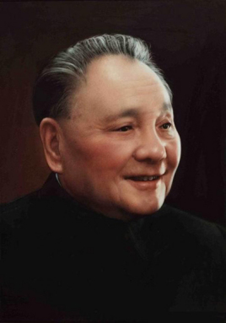
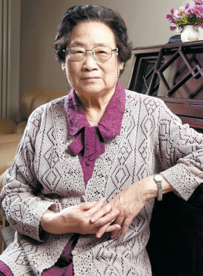
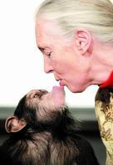
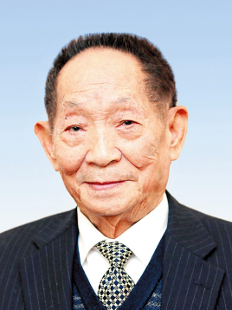
Activity 1 Guessing Game
30 seconds
1
2
3
4
A
At the age of 29, he began to study hybrid rice.
B
At the age of 26,she began to observe and record chimps' daily activities for over 25 years.
C
At the age of 18, he participated in the organization of the Communist Party of China.(中国共产党）
D
At the age of 25, she began to engage in the research of traditional Chinese medicine.
Making wise choices
Keeping on chasing their dreams
Making the world a better place
Today, we are going to learn another great person with these qualities.
Q:What do they have in common?
1.They made wise choices when they were .
2.They kept on chasing（追逐） their .
3.They made great achievements that made the world a place.
young
dreams
better

Slide 4
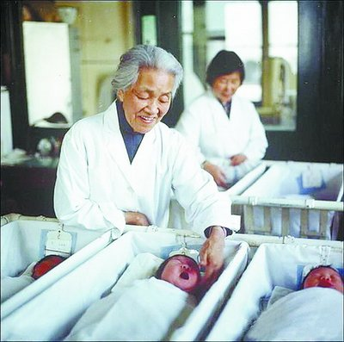
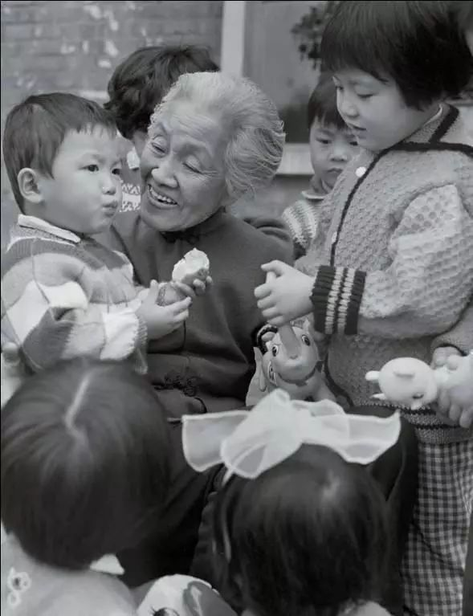
Activity 2 Analysing the structure of the passage
Mother of Ten Thousand Babies
①What was she?
②What did she do?
1.From the title and the pictures, we can know the passage might be about a female _______who___________________
doctor
(physician)
delivered a lot of babies.

Slide 5
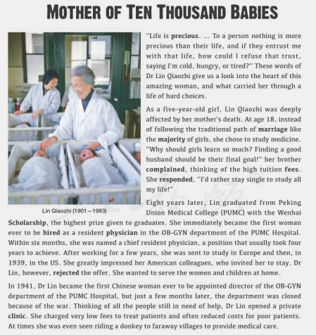
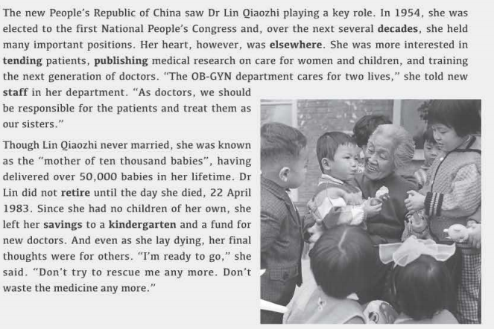
Activity 2 Analysing the structure of the passage
Skim the passage and answer the following questions (3 min).
2. What is the purpose of the text ?
A.To prove a point B. To describe a job C. To introduce a person
3. How is the passage developed?
A.By following time order B.By comparing facts C.By listing numbers
4.How can the passage be divided into?
A. 123/456 B. 1/2/3456
3 minutes
Biography

Slide 6
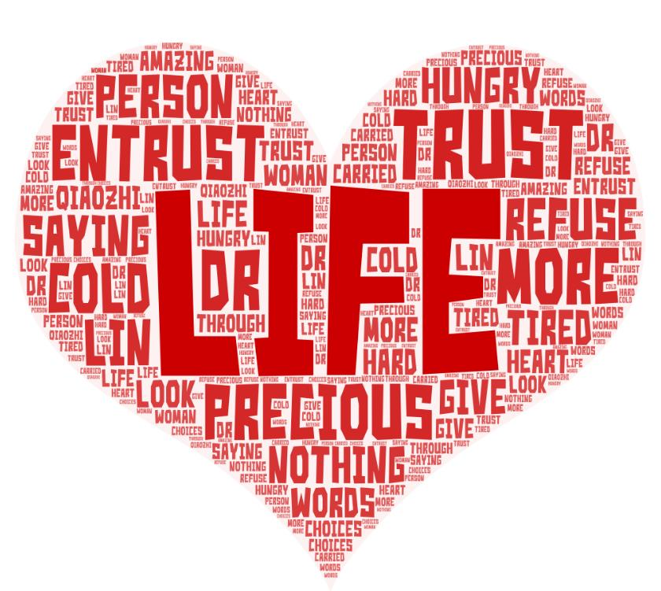

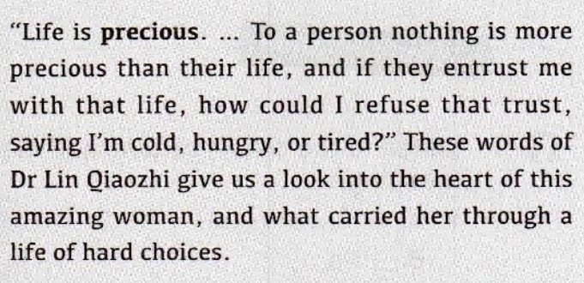
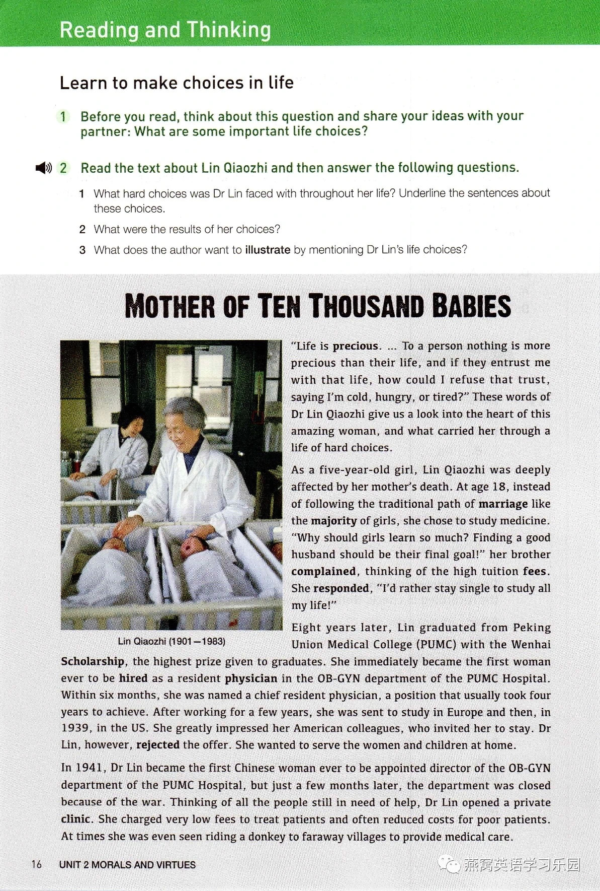
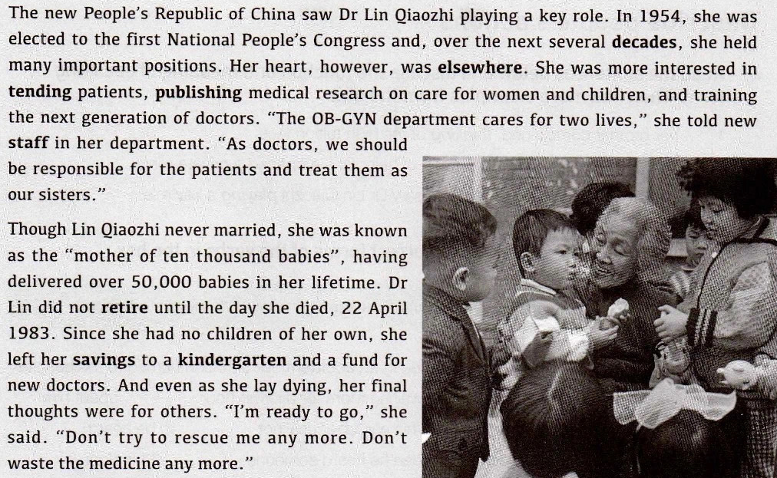

Activity 2 Analysing the structure of the passage
5.Choose the key words to complete the main idea of each part
Part 1:The that led to her life choices.
Part 2:The that made her life choices possible.
Part 3:The that she chose.
A.career
B.education
C.belief
C
B
A
Part 1
Part 2
Part 3

Slide 7
Activity 3 Learning more information about Lin's life
4 minutes
Name | Lin Qiaozhi
Nationality | China
Job
Events | At age 5, Lin Qiaozhi’s mother , which affected her a lot. At age 18, she made up her mind to . At age 26, she from PUMC and was named a chief resident physician. After a few years, she went to study in . At age 38, she the offer from the US and returned to China. At age 40, she was director of the OB-GYN department of the Hospital, but a few months later, she opened a . At age 53, she was to the first National People's Congress. However, she was more interested in patients.... At age 82, she passed away.
A physician
died
study medicine
graduated
Europe
rejected
appointed
private clinic
elected
tending

Slide 8
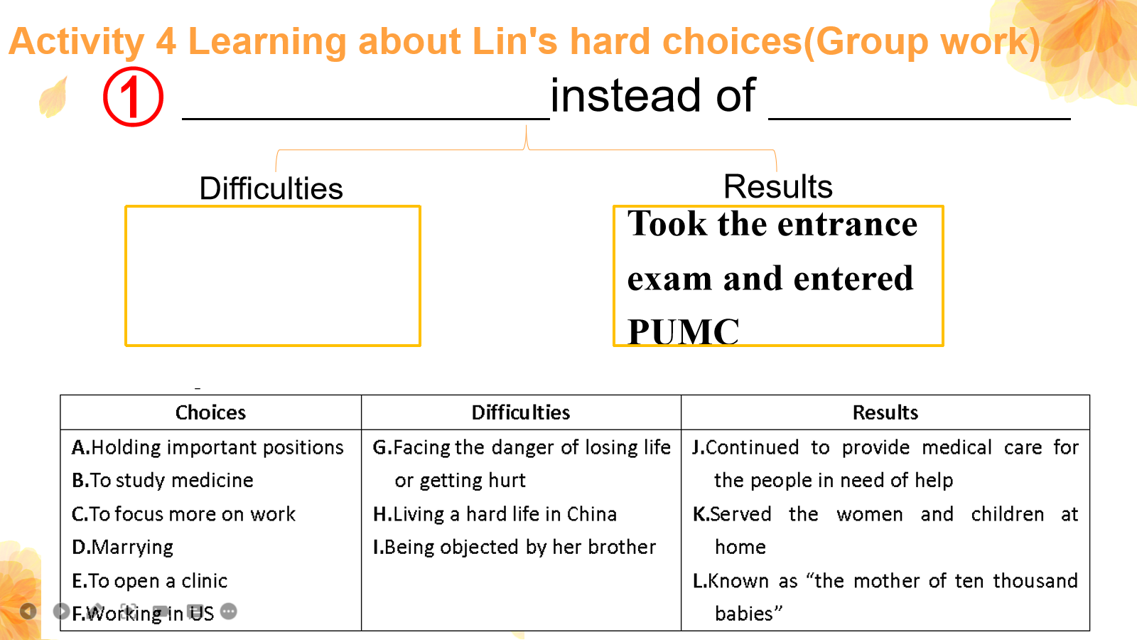
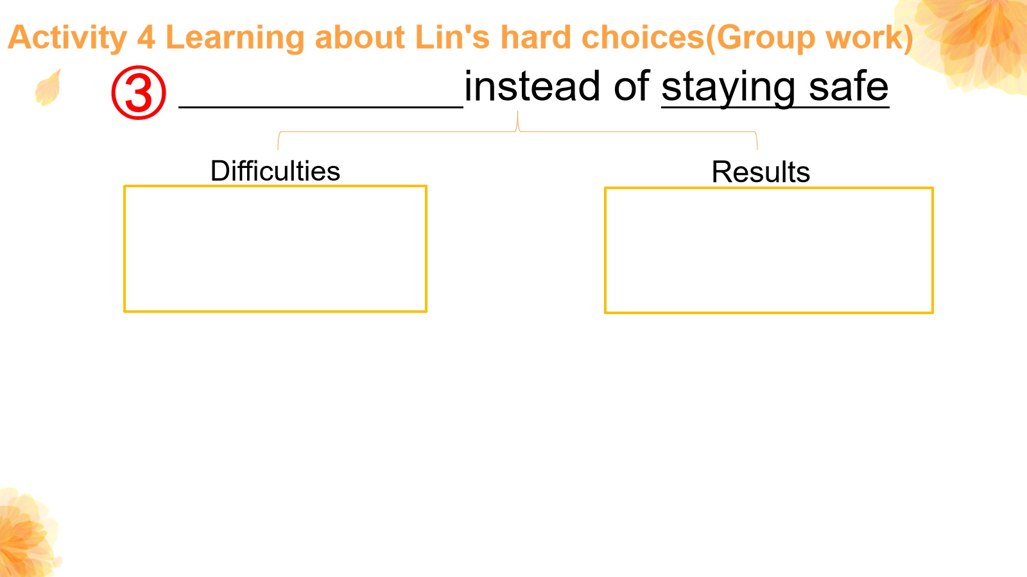
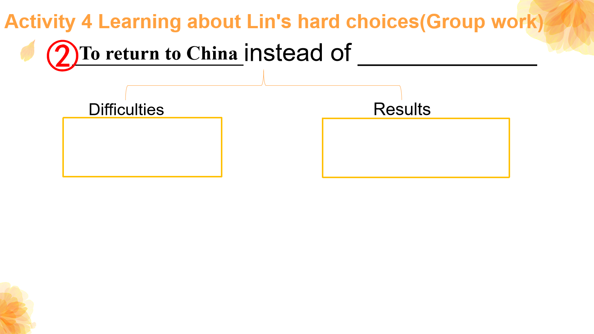
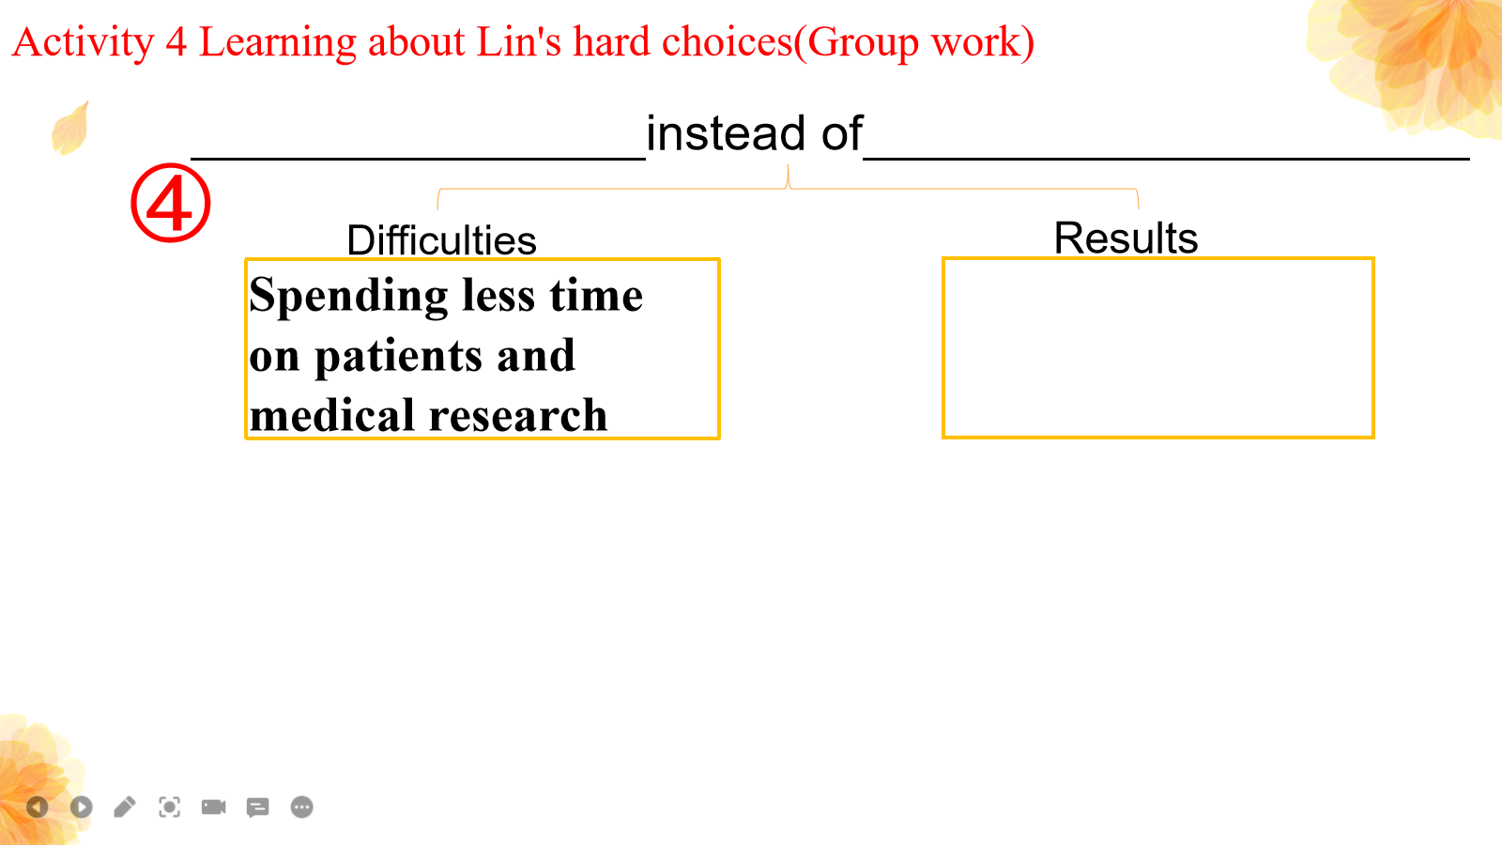
Activity 4 Learning about Lin's hard choices(Group work)

Slide 9
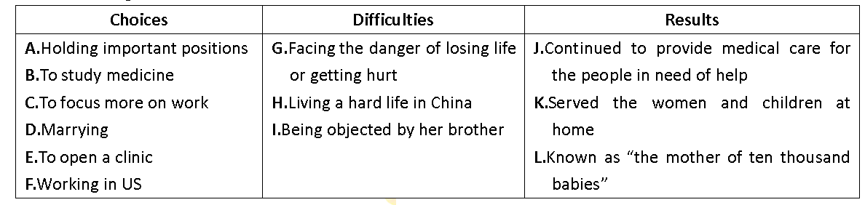
Activity 4 Learning about Lin's hard choices(Group work)
①
instead of .
B.To study medicine
D.marrying
Difficulties
Results
Took the entrance exam and entered PUMC
I.Being objected by her brother

Slide 10
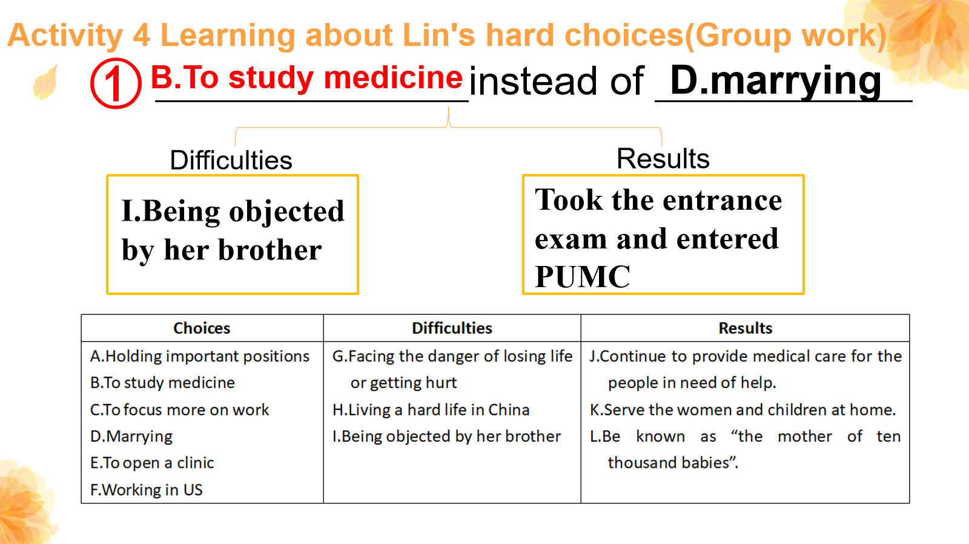
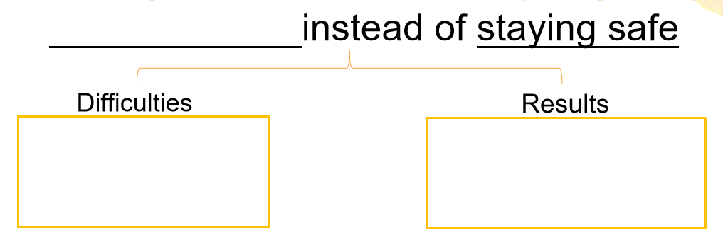
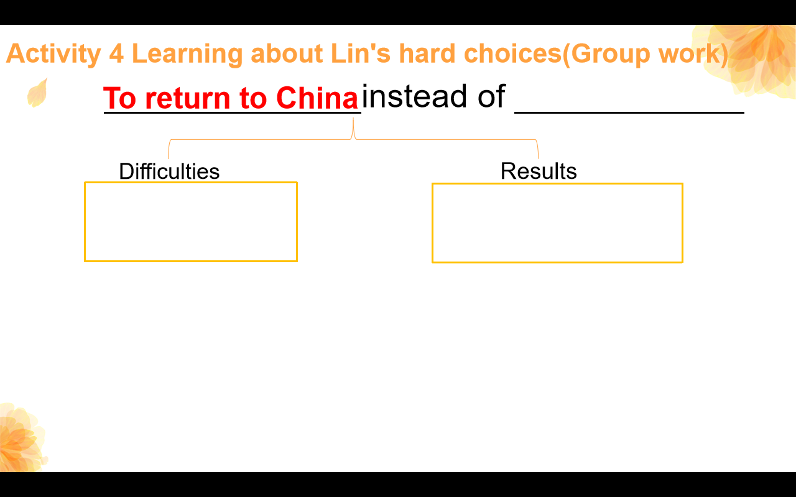
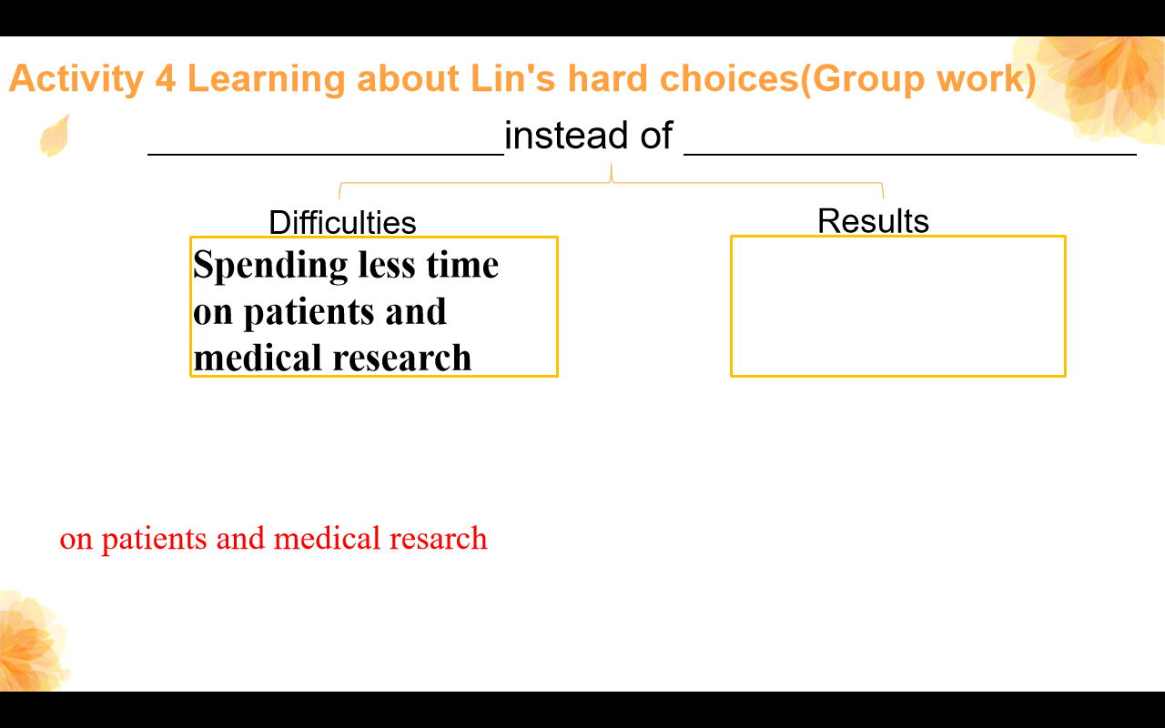
Activity 4 Learning about Lin's hard choices(Group work)
E
③
G
J
F
C
A
②
④
H
K
L
4 minutes to do it by yourself
3 minutes to discuss with your teammates
4 minutes

Slide 11
Activity 4 Learning about Lin's hard choices(Group work)
instead of .
①
B.To study medicine
D.marrying
Difficulties
Results
Took the entrance exam and entered PUMC
I.Being objected by her brother
study medicine
At age 18, Lin Qiaozhi chose to instead of
, which meant the difficulties she faced was
. Finally, she .
.
marrying
being objected by her brother
took the entrance exam and
entered PUMC

Slide 12
Activity 4 Learning about Lin's hard choices(Group work)
②
instead of _____________
To return to China
F.working in the US
Difficulties
Results
H.Living a hard life in China
K.Served the women and children at home
return to China
At age 38, Lin Qiaozhi chose to instead of
, which meant the difficulties she faced was
. And she .
.
working in the US
living a hard life in China
served the women and children
at home

Slide 13
Activity 4 Learning about Lin's hard choices(Group work)
instead of staying safe
③
E.To open a clinic
Difficulties
Results
G.Facing the danger of losing life or getting hurt
J.Continued to provide medical care for the people in need of help.
open a clinic
At age 40, Lin Qiaozhi chose to instead of
, which meant she might .
.And she .
.
staying safe
face the danger of losing life of
getting hurt
continued to provide medical care for the people in
need of help

Slide 14
Activity 4 Learning about Lin's hard choices(Group work)
instead of .
C.To focus more on work
A.holding important positions
④
Difficulties
Results
Spending less time on patients and medical research
L.Known as “the mother of ten thousand babies”.
focus more on work
At age 53, Lin Qiaozhi chose to instead of
, which meant she would .
.And she .
.
holding important positions
spend less time
on patients and medical resarch
was known as “the mother of ten
thousand babies

Slide 15
Activity 5 Drawing conclusions
Discuss:
1.What kind of person do you think Lin Qiaozhi was?
2.What was the min principle guiding Dr Lin through the choices in her life?
Focusing more on work
Focusing more on work
Holding important position
Opening a private clinic
Opening a private clinic
Staying safe
Lin Qiaozhi’s life choices
Returning to China
Returning to China
We all make choices, but in the end our choices make us.
Working in the US
Studying medicine
Studying medicine
Marrying

Slide 16
Assignments
1.What are your expectations for life? What life
choices will you make? What would you do?
Please write a short passage to share it with us.
2.（Optional）What would Lin Qiaozhi's life have
been if she had made another choice? Please
rewrite her life in a short paragraph.

Slide 17
THANK YOU!
We all make choices, but in the end our choices make us.

