Slide 1

感恩遇见，相互成就，本课件资料仅供您个人参考、教学使用，严禁自行在网络传播，违者依知识产权法追究法律责任。
更多教学资源请关注
公众号：溯恩高中英语
知识产权声明

Slide 2

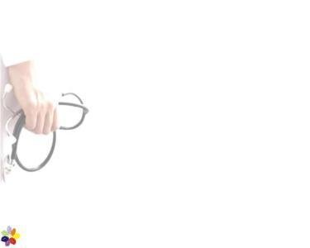
Discover useful structures
U5 First Aid
Grammar：
The usage of the –ing form
杭州二中许丽君

Slide 3
Learning objectives
In this class, students will
analyze the difference in meaning and use of the -ing form;
summarise the different structures of the -ing form;
rewrite sentences and complete passages using the -ing form;
talk about helping elderly people and avoiding accidents in life using the -ing form.
A
B
C
D

Slide 4
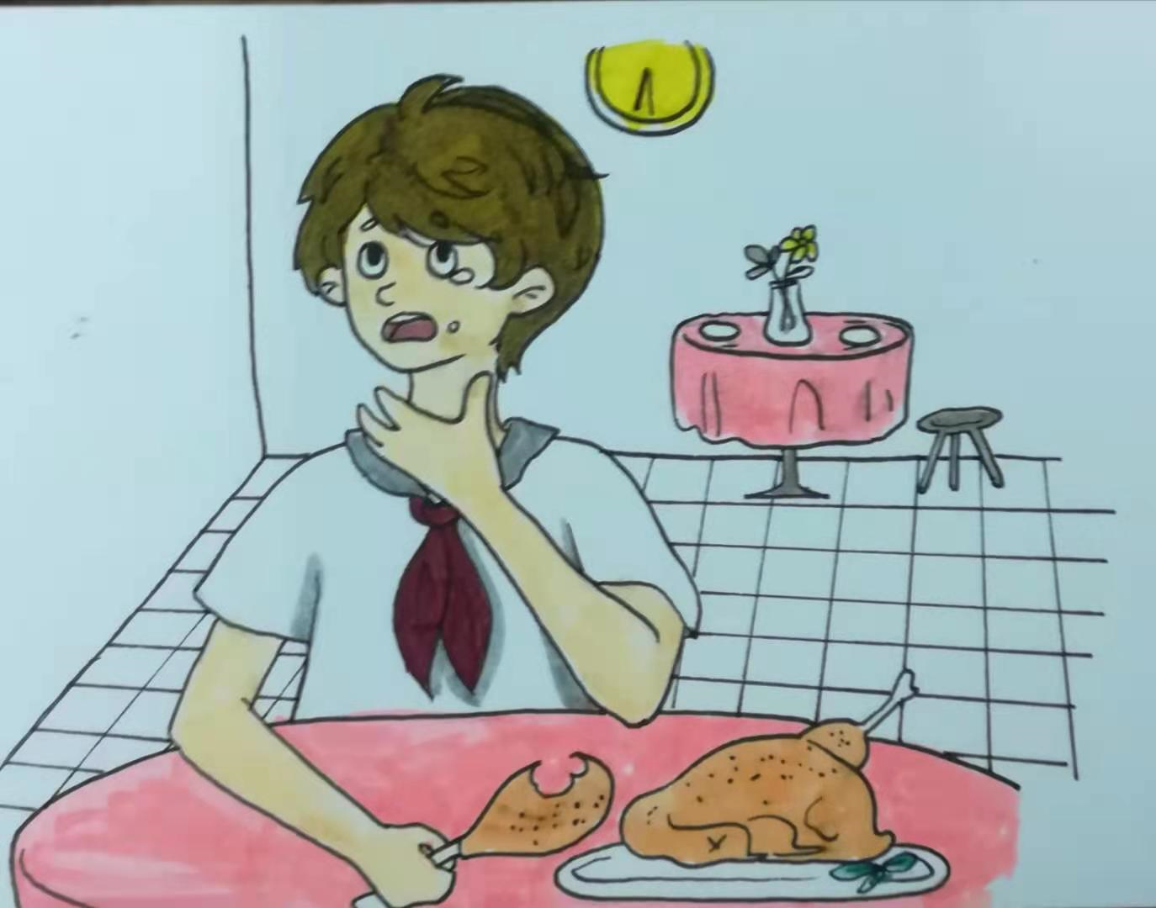
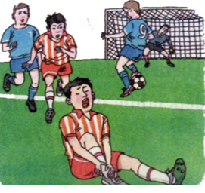
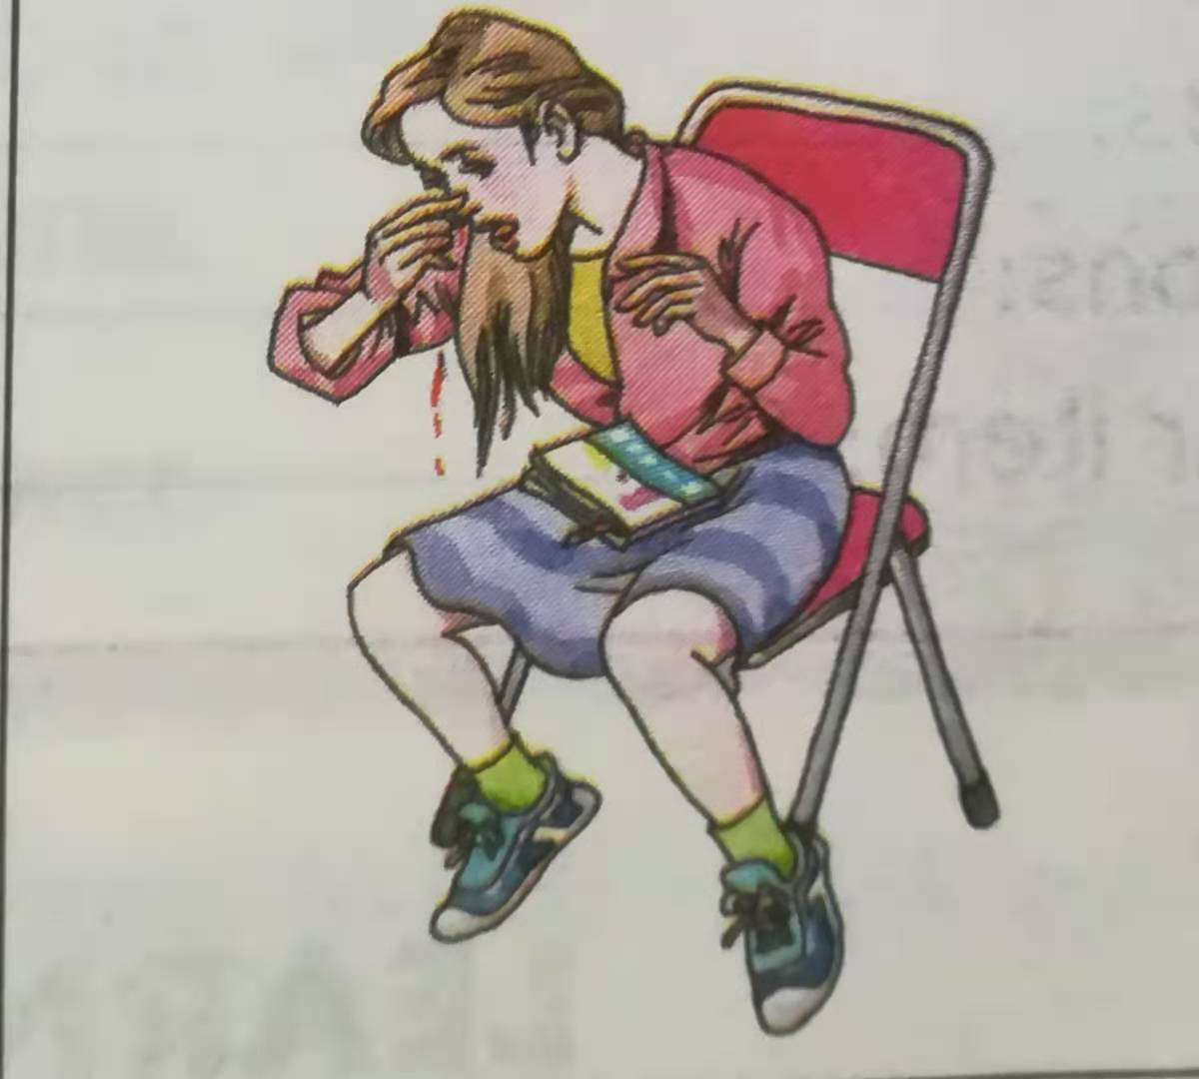
Examples with -ing form
主语
Performing first aid properly and quickly can save a life.

Slide 5
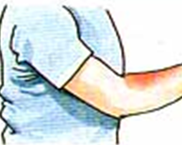
Fill in the blanks with the correct form
First aid for burns
1. _____ (get) burnt can lead to serious injuries.
2. The first step in the treatment of burns is _____ (give) first aid.
3. Placing burns under cool _____(run)water reduces pains and swelling.
4. Remove any clothes _____(use) scissors unless you see the fabric ______ (stick) to the burnt skin.
5. You can protect the burnt area by _____(cover) it with a loose clean cloth.

Slide 6
Analyze the function
First aid for burns
1. Getting burnt can lead to serious injuries.
2. The first step in the treatment of burns is giving first aid.
3. Placing burns under cool running water reduces pains and swelling.
4. Remove any clothes using scissors unless you see the fabric
sticking to the skin.
5. You can protect the burnt area by covering it with a loose clean cloth.
主语
表语
 | 主语 | 谓语 | 表语 | 宾语 | 定语 | 状语 | 宾补
ing
定语
状语；宾补
宾语

Slide 7
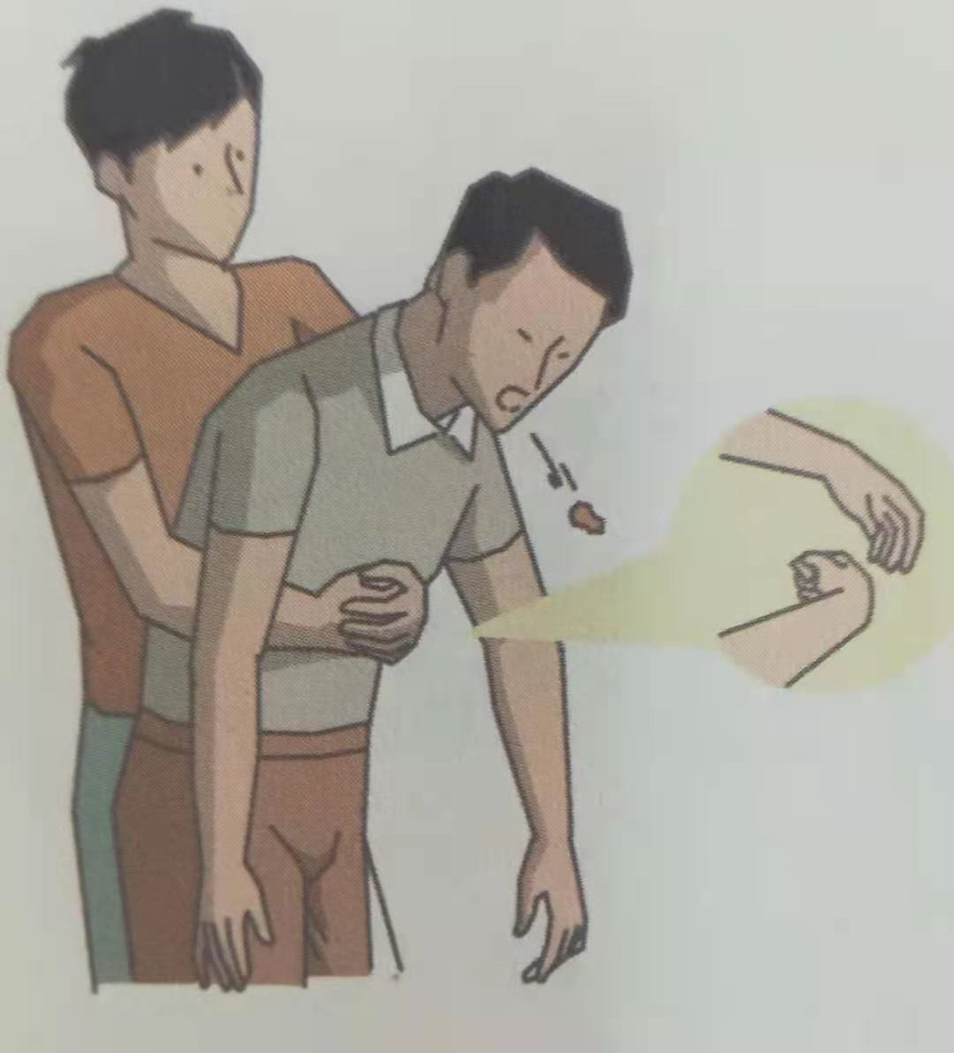
Examples with -ing form
First aid for serious choking
____________(perform) Heimlich manoeuvre is easy. Stand behind the _________(choke) person and wrap your arms around his waist. Put one fist in his or her upper part of the stomach. ___________(grab) your fist
with your other hand tightly, you can force out the obstruction by __________(push ) up and into his stomach in one motion.
performing
choking
Grabbing
pushing

Slide 8
Examples with -ing form
First aid for a nosebleed
Having a nosebleed is not very frightening. Bending your head forward, you can stop blood from running down your throat. Then reduce bleeding by pinching the nose.

Slide 9
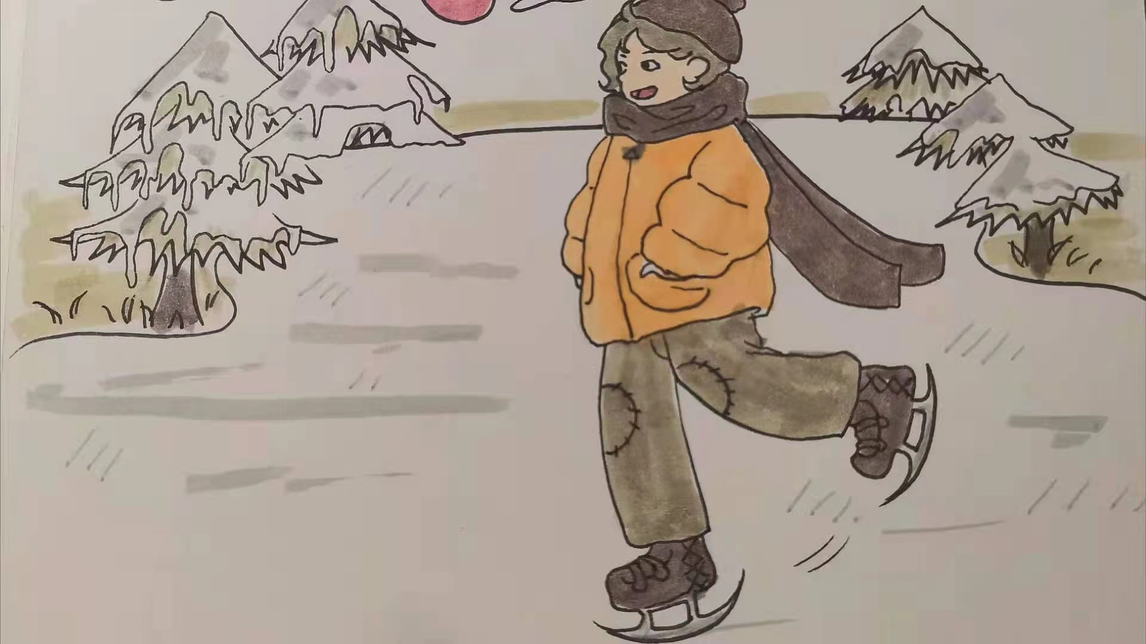
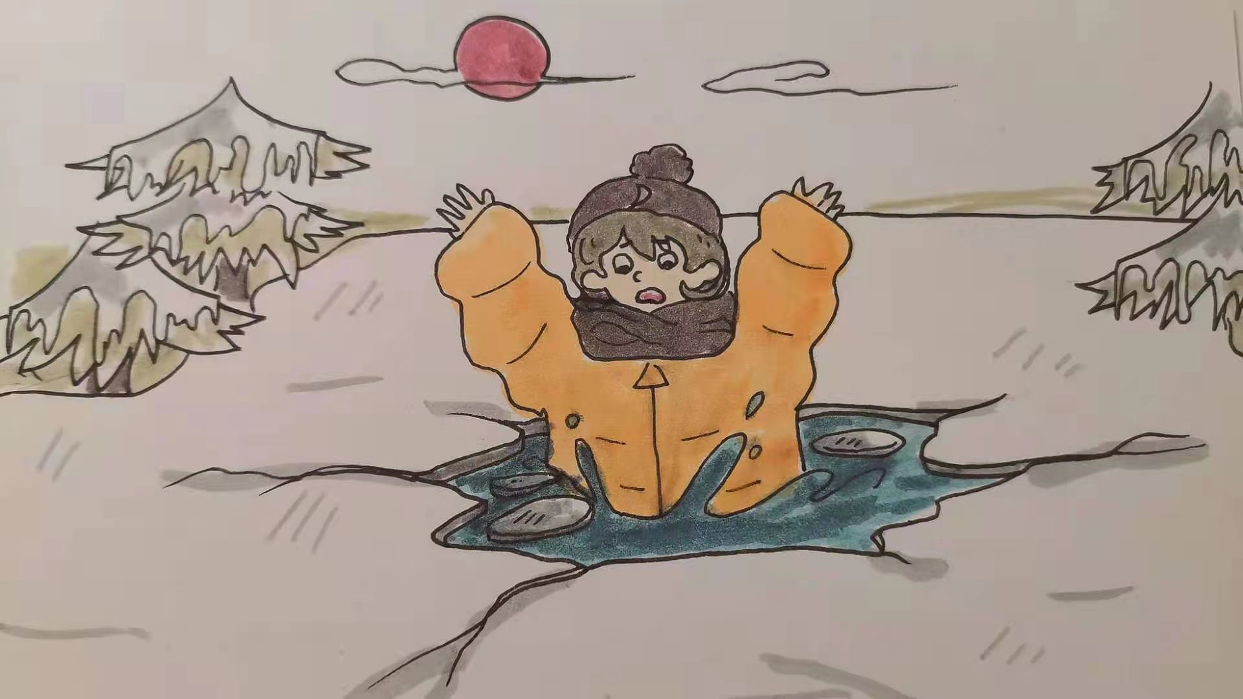
Examples with -ing form
React to a fall into the ice hole
1. When I was skating in the pond, I suddenly fell into the pond.
2. When I was trapped there, I felt cold and scared.
3. Because I didn't know what to do, I shouted for help.

Slide 10
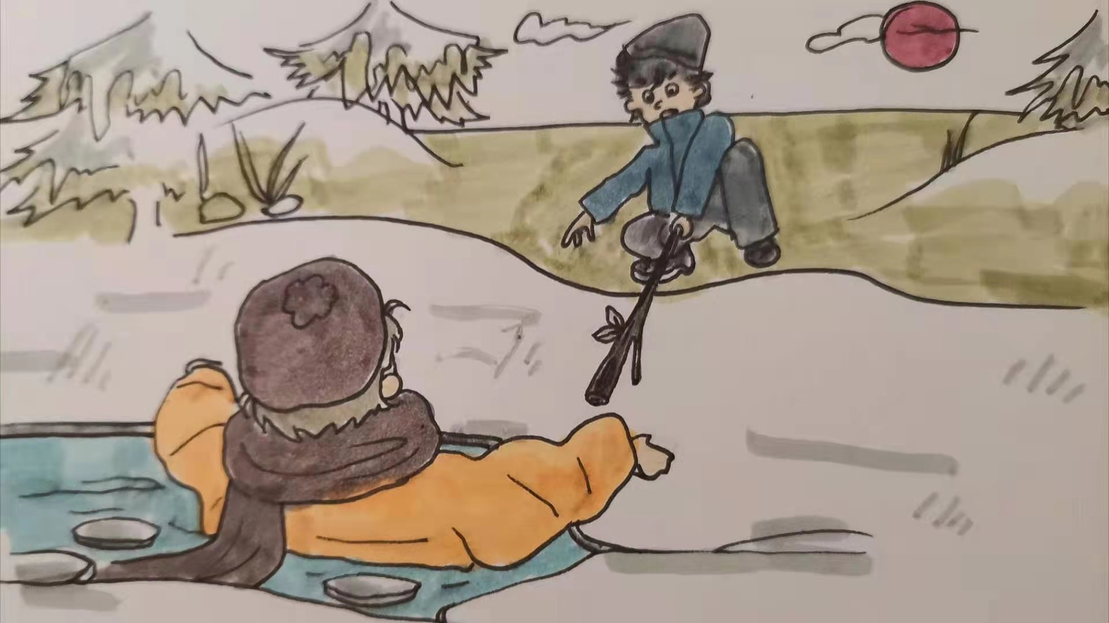
Examples with -ing form
React to a fall into the ice hole
4. After the boy had heard my call, a boy found a long stick and
dragged me out.
5. After I had been rescued from the hole, I was thankful to him.

Slide 11
Replace underlined parts with suitable -ing forms.
1. When I was skating in the pond , I suddenly fell into the pond.
2. When I was trapped there, I felt cold and scared.
3. Because I didn't know what to do, I shouted for help.
4. After the boy had heard my call, he found a long stick and me out.
5. After I had been rescued from the hole, I was thankful to him.

Slide 12
Replace underlined parts with suitable -ing forms.
1. When I was skating in the pond, I suddenly fell into the pond.
主动
When skating in the pond, I suddenly fell into the pond.
2. When I was trapped there, I felt cold and scared.
被动
Being trapped there, I felt cold and scared.
3.Because I didn't know what to do, I shouted for help.
Not knowing what to do, I shouted for help.
否定

Slide 13
Replace underlined parts with suitable -ing forms.
4. After the boy had heard my call, he found a long pole and dragged me out of the hole.
Having heard my call, the boy found a long pole and dragged me out of the hole.
主动 ；先后
5. After I had been rescued from the hole, I was thankful to him.
一般式 | 被动式 | 完成式 | 完成被动式 | 一般式否定
doing
Having been rescued from the hole, I was thankful to him.
being
done
having
done
having been done
被动 ；先后
not
doing

Slide 14
Retell the story using –ing form
One day, when skating in the pond behind our farm, I suddenly fell into the cold water. Being trapped there, I felt cold and frightened. Not knowing what to do, I shouted for help. A boy happened to pass here. Having heard my call, he found a long stick and dragged me out. Having been rescued from the hole, I was thankful to him.

Slide 15
Rewrite the sentence with –ing form
Replace each underlined part with a suitable -ing form and rewrite the sentence as necessary. Work with a partner and summarise the different structures of the -ing form. When is each one used?
1. When he got out of the bathtub, he slipped and fell on the floor.
When getting out of the bathtub, he slipped and fell on the floor.
2. Is there any reason why we are not going to have the first-aid training this week?
Is there any reason for not having the first-aid training this week?

Slide 16
Rewrite the sentence with –ing form
3. She had been told about the risk of electric shocks and this made he very careful while using hairdryers.
4. Because the child was not watched carefully by his parents, he touched a hot iron and burnt his finger.
5. After she had been bitten by mosquitoes, she applied some medicine to her skin.
Having been told about the risk of electric shocks, she was very careful while using hairdryers.
Not being watched carefully by his parents, the child touched a hot iron and burnt his finger.
After being/having been bitten by mosquitoes, she applied some medicine to her skin.

Slide 17
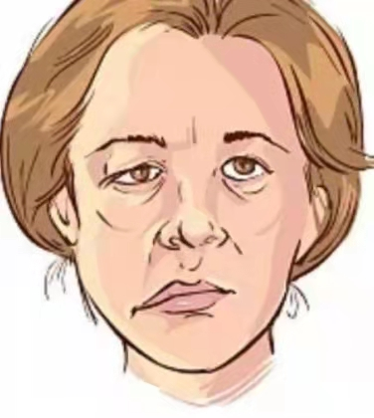
Self-protection in a stroke
Complete the passage with the correct forms of the given words. What happened to Mrs Tayor?
adj. 年纪较大的；上了年纪的
Mrs Taylor was an elderly woman ______ (live) alone. One day, she was in her living room cleaning the windows, when suddenly she could no longer feel the right side of her body. ________ (try) to walk to her sofa to sit down, she fell over onto the carpet. Then she realised that she could not get up, and that she was having troule __________ (breathe).
living
Trying
breathing
n. 地毯

Slide 18
Self-protection in a stroke
Fortunately, she had her mobile phone with her, and she was able to reach it with her left hand while _______ (lie) on the floor. Her mobile phone ________________ (already, set up) to call an emergency number at the push of a button, so it was easy to call for help. While attempting to talk to the operator, Mrs Tayor discovered that she could not speak. ___________ (not, hear) an answer, the operator knew that Mrs Tayor must be in trouble. Telling Mrs Tayor that everything would be OK,
lying
was already set up
Not hearing

Slide 19
Self-protection in a stroke
vi.& vt. 推迟；延期
n. 救护车
she immediately sent an ambulance. After _________ (arrive), the ambulance team quickly found Mrs Tayor and without delay gave he oxygen, put in an IV needle, and checked her vital signs. ________________ (take) to the hospital and treated immediately, Mrs Tayor's health was in no great danger, though she had to stay in the hospital ward. After a week, her __________ (frighten) experience was over, and she was allowed to go home.
arriving
Having been taken
frightening
n. 病房
n. 针；注射针

Slide 20
3 parts of a short story:
Mrs Taylor was an elderly woman living alone. One day, when cleaning the windows, she suddenly could not feel the right side of the body. Trying to walk to her sofa to sit down, she fell over onto the carpet. Having realized she couldn't get up and had trouble breathing, she reached into the pocket for her phone for an emergency call. After arriving (arrive), the ambulance team quickly found her and without delay gave her oxygen, put in an IV needle, and checked her vital signs. Having been taken (take) to the hospital and treated immediately, her health was in no great danger, though she had to stay in the hospital ward.Afte a week, her frightening (frighten) experience was over, and she was allowed to go home.
What ; who; when ;where ?
3
parts
What ; how ?
How?

Slide 21

What happened to Mrs Tayor?
n. 中风
She had a stroke when she was alone at home. She called for an ambulance and was saved in time.
You have just read about Mrs Taylor’s experience.
Do you think she is lucky? Why or why not?
Do you know any old person living alone? What is his/her life like?

Slide 22

Discuss the following questions.
1. What should people do when facing a frightening experience like Mrs Tayor's?
When having a frightening experience like Mrs Taylor's, people should try to get help, like she did.
2. What are some risks that elderly people may encounter when living alone?
When living alone, elderly people may fall or get injured, and not be able to help themselves or even call for help.

Slide 23
Discuss the following questions.
3. What can we do to help prevent elderly people from taking unnecessary risks?
To help prevent elderly people from taking unnecessary risks, we should make sure that their homes are easy to get around in, with handrails, ramps instead of stairs, and even walking surfaces.

Slide 24
Write a short story based on the picture trying to use -ing form .
what; who; when; where ?
what; how ?
how ?
useful --ing forms:
doing;
not doing
being done;
having done;
having been done;

Slide 25

Write a short story based on the picture trying to use -ing form .
One day when playing football with his classmates at school, Tom carelessly had his ankle sprained. Immediately it swelled and hurt so much that he couldn't help letting out screams. Realizing the situation was dangerous, One student called 120 and another began performing first-aid on him. He raised his ankle higher and reduced swelling by putting ice bags on it until the ambulance came. Having been taken to hospital and checked, he returned because the doctor said it was not very serious. He was thankful to his classmates for what they did for him.
What kind of persons were Tom's classmates ?

Slide 26
Reflect on what you have learned today:
Keeping calm and having a knowledge of first aid, you can make a difference to saving a life, which is a great honor.
1. Have your grasped different functions and structures of -ing form ?
2. Can you describe how to react in emergencies using proper -ing form?
3. Have you raised your awareness of safety and caring for others?

Slide 27
Assignment
1. Discuss with your partner the treatments for a bad bleeding in the leg. Then write a paragraph about it.
2. Retell the story about Mrs Taylor you completed, using –ing form.

Slide 28

Thank you for your attention!

