Slide 1

感恩遇见，相互成就，本课件资料仅供您个人参考、教学使用，严禁自行在网络传播，违者依知识产权法追究法律责任。
更多教学资源请关注
公众号：溯恩高中英语
知识产权声明

Slide 2

The Week
Feb 5th-11th, 2022

Slide 3
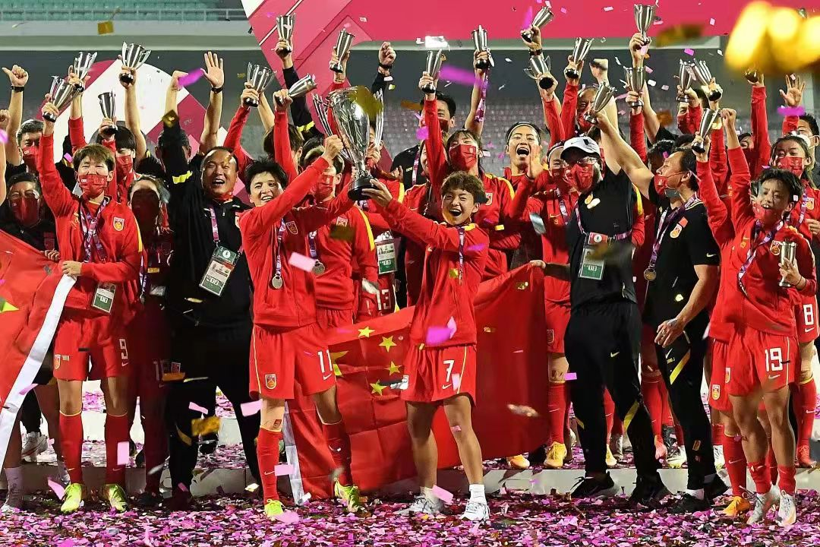
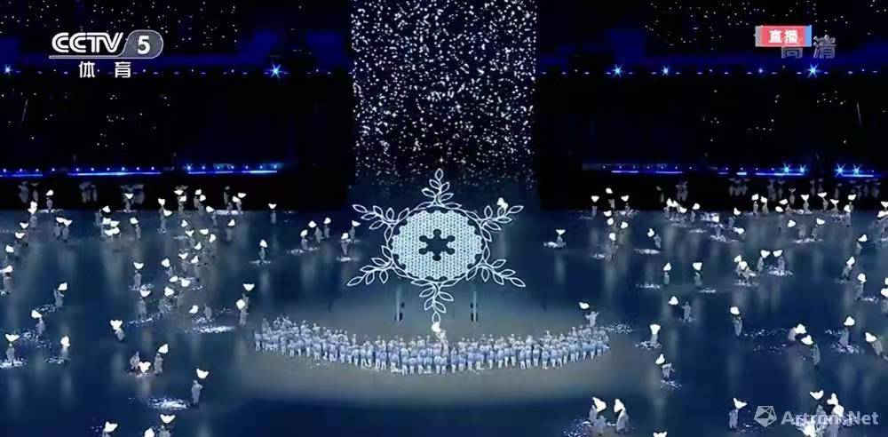
拼搏成就天赋，坚持成就现在，选择决定未来
1. Someone said, "You can always trust the Chinese women’s soccer team." To believe in them is to believe in the strength of struggle, the indomitable will, the confidence that we will not be discouraged even if we fall behind, and the courage of the former champion to return to the peak!
2. Together for a shared the future.

Slide 4
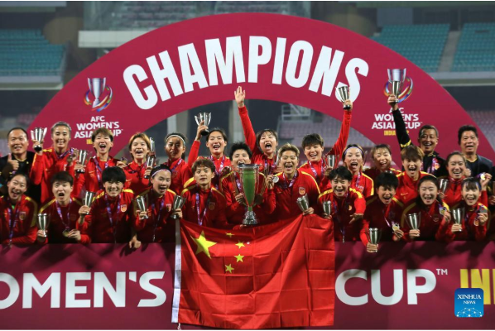
1. Steel Roses back to their roots and back in bloom
铿将玫瑰再次绽放
“We’ve put the past behind us and are looking to the future. Thanks to all the fans who kept supporting the Chinese women’s soccer team, and we will keep trying hard in the future.”
—Xiao Yuyi, who scored China’s winning goal

Slide 5
语篇填空
（《China Daily》2022年2月8日 19页）
lifted
The 2022 AFC Asian Women’s Cup has its Champion as China _______ (lift) the cup for the ninth time in the country’s history with a 3-2 victory ______ South Korea. Meanwhile, Vietnam earned a historic World Cup birth after __________ (defeat) Chinese Taipei 2-1 in a three-team playoff for the fifth and final 2023 FIFA World Cup qualifying spot of the tournament.
The Chinese women’s soccer team rekindled their famous fighting spirit to end a 16-year wait _______ (lift) the Asian Cup.
Having trailed 2-0 in the final in Navi Mumbai, India, on Sunday night, the Steel Roses summoned all their _____________ (determine) and resolve to battle back and tie ____ game before Xiao Yuyi fired home a ________ (drama) 93rd-minute winner from a Wang Shanshan assist to secure the title.
The Steel Roses’ victory ___________ (complete) dominated discussion on Chinese social media on Sunday night. The hashtag “Chinese women’s team wins Asian Cup” ___________ (view) over 1.1 billion times by Monday morning, _____ that was just one of 10 trending topics related to the Women’s team on Weibo.
over
defeating
to lift
determination
the
dramatic
completely
was viewed
but

Slide 6
词汇讲解1
1. rekindle: to make sth become active again 使重新活跃；使复苏
He tried to rekindle her attention. 他想再去引起她的关注。
2. summon: to make an effort to produce a particular quality in yourself, especially when you find it difficult 鼓起；振作；使出
She was trying to summon up the courage to leave him.
当时她试图鼓起勇气离开他。
翻译句子
有人担心这一系列的事情可能会重新引发他们的敌意。
There are fears that the series could rekindle animosity among them.
翻译句子
我甚至连下床的力气都没有。
I couldn’t even summon the energy to get out of bed.

Slide 7
词汇讲解2
3. tie: to have the same number of points 打成平局；得分相同
They tied for second place. 他们并列第二名。
4. dominate: to control or have a lot of influence over sb/sth, especially in an unpleasant way 支配；控制；左右；影响
As a child he was dominated by his father. 他小时候由父亲主宰一切。
翻译句子
在第一轮比赛中英格兰队与德国队以2:2打成平局。
England tied 2–2 with Germany in the first round.
翻译句子
他往往左右着交谈的内容。
He tended to dominate the conversation.

Slide 8
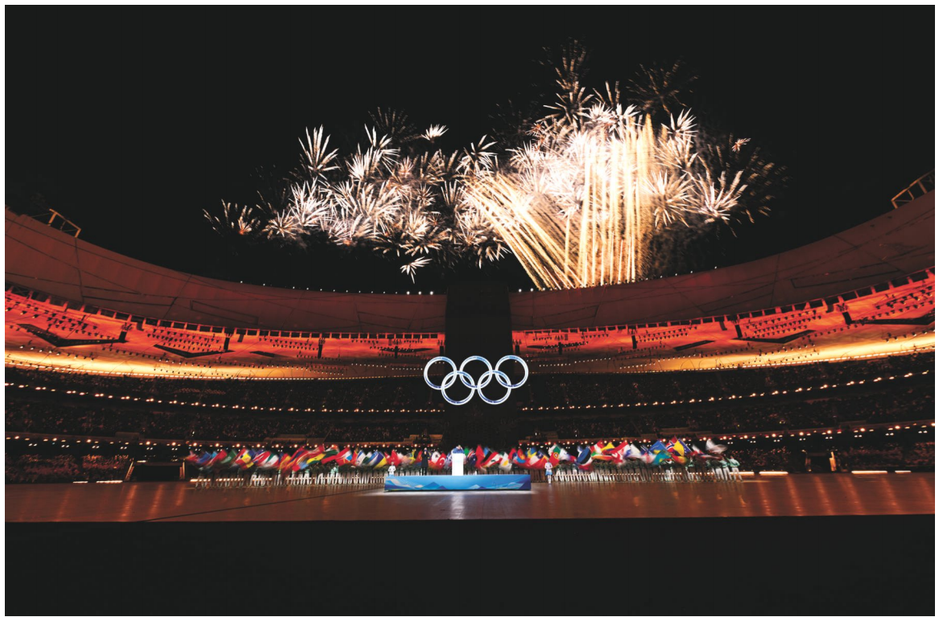
2. A Show of Strength and Unity
北京冬奥会开幕式惊艳全球
The 2022 Winter Games officially began Friday at Beijing’s National Stadium with the customary Opening Ceremonies. This year’s event featured many young performers and high-tech flourishes.

Slide 9

语篇填空
（《华盛顿邮报》2022年2月5日 A1 & A10版面）
From dancers waving giant green glow sticks like ______ (fresh) sprouting grass to six ice hockey _______ (player) covered in psychedelic (产生迷幻效果的) colors slapping pucks (冰球) toward the Olympic rings, the Opening Ceremonies of the Beijing 2022 Winter Games were meant to represent unity and a new beginning.
___ a freezing Friday evening, 45,000 spectators piled on layers to half-fill Beijing’s National Stadium, also known as the “Bird’s Nest”, on the day __________ marks the start of spring in the _________ (tradition) lunisolar calendar.
This year’s tech-no-utopian celebration of youth, ________ (feature) mostly child performers, reflects __ shift from talking about the past to focusing on the future, well-known Chinese director Zhang Yimou, mastermind (出谋划策者) of both the 2008 and 2022 Opening Ceremony, told Chinese media.
As state-run Xinhua News Agency wrote, “Ensuring the Beijing Winter Olympics ________ (hold) on schedule demonstrates the significant advantages of Socialism with Chinese characteristics and is a bold _________ (declare) that no force can stop the Chinese people _____ realizing their dreams.”
freshly
players
On
which / that
traditional
featuring
a
were held
declaration
from

Slide 10
词汇讲解
1. slap: ( -pp- ) to hit sb/sth with the flat part of your hand （用手掌）打，拍，掴
“Congratulations!” he said, slapping me on the back.
“祝贺你！”他拍着我的背说。
2. demonstrate: to show or prove something clearly 证实；表明；展现
It has been demonstrated that this drug is effective. 这药已证实是有效的。
The theories were demonstrated to be false. 这些理论已被证明是错误的。
翻译句子
她狠狠给了他一个耳光。
She slapped him hard across the face/ slapped his face hard.
翻译句子
这项研究表明了贫困和营养不良之间的联系。
The study demonstrates the link between poverty and malnutrition.

Slide 11
句子翻译
On a freezing Friday evening, 45,000 spectators piled on layers to half-fill Beijing’s National Stadium, also known as the “Bird’s Nest”, on the day that marks the start of spring in the traditional lunisolar calendar.
在一个寒冷的周五晚上，45000名观众在北京国家体育场（也被称为“鸟巢”挤满了看台，这一天在传统的阴阳历中标志着春天的开始。
翻译
Ensuring the Beijing Winter Olympics were held on schedule demonstrates the significant advantages of Socialism with Chinese characteristics and is a bold declaration that no force can stop the Chinese people from realizing their dreams.
确保北京冬奥会如期举行，体现了中国特色社会主义的显著优势，是任何力量都阻挡不了中国人民实现梦想的果敢宣言。
翻译

Slide 12

冬奥会比赛项目中英对照
高山滑雪 Alpine Skiing
自由式滑雪 Freestyle Skiing
单板滑雪 Snowboard
跳台滑雪 Ski Jumping
越野滑雪 Cross-Country Skiing
北欧两项 Nordic Combined
冰球 Ice Hockey
冰壶 Curling
雪橇 Luge
雪车 Bobsleigh
钢架雪车 Skeleton
短道速滑 Short Track Speed Skating
速度滑冰 Speed Skating
花样滑冰 Figure Skating
冬季两项 Biathlon

Slide 13
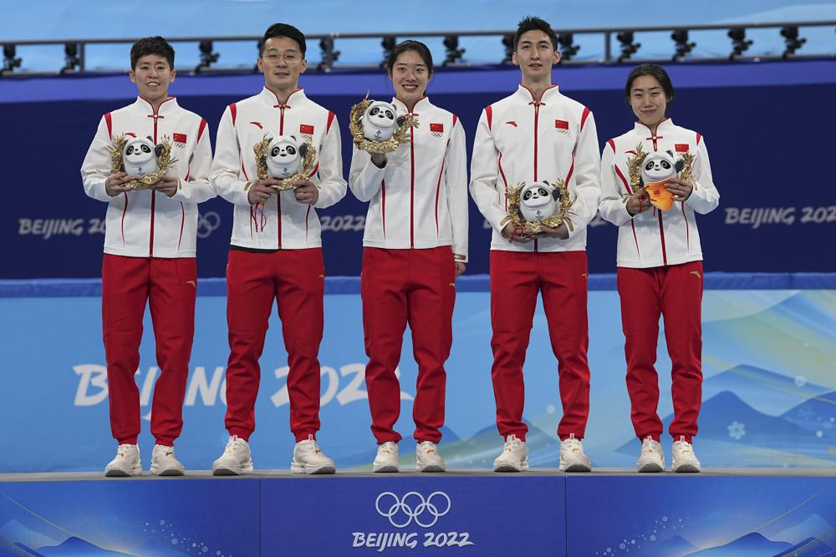
3. China wins 1st gold of home Olympics in short track relay
中国速度！中国首金！
Team China celebrate on the podium after winning the gold medal in the mixed team relay during the short track speedskating competition at the 2022 Winter Olympics, Saturday, Feb. 5, 2022, in Beijing.

Slide 14
语篇填空
（美联社 2022年2月6日新闻）
https://apnews.com/article/winter-olympics-short-track-speed-skating-sports-skating-china-a73dc565c45988772ee8e0232d9ff5d0
Darting through traffic, zipping around tight turns, avoiding potential disaster with every relay exchange. China eked out (通过艰难努力而获得) its first gold medal of the Beijing Games, _______ (win) the Olympic debut (首次登台) of mixed team relay in short track speedskating (短道速滑混合团体接力赛).
Asia is a hotbed of the sport ______ (know) as roller derby on ice, although the typically raucous (刺耳的) atmosphere Saturday night was ______ (great) subdued by COVID-19 restrictions at the Olympic venues. Still, the small number of Chinese allowed in the stands at Capitol Indoor Arena celebrated the host nation’s _______ (history) win, yelling behind masks and waving tiny ____ (flag).
Wu Dajing edged Pietro Sighel of Italy ___ 0.016 seconds — or half a skate blade — _______ (claim) gold. Hungary earned bronze. Qu Chunyu, Fan Kexin and Ren Ziwei joined Wu for the victory. “It was a huge _____ (relieve),” Wu said. “Now we finally realized our dream on the first day.”
China’s first gold of the games _______ (bring) cheers from a crowd gathered in front of __ big screen outdoor TV in Beijing’s Wangfujing shopping district.
winning
known
greatly
historic
flags
by
to claim
relief
brought
a

Slide 15
词汇讲解
1. dart: to move suddenly and quickly in a particular direction 猛冲；突进；飞奔
A dog darted across the road in front of me. 一条狗突然在我面前窜过马路。
Ingrid darted across the deserted street. 英格里德飞奔过空无一人的街道。
2. subdue: to calm or control your feelings 抑制，压制，克制（感情）
He forced himself to subdue and overcome his fears.
他强迫自己克制并战胜他的恐惧。
翻译句子
吉尔冲上前，把他从火边拉开。
Jill darted forward and pulled him away from the fire.
翻译句子
他很想道歉，但后来又忍住了。
He felt the urge to apologize, but then subdued it.

Slide 16
熟词生义
1. zip: 常见义 → n.拉链 v.拉上拉链
生义 → to go somewhere or do something very quickly 快速移动
A sports car zipped past us. 一辆跑车从我们身边呼啸而过。
2. edge: 常见义 → n.边缘；刀刃
生义 → to win by a very small amount 险胜
Opinion polls showed him edging into a slight lead.民意调查显示他略微领先。
翻译句子
他没有拉上夹克衫的拉链就飞快地走出门去。
He zipped through the door without zipping his jacket.
翻译句子
意大利以两分险胜法国。
Italy edged out France by two points.

Slide 17
句子翻译
China eked out its first gold medal of the Beijing Games, winning the Olympic debut of mixed team relay in short track speedskating.
中国队在短道速滑混合队接力赛中努力获得奥运会金牌，这是中国队在北京奥运会上获得的首枚金牌。
翻译
China’s first gold of the games brought cheers from a crowd gathered in front of a big screen outdoor TV in Beijing’s Wangfujing shopping district.
在北京王府井购物中心，聚集在户外大屏幕电视前的人群为中国获得了本届奥运会的第一枚金牌，发出了欢呼声。
翻译

Slide 18
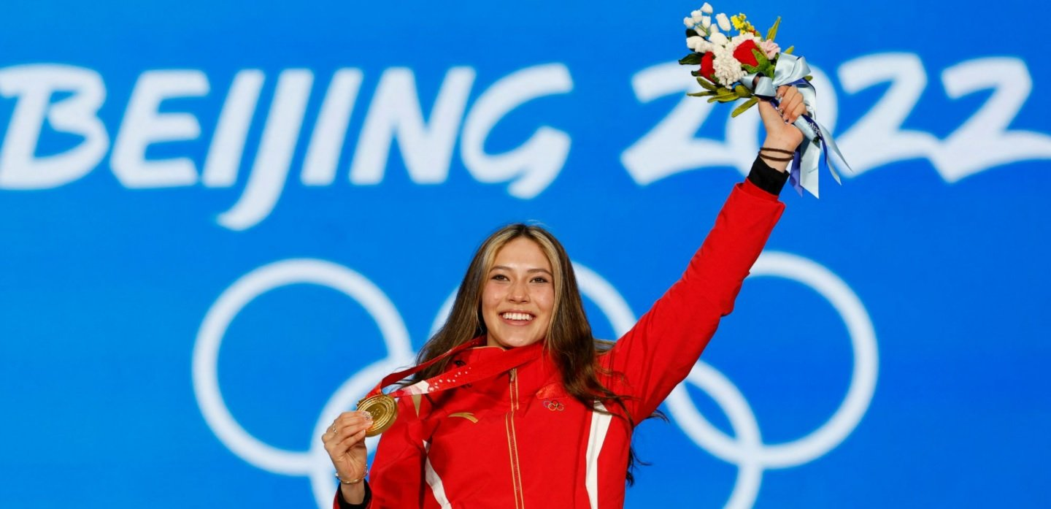
4. Gu Ailing goes gold in big air for China
谷爱凌冬奥会自由式滑雪女子大跳台夺冠

Slide 19
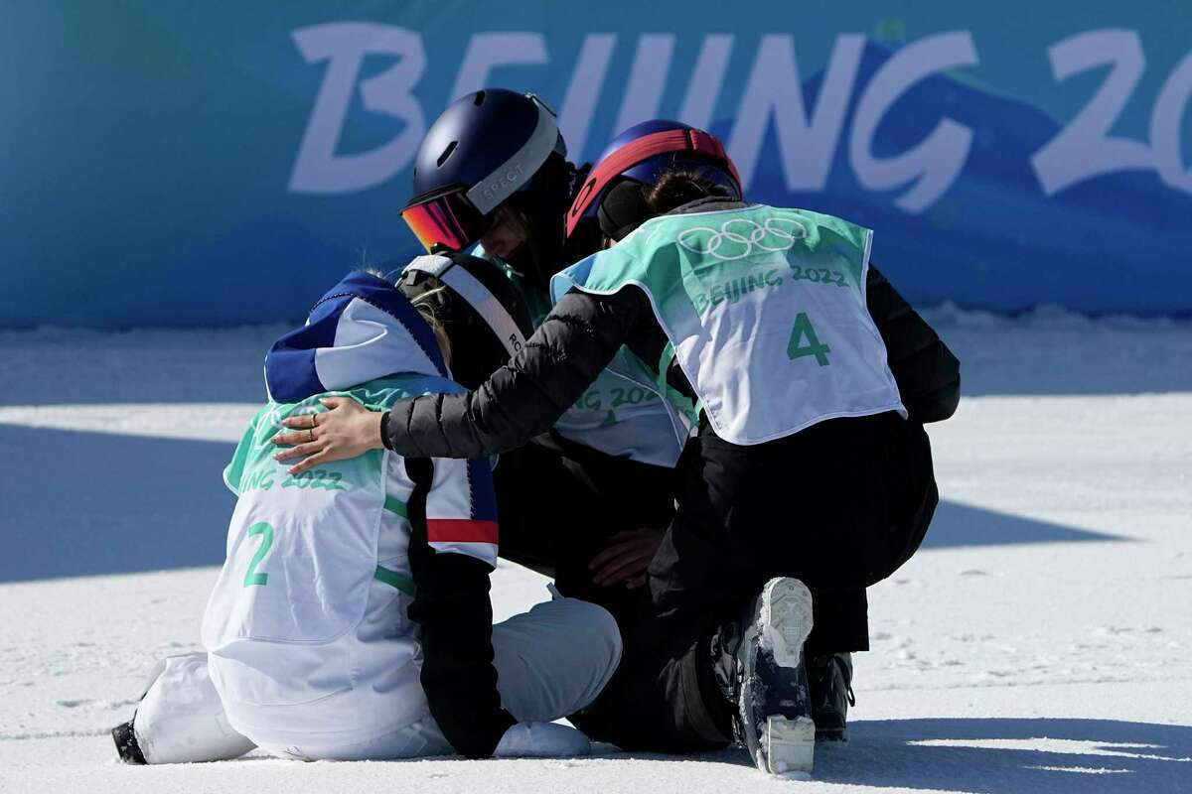
Gu consoled Tess Ledeux of France, who could not match her score and settled for silver.

Slide 20
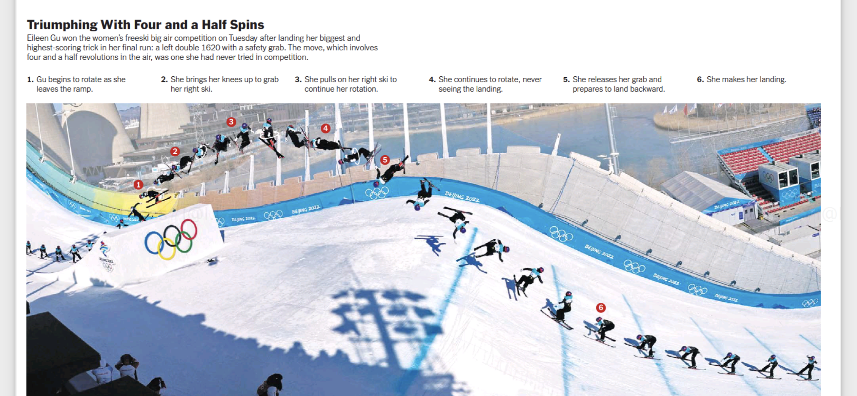
Gu Ailing’s highest-scoring trick in her final run

Slide 21
语篇填空
（《纽约时报》2022年2月9日 B9版面）
best
Eileen Gu needed the ____ (good) jump of her life to win a gold medal. The 18-year-old from California had come to her mother’s home country hoping ______ (win) three events at the Winter Olympics while ___________ (represent) China.
Under the glare of a bright sun and the eyes of the international news media, Gu stood on top of the huge, modern big air jump, set in an industrial park amid concrete cooling towers. She was in third place ____ one jump to go.
In her final run, Gu landed a left double 1620 with a safety grab, the first time she ________ (try) it, she said. ___ earned enough points to vault her into first.
____ Gu waited for her results, Thomas Bach, the president of the International Olympic Committee, ____________ (congratulate) her at the finish. When the numbers came in, fans in the grandstands cheered for Gu and waved small Chinese _____ (flag).
Gu has said that she wants to be ___ bridge between the United States and China while inspiring young women and helping China's nascent (新兴的) winter-sports industry to grow.
to win
representing
with
had tried
It
As
congratulated
flags
a

Slide 22
词汇讲解
1. glare: a very bright, unpleasant light 刺眼的光
The rabbit was caught in the glare of the car’s headlights.
兔子在耀眼的汽车前灯照射下。
2. vault: to jump over an object in a single movement, using your hands or a pole to push you （用手支撑或撑杆）跳跃，腾跃
He could easily vault the wall. 他可以轻松地翻过墙去。
翻译句子
这些太阳眼镜是为减少刺眼的强光而设计的。
These sunglasses are designed to reduce glare.
翻译句子
她用手一撑跃过门沿着小路跑去。
She vaulted over the gate and ran up the path.

Slide 23
句子翻译
Under the glare of a bright sun and the eyes of the international news media, Gu stood on top of the huge, modern big air jump, set in an industrial park amid concrete cooling towers.
在耀眼的阳光和国际新闻媒体的注视下，谷爱凌站在巨大的现代化的自由式滑雪大跳台上，该跳台位于一个工业园区内的混凝土冷却塔旁。
翻译
Gu has said that she wants to be a bridge between the United States and China while inspiring young women and helping China's nascent winter-sports industry to grow.
谷爱凌曾表示过，她希望成为美国和中国之间的桥梁，同时激励年轻女性，并帮助中国新兴的冬季运动产业发展。
翻译

Slide 24
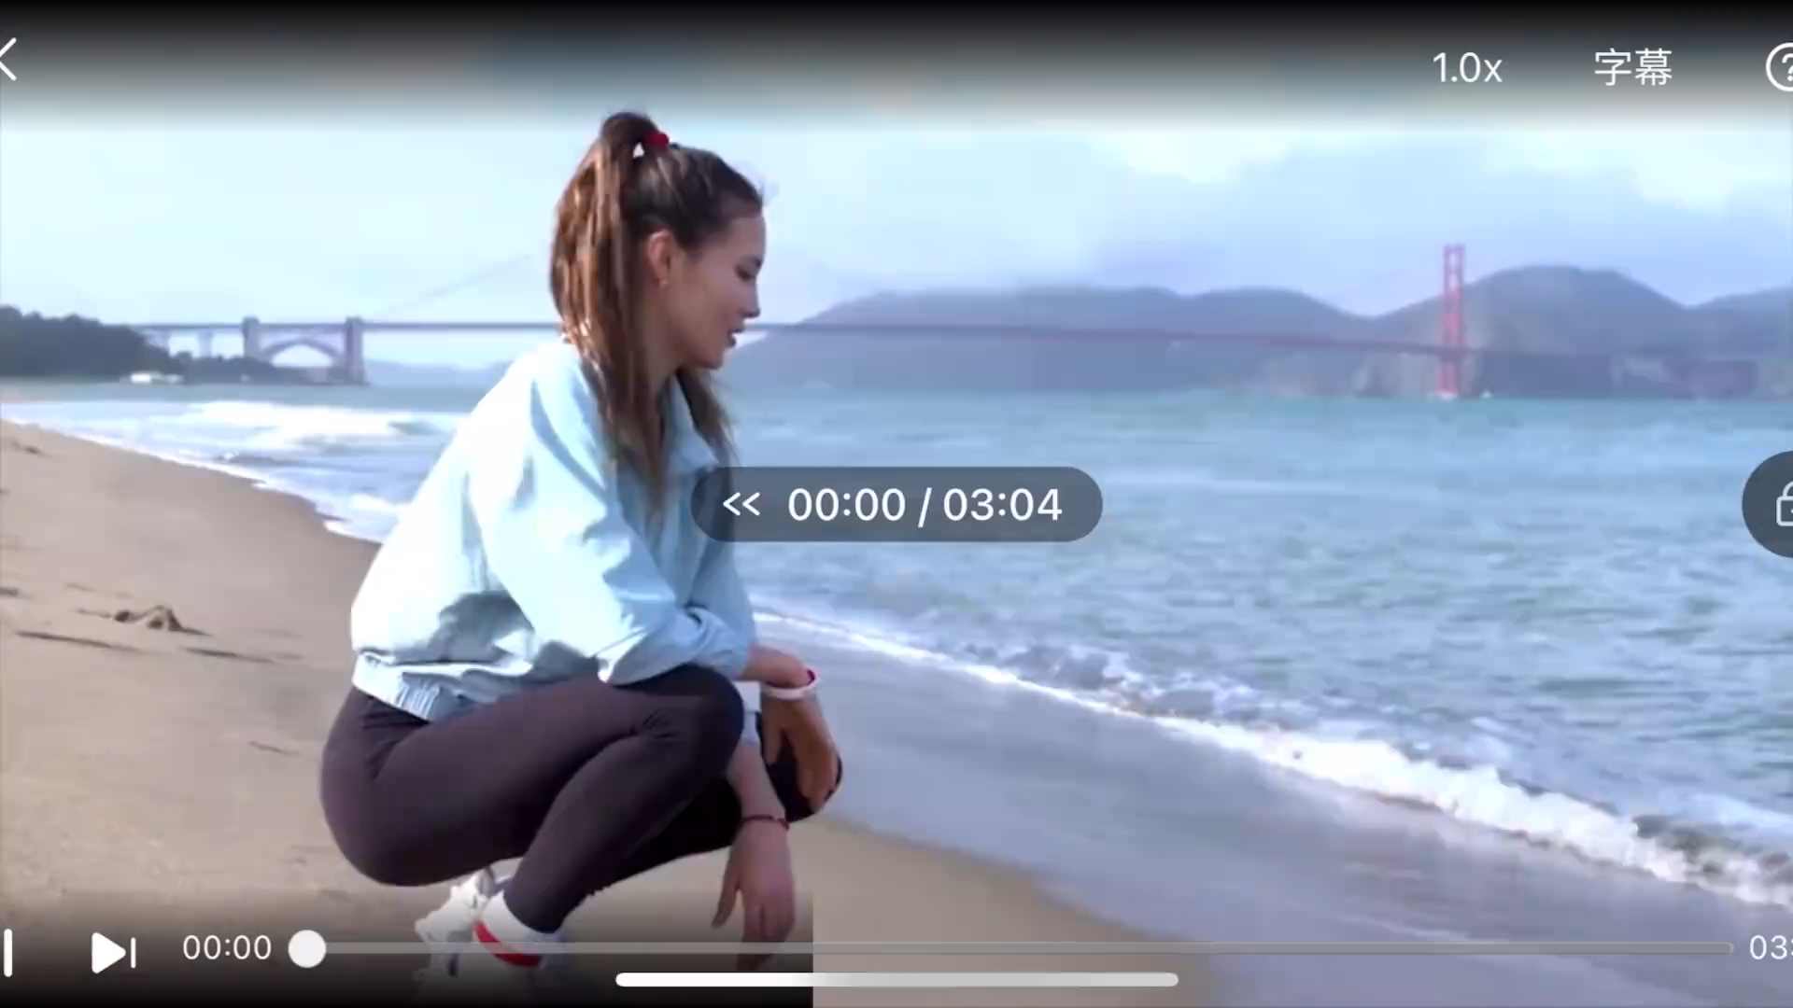
5. Gu Ailing aims to inspire young people in China to try sports
谷爱凌鼓励中国年轻人积极参与运动

Slide 25

听写 Part I
Since I was little I’ve always said when I’m in the U.S., I’m American, when I’m in China, I’m Chinese. I preserve it by ____________ and being able to ________________ people because that’s the best way to _______ culture.
Sports are ingrained in ___________ in the U.S. Almost every American kid plays some sport at least one time in their childhood. I hope to ______ more of that to happen in China.
I played basketball over the summers in China. I was __________ on the team. I met a friend in a math class that I was taking during the day, so I was like “hey, you should come to this ________________ that I do at night”. She said, “Okay, whatever.” So she came and ____________ I wasn’t the only girl anymore and so ______________. And then every day every week we’d bring another one, everyone, another person from the class until our math class was all playing basketball and ___________________ were all playing basketball.
having friends
communicate with
transmit
youth culture
inspire
the only girl
basketball program
all of a sudden
we had two girls
my friends from China

Slide 26
听写 Part II
I just want to give more kids the __________ to try sports because I think that sport culture still _______________. And so I hope to be a part of that group.
I knew that ___________ were gonna be in China and I think that this actually offered a really good opportunity because a lot of people were gonna watch the Olympics who perhaps hadn’t _______________ before, look at their TVs and say, “hey, we’re the same age and she’s ________________. I can, too.”
Standing on the podium, it’s very ________. But to me, I think my most emotional moments happen _______________ because that's really where the work happens. After my halfpipe run, I got a 93.5 or 93 and so I’m just ______ on this, on this sled on the way up. And there’s a guy driving the sled. So I'm like _________________. He’s like, “Are you okay?” And I’m like, “I’m great. I'm more than okay. This is the moment _____________.”
opportunity
has room to grow
the Olympics
heard of the sport
out there doing that
symbolic
behind the scenes
crying
shaking behind him
I’ve dreamed of

Slide 27
听写 Part III
I didn’t make any adjustments and I’ve made my routine and the way that I ski, and the way that I _______ and the way that I train have ________________ because I don’t think that should be limited to _______________________. It really just is ______ to me. I think because the sport is international and my whole _______ is that I want to make sports international.
When you have an opportunity to ____________, always take it because ________ that can happen is you don’t like it, even if that means if you're the only girl in something that ________________, and overcoming, speaking up at a board meeting or speaking up in class or ______ next to someone who you normally don’t sit next to at lunch. Just kind of encouraging people through my ___________, in an extreme sport, and my participation in extreme sport in China, competing in China.
prepare
remained the same
what country I’m skiing for
unique
message
try something
the worst
you’re afraid to do
sitting
participation

Slide 28
词汇讲解
1. transmit: make someone understand and share an idea or a feeling 传达，传输（思想、感情）
The message they are transmitting to their daughters is very different from that of previous generations. 他们向女儿传输的信息与上几代人截然不同。
翻译句子
他把自己对演唱的激情投入传递给了观众。
He transmitted his keen enjoyment of singing to the audience.
2. ingrained: that has existed for a long time and therefore is difficult to change 根深蒂固的；难以根除的
Such ingrained prejudices cannot be corrected easily. 这种根深蒂固的偏见不容易纠正。
翻译句子
你应该拥有住房的观念在我们的社会中根深蒂固。
The belief that you should own your house is deeply ingrained in our society.

